Slide 1
MRCM Diagramming
Ed Cheetham
For
SI MAG February 13th 2020

Slide 2
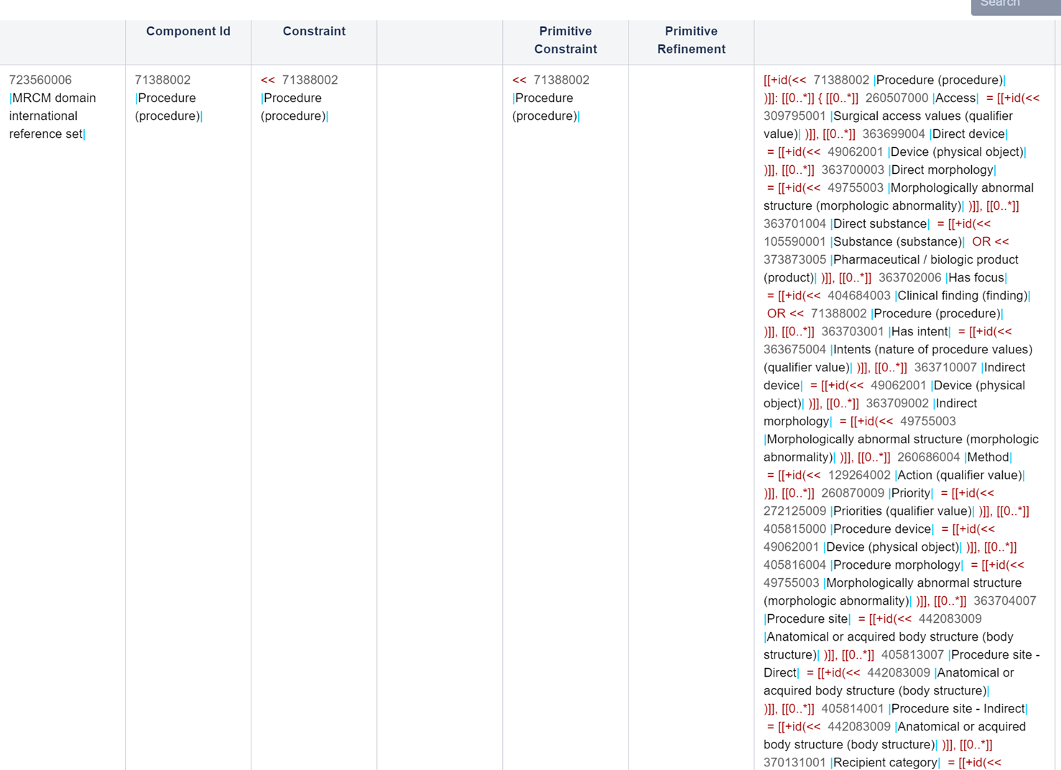

Slide 3
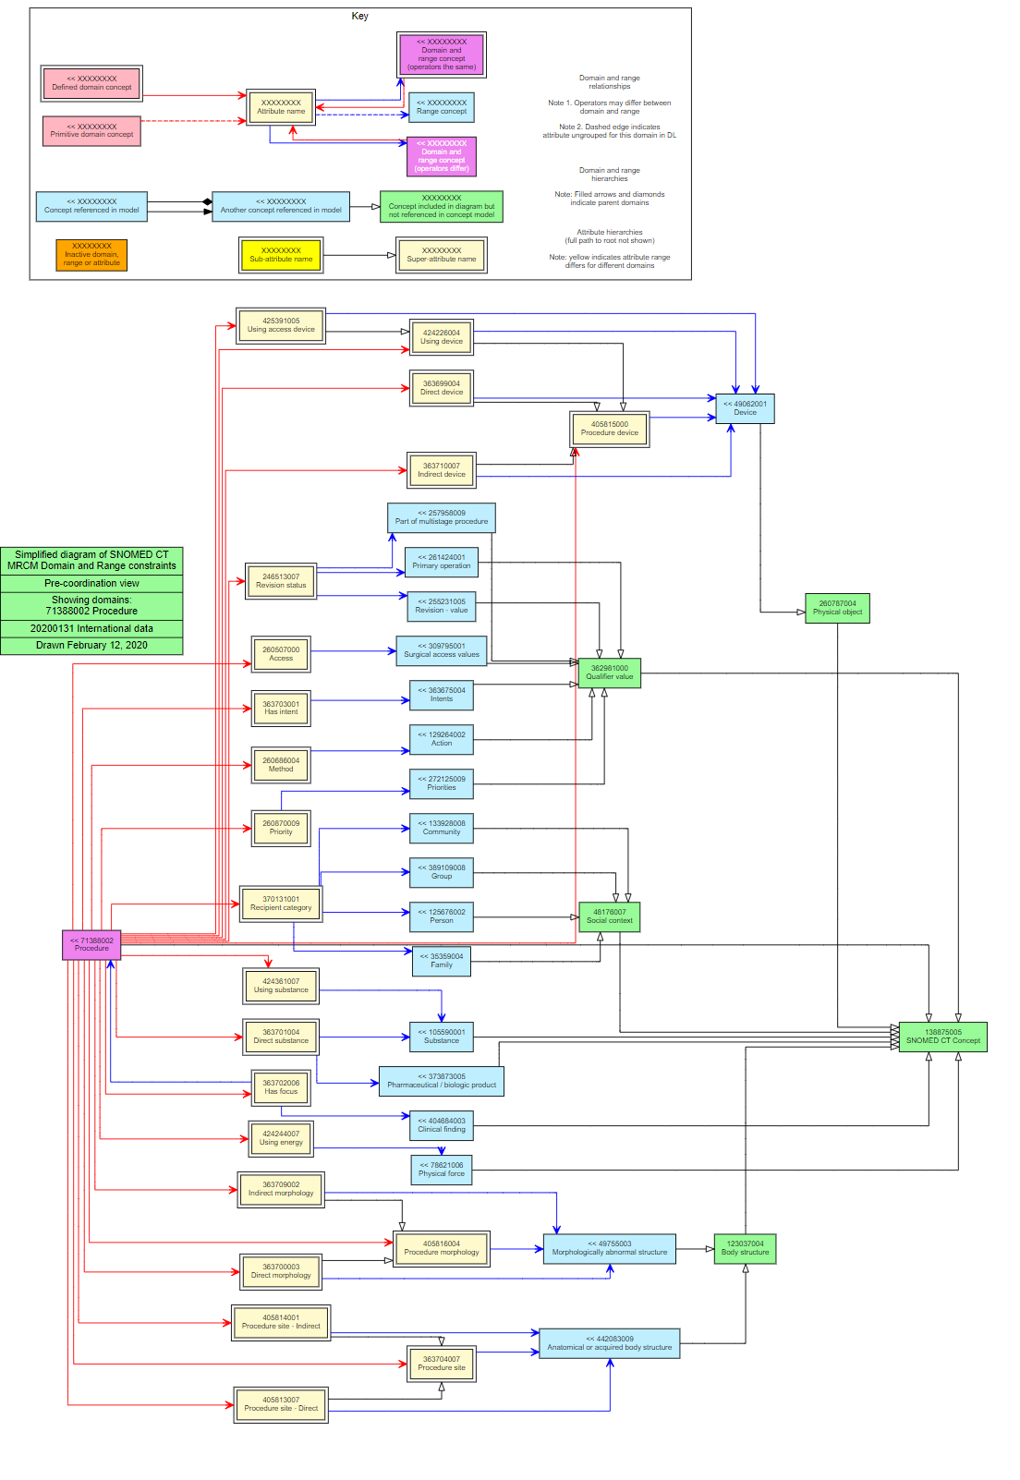

Slide 4
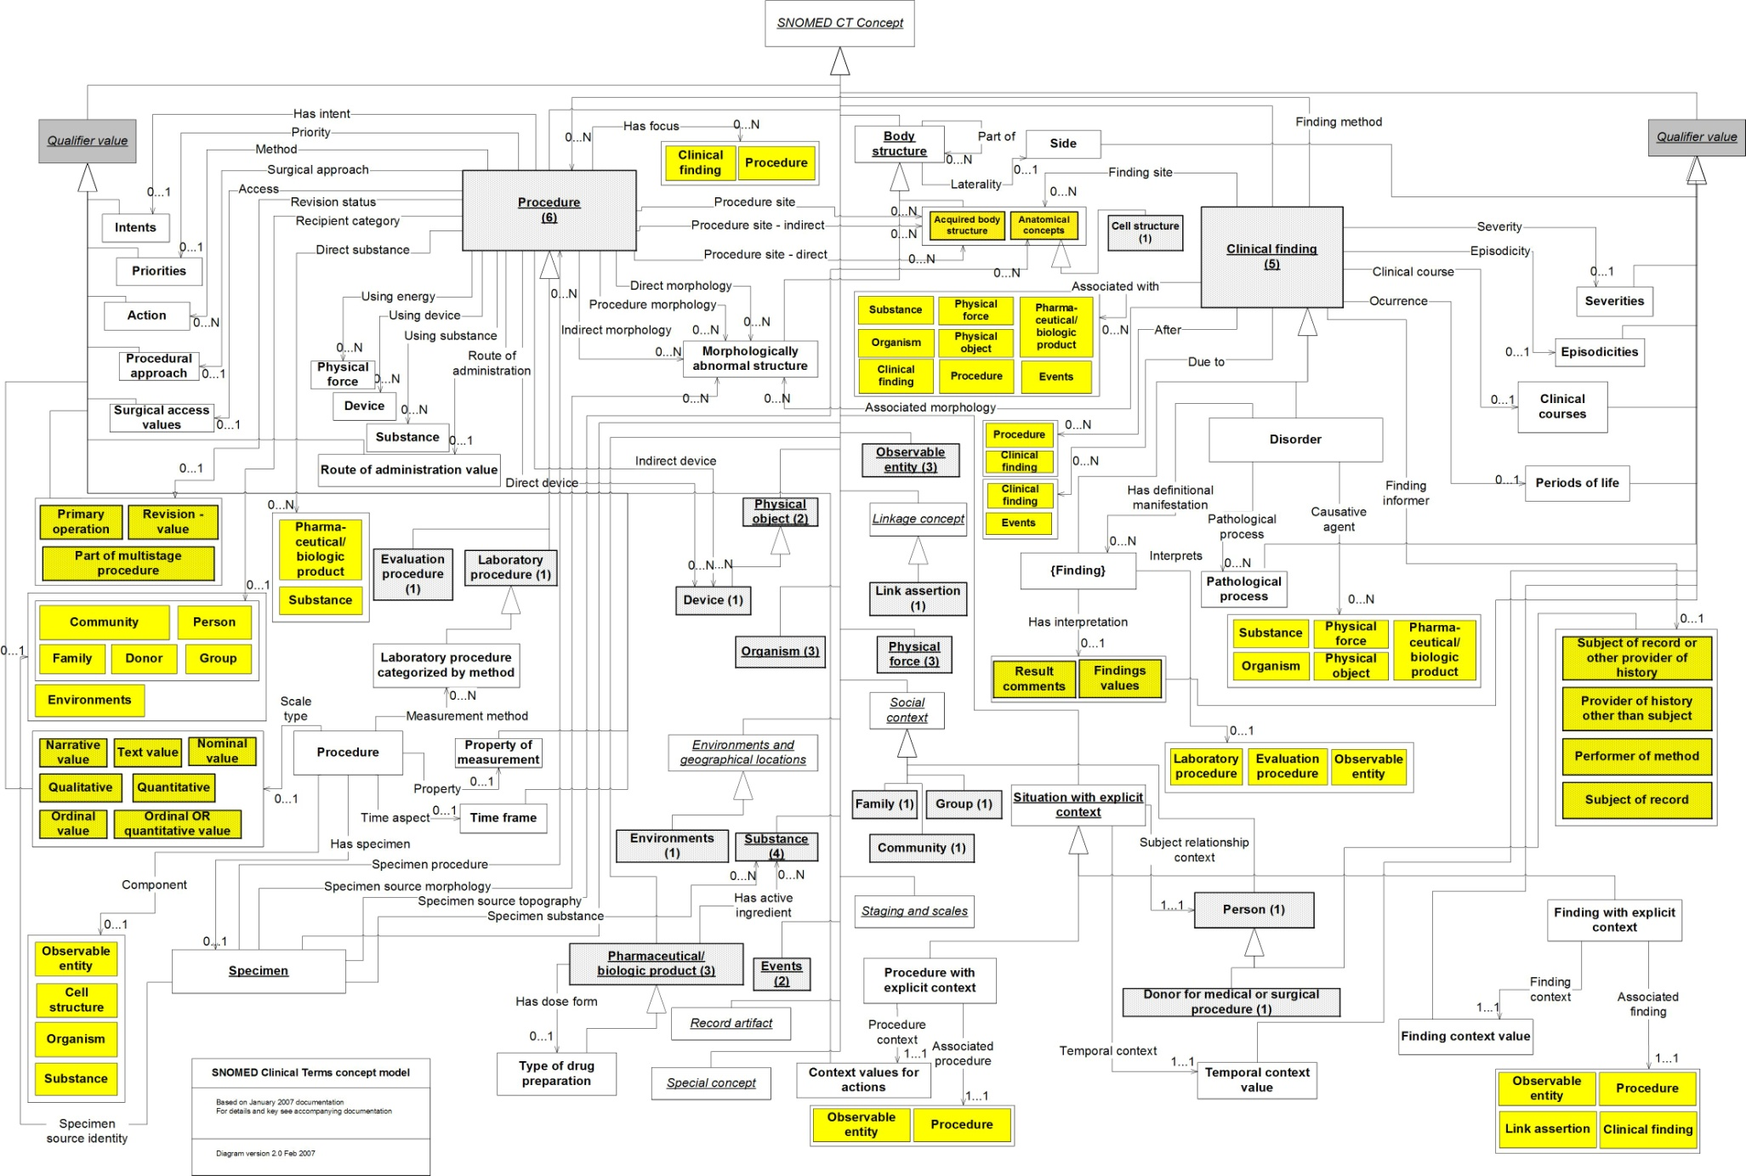
2007: SNOMED CT ‘Meta-model’

Slide 5
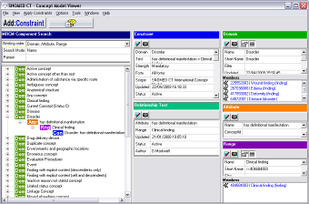
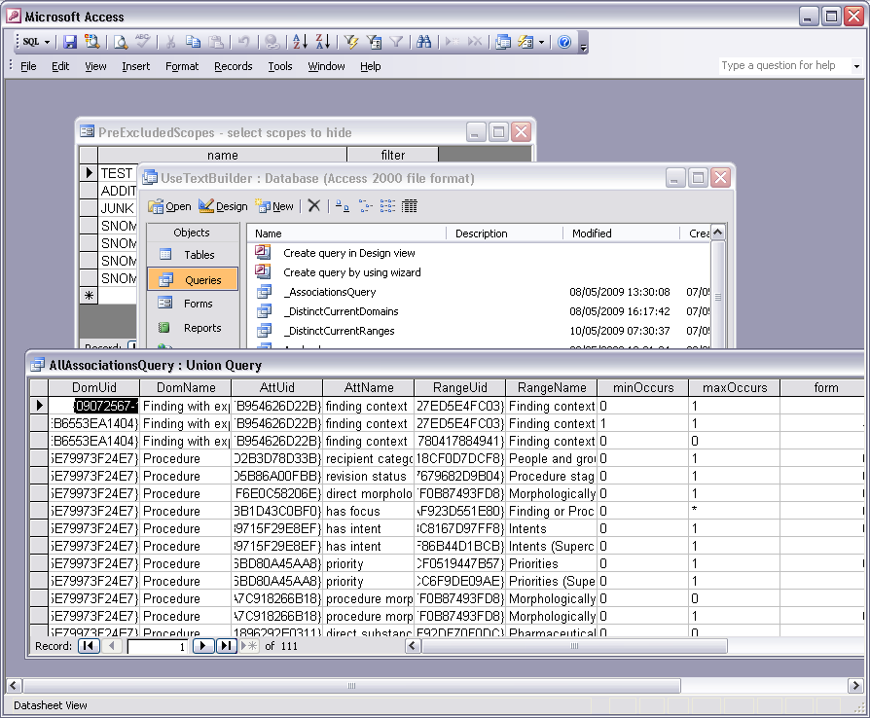
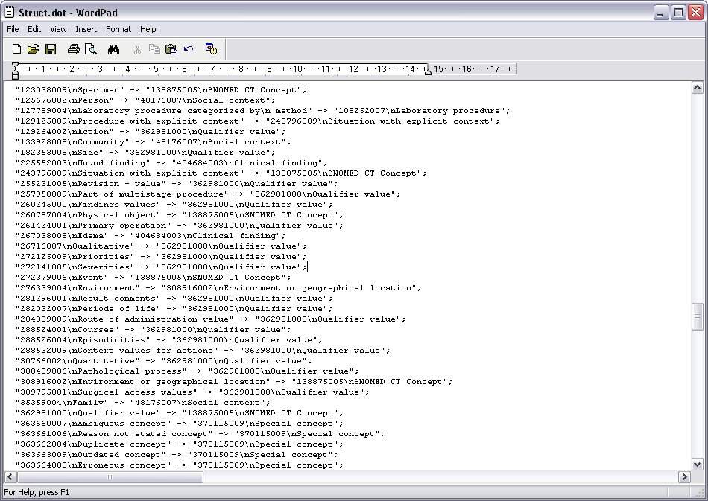
2009: MRCM Editor prototype
Edit content in MRCM editor prototype.
Build required data views in underlying MS Access db
Build sub-graph of model-referenced
SNOMED CT concepts in MS Access/VBA
Generate dot file - VBA
Notes:
Edit content in MRCM editor prototype.
Build data views in/based on underlying MS Access db

Slide 6
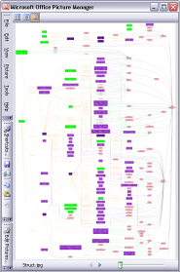
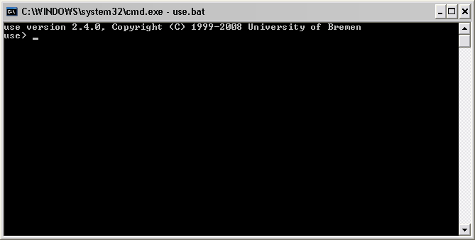
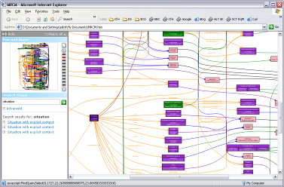
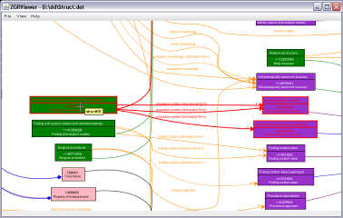
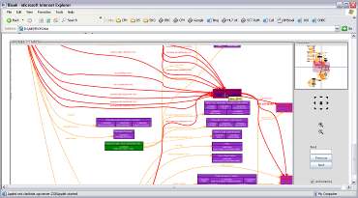
dot -Tjpg Model.dot -o Model.jpg
process dot file
java -jar zgrviewer-0.8.2.jar Model.dot
dot -Tsvg Model.dot -o Model.svg
Visio-html
ZGR applet
ZGRviewer
Notes:
Classes – SNOMED CT concept classes
Associations
Aggregations (‘RefSets’)
Relationship and cardinality tests (incl. strength, scope)
Visualisation of dot file:
Generate image file (dot.exe with specific args)
View via ‘dynamic’ environment – ZGRViewer

Slide 7
Ten years later…

Slide 8
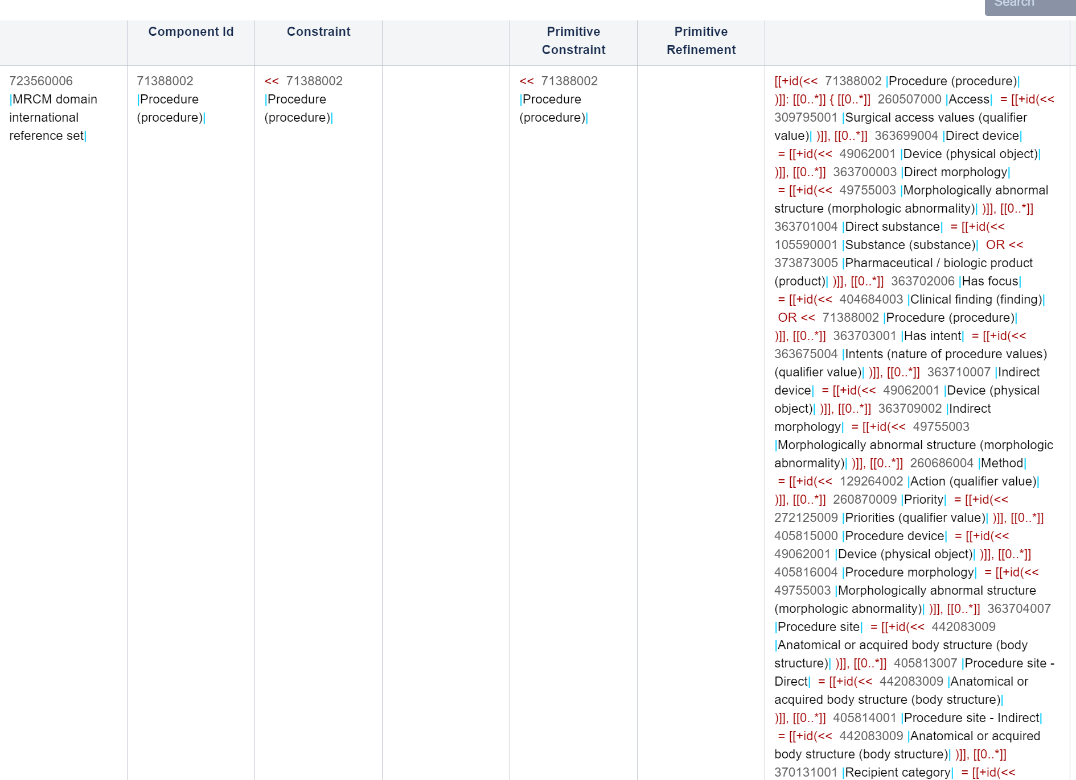
723560006 MRCM domain international reference set
(+
723561005 MRCM attribute domain international reference set)
<< 71388002 Procedure 0..1 260507000 Access << 309795001 Surgical access values
<< 71388002 Procedure 0..1 363699004 Direct device << 49062001 Device
<< 71388002 Procedure 0..1 363700003 Direct morphology << 49755003 Morphologically abnormal structure
<< 71388002 Procedure 0..1 363701004 Direct substance << 105590001 Substance
<< 71388002 Procedure 0..1 363701004 Direct substance << 373873005 Pharmaceutical / biologic product
<< 71388002 Procedure 0..1 363702006 Has focus << 404684003 Clinical finding
<< 71388002 Procedure 0..1 363702006 Has focus << 71388002 Procedure
<< 71388002 Procedure 0..1 363703001 Has intent << 363675004 Intents
<< 71388002 Procedure 0..1 363710007 Indirect device << 49062001 Device
<< 71388002 Procedure 0..1 363709002 Indirect morphology << 49755003 Morphologically abnormal structure
<< 71388002 Procedure 0..1 260686004 Method << 129264002 Action
<< 71388002 Procedure 0..1 260870009 Priority << 272125009 Priorities
<< 71388002 Procedure 0..* 405815000 Procedure device << 49062001 Device
<< 71388002 Procedure 0..* 405816004 Procedure morphology << 49755003 Morphologically abnormal structure
<< 71388002 Procedure 0..* 363704007 Procedure site << 442083009 Anatomical or acquired body structure
<< 71388002 Procedure 0..1 405813007 Procedure site - Direct << 442083009 Anatomical or acquired body structure
<< 71388002 Procedure 0..1 405814001 Procedure site - Indirect << 442083009 Anatomical or acquired body structure
<< 71388002 Procedure 0..1 370131001 Recipient category << 125676002 Person
<< 71388002 Procedure 0..1 370131001 Recipient category << 35359004 Family
<< 71388002 Procedure 0..1 370131001 Recipient category << 133928008 Community
<< 71388002 Procedure 0..1 370131001 Recipient category << 389109008 Group
<< 71388002 Procedure 0..1 246513007 Revision status << 261424001 Primary operation
<< 71388002 Procedure 0..1 246513007 Revision status << 255231005 Revision - value
<< 71388002 Procedure 0..1 246513007 Revision status << 257958009 Part of multistage procedure
<< 71388002 Procedure 0..1 425391005 Using access device << 49062001 Device
<< 71388002 Procedure 0..* 424226004 Using device << 49062001 Device
<< 71388002 Procedure 0..1 424244007 Using energy << 78621006 Physical force
<< 71388002 Procedure 0..1 424361007 Using substance << 105590001 Substance

Slide 9
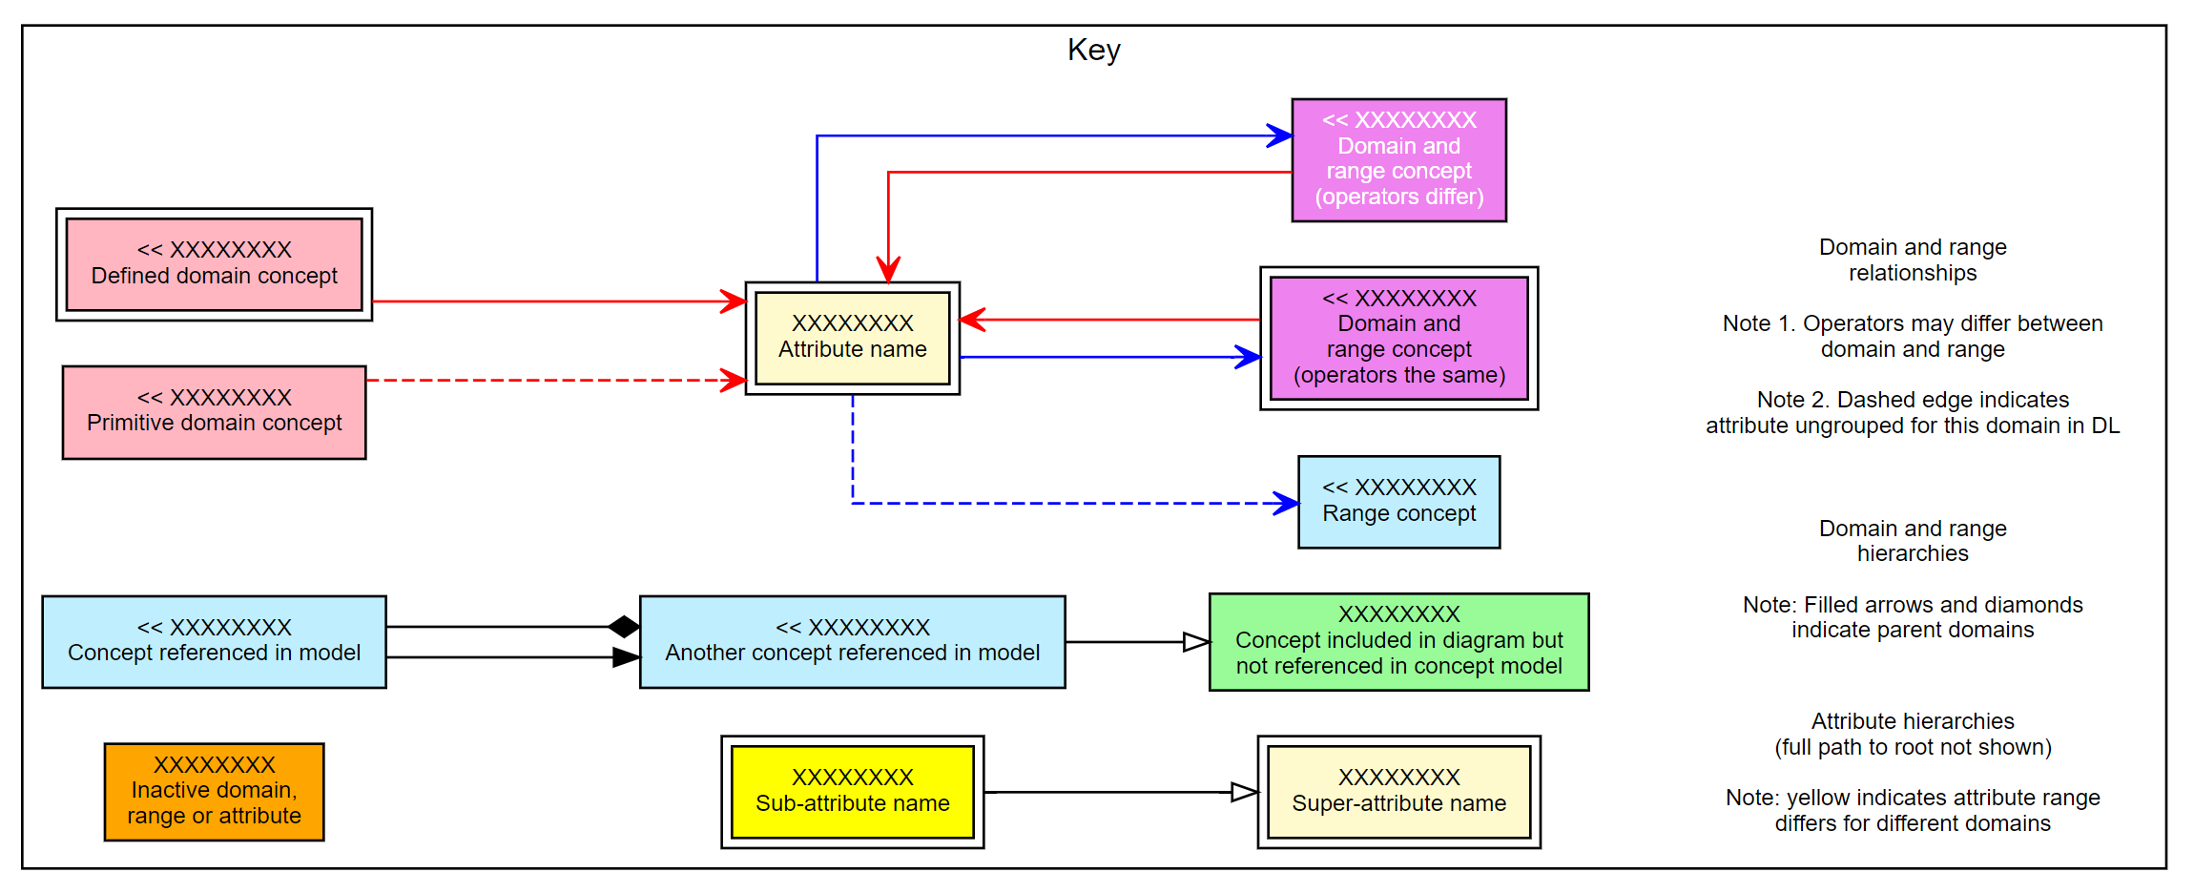
-> Graphviz diagram (dot layout, key shown here)
https://graphviz.org/
Ancestry/descendant checking, subgraph reconstruction, defined/primitive, groupable/ungrouped, data version for caption

Slide 10
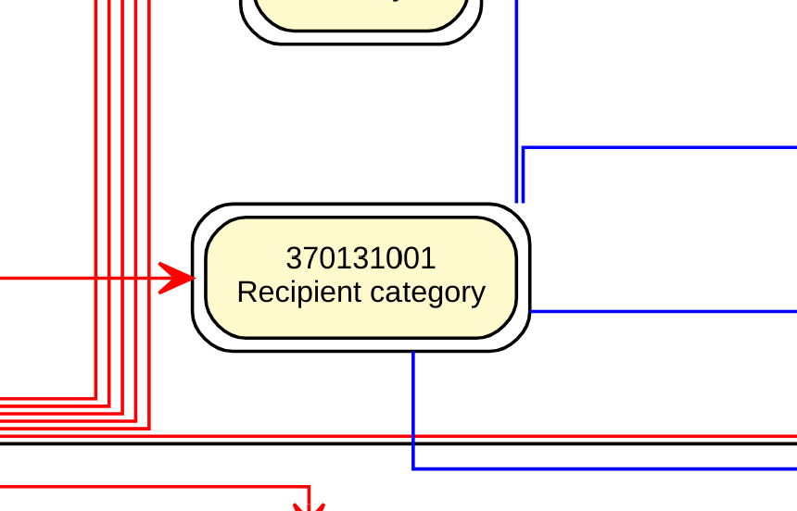
Loosely replicates diagramming guideline :
Hard rectangles for attribute names – bug with edge connectors if rounded
Currently rendered as SVG
Distinct groups not shown (groupable/ungroupable is shown…)
Configurable, e.g.:
Domain combinations
+/- Cardinalities, constraint operators, key, caption, tooltips, direction
Experimental – attribute use/domain+range size

Slide 11
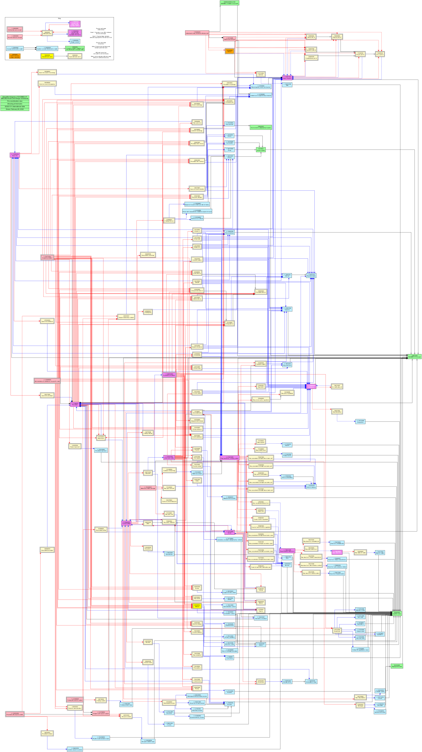
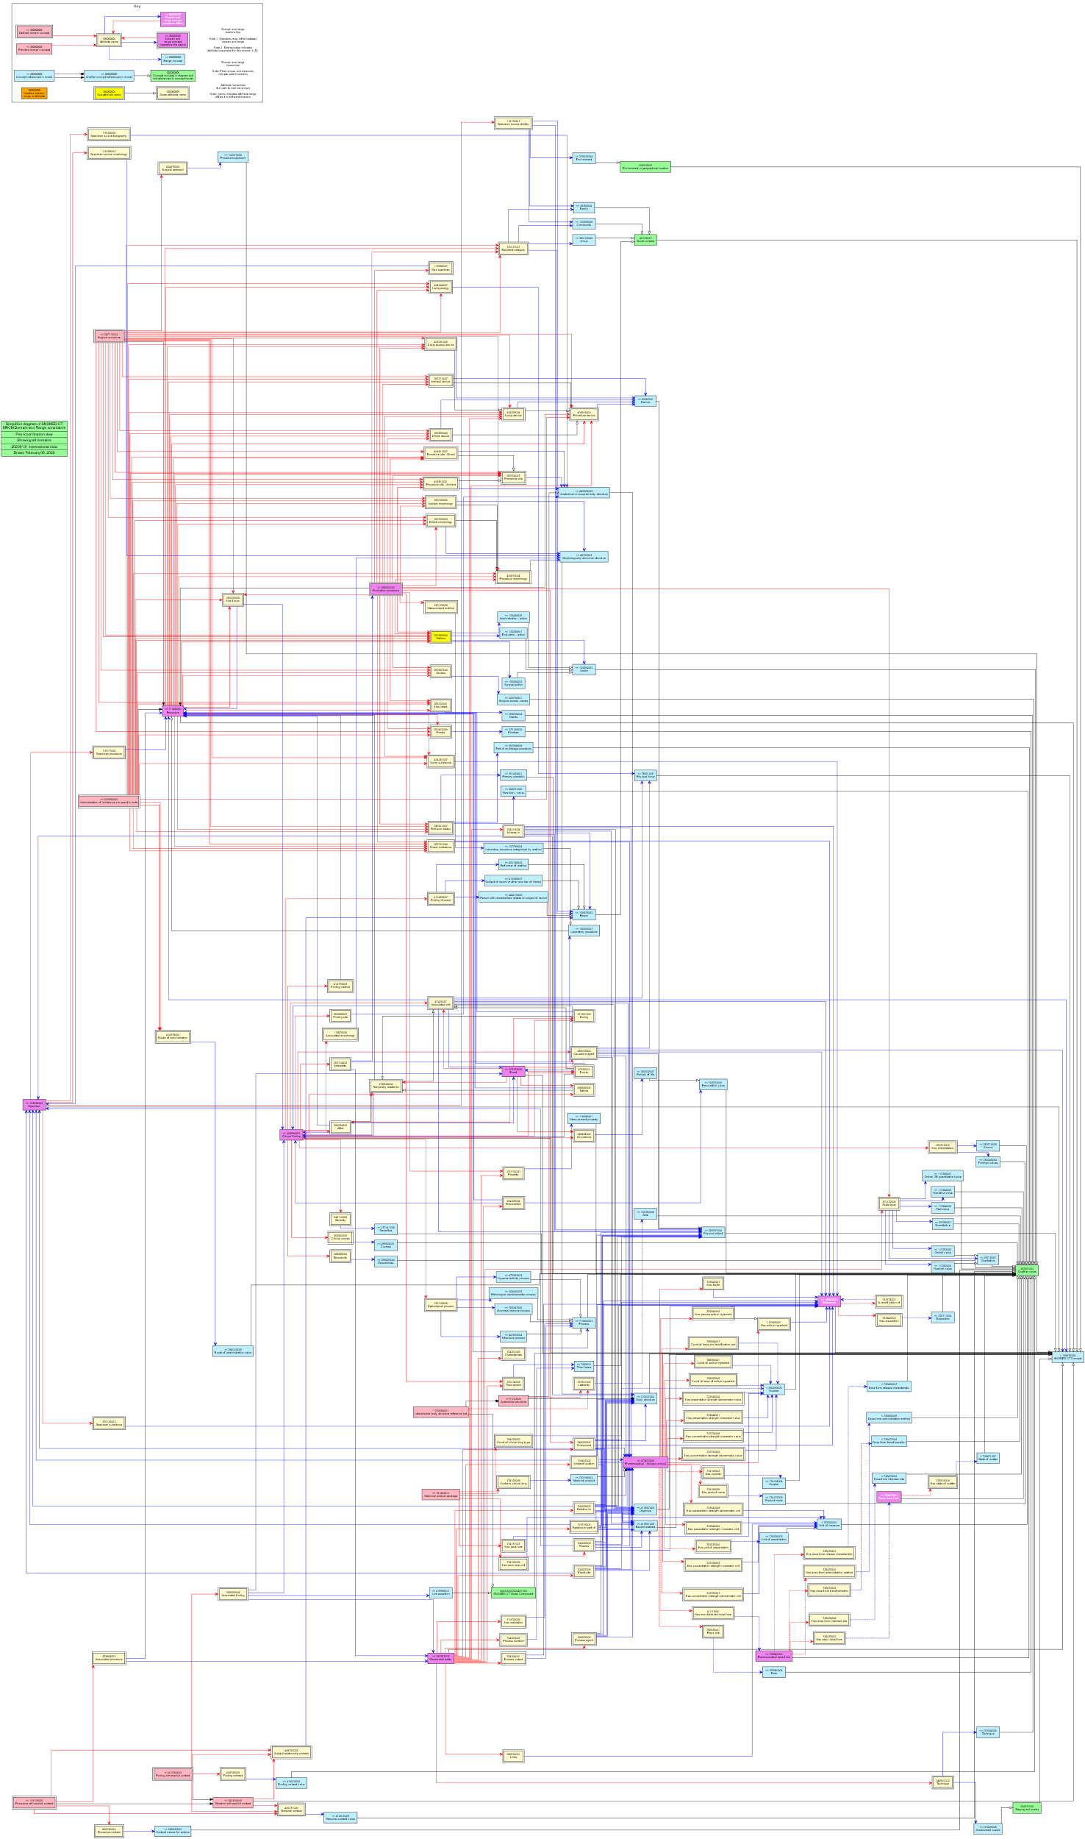
Pre-coordination
Post-coordination

Slide 12
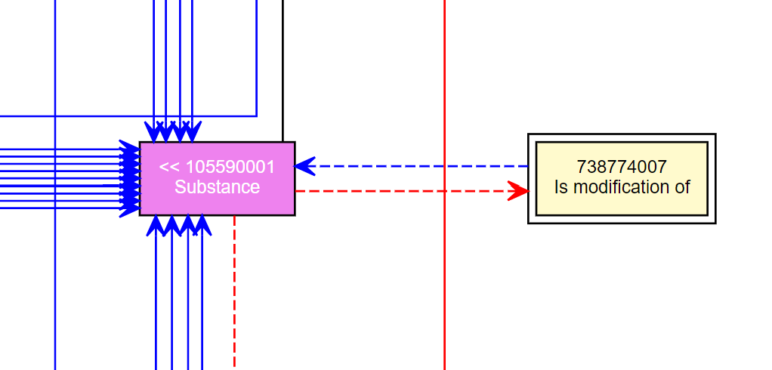
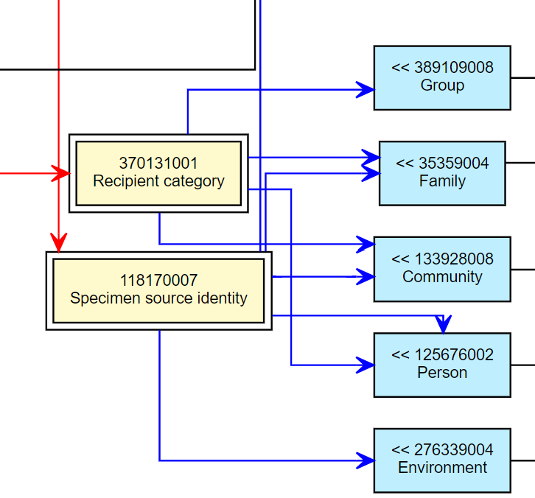
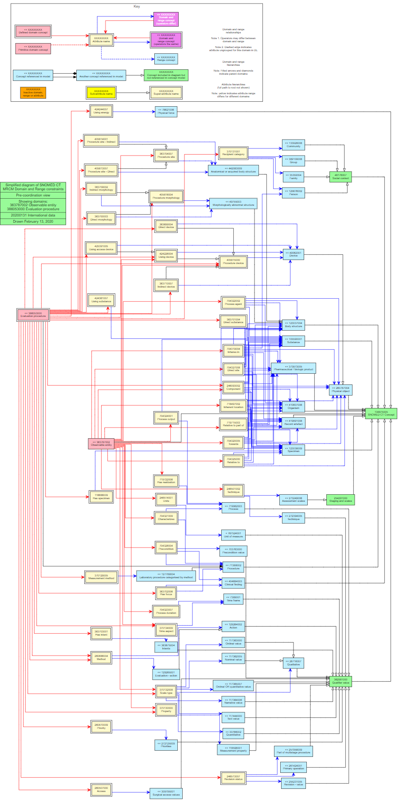
Are periods of life necessarily kinds of precondition?
[[0..1]] 732943007 |Has basis of strength substance| = [[+id(< 105590001 |Substance (substance)|)]]
740685003 |Inject (administration method)| vs. 129326001 |Injection - action (qualifier value)|
Possible value set alignment
738983006 |Otic (intended site)| vs. 10547007 |Otic route (qualifier value)|

Slide 13
Interested?
Add diagrams back into to documentation
Links into documentation/resolve to guide URLs (Domain & Range classes), or
Add relevant definitions to named domain/range classes
Incorporate into cross-domain human/machine QA
Improvements?
How to produce?
Model changes
Address queries raised
Rework/simplify qualifier value ranges
Anyone using MRCM?

