Slide 1

T07: Practical Modeling Issues: Representing Coded and Structured Patient Data in EHR Systems
AMIA Fall Symposium
Sunday November 17, 2013
Stanley M Huff, MD
Chief Medical Informatics Officer

Slide 2
Acknowledgements
Tom Oniki
Joey Coyle
Craig Parker
Yan Heras
Cessily Johnson
Roberto Rocha
Lee Min Lau
Alan James
Harold Solbrig
Many others…

Slide 3
Patient

Slide 4
Core Assumptions
‘The complexity of modern medicine exceeds the inherent limitations of the unaided human mind.’
~ David M. Eddy, MD, Ph.D.
‘... man is not perfectible. There are limits to man’s capabilities as an information processor that assure the occurrence of random errors in his activities.’
~ Clement J. McDonald, MD

Slide 5
Clinical System Approach
Intermountain can only provide the highest quality, lowest cost health care with the use of advanced clinical decision support systems integrated into frontline workflow

Slide 6
Decision Support Modules
Antibiotic Assistant
Ventilator weaning
ARDS protocols
Nosocomial infection monitoring
MRSA monitoring and control
Prevention of Deep Venous Thrombosis
Infectious disease reporting to public health
Diabetic care
Pre-op antibiotics
ICU glucose protocols
Ventilator disconnect
Infusion pump errors
Lab alerts
Blood ordering
Order sets
Patient worksheets
Post MI discharge meds

Slide 7
Strategic Goals
Minimum goal: Be able to share applications, reports, alerts, protocols, and decision support with ALL customers of our same vendor
Maximum goal: Be able to share applications, reports, alerts, protocols, and decision support with anyone in the WORLD

Slide 8
Order Entry API (adapted from Harold Solbrig)
VA Order Entry
Application
Update Medication Order
Interface
COS
COS
VA Order
Services
Update PharmacyOrder
WHERE orderNumber = “4674” …
Service
Data
MUMPS
Database

Slide 9
Order Entry API:
Different Client, Same Service (adapted from Harold Solbrig)
Department of Defense
Department of Defense
Application
Update Medication Order
Interface
COS
COS
VA Order
Services
Update PharmacyOrder
WHERE orderNumber = “4674” …
Service
Data
MUMPS
Database

Slide 10
Order Entry API:
Different Server, Same Client (adapted from Harold Solbrig)
Department of Defense
Application
Update Medication Order
Interface
COS
Update PharmacyOrder
WHERE orderNumber = “4674” …
Service
Data
Oracle
Tables

Slide 11
Order Entry API (adapted from Harold Solbrig)
. . .
Application
Interface
COS
Service
Data

Slide 12
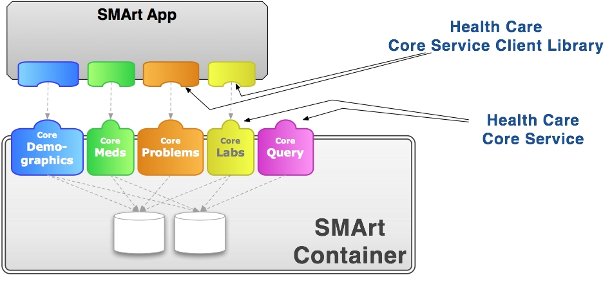
From Ben Adida and Josh Mandel
Notes:
SMArt is using RDF to represent models and data. Right now they have very simple models. We are hoping to collaborate on model development.

Slide 13
What Is Needed to Create a New Paradigm?
Standard set of detailed clinical data models coupled with…
Standard coded terminology
Standard query language
Standard API’s (Application Programmer Interfaces) for healthcare related services
Open sharing of models, coded terms, and API’s
Sharing of decision logic and applications

Slide 14
Why do we need detailed clinical models?

Slide 15
A diagram of a simple clinical model
Clinical Element Model for Systolic Blood Pressure
SystolicBPObs
SystolicBP
data
138 mmHg
quals
BodyLocation
BodyLocation
data
Right Arm
PatientPosition
PatientPosition
data
Sitting

Slide 16
Need for a standard model
A stack of coded items is ambiguous (SNOMED CT)
  Numbness of right arm and left leg
    Numbness (44077006)
    Right (24028007)
    Arm (40983000)
    Left (7771000)
    Leg (30021000)
  Numbness of left arm and right leg
    Numbness (44077006)
    Left (7771000)
    Arm (40983000)
    Right (24028007)
    Leg (30021000)

Slide 17
What if there is no model?
Site #1
70
Dry Weight:
70
kg
Site #2
70
Dry
Weight:
70
kg
Wet
Ideal

Slide 18
Too many ways to say the same thing
A single name/code and value
  Dry Weight is 70 kg
Combination of two names/codes and values
  Weight is 70 kg
    Weight type is dry

Slide 19
Model fragment in XML
Pre-coordinated representation
<observation>
<cd>Dry weight (LOINC 8340-2) </cd>
<value>70 kg</value>
</observation>
Post-coordinated (compositional) representation
<observation>
<cd>Weight (LOINC 3141-9) </cd>
<qualifier>
<cd> Weight type (LOINC 8337-8) </cd>
<value> Dry (SNOMED CT 13880007) </value>
<qualifier>
<value>70 kg</value>
</observation>

Slide 20
Relational database implications
Patient Identifier
Date and Time
Observation Type
Observation Value
Units
123456789
7/4/2005
Dry Weight
70
kg
123456789
7/19/2005
Current Weight
73
kg
Patient Identifier
Date and Time
Observation Type
Weight type
Observation Value
Units
123456789
7/4/2005
Weight
Dry
70
kg
123456789
7/19/2005
Weight
Current
73
kg
How would you calculate the desired weight loss during the hospital stay?

Slide 21
Another example, from Linda Bird

Slide 22
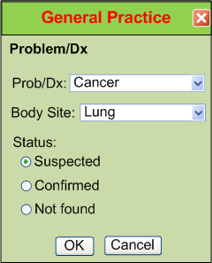
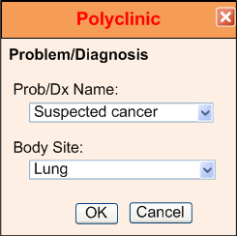
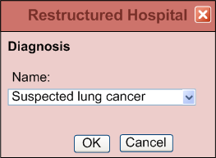
IsoSemantic Models – Example of Problem
(from Dr. Linda Bird)
e.g. “Suspected Lung Cancer”

Slide 23
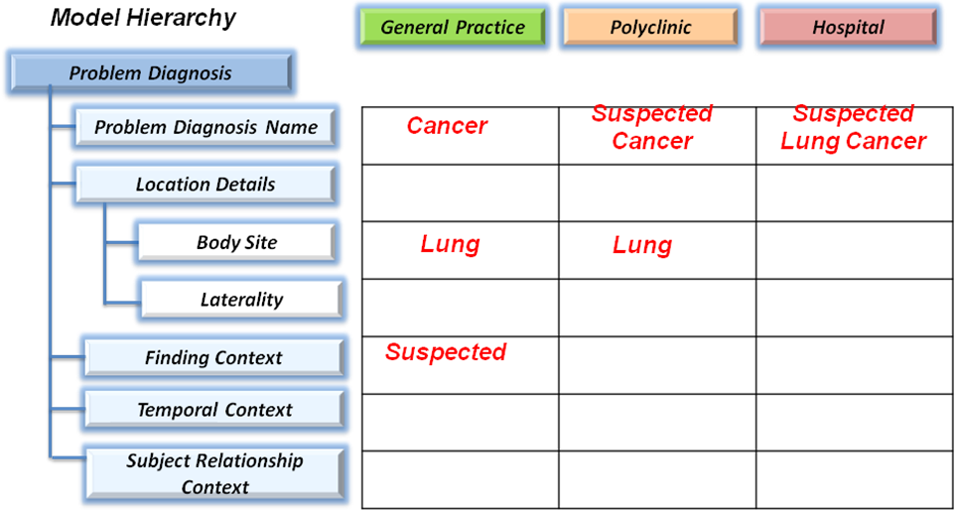
IsoSemantic Models – Example Instances
(from Dr. Linda Bird)
e.g. “Suspected Lung Cancer”

Slide 24
More complicated items:
Signs, symptoms
Diagnoses
Problem list
Family History
Use of negation – “No Family Hx of Cancer”
Description of a heart murmur
Description of breath sounds
  “Rales in right and left upper lobes”
  “Rales, rhonchi, and egophony in right lower lobe”

Slide 25
What do we model?
All health related data, including:
  Allergies
  Problem lists
  Laboratory results
  Medication and diagnostic orders
  Medication administration
  Physical exam and clinical measurements
  Signs, symptoms, diagnoses
  Clinical documents
  Procedures
  Family history, medical history and review of symptoms

Slide 26
How are the models used in an EMR?
Data entry screens, flow sheets, reports, ad hoc queries
  Basis for application access to clinical data
Computer-to-Computer Interfaces
  Creation of maps from departmental/external system models to the standard database model
Core data storage services
  Validation of data as it is stored in the database
Decision logic
  Basis for referencing data in decision support logic
Does NOT dictate physical storage strategy

Slide 27
Clinical Information Modeling Initiative (CIMI)

Slide 28
Clinical modeling activities
Netherlands/ISO Standard
Results4Care
CEN 13606
United Kingdom – NHS
Singapore
Sweden
Australia
openEHR Foundation
Canada
US Veterans Administration
US Department of Defense
Intermountain Healthcare
Mayo Clinic
HL7
  Version 3 RIM, message templates
  TermInfo
  CDA Templates
  Detailed Clinical Models
  greenCDA
Tolven
NIH/NCI – Common Data Elements, CaBIG
CDISC SHARE
Korea
Brazil

Slide 29
Clinical Information Modeling Initiative
CIMI Mission
Improve the interoperability of healthcare systems through shared implementable clinical information models.

Slide 30
Clinical Information Modeling Initiative
CIMI Goals
Shared repository of detailed clinical information models
Using a single formalism
Based on a common set of base data types
With formal bindings of the models to standard coded terminologies
Repository is open and models are free for use at no cost

Slide 31
Decisions (London, Dec 1, 2011)
We approve ADL 1.5 as the initial formalism in the repository using OpenEHR Constraint Model noting that modifications are required.
The corresponding Archetype Object Model will be included and adapted as the CIMI UML profile
The CIMI UML profile will be developed concurrently as a set of UML stereotypes, XMI specification and transformations (OMG Archetype Modelling Language RFI)

Slide 32
Terminology
SNOMED CT will be the primary reference terminology
LOINC was also approved as a reference terminology
  In the event of overlap, SNOMED CT will be the preferred source
CIMI will propose extension to the reference terminologies when needed concepts do not exist
  CIMI will maintain the extensions until they are accepted by the RT organization

Slide 33
Follow or Participate in CIMI
4-5 face-to-face meetings a year
www.cimiwiki.org (hosted by Mayo)
  Announcements
  Background
  Minutes
To get on the mailing list send an email to Virginia Riehl:
  virginia.riehl@verizon.net

Slide 34
Detailed Clinical Models (Clinical Element Models) at Intermountain Healthcare

Slide 35
Goal: Open Sharing of Models and Terms
GE owns and holds the copyright for the models and terminology
GE and Intermountain are providing a no cost license for the models and terminology in perpetuity
The no cost license allows use of the models for any purpose including commercialization and creation of derivative works
Models and terminology are posted to a website for browsing and download

Slide 36
Access to the models
Browser, download, and model request site
  http://www.clinicalelement.com

Slide 37
Detailed clinical models and terminology

Slide 38
Model & terminology must be done together
Terminology models and information models
  models made by data modelers (message standards)
  models made by terminology groups (maintenance of terms)
“Impedance mismatch” arises when one group is making terms and another group is making the model
Post coordination in a single field in the model is just another style of modeling – it is important to make the semantics explicit

Slide 39
Model Centered Data Representation
SNOMED
LOINC
FDB
RxNorm
ICD-10
CPT
SNOMED
LOINC
FDB
RxNorm
ICD-10
CPT
Context Specific
Mapping Tables
Internal
Terminology
(ECIDS)
Models
ECIS
Thesaurus
Mayo
Thesaurus
IH
Thesaurus
Models and Concepts
LexGrid Terminology Server

Slide 40
We assume that the model is used in association with a terminology server, or at least terminology tables.

Slide 41
Model and Terminology
Model
Instance data
MedicationOrder ::= SET {
drug Drug,
dose Decimal,
route DrugRoute,
frequency DrugFrequency,
startTime DateTime,
endTime DateTime,
orderedBy Clinician,
orderNumber OrderNumber}
MedicationOrder {
drug PenVK,
dose 250,
route Oral,
frequency Q6H,
startTime 09/01/95 10:01,
endTime 09/11/95 23:59,
orderedBy Don Jones, M.D.,
orderNumber A234567 }
If the medicationOrder.drug is_a “antibiotic”
then notify the infection control officer.

Slide 42
Concept Semantic Network
Drug
Antibiotics
Analgesics
Cardiovascular
Penicillins
Cephalosporins
Aminoglycosides
Pen VK
Amoxicillin
Nafcillin

Slide 43
Denormalized Semantic Network
Drugs has-child Antibiotics
Drugs has-child Analgesics
Drugs has-child Cardiovascular
Antibiotics has-child Penicillins
Antibiotics has-child Cephalosporins
Antibiotics has-child Aminoglycosides
Penicillins has-child Pen VK
Penicillins has-child Amoxicillin
Penicillins has-child Nafcillin
Drugs has-member Antibiotics
Drugs has-member Penicillins
Drugs has-member Pen VK
Drugs has-member Amoxicillin
Drugs has-member Nafcillin

Slide 44
The Clinical Element Model

Slide 45
Examples of reference models
HL7 RIM
openEHR reference model
CEN reference model
CIMI reference model
Clinical element model

Slide 46
The Logical Structure is Preeminent
A formalism is needed to be able to discuss the modeling issues. However, the details of a particular formalism are not the issue. The logical structure of the data and relationships and associations between data elements and bindings to terminology are the most important issues.

Slide 47
Basic elements of the core model
Type - The name of a particular model
Key - Links the model to a concept in an external coded terminology.
Value Choice - Possible ways to convey the model’s value.
Notes:
Do not want to store LOINC, SNOMED code directly by design. We link to external coded terminology.
1. Impossible to correct errors made in standard terminology, I.e. SNOMED, unless change database. If use mapping, then can just change the mapping to correct the error.
2. Standard terminology makes mistakes.

Slide 48
Value Choice
Data - Value conveyed as an HL7 version 3 data type
Items - Value conveyed by multiple Clinical Elements collectively

Slide 49
A Simple Laboratory Observation
SerumSodiumMeas

Slide 50
Simplified Representation

Slide 51
A Panel containing 2 Observations

Slide 52
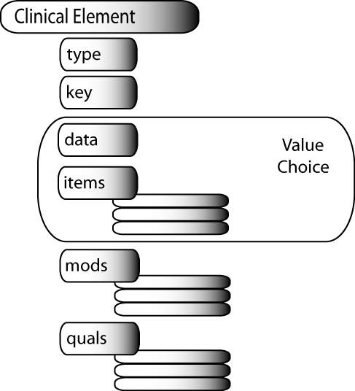
Mods and Quals of the Value Choice
Mods - Component CE’s which change the meaning of the Value Choice.
Quals - Component CE’s which give more information about the Value Choice.

Slide 53
The Use of Qualifiers
SystolicBPObs
SystolicBP
data
138 mmHg
quals
BodyLocation
BodyLocation
data
Right Arm
PatientPosition
PatientPosition
data
Sitting

Slide 54
The Use of Modifiers (subject)
BloodTypeObs
Blood Type
data
O negative
mods
Subject
Subject
data
Self (patient)
BloodTypeObs
Blood Type
data
O positive
mods
Subject
Subject
data
Fetus

Slide 55
Specific Cases in Modeling

Slide 56
Disclaimer: This is our current best thinking. Some models have not been used in a production system yet. Some models may change when we have more production experience.

Slide 57
Assertion versus Evaluation Styles

Slide 58
Data Entry Styles
Hair Color
Hair Color
Brown
Brown
Brown
Blonde
Red
Blonde
Evaluation Styles
Red
Finding
Brown hair
Brown hair
Blonde hair
Red hair
Assertion Style

Slide 59
Assertion Vs Evaluation
Evaluation Style
HairColorEval
Hair Color
data
Brown
Assertion Style
HairColorAssert
Assertion
data
Brown Hair Color

Slide 60
Assertion Vs Evaluation
Both evaluation and assertion styles are accurate and unambiguous
Evaluation style is our preferred storage form when the value represents an attribute of the patient
Storage of assertion style instances is best for diagnoses, reasons, complications, etc.
Assertion style allows each assertion to become a present/absent column for statistical analysis
Conclusion: Support only evaluation OR assertion style for a given type of data. If you need to use both styles for a given kind of data, support conversion of data between the two styles

Slide 61
Assertion Vs Evaluation
Assertion Style
HairColorAssert
Assertion
data
Brown Hair Color
Single Code Style
HairColorObs
Brown Hair Color

Slide 62
Deprecated representation
Only the “code” (HL7) or key (CEM) has a value
It is implied that this means that “the patient has brown hair color
Implying meaning is usually a bad idea

Slide 63
Subject

Slide 64
Subject – Evaluation Style
FetalBloodTypeEval
Fetal Blood Type
data
O negative
BloodTypeEval
Blood Type
data
O negative
mods
Subject
Subject
data
Fetus

Slide 65
Subject – Assertion Style #1
FetalBloodTypeAssert
Assertion
data
Fetal Blood Type O negative
BloodTypeAssert
Assertion
data
Blood Type O negative
mods
Subject
Subject
data
Fetus

Slide 66
Subject – Assertion Style #2
BreastCancerInMotherAssert
Assertion
data
Breast Cancer in Mother
BreastCancerAssert
Assertion
data
Breast Cancer
mods
Subject
Subject
data
Mother

Slide 67
Subject as a Compound Statement
Subject
Subject
items
Relationship
Relationship
data
Maternal Aunt
PersonIdentity
Person Identity
items
PersonName
PersonName
data
Clara Barton

Slide 68
Representation of Family History
BreastCancerAssert
Assertion
data
Breast Cancer
mods
Subject
Subject
items
Relationship
Relationship
data
Family (ancestor)

Slide 69
Pre Vs Post Coordinated Subject
Pre coordinated
  Easier for data entry
  Can lead to combinatorial explosion
Post coordinated
  Easier to coordinate findings between patient and related party
  Easier to extend model with additional qualifiers
  Consistent with family history
  Allows detail on the identity of the subject
  Easier to misuse data (mistake cancer in mother for cancer in patient)
Conclusion: Support both pre and post coordinated subject styles. Try to use only one or the other style for a given kind of data. Use post coordinated model for storage. Do conversion of data between styles when needed.

Slide 70
“Isosemantic” Models

Slide 71
Pre and Post Coordination
Precoordinated Model (User Interface Model)
SystolicBPRightArmSittingObs
SystolicBPRightArmSitting
data
138 mmHg
Post coordinated Model (Storage Model)
SystolicBPObs
SystolicBP
data
138 mmHg
quals
BodyLocation
BodyLocation
data
Right Arm
PatientPosition
PatientPosition
data
Sitting

Slide 72
Isosemantic models
User interface models
  Convenient for data entry
  Typically pre-coordinated
  Many variations
Storage models
  Only one model is designated as the storage model
  Comprehensive set of qualifiers and modifiers
  The storage model is referenced in reports, rules, protocols, data analysis
Composition – Decomposition mappings

Slide 73
Decomposition Mapping
Precoordinated Model (User Interface Model)
SystolicBPRightArmSittingObs
SystolicBPRightArmSitting
data
138 mmHg
Post coordinated Model (Storage Model)
SystolicBPObs
SystolicBP
data
138 mmHg
quals
BodyLocation
BodyLocation
data
Right Arm
PatientPosition
PatientPosition
data
Sitting

Slide 74
Negation and Uncertainty

Slide 75
Data Entry Styles
Medical History
(handles pertinent
negatives)
Yes
No
Unk
Diabetes
Renal Disease
Cancer
Hx Finding
Diabetes
(repeating field)
Diabetes
Renal Disease
Cancer

Slide 76
Negation
Finding
Diabetes
data
Yes
(Implicit that this means “diabetes is present.”)
FindingAssert
Assertion
data
Diabetes
mods
NegationIndicator
Negation
data
Present

Slide 77
Pre Coordinated Negation
FindingAssert
Assertion
data
No Diabetes
(Leads to combinatorial explosion)

Slide 78
Negation and Uncertainty
FindingAssert
Assertion
data
Diabetes
mods
NegationIndicator
Negation
data
Present
Uncertainty
Uncertainty
data
Probable
Use of Negation and Certainty can be expressed as mutually exclusive sets. Negation is only present/absent. All other degrees of probability are represented as values of Certainty.

Slide 79
Combined Negation and Uncertainty
FindingObs
Assertion
data
Diabetes
mods
CombinedUncertainty
Negation
data
Probably Not
Possible values for CombinedUncertainty: Not present, present, maybe, maybe not, probably, probably not, might, might not, likely, unlikely, very unlikely, very likely….

Slide 80
Conclusions on Negation
“Picklist” style selection of findings does not allow for the representation of pertinent negative findings
Pre coordinating negation with findings leads to “combinatorial explosion” in many situations
It is difficult to avoid using pre-coordination for some common phrases, “No Salmonella, Shigella, or Campylobacter identified.”
You can separate pure negation from uncertainty, or combine them into one field.
Combining negation and uncertainty into one field will probably prevent entry of some nonsensical expressions.

Slide 81
Done and Not Done

Slide 82
Done and Not Done
AppendectomyProc
Appendectomy
data
Done
(Implicitly this means “appendectomy was done.”)
Procedure
Procedure
data
Appendectomy
mods
DoneNotDoneIndicator
DoneNotDone
data
Done

Slide 83
Done and Not Done
Recording of whether actions or events occurred or not has a similar structure to negation, but the values are Done and Not Done.
Theoretically, it is possible to use both Negation, and Done/Not Done in a single statement. For example: The patient had abdominal surgery but it was NOT an appendectomy.”

Slide 84
History Of

Slide 85
“History Of” issues
A clinician can observe a sign or perform a procedure and record the event in the EHR.
The patient or family can report a symptom or procedure occurred.
It is essential to distinguish these two cases.
When you query for existence of a given disease you want consistency of representation between direct observations and historical observations.

Slide 86
Consistency of Representation
FindingAssert
Assertion
data
Vomiting
(Observed by a clinician)
FindingAssert2
Assertion
data
History of Vomiting
(Reported by the patient’s mother)
As data ages, the observed information becomes the same as reported information.
If you ask the database “Did the patient have vomiting?”, you want “True” to be returned in either case.

Slide 87
Attribution
Recording the source of information
  Who, when, where
Database add/modify/delete timestamps are handled separately from clinical processes
Attributions pertain to actions or events
Attributions are represented as a special class of qualifiers

Slide 88
General model for act attribution
State the act (action or event)
  Observed, reported, ordered, counter signed, transcribed
State the attribution information
  Who
    Participation (observer, reporter, receiver)
    Role (mother, physician, nurse, student)
  When (exact or fuzzy time)
  Where
    Geograpical place
    Network place
    Could be different for patient than for clinician
  Reason for the action
    Reason for order, reason for cancel, reason for hold

Slide 89
Differences for Observed and Reported
Observed
  Action (Observed)
  Observer
  Timestamp
Reported
  Action (Reported)
  Reporter
  Receiver
  Timestamp
Observer, reporter, and receiver could be programs or electronic data stores

Slide 90
Attribution - Observed
Observed
Action
data
Observed
quals
Participant
Participant
data
Observer
quals
Role
Role
data
Physician

Slide 91
Attribution - Reported
Reported
Action
data
Reported
quals
ReportTimeObs
ReportTime
data
11/09/2007
Participant
Reporter
items
Role
Role
data
Mother
Participant
Receiver
items
Role
Role
data
Clnician

Slide 92
Assertion with Attributions
VomitingObs
Assertion
data
Vomiting
mods
Subject
Subject
data
Patient
quals
Observed
(As previously defined)
Reported

Slide 93
Attributions
Attribution information unifies the historical and observational data.
Attribution allows status change information to be carried in the instance of data.
Specific models for particular kinds of attributions allows participants, roles, locations, and reasons to be specified.

Slide 94
Pain and Pain Severity

Slide 95
Pain Assertion and Qualifiers
PainAssert
Assertion
data
Pain
quals
BodyLocation
Body Location
data
Abdomen
PainQuality
Pain Quality
data
Dull
PainSeverity
Pain Severity
data
Moderate

Slide 96
Pain Scale
PainScaleEval
PainScale
data
Mild, 3

Slide 97
Pain Modeling Issues
Pain severity is not usually measured unless there is pain.
A pain severity of (None, 0) is the same as no pain.
In common practice Pain Severity Scales are thought of as independent observations, not qualifiers of pain.
Conclusion: We allow the pain severity scales as independent observations. However, the pain assertion model is more expressive. We allow the use of both models.

Slide 98
Semantic links

Slide 99
How much data in a single record?
“Chest pain made worse by exercise”
  Two events, but very close association
  Normally would go into a single finding
“Ate a meal at a restaurant and 30 minutes later he felt nauseated, and then an hour later he began vomiting blood.”
  Discrete events with known time and potential causal relationships
  May need to be represented by multiple associated findings
Semantic links are used to represent relationships between distinct event instances

Slide 100
Semantic Links (from Roberto Rocha)
Diagnostic
Procedure
Observation
In comparison to a
study of 6.2.92, there
has been a slight
increase in the degree
of cardiomegaly.
The previously described
area of consolidation in the
left upper lobe has improved.
PA view is compared to the
previous examination dated
10-22-91.
Diagnostic
Procedure
Observation
Post-operative changes
consistent with coronary
artery bypass.
Surgical
Procedure
There is persistent bilateral
apical pleural thickening and
superior paramediastinal
streaky opacities.

Slide 101
Representation of Semantic Links
InstanceId 1 Relationship InstanceId 2
(123) Nausea followed-by (987) Vomiting
Semantic links can also have certainty and attribution
  Certainty (certain, possible, probable, not likely)
  Attribution (who or what asserted the relationship, when, and why?)

Slide 102
Requirements for “Good” Models

Slide 103
Requirements for good models
Accurate – corresponds to the real world
Unambiguous – only one meaning
Understandable
  People recognize the real world referent(s)
Reproducible
  Different modelers would model in the same way
Parsimonious and harmonious use of terminology
  Semantics of the model and terminology match
Flexible
  Evolve gracefully over time
Consistent across domains – Specimen Collection and I&O Charting
Practical – implementable in current databases and standard languages
Minimally complex – cover only what is needed
Common queries are easy

Slide 104
Ambiguity
Pulse
???
Present (Present/Absent)
72 beats/minute (Rate)
Thready (Quality)
Irregular (Rhythm)

Slide 105
Questions?
stan.huff@imail.org

Slide 106
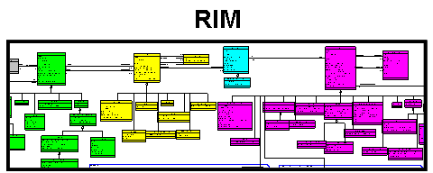
Information Model Ideas
CEM
V2 “|”
Standard
Terminologies
LRA
V2 XML
HTML
CEMs
V3 XML
DCMs
V3 Next
Repository of Shared
Models in
a Single Formalism
Translators
Realm
Specific Specializations
Translators
UML
Realm
Specific Specializations
Translators
CDA
Templates
Realm
Specific Specializations
Realm
Specific Specializations
Realm
Specific Specializations
ADL
openEHR
Archetypes
CDA
OWL
CEN
Archetypes
LRA
Models
CDISC
SHARE
SOA
Payload
CMETs, HMDs
RMIMs
CEN
Archetype
Initial Loading of Repository

Slide 107
Other issues
Levels of models – boundary between what is in “file” and what we represent in tables or some other kind of knowledge representation. Models in files to the level of different attributes and then further constraints in tables?
Examples using coded ordinal data type
Yes/no questions are really a different user entry style for assertion models
More examples with Family History
Better slides for semantic links
Specific examples of “Hx of”
Discussion of other modifiers – planned procedures, goals, etc.
Examples of “Relative Temporal Context”
Implementation choices in object oriented languages

Slide 108
Other issues
Show how the hierarchy of CEMs could produce the Act hierarchy in the HL7 RIM
Inheritance of qualifiers and attributions between panels and statements
Common qualifiers across models and within the same family of models
  Status, body location, changes (in vision, appetite, etc.)
  Don’t want “hard” hierarchies, but want common query and behaviors across different models
Co-occurrence constraints
“CHOICE in Qualifiers”
  Items that could be numeric or conceptual (frequency of “after meals” XOR “every 4 hours”
Use of “aggregate data”

Slide 109
Other issues
Details of modeling health issues (problems)
Storage of data that does not conform to the model
  Alternative data (data type does not match)
  Unrecognized qualifier
  Too many qualifiers - cardinality of qualifier is not allowed
Support for calculated values
Relative temporal context
Practical compromises
  Allowing value sets with “low, med, high, not assessed”

Slide 110
Other Issues
Types of collections
  Statements
  Complex statements – orders
  Panels
  Apgar scores, Treadmill test
  Folders, sections, and other arbitrary collections (from CEN 13606)

