Slide 1
Topics from ECE project group
Bruce Goldberg, MD, PhD

Slide 2
Complication model revisited

Slide 3
Current definition of complication in editorial guidelines
A complication is a disorder caused by another disorder, procedure, or event which is not a natural progression or expected outcome of its cause; temporally may be During and After the causative disorder, procedure, or event.

Slide 4
Results of survey
 |  | Complication (Y/N)
SCTID | FSN | Reviewer 1 | Reviewer 2 | Reviewer 3 | Reviewer 4 | Reviewer 5 | Reviewer 6 | Reviewer 7 | # complications | # not complications
724557008 | Acquired iron deficiency anemia due to decreased absorption (disorder) | N | N | N | N | Y | N | N | 1 | 6
724816007 | Acquired anhidrosis co-occurrent and due to primary autonomic disorder (disorder) | N | N | N | N | Y | ? | N | 1 | 6
721283000 | Acidosis due to type 1 diabetes mellitus (disorder) | Y | Maybe | N | N | Y | N | N | 2 | 5
431804003 | Acquired scleral show due to eyelid deformity (finding) | N | N | N | N | Y | N | N | 1 | 6
698741009 | Acute complete quadriplegia due to spinal cord lesion between first and fourth cervical vertebra (disorder) | Y | N | N | N | Y | N | N | 2 | 5
762353009 | Acute headache due to traumatic injury of head (disorder) | N | N | N | Y | Y | N | N | 2 | 5
722095005 | Acute kidney injury due to circulatory failure (disorder) | Y | N | N | Y | Y | N | N | 2 | 5
698755001 | Acute paralysis due to lesion of spinal cord (disorder) | Y | N | N | N | Y | N | N | 1 | 6
429224003 | Acute renal failure due to acute cortical necrosis (disorder) | N | N | N | N | Y | N | N | 1 | 6
707323002 | Anemia co-occurrent and due to chronic kidney disease (disorder) | Y | N | N | N | Y | N | N | 1 | 6
413532003 | Anemia due to blood loss (disorder) | N | N | N | N | N | N | N | 0 | 7
413533008 | Anemia due to chronic blood loss (disorder) | N | N | N | N | N | N | N | 0 | 7
707753007 | Angular cheilitis due to lack of adequate intermaxillary vertical dimension (disorder) | Y | N | N | Y | Y | N | N | 3 | 4
53868003 | Anterior cord syndrome co-occurrent and due to closed fracture of C1-C4 level (disorder) | Y | N | N | Y | Y | N | N | 3 | 4
233864007 | Aortic regurgitation due to cystic medial necrosis of aorta (disorder) | Y | N | N | Y | Y | N | N | 3 | 4
361272001 | Cerebellar ataxia due to alcoholism (disorder) | N | Y | N | Y | Y | N | N | 3 | 4
438513002 | Cerebral degeneration due to Parkinson's disease (disorder) | Y | N | N | Y | N | N | N | 2 | 5
705128004 | Cerebral infarction due to embolism of middle cerebral artery (disorder) | N | N | N | Y | Y | N | N | 2 | 5
1.60243E+16 | Cerebrovascular accident due to occlusion of right cerebellar artery (disorder) | N | N | N | N | Y | N | N | 1 | 6
717936002 | Classic onset hemorrhagic disease of newborn due to vitamin K deficiency (disorder) | Y | N | N | N | N | N | N | 1 | 6
722369003 | Congenital nephrotic syndrome due to diffuse mesangial sclerosis (disorder) | Y | N | N | Y | Y | N | N | 3 | 4
1.62367E+16 | Delirium due to methamphetamine intoxication (disorder) | N | N | N | N | Y | N | N | 1 | 6
6.72511E+14 | Dysarthria due to and following hemorrhagic cerebrovascular accident (disorder) | Y | N | N | Y | Y | N | N | 3 | 4
1.08522E+15 | Rectal hemorrhage due to chronic ulcerative proctitis (disorder) | N | N | N | Y | N | N | N | 1 | 6
735173007 | Shock co-occurrent and due to anaphylaxis (disorder) | N | N | N | N | Y | N | N | 1 | 6
 | Totals |  |  |  |  |  |  |  | 41 (23%) | 134 (77%)

Slide 5
Decision by ECE
Complications of disorders
  Due to difficulty achieving consistency in determining natural progression or expected outcome as a criterion for determining whether something is a complication, model using due to relationship and do not add complication (disorder) as a parent.
Complication of procedures
  Model with a complication (disorder) as a parent
Disorders due to events need further investigation
Sequelae
  Define sequela using both due to and after relationships
  Define disorders following other disorders or procedures without a causal relationship using only an after relationship
  Need to determine whether above distinctions are reproducible
    If so, Sequelae may be modeled using GCIs

Slide 6
Injuries

Slide 7
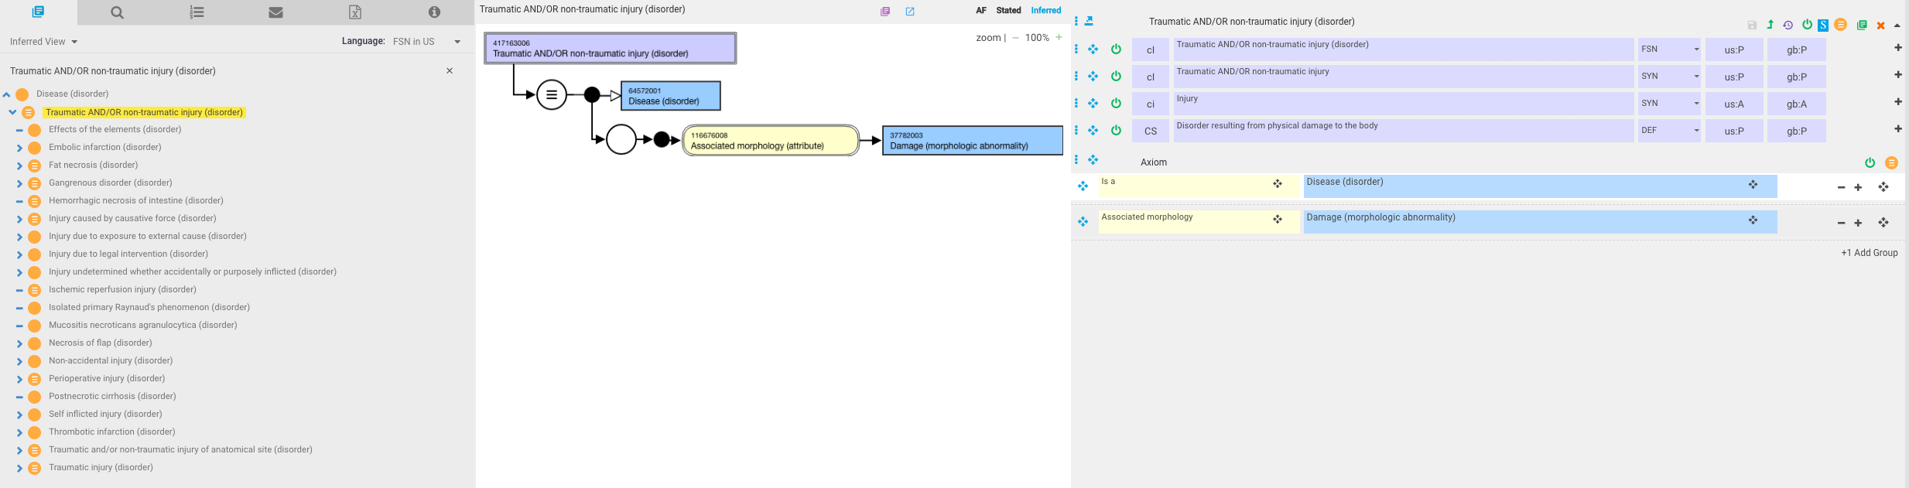
Injury
The current model for injury (traumatic or nontraumatic) is fully defined with an associated morphology of damage
The meaning of damage as a subtype morphologic abnormality is unclear, many sources provide circular definitions of injury and damage
Specific types of injury would need to have morphologies that are subtypes of damage which is not always the case in order to be fully defined

Slide 8
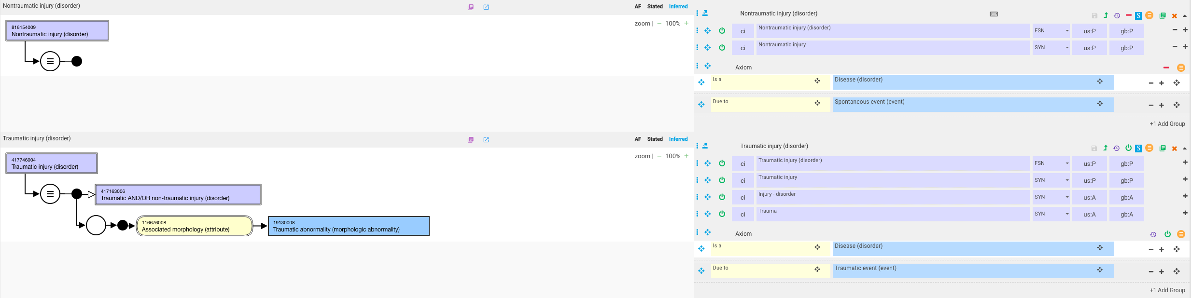
Proposed models for Traumatic injury (disorder) and new concept Nontraumatic injury (disorder)

Slide 9
Decision by ECE
Retain 417163006 |Traumatic AND/OR non-traumatic injury (disorder)|but make primitive by removing associated morphology of 37782003 |Damage (morphologic abnormality)|
Subtypes would be Traumatic injury (disorder), Nontraumatic injury (disorder) and injuries which may be either traumatic or nontraumatic (modeled with a due to traumatic/spontaneous event relationship)
Decision by ECE

Slide 10
Fractures

Slide 11
Decisions reached during August 28 EAG call
Remodel 72704001 |Fracture (morphologic abnormality)|by removing parent of 400015001 |Traumatic abnormality by morphology (morphologic abnormality)|
Model Pathological fractures as due to Spontaneous event while replacing associated morphology 22640007 |Pathologic fracture (morphologic abnormality)|with 72704001 |Fracture (morphologic abnormality)|
Model All existing fractures other than pathological fractures as due to traumatic event. Note all fractures including pathological fractures are currently considered to be traumatic in SNOMED
For those fractures in SNOMED that are represented as both pathological fractures and traumatic fractures, create additional fracture concepts without a due to spontaneous/traumatic event relationship

Slide 12
Examples in SNOMED of fractures that are represented as both pathological fractures and traumatic fractures
id | fsn
704173002 | Pathological fracture of ankle (disorder)
16114001 | Fracture of ankle (disorder)
424455005 | Pathological fracture of clavicle (disorder)
58150001 | Fracture of clavicle (disorder)
409667007 | Pathological fracture of femur (disorder)
71620000 | Fracture of femur (disorder)
445527009 | Pathological fracture of fibula (disorder)
75591007 | Fracture of fibula (disorder)
424644003 | Pathological fracture of foot (disorder)
15574005 | Fracture of foot (disorder)
1.13152E+16 | Pathological fracture of mandible (disorder)
263172003 | Fracture of mandible (disorder)
1.13152E+16 | Pathological fracture of maxilla (disorder)
263156006 | Fracture of maxilla (disorder)
409666003 | Pathological fracture of neck of femur (disorder)
5913000 | Fracture of neck of femur (disorder)
426777008 | Pathological fracture of patella (disorder)
51037009 | Fracture of patella (disorder)
426115002 | Pathological fracture of pelvis (disorder)
77493009 | Fracture of pelvis (disorder)
704172007 | Pathological fracture of phalanx of finger (disorder)
18171007 | Fracture of phalanx of finger (disorder)
704168008 | Pathological fracture of phalanx of foot (disorder)
21351003 | Fracture of phalanx of foot (disorder)
704171000 | Pathological fracture of proximal end of femur (disorder)
263225007 | Fracture of proximal end of femur (disorder)
704170004 | Pathological fracture of radius (disorder)
12676007 | Fracture of radius (disorder)
704169000 | Pathological fracture of rib (disorder)
33737001 | Fracture of rib (disorder)
422469006 | Pathological fracture of scapula (disorder)
9682006 | Fracture of scapula (disorder)
704167003 | Pathological fracture of ulna (disorder)
54556006 | Fracture of ulna (disorder)

Slide 13
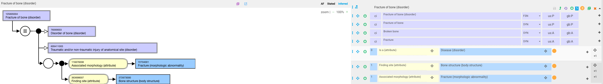
125605004 |Fracture of bone (disorder)|

Slide 14
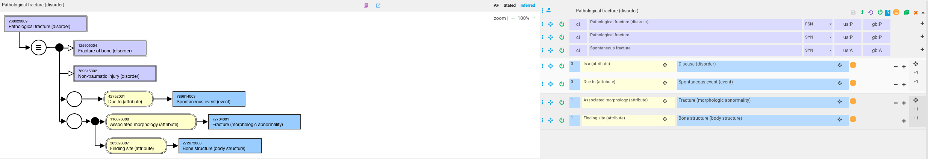
268029009 |Pathological fracture (disorder)|

Slide 15
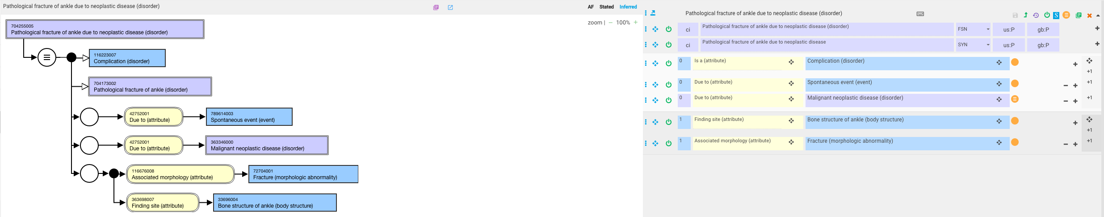
704255005 |Pathological fracture of ankle due to neoplastic disease (disorder)|

Slide 16
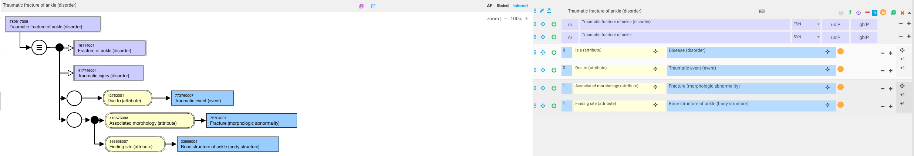
789617005 |Traumatic fracture of ankle (disorder)|

Slide 17
Manifestations of multisystem inflammatory disorders that are named and modeled for the primary manifestation of the multisystem disorder

Slide 18
Multisystem inflammatory disorders
In some cases, a multisystem inflammatory disorder may be named and modeled based on a single manifestation that is the hallmark of the disorder (e.g. rheumatoid arthritis)

Slide 19
Examples of multisystem inflammatory disorders named and modeled based on a single manifestation that is the hallmark of the disorder
Primary body system | Example | Secondary manifestations
Articular | Rheumatoid arthritis | Scleritis, pleural effusions, pulmonary nodules, pericarditis, myocarditis, mesangial glomerulonephritis, peripheral neuropathy, Hematological manifestations
Skin | Psoriasis | Uveitis, arthritis, enthesitis, coronary artery disease
Liver | Hepatitis C virus infection | Cryoglobulinemic vasculitis, renal disease with or without cryoglobulinemia, skin disorders including cutaneous leukocytoclastic vasculitis and porphyria cutanea tarda, diabetes mellitus and metabolic syndrome, and lymphomas
Gastrointestinal | Inflammatory bowel disease | Arthritis, pyoderma gangrenosum, primary sclerosing cholangitis, uveitis/iritis
Muscle | Polymyositis | Interstitial lung disease, arthritis, myocarditis

Slide 20
Issue modeling manifestations of multisystem inflammatory disorders based on the multisystem disorder named and modeled as the primary manifestation
As the disorders mentioned on the preceding slide are modeled using a finding site of the primary manifestation, modeling a manifestation at a different anatomic location using a due to relationship to the primary site would imply that the secondary manifestation is due to inflammation of the primary site.
  i.e. 28880005 |Rheumatoid carditis (disorder)|is due to joint inflammation

Slide 21
Decision by ECE
Example: Rheumatoid arthritis
  Use 52661003 |Extra-articular rheumatoid process (disorder)|as a parent
    52661003 |Extra-articular rheumatoid process (disorder)| is currently a subtype of Rheumatoid arthritis (disorder). Need to make these siblings
    Similar concepts would need to be created for other multisystem inflammatory disorders e.g. extracutaneous, extrahepatic, extragastrointestinal, extramuscular.

Slide 22
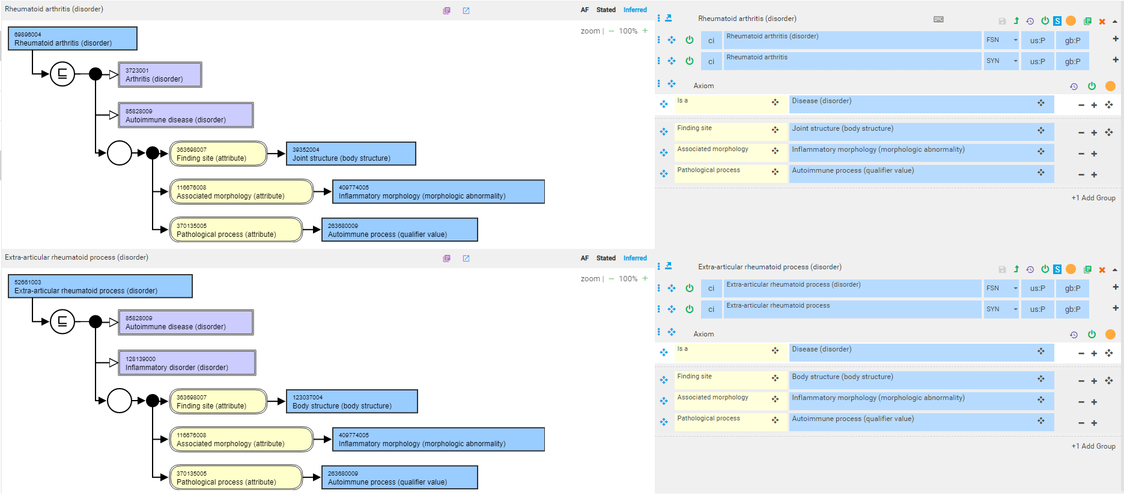
52661003 |Extra-articular rheumatoid process (disorder)|- remodeled

Slide 23
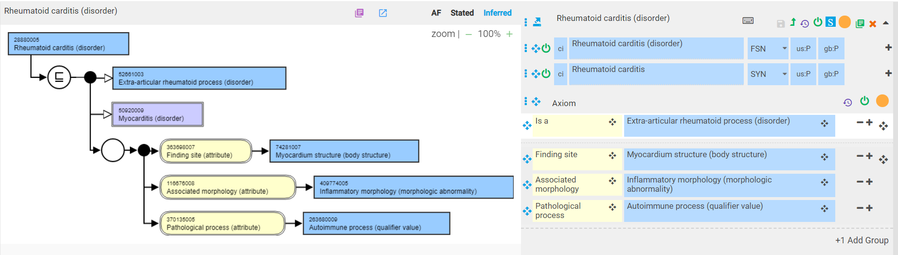
28880005 |Rheumatoid carditis (disorder)| - remodeled
Need to test model with cutaneous, muscular, hepatic, gastrointestinal multisystem disorders

