Slide 1
Secondary disorders
Test of inactivating Secondary X (disorder)

Slide 2
Some uses of “secondary” in SNOMED CT
128462008 |Secondary malignant neoplastic disease (disorder)| | A term used to describe cancer that has spread (metastasized) from the place where it first started to another part of the body. Secondary cancers are the same type of cancer as the original (primary) cancer.
239843003 |Secondary gout (disorder)| | Gout resulting from increased serum uric acid levels as a result of an antecedent disease, such as a proliferative disease of the blood and bone marrow, lead poisoning, or prolonged chronic renal failure (on dialysis).
59818004 |Secondary dentin (disorder)| | Secondary dentin (adventitious dentin) is formed after root formation is complete, normally after the tooth has erupted and is functional. It grows much more slowly than primary dentin, but maintains its incremental aspect of growth.
240557004 |Secondary syphilis (disorder)| | Secondary syphilis usually presents 4-10 weeks after initial chancre as a systemic illness, including a rash, fever, and generalized lymphadenopathy. Other frequent areas of involvement are the eye and the liver.
264569006 |Secondary infection (disorder)| | A secondary infection is an infection that occurs during or after treatment for another infection. It may be caused by the first treatment or by changes in the immune system.

Slide 3
WHO proposed guidelines for disease associations
2.3.5 ‘Due to’ and ‘With’
  ‘Due to’ is the preferred term for categories where two conditions are mentioned and a causal sequence exists. Other terms, such as ‘caused by’ or ‘attributed to’ are allowable synonyms. The phrase ‘secondary to’ is equivalent and may also be included as a synonym.

Slide 4
Secondary disorders (where the meaning of secondary is “due to, caused by or after”)*
A secondary disorder in this scenario is a disorder occurring as a consequence of another disorder, procedure, event, physical force, physical object or substance
There 238 Secondary disorders fitting the above criteria in SNOMED CT
Secondary disorders are mostly intermediate primitives
Secondary disorders can now be modeled using GCIs
* Excludes other use of secondary such as secondary malignant neoplasm and secondary syphillus

Slide 5
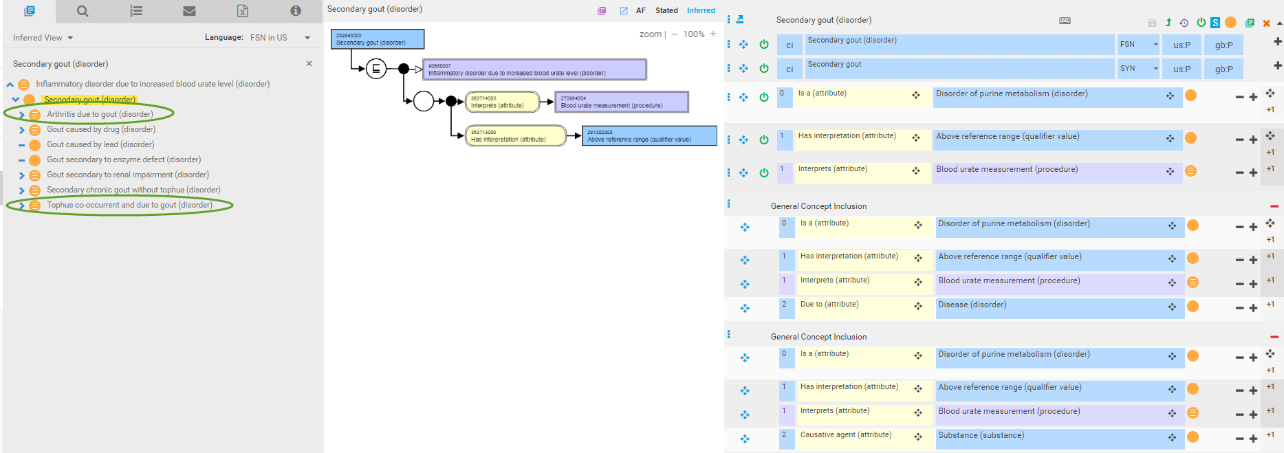
Secondary gout remodeled using GCIs

Slide 6
Should secondary diseases be modeled using GCIs or inactivated ?
When modeling secondary diseases using GCIs was discussed during an ECE call, it was brought up that perhaps these are not clinically useful classifications
Many are derived from ICD
Secondary disease X is just a subtype of Disease X e.g. Disease X due to Y

Slide 7
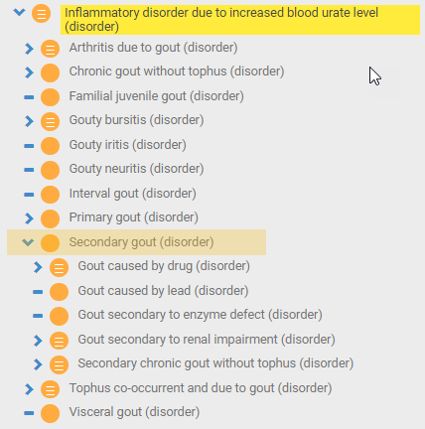
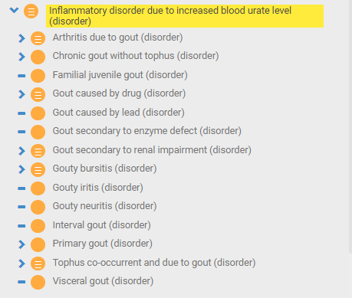
Inactivation of secondary gout
Before inactivation
After inactivation

Slide 8
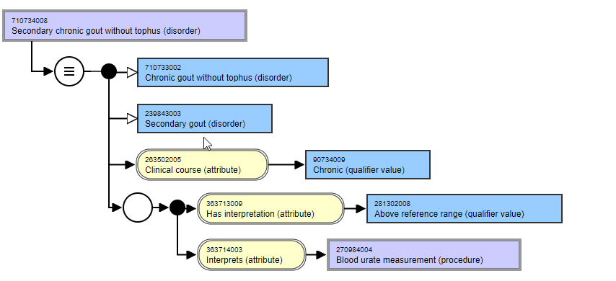
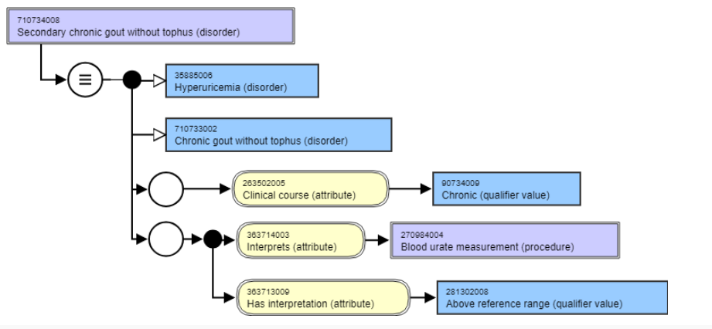
Secondary chronic gout without tophus*
Before inactivation of secondary gout
After inactivation of secondary gout
No longer fully defined
Includes a stated fully defined parent of gout
Secondary chronic gout without tophus has no children*

Slide 9
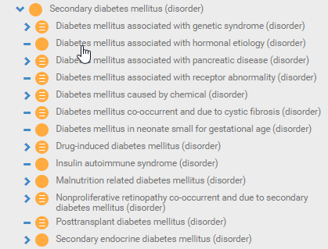
Secondary diabetes mellitus

Slide 10
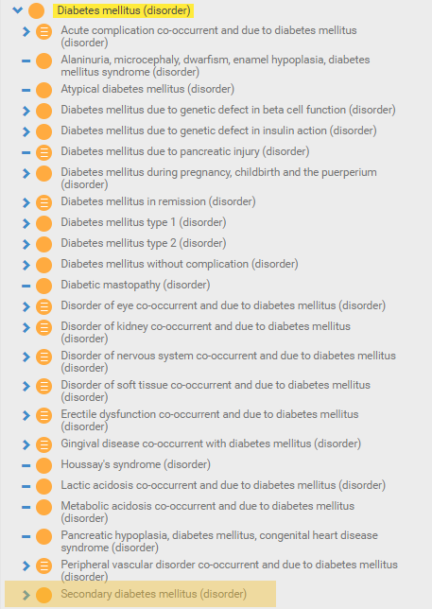
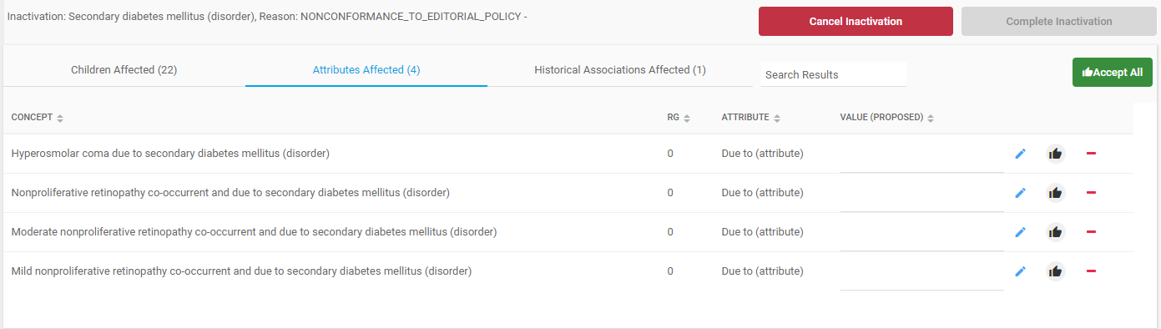
Inactivation of secondary diabetes mellitus - 1
Before inactivation of secondary diabetes mellitus
After inactivation of secondary diabetes mellitus

Slide 11
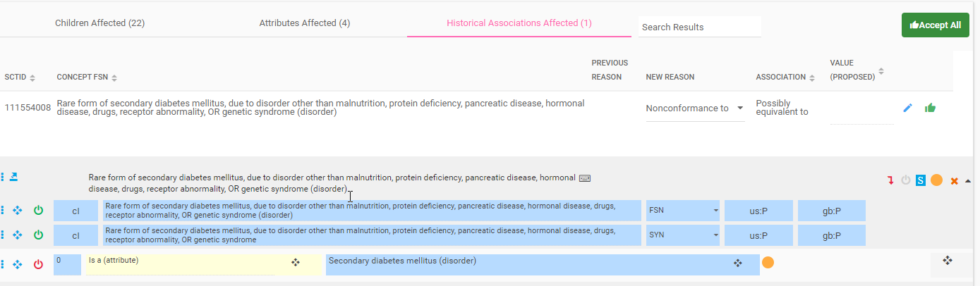
vation of secondary diabetes mellitus - 2

Slide 12
Conclusions
Inactivation of secondary X will require manual inspection of results for each subhierarchy
These subhierarchies in any case will require much revision as the causal relationships and FSNs are often inconsistent (use of associated with, co-occurrent and due to, due to vs. causative agent)

Slide 13
Is "Gout caused by drug" a secondary gout? Complication?

Slide 14
Definition of primary and secondary gout
Hyperuricaemia is a common clinical condition that can be defined as a serum uric acid level >6.8 mg/dl (404 mmol/l). Gout, a recognized complication of hyperuricaemia, is the most common inflammatory arthritis in adults.
C. Ben Salem, Raoudha Slim, Neila Fathallah, Houssem Hmouda, Drug-induced hyperuricaemia and gout, Rheumatology, Volume 56, Issue 5, May 2017, Pages 679–688, https://doi.org/10.1093/rheumatology/kew293
Etiology and pathogenesis of gout
Lachy McLean, Nicola Dalbeth, in Rheumatology (Sixth Edition), 2015
Classification of hyperuricemia
Hyperuricemia and gout may arise in individuals with or without an underlying clinical disorder or toxic or drug exposure. When a specific process resulting in hyperuricemia is identifiable, it is said to be secondary. When no such process is evident, the hyperuricemia is termed primary or idiopathic.

Slide 15
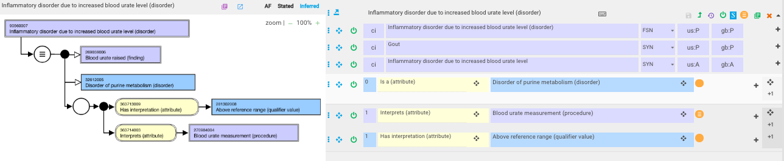
Gout – current model

Slide 16
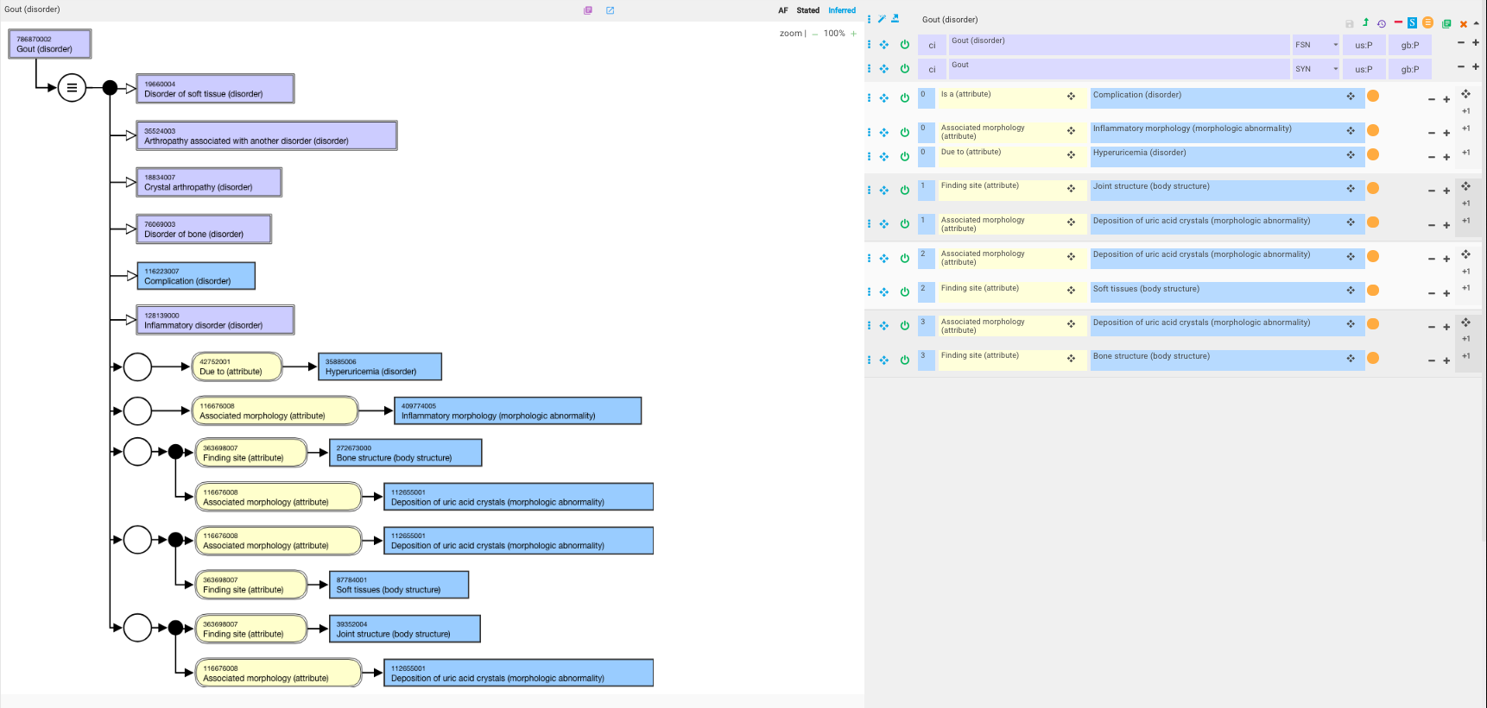
Gout – proposed revision to model
Gout refers to disease that occurs in response to the presence of monosodium urate (MSU) crystals in joints, bones, and soft tissues*.
*https://www.uptodate.com/contents/pathophysiology-of-gout

Slide 17
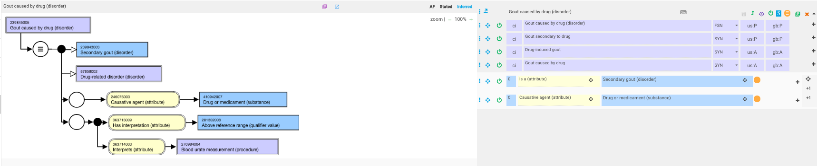
Gout caused by drug – current model

Slide 18
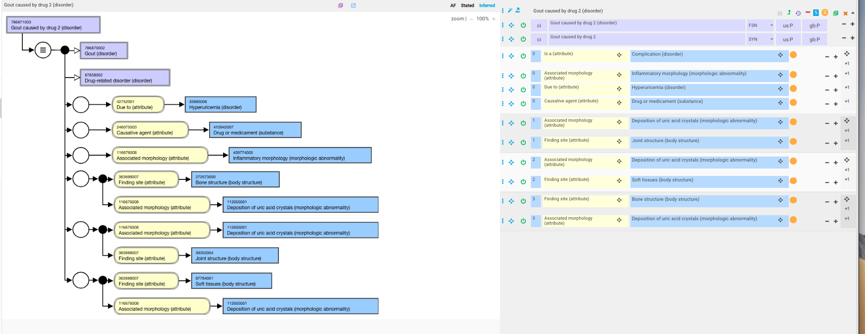
Gout caused by drug – revised model

