Slide 1
Injury, damage, traumatic, non-traumatic

Slide 2
Injury
Hurt, damage, or loss sustained (Merriam-Webster)
Physical harm or damage done to a living thing (Cambridge dictionary)
Physical damage done to a person or a part of their body (Macmillan dictionary)
Harm or hurt. To harm, hurt, or wound. The word injure may be in physical or emotional sense. From the Latin injuria meaning injury (MedicineNet)
Injury, also known as physical trauma, is damage to the body caused by external force Wikipedia).An injury or illness is an abnormal condition or disorder. Injuries include cases such as, but not limited to, a cut, fracture, sprain, or amputation. Illnesses include both acute and chronic illnesses, such as, but not limited to, a skin disease, respiratory disorder, or poisoning. (OSHA)

Slide 3
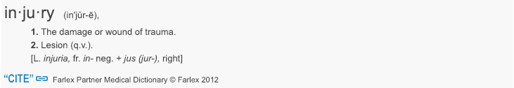
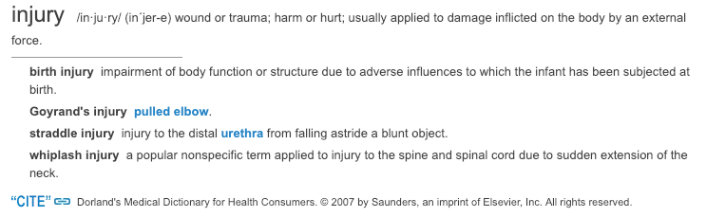
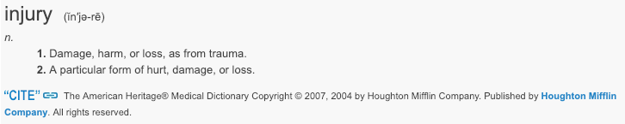
Injury – additional definitions 1

Slide 4
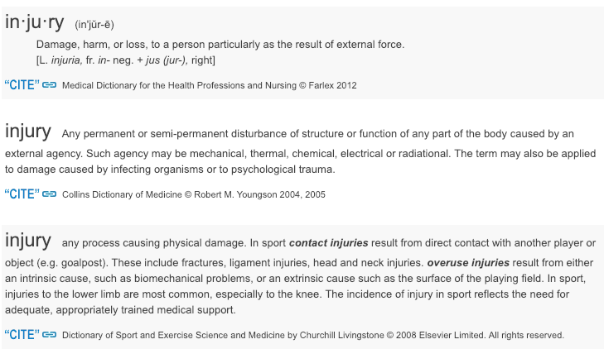
Injury – additional definitions 2

Slide 5
Injury – ICD-11 Definition
In the ICD, injury means physical or physiological bodily harm resulting from interaction of the body with energy (mechanical, thermal, electrical, chemical or radiant, or due to extreme pressure) in an amount, or at a rate of transfer, that exceeds physical or physiological tolerance.

Slide 6
Injury – ICD-11 continued
Injury can also result from lack of vital elements, such as oxygen.
Poisoning by and toxic effects of substances are included, as is damage of or due to implanted devices.
Maltreatment syndromes are included even if physical or physiological bodily harm has not been reported.
Injury usually has rapid onset in response to a well-defined event (e.g. a car crash, striking the ground after falling, drinking a strongly alkaline liquid, an overdose of a medication, a burn sustained during a surgical procedure).
  These events are often referred to as external causes of injury.
  The injurious energy can, however, originate from the injured person and/or from his or her immediate environment (e.g. a person running on a hot day sustains heat exhaustion), and injury can be caused by the injured person (i.e. intentional self-harm).
Injury includes manifestations that are evident immediately after onset, which may persist or not, and manifestations that first become evident at a later date.

Slide 7
Traumatic injury
Traumatic injuries are defined with an associated morphology of 19130008 |Traumatic abnormality (morphologic abnormality)|
It is questionable whether trauma is a kind of morphologic abnormality rather than a pathological process
Proposal is to model traumatic injuries using pathological process 263904004 |Traumatic (qualifier value)|
A non-traumatic pathological process would be difficult to define

Slide 8
Non-traumatic injury
A search for non-traumatic injury on the internet yields 63, 400,000 hits
Most references to non-traumatic injury are related to non-traumatic brain injury (50,500,000)
There is no concept for non-traumatic brain injury in SNOMED CT only for 127294003 |Traumatic AND/OR non-traumatic brain injury (disorder)|
Non-traumatic brain injuries are defined by their causes

Slide 9
Brain injuries*
An insult to the brain that affects its structure or function, resulting in impairments of cognition, communication, physical function, or psychosocial behavior.
Acquired brain injury (ABI) includes both traumatic and nontraumatic brain injury.
Traumatic brain injuries may include open head injuries ( e.g., gunshot wound, other penetrating injuries) or closed head injuries ( e.g., blunt trauma, acceleration/deceleration injury, and blast injury).
Nontraumatic brain injuries may include those caused by strokes, nontraumatic hemorrhage, tumor, infectious diseases, hypoxic injuries, metabolic disorders, and toxic exposure.
ABI does not include brain injuries that are congenital, degenerative, or induced by birth trauma."
*Reference: Commission on Accreditation of Rehabilitation Facilities. Glossary. In: CARF Medical Rehabilitation Standards manual. Commission on Accreditation of Rehabilitation Facilities; 2012:317.

Slide 10
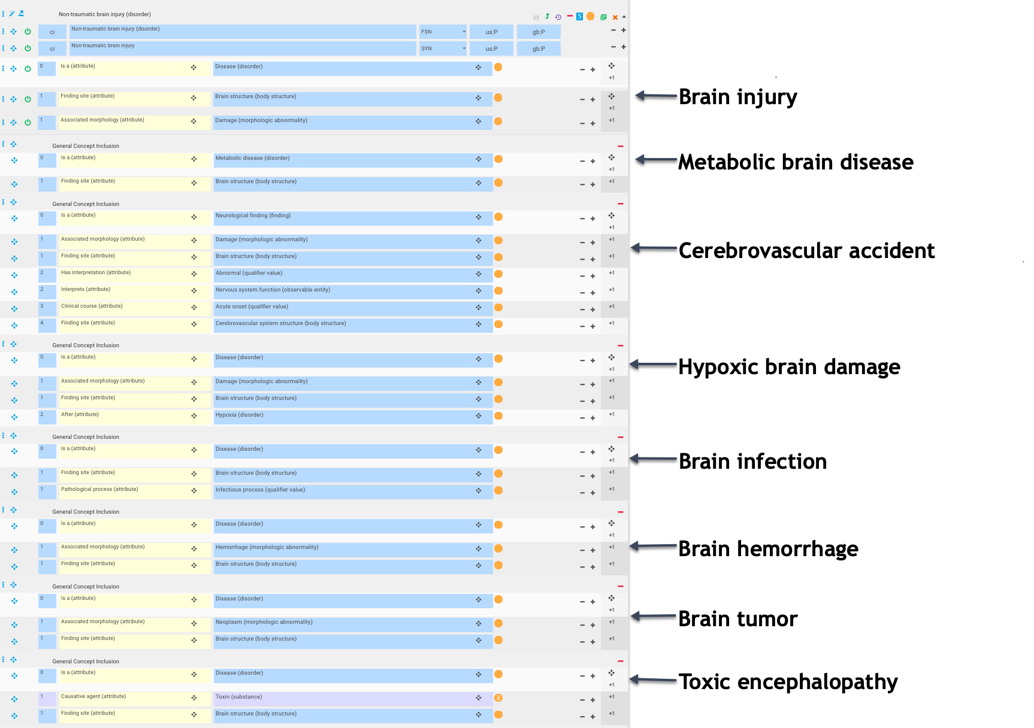
Non-traumatic brain injury modeled as GCI

Slide 11
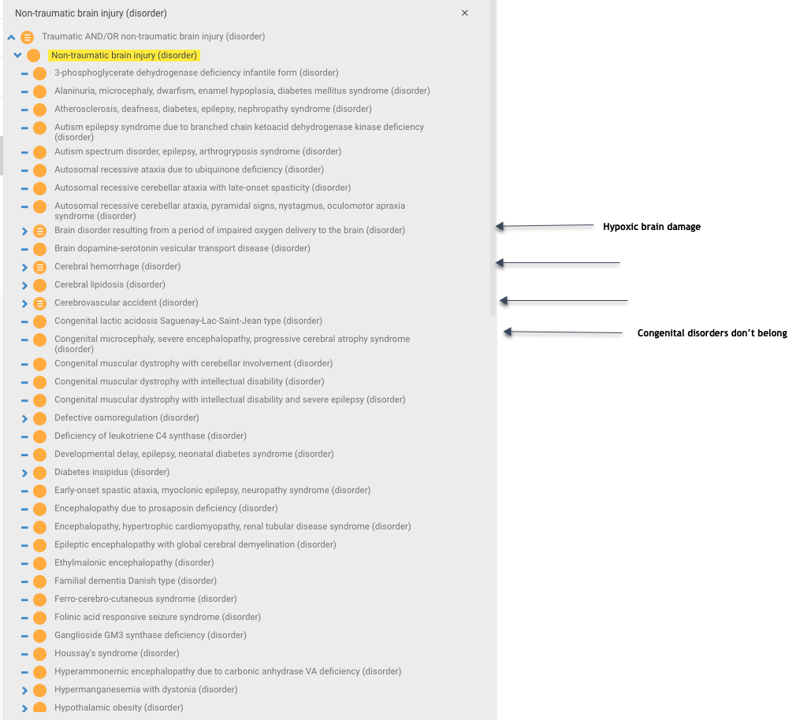

Slide 12
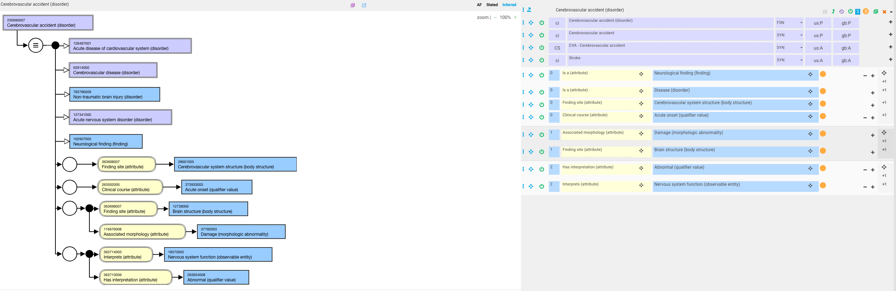
Cerebrovascular accident

Slide 13
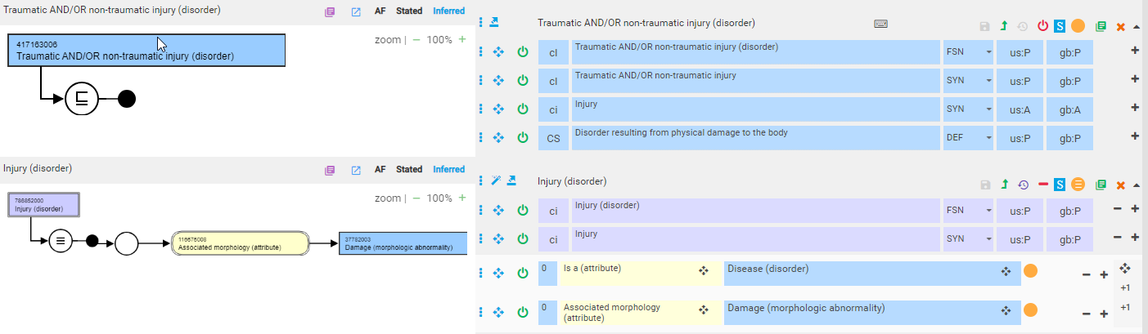
Alternative model –traumatic injury

Slide 14
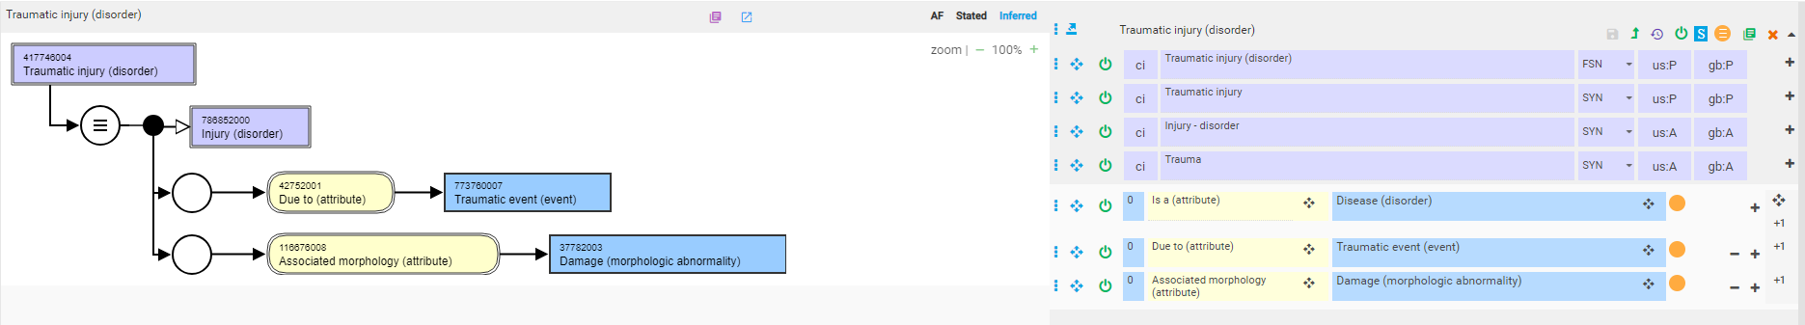
Traumatic injury

Slide 15
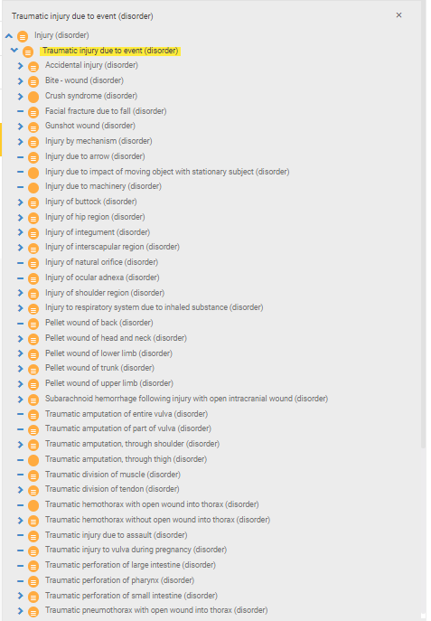
419945001 |Traumatic injury due to event (disorder)| - 1
37 children, 815 descendants

Slide 16
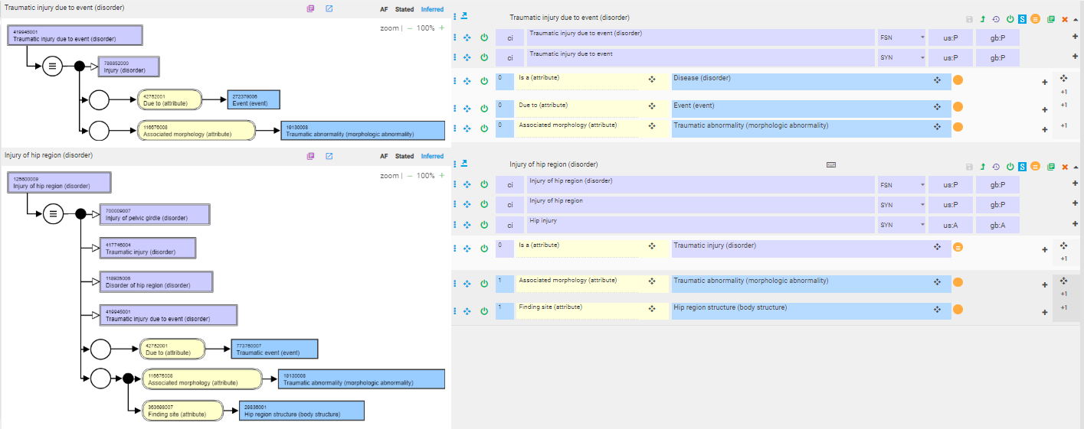
419945001 |Traumatic injury due to event (disorder)| - 2

Slide 17
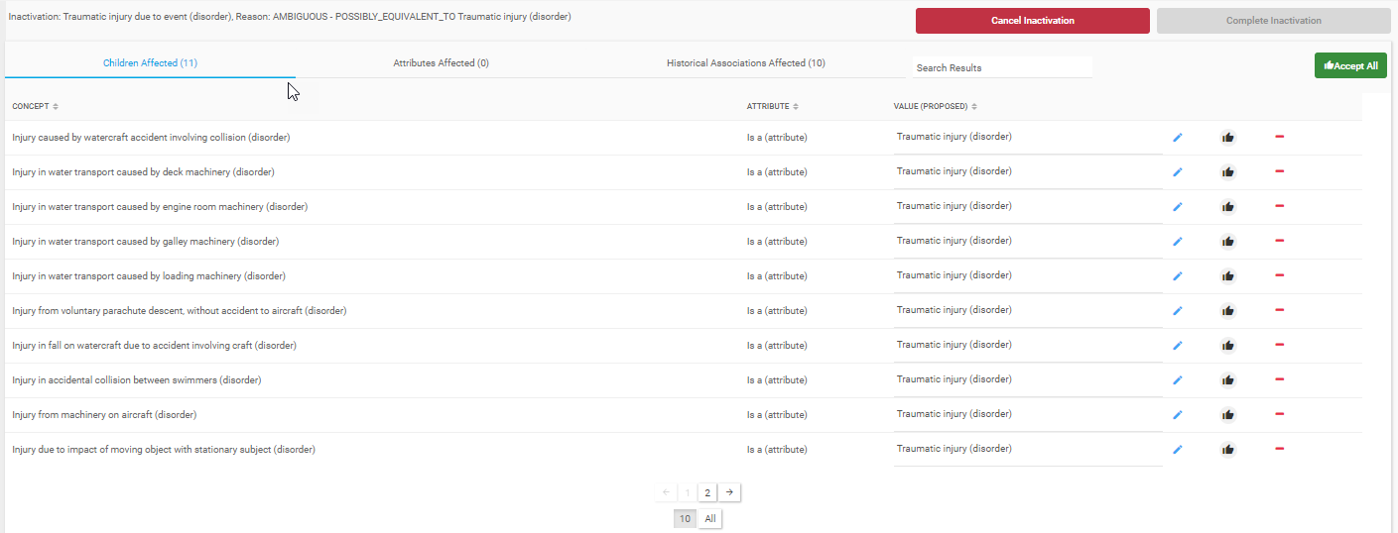
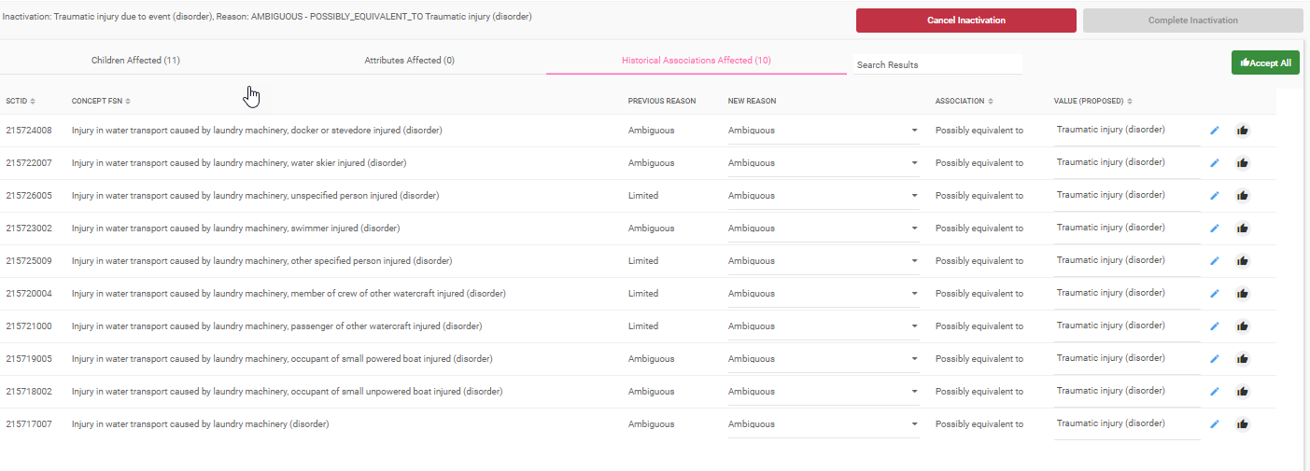
Results of inactivation of 419945001 |Traumatic injury due to event (disorder)|

Slide 18
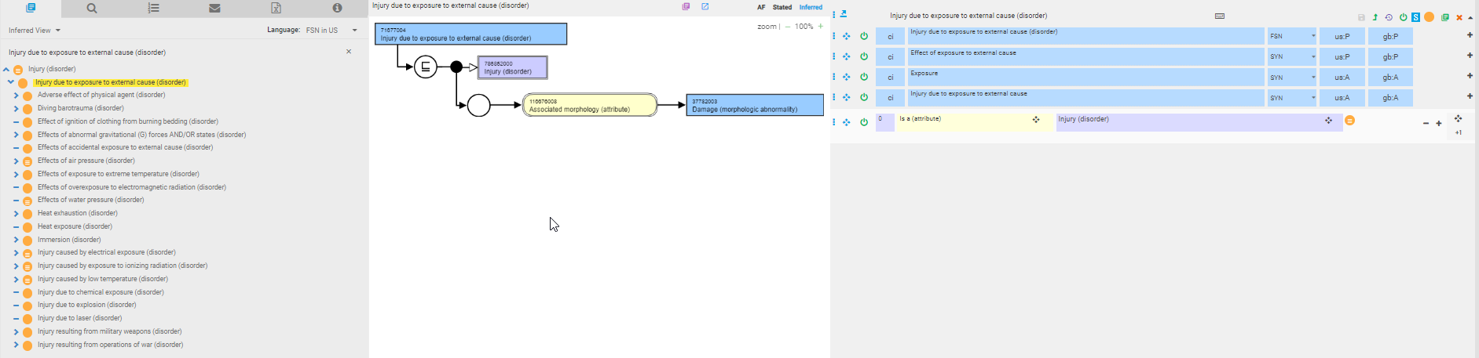
Injury due to exposure due to external cause (disorder)

Slide 19
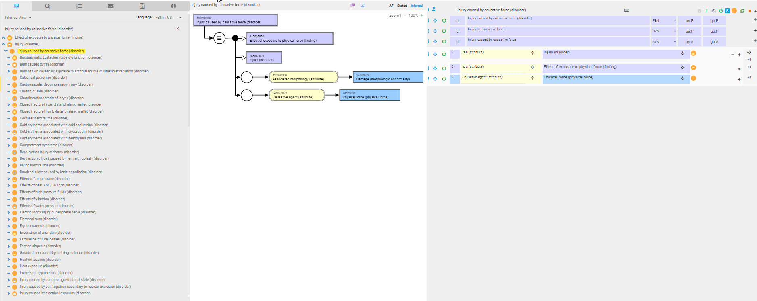
Injury caused by causative force - 1

Slide 20
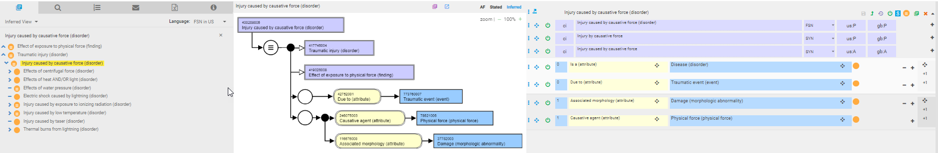
Injury caused by causative force - 2

Slide 21
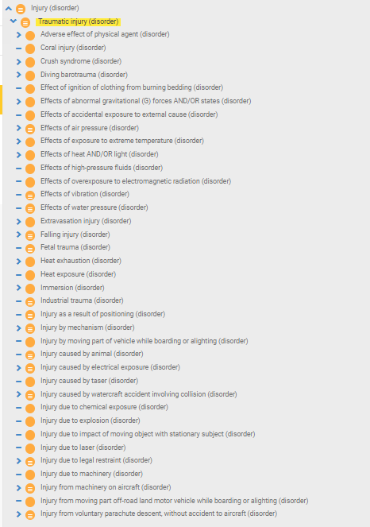
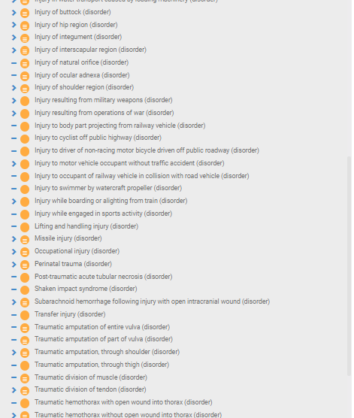

Traumatic injury hierarchy after retiring 400209005 |Injury caused by causative force (disorder)|

Slide 22
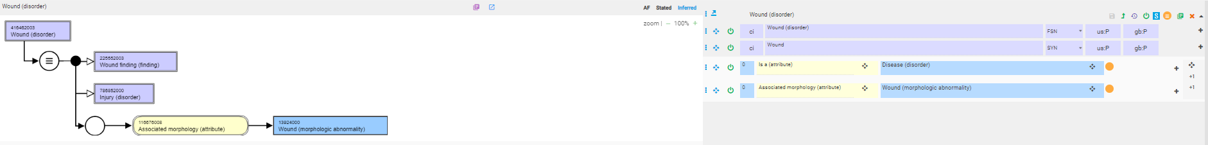
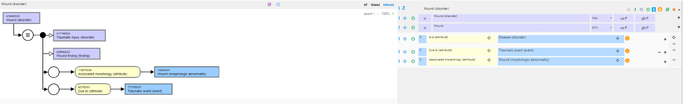
Wound disorder

Slide 23
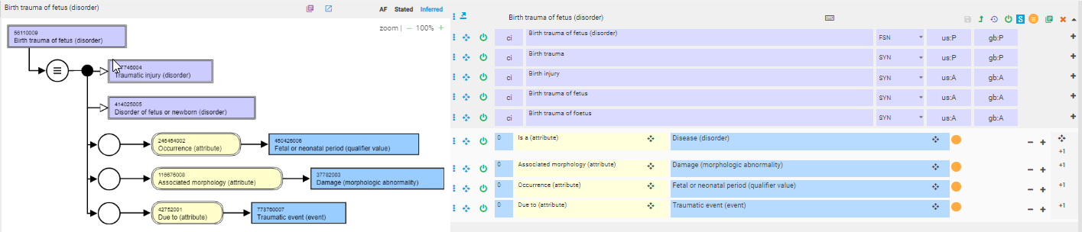
Birth trauma (of fetus)

Slide 24
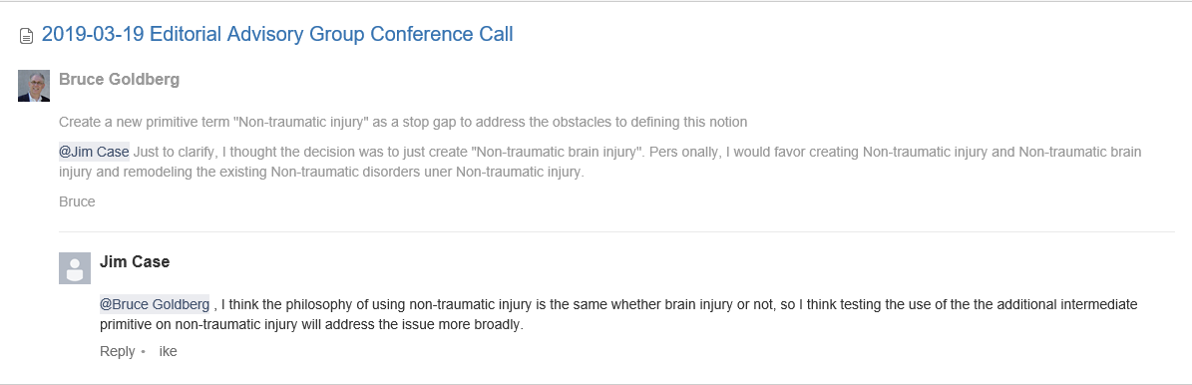
Notes from 3/19 EAG call

Slide 25
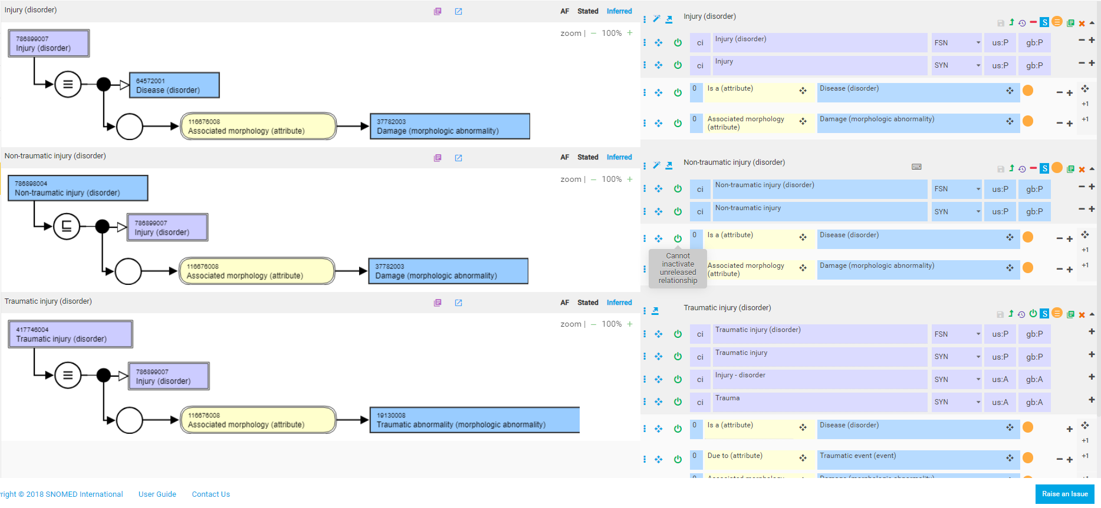
Non-traumatic injury – alternate model

Slide 26
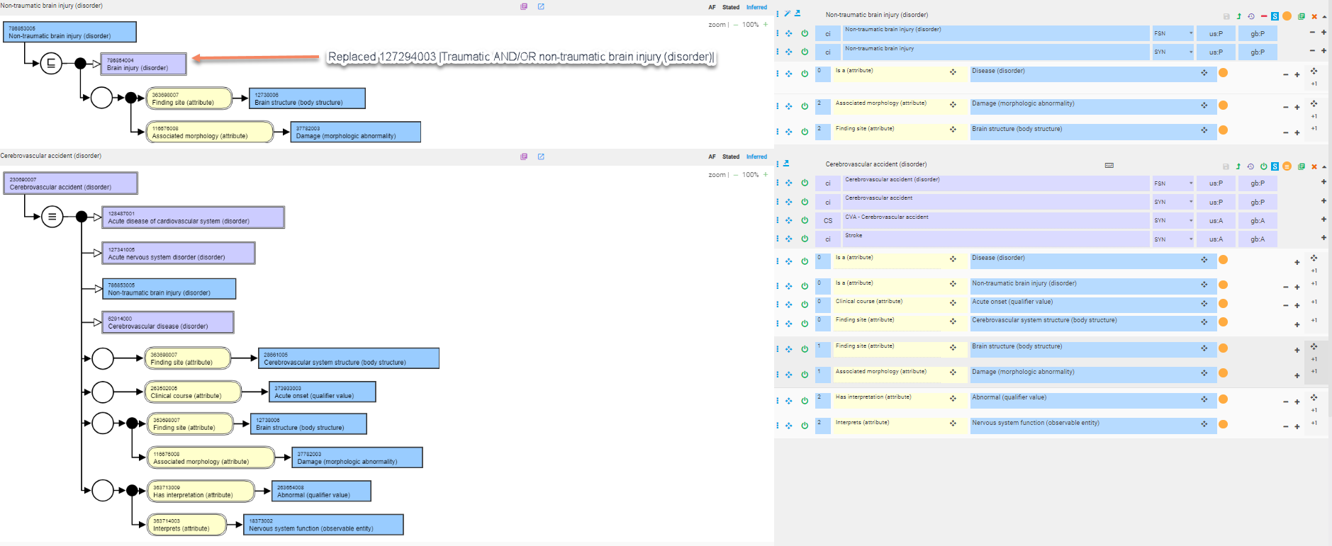
Cerbrovascular accident

Slide 27
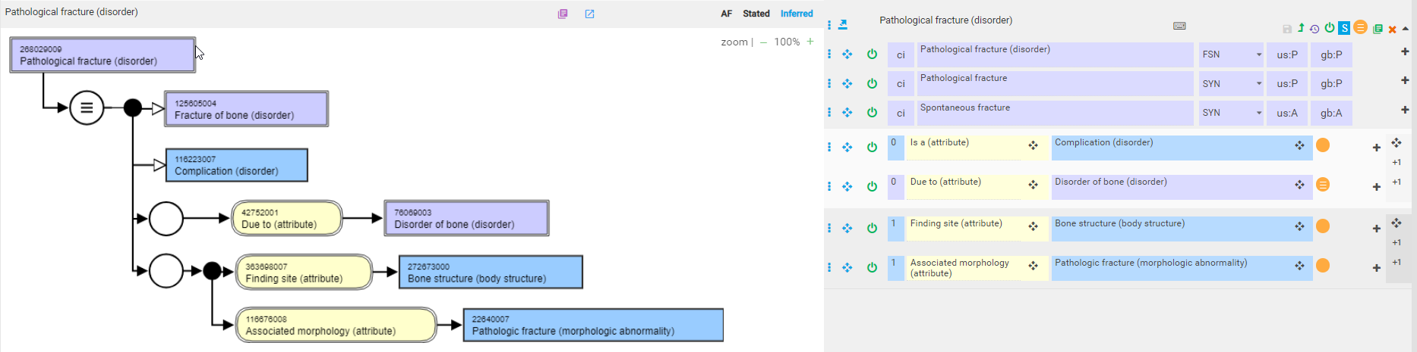
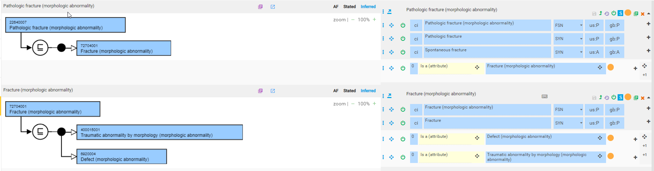
Pathological fracture

Slide 28
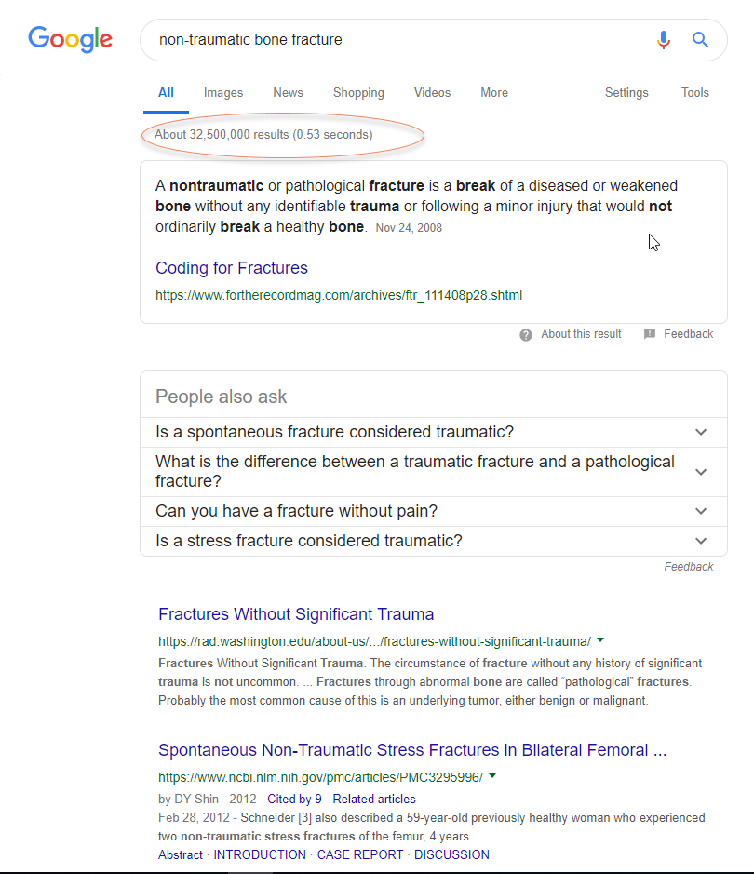
Non-traumatic bone fracture

Slide 29
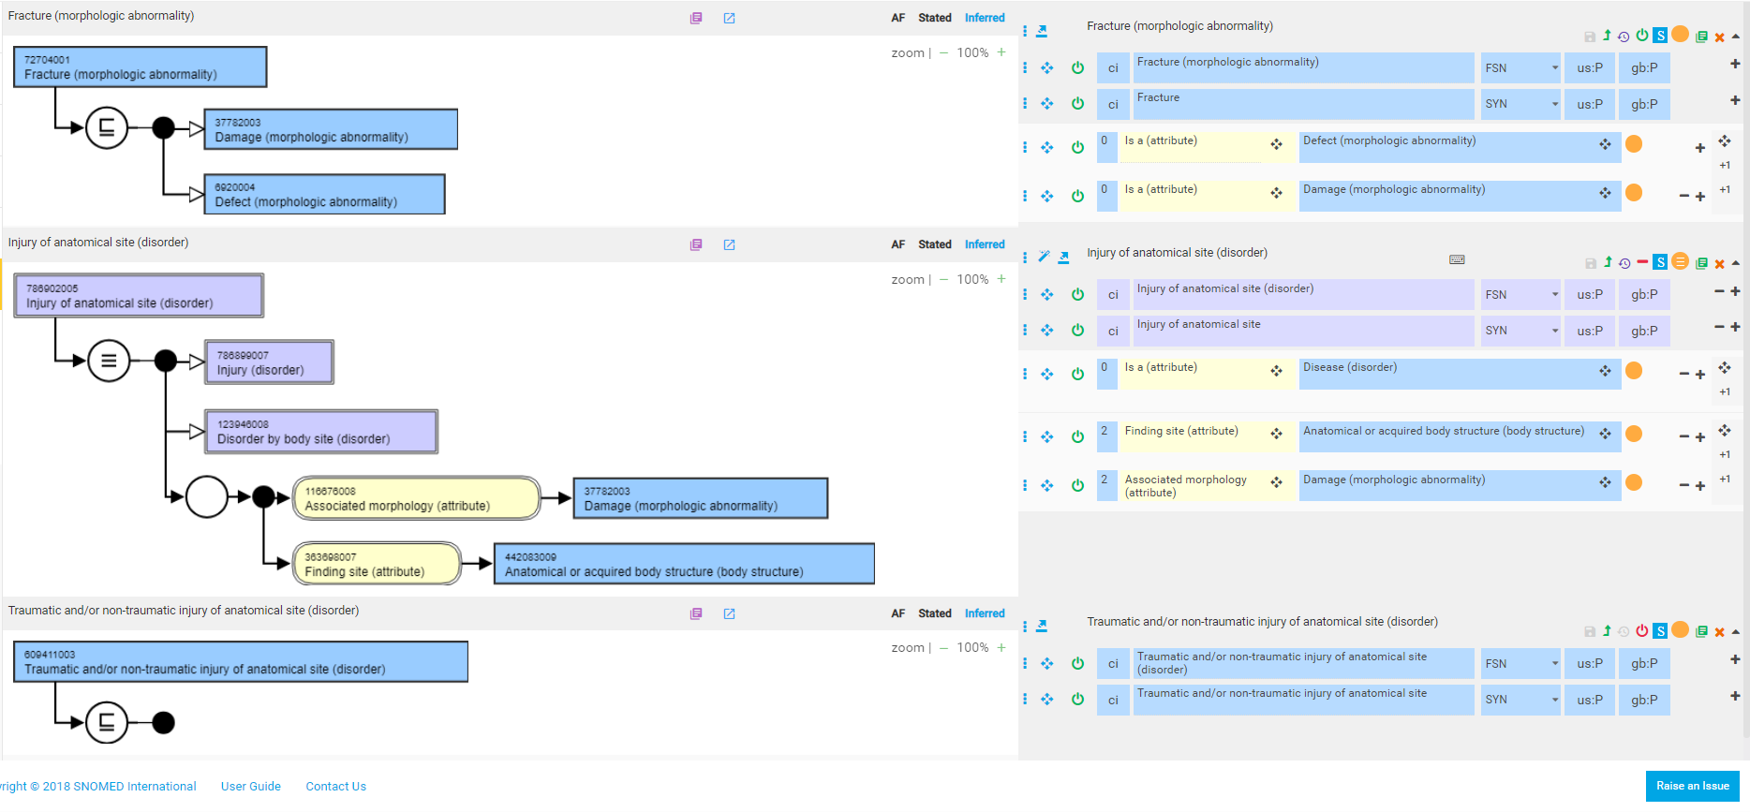
Remodel Fracture (morphologic abnormality)

Slide 30
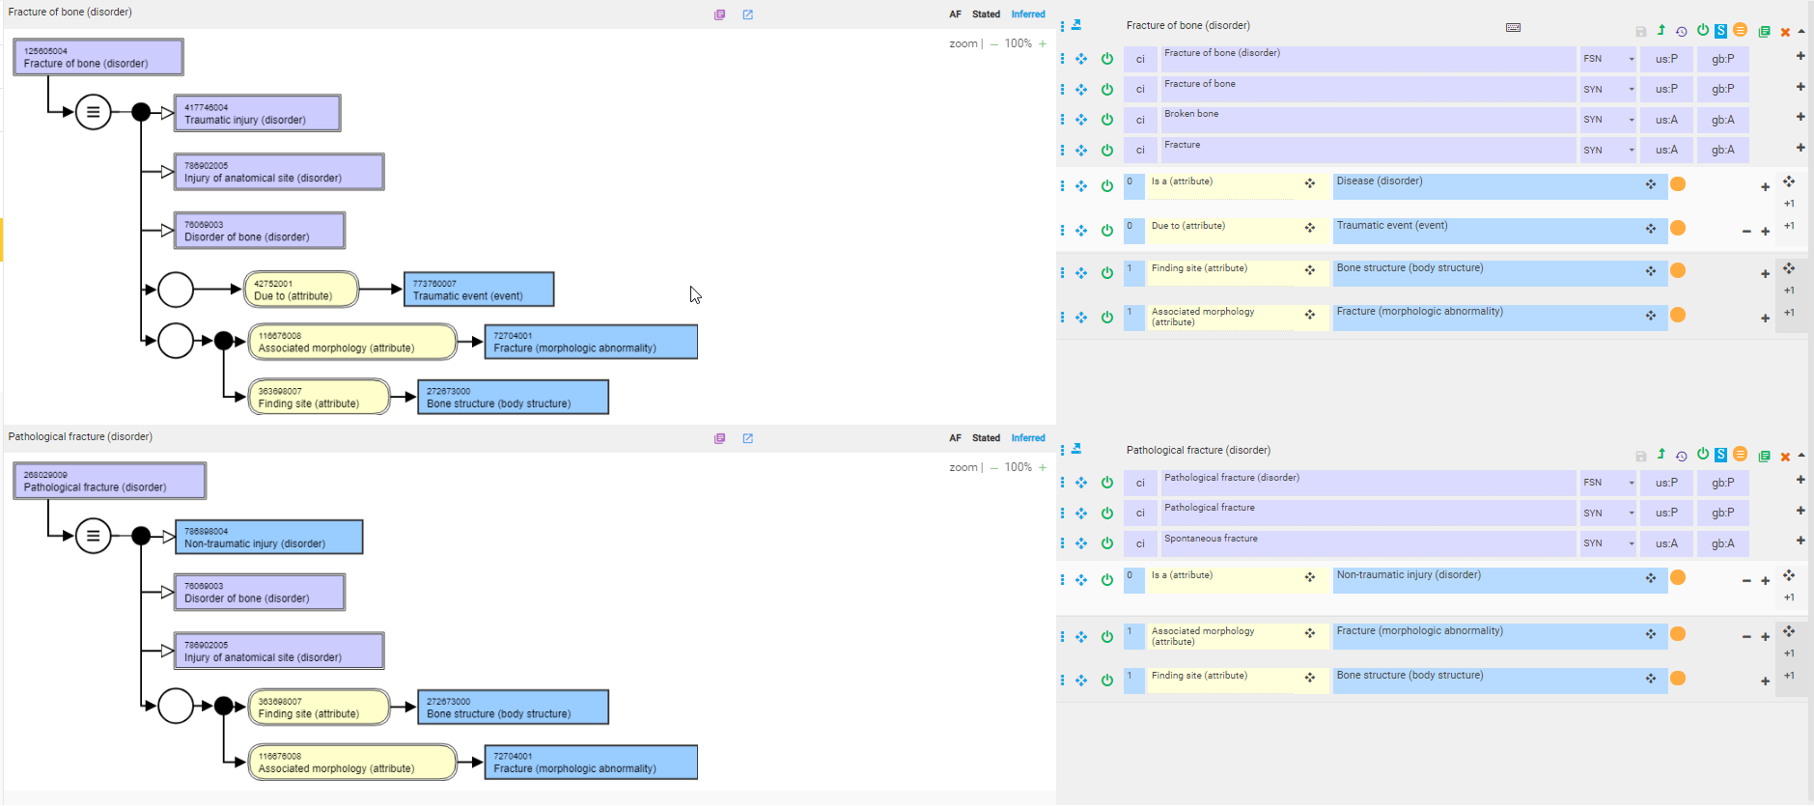
Proposed model for fractures - 1

Slide 31
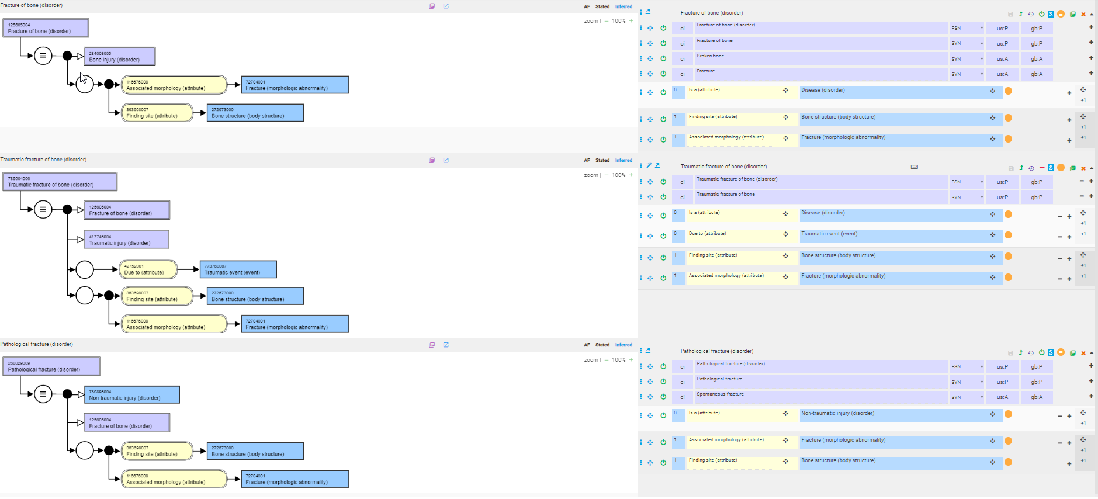
Proposed model for fractures - 2

Slide 32
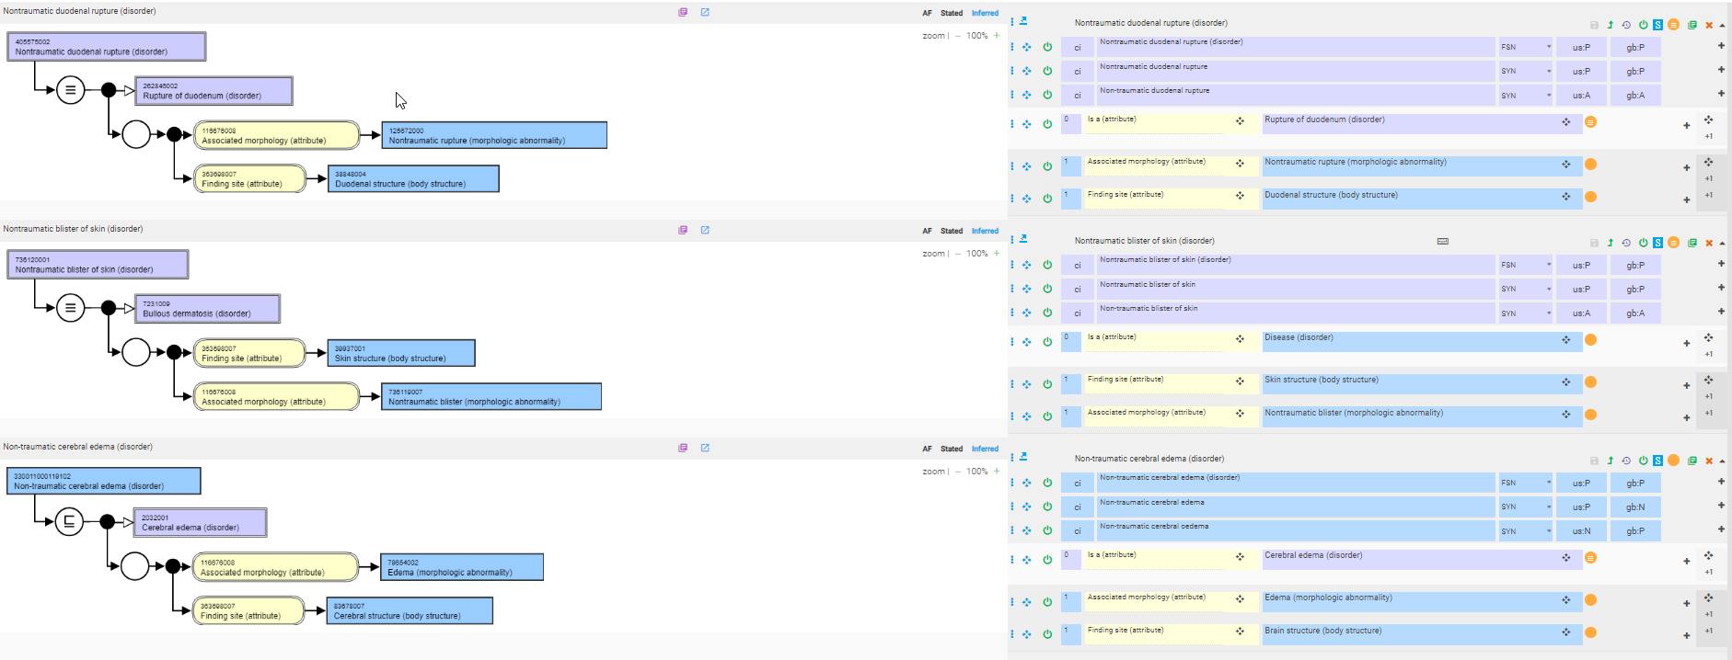
Other non-traumatic injuries

Slide 33
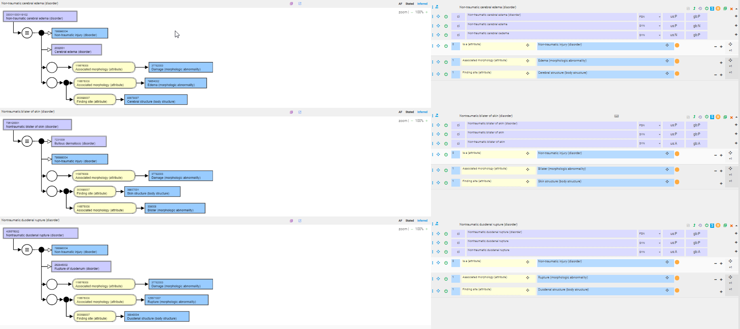
Other non-traumatic injuries - remodeled

