Slide 1
Starting Practical use of SNOMED CT
Real world examples from Barts Health
SNOMED London April 2019

Slide 2
Practical use of SNOMED Clinical Terms
Clinical overview for point of care
    Problem and diagnosis listing
    Alerts and flags
Population health interventions
    Patient finding
    Indexing
    Analytics and reporting

Slide 3
Data Extraction and Clinician Led Analytics
Timely access to data
Rapid iteration of queries
Self-service analytics

Slide 4
Actionable Analytics
Use of routinely recorded EHR data in real-time to…
  Draw insights about current patient care at whole Trust level
  Develop and implement actions that add value
  Standardise care across the Trust
  Reduce variation across the Trust
What is happening now ?
Where does attention need to be focused today ?

Slide 5
Two Approaches
EHR pop-ups
Seen and actioned by ward based teams
Variability in care
Real-time reports
Seen and actioned by specific teams
Standardisation of care

Slide 6
Infection Control
Problem
Unable to identify patients with infection risk
Unable to ensure these patients are in side rooms
Increased risk of infection transmission and potential increased LoS
Solution
IPC team flag infections + infection status in EHR
Daily report – lists inpatients with active infection + in open bay
IPC team contact relevant wards to ensure these patients are moved
Improvements
Insights are made by central IPC team + actioned in real-time
40% reduction in number of patients inappropriately in open bays
Standardisation of infection control care across Trust

Slide 7
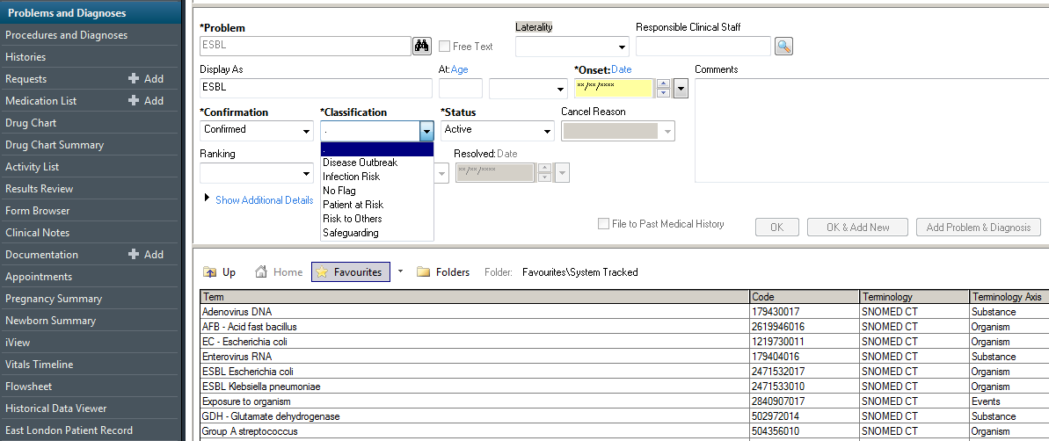
SNOMED
Term
Flagging
Infection
Risk
Status
Selection

Slide 8
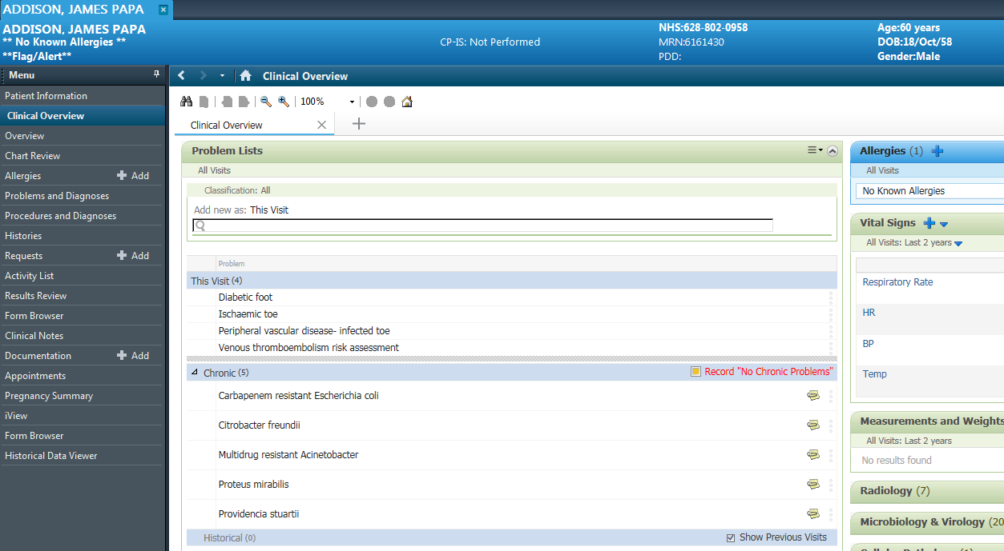
Infection related SNOMED Terms in Problem List

Slide 9
Infection Control
Problem
Unable to report on MRSA screening status of all current inpatients
Unable to take timely correct action for unscreened patients
Increased risk of MRSA transmission and potential increased LoS
Solution
Daily report utilising real-time lab data
Lists all inpatients without MRSA screen 24 hrs post-admission + location
IPC team contact relevant ward and request urgent screening
Improvements
Insights are co-ordinated by central IPC team + actioned in real-time
MRSA screening status of all current inpatients assessed daily
Standardisation of infection control care across Trust

Slide 10
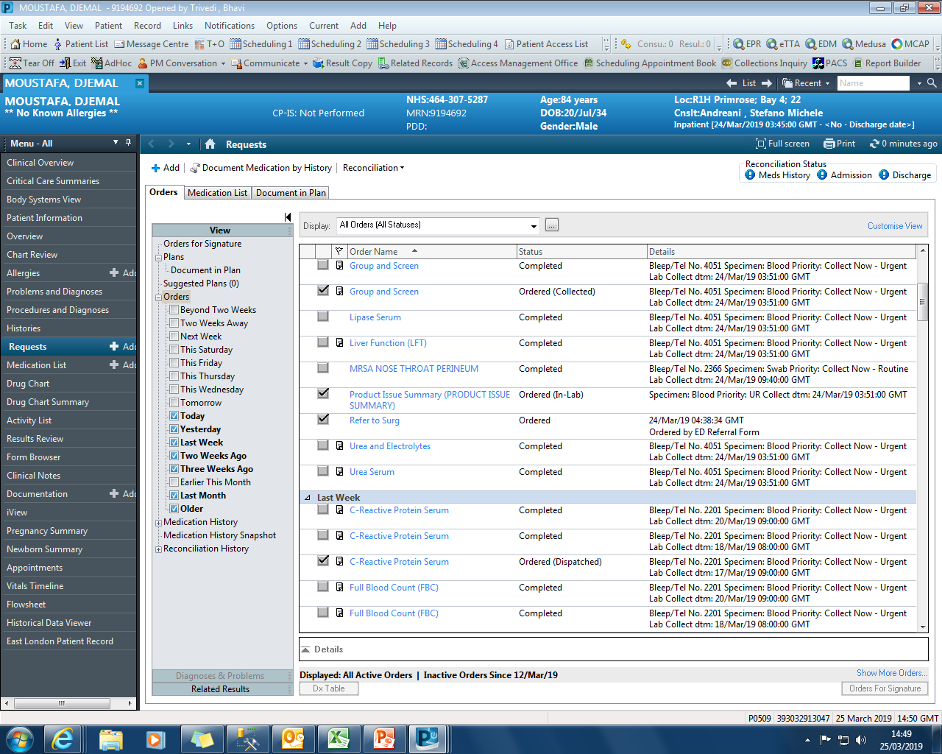

Slide 11
Surgical Site Infections
Problem
Unable to accurately identify at whole Trust level patients with SSIs
Variability in rates of SSIs between teams and within teams
Variability in post-op readmission rates and LoS due to SSIs
Solution
Daily report using routinely entered Surginet data + lab data
Lists post-op patients (last 30 days) + if post-op wound swab ordered
If wound swab +ve, IPC team contact surgical team
Improvements
Insights are co-ordinated by central IPC team + actioned in real-time
Post-op wound swab results reviewed daily and fed back to surgical teams
Standardisation of infection control care across Trust

Slide 12
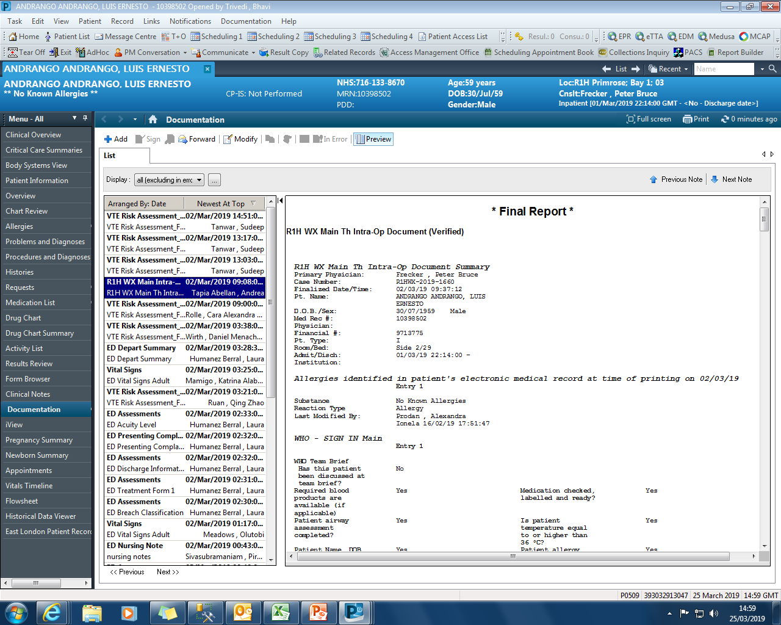

Slide 13
Smoking CQUIN
Problem
Unable to identify in real-time, smoking status for current inpatients
Retrospective reports showed consistently poor performance
Unable to achieve improvements required for CQUIN
Solution
Weekly report run by Public Health team
Lists completeness of smoking status for current inpatients
Direct feedback to poorly performing wards
Improvements
Insights are co-ordinated by Public Health team and actioned in real-time
Improvement in completeness of recording from 5% to 50% in 6 months
Higher rates of referral to smoking cessation

Slide 14
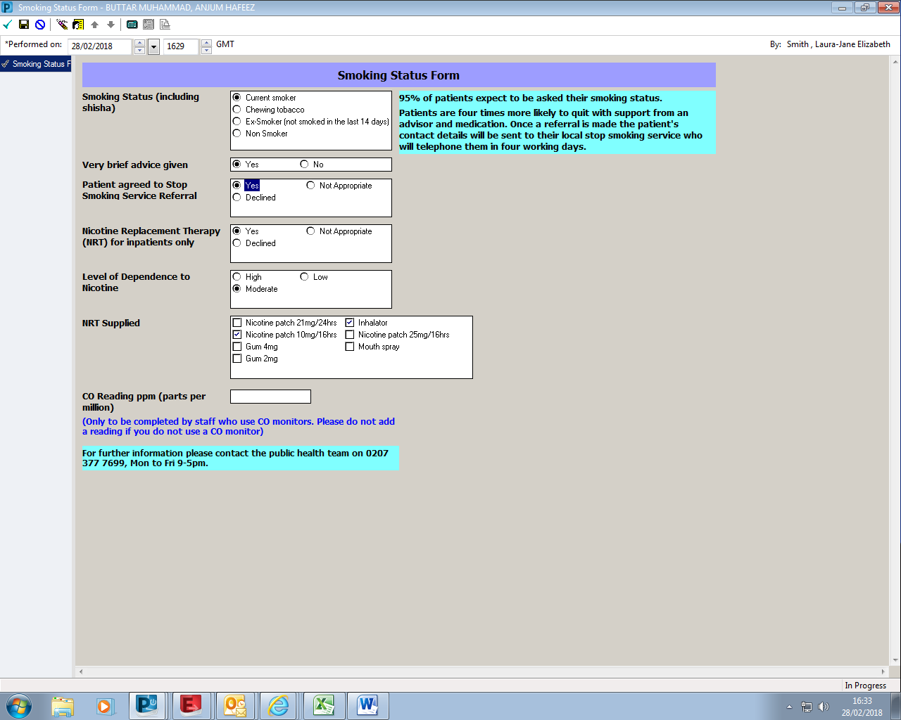
Data Collection
Smoking Status added to the
Problem List
as a
SNOMED Term
Selecting ‘YES’ auto-generates a referral to the Smoking Cessation Clinic
Notes:
A bespoke PowerForm was built to record detail about smoking status
Making smoking status easier to record was the main aim.
We also included chewing tobacco as a smoking status which is of particular relevance to our local population at Barts Health.
Junior doctors are responsible for screening and advising patients about tobacco as part of the clerking process (routine clinical care).
Training was provided to junior doctors so they know how to access the Powerform and the importance of documenting correctly. It is also easy to use and generates automatic referrals to stop smoking services which saves time for them!
Additional feature of the PowerForm is that it has been designed to add the smoking status that is selected to the patient’s problem list, as a SNOMED term.

Slide 15
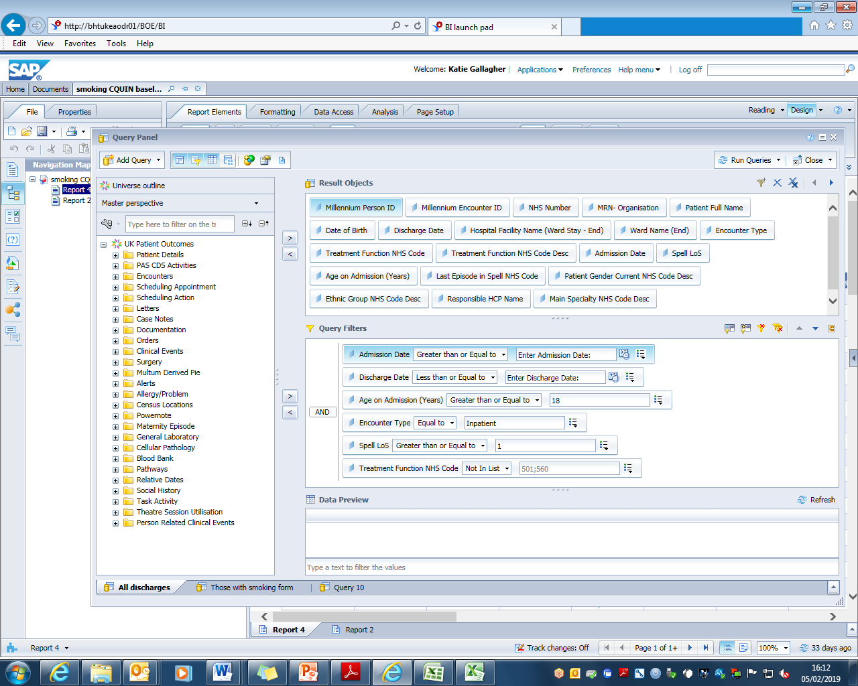
Data Extraction and Utilisation
Notes:
Using the Powerform a report was put together using PowerInsight which details which patients have and have not been screened for tobacco. This can be filtered by site, speciality, ward and consultant. It includes admission dates and length of stay. The data includes all hospital inpatient admissions.
If a Powerform was completed the data shows when it was completed, the patients smoking status (including if they use chewing tobacco), nicotine dependence levels, if brief advice was given, if nicotine replacement therapy was offered, what nicotine replacement therapy products were prescribed and if the patient accepted a referral to a stop smoking service (all of the individual elements from the Powerform).
I was trained to run this report and make basic edits and as a result I can use this for real time reporting. The data is shared with site management teams, wards and specialities.
How is this used? The data can be put into graphs such as the one on the right hand side of the screen. It shows the 4th floor at St Barts hospital, 4E and 4D are the high performing respiratory wards . By presenting this data to other 4th floor wards they are now working together to improve performance as a floor by sharing best practice. You will see an increase in the proportion of inpatients screened for tobacco on the ward.

Slide 16
Learning Disabilities
Problem
Unable to identify in real-time, inpatients with LD at whole Trust level
Unable to identify in real-time, patients with LD at risk of admission
Variability in care and LoS
Solution
LD team add flag to EHR of patients with LD
Daily report - lists current inpatients with LD flag and location
Daily report – lists patients with LD flag discharged from ED yesterday
Improvements
Insights are co-ordinated by central LD team + actioned in real-time
Reduction in time from admission to LD team involvement
Focused admission prevention efforts

Slide 17
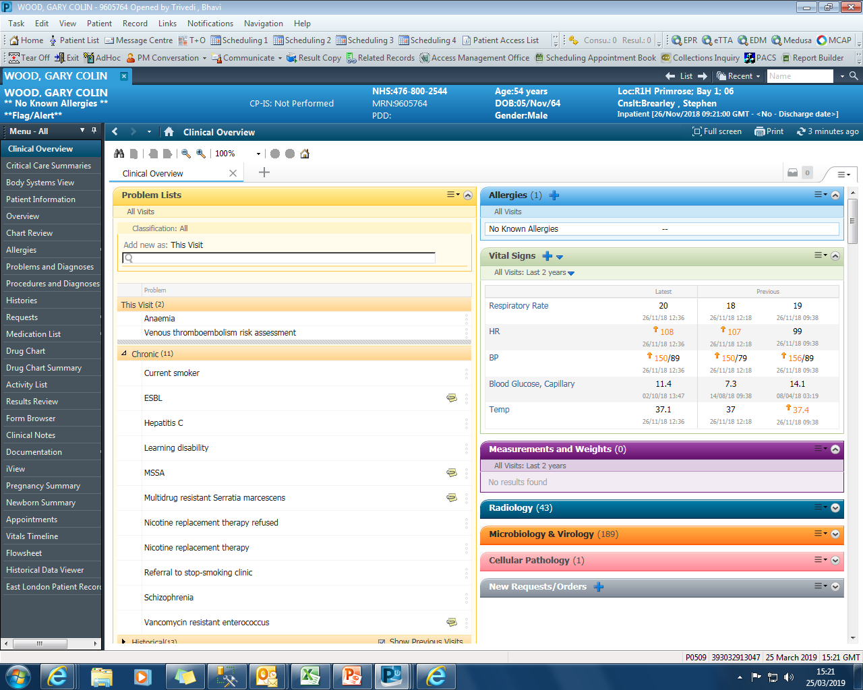

Slide 18
AKI
Problem
AKI alert reported in real time in CRS but variability in time to action
Delays in recognition of AKI increase morbidity, mortality and LoS
Unable to achieve improvements required for CQUIN
Solution
Real-time report to identify all current inpatients with AKI
To be reviewed several times daily by specialist team (?CCOT)
Direct intervention
Improvements
Insights are co-ordinated by central team and actioned in real-time
Reduction in time to recognition of AKI and time to intervention
Standardisation of care for patients with AKI across the Trust

Slide 19
COPD
Problem
High prevalence + common reason for readmission (in top 3)
Unable to collate data to participate in RCP rolling audit
Loss of £1.8m in BPT
Solution
Rolling report created using EHR data for RCP audit submissions
ARCARE team flag (in EHR) patients at high risk of readmission
Daily report lists discharged ‘flagged’ patients - focuses readmission prevention (telephone support and home visits)
Improvements
Pro-active approach to readmission avoidance
Facilitates participation in RCP audit and achieving BPT
Standardisation of COPD care across Trust

