Slide 1
SNOMED CT Genomics Pilots
Michael Lawley
April 2019
Australian e-health research centre

Slide 2
Genomics and Genetics in Medicine
A genetic test typically tests for one genetic marker
A genomics sequence captures a person’s whole genetic profile
The sequence can be stored –
  For future re-analysis to support diagnosis and treatment decisions for that individual
  To be used for supporting research into a disease that patient is diagnosed with
  To support treatment decisions with patients with the same disease
These use cases require that accurate clinical phenotype information is captured about the patient

Slide 3
AEHRC in Australia’s Genomics Initiatives
AEHRC clinical and bio informatics scientists are involved in Australia’s Genomics initiatives
  Queensland Genomics Health Alliance
  Australian Genomics Health Alliance
  Melbourne Genomics Health Alliance
Also involved in many other genomics projects with collaborators around Australia

Slide 4

Clinical Use of Genomics
Hospital EMR
Laboratory
Clinical Genome Sequencing
Laboratory receives the order
Whole genome, whole exome or panel
Clinician decides to order a genomics test
Achieve a better diagnosis
Help with a treatment decision
Enable prognosis for the person and family
Analysis
Bioinformatics pipelines annotate the sequence with variants which differ from a reference genome
A report is returned to the EMR
Pathologist will curate the variants and write a report
Only variants relevant to the suspected diagnosis are reported
Curation
Accurate clinical phenotype information
Supports the clinician in making the test order
Aids the pathologist in the decision making on what to report
Is vital for future use of the sequence in treating the patient and supporting research

Slide 5
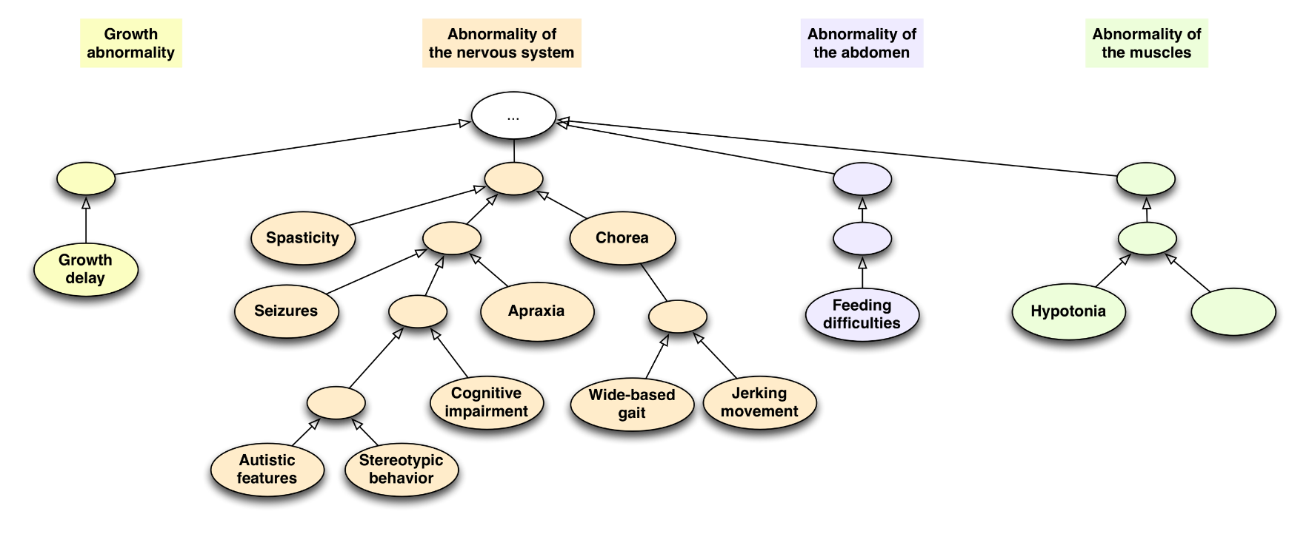
Clinical Terminology: SNOMED CT, HPO
SNOMED CT: General medical terminology used increasingly in EMR’s
HPO: specific terminology for describing clinical phenotypes of rare diseases

Slide 6
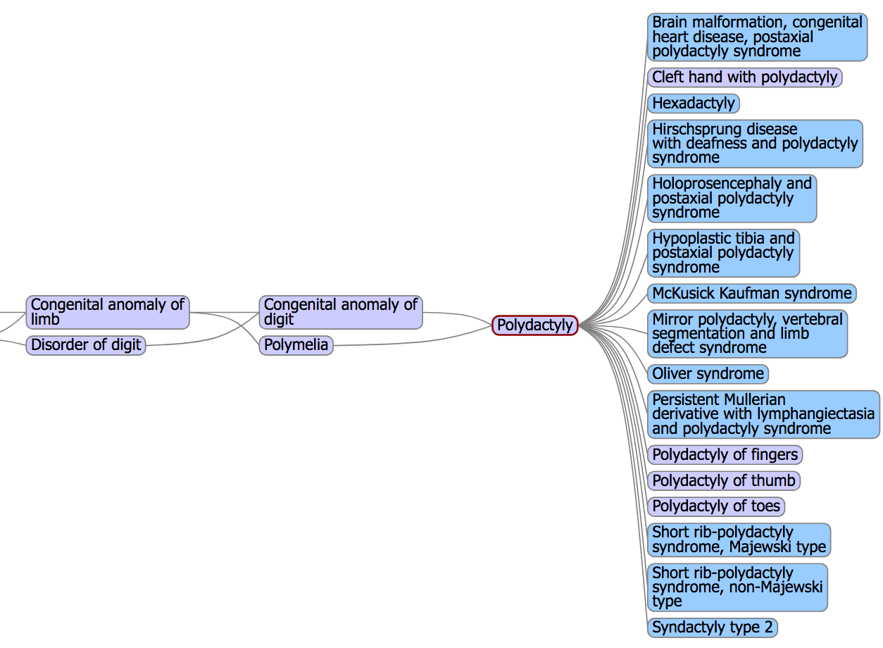
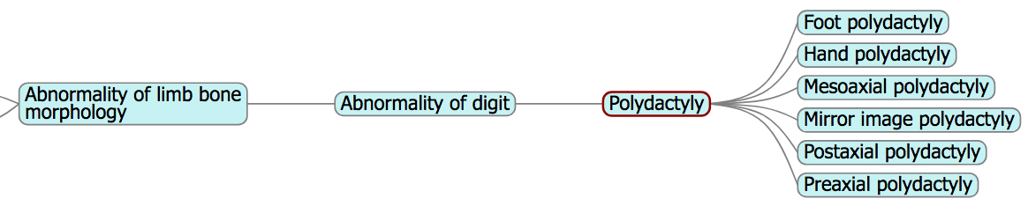
Clinical Terminology: SNOMED CT, HPO
Overlapping concepts are modelled differently

Slide 7
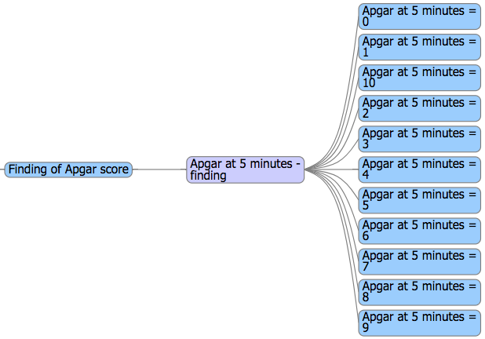
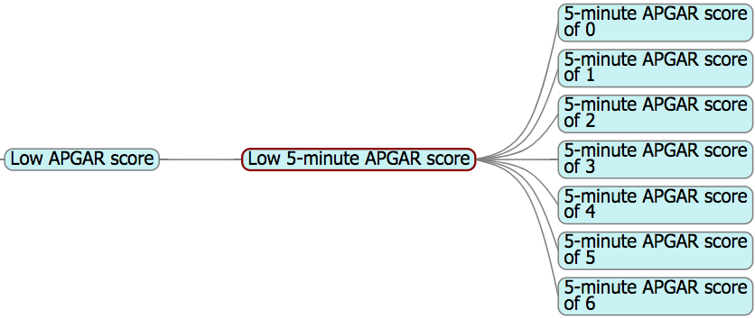
Clinical Terminology: SNOMED CT, HPO
HPO does not model normal phenotypes
  E.g. APGAR scores (7, 8 and 9 are not included)

Slide 8
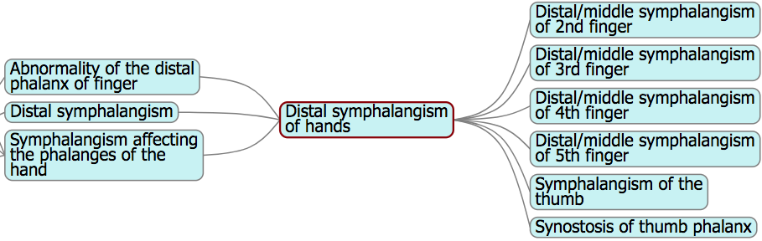
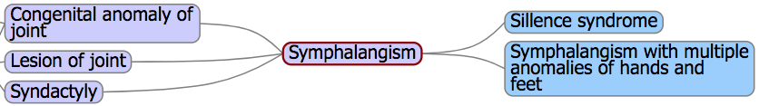
Clinical Terminology: SNOMED CT, HPO
But HPO has more detail than SCT in certain areas
  E.g. HPO is better at defining conditions in specific places, such as finger and toe abnormalities

Slide 9
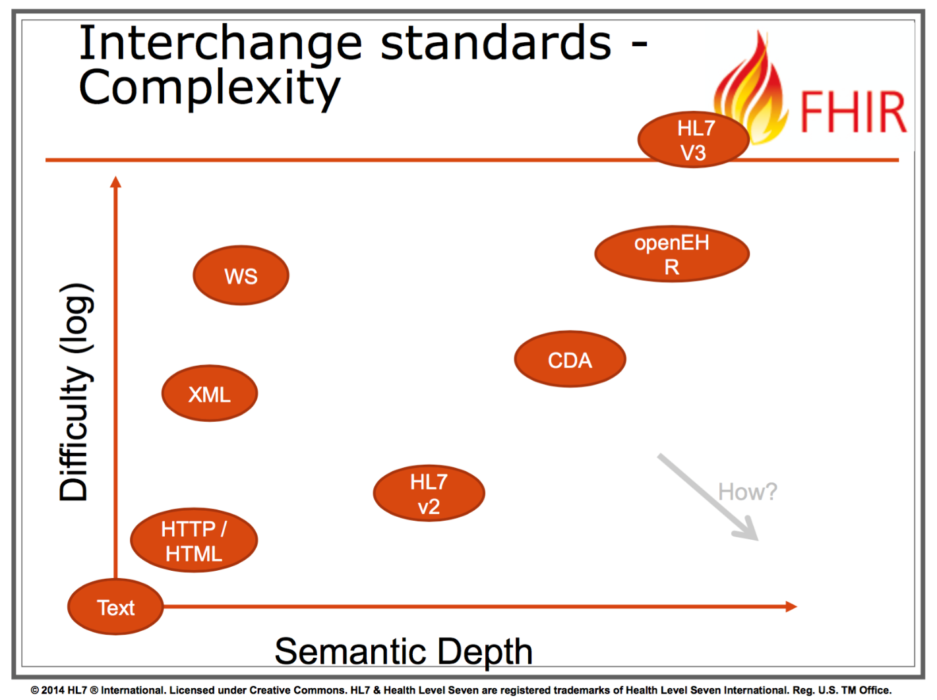
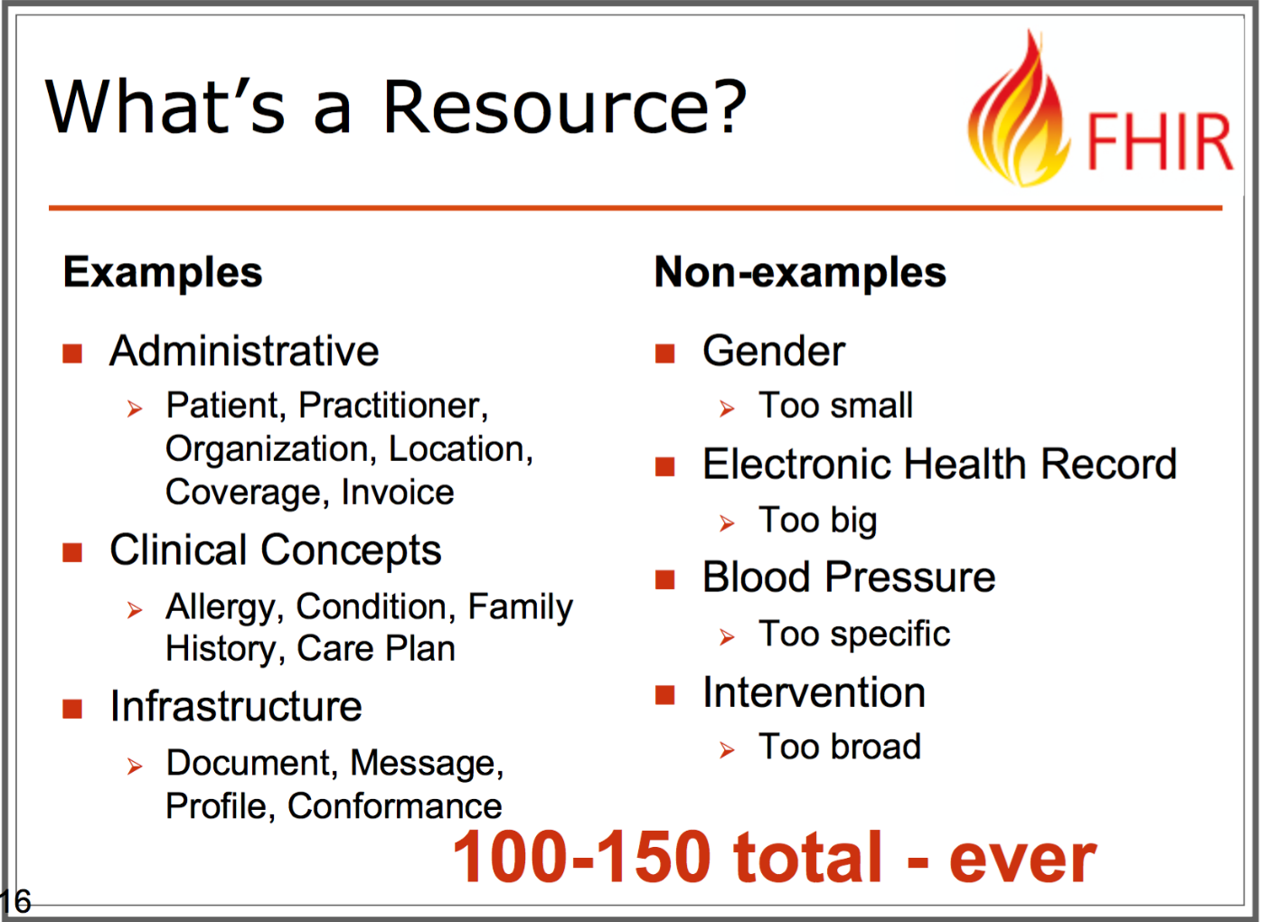
Data exchange: FHIR, Phenopackets

Slide 10
Data Exchange: FHIR and Phenopackets
PhenoPackets
Patient
id: “#1”
gender: male
birthDate: 1999-01-01
Phenopacket
id: “my_phenopacket”
persons
phenotypeAssociations
Person
id: “#1”
sex: M
Date_of_birth: 1999-01-01
Phenotype Association
entityId: “#1”
subject
Observation
code: {
coding: {
system: “http://snomed.info/sct”,
code: “73297009“
},
text: “Muscular dystrophy“
}
phenotype
Phenotype
measurements
Measurement
types
OntologyClass
id: “HP:0003584”
label: “Muscular dystrohpy”

Slide 11
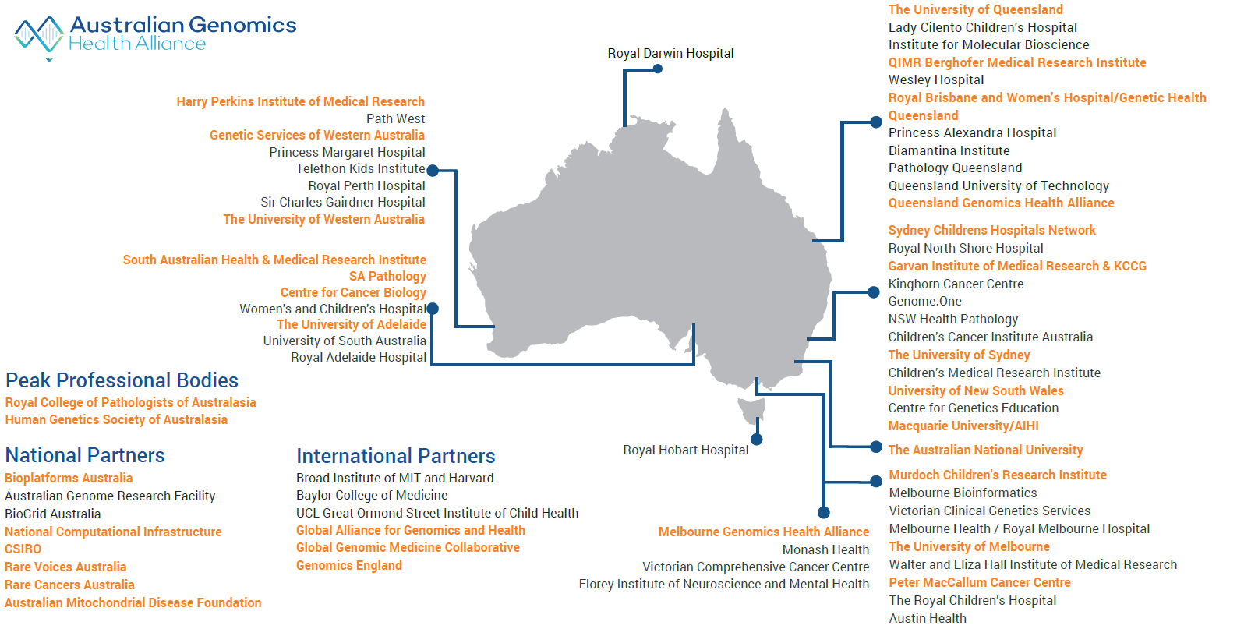
Australian Genomics
BUILT ON NATIONAL COLLABORATION (80 PARTNERS)

Slide 12
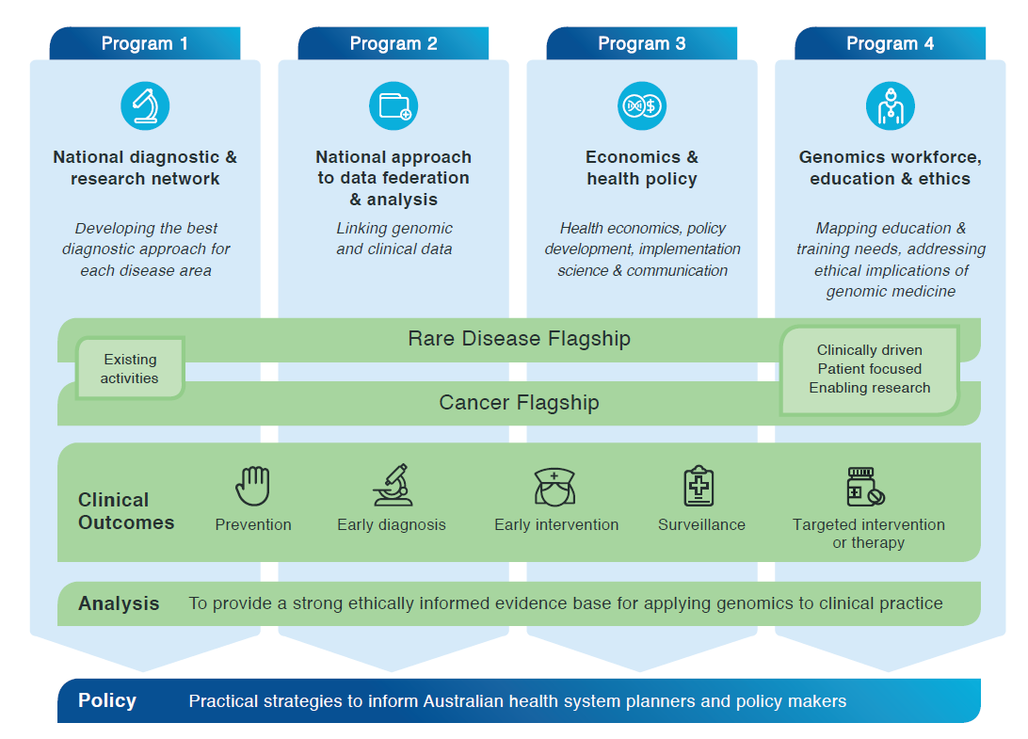
Australian Genomics
PROGRAMS, FLAGSHIPS AND PROJECTS

Slide 13
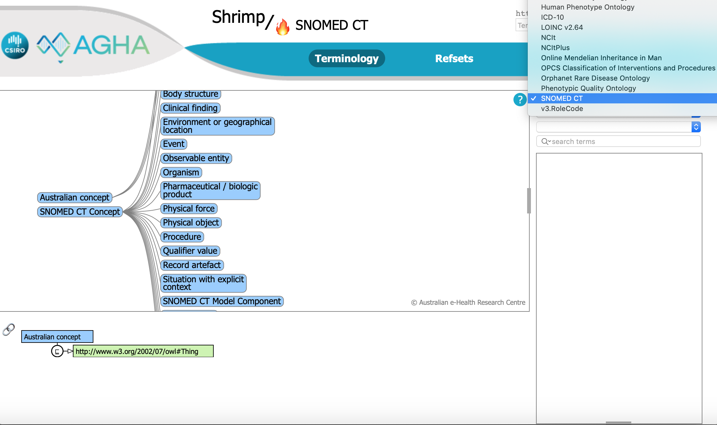
Australian Genomics
Terminology Server

Slide 14
A National Gen-Phen Database
A national approach for data federation and analysis
  Linking genomic and clinical data
    Standardised
    Secondary use
    De-identified, pseudonymised
  Initial sources are Flagships - most use REDCap
  Will need to support other sources

Slide 15
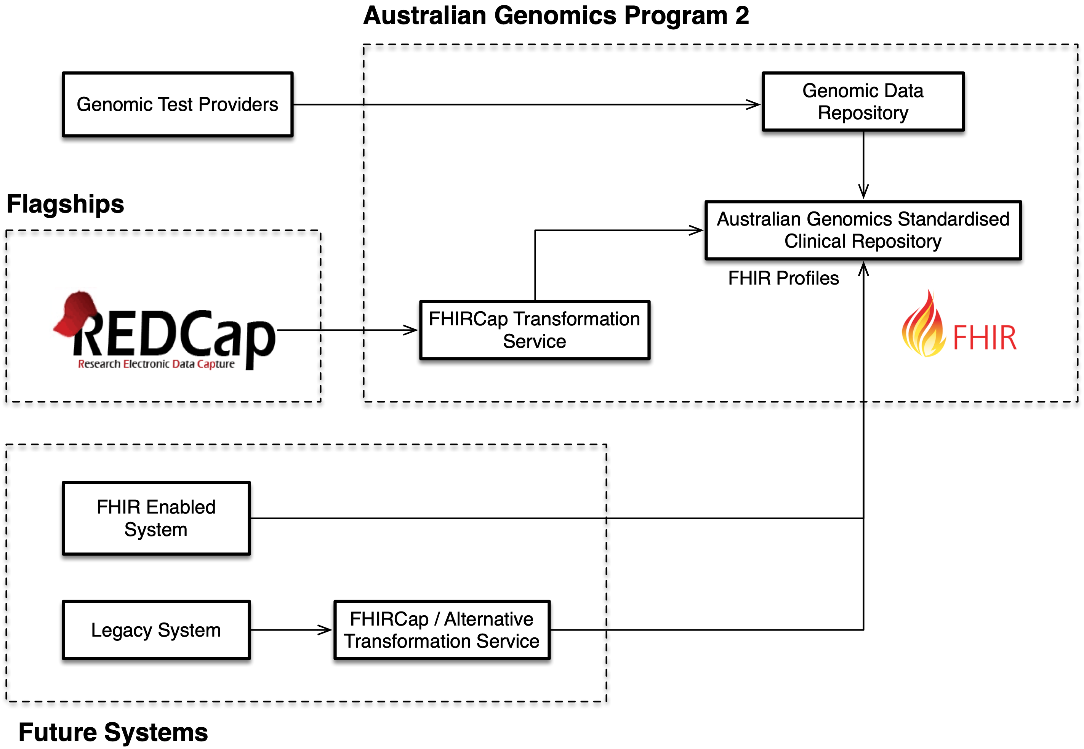
A National Gen-Phen Database

Slide 16
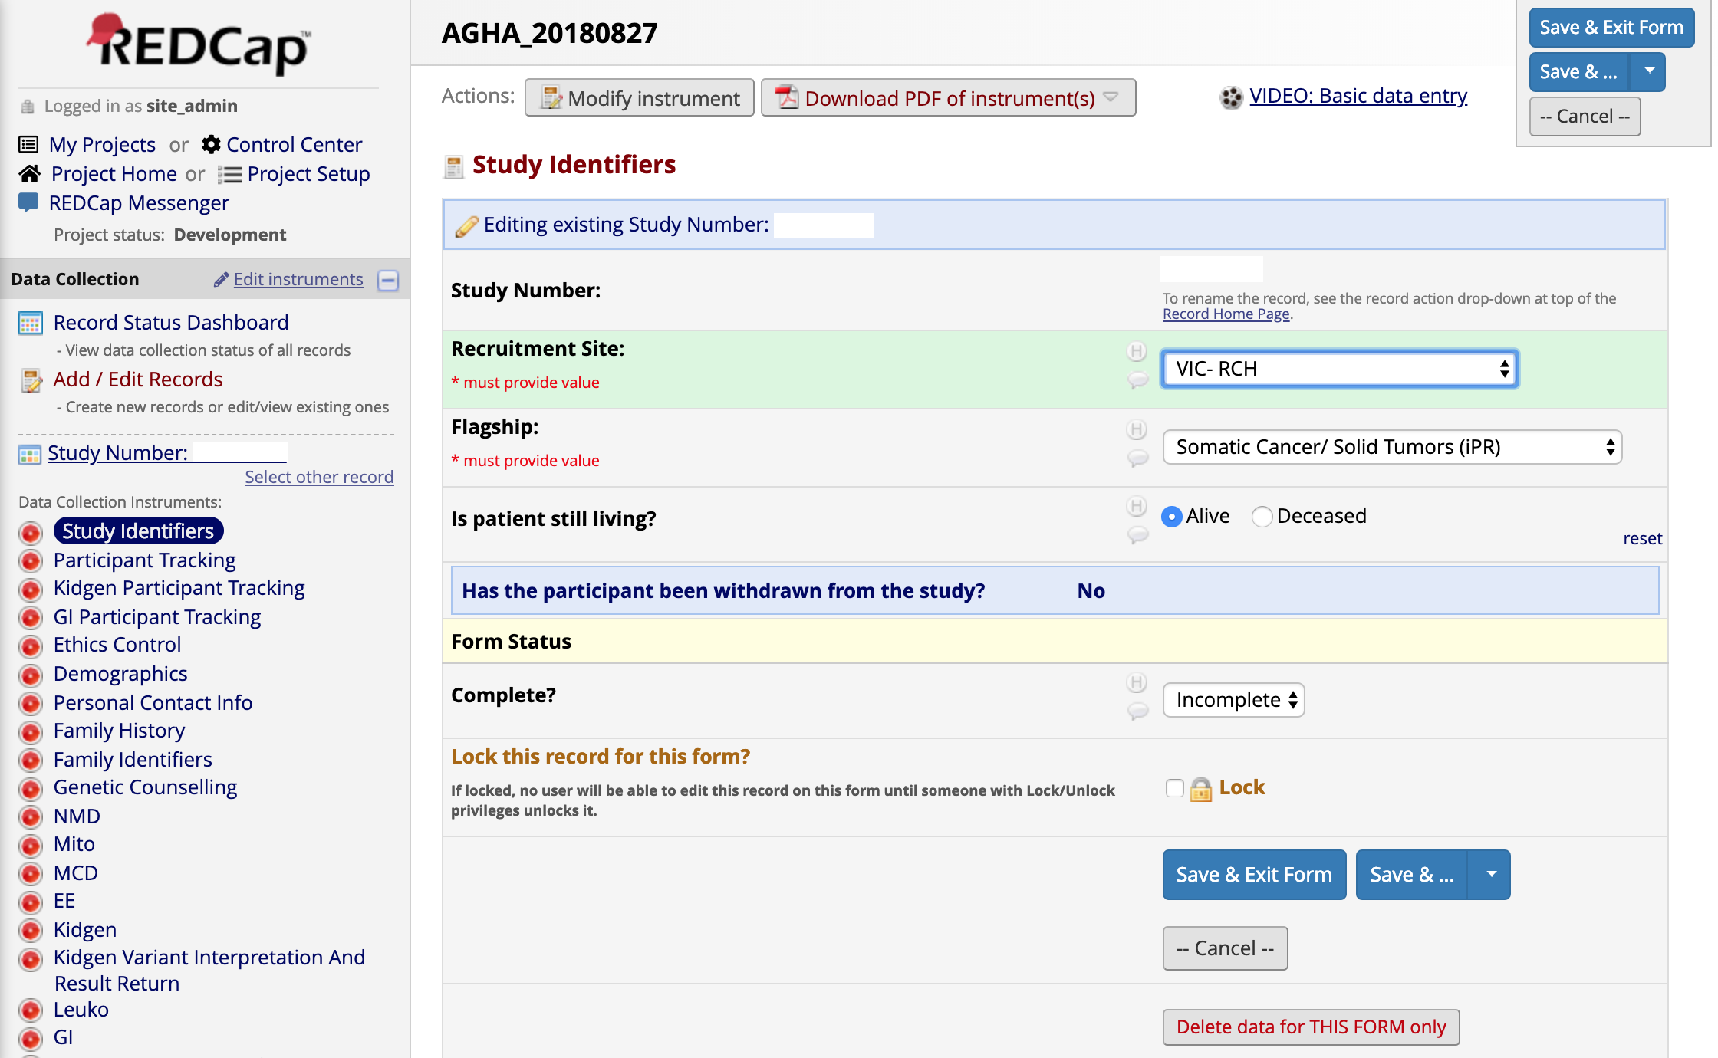
REDCap in the Flagships

Slide 17
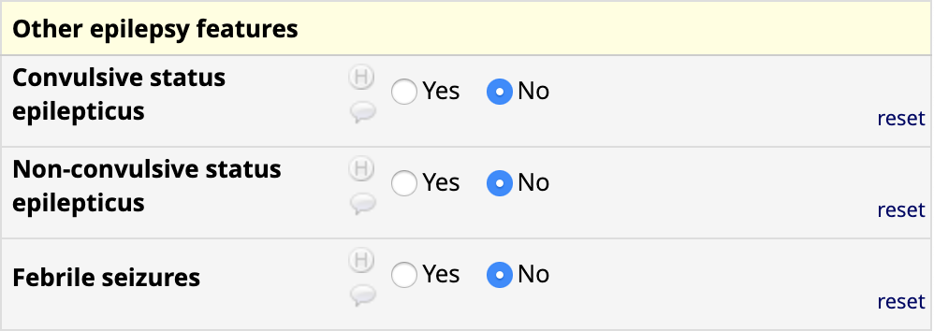
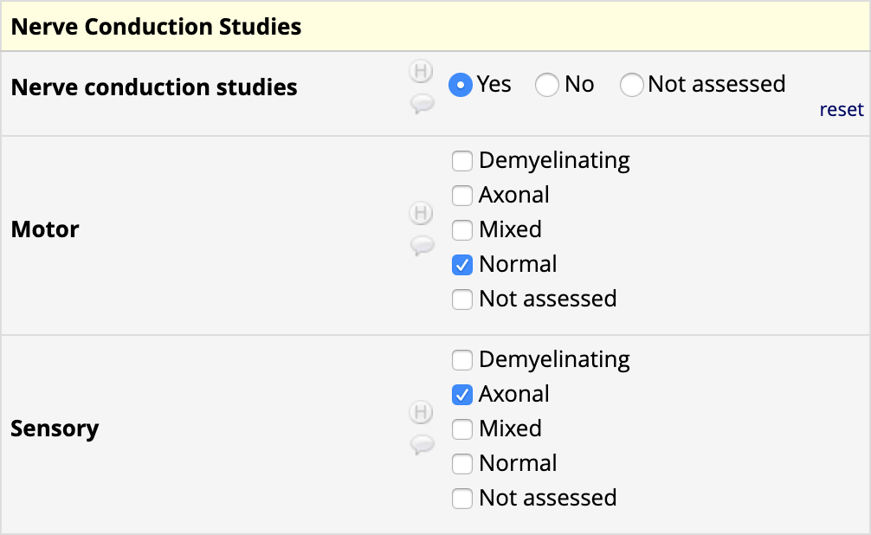
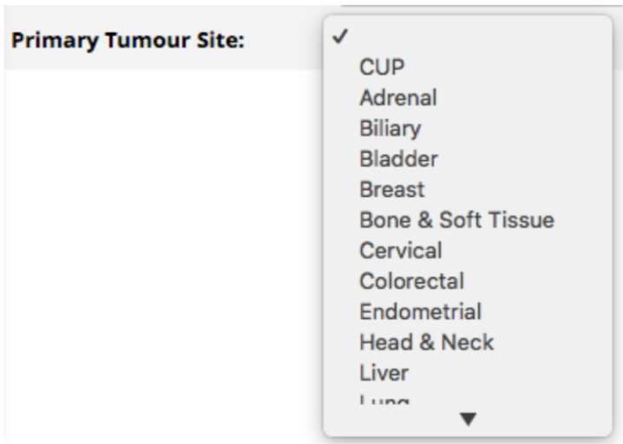
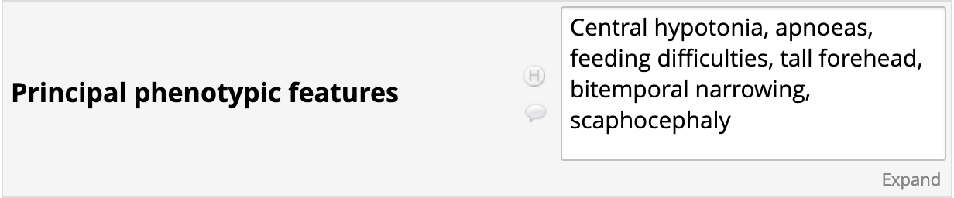
REDCap in the Flagships
Clinical data capture is not standardised

Slide 18
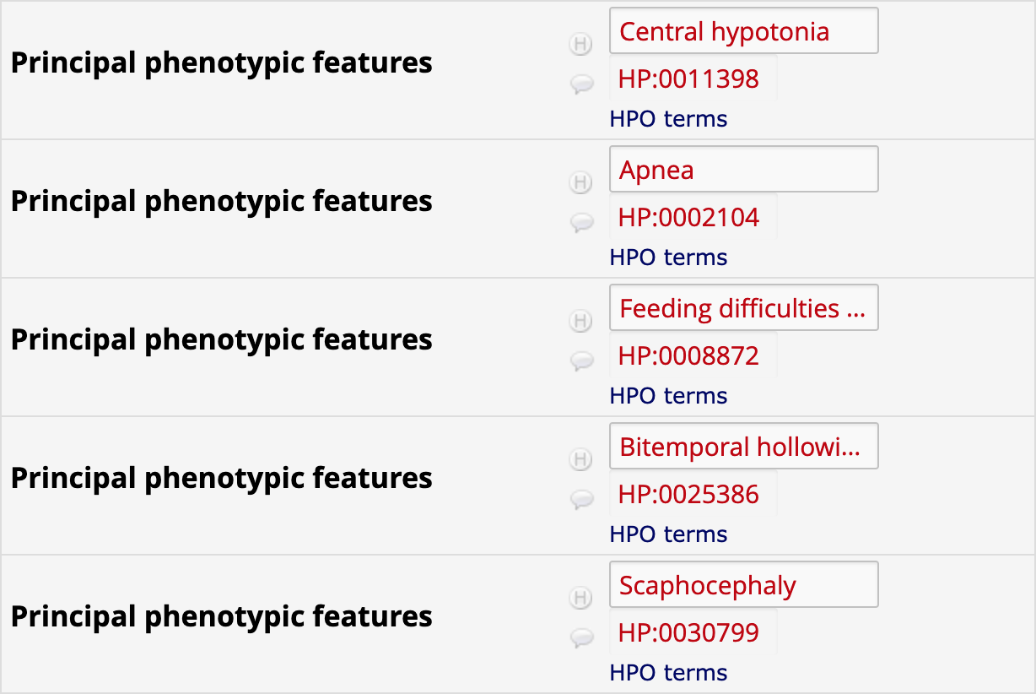
REDCap in the Flagships
REDCap FHIR Terminology Plugin
Get the REDCap plugin here:
https://github.com/aehrc/redcap_fhir_ontology_provider
Try Ontoserver here: http://genomics.ontoserver.csiro.au

Slide 19
A National Gen-Phen Database
The proposed solution
  Use FHIR to represent the clinical data
  Map values to terminologies (e.g. SNOMED CT, HPO)
  Transform REDCap data from flaghships into FHIR
  Upload to national FHIR repository
  Design profiles before collecting data from other sources

Slide 20
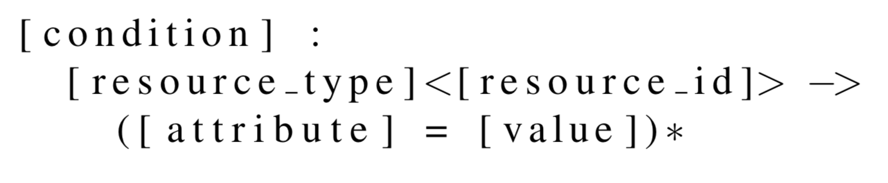
FHIRCap
Rules-based transformation engine
  Usable by non-programmers (but still need to understand FHIR!)
  Rule structure

Slide 21

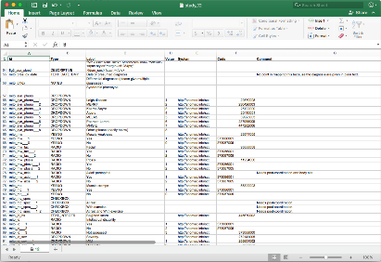
FHIRCap Basics
Rules:
VALUE (pts) != null :
Condition<c1> ->
bodySite[0] = CONCEPT_SELECTED (ts),
code = CONCEPT_VALUE(
http://snomed.info/sct|108369006
);
Mappings:

Slide 22
FHIRCap in Australian Genomics
KCCG
Variant Atlas
CSIRO
MCRI
Docker image
Docker image
Docker image
RedCap
Ontoserver
CSIRO HAPI FHIR Server
FhirCap
DB
DB
DB
DB

Slide 23
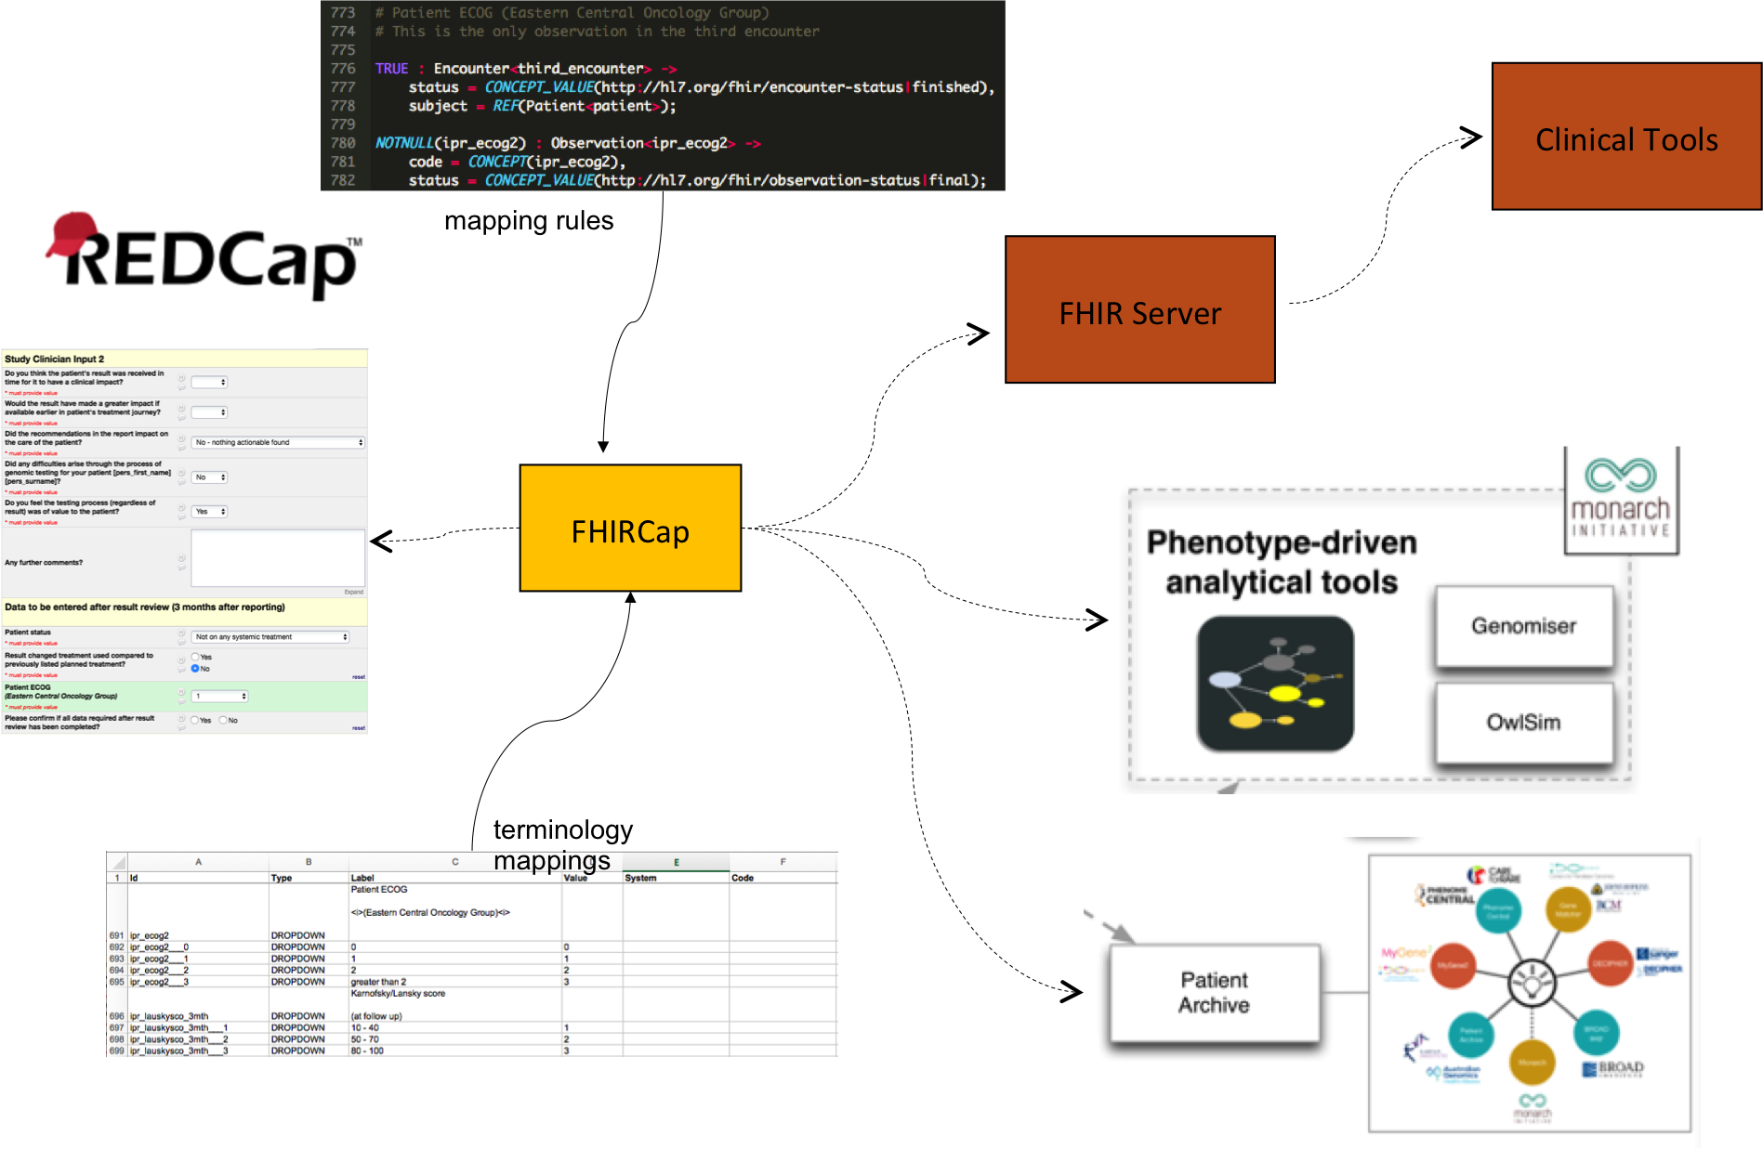
FHIRCap: Preparing for the EMR world

Slide 24
Preparing for the EMR world
Electronic Health Records
As clinical systems support FHIR

Slide 25
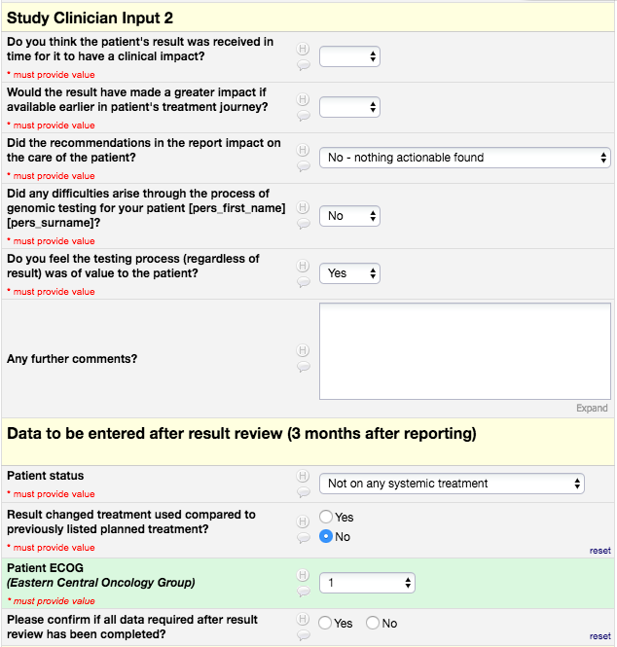
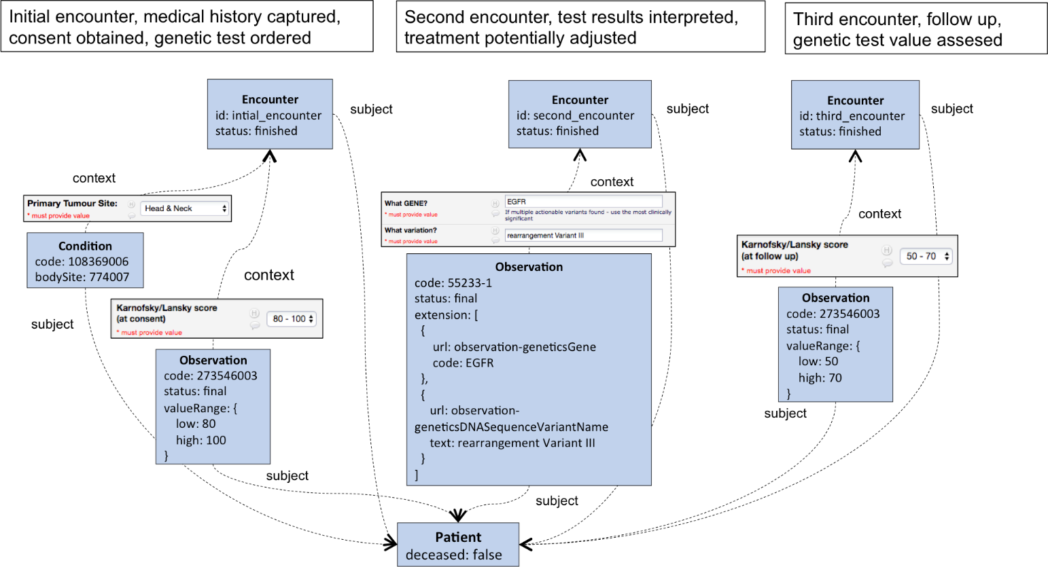
FHIRCap Transformation Example
Somatic Cancer Flagship REDCap Forms
FHIR Representation using SNOMED CT

Slide 26
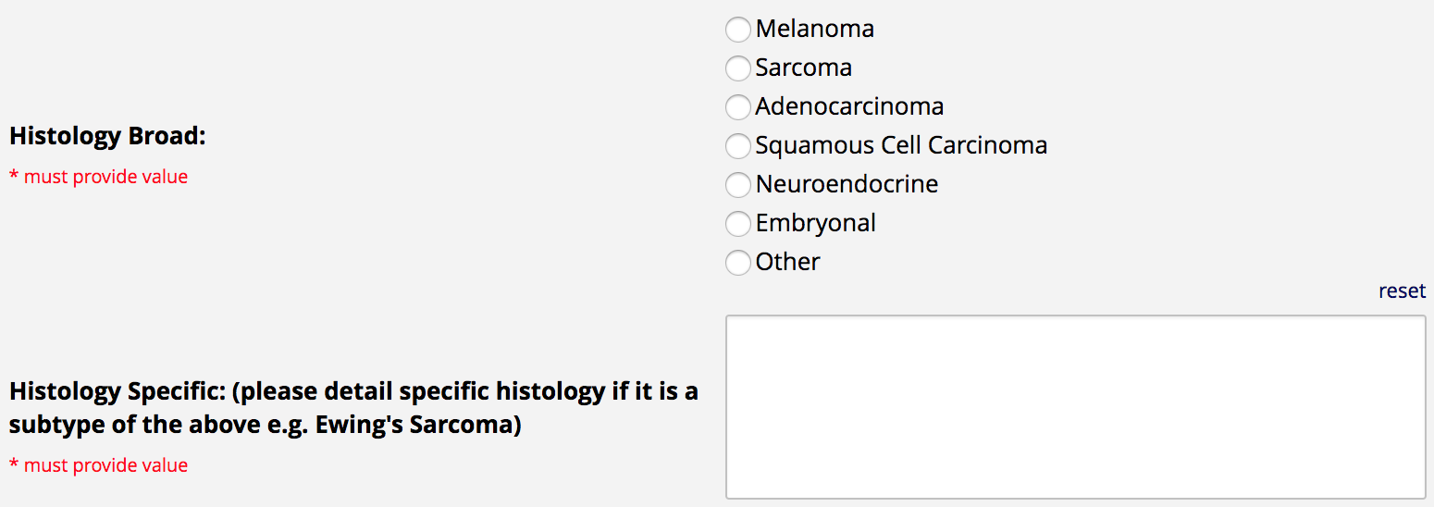
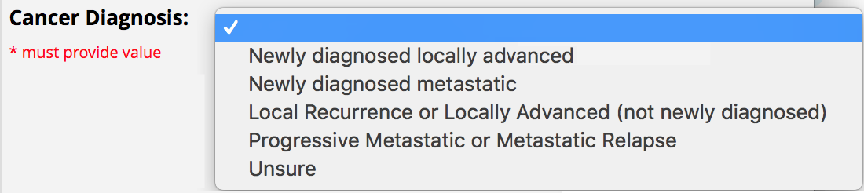
Examples of Mapping Issues
Patient
gender: male
birthDate: 1999-01-01
subject
DiagnosticReport
code: {
coding: {
system: “http://snomed.info/sct”,
code: “15886004“
},
text: “Screening for cancer“
},
codedDiagnosis: {
coding: {
system: “http://snomed.info/sct”,
code: “128462008“
},
text: “Secondary malignant neoplastic disease“
}
subject
Condition
code: {
coding: {
system: “http://snomed.info/sct”,
code: “372244006“
},
text: “Malignant Melanoma“
}
Free text might not always map to SCT
Some detail is lost in the mapping

Slide 27
Pilot 1: Cardiovascular Genetic Disorders Flagship
The capability of the Cardiovascular Flagship has recently been expanded
  Now expected to have up to 600 families recruited
  Patients will undergo whole genome sequencing
  High-quality clinical data will be captured up front, as a prerequisite for ordering the genomic tests
The main aim of this pilot is to determine if SNOMED CT provides adequate coverage to do deep phenotyping for the patients recruited in this clinical area

Slide 28
Pilot 1: Scope
Work with the Flagship clinicians to refine the current definition of the patient phenotype for this particular clinical area
Identify the terminology content requirements to support the Flagship
Assess any content gaps and triage content requests
Act as a liaison point to the National Clinical Terminology Service to manage content requests
Develop and maintain local extensions and value sets where identified as being required

Slide 29
Pilot 1: Deliverables
A FHIR value set of SNOMED CT codes for the Cardiovascular Genetic Disorders Flagship
  Can be used as the basis for an SNOMED CT reference set
A report describing the way that SNOMED CT was used to capture deep phenotype data on participants in the AGHA Cardiac Flagship
  The report will identify any gaps or modelling issues identified in SNOMED CT
A report assessing the suitability of SNOMED CT to do deep phenotyping of cardiovascular genetic disorders

Slide 30
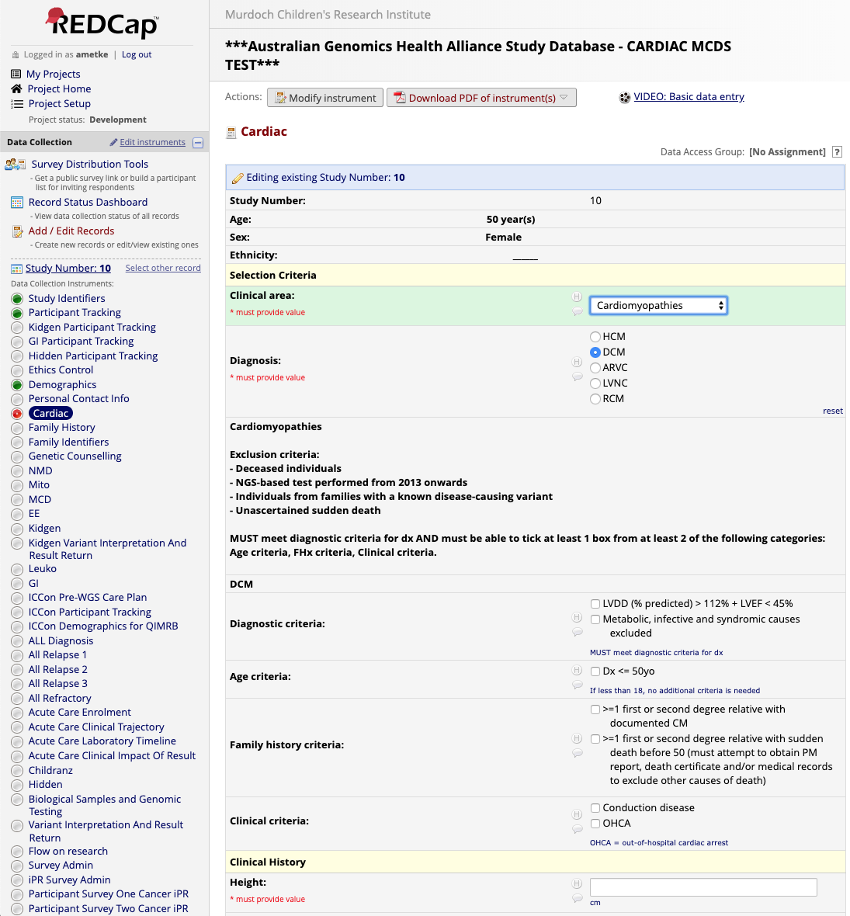
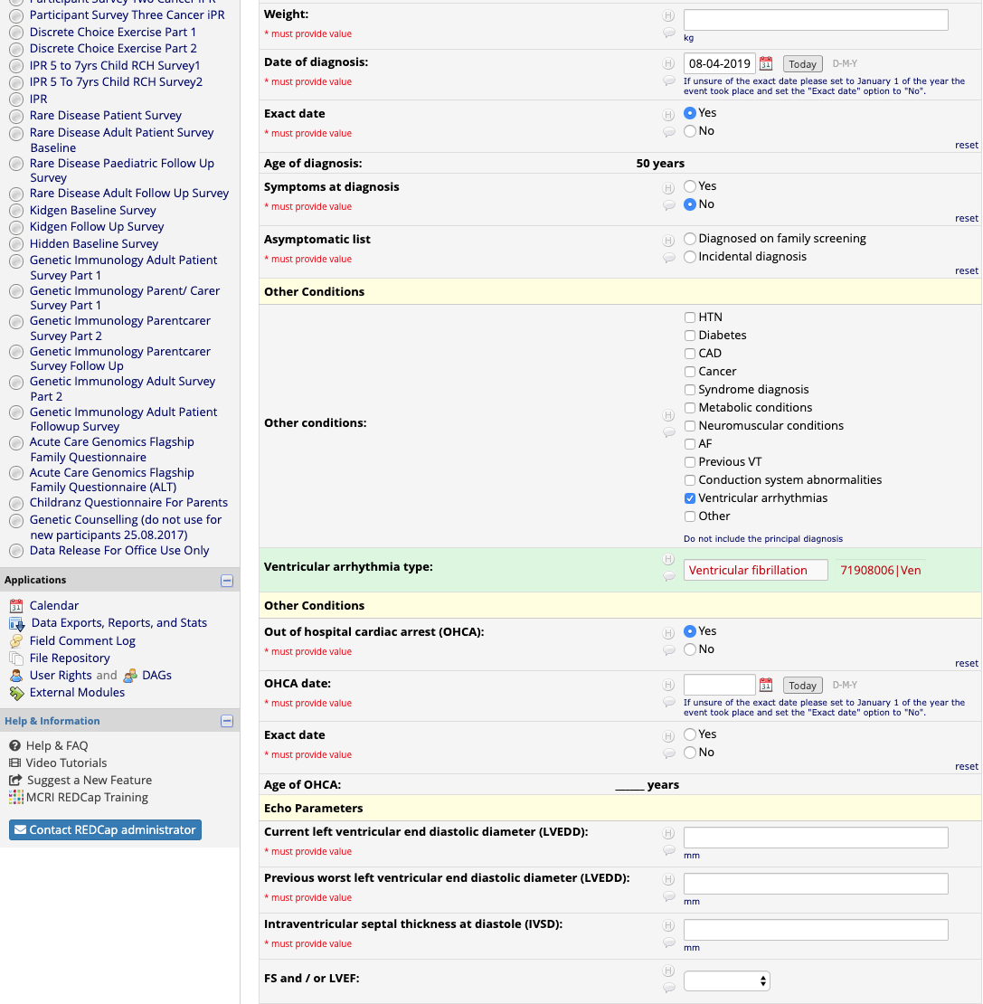
Pilot 1: Progress
Finalising the REDCap forms used to collect clinical data

Slide 31
Pilot 1: Progress
Created the following SNOMED CT value sets:
  Comorbidities:
    Coronary artery disease
    Cancer
    Conduction abnormalities
    Ventricular arrhythmias
    Other
  Dilated cardiomyopathy
    Echo Valve Disease
  Congenital heart disease
    Diagnosis
    Non-cardiac anomalies
    Procedures

Slide 32
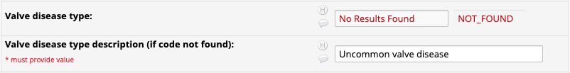
Pilot 1: Next steps
Monitor real data when recruitment starts
  REDCap forms are designed using the following pattern:
  The user has to look for a concept in SNOMED CT using the auto-complete widget and specifically indicate that the concept was not found before a free text box is displayed
  Whenever a “No Results Found” is detected, one of our clinical terminologists will look at the data that was entered and decide what to do

Slide 33
Pilot 1: Next steps
  There are four possible outcomes:
    The concept is in SNOMED CT but it is missing a synonymy
    The concept is in SNOMED CT but could not be found (i.e. the user does not find the concept using the widget but then enters free text that matches a synomyn – unlikely but possible)
    The text entered by the user does not make sense in that context
    The concept is valid and not in SNOMED CT
  The corresponding actions are:
    Request the synonym to be added to SNOMED CT AU
    Follow up with the user
    Follow up with the user
    Request the concept to be added to SNOMED CT AU

Slide 34
Pilot 2: Kidgen Flagship
The Australian Genomics Renal Genetics Flagship is a project that builds upon the KidGen consortium to integrate genomic medicine into care for those with inherited kidney diseases, with the aim to better diagnose, manage and treat these diseases
The project will have two main goals:
  Improving the current REDCap forms used to collect participant data by replacing some free text fields with SNOMED CT codes
  Exploring analytics use cases using SNOMED CT and FHIR

Slide 35
Pilot 2: Scope
Phase 1
  Work with Flagship clinicians to replace the current free-text fields used to capture patient diagnosis at different stages with SNOMED CT coded fields, using the new REDCap FHIR Terminology plugin
  Migrating existing free text data to the new coded fields and discuss complex cases with Flagship clinicians1
Phase 2
  Define an analytics use case around the evolution of patients’ diagnoses to help understand to what extent the diagnoses are refined at every encounter (e.g., at referral, at the clinic, etc.) and provide insights into how to optimise the current process
  Implement the use case in the CSIRO analytics platform to validate its design

Slide 36
Pilot 2: Deliverables
A FHIR value set of SNOMED CT codes for the KidGen Flagship
A report describing the process of migrating the REDCap forms to use SNOMED CT to represent the diagnoses of patients in coded form, at different points during the patient journey
  The report will identify any challenges encountered in this process including complex cases and any gaps or modelling issues identified in SNOMED CT
A report detailing how SNOMED CT and FHIR can be used as part of an analytics platform and how the KidGen data was used to implement an example around the evolution of patients’ diagnoses

Slide 37
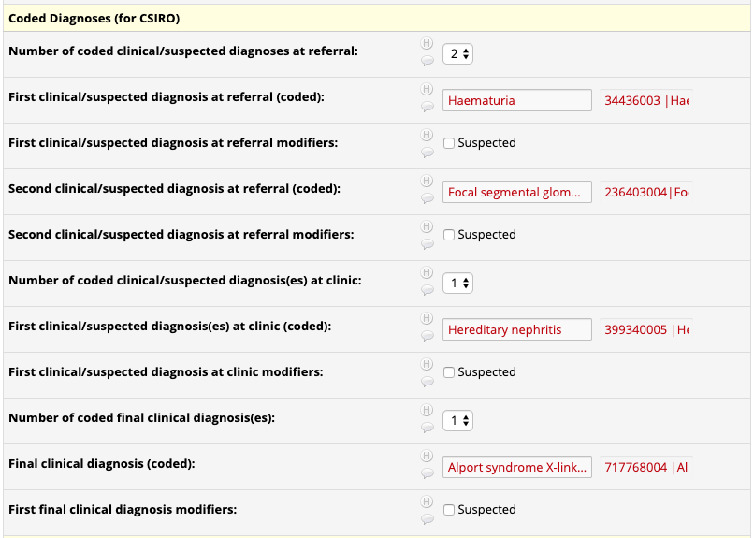
Pilot 2: Progress
Created an initial diagnosis value set for KidGen
  Can be browsed here: https://genomics.ontoserver.csiro.au/vs.html
Added coded fields to existing REDCap form and did initial round of coding

Slide 38
Pilot 2: Next steps
Get feedback from clinicians on difficult cases to code
  Some fields contain very noisy text
Write FHIRCap rules to produce a FHIR representation of the data with SNOMED CT codes
Implement the chosen analytics use case using CSIRO’s FHIR analytics engine

Slide 39
Thank you
Michael Lawley
The Australian eHealth Research Centre
e: michael.lawley@csiro.au
The Australian e-health CENTRE

