Slide 1
Supporting the Precision Medicine Ecosystem: Integrating Discrete Pathology and Molecular Data into EHRs using SNOMED CT
W. Scott Campbell, PhD, MBA
James R. Campbell, MD
Monica de Baca, MD
SNOMED CT Genomics
April 11, 2019

Slide 2
Acknowledgements
College of American Pathologists –Raj Dash, MD; Alexis Carter, MD; Mark Routbort ,MD PhD; Mary Kennedy; Monica de Baca, M; Sam Spencer, MD
UNMC - Allison Cushman-Vokoun, MD PhD, Tim Griener, MD
Swedish Board of Health, Sweden - Daniel Karlsson, PhD, Keng-Ling Wallin, PhD, Carlos Moros (Karolinska Institute)
Royal College of Pathologists and eDigital Health (NHS) – Deborah Drake, Laszlo Iglali, MBBS
SNOMED International Observable Project –Farzaneh Ashrafi, Ian Green
Regenstrief Institute Inc. – Daniel Vreeman, DPT, Swapna Abhyankar, MD
International Collaboration on Cancer Reporting – David Ellis, MD; John Srigley, MD
Dr. W. Scott Campbell and Dr. James R. Campbell partially supported by NIH Award: 1U01HG009455-02; Patient Centered Outcomes Research Institute (PCORI) Award CDRN-1306-04631); Funding from UNMC Departments of Pathology and Microbiology and Internal Medicine

Slide 3
Primary Data – Bridge the Gap
Translational Junction
Bedside
Bench
Patients
Phenotypes
Outcomes
Intervention
Experiment
Hypothesis

Slide 4
Begin with the end in mind
Render pathology data to computable forms for patient care at the point of care
Render genomics data to computable form for use at the point of care
for patient care
Capture data in pathology and genomics at the point of care to support new discovery at the bench
Bring bench discovery back to the point of care to support patient care
It is about the patient and aiding the patient and care team to make informed decisions

Slide 5
Example Use Cases
Cancer treatment planning:
Colon cancer (Stage IV or metastatic), testing for BRAF, *RAS, MSI, and use of BRAF, EGFR or immunologic therapy by protocol/not by protocol…Outcome?
Research Project Planning:
How many healthy patients do we have that are BRCA1 or BRCA2 positive
Retrieve all breast cancer cases that tested ER-, PR- and Her2/neu
Medical-legal, compliance and safety:
Recall of all cancer cases for treatment review with (formerly thought insignificant) somatic gene sequence variant reported
CAP accreditation requirements for molecular laboratories.
Tissue Biobank Applications:
Find all malignant neoplasms of any origin tested for BRAF mutation AND reported positive for lymphatic metastases.
What is needed to meet the needs of these researchers and
clinicians is a domain ontology (structured, defined coding
hierarchy) which we can query for detailed results
These data types are called “Observables”

Slide 6
Terminology Implementation Requirements
Conform to the current EHR ecosystem
Incorporation into natural workflows of providers
  Upstream systems
  Point of care
  Non-intrusive
Support primary and secondary uses of data

Slide 7
EHR Technology
What it is:
  Patient-centric
  Encounter based
  Longitudinal Medical Record
  Transactional
  Billing orientation
What it can be:
  Integrated patient-centric data
  Basis for clinical decision support
  Population management
Requirements (Just a few…)
  Standards
  Standard use of standards
  System Integration/Interoperability

Slide 8
Histopathology Reporting Evolution
Basic Advanced
Level 1 - Narrative
Level 2 – Narrative with required data elements
Level 3 – Narrative with required data elements in Synoptic format
Level 4 – Level 3 plus electronic user interface for data entry
Level 5 – Level 4 plus structured language and discrete data capture
Level 6 – Level 5 plus all data encoded in machine readable, standard terminology
Level 7-
Semantic
interoperability
1. Srigley JR, McGowan T, Maclean A, Raby M, Ross J, Kramer S, et al. Standardized synoptic cancer pathology reporting: a population-based approach. J Surg Oncol. 2009 Jun 15;99(8):517-24.

Slide 9
Sample Pathology Reports (1990 – 2005); Level <3
I: Pancreatic resection with adherent duodenal resorption (measuring 11 cm), ventricular resorption (measuring approximately 5 cm), and gall bladder, macroscopic u a. Pancreatic resection approximately 8 x 4 cm, with a 3 x 3 cm tumor, cut and chopped and constricted choledochus and pancreatic cancer.
Histologically, the corresponding tumor, infiltratively growing atypical gland formations, is seen. Cylindrical gland epithelium with nuclear stratification, enlarged hyperchromatic cell nuclei and mitosis. Central tumor necrosis. Picture as in medium differentiated adenocarcinoma. Macroscopically and with taken histological cuts, radically excited with narrow but free margin against the retinal vena porta. (B). The medi preparation contains a reactive lymph node.
I (1): 7.7 cm ventricle with …until the papilla. Continuous 8.5 x 2.5 cm gallbladder. 2.5 x 3 x 2 cm yellow-white tumor-like change, growing partially in the pancreatic head against the duodenal mucosa and choledochus and papilla vateri.
The ventricular free ducts, duodenum, leftover pancreatic tissue and choledochus without detectable tumor growth. In the gall bladder, microscopic focal hyperplastic mucosa and signs of chronic cholecystitis with lymphocytic infiltration are observed. No signs of malignancy in the gall bladder.
Similar to the macroscopic tumor, a medium to focal low differentiated adenocarcinoma is seen that grows under the duodenal mucosa and into the pancreatic head with large necrotic areas and desmoplastic connective tissue formation. …comprised of major tubular formations, means that one should primarily suspect the outcome of proximal choledochus or pancreatic cancer. Biggest tumor size 2.5 x 2.2 cm. Distance to the nearest travel area 1.6 cm.
In fraction I, 21 tumor-free lymph nodes are found. In addition, two tumor tumors of tumor growth per continuitatem from the tumor.
T3 N0 MX.
Examples – Courtesy of Carlos Fernandez Moro, Karolinska Institute

Slide 10
Structured Report Efforts
1998 - College of American Pathologists (CAP) began creating and disseminating the cancer worksheets. Electronic versions shortly thereafter.
International professional societies produced similar synoptic data sets
  Royal College of Pathology (RCPath – UK)
  Royal College of Pathology Australasia (RCPA)
  Canadian Association of Pathologists (use CAP from US)
  International Collaboration on Cancer Reporting (ICCR)
Why?
Completeness of data
Welcomed by “consumers” – Surgeons, oncologists
Tolerated by pathologists (loss of essential, nuanced information?)

Slide 11
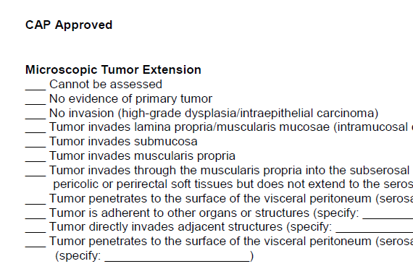
AP Example: Microscopic local invasion of colon tumor

Slide 12
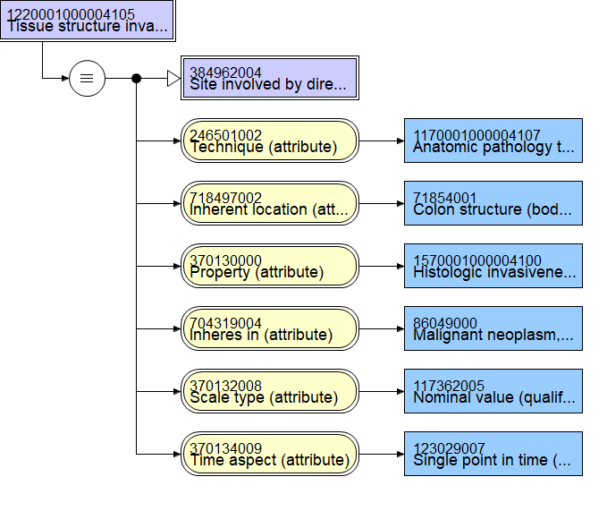
SNOMED CT –
Tissue structure invaded by direct extension of primary malignant neoplasm of colon

Slide 13
Example Value set
Direct extension of colon tumor | 1220001000004105 |Tissue structure invaded by direct extension of primary malignant neoplasm of colon (observable entity)|
 |  | Tumor invasion cannot be assessed | 460831000004104|Body structure without current definition (body structure)
 |  | Carcinoma in situ, intraepithelial | 42978003 | Colonic epithelium (body structure) |
 |  | Carcinoma in situ, invasion of lamina propria | 113284008 | Colonic lamina propria (body structure) |
 |  | Tumor invades submucosa | 61647009 | Colonic submucosa (body structure) |
 |  | Tumor invades muscularis propria | 41948009 | Colonic muscularis propria structure (body structure) |
 |  | Tumor invades through the muscularis propria into the subserosa or into non-peritonealized pericolic or perirectal tissue | 52010009 | Colonic subserosa (body structure) |
 |  | Tumor penetrates serosa | 90132000 | Colonic serosa (body structure) |
Value set of answers

Slide 14
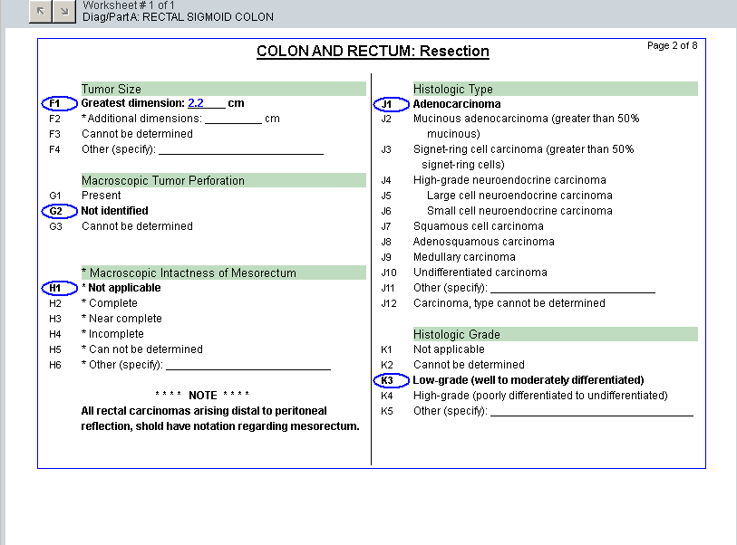
Implementation - Terms Bound to CoPath® for Pathologist

Slide 15
Resultant Data Exchange between Information Systems
MSH|^~\&|COPATH|COPATH|EPIC||2017NNNN||ORU^R01||P|2.3.1
PID|1||2529400||NAME^^^||1968NNNN|M||W|ADDRESS||
PV1|1||3BE||||||||||||||^NAME||TCE
OBR|1||SNN-NNNN^CoPathPlus|EXAM^EXAM|||||A|^RIGHT COLON|NNNNNN|||||F
OBX|2|CWE|1150001000004109^Colon-Polyp Type in which invasive carcinoma arose^SCT||61722000^Tubulovillous adenoma^SCT||||||F
OBX|18|CWE|194831101000004102^Bio-Results-MSH2-IHC testing for Mismatch Repair (MMR) Proteins^SCT||782951581000004109^MSH2: Intact nuclear expression^SCT||||||F
OBX|24|CWE|890001000004107^Colon-Histologic type of neoplasm^SCT||35917007^Adenocarcinoma^SCT^M-81403^^SCT2|||colon:84882-0|||F
Question
Answer

Slide 16
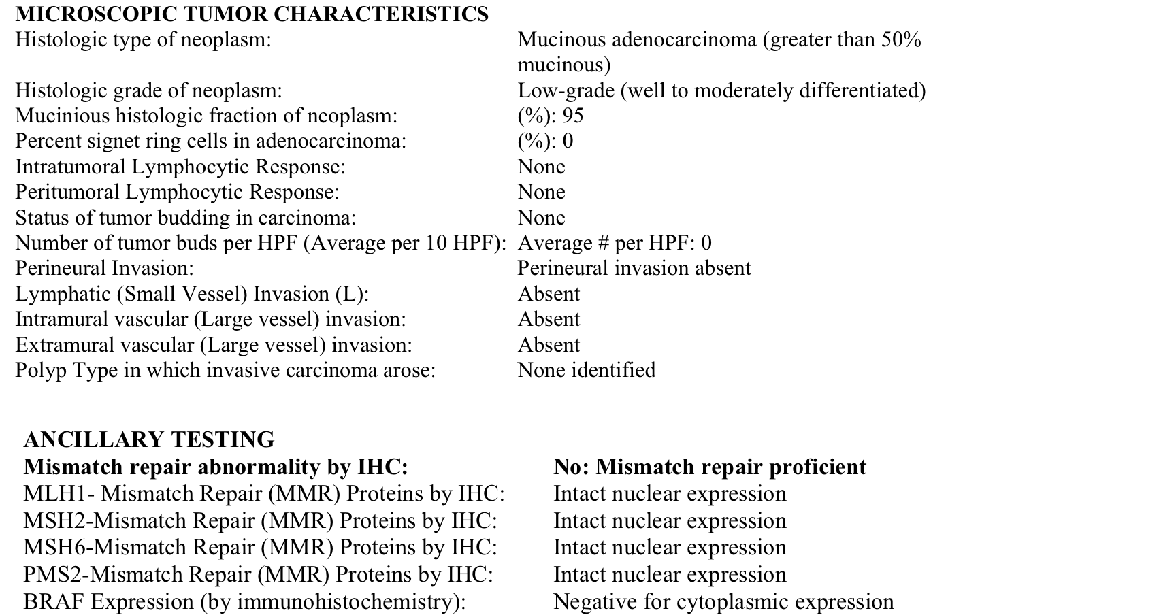
Resultant Report (w/ IHC)
(Fully human and machine readable)

Slide 17
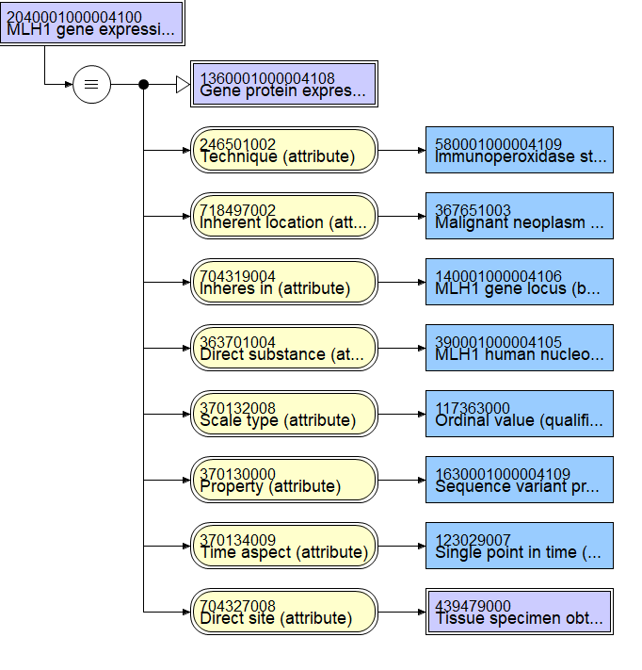
SNOMED CT –
MLH1 gene expression by immunoperoxidase staining of excised malignant neoplasm

Slide 18
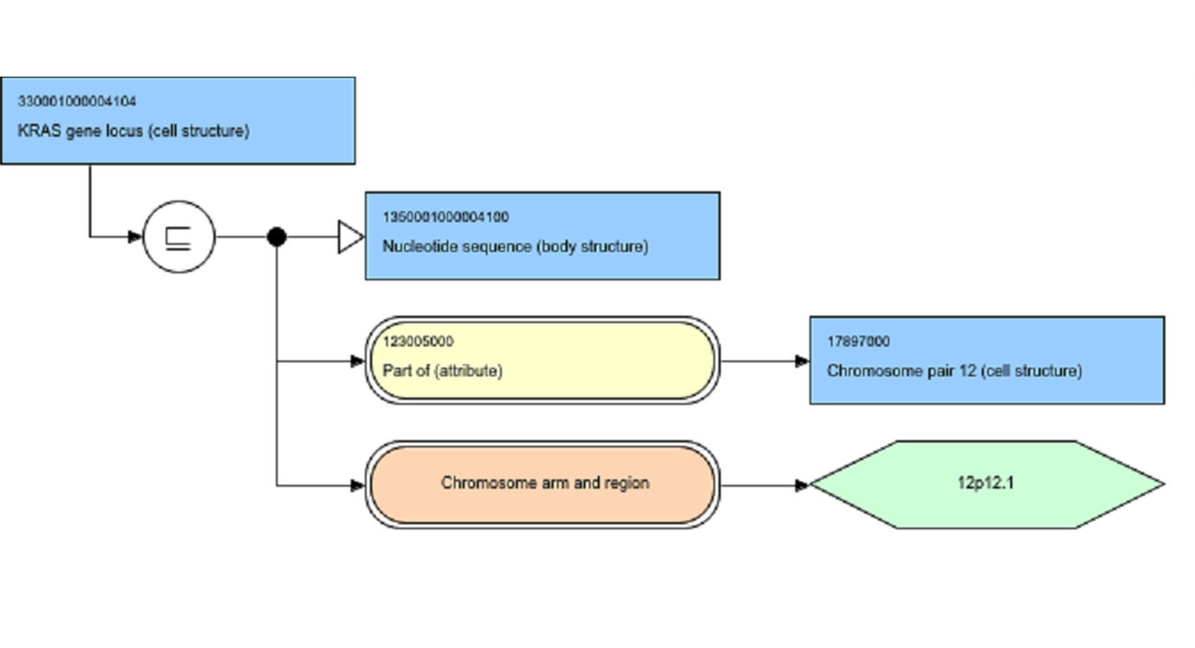
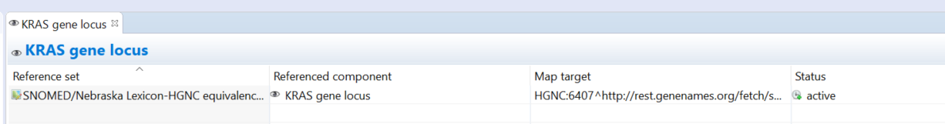
What is a gene?

Slide 19
What to do with Genomics Data?
Technical Desiderata for integration of genomic data into the EHR
1. Maintain separation of primary molecular observations from the clinical interpretations of those data
2. Support lossless compression from primary molecular observations to clinically manageable subsets
3. Maintain linkage of molecular observations to the laboratory methods used to generate them
4. Support compact representation of clinically actionable subsets for optimal performance
5. Simultaneously support human viewable formats and machine readable formats in order to facilitate implementation of decision support rules
6. Anticipate fundamental changes in the understanding of human molecular variation
7. Support both individual clinical care and discovery science
1. Masys DR, Jarvik GP, Abernethy NF, Anderson NR, Papanicolaou GJ, Paltoo DN, et al. Technical desiderata for the integration of genomic data into Electronic Health Records. J Biomed Inform. 2012 Jun;45(3):419-22.

Slide 20
Molecular Pathology Data Flow
Data Generation
Data Analysis
Data Use and Storage
Specimen
Pathologist Assessment
Final Report
Sequencing
Raw Data
BAM files
VCF files
Tissue type
Tumor %
Gene ID’s
Reference Gene
Knowledge bases
EHR

Slide 21
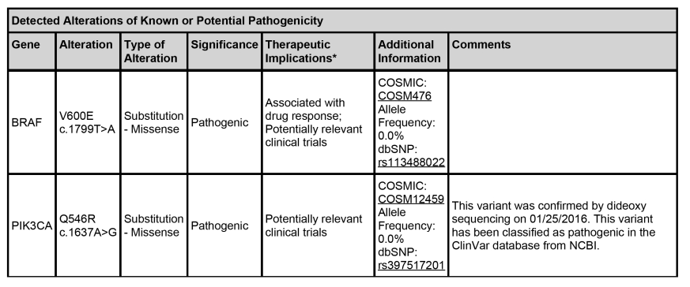
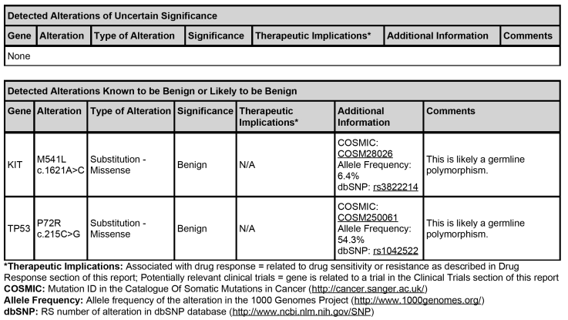
Sample Molecular pathology report – VERY truncated

Slide 22
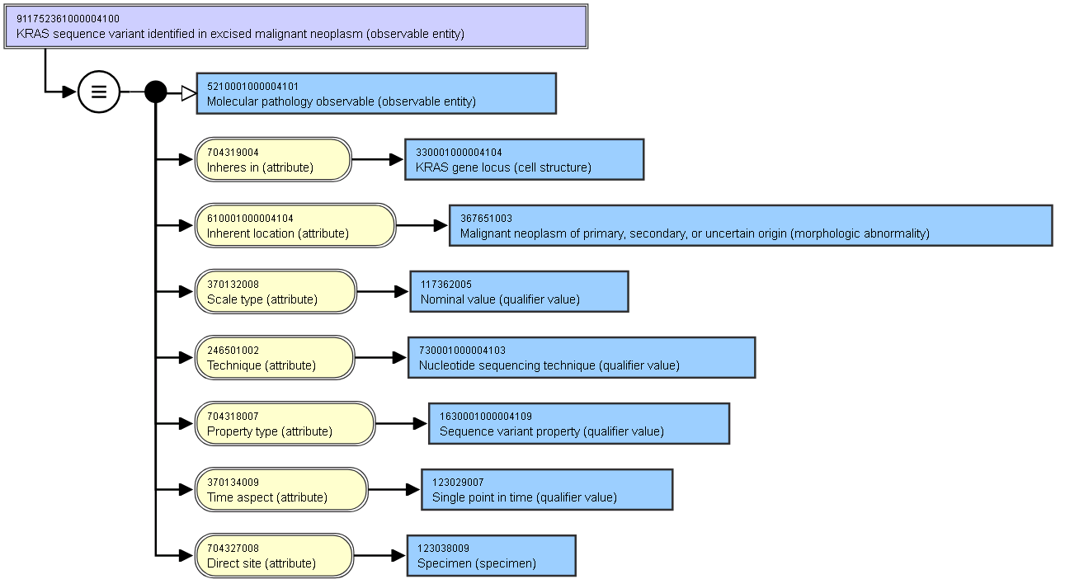
Terminology Approach
KRAS Variant Detected

Slide 23
Variant Call Format
#CHROM POS ID REF ALT QUAL FILTER INFO FORMAT NORMAL TUMOR
20 14370 rs6054257 G A 29 PASS NS=3;DP=14;AF=0.5;DB;H2 GT:GQ:DP:HQ 0|0:48:1:51,51 1|0:48:8:51,51
20 17330 . T A 3 q10 NS=3;DP=11;AF=0.017 GT:GQ:DP:HQ 0|0:49:3:58,50 0|1:3:5:65,3
20 1110696 rs6040355 A G,T 67 PASS NS=2;DP=10;AF=0.333,0.667;DB GT:GQ:DP:HQ 1|2:21:6:23,27 2|1:2:0:18,2
20 1230237 . T . 47 PASS NS=3;DP=13;AA=T GT:GQ:DP:HQ 0|0:54:7:56,60 0|0:48:4:51,51
20 1234567 microsat1 GTC G,GTCTC 50 PASS NS=3;DP=9;AA=G GT:GQ:DP 0/1:35:4 0/2:17:2
Important data
Essential data for EHR?
Discrete and computable
Contains data that has limited value outside the context of the initial report
Difficult to import and manage within EHR structures
TOO COMPLICATED FOR EHR – Need something simple

Slide 24
Human Genome Variation Society Representation
Human Genome Variation Society (HGVS)
  Standardized nomenclature for variants
  Includes nomenclature for normal sequences
Examples:
BRAF V600E: NM_004333.4:c.1799T>A(p.Val600Glu)
BRAF normal: NM_004333.4:c.(=)
Coding change
Amino Acid change
Accession.version
No coding change

Slide 25
HGVS in EHR and Biobank
HGVS representation of genetic information in EHR is tractable
Data is a structured string
  Easily accommodated in EHR
  Data easily queried by regular expression
Maintain links to curated gene knowledge bases
  Standardized representation
  Used by reference databases, knowledge bases
Applicable to targeted gene sequencing and whole genome sequencing
Retains clinically relevant and actionable information
Can be readily moved via HL7

Slide 26
Genomic Data Flow and Store
Data Generation
Data Analysis
Data Use and Storage
Raw Data
BAM files
VCF files
Tissue type
Tumor %
Gene ID’s
Reference Gene
Final Report (pdf)
Pathologist Assessment
EHR
Final Report (HL7)
VCF data (reported and not reported) in VCF and HGVS form in biorepository
Report (pdf) and HGVS data stored in EHR
Raw data stored in original form for research at point of creation
Biobank

Slide 27
Genomic Data Flow Example
Data Analysis
Data Use and Storage
Pathologist sign-out is the trigger event
PDF report sent per usual practice
HL7 version 2.5.1 message sent to biobank and EHR, simultaneously
Pathologist Assessment
Final Report (pdf)
EHR
Final Report (HL7)
Biobank
HL7 Message Sent
MSH|^~\&|GenomOncology Workbench|UNMC|Mirth|UNMC|||ORU^R01^ORU_R01|77801|P|2.5.1|
PID|1||12345||Doe^Jane^||19850206|F
ORC|1||G17-xxx||CM||^^^^
OBR|1||G17-xxx|55232-3^Genetic analysis summary panel^LN|||
OBX|1|FT|51969-4^Genetic analysis summary report^LN||<p>For this specific specimen there was 200X coverage for the following regions,
therefore low frequency variants in these regions may not be identified: three amplicons of CEBPA exon1, CUX1 exons 1, 19, and 23, and STAG2 exon 7.
Only clinical trials that pertain to genes with identified somatic mutations are reported.
OBR|2||G17-xxx|55207-5^Genetic analysis discrete result panel^LN||||||||||||^Bruce Willis, MD
OBX|1|CWE|911752541000004109^TP53 sequence variant identified in excised malignant neoplasm (observable entity)^SCT|1|TP53 NP_000537.3:R175H NM_000546.5:c.524G>A^TP53 R175H|||Pathogenic|||F
OBX|2|CWE|911752871000004102^ASXL1 sequence variant identified in excised malignant neoplasm (observable entity)^SCT|1|ASXL1 NP_056153.2:N986S NM_015338.5:c.2957A>G^ASXL1 N986S|||Likely Benign|||F
OBX|3|CWE|911752061000004102^ABL1 sequence variant identified in excised malignant neoplasm (observable entity)^SCT|1|ABL1 NM_005157.4:c.(=)|||Normal|||F
OBX|4|CWE|911752881000004104^ATRX sequence variant identified in excised malignant neoplasm (observable entity)^SCT|1|ATRX NM_000489.3:c.(=)|||Normal|||F
OBX|5|CWE|911752891000004101^BCOR sequence variant identified in excised malignant neoplasm (observable entity)^SCT|1|BCOR NM_001123385.1:c.(=)|||Normal|||F
OBX|6|CWE|911752901000004102^BCORL1 sequence variant identified in excised malignant neoplasm (observable entity)^SCT|1|BCORL1 NM_021946.4:c.(=)|||Normal|||F
OBX|7|CWE|911752111000004101^BRAF sequence variant identified in excised malignant neoplasm (observable entity)^SCT|1|BRAF NM_004333.4:c.(=)|||Normal|||F

Slide 28
Sample intramural HL7 message
OBX|1|CWE|911752541000004109^TP53 sequence variant identified in excised malignant neoplasm (observable entity)^SCT|1|
TP53 NP_000537.3:R175H NM_000546.5:c.524G>A^TP53 R175H|||Pathogenic|||F
OBX|2|CWE|911752111000004101^BRAF sequence variant identified in excised malignant neoplasm (observable entity)^SCT|1|
BRAF NM_004333.4:c.(=)|||Normal|||F
OBX|3|CWE|911752871000004102^ASXL1 sequence variant identified in excised malignant neoplasm (observable entity)^SCT|1|ASXL1 NP_056153.2:N986S NM_015338.5:c.2957A>G^ASXL1 N986S||
|Likely Benign|||F
Question
Answer
Pathogenicity

Slide 29
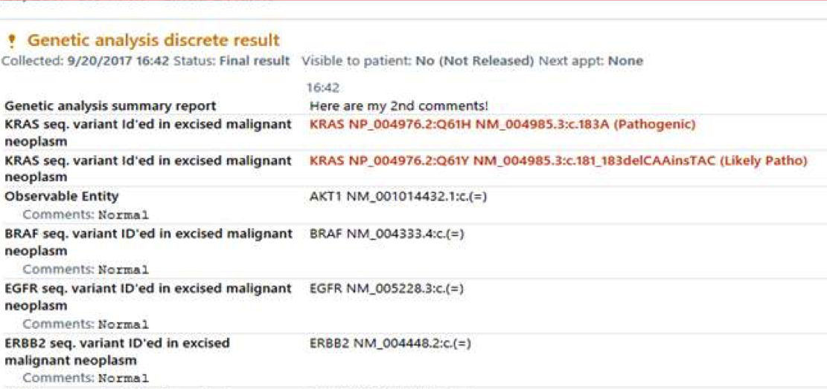
EPIC Clinician View
© Epic Computer Systems. Used with permission.
© Nebraska Lexicon (SNOMED CT extension)

Slide 30
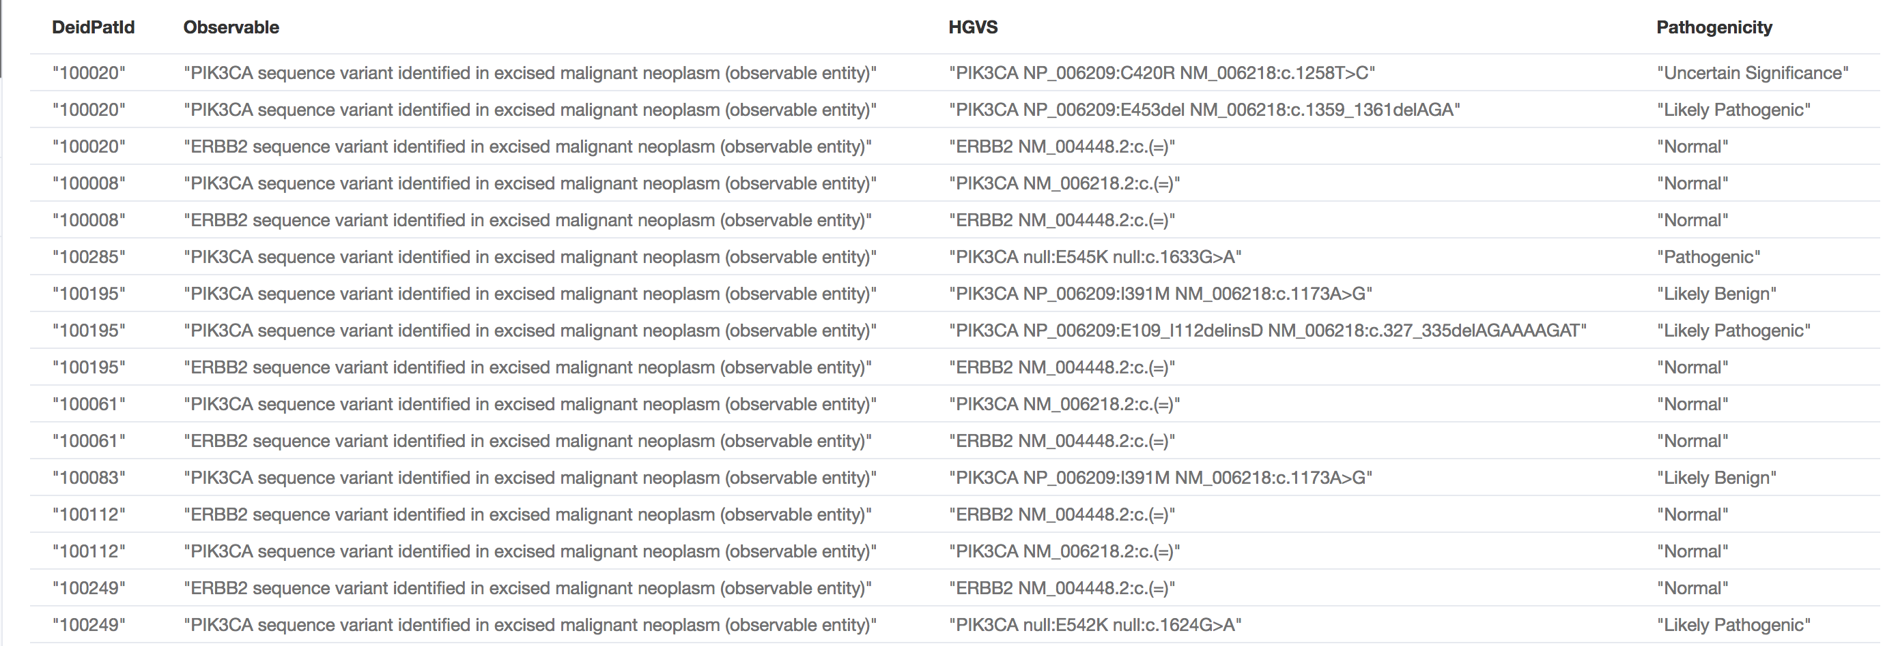
Patient Care Use
Find all patients with colorectal cancer AND a mutation in the PIK3CA locus and/or the ERBB2 gene locus.
Aspirin therapy shown to be beneficial

Slide 31
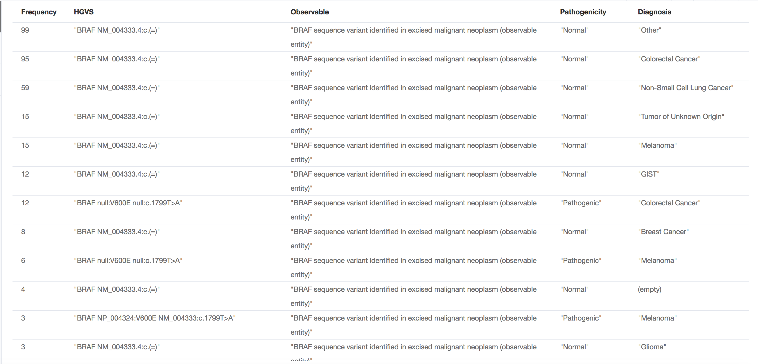
Quality
Frequency of BRAF mutations by disorder

Slide 32
Primary Data – Bridge the Gap
Translational Junction
Bedside
Bench
Patients
Phenotypes
Outcomes
Intervention
Experiment
Hypothesis
Anatomic Pathology data
IHC data –> HGNC/Uniprot links
Sequence data –> HGNC links
Anatomic Pathology data
HGNC/Uniprot links -> NCBI, etc
HGNC links -> NCBI, COMSIC, …

Slide 33


Slide 34
References
1. Campbell WS, Carter AB, Cushman-Vokoun AM, Greiner TC, Dash RC, Routbort M, et al. A Model Information Management Plan for Molecular Pathology Sequence Data Using Standards: From Sequencer to Electronic Health Record. J Mol Diagn. 2019 Feb 20.
2. Campbell WS, Karlsson D, Vreeman DJ, Lazenby AJ, Talmon GA, Campbell JR. A computable pathology report for precision medicine: extending an observables ontology unifying SNOMED CT and LOINC. J Am Med Inform Assoc. 2017 Sep 13.
Questions

