Slide 1

“SNOMED CT, Genomics and global standards”
Ian Green [Date]

Slide 2
Current situation and requirements
Current situation and requirements
Use cases
Working together – GA4GH/HL7/SNOMED International
Bringing together clinical and genomics data
Next steps
The future view

Slide 3
Current situation
Lack of interoperability between EHR and Genomics researchers
Genomics terminologies only utilized within the Genomics research world
Clinical terminologies not used by the Genomics research world
Genomic researchers reliant on summary classification data
Useful clinical information is available with EHR’s, that cannot be
Accessed by Genomics researchers
No agreed exchange format for clinical Genomic information, that has unique
requirements
Dispersed global Genomics research community

Slide 4
Current landscape
Genomic data refers to the genome and DNA data of an organism.
Genomic research brings together Genomic data with clinical data, in the form of phenotypes
A "phenotype" refers to the observable physical properties of an individual
Current developments rely on taking the enormous amount of genomic data, and analyzing it together with phenotypic data to inform future clinical practice, in the form of precision (personalized) medicine
Precision (personalized) medicine will allow individuals to receive the optimal treatment for their condition

Slide 5
Standards
Electronic Health Record (EHR)
GENOMJCS RESEARCH COMMUNITY
SNOMED CT
LOINC
HL7
ICD-10
ICD-10CM
MedDRA
RxNorm
. . . and numerous others
Human Phenotype Ontology (HPO)
Online Mendelian Inheritance in Man (OMIM)
Orphanet
Clinical Data Interchange Standards Consortium (CDISC)
VCF (Variant Call File)
. . . and numerous others

Slide 6
Use case .1.
Supporting the genomics research community’s need to access clinical information from the EHR
  Genomics research requires granular details of clinical diagnoses and findings from EHR, to assist in research activities
  An agreed exchange format is required that supports the level of granularity required of the data, the need for consistency, and the need to share data across the global genomics research community
  Genomics researchers use specific terminologies which have been developed to meet their needs, these are not in use within EHR’s, nor would they meet the requirements of EHR systems

Slide 7
Use case .2.
Precision medicine
  To deliver precision medicine into clinical practice requires the genomics research community to specify pathways of care that can be implemented within EHR systems
  Pathways will need to be implemented in an automated fashion to support uptake and accuracy of usage
  Pathways will need to be implemented in an automated manner using clinical decision support systems, that are driven by international terminology standards

Slide 8

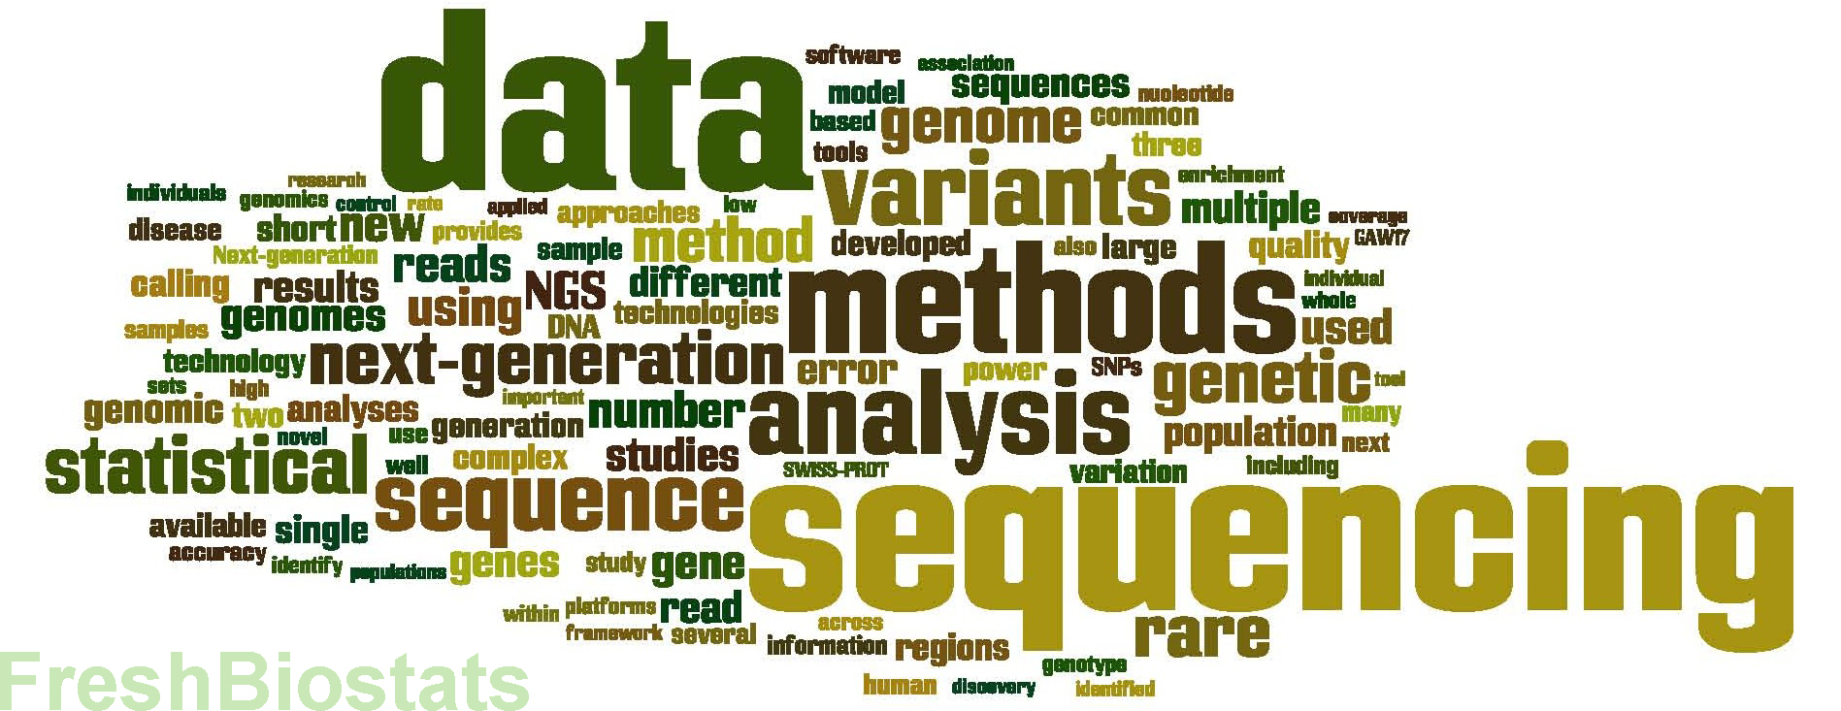
Required solutions
Must support interoperability across the EHR/genomic research boundary
Must support the sharing of data within global Genomics research community
Must provide specification of information standards that support new use cases
Multiple standards must be specified in a way that supports the integration of standards within existing structures and processes, in both the EHR and Genomic communities
Standards bundle that leverage the strengths of individual existing standards, and package them for ease of implementation

Slide 9
A vision of future process flows
EHR
Clinical phenotype data
Treatment algorithms
GENOMICS
Research
community
“Personalized
Medicine”

Slide 10
Personalized medicine
Understanding each individual’s genome – foundation of precision medicine
Precision medicine uses individuals genetic data to identify optimum treatments
Medicine is not, and should not be a “one-size” fits all
Using genomic data, with other medical data, can provide a individual “personalized” view of treatment options
The goal is to identify the optimum treatment of an individual’s illness.

Slide 11

ISO TC215
Why ?
  Genomics/omics is rapidly growing field
  Rapid advances in next generation DNA sequencing (NGS) technologies are driving major developments in clinical practice and medical research
  Effective use involves the capture, processing and analysis of massive amounts of data
  Requires uniform approaches to clinical presentation and reporting of genomic information and its interpretation, and to assess the quality of the associated testing methods and information repositories
  Multiple standards organisations involved
  Community requires a cohesive response to the specification of international standards
  TC215 Health Informatics – established ISO group, with a number of focused sub-groups

Slide 12
ISO TC215
Title
  Genomics Informatics
  (sub group of ISO TC 215
Scope
  Standardization of computable data, metadata, information, and representation of knowledge for the application of omics, including but not limited to genomics, transcriptomics and proteomics, to support human health and clinical research.
ISO groups
  ISO/TC 034/SC 09/WG 25
  ISO/TC 276
  ISO/IEC/JTC1 SC29 WG11
  GA4GH
  HL7 Clinical Genomics
  SNOMED International
  CDISC
  LOINC

Slide 13

Global Alliance for Genomics and Health (GA4GH)
GA4GH Aims
The Global Alliance for Genomics and Health (GA4GH) is an international, nonprofit alliance formed in 2013 to accelerate the potential of research and medicine to advance human health. Bringing together 500+ leading organizations working in healthcare, research, patient advocacy, life science, and information technology, the GA4GH community is working together to create frameworks and standards to enable the responsible, voluntary, and secure sharing of genomic and health-related data. All of our work builds upon the Framework for Responsible Sharing of Genomic and Health-Related Data.

Slide 14
Global Alliance for Genomics and Health (GA4GH)
Aims of collaboration activities
To provide interoperable complete solutions for implementers
To provide cross standards expertise to advise on developments
To provide standards specifications that are aligned, and packaged to support implementation
To engage early with standards communities, to inform the development of standards specifications

Slide 15
Global Alliance for Genomics and Health (GA4GH)
Foundational and Technical Work Streams
GA4GH Foundational and Technical Work Streams develop standards and tools that are designed to overcome technical and regulatory hurdles to international genomic data-sharing
Data Security
Regulatory & Ethics
Clinical & Phenotypic Data Capture
Cloud
Data Use & Researcher Identities (DURI)
Discovery
Genomic Knowledge Standards
Large Scale Genomics

Slide 16
GA4GH Clinical & Phenotypic Data Capture & Exchange
Sub-group 2: Data Exchange / Interoperability
Original developments undertaken by Melissa Haendel, Peter Robinson, Chris Mungall
  Work Stream Leads:
  Melissa Haendel (Monarch)
  David Hansen (CSIRO / AGHA)
  Sub-group leads:
  Michael Baudis (University of Zurich)
  Grant Wood (Intermountain Health Care Clinical Genetics Institute)
  Alejandro Metke (CSIRO / AGHA)
  Jules Jacobsen (QMUL / Monarch)

Slide 17
GA4GH Genomic Knowledge Standards (GKS)
Goal: Develop a framework of standards-based components that lower barriers for the exchange of genomic information and its translation into clinical practice
Work Stream Leads:
Andy Yates (EBI)
Robert Freimuth (Mayo Clinic)
Variant Representation subgroup:
Larry Babb (Broad)
Michael Baudis (Univ Zurich)
Variant Annotation subgroup:
Matt Brush (OHSU)
Javier Lopez (Genomics England)

Slide 18

HL7
Founded in 1987, Health Level Seven International (HL7) is a not-for-profit, ANSI-accredited standards developing organization dedicated to providing a comprehensive framework and related standards for the exchange, integration, sharing and retrieval of electronic health information that supports clinical practice and the management, delivery and evaluation of health services.
Produce a set of international standards for transfer of clinical and administrative data between software applications used by various healthcare providers

Slide 19
HL7 Clinical Genomics (CG)
Goal: Develop standards for the exchange of clinical and translational information related to an individual’s genomic data and family health history, and (its linkage to) relevant clinical information
Bob Milius (National Marrow Donor Program)
Kevin Power (Cerner)
Robert Freimuth (Mayo Clinic)
Gil Alterovitz (Boston Children’s Hospital)

Slide 20
Genomics and Precision Medicine Clinical Reference Group (CRG)
Established to ensure that the requirements of Genomics and Precision Medicine are incorporated into the content of SNOMED CT International Release by providing a forum for discussion, and also to support the development of derivative products that will support implementations focused on using SNOMED CT for Genomics and Precision Medicine purposes.
SNOMED International has published its commitment to moving forwards with Genomics and Precision Medicine through its "SNOMED CT and Genomics Medicine” by publication of a strategy for “SNOMED CT and genomics”
Main commitments within the strategy are:
Build links between SNOMED CT and genomic terminologies
Develop pilot sites to explore SNOMED CT usage and provide recommendations for future developments

Slide 21
Terminology developments
Review of exisiting terminologies to assess the strengths and weaknesses of each one
Acceptance that a single terminology solution is neither desirable or realistic
Formal collaboration between terminology standards across the Genomics and EHR boundary
Development of subsets of content that can be used in information exchange specifications to support consistent data representation

Slide 22
Terminology interoperability
“Acceptance that a single terminology solution is neither desirable or realistic”
Requirement to view data in a format dictated by the users, dependent on their individual requirements
The ability to easily transfer between different views of the data using different terminology specifications
Provide computable and quality assured linkages between terminology standards

Slide 23
Exchange standards
To provide a standard for the transmission of data between clinical and genomic settings, and also to support the transfer of data between genomics organizations
Specification should provide a standard way of recording Genomics information, specifically phenotypic data, supports transfer and data usage
Leverage work currently in progress – Genomic Knowledge Standards
HL7 Genomics Working Group (HL7 Domain Analysis Model – Clinical Sequencing)
GA4GH Clinical & Phenotypic Data Capture working group

Slide 24
FHIR message development
While ontologies and terminologies provide the standard data concept definitions for capturing clinical information, an information model is required to successfully exchange that information between clinical information systems and with related information systems
The standard will provide information models with different levels of complexity to enable high level clinical phenotype information as well as deep clinical phenotype information to be exchanged
Leveraging the strengths and flexibility of the FHIR specification, to develop FHIR resources specification specific to the requirements of recording and communicating phenotype information
Development of example specifications based on specified use cases
Identification of driver projects to validate proposed FHIR specifications to ensure they are fit for purpose

Slide 25
Phenopackets
“Phenopacket” is a collection of data types focused on the representation of rare disease and cancer samples for both initial capture and analysis
Identification of use cases to engage in trial the use of “Phenopackets” to exchange clinical information between systems, and also for Genomics researchers to use in the analysis and “Discovery” processes
Identify and engage with Genomics research community organizations
Production of implementation guidance to support the implementation of FHIR resources and Phenopackets

Slide 26



Standard exchange formats exist for genes … but not for phenotypes
Genetic data
Phenotypes
NEW
GFF
VCF
BED
PXF
“PHENOPACKETS”

Slide 27


Finding the sweet spot between simple and expressive
List
The gap
PHENOPACKETS
CSV
Ease of use
CDEs
Expressivity

Slide 28
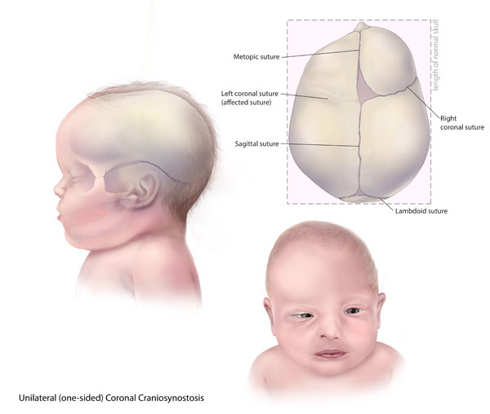
Single term…
Craniosynostosis
HPO:0001363
Craniosynostosis syndrome (disorder)
SCTID: 57219006

Slide 29
List of terms…
Craniosynostosis syndrome
SCTID: 57219006
Craniosynostosis
HPO:0001363
Brachydactyly
HPO:0001156
Brachydactyly
SCTID: 43476002
Proptosis
HPO:0000520
Proptosis
SCTID: 18265008
Broad thumb
HPO:0011304
Broad thumbs
SCTID: 249773003

Slide 30


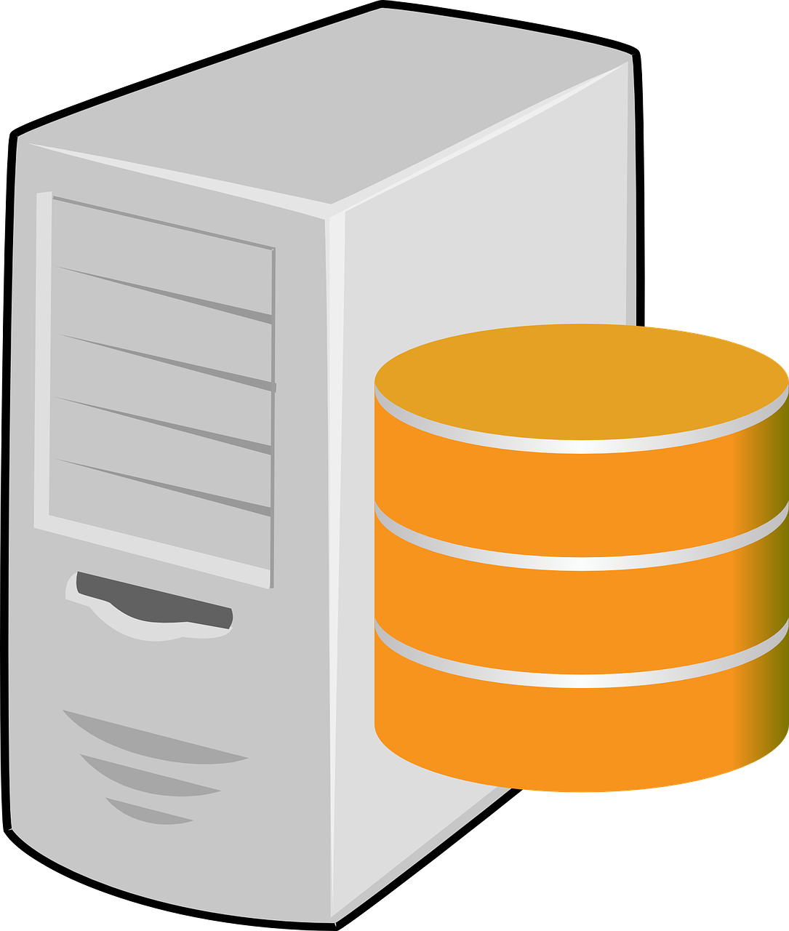


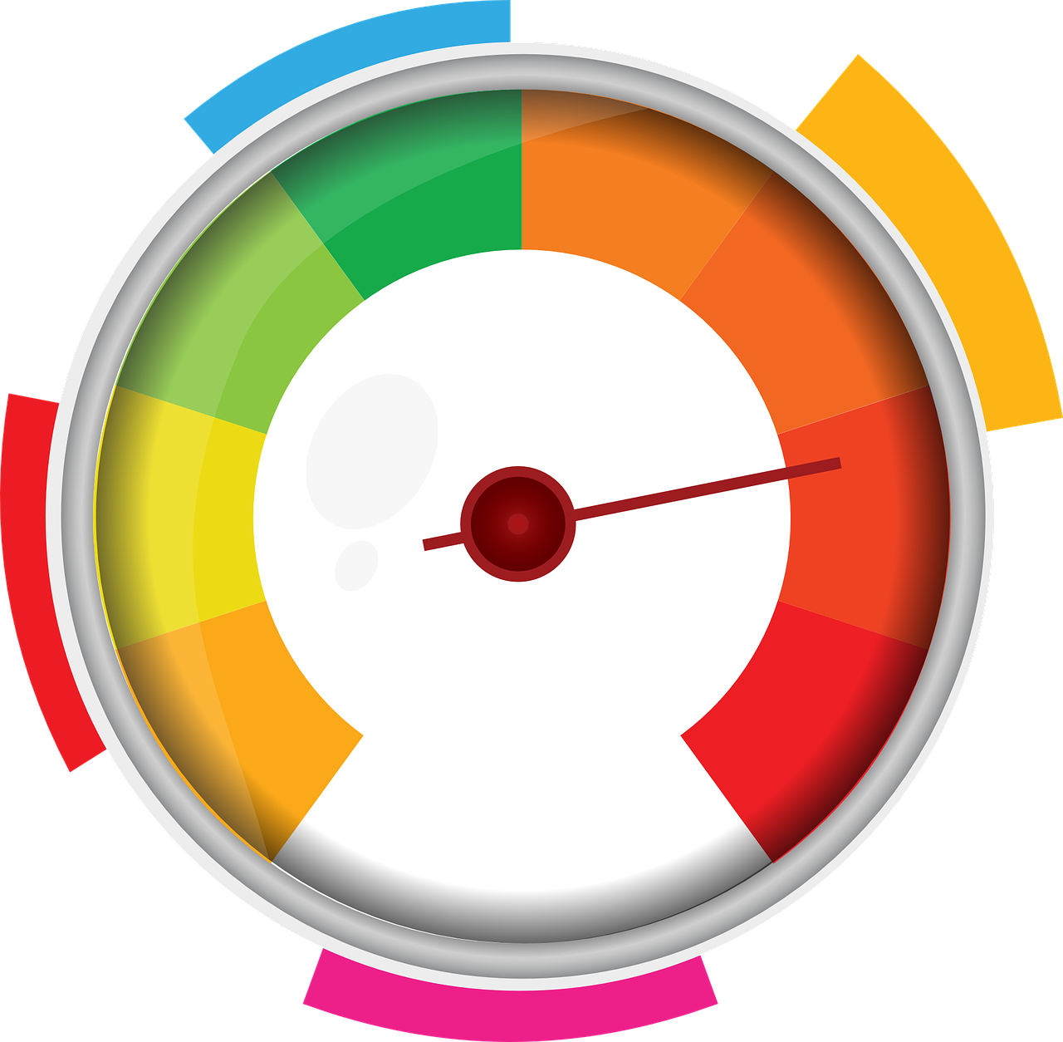
Can we do better?
How are these linked to a patient?
What about the parents and siblings?
Craniosynostosis
Brachydactyly
Proptosis
Broad thumb…
Were they
NOT observed?
How severe
are these?
Are some more severe than others?
When were
they first
observed?

Slide 31

We need structure!
who?
patient:
id: "PROBAND#1"
sex:
id: "PATO:0000384"
label: "male"
phenotypes:
- type:
id: "HP:0000520"
label: “Proptosis"
severity:
id: "HP:0012828"
label: "Severe"
classOfOnset:
id: "HP: 0003577"
label: “Congenital onset"
what?
what?
when?

Slide 32
Phenopacket Implementations
Reference implementation/spec:
  Phenopacket-schema GitHub repo (https://github.com/phenopackets/phenopacket-schema)
Proof of concept applications:
  Exomiser web (Monarch web-app) (bit.ly/phenopacket-app-beta)
  FHIR -> Phenopacket service
  Exomiser service
  SMART on FHIR app
In production systems:
  Biosamples exporting Phenopackets (e.g. https://www.ebi.ac.uk/biosamples/samples/SAMN05324082)

Slide 33
Next steps
Engaging the community
Collecting use case requirements
Development of standards bundles to assist implementation
Collaboration between SDO’s, and clinical and Genomic bodies

Slide 34
Future view
EHR
  Increased terminology content to support recording of detailed Genomic related information
  Automated clinical pathways supporting the implementation of personalized (precision) medicine
  Data transfer available to other organizations available in an automated manner
Genomics researchers
  Access to granular clinical information
  Automated collection of clinical data from EHR’s
  Availability of data, using different terminology standards as required

Slide 35
Future view
EHR
  Increased terminology content to support recording of detailed Genomic related information
  Automated clinical pathways supporting the implementation of personalized (precision) medicine
  Data transfer available to other organizations available in an automated manner
Genomics researchers
  Access to granular clinical information
  Automated collection of clinical data from EHR’s
  Availability of data, using different terminology standards as required

Slide 36


Slide 37

Thank
you!
Please contact: Ian Green – igr@snomed.org for further information.
37

