Slide 1

Genomics informatics interoperability standards supporting precision medicine across health IT systems
Ben McAlister
Sr Solution Strategist, Interoperability Strategy, Europe
Notes:
Name, Role, Cerner a Vendor of Health IT systems, how I came to be here, bit of background, 12 years Cerner, Medicine, Manchester, Alan Rector, Andy Brass,

Slide 2
"We believe that genomic data and the genomic aspects of precision medicine should be incorporated into the routine clinical workflow in as seamless and transparent a fashion as possible."
David McCallie Jr., Cerner Senior Vice President of Medical Informatics
genomeweb, Cerner Banking on Third-Party Apps for Genomic Integration, Starting with PGx, 28th Dec 2018
Notes:
Start with quote from recent article in genome web by David McCallie, VP of Medical Informatics, just recently retired last week
Key part is that no party can solve alone, not looking to store data on the EHR, looking to integrate

Slide 3
Introduction
Roles
Associate Vice Chair for Standards, BCS Health and Care Group
BCS representative, BSI IST/35 Health Informatics Committee
Member at Large, HL7 UK Management Board
Member, IHE UK Steering Committee
Vendor representative, INTEROPen Board
Notes:
Bit of background of external roles explaining organisations and ISO Genomics Informatics Subcommittee proposal

Slide 4
Introduction
Agenda
Health IT vendor perspective
Standards landscape
Challenges and possible ways forward
Notes:
Here as much to learn as to share, preparing has been a useful exercise

Slide 5

Health IT vendor perspective
Notes:
SECTION SLIDE: Right-click image to replace.
**Slide not built in master slides due to the ability to swap out images.

Slide 6
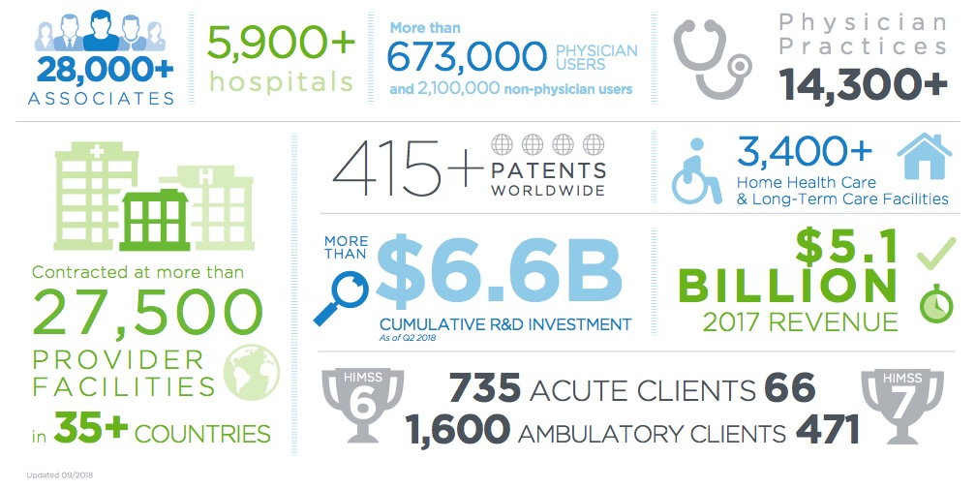
Health IT vendor perspective
Cerner overview
Notes:
Basic one column slide.
This slide can also be used as a NASCAR SLIDE, where we want to show multiple partner/client logo or the like.

Slide 7











Health IT vendor perspective
Solution portfolio
Services
ITWorksSM
RevWorksSM
HealtheIntent ®
Big data platform
Future state
Cloud-enabled
Continuous deployment
Open
Interoperable
Collaborative
Millennium ®
EHR
CareAware®
Device connectivity
3 PLATFORMS • 1 ARCHITECTURE • 1 EXPERIENCE
Enable high performance organization • Lower total cost of ownership • Data liquidity
Provider
Employer
Consumer
Health plan
Government
Notes:
Basic one column slide.
This slide can also be used as a NASCAR SLIDE, where we want to show multiple partner/client logo or the like.

Slide 8





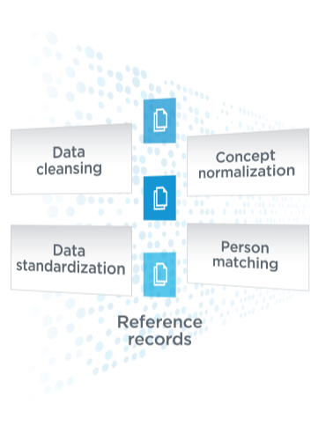


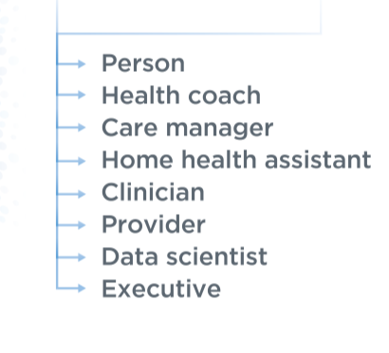
Health IT vendor perspective
HealtheIntent
Notes:
Basic one column slide.
This slide can also be used as a NASCAR SLIDE, where we want to show multiple partner/client logo or the like.

Slide 9

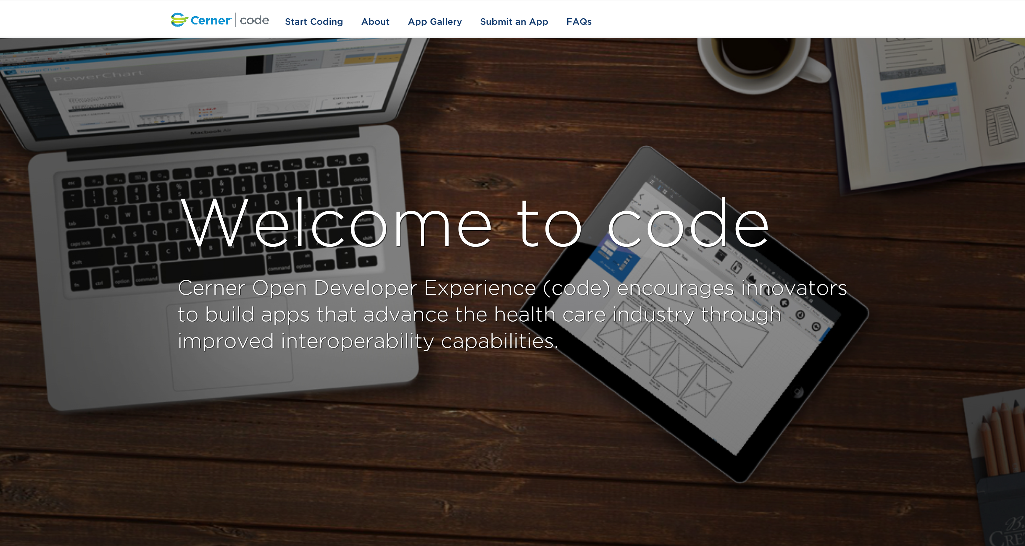
Health IT vendor perspective
Open Platforms
Cerner Open Developer Experience (code)
  https://code.cerner.com/
Open APIs - Ignite
  EHR
    https://fhir.cerner.com/
  Population Health
    https://docs.healtheintent.com/
Notes:
Basic one column slide.
This slide can also be used as a NASCAR SLIDE, where we want to show multiple partner/client logo or the like.

Slide 10
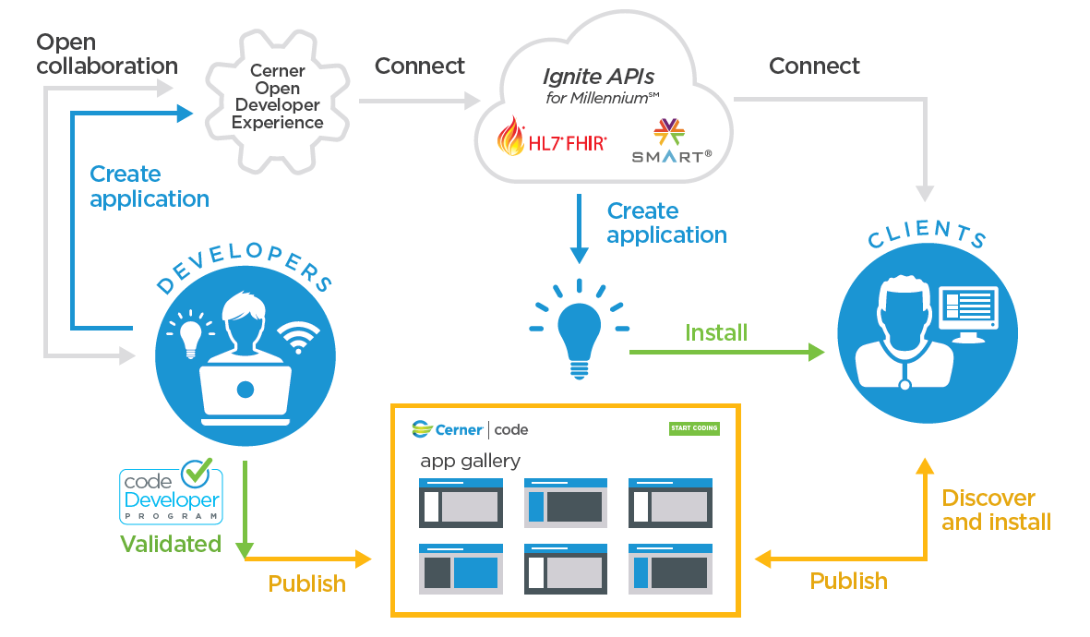

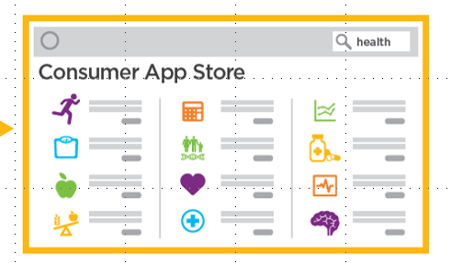

Health IT vendor perspective
Open Platforms
Notes:
Basic one column slide.
This slide can also be used as a NASCAR SLIDE, where we want to show multiple partner/client logo or the like.

Slide 11
Health IT vendor perspective
Discern Ontology
Concept normalisation for population health and EHR FHIR API concept mapping
Supports rules engine that drives registries
https://docs.healtheintent.com/api/v1/ontology/
Notes:
Basic one column slide.
This slide can also be used as a NASCAR SLIDE, where we want to show multiple partner/client logo or the like.

Slide 12
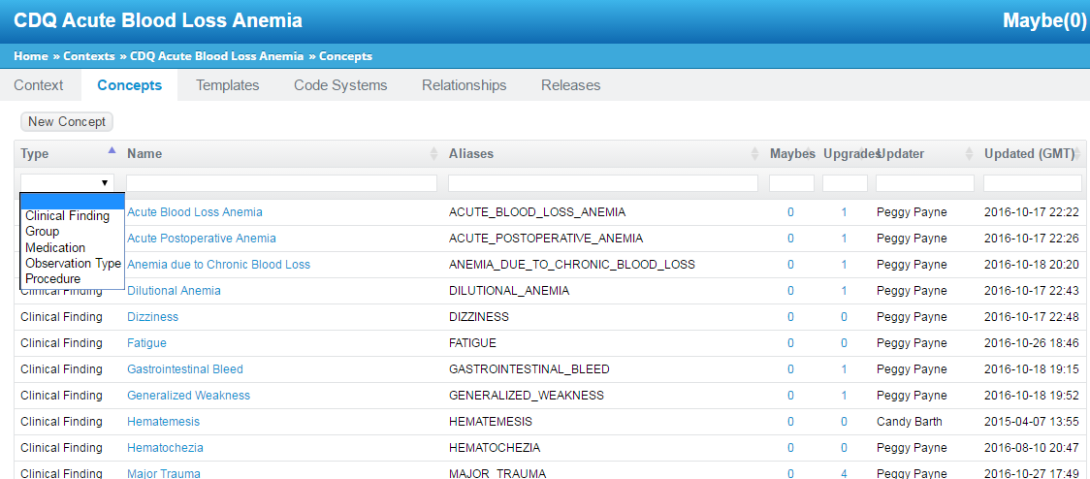
Health IT vendor perspective
Discern Ontology
Notes:
Basic one column slide.
This slide can also be used as a NASCAR SLIDE, where we want to show multiple partner/client logo or the like.

Slide 13
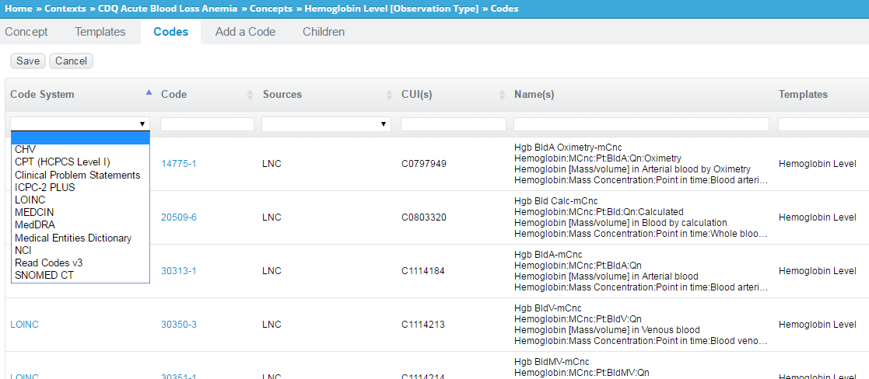
Health IT vendor perspective
Discern Ontology
Notes:
Basic one column slide.
This slide can also be used as a NASCAR SLIDE, where we want to show multiple partner/client logo or the like.

Slide 14
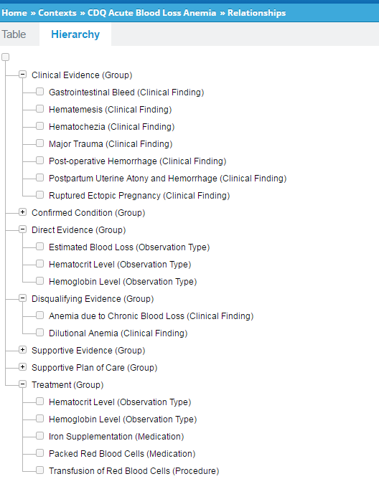
Health IT vendor perspective
Discern Ontology
Symptoms
Observations
Treatments
Notes:
Basic one column slide.
This slide can also be used as a NASCAR SLIDE, where we want to show multiple partner/client logo or the like.

Slide 15
Health IT vendor perspective
Cerner Associates driving Genomics
Kevin Power, Director of Genomics Solutions and Co-Chair on the HL7 Clinical Genomics Work Group
Terah Collins, Senior Strategist for Precision Medicine and Genomics
Marc Overhage, Chief Medical Informatics Officer & VP Intelligence Strategy
Notes:
Basic one column slide.
This slide can also be used as a NASCAR SLIDE, where we want to show multiple partner/client logo or the like.

Slide 16
Health IT vendor perspective
Precision Medicine
EHR
Consumer
LIMS
Population Health
Research
Notes:
Basic one column slide.
This slide can also be used as a NASCAR SLIDE, where we want to show multiple partner/client logo or the like.

Slide 17
Health IT vendor perspective
Precision Medicine
Pharmacogenomics
  Oncology
  Cardiovascular
  Mental Health
  Pain Management
Oncology
  Somatic sequencing
Newborn screening
Rare and undiagnosed disease
Notes:
Basic one column slide.
This slide can also be used as a NASCAR SLIDE, where we want to show multiple partner/client logo or the like.

Slide 18
Health IT vendor perspective
EHR
Millennium
  Model Experience -> Precision Medcine -> Pharmacogenomics
    Decision Support Rules
      High Risk Genotype
      Drug-metabolizing enzymes
      Transporters
  Ignite API for Millennium
    YouScript
      https://code.cerner.com/en/apps/youscript
    MyLegacy by Family Care Path
      https://code.cerner.com/apps/mylegacy
Notes:
Localization
The reference build on the website demonstrates what is included in Model Experience and deemed standard. Unique localization steps exist that you must complete to have a functioning system. See the local configurations below.
Discern rules are set to expired, and must be activated and customized for your organization. The following rules area available for customization:
Discern Rule:
Phenotype:
PGX_ABACAVIR_HLAB5701High risk genotype
PGX_CODEINE_CYP2D6 Drug-metabolizing enzymes
PGX_SIMVASTATIN_SCLO1B1Transporters
Phenotips (clarify if ok to mention)

Slide 19
Health IT vendor perspective
Consumer
Millennium
  Ignite API for Millennium
    Apple Health
      https://code.cerner.com/apps/apple-health
    MyLegacy by Family Care Path
      https://code.cerner.com/apps/mylegacy
  HealtheLife, Patient Portal
    https://fhir.cerner.com/smart/#healthelife
CommonWell Members Enable Patient Access to Their Health Data
All of Us Research Program to Test Options for Returning Results
Notes:
Localization
The reference build on the website demonstrates what is included in Model Experience and deemed standard. Unique localization steps exist that you must complete to have a functioning system. See the local configurations below.
Discern rules are set to expired, and must be activated and customized for your organization. The following rules area available for customization:
Discern Rule:
Phenotype:
PGX_ABACAVIR_HLAB5701High risk genotype
PGX_CODEINE_CYP2D6 Drug-metabolizing enzymes
PGX_SIMVASTATIN_SCLO1B1Transporters
Phenotips (clarify if ok to mention)

Slide 20
Health IT vendor perspective
LIMS
LabSequence
  Workflow engine – Polymerase Chain Reaction (PCR), Microarray, Multiplex Ligation-dependent Probe Amplification (MLPA), Next Generation Sequencing (NGS) etc
  API available for customising and integrating with devices and software
Notes:
Polymerase chain reaction

Slide 21
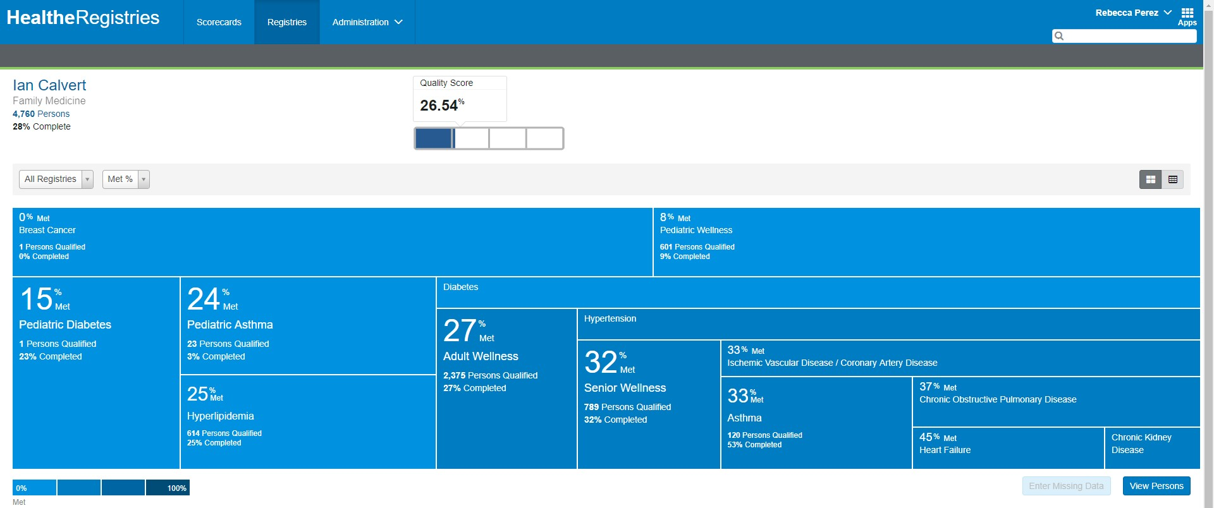
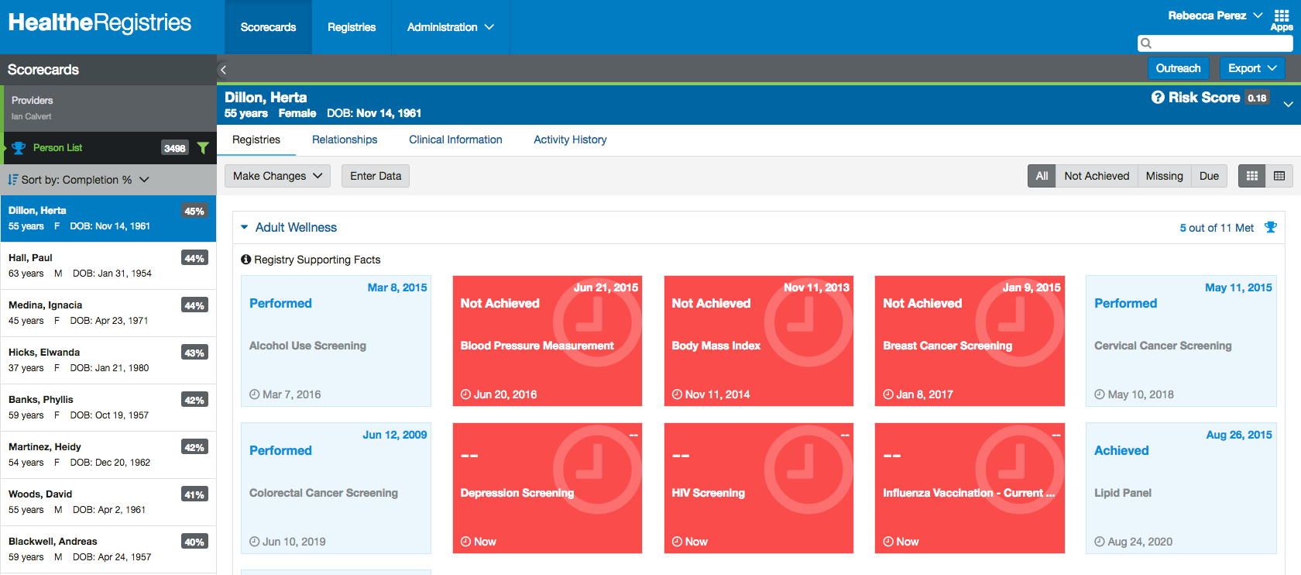
Health IT vendor perspective
Population Health
HealtheIntent
  HealtheRegistries
    Synapse (Drools and Clojure)
Notes:
Basic one column slide.
This slide can also be used as a NASCAR SLIDE, where we want to show multiple partner/client logo or the like.

Slide 22






















Health IT vendor perspective
Research
HealtheIntent
  HealtheDatalab
HealtheIntentSM data
Identified
De-identified
De-identified
Outside data
Anonymization or
De-identification
Physical storage
& processing
Role-based access control
User tools
Notes:
Basic one column slide.
This slide can also be used as a NASCAR SLIDE, where we want to show multiple partner/client logo or the like.

Slide 23
Health IT vendor perspective
Client initiatives
The Alliance for Genomics (TAG)
  Pete Celano, Director of Consumer Health Initiatives, MedStar Health, MedStar Institute of Innovation
    https://www.cerner.com/blog/ep-100-future-of-precision-medicine
Notes:
Presenter: Pete Celano
Title: The Alliance for Genomics (TAG)-- All Cerner Systems
Abstract: TAG stands for The Alliance for Genomics. It brings together a set of US healthcare systems that use the Cerner EMR, to share best practices, leverage our collective size especially relating to genetics software we might need, and potentially build a Shared Research Database.
1 year, meet monthly, 30 clients shared research database

Slide 24
Health IT vendor perspective
Client initiatives
The Alliance for Genomics (TAG)
  Presentations to date
    Illumina
    YouScript
    Dignity Health and Catholic Health Initiatives, Precision Medicine Alliance LLC
    Million Veteran Program
    HudsonAlpha institute for Biotechnology
    American Heart Association, Institute for Precision Cardiovascular Medicine
    AWS
    Cerner
      Pharmacogenomics
      HealtheDatalabs
Notes:
The Alliance for Genomics (TAG)-- All Cerner Systems
TAG stands for The Alliance for Genomics. It brings together a set of US healthcare systems that use the Cerner EMR, to share best practices, leverage our collective size especially relating to genetics software we might need, and potentially build a Shared Research Database.

Slide 25
Standards landscape
Notes:
SECTION SLIDE: Right-click image to replace.
**Slide not built in master slides due to the ability to swap out images.

Slide 26
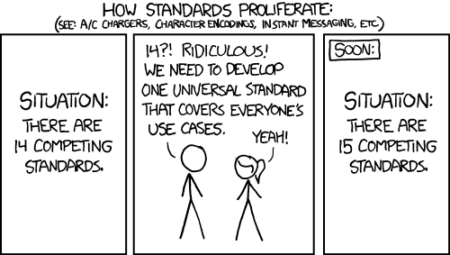
Standards landscape
Notes:
Basic one column slide.
This slide can also be used as a NASCAR SLIDE, where we want to show multiple partner/client logo or the like.

Slide 27
Standards landscape
ISO
ISO/TC 215 N 2776 - Proposal for Subcommittee on "Genomics informatics“
Proposed liaison organisations and survey of similar work
  Other ISO Committees
    ISO/TC 276 Biotechnology
    ISO/IEC JTC 1/SC29 Coding of audio, picture, multimedia and hypermedia information
  Global Alliance for Genomics and Health (GA4GH) and driver projects
  HL7 International Clinical Genomics Working Group
  Clinical Data Interchange Standards Consortium (CDISC)
  SNOMED International
  Regenstrief Logical Observation Identifiers Names and Codes (LOINC)
  National Cancer Institute Enterprise Vocabulary Services NCI Thesaurus
  Massive Analysis and Quality Control (MAQC) Society
Notes:
Basic one column slide.
This slide can also be used as a NASCAR SLIDE, where we want to show multiple partner/client logo or the like.

Slide 28
Standards landscape
ISO
ISO/TC215 SC1 Genomic Informatics proposed initial active programme of work
  ISO/IS 25720:2009 Health Informatics ‐ Genomic sequence variation markup language (GSVML)
  ISO/TS 20428:2017 Health Informatics ‐ Data elements and their metadata for describing structured clinical genomic sequence information in electronic health records
  ISO/CD 21393 Health Informatics ‐ Omics Markup Language (OML) (in development)
  ISO/NP TS 23357 Clinical genomics data sharing specification for next generation sequencing (in development)
  ISO/AWI TR 21394 Health Informatics ‐ Whole genome sequence markup language (WGML) (in development)
  ISO/AWI TR 22693 Health Informatics ‐ Structured clinical gene fusion report in electronic health records (in development)
Notes:
Basic one column slide.
This slide can also be used as a NASCAR SLIDE, where we want to show multiple partner/client logo or the like.

Slide 29
Standards landscape
GA4GH Work Streams
Key Technical Work Streams
  Genomics Knowledge Standards
  Clinical and Phenotypic Data Capture
Other Work Streams
  Foundational
    Data Security
    Regulatory & Ethics
  Technical
    Cloud
    Data Use & Researcher Idenities (DURI)
    Discovery
    Large Scale Genomics
Notes:
The current focus of GKS lies in the evaluation and definitions of forward-looking formats and implementations for representation and annotation of genomic variants.
The current focus of Clin/Pheno Work Stream lies in establishing best practice guidelines for use of phenotype ontologies and terminologies in clinical & research settings, and in supporting the creation of information models for the exchange of clinical and genomic information.

Slide 30
Standards landscape
GA4GH Driver Projects
Key projects
  Monarch Initiative
    Human Phenotype Ontology (HPO)
  Clinical Genome Resource (ClinGen)
  Variant Interpretation for Cancer Consortium (VICC)
Notes:
Key projects, at least those cited by the ISO proposal
The Monarch Initiative is a collaboration between:
Oregon Health & Science University
The Jackson Laboratory
Lawrence Berkeley National Laboratory
Charité - Universitätsmedizin Berlin
Garvan Institute of Medical Research
William Harvey Research Institute
Barts & The London School of Medicine & Dentistry, Queen Mary University of London
Renaissance Computing Institute, University of North Carolina at Chapel Hill
Monarch is supported generously by a NIH Office of the Director Grant #5R24OD011883, as well as by NIH-UDP: HHSN268201300036C, HHSN268201400093P, NCI/Leidos #15X143
ClinGen is a National Institutes of Health (NIH)-funded resource dedicated to building a central resource that defines the clinical relevance of genes and variants for use in precision medicine and research
ClinGen was founded in 2013 by the National Human Genome Research Institute, ClinGen is a growing collaborative effort, involving three grants, nine principal investigators and over 850 contributors from more than 27 countries. Below are a series of recent updates that ClinGen has been working on.

Slide 31
Standards landscape
GA4GH Driver Projects
Other
  All of Us Research Program
  Australian Genomics
  Autism Sharing Initiative
  BRCA Challenge
  Canadian Distributed Infrastructure for Genomics (CanDIG)
  ELIXIR Beacon
  European Genome-phenome Archive (EGA), European Variation Archive (EVA), and European Nucleotide Archive (ENA)
  EpiShare
  EUCANCan
  European Joint Programme on Rare Disease
  GEnome Medical alliance Japan (GEM Japan)
Notes:
The Monarch Initiative is a collaboration between:
Oregon Health & Science University
The Jackson Laboratory
Lawrence Berkeley National Laboratory
Charité - Universitätsmedizin Berlin
Garvan Institute of Medical Research
William Harvey Research Institute
Barts & The London School of Medicine & Dentistry, Queen Mary University of London
Renaissance Computing Institute, University of North Carolina at Chapel Hill
Monarch is supported generously by a NIH Office of the Director Grant #5R24OD011883, as well as by NIH-UDP: HHSN268201300036C, HHSN268201400093P, NCI/Leidos #15X143
ClinGen is a National Institutes of Health (NIH)-funded resource dedicated to building a central resource that defines the clinical relevance of genes and variants for use in precision medicine and research
ClinGen was founded in 2013 by the National Human Genome Research Institute, ClinGen is a growing collaborative effort, involving three grants, nine principal investigators and over 850 contributors from more than 27 countries. Below are a series of recent updates that ClinGen has been working on.

Slide 32
Standards landscape
HL7 International Clinical Genomics Working Group
Confluence Work Group Home
Wiki
Existing Products, v2, v3, CDA Implementation Guides Domain Analysis Models
FHIR Implementation Guides
  Genomics Implementation Guidance
  Genetic Reporting Implementation Guide (Jan 2019 v0.3.0: STU 1 Ballot 2)
    MolecularSequence Resource, DiagnosticReport, Observation profiles
    General Genomic Reporting, Variant Reporting, Cytogenic Reporting, Pharacogenomic Reporting, Histocompatability Reporting
Notes:
Early days, what labs need today

Slide 33
Standards landscape
CDISC
Study Data Tabulation Model Implementation Guide (SDTMIG)‐Pharmacogenomics/Genetics (PGx) v1.0
Notes:
Basic one column slide.
This slide can also be used as a NASCAR SLIDE, where we want to show multiple partner/client logo or the like.

Slide 34
Standards landscape
SNOMED International
Genomics and Precision Medicine Clinical Reference Group
Seminars
  Genomics Symposium (Ontologies for Clinical Value) - London, 12th, April 2018
  "Making it real" - Genomics session, Vancouver, 17th, October 2018
Observable and Investigation Model Project Home
SNOMED on FHIR
Notes:
Basic one column slide.
This slide can also be used as a NASCAR SLIDE, where we want to show multiple partner/client logo or the like.

Slide 35
Standards landscape
LOINC
Standardised terms for genetic test ordering and reporting, and genetic findings (observations about the specimen's genetic characteristics)
Links between LOINC and other genetic terminologies and coding systems
https://loinc.org/genetics/ Coming soon!
Deckard J, et al. J Am Med Inform Assoc 2015;22:621–627. Supporting interoperability of genetic data with LOINC
Notes:
Basic one column slide.
This slide can also be used as a NASCAR SLIDE, where we want to show multiple partner/client logo or the like.

Slide 36
Standards landscape
NCI
National Cancer Institute Enterprise Vocabulary Services NCI Thesaurus
Notes:
Basic one column slide.
This slide can also be used as a NASCAR SLIDE, where we want to show multiple partner/client logo or the like.

Slide 37
Standards landscape
Massive Analysis and Quality Control (MAQC) Society
Notes:
Basic one column slide.
This slide can also be used as a NASCAR SLIDE, where we want to show multiple partner/client logo or the like.

Slide 38
Standards landscape
Other related organisations and initiatives
Online Mendelian Inheritance in Man (OMIM)
INSERM Orphanet
European Bioinformatics Initiative (EBI)
  Related initiatives ChEMBL etc
Disease Ontology (DO)
Gene Ontology (GO)
Basic Formal Ontology (BFO)
  From which GO, HPO, DO, Information Artefact Ontology (IAO) among others are derived
Open Biological and Biomedical Ontology (OBO) Foundry

Slide 39
Standards landscape
Indirectly related organisations and initiatives
HL7
  FHIR
    Other pertinent resources
      Phenotype
        Patient, Condition (Diagnosis, Problem), Observation, Allergy etc
      FamilyHistory
      Interventions
        MedicationRequest and related, Procedure, CarePlan, ServiceRequest etc
    Security
      Authenticatiion and Authorisation, Consent, Provenance, AuditEvent

Slide 40
Standards landscape
Indirectly related organisations and initiatives
HL7 Continued
  Clinical Quality Language (CQL)
  FHIRPath
  Terminology Service
  Bulk data
  Regional Implementation Guides, Argonaut Data Query, CareConnect Core API
GraphQL (Using GraphQL with FHIR)
Grading of Recommendations Assessment, Development and Evaluation (GRADE) working group
MAGIC
Observational Health Sciences Data Science and Informatics (OHDSI) OMOP Data Model
Notes:
MAGIC is a research and innovation programme and non-profit initiative within the health sector, working to improve the creation, dissemination and dynamic updating of clinical practice guidelines, evidence summaries and decision aids.

Slide 41
Standards landscape
Indirectly related organisations and initiatives
SMART Health IT
  SMART on FHIR (in collaboration with HL7)
  CDS Hooks (in collaboration with HL7)
  Sync for Science (S4S)

Slide 42
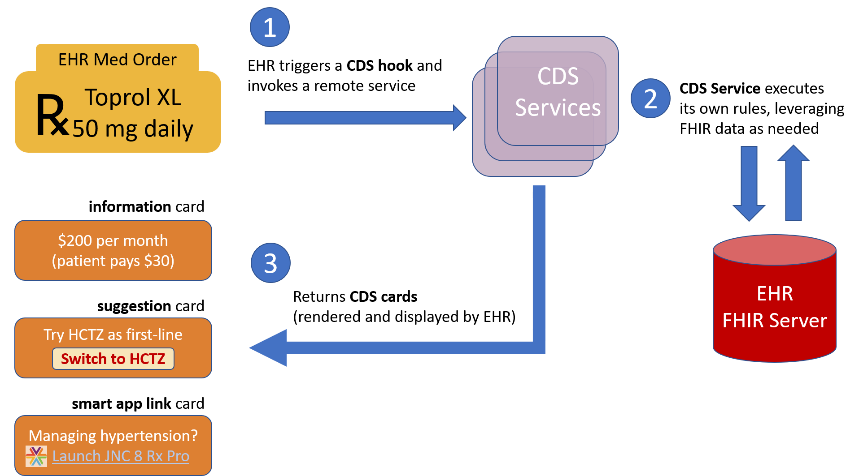
Standards landscape
Indirectly related organisations and initiatives
CDS Hooks

Slide 43
Standards landscape
Indirectly related organisations and initiatives
ISO
  ISO/IEC JTC 1/SC 32 Data management and interchange
    ISO/IEC 11179-1:2015 Information technology -- Metadata registries (MDR)
      ISO/IEC 11179-1:2015 Part 1: Framework
      ISO/IEC 11179-2:2005 Part 2: Classification
      ISO/IEC TR 11179-2 Inform Part 2: Classification (Under development)
      ISO/IEC 11179-3:2013 Part 3: Registry metamodel and basic attributes
      ISO/IEC 11179-3:2013/DAmd 1 (Under development)
      ISO/IEC 11179-4:2004 Part 4: Formulation of data definitions
      ISO/IEC 11179-5:2015 Part 5: Naming principles
      ISO/IEC 11179-6:2015 Part 6: Registration
      ISO/IEC DIS 11179-7 Part 7: Metamodel for data set registration (Under development)
      Metadataworks
        Genomics England
        ‘Model Driven Data Management in Healthcare’ David Milward, Best Paper award at MODELSWARD 2019 International Conference on Model-Driven Engineering and Software Development
          Metadata Management Language (MDML)

Slide 44
Standards landscape
Indirectly related organisations and initiatives
ISO
  Identification of Medicinal Products (IDMP)
    FHIR MedicationKnowledge resource
  ISO 13606 Health informatics -- Electronic health record communication
    openEHR
Notes:
Within the context of Pharmacogenomics

Slide 45
Challenges and possible ways forward
Notes:
SECTION SLIDE: Right-click image to replace.
**Slide not built in master slides due to the ability to swap out images.

Slide 46
Challenges and possible ways forward
Challenges
Knowledge representation and reasoning conundrum
Authentication and authorisation
Ethics
Notes:
Basic one column slide.
This slide can also be used as a NASCAR SLIDE, where we want to show multiple partner/client logo or the like.

Slide 47
Challenges and possible ways forward
Knowledge representation and reasoning conundrum
Relationship between ontologies and classifications/terminologies
Relationship between ontologies
Relationship between information model representations of EHR and classifications/terminologies and ontologies
Reasoning
Notes:
Basic one column slide.
This slide can also be used as a NASCAR SLIDE, where we want to show multiple partner/client logo or the like.

Slide 48
Challenges and possible ways forward
Relationship between ontologies and terminologies
ICD10 -> ICD11 alignment by way of example
Notes:
Basic one column slide.
This slide can also be used as a NASCAR SLIDE, where we want to show multiple partner/client logo or the like.

Slide 49
Challenges and possible ways forward
Relationship between ontologies
BFO as key component in alignment efforts
  Alignment of SNOMED with BFO
    Stakeholder Engagement for Consultant Terminologist Project IHTSDO-836, entitled “Concept Model: Presence” David Sperzel, MD, MS, August-September 2016
      SNOMED CT and formal ontological principles p.17
    SNOMED CT standard ontology based on the ontology for general medical science El-Sappagh et al. BMC Medical Informatics and Decision Making (2018) 18:76
Notes:
Basic one column slide.
This slide can also be used as a NASCAR SLIDE, where we want to show multiple partner/client logo or the like.

Slide 50
Challenges and possible ways forward
Relationship between information model representations of EHR terminologies and ontologies
ZOUD
Standards based EHR information models
  FHIR
  ISO 13606 / openEHR
  INTEROPen Digital Health Rewired Panel Paper: FHIR and openEHR
Articulating relationships, BFO and IAO as possible component in alignment efforts
  FHIR and Ontology - Barry Smith, Fourth Clinical and Translational Science Ontology Workshop 2015
Notes:
Basic one column slide.
This slide can also be used as a NASCAR SLIDE, where we want to show multiple partner/client logo or the like.

Slide 51
Challenges and possible ways forward
Reasoning
Workflow, CDS Hooks
Domain Specific Languages, CQL
  Beyond the Curly Braces: Exploring CQL on FHIR based CBK, Mobilizing Computable Biomedical Knowledge (MCBK) Marc Overhage with Motive Medical Intenigence, July 2018
Rules engines/reasoners
Notes:
Basic one column slide.
This slide can also be used as a NASCAR SLIDE, where we want to show multiple partner/client logo or the like.

Slide 52
Challenges and possible ways forward
Authentication and authorisation
SMART on FHIR
FHIR Security
Notes:
Basic one column slide.
This slide can also be used as a NASCAR SLIDE, where we want to show multiple partner/client logo or the like.

Slide 53
Challenges and possible ways forward
Ethics
NIH National Human Genome Resource Institute
  Ethical, Legal and Social Issues in Genomic Medicine
    Genetic Discrimination
    Intellectual Property and Genomics
    Regulation of Genetic Tests
    Privacy in Genomics
Knowledge sharing and resource distribution
Notes:
Basic one column slide.
This slide can also be used as a NASCAR SLIDE, where we want to show multiple partner/client logo or the like.

Slide 54
Challenges and possible ways forward
Pragmatism
The pragmatic maxim
  Consider the practical effects of the objects of your conception. Then, your conception of those effects is the whole of your conception of the object.
  Charles Sanders Peirce
Notes:
Basic one column slide.
This slide can also be used as a NASCAR SLIDE, where we want to show multiple partner/client logo or the like.

Slide 55
Challenges and possible ways forward
aligning terminologies with ontologies
aligning ontologies with SNOMED, BFO and derivatives being a key components of alignment efforts
aligning EHR information models with ontologies with FHIR, SNOMED, BFO and derivatives being key components in alignment efforts
progressing approaches to reasoning and clinical decision support with CDS Hooks, CQL being key components
progressing Authentication and Authorisation with SMART on FHIR, FHIR Security being key components
progressing ethics.
Engage industry, be pragmatic!
Continued collaboration..
Notes:
Basic one column slide.
This slide can also be used as a NASCAR SLIDE, where we want to show multiple partner/client logo or the like.

Slide 56
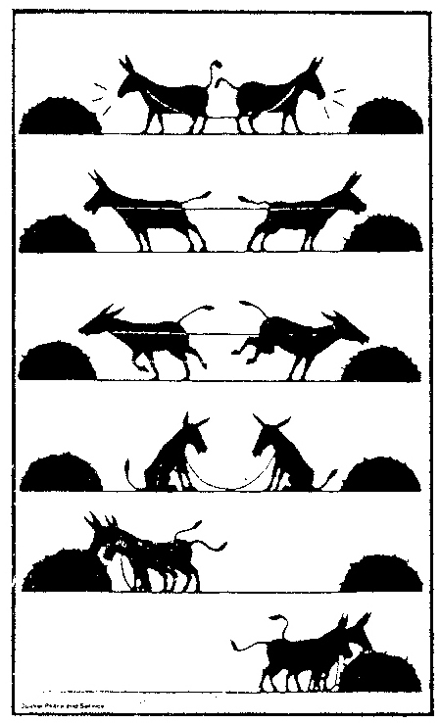
Challenges and possible ways forward
Cooperation is better than conflict!
Notes:
The solution
Came across this in a Baclava Salonori in North London

Slide 57

Thank you.
Ben McAlister
ben.mcalister@cerner.com
Notes:
THANK YOU SLIDE: Right-click image to replace.
**Slide not built in master slides due to the ability to swap out images.

