Slide 1




clinical terminology for e-health
Genetic and Genomic Terminologies Clinical vs research scenarios
About a Spanish Initiative
Genomics Session
April Business Meeting, Thursday, 11th, April 2019

Slide 2
BITAC company
Barcelona Health Hub (BHH)
Bioinformatics Barcelona (BIB)
Data Integration Group (DIG)
Overview. Elixir/EGA
Standard Terminologies in Genomics. NHS digital study.
Clinical Genomics use cases (Clinical vs Research scenarios)
Genomics Session. April Business Meeting, Thursday, 11th, April 2019

Slide 3

Global company based in Barcelona
Activity since 2008
We offer a SAAS platform of services combining a team of clinical terminology experts (strong background LOINC, SNOMED CT, ICD10, OMIM…) and a set of tools for Computer assisted coding.
Genomics Session. April Business Meeting, Thursday, 11th, April 2019

Slide 4
Our experts come from clinical lab background, biochemistry, cancer research and collaborate with specialists of several clinical domains.
(radiology, pathology, infectious diseases)
Our expertise:
Clinical terminology Normalization and implementation in digital health environments
Genomics Session. April Business Meeting, Thursday, 11th, April 2019

Slide 5
Our offer
      Clinical lab LOINC/SNOMED CT
      Radiology LOINC/SNOMED CT
      Nuclear Medicine LOINC
      Diagnoses and Procedures ICD10MC/ SNOMED CT
Digital health Consultancy services
  Semantic interoperability for governments and clinical organizations (either public or private)
  Business Opportunities related to management of clinical data
  Converting data into clinical knowledge
Genomics Session. April Business Meeting, Thursday, 11th, April 2019

Slide 6

CTMAP is a clinical terminology platform
Our semantic hub has the following features:
        SAAS, Software As A Service coding tool.
        Easy to connect through web services
        Has different modules with following terminologies (ICD9, ICD10MC/PCS,
        LOINC, SNOMED CT, OMIM)
        Keeps semantic net between terminologies
        Multilanguage (spanish, english, german, italian, french)
        Self learning processes
Genomics Session. April Business Meeting, Thursday, 11th, April 2019

Slide 7


ACKNOWLEDGMENTS
BITAC has been awarded the seal of excellence of a H2020 call for SMEs entitled COMPUTER ASISTED CODING FOR HEALTH
Certificate delivered by the European Commission, as the institution managing Horizon 2020, the EU Framework Programme for Research and Innovation 2014-2020
This means passing all stringent Horizon 2020 assessment thresholds for the 3 award criteria (excellence, impact, quality and efficiency of implementation) required to receive funding from the EU budget Horizon 2020.

Slide 8





























www.bitac.com

Slide 9
International alliances
REGENSTRIEF INSTITUTE-LOINC
LOINC developers. Participating in LOINC Committee annually
SNOMED International - SNOMED CT
Consulting services for clinical lab area
Participating in SNOMED CT Vendor Liaison Forum
Genomics Session. April Business Meeting, Thursday, 11th, April 2019

Slide 10
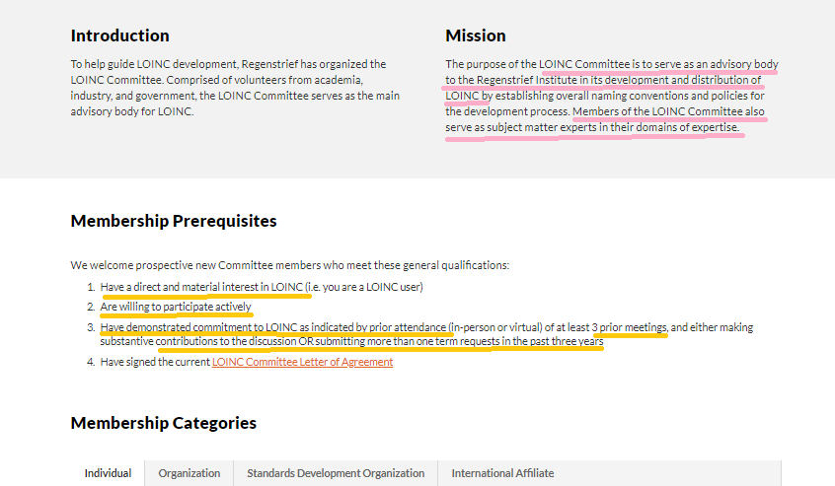
Genomics Session. April Business Meeting, Thursday, 11th, April 2019

Slide 11
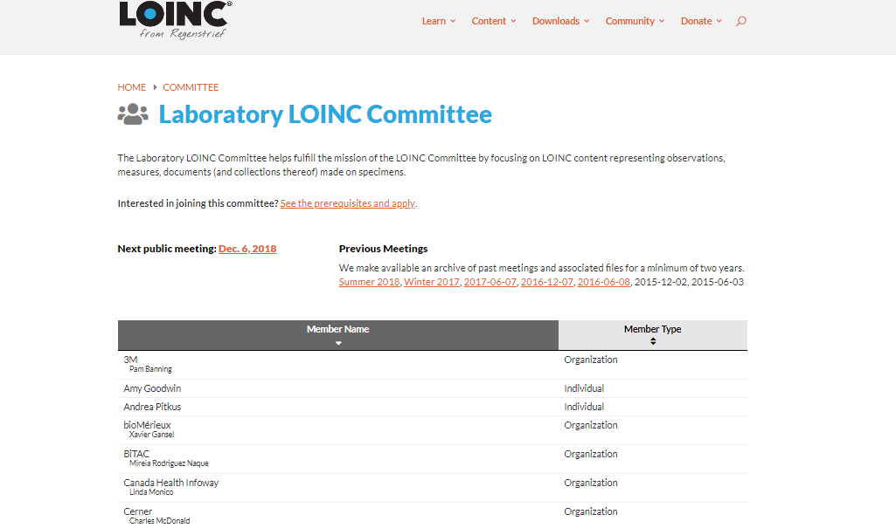
Genomics Session. April Business Meeting, Thursday, 11th, April 2019

Slide 12
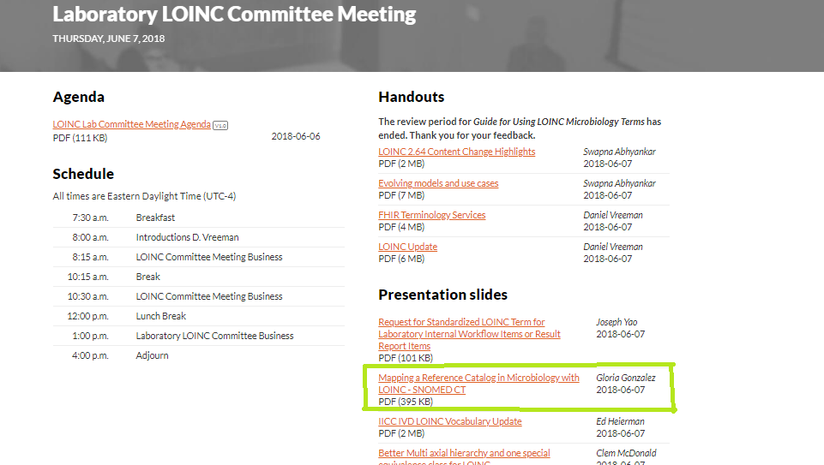
Genomics Session. April Business Meeting, Thursday, 11th, April 2019

Slide 13
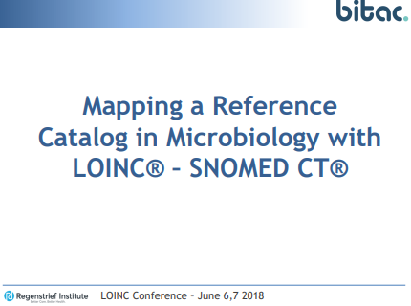
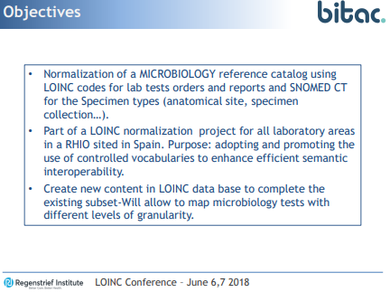
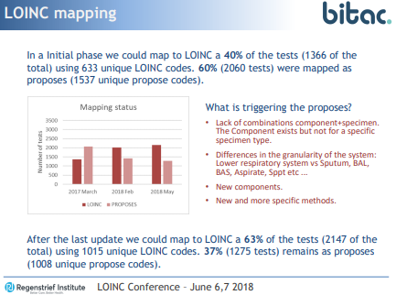
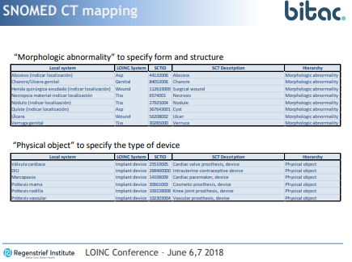
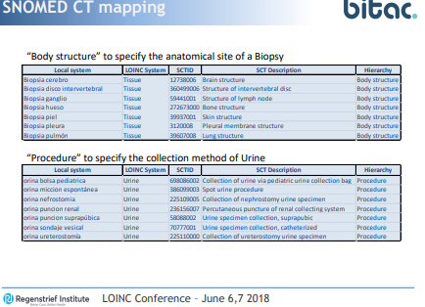
Genomics Session. April Business Meeting, Thursday, 11th, April 2019

Slide 14
BITAC company
Barcelona Health Hub (BHH)
Bioinformatics Barcelona (BIB)
Data Integration Group (DIG)
Overview. Elixir/EGA
Standard Terminologies in Genomics. NHS digital study.
Clinical Genomics use cases (Clinical vs Research scenarios)
Genomics Session. April Business Meeting, Thursday, 11th, April 2019

Slide 15

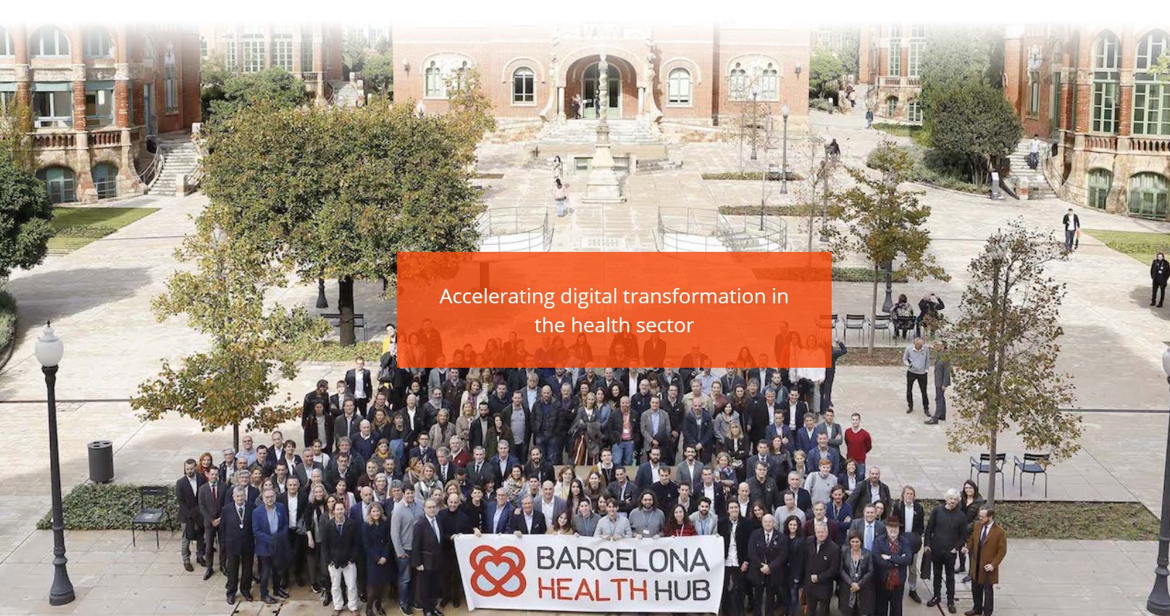

Slide 16
GOALS:
Being an international reference center in digital medicine, attracting innovation and talent.
Stimulating innovation in health through the adoption of new digital technologies.
Promoting companies and entities that develop their business in the digital health sector, making them more competitive.
Positioning Barcelona as a leader, a global benchmark and European capital of the emerging digital health sector.
Promoting collaboration among all agents in the sector.
PURPOSE:
Generate innovation in health through IT.
Promote startups of the health environment so that they reach the public and/or private healthcare reality.
Foster the interaction among startups, health corporations and investors to activate the digital change in healthcare.
Genomics Session. April Business Meeting, Thursday, 11th, April 2019

Slide 17
BITAC company
Barcelona Health Hub (BHH)
Bioinformatics Barcelona (BIB)
Data Integration Group (DIG)
Overview. Elixir/EGA
Standard Terminologies in Genomics. NHS digital study.
Clinical Genomics use cases (Clinical vs Research scenarios)
Genomics Session. April Business Meeting, Thursday, 11th, April 2019

Slide 18

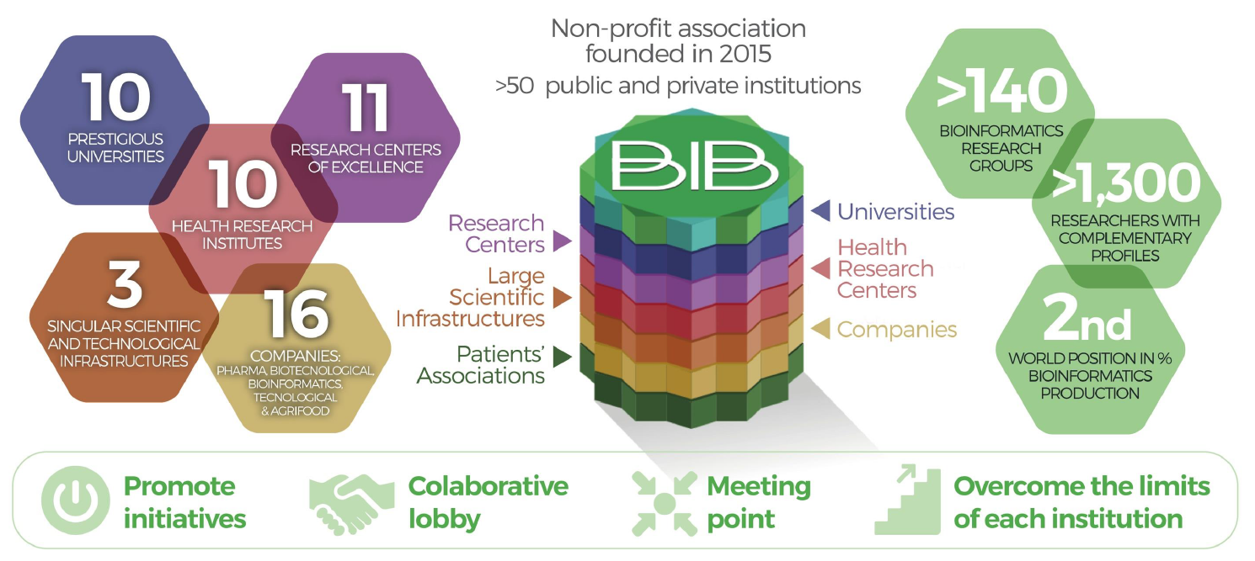
Genomics Session. April Business Meeting, Thursday, 11th, April 2019

Slide 19
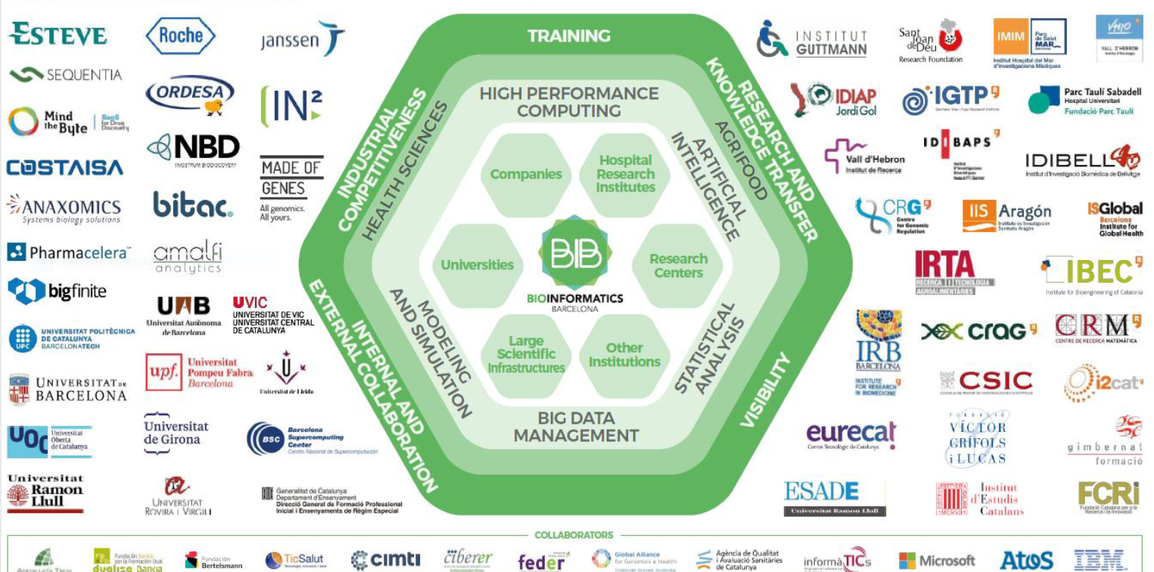

Slide 25
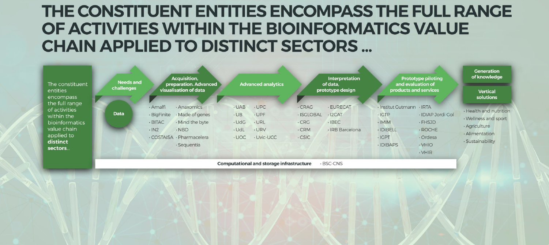
Genomics Session. April Business Meeting, Thursday, 11th, April 2019

Slide 26
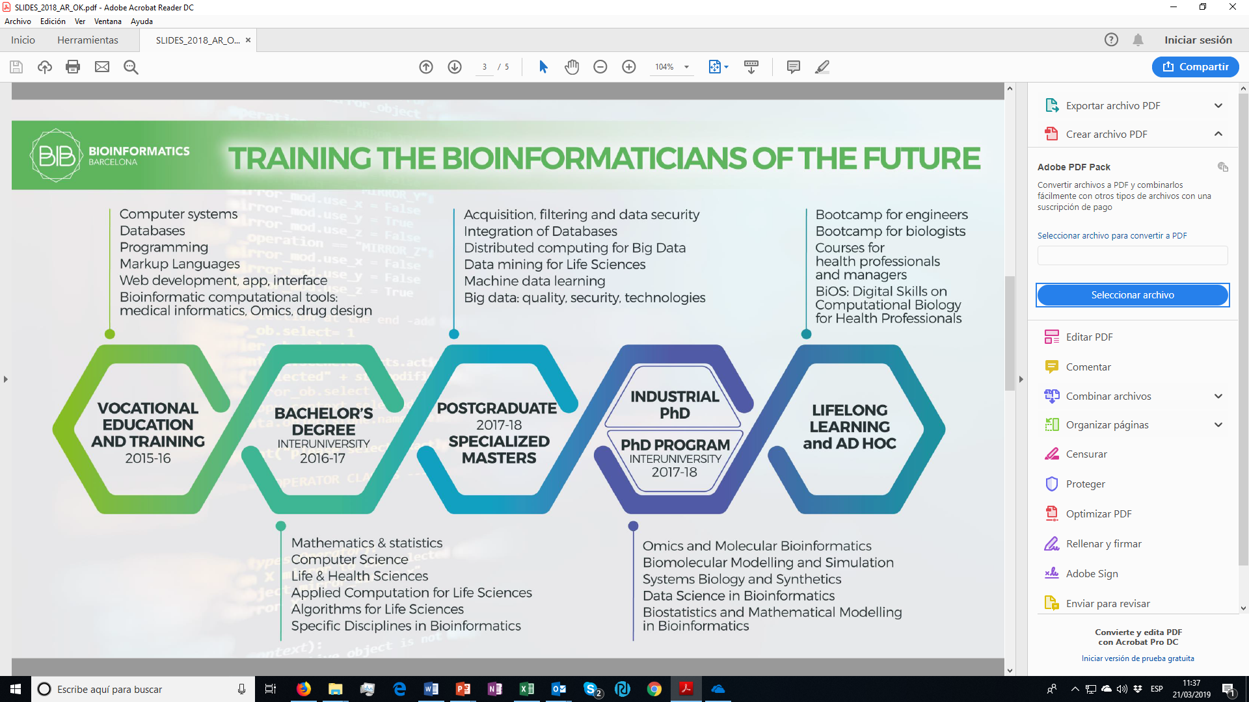
Genomics Session. April Business Meeting, Thursday, 11th, April 2019

Slide 27
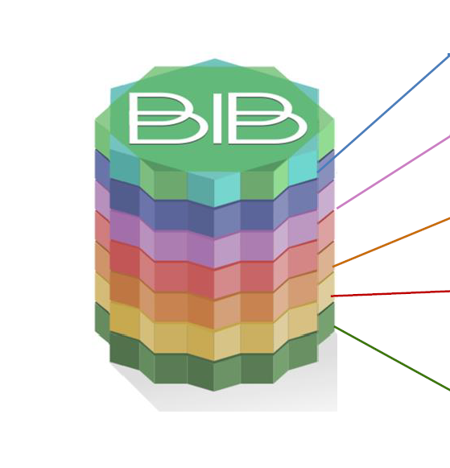
WORKING GROUPS
TRAINING AND WORK
Improves the training and occupation of students of all levels in bioinformatics, analyze the strengths and differentiation of research groups and companies in the field of bioinformatics.
ETHICS, SECURITY AND REGULATION ON DATA ACCESS
Establish recommendations on the ethical aspects of data and generate proposals for the regulation of access to health data and bioinformatics.
DATA INTEGRATION
Analyze the problems associated with the integration of bioinformatics and health data, search for standards and enhance collaboration among the members of the pilot project.
BIB COMPANIES
Improve the capacities and projection of the members of the BIB, and establish new collaborative projects. Work to increase the number of industrial Phds in bioinformatics, as well as professional training programs for students.
VISIBILITY AND COMMUNICATION
Propose improvements for the visibility and internal communication of the BIB associated entities, and improve the external communication of both the BIB and partners.
Genomics Session. April Business Meeting, Thursday, 11th, April 2019

Slide 28
WORKING GROUPS
Each Working Group meets face to face three times per year
Working Groups documentation is available (Dropbox) to all Working Group members
BIB organizes regular symposiums / workshops for Working Groups
The BIB Working Groups are a resource of the BIB community to discuss and move forward actions of interest for the BIB entities, in each of their fields. Currently around 75 people from 35 BIB entities participate in the Working Groups
Genomics Session. April Business Meeting, Thursday, 11th, April 2019

Slide 29
BITAC company
Barcelona Health Hub (BHH)
Bioinformatics Barcelona (BIB)
Data Integration Group (DIG)
Overview. Elixir/EGA
Standard Terminologies in Genomics. NHS digital study.
Clinical Genomics use cases (Clinical vs Research scenarios)
Genomics Session. April Business Meeting, Thursday, 11th, April 2019

Slide 30
DATA INTEGRATION - WORKING GROUP BIB
OBJECTIVES
COMMUNITY
Analyze current status for integration of omics data into the Electronic Health Records (EHR), and propose solutions to optimize this integration.
Analyze current status of integration of different omics data (genomics, transcriptomics, proteomics, metabolomics, etc.) with phenotype data, and propose solutions to optimize this integration.
The Data Integration BIB Working Group has held two workshops (July 2018 and February 2019) to discuss and plan actions on EHR / omics integration
The Data Integration BIB Working Group is composed by around 30 people from:
7 Research Institutes / Universities / Research Infrastructures
7 Hospitals / Hospital Research Institutes
6 BIB companies
Genomics Session. April Business Meeting, Thursday, 11th, April 2019

Slide 31
DATA INTEGRATION - WORKING GROUP BIB
History
Trigger: BIB detected the need for their associates to get involved in knowing/Using international standards
Idea: Original idea was to create and disseminate a kind of catalog of standards.
Consideration: At least for genomics, such catalog is being covered by well know organizations: GA4GH/Elixir are defining, reaching consensus and fostering international standards.
Fact: BIB has a rich and diverse ecosystem, we see this as an strength that other communities could be lacking
New idea: look for an example Project where that strength could flourish
Consideration: Should be light on workload & fun, useful/applicable in the very short term for a broader audience
New idea: Systems integrative approach seems attractive.
  - Gather the types of data that BIB Partners could manage/bring to the table
  - Look at the current standards (or lack of) used in such fields
  - Explore (play with) how to integrate such standards into “EHR”
  - Demonstrate the added value of Using such standards in such context

Slide 32
DATA INTEGRATION - WORKING GROUP BIB
“Data Integration: Electronic Health Record – Omics Data”. 5th July 2018
Big Data: how to overcome the challenge of the regulated environment . Toni Manzano, CSO & co-founder, Bigfinite
Strategic vision of a University Hospital about the secondary use of clinical data for Advanced research. Raimundo Lozano, Medical Informatics, Hospital Clínic
The Liquid Hospital project: experience in the Integration of data from different origins in a hospital cloud platform. Arnau Valls, Innovation Department, Hospital Sant Joan de Déu
Transactional genomics framework for the implementation of precision medicine in clinical Settings. Oscar Flores, Genomcore / Made of Genes
Standard terminologies used in the Genetics, Genomics and Research environments. Gloria González / Mireia Rodríguez, Bitac
From the Shared Health Record to the longitudinal Electronic Health Record. Pol Pérez, Departament de Salut, Generalitat de Catalunya
Real World Data for Health research and translational knowledge . Maria García, IDIAP JordiGol

Slide 33
















DATA INTEGRATION - WORKING GROUP BIB
“Genomic Data Integration Challenges”. 28th Feb 2019
Consideration: This new approach must be considered from a Clinical and Genomic point of view
New idea: To Create a multidisciplinary team (Clinician, Geneticist consultant and Bioinformatician)
HOSPITALS
RESEARCH CENTERS AND UNIVERSITIES
COMPANIES
Genomics Session. April Business Meeting, Thursday, 11th, April 2019

Slide 34
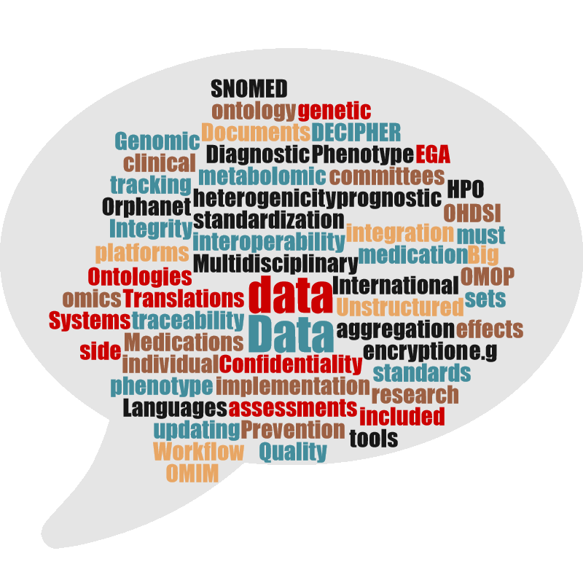
DATA INTEGRATION - WORKING GROUP BIB
“Genomic Data Integration Challenges”. 28th Feb 2019
- Patient data sets
- Genomics data sets
- Genomic interpretation
- Data storage and privacy
- Data access
- Data for EHR and archetypes
- Problems in the workflow and solutions
We discuss:
Genomics Session. April Business Meeting, Thursday, 11th, April 2019

Slide 35


DATA INTEGRATION - WORKING GROUP BIB
NEXT STEPS:
“Task Force” with representants of the multidisciplinary team
Hospital team will elaborate a document of common needs to integrate genomic data into EHR before may 2019
Universities/ Research centers and companies will study the document to offer possible solutions.
Genomics Session. April Business Meeting, Thursday, 11th, April 2019

Slide 36
BITAC company
Barcelona Health Hub (BHH)
Bioinformatics Barcelona (BIB)
Data Integration Group (DIG)
Overview. Elixir/EGA
Standard Terminologies in Genomics. NHS digital study.
Clinical Genomics use cases (Clinical vs Research scenarios)
Genomics Session. April Business Meeting, Thursday, 11th, April 2019

Slide 37
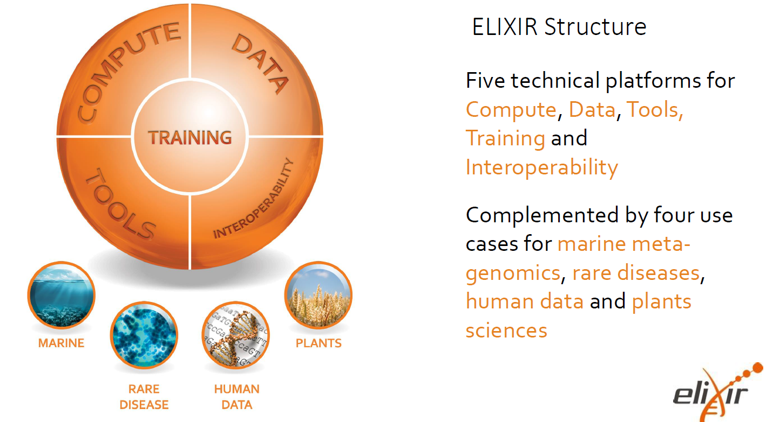
Genomics Session. April Business Meeting, Thursday, 11th, April 2019

Slide 38
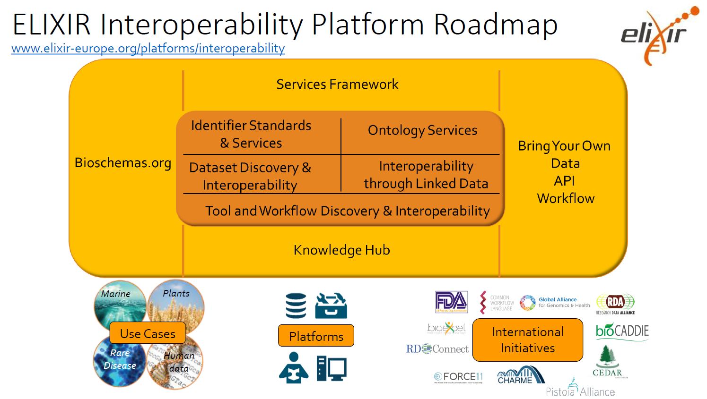
Genomics Session. April Business Meeting, Thursday, 11th, April 2019

Slide 39
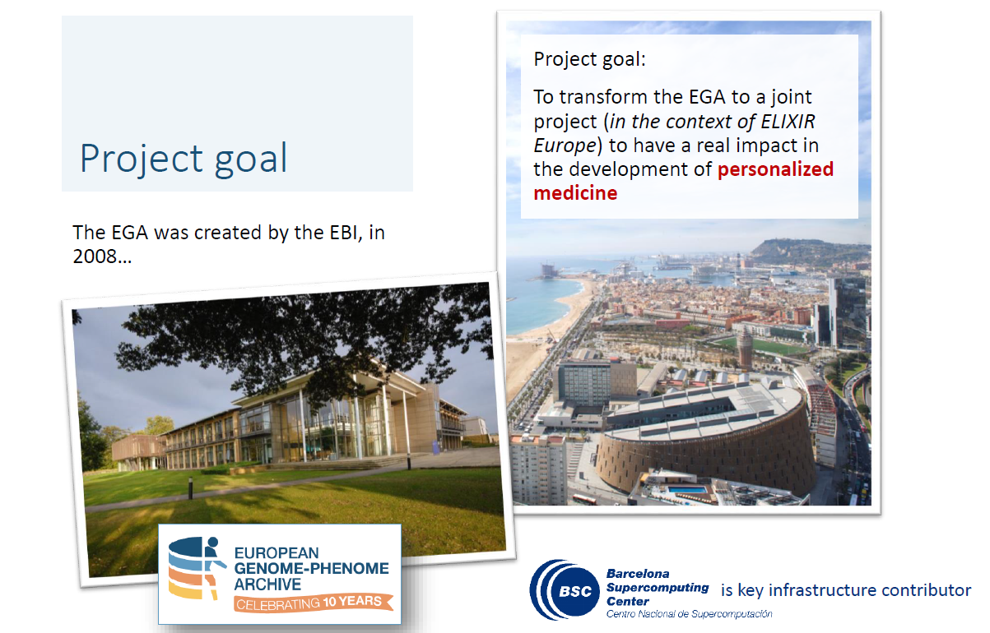
Genomics Session. April Business Meeting, Thursday, 11th, April 2019

Slide 40
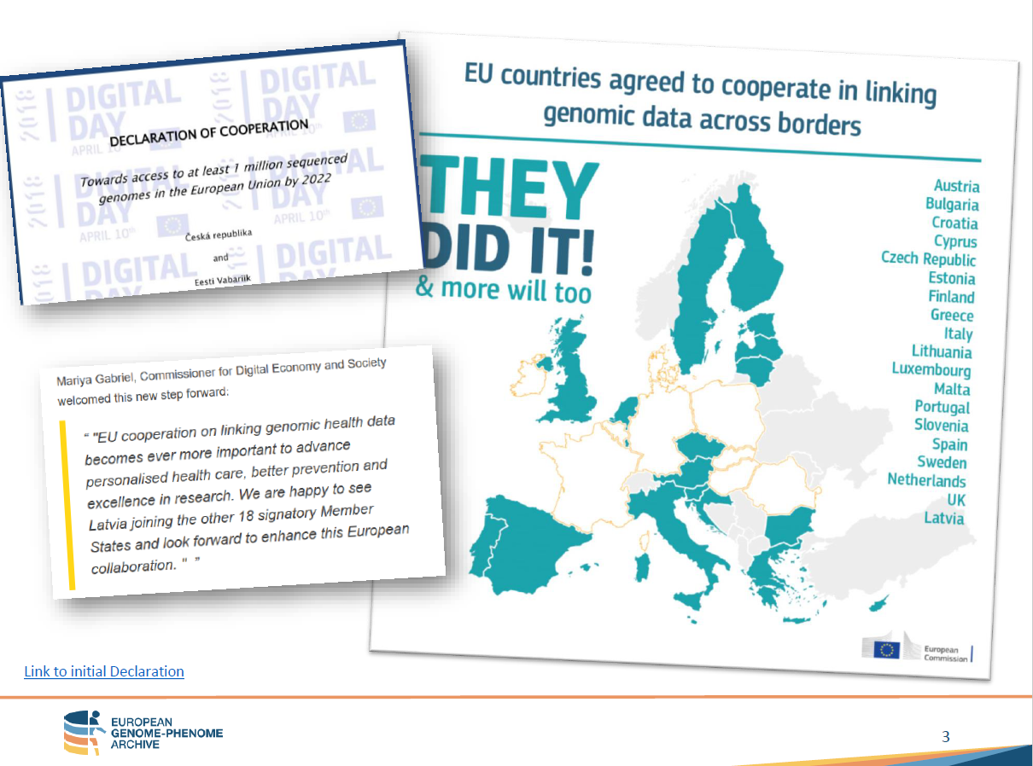
Genomics Session. April Business Meeting, Thursday, 11th, April 2019

Slide 41
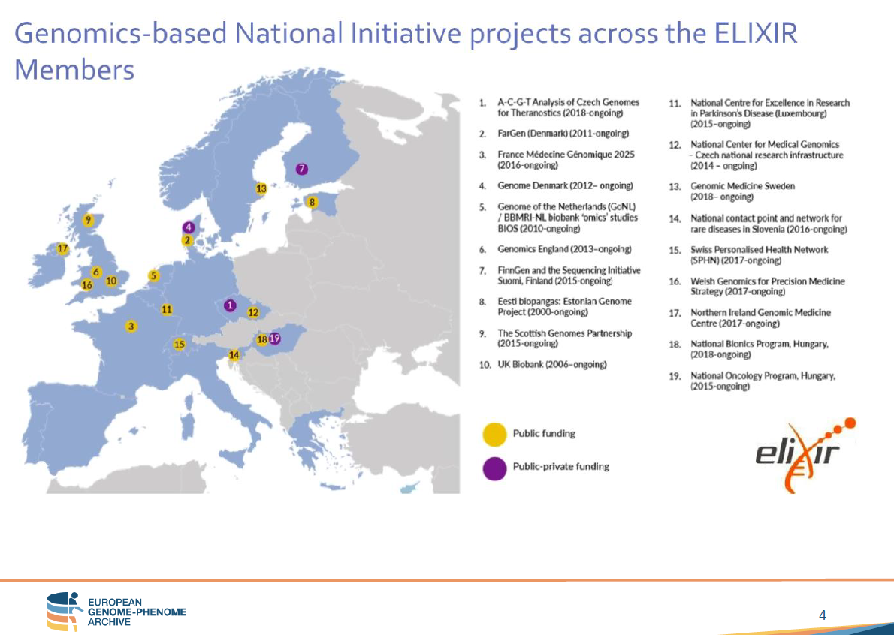
Genomics Session. April Business Meeting, Thursday, 11th, April 2019

Slide 42
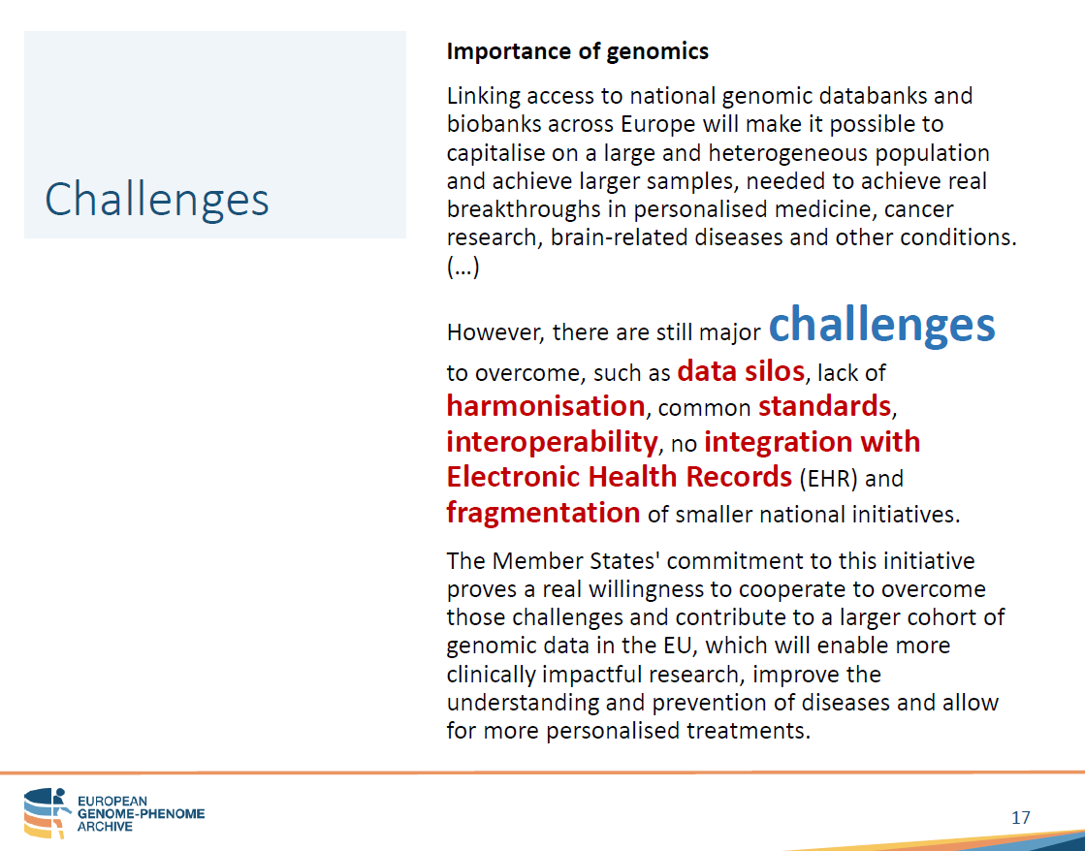
Genomics Session. April Business Meeting, Thursday, 11th, April 2019

Slide 43
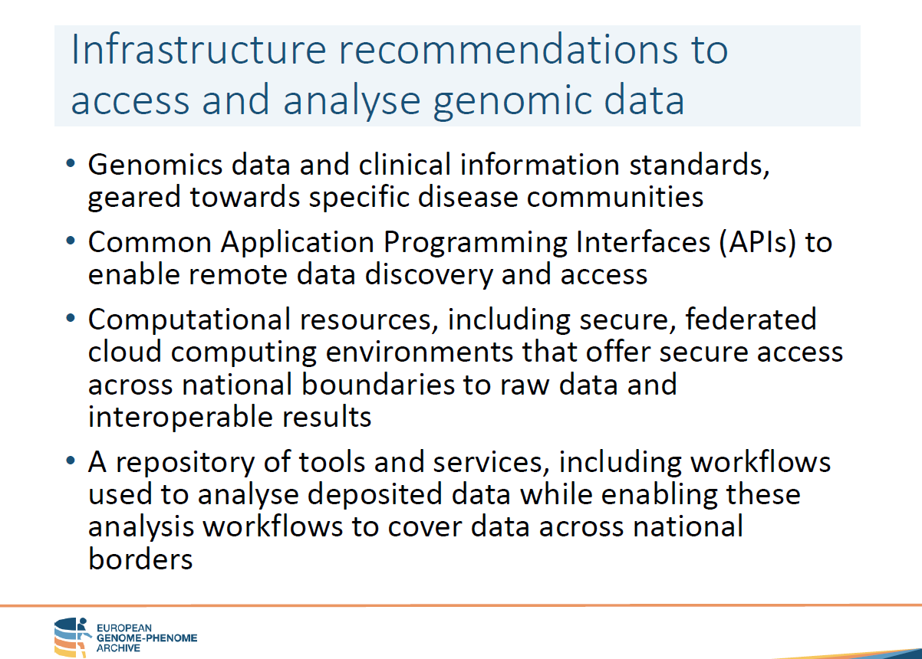
Genomics Session. April Business Meeting, Thursday, 11th, April 2019

Slide 44
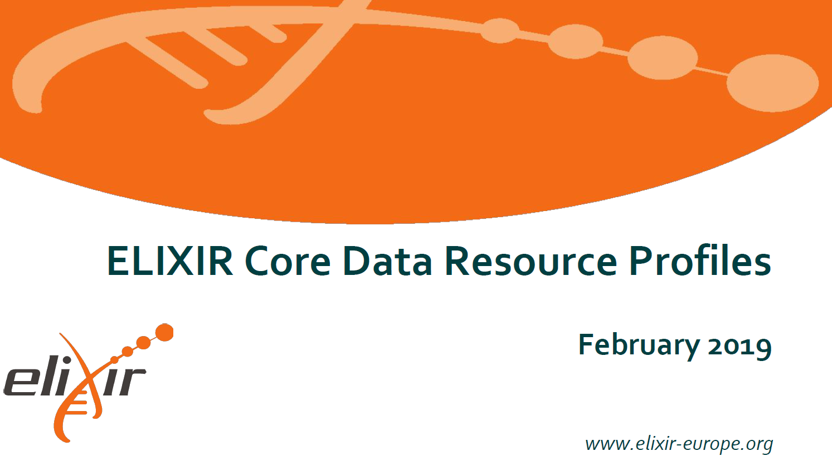
Genomics Session. April Business Meeting, Thursday, 11th, April 2019

Slide 45
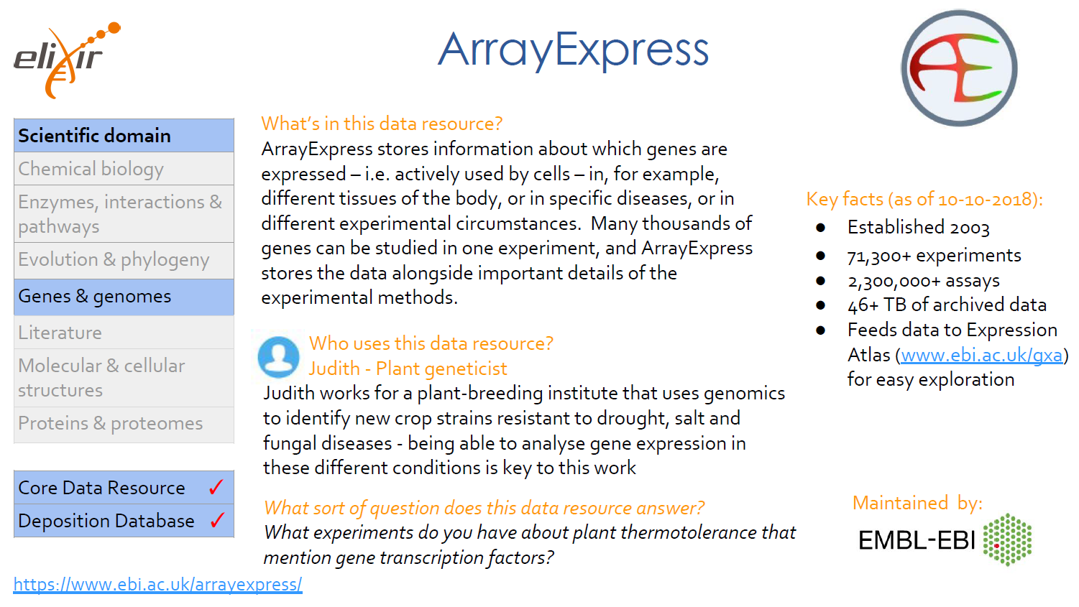
Genomics Session. April Business Meeting, Thursday, 11th, April 2019

Slide 46
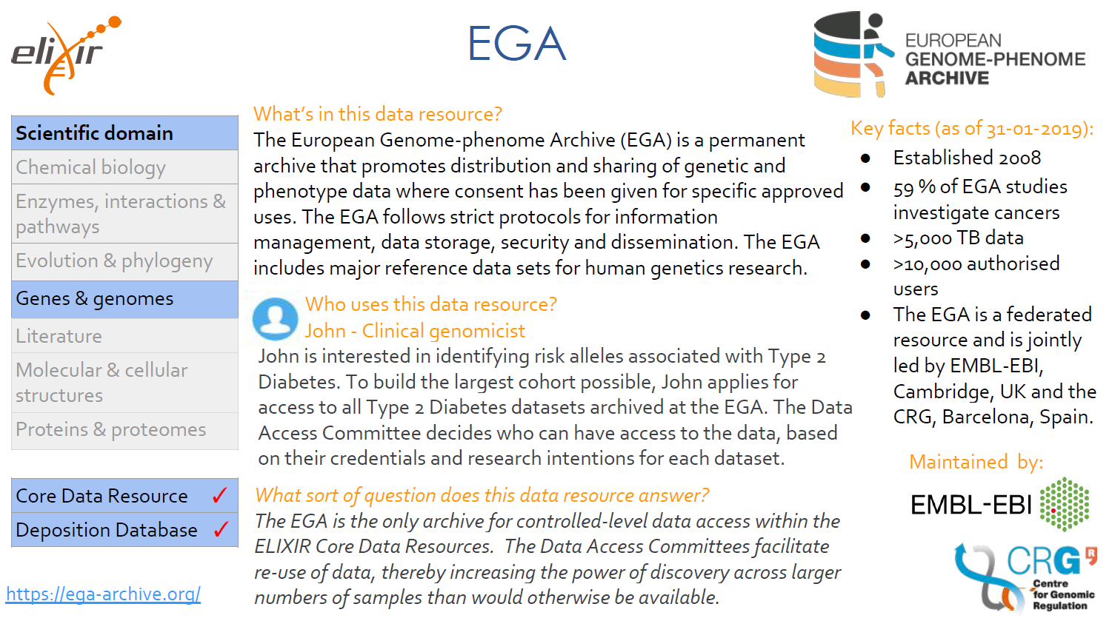
Genomics Session. April Business Meeting, Thursday, 11th, April 2019

Slide 47
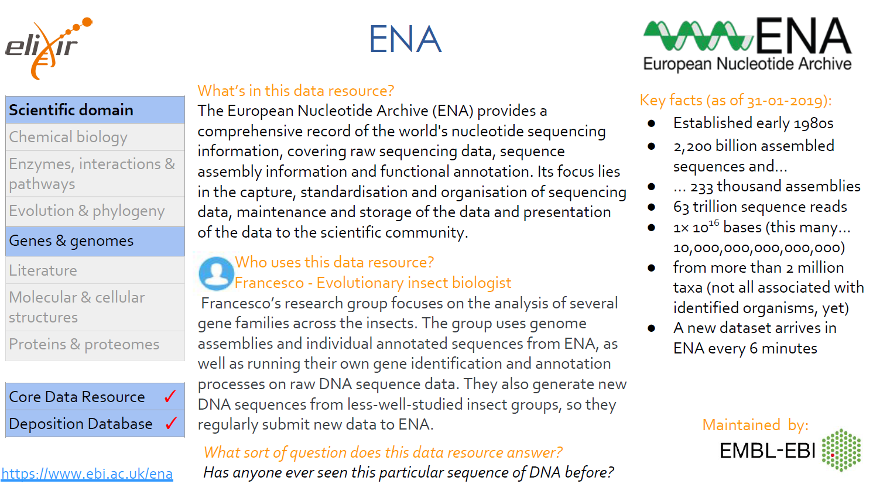
Genomics Session. April Business Meeting, Thursday, 11th, April 2019

Slide 48
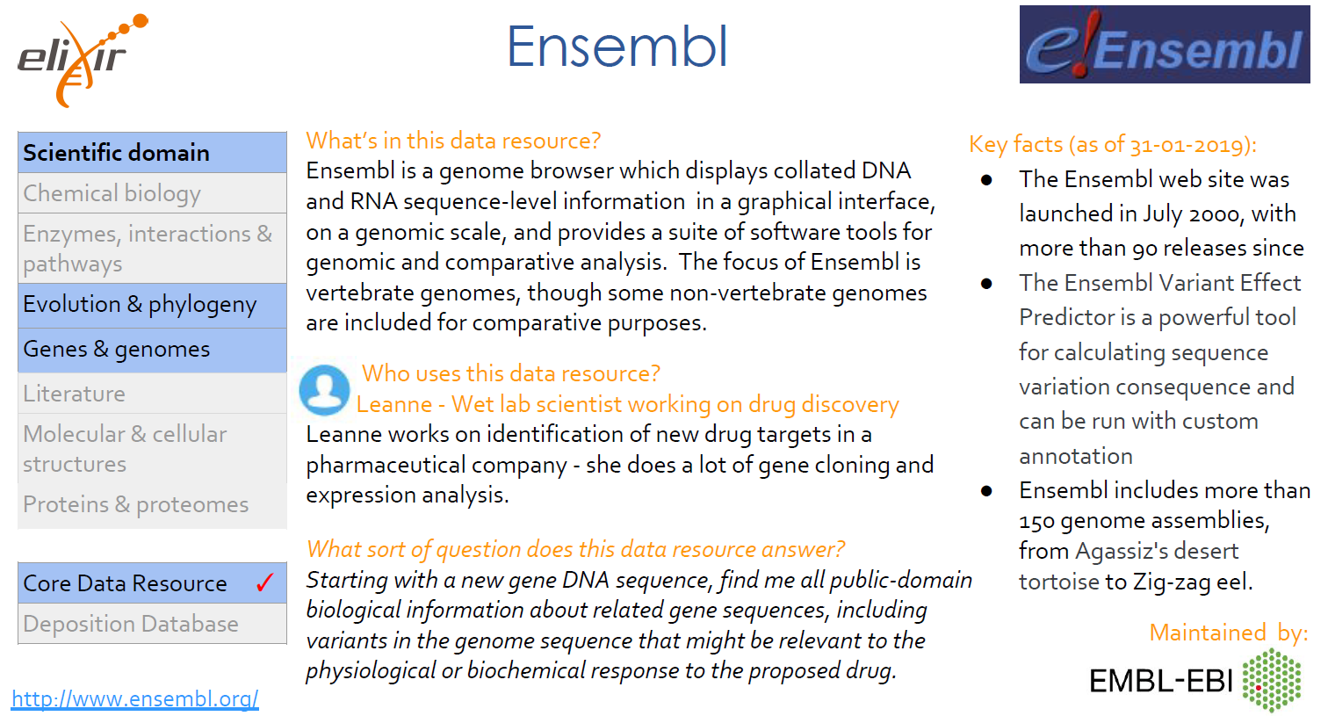
Genomics Session. April Business Meeting, Thursday, 11th, April 2019

Slide 49
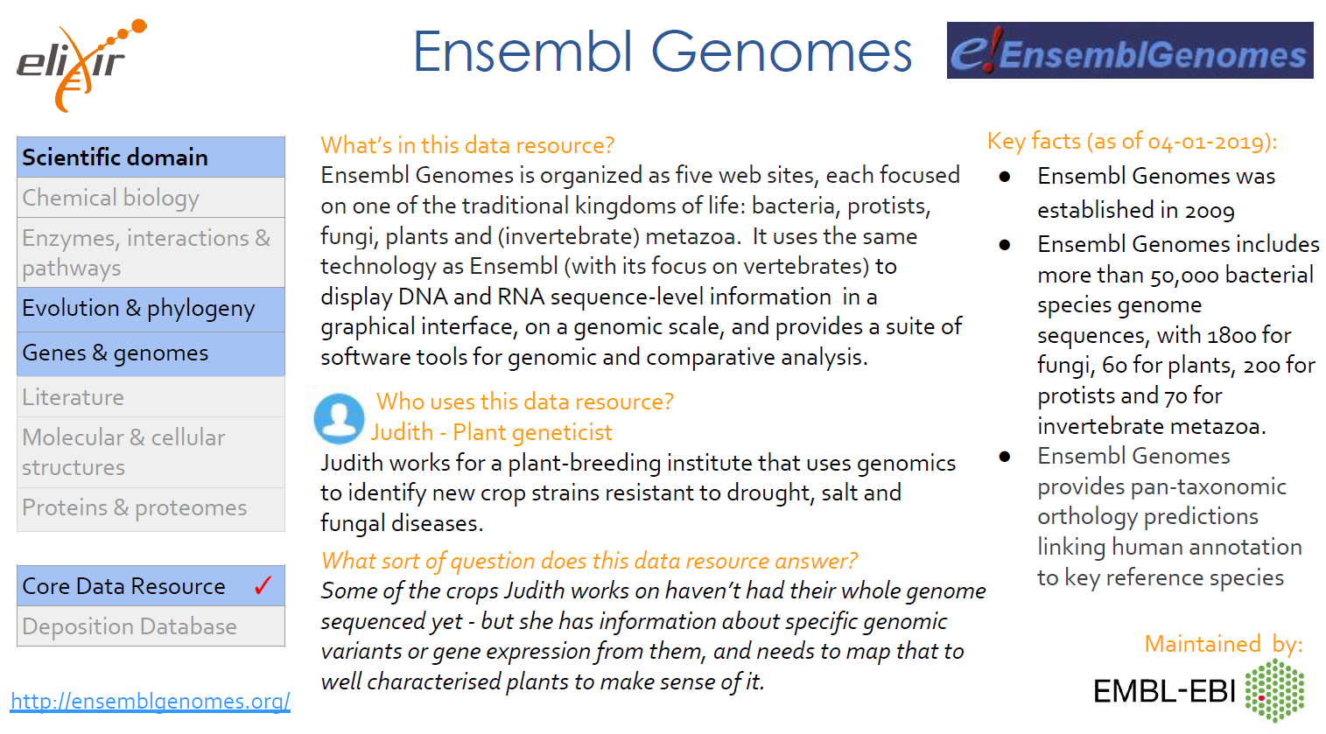
Genomics Session. April Business Meeting, Thursday, 11th, April 2019

Slide 50
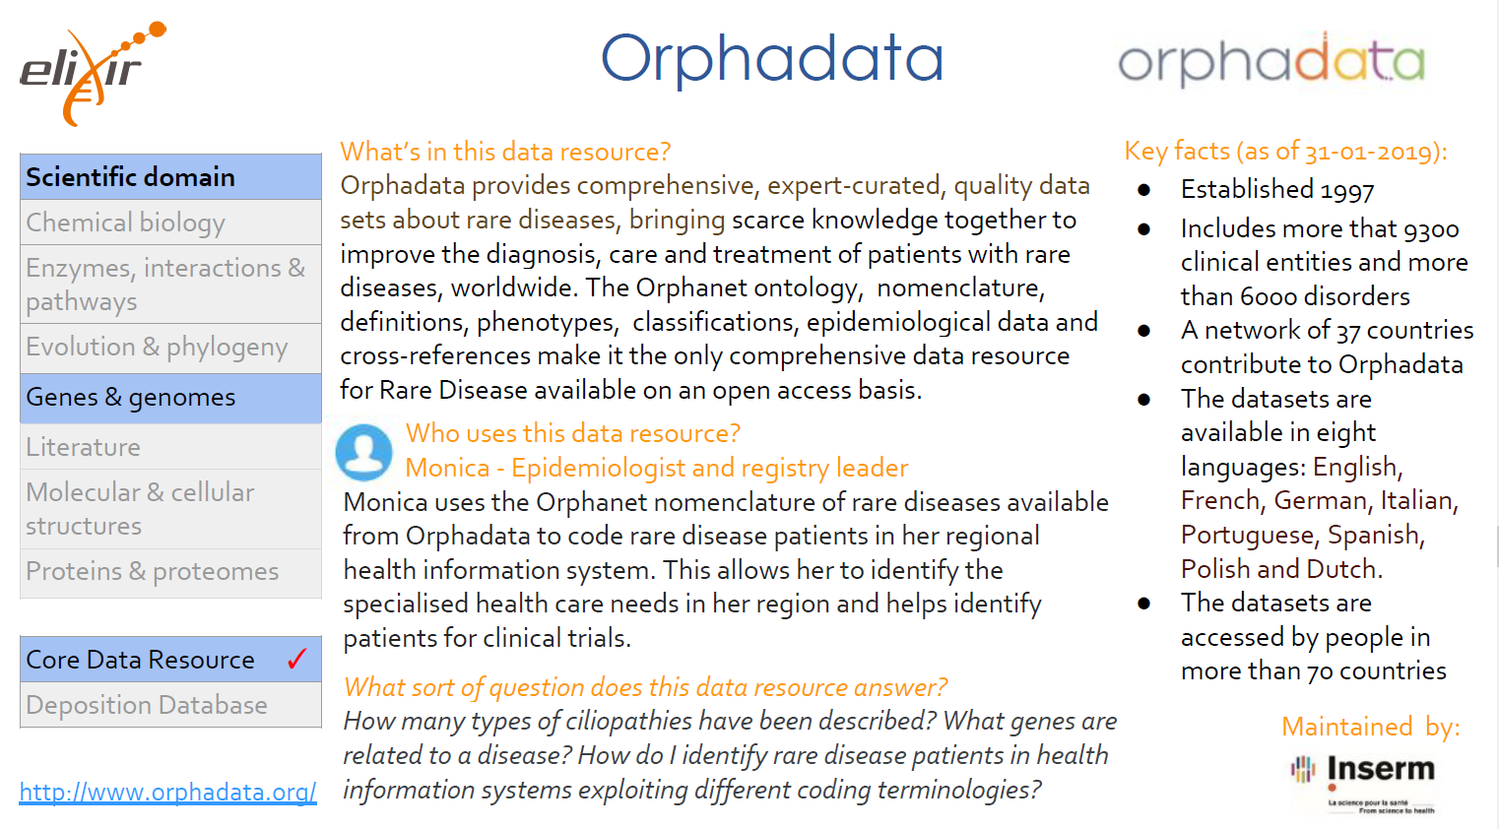
Genomics Session. April Business Meeting, Thursday, 11th, April 2019

Slide 51
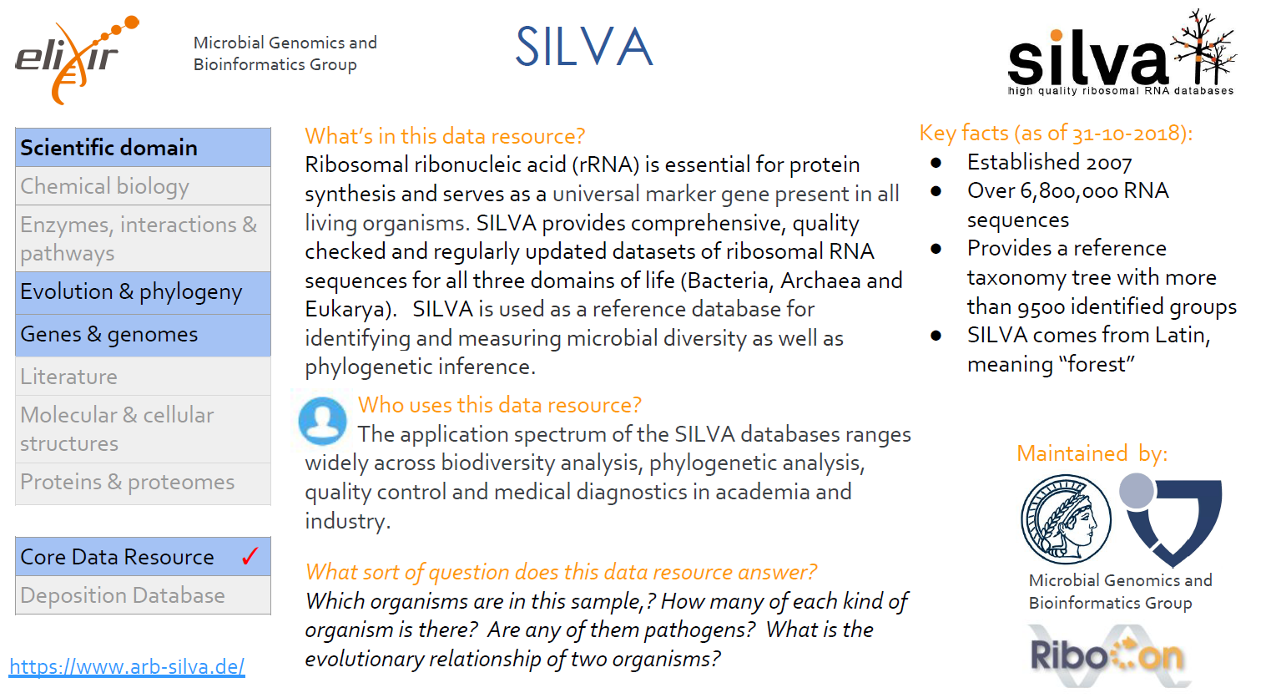
Genomics Session. April Business Meeting, Thursday, 11th, April 2019

Slide 52
BITAC company
Barcelona Health Hub (BHH)
Bioinformatics Barcelona (BIB)
Data Integration Group (DIG)
Overview. Elixir/EGA
Standard Terminologies in Genomics. NHS digital study.
Clinical Genomics use cases (Clinical vs Research scenarios)
Genomics Session. April Business Meeting, Thursday, 11th, April 2019

Slide 53

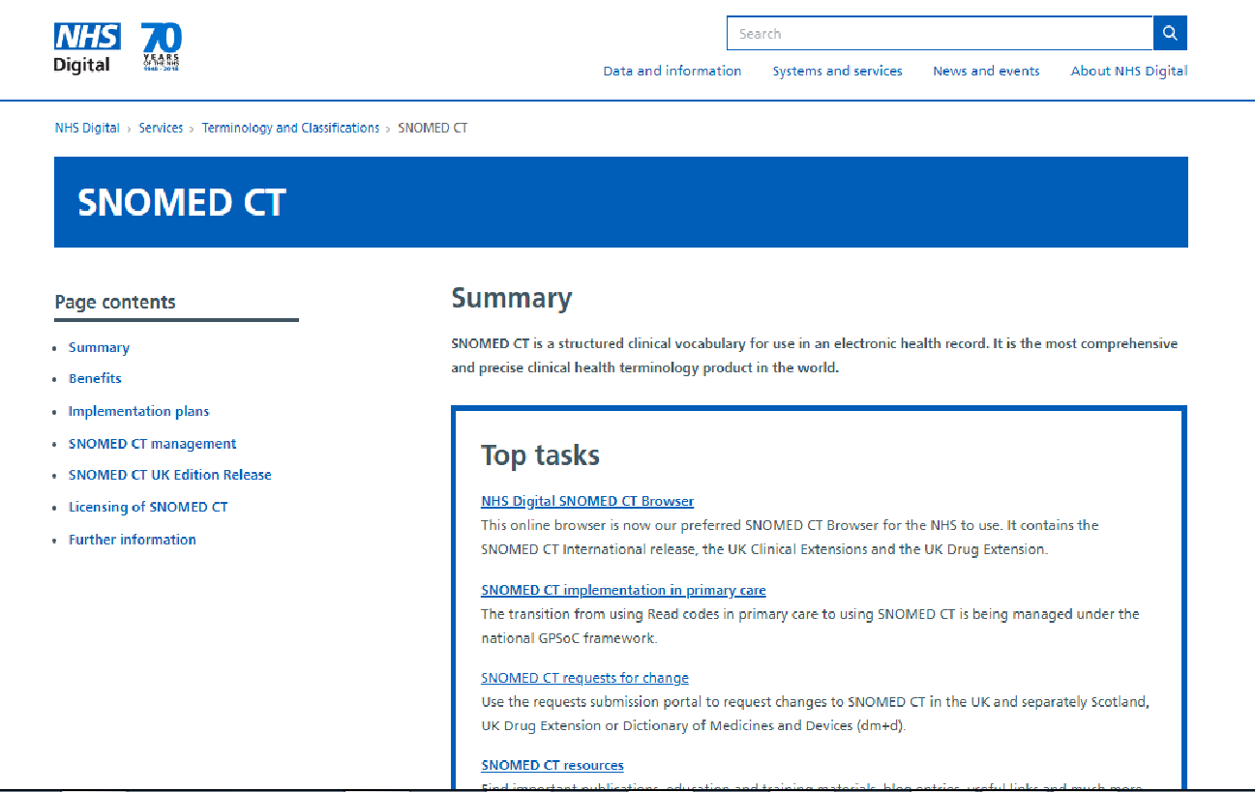
Standard Terminologies in Genomics
Genomics Session. April Business Meeting, Thursday, 11th, April 2019
Notes:
We are glad to share with the audience part of the study about Standard terminologies in Genomics carried out last year for NHS Digital.

Slide 54
Standard Terminologies in Genomics
The goal of this project has been researching the standard international terminologies involving genomics to develop a national terminology strategy for an optimum use of genetic and genomic data towards a better personalized care and research.
It is well known that SNOMED CT is one of the most preferred clinical terminology worldwide but the language of genetic and genomic medicine extends beyond SNOMED CT’s current scope.
Genomics Session. April Business Meeting, Thursday, 11th, April 2019
Notes:
It is well known that SNOMED CT is the clinical terminology mostly adopted worldwide but requirements to support genomics extends beyond SNOMED CT current scope. The goal of this project was to find out the international terminologies involving genomics to develop an strategy for an optimum use of genetic and genomic data towards a better personalized care and research.

Slide 55
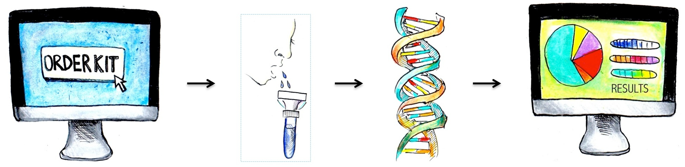
Standard Terminologies in Genomics
EHR and genetic data, what is the scope?:
Requesting a genomic test
Sharing and comparing test results
Representation of genomic information reports in any clinical information system.
THEN: Which terminologies are involved beyond the most used clinical standards?
Genomics Session. April Business Meeting, Thursday, 11th, April 2019
Notes:
EHR in this environment must serve to request a test, sharing and comparing results and must allow the representation of genomic information in any clinical information system.
So, which terminologies are involved beyond the most used clinical standards?

Slide 56

Standard Terminologies in Genomics
Terminologies involved in reporting Genomic lab test results:
Next generation sequencing is expanding as gold standard test for genomics
Many laboratory workflows must cope with :
Identification of sequence
Report of sequence interpretation
Report of clinical significant variants
Genomic standards appear to be required to support this 3 items
Genomics Session. April Business Meeting, Thursday, 11th, April 2019
Notes:
Genomics data are complex . NGS technique is the gold standard method for genomic and it produce complex data, so the laboratory must cope with
the identification and interpretation of the sequence
and the way to report the clinical significant variants.
Genomic standards appear to be required to support this 3 items.

Slide 57

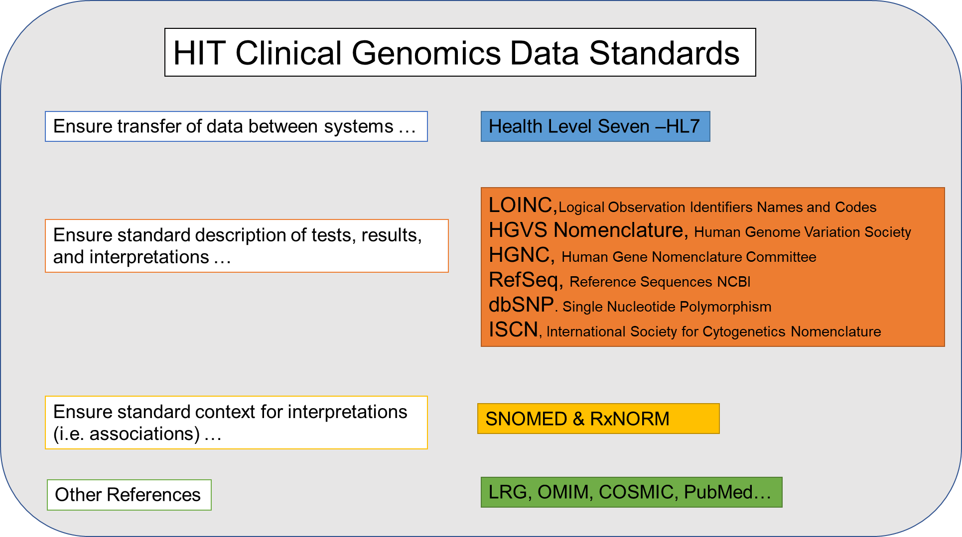
Standard Terminologies in Genomics
Recommendations to Extend Healthcare IT (HIT) Standards for Personalized Medicine
• Standard(s) for coding genetic based disease.
• Standard(s) for representation of genetic data (for human and computer consumption)
• Minimal core data sets
• Standard(s) for representation of clinical associations
• Standard(s) for representation of clinical decision support rules
Genomics Session. April Business Meeting, Thursday, 11th, April 2019
Notes:
To extend Standards for personalized medicine different kind of data products is needed:
S for coding genetic based diseases
S for representation of genetic data and clinical associations
S to represent clinical decision support rules
and also it is necessary to identify minimal core data sets.

Slide 58
Standard Terminologies in Genomics
As an answer to all this challenges the project aimed to:
Evaluate the existing terminologies to represent relevant data (phenotype and genomic data)
Examine the workflow and reporting procedures to highlight shared practices and identify relevant data to share
Evaluate the use of already existing standards in this workflow
Identify areas in need of standardization
Genomics Session. April Business Meeting, Thursday, 11th, April 2019
Notes:
So looking to all this challenges the project aimed to:
1/ Evaluate the existing terminologies to represent relevant phenotype and genomic data.
2/ Study the workflows and reporting procedures to highlight shared practices.
3/ Evaluate the use of existing standards in this workflow and
4/ Identify areas in need of standardization.

Slide 59
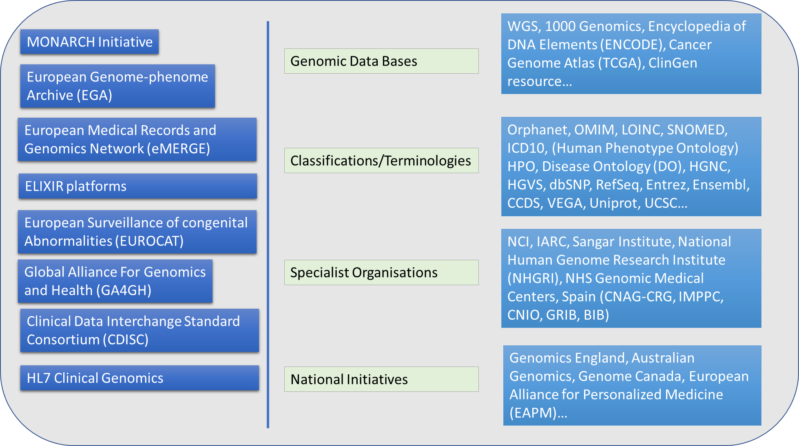
Standard Terminologies in Genomics
Actions have been the following:
Identifying projects/organizations/initiatives involved in Clinical Genomics (EGA/ELIXIR, Monarch Initiative, eMERGE, Australian genomics, Genomics England…).
Identifying Vocabulary standards involved in Genomics (OMIM, GO, HPO, RefSeq, HGVS…).
Identifying frameworks of harmonized approaches to enable the responsible, voluntary, and secure sharing of genomic and clinical data (HL7, CDISC, GA4GH…)
Genomics Session. April Business Meeting, Thursday, 11th, April 2019
Notes:
As an started point to identify the state of the art we tried to explore some resources:
projects/organizations or initiatives involved in Clinical Genomics like: EGA/ELIXIR, Australian Genomics, eMERGE etc.
Vocabulary standards involved in Genomics: OMIM, HPO, RefSeq…
And frameworks for sharing genomic and clinical data (HL7 or GA4GH).

Slide 60
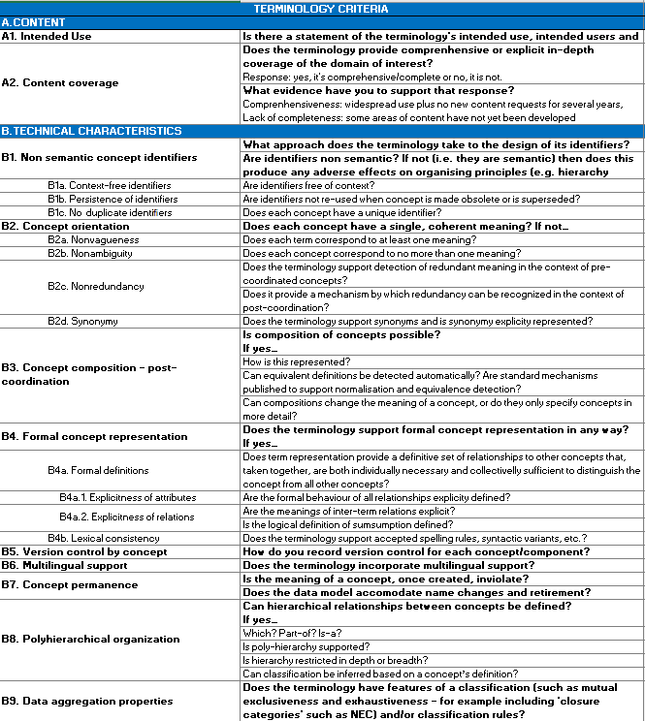
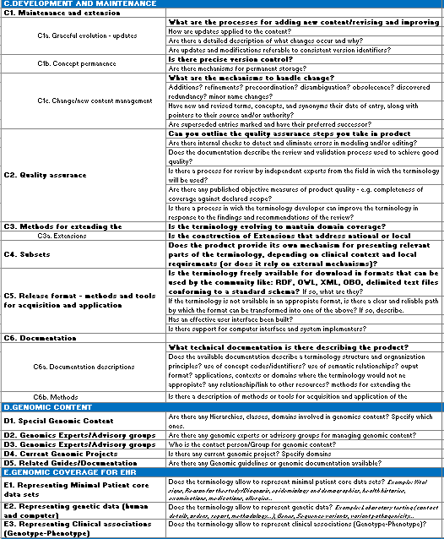
Standard Terminologies in Genomics
DEVELOPING SURVEYS
We have developed a survey for key terminology developers in order to collect minimal requirements to support clinical genomics.
We have developed a survey for users in order to find out usage trends in research and clinical context and direct related to EHR, referenced in International specifications and profiles .
Genomics Session. April Business Meeting, Thursday, 11th, April 2019
Notes:
So we worked with NHS digital to produce a survey for developers of terminologies, vocabularies and data product. These terminologies must fullfill minimal requirements to support clinical genomics.
We have developed in parallel a survey for the users of these terminologies to identify usage patterns and trends.

Slide 61

Standard Terminologies in Genomics
Newest papers related to clinical genomics in some scenarios like personalized medicine and cancer, developmental and rare disorders, pharmacogenomics in order to select the most proper terminologies involved and their real use.
Information resources related to clinical and genomic terminologies
Literature related to EHR, share of genomic and clinical data, and interoperability.
ISO documentation and specific guidelines for genomics and health from international frameworks for sharing genomic data.
Genomics Session. April Business Meeting, Thursday, 11th, April 2019
Notes:
As a background information we reviewed:
-recent papers related to clinical genomics in some scenarios of interest: cancer, rare diseases and developmental disorders and PGX to select the most proper terminologies involved.
-We also reviewed resources related to EHR, data sharing and interoperability and
-we added documentation related to ISO protocols and specific guidelines from international frameworks for sharing genomic data.

Slide 62
Standard Terminologies in Genomics
SURVEYS for developers (Terminologies)
Genomics Session. April Business Meeting, Thursday, 11th, April 2019
Notes:
The developers survey contains questions related to the terminology such as content coverage and technical characteristics.

Slide 63
Standard Terminologies in Genomics
SURVEYS for developers (Terminologies)
Cimino JJ. Desiderata for Controlled Medical Vocabularies in the Twenty-First Century. Methods Inform Med 1998; 37: 394-403.
Content | To most users "What can be said" is more important than "how it can be said". Omissions are readily noticed and timely, formal and explicit methods for plugging gaps are required
Concept orientation | The unit of symbolic processing is the concept and each concept in the vocabulary should have a single, coherent meaning.
Concept permanence | A concept's meaning cannot change and it cannot be deleted from the vocabulary.
Meaningless concept identifier | Concepts typically have unique identifiers (codes) and these should be non-hierarchical (see code-dependance) to allow for later relocation and for multiple classification.
Polyhierarchy | Multiple classification
Formal definitions | Semantic definitions of concepts, for example, Streptococcal tonsillitis=Infection of tonsil caused by streptococcus
No residual categories | Traditional classifications have rubrics that include NOS, NEC, Unspecified, Other whose meaning may change over time as new concepts are added to the vocabulary. These are not appropriate for recording data in an electronic health record. .
Multiple granularities | Different users require different levels of expressivity. A general (family) practitioner might use myocardial infarction whilst a surgeon may record acute anteroseptal myocardial infarction.
Multiple consistent views | Although there may be multiple views of the hierarchy required to support different functional requirements and levels of detail, these must be consistent.
Representing context | There is a crucial relationship between concepts within the vocabulary and the context in which they are used. Cimino defines 3 types of knowledge:
 | Definitional - how concepts define one another
 | Assertional - how concepts combine
 | Contextual - how concepts are used
Graceful evolution | Vocabularies must be designed to allow for evolution and change, to incorporate new advances in healthcare and to correct errors.
Recognise redundancy | Where the same information can be expressed in different ways, a mechanism for recognizing equivalence is required.
Genomics Session. April Business Meeting, Thursday, 11th, April 2019
Notes:
We look at Cimino’s Desiderata to produce questions to asses the terminology requirements. I think it is not necessary to enumerate them at this moment.

Slide 64
Standard Terminologies in Genomics
SURVEYS for developers (Terminologies)
Genomics Session. April Business Meeting, Thursday, 11th, April 2019
Notes:
The survey also explore and describe process features such as: content development and maintenance, quality assurance and governance
and in use factors such as the relevance of each terminology to health records and research settings, implementation experiences and the need of complementary resources as cross mappings.
We included a set of questions related to the genomic content and the genomic coverage for HER for example the capability of the terminology to represent patient data, genetic data or clinical associations.

Slide 65
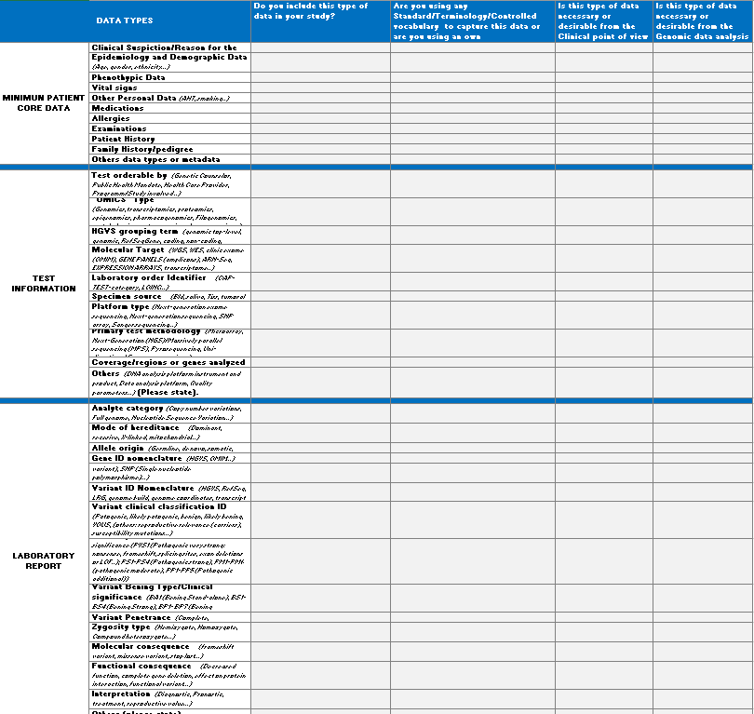
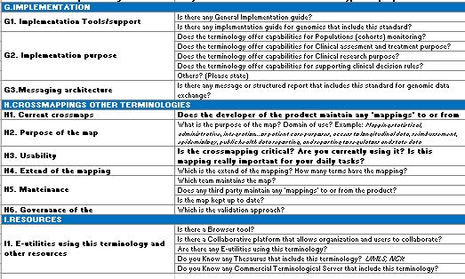
Standard Terminologies in Genomics
SURVEYS for Users
Genomics Session. April Business Meeting, Thursday, 11th, April 2019
Notes:
The users survey aimed to find out how the standards are used in the workflow of genomic-based patient care.
Both, phenotypic elements: sigs, symptoms, clinical features, family history…and genome data: test information and laboratory report: Gen Id, variant type etc…
Also, we included questions related to the specific use of terminologies: real use, limitations, boundaries, adoption and implementation problems…

Slide 66
Standard Terminologies in Genomics
SELECTING TERMINOLOGIES
We created a list of the current vocabularies used internationally to support genetic and genomic medicine and research, including (but not limited to) a list of terminologies, vocabularies, and data products
BITAC selected 29 terminologies, vocabularies and data exchange protocols mostly used in genomics and EHR as a starting point.
These standards included:
Clinical vocabularies (broad scope, not genomic restricted)
Vocabularies for sequence/genes
Phenotype-genotype association vocabularies
Clinical Association phenotypes - sequence variation
Genomics Session. April Business Meeting, Thursday, 11th, April 2019
Notes:
We proposed a list of 29 vocabularies and data products mostly used in genomics and EHR.
These standards included:
-clinical vocabularies not genomic restricted (SCT, ICD10…but these standards were out of the scope.
-Vocabularies for sequence and genes (HUGO, RefSeq),
-for phenotypes-genotypes vocabularies (OMIM)
-and vocabularies for clinical associations (ClinVar).

Slide 67
SELECTING TERMINOLOGIES
Together with the NHS Digital we selected the key vocabularies, ontologies, classifications we would like to study in a first line. The clinical terminologies with broader scope than genomics were out of the scope of this project.
Genomics Session. April Business Meeting, Thursday, 11th, April 2019
Notes:
Together with NHS digital we selected 10 terminologies that include:
3 Ontologies: HPO, DO or GO
7 data products: OMIM, ClinVar, HGNC, HGVS, dbSNP, RefSeq, LRG
Clinical terminologies (SCT or ICD10MC were out of the scope of this project)

Slide 68
Standard Terminologies in Genomics
SELECTING USE CASES
The ideal scenarios proposed for the study were (not limited to):
. Rare Diseases/Developmental disorders
. Pharmacogenomics
. Somatic cancer
Disease Test Type | Purpose/Intended Use/Clinical utility
Rare Diseases | Diagnosis and Gene discovery (research). Spain
Pharmacogenomics | Clinical Implementation of PGx. US
Specific Cancer types | Diagnosis and targeting treatment decisions. Australia
Genomics Session. April Business Meeting, Thursday, 11th, April 2019
Notes:
Related to the use cases we wanted to explore 3 different scenarios and we found one example for each case:
- a project with the purpose of diagnosis and gene discovery in rare diseases research
- a project for clinical implementation in PGX
- and 1 project for Clinical implementation in cancer (with the purpose of diagnosis and targeting treatment decisions)

Slide 69
Standard Terminologies in Genomics
Some USE CASE Conclusions
Genomics Session. April Business Meeting, Thursday, 11th, April 2019
Notes:
Through this pilot study we could see that:
- Related to patient data ontologies HPO, ORDO, OMIM are used to capture phenotyping in research and SCT are used for phenotyping in cancer clinical care. LOINC is used to capture imaging and pathology. In PGx CPIC is used to specified the metabolizer status.
- Related to laboratory reporting The Gen ID is mostly represented with OMIM or HUGO. Variant ID representation uses different types of standards: Ensembl, dbSNP, Refseq…. Clin Var is used for clinical associations and ACMG guides for interpretation of clinical variants and CPIC for PGX.
- Related to the specific use of terminologies we can highlight that standards are useful for: interoperate systems, integrate phenotype-genotype data for gene discovery and support clinical decision systems. Some limitations described were: missing terms and the necessity to propose new ones and the lack of capabilities of the systems to store genomic information. The use of crossmapping is implemented only in 1 of the use cases for researching. All of them follow international recommendations for implementation (GA4GH or FHIR)

Slide 70
Standard Terminologies in Genomics
CONCLUSIONS:
. Further studies are needed to asses survey answers.
. More terminologies must be added to the study for example: SO, ORDO…
. More experiences and use cases in other scenarios are necessary to evaluate the use of current standards and the standardization necessities.
Genomics Session. April Business Meeting, Thursday, 11th, April 2019
Notes:
It must be considered that it was only a preliminary study, we need more uses cases to evaluate workflows and explore other terminologies like ORDO or SO in other scenarios.

Slide 71
BITAC company
Barcelona Health Hub (BHH)
Bioinformatics Barcelona (BIB)
Data Integration Group (DIG)
Overview. Elixir/EGA
Standard Terminologies in Genomics. NHS digital study.
Clinical Genomics use cases (Clinical vs Research scenarios)
Genomics Session. April Business Meeting, Thursday, 11th, April 2019
Notes:
As Mireia explained before the Future tasks of Data Integration group it is to identify the needs of users (clinical care and research) to capture genomic data and to reuse this information for patient care. In the framework of this working group we have started to explore the use of standards through 4 real use cases.

Slide 72
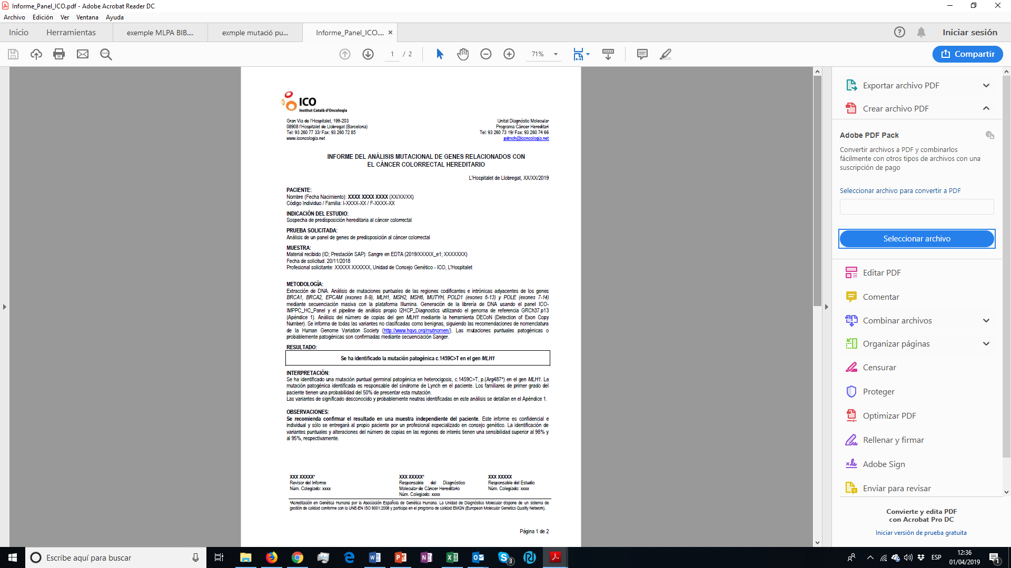
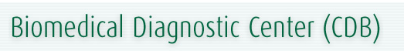


Clinical Genomics Use Cases (Clinical Care vs Research)
Catalonia Oncology Institute. Clinical care and Research.
Biomedical Diagnostic Center. Molecular area (Hospital Clinic de Barcelona).
Clinical care and Research.
Integrated platform for rare disease.
Research.
Undiagnosed Rare Disease Program of Catalonia.
Research
Genomics Session. April Business Meeting, Thursday, 11th, April 2019
Notes:
We would like to share 4 use cases that explore the use of standards in both scenarios: Clinical care and research. The hospital clinic of Barcelona and the Catalonia Oncology Center from the Catalan Health System and 2 research projects in rare diseases (RD-Connect and URDCat.

Slide 73
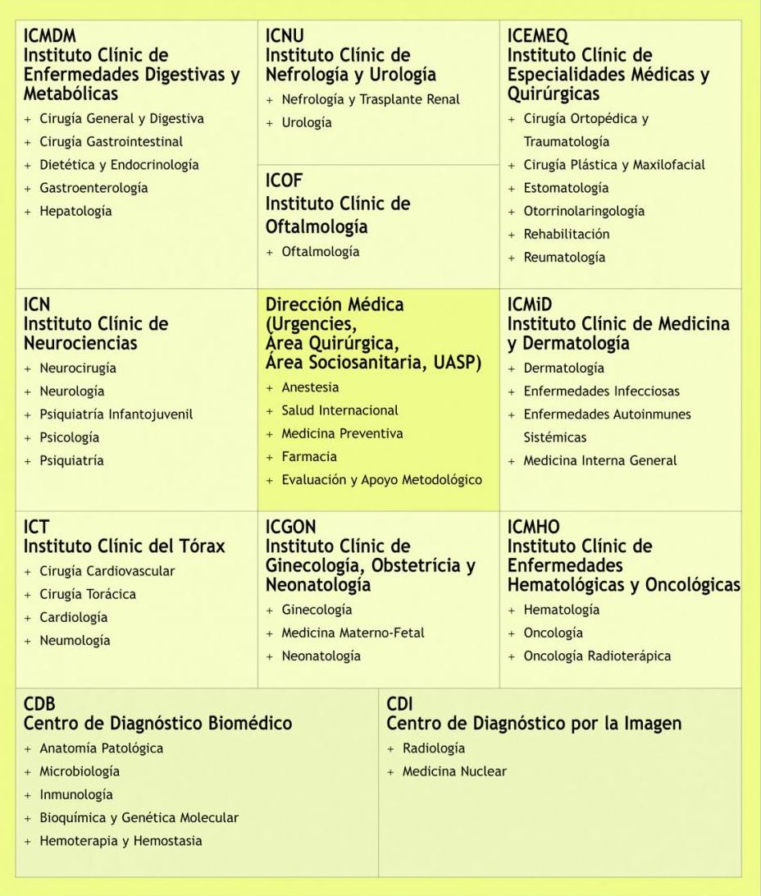
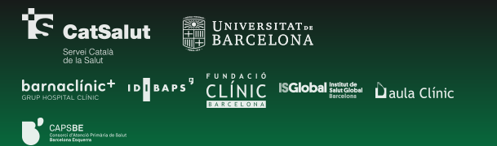
Hospital Clinic Barcelona (HCB)
University hospital founded in 1906 that belongs to the Catalan Public Hospital Network (XHUP). Activities: Health Care, Research and Teaching.
The hospital has a long-standing tradition of research, and is recognized as a institution of reference, both locally and internationally.
The Biomedical Diagnostic Center (CDB) comprehends all the laboratories of Hospital Clínic de Barcelona. More than 400 professionals work in CDB, including 100 staff specialists in several laboratory areas.
The molecular area is a reference center for the network of hospitals linked to the Catalan Health Institute (ICS) and other hospitals in our geographic area.
11 institutes and centers, organized by specialty
Genomics Session. April Business Meeting, Thursday, 11th, April 2019
Notes:
Hospital Clinic of Barcelona belongs to the Catalan Public Hospital Network and also is a reference institution for research. All the laboratories are Unified in the Biomedical Diagnostic Center. The molecular area is a reference center for the network of hospitals linked to the Catalan Health Institute and other hospitals in our area.

Slide 74
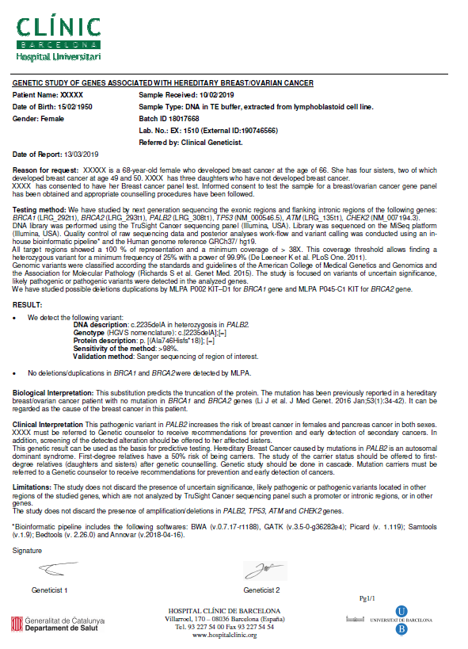
Genetic study of Genes associated with hereditary Breast/Ovarian Cancer
MINIMUN PATIENT CORE DATA
Clinical Suspicion/Reason for the study? | Free text
Epidemiology and Demographic Data | Categorized data
Phenothypic Data | Free text
Medications | Structured data selectes from coded catalogue (PGx)
Allergies | categorized data from Coded catalogue (PGx)
Patient History | Free text (Usually reported in the clinical suspicion)
Family History/pedigree | Free text (Usually reported in the clinical suspicion)
GENOMIC TEST INFORMATION (Testing method)
Test orderable by | Any allowed person according internal regulations
HGVS grouping term | RefSeqGene
Molecular Target | Controlled vocabulary
Laboratory order Identifier | Internal coded catalogue
Specimen source | Categorized data
Platform type | Controlled vocabulary
DNA analysis platform instrument and product | Product Name
Data analysis platform | Product Name
Primary test methodology | Controlled vocabulary
Coverage/regions or genes analyzed | free text
Quality parameters | free text
Notes:
This is a model of reporting for a study of genes associated with hereditary Breast and ovarian cancer.
They are using free text or categorized data to capture patient data: Phenotyping, patient and family history and epidemiology or demographic data.
No standards are used to report testing information: molecular target, Laboratory order, specimen source, platform used, data analysis platform, coverage or quality parameters. Only to Identify the HGVS group term.

Slide 75
LABORATORY REPORT (Result)
Analyte category | Free text
Mode of Inheritance | Free text
Allele origin | Free text
Gene ID nomenclature | HGNC
Variant Type | Controlled vocabulary
Variant ID Nomenclature | HGVS, RefSeq, LRG
clinical Variant classification ID | ACMG Standards and guidelines
Pathogenic Variant | Free text
Variants: Bening Type/Clinical significance | Free text
Variant Penetrance | Controlled vocabulary
Zygosity type | Controlled vocabulary
Molecular consequence | Controlled vocabulary
Functional consequence | Free text
Interpretation | Free text
Genetic counselling | Free text
Notes:
Related to results they are using HGNC to identify the genes studied, HGVS, RefSeq or LRG ID to identify the sequence and ACMG guideline to classify the variant. For the other elements they are using free text or controlled vocabularies: Mode of inheritance, variant type, penetrance, molecular and functional consequence, interpretation or counselling.

Slide 76
Hospital Clinic Barcelona (HCB)
Strategic vision about secondary use of clinical data
Genetic data into the clinical history at HCB takes places in a non structured manner (mostly free text).
75 - 80% of the researchers generated, submitted the data themselves in a non-automated manner.
Limitations of the SAP system to store clinical history.
The proposed strategy to enable secondary use of clinical data includes:
  technological infrastructure for patient's informed consent in the clinical workstation
  use of ISO and ontology standards (OMOP as common data model)
  Use of terminologies: SNOMED-CT has been chosen as it connects very well with lab codes (LOINC).
  Training in data science and data management for using and producing clinical data
  Implementing decision making rules eg: drug dosage alerts
A couple of projects will be selected to start implementing the strategy at HCB.
Genomics Session. April Business Meeting, Thursday, 11th, April 2019
Notes:
To enable a secondary use of clinical data the HCB must to deal with these main issues: mostly genetic data is reported as free text in HER, in research this data is submitted in a non automated manner
And There are Limitations of the SAP system to store clinical history
So, the proposed strategy at HCB includes:
development of a technological infrastructure that enables recording of patient's informed consent in the clinical workstation
use of ISO and ontology standards (OMOP as common data model)
Expertising and training in data science and data management.
Use of terminologies: SNOMED-CT has been chosen as it connects very well with lab codes (LOINC). The HCB is open to use further ontologies however.
Start to implement decision-making rules eg: for drug dosage.
A couple of projects will be selected to start implementing the strategy at HCB.

Slide 77
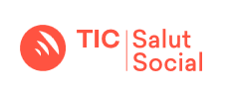
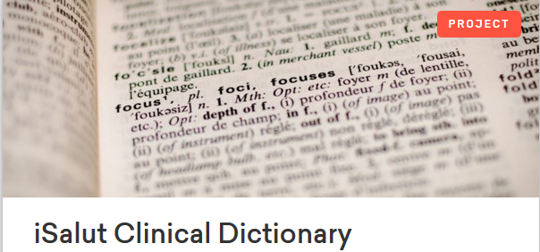
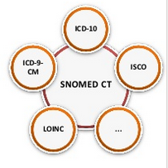
TIC Salut Social Foundation
iSalut Clinical Dictionary
as part of the Catalan Ministry of Health, works to promote the development and use of ICT and networking in the field of health, keeps abreast of new trends, innovation and emerging initiatives, and offers accreditation and product approval services.
The iSalut Clinical Dictionary is a transversal project that aims to normalize the vocabulary used by SISCAT (the Integrated Health System of the Public Health Network of Catalonia)
Leaded by the Office of Standards and Interoperability (TIC Salut)
The basis of the dictionary is SNOMED CT but also contains other controlled vocabularies (e.g. ICD9, ICD-10MC, LOINC, etc.).
Catalonian extension of the standard. Submissions to the Spanish Minister of Health.
Multidisciplinary team of experts from the Catalan Health System responsible for each domain. BITAC is involved in this group of experts.
Genomics Session. April Business Meeting, Thursday, 11th, April 2019
Notes:
Related to the use of SCT in Catalonia I would like to introduce here the project iSalut clinical dictionary.
The iSalut Clinical Dictionary is a transversal project that aims to normalize the vocabulary used by SISCAT (the Integrated Health System of the Public Health Network of Catalonia)
Leaded by the Office of Standards and Interoperability (TIC Salut)
The basis of the dictionary is SNOMED CT but also contains other controlled vocabularies that are already used by SISCAT, both locally and internationally (e.g. ICD 9, ICD10MC, LOINC, etc.). However, most are mapped to SNOMED CT to guarantee the semantic interoperability
New components of SNOMEDCT are created in the Catalonian extension of the standard and are submitted to the Spanish Minister of Health.
A multidisciplinary team of experts from the Catalan Health System is responsible for each domain. BITAC is involved in this expert group.

Slide 78
TIC Salut Social Foundation
iSalut Clinical Dictionary
Each of the dictionary’s domains works at the level of subsets
Nuclear Medicine
Allergies
Anatomic Pathology
Clinical Documents
Assessment Scales
Surgical Sheet
Active and passive immunizations
Groups of professionals (Occupations)
Spirometry report
Breast Cancer Screening Report
Laboratory (LOINC)
Procedures
Procedures attributes
Ophthalmology
Radiology
Clinic Variables
Wifis project
Genomics Session. April Business Meeting, Thursday, 11th, April 2019
Notes:
The dictionary manage some domains at the level of subsets eg: Allergies, Radiology or Laboratory. This is an open resource for all the Health Public Network in Catalonia.

Slide 79
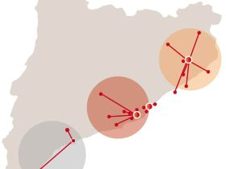
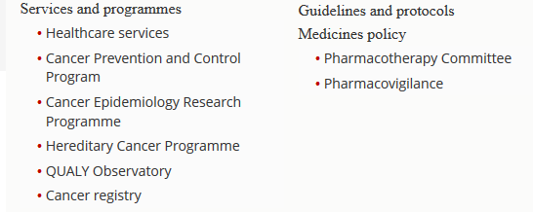
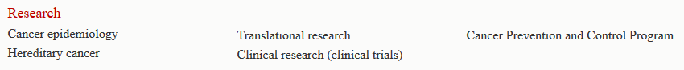
Catalan Institute of Oncology (ICO)
Currently, ICO is an oncology referral center for 40% of the adult population of Catalonia
Genomics Session. April Business Meeting, Thursday, 11th, April 2019
Notes:
Let´s see the second use case: The Catalan Institute of oncology is an oncology referral center for 40% of the adult population of Catalonia. They offer Healthcare services and cancer programs. Also is a research center in clinical and translational medicine.

Slide 80
Genetic study of Genes associated with Hereditary Colorectal Cancer
MINIMUN PATIENT CORE DATA
Clinical Suspicion/Reason for the study? | Free text
Epidemiology and Demographic Data | Free text
Phenothypic Data | Free text
Patient History
Family History/pedigree | Free text (Usually reported in the clinical suspicion)
GENOMIC TEST INFORMATION (Testing method)
Test orderable by | Free text
HGVS grouping term | Free text
Molecular Target | Free text
Laboratory order Identifier | Internal coded catalogue
Specimen source | Free text
Platform type | Free text
DNA analysis platform instrument and product | Product Name
Data analysis platform | Product Name
Primary test methodology | Free text
Coverage/regions or genes analyzed | RefSeq, LRG
Quality parameters | Free text
Notes:
This is a report model for genetic study of genes associated with Hereditary Colorectal cancer. As you can see They are not using standards to capture patient data and no standards for testing method apart from genetic codes (RefSeq or LRG) to identify the regions analyzed.

Slide 81
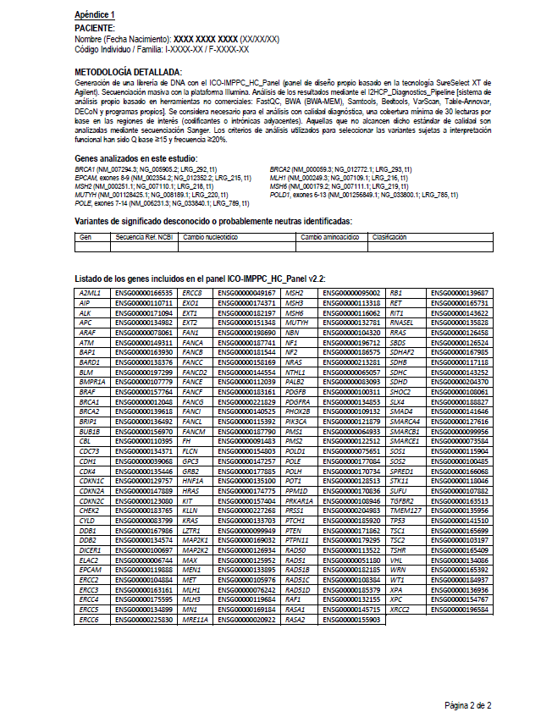
Genetic study of Genes associated with Hereditary Colorectal Cancer
MINIMUN PATIENT CORE DATA
Clinical Suspicion/Reason for the study? | Free text
Epidemiology and Demographic Data | Free text
Phenothypic Data | Free text
Patient History
Family History/pedigree | Free text (Usually reported in the clinical suspicion)
GENOMIC TEST INFORMATION (Testing method)
Test orderable by | Free text
HGVS grouping term | Free text
Molecular Target | Free text
Laboratory order Identifier | Internal coded catalogue
Specimen source | Free text
Platform type | Free text
DNA analysis platform instrument and product | Product Name
Data analysis platform | Product Name
Primary test methodology | Free text
Coverage/regions or genes analyzed | RefSeq, LRG
Quality parameters | Free text
Notes:
They report methodology details in an appendix using standards only to identify the region analyzed using RefSeq and LRG.

Slide 82
Genetic study of Genes associated with Hereditary Colorectal Cancer
LABORATORY REPORT (Result)
Analyte category | Free text
Mode of Inheritance | Not included but desirable
Allele origin | Not included but desirable
Gene ID nomenclature | HGNC (HUGO)
Variant Type | Controlled vocabulary
Variant ID Nomenclature | HGVS, LRF, RefSeq, genome build, transcript references
clinical Variant classification ID | IARC 5 classification system, Classification rules: ENIGMA, Insight, ACMG
Pathogenic Variant | Classification rules: ENIGMA, Insight, ACMG
Variants: Bening Type/Clinical significance | Classification rules: ENIGMA, Insight, ACMG
Variant Penetrance | Not included but desirable
Zygosity type | Controlled vocabulary
Molecular consequence | Not included but desirable
Functional consequence | Not included but desirable
Interpretation | Included in the associated clinical report
Genetic counselling | Included in the associated clinical report
Notes:
Related to results they use HGNC to identify the gene, HGVS, RefSeq and other codes to identify the sequence and classification systems and rules: IARC 5 (International Agency for research on cancer) or ACMG American College of Medical Genetics and Genomics to identify the clinical classification of the variant.
They don´t include some elements like: mode of inheritance, allele origin, penetrance, or molecular and functional consequence but claims that it will be desirable.
The interpretation and genetic counselling are reported in a associated clinical report.

Slide 83

Connecting rare disease researchers worldwide
RD-Connect is an integrated platform connecting databases, registries, biobanks and clinical bioinformatics for rare disease research.
Help researchers study rare diseases
Links different data types - omics (e.g. genomics), clinical information, patient registries and biobanks - into a common resource.
Enables scientists and clinicians around the world to analyze genomics data and share them with other researchers.
As a member of the International Rare Diseases Research Consortium (IRDiRC), RD-Connect contributed to research, improving diagnostics and development of new therapies for the rare disease patients worldwide.
Genomics Session. April Business Meeting, Thursday, 11th, April 2019
Notes:
What happens in research? RD-Connect is a platform that integrates in a common resource different omics data types, clinical information, patient registries and biobanks for rare disease research. Enables scientists and clinicians to analyze genomics data for improving diagnostics and development of new therapies. It is member of the International Rare Disease Research Consortium.

Slide 84

RD-Connect has built three integrated online systems open to any rare disease:
Genome-Phenome Analysis Platform(GPAP) for analysis and sharing of omics data to diagnose patients and discover new disease genes
Registry & Biobank Finder, a global directory of rare disease patient registries and biobanks
Sample Catalogue, which helps researchers find rare biosamples stored in biobanks
Genomics Session. April Business Meeting, Thursday, 11th, April 2019
Notes:
Integrate 3 online systems:
Genome-Phenome Analysis platform for analysis and sharing of omics data
Registry and Biobank finder
And Sample catalogue to help researches find rare biosamples stored in biobanks.

Slide 85




PhenoTips® is a software tool for collecting and analyzing phenotypic information of patients with genetic disorders.
Genomics Session. April Business Meeting, Thursday, 11th, April 2019
Notes:
The Genome-Phenome Analysis platform was designed to help clinicians and researchers to identify disease-causing mutations in their patients and confirm the diagnosis by finding matching cases submitted by other researches. The genomic data are transferred to EGA. Associated phenotypic data are recorded in the PhenoTips database using the HPO, OMIM and ORDO ontologies to permit machine-readable querying.

Slide 86
MINIMUN PATIENT CORE DATA
Clinical Suspicion/Reason for the study? | HPO/ORDO
Epidemiology and Demographic Data | HPO
Phenothypic Data | HPO
Patient History | No standard
Family History/pedigree | No standard
LABORATORY REPORT (Result)
Analyte category | No standard
Mode of Inheritance | HPO
Allele origin | HPO
Gene ID nomenclature | Ensembl, HGNC, OMIM
Variant Type | dbSNP
Variant ID Nomenclature | Ensembl
clinical Variant classification ID | ACMG, ClinVar
Pathogenic Variant | -
Variants: Bening Type/Clinical significance | -
Variant Penetrance | HPO
Zygosity type | No standard
Molecular consequence | snpEff/dbNSFP/Annovar
Functional consequence | -
Interpretation | -
Genetic counselling | -
GENOMIC TEST INFORMATION (Testing method)
Test orderable by | -
HGVS grouping term | No standard
Molecular Target | No standard
Laboratory order Identifier | -
Specimen source | -
Platform type | No standard
DNA analysis platform instrument and product | No standard
Data analysis platform | No standard
Primary test methodology | No standard
Coverage/regions or genes analyzed | OMIM (Clinical exome)
Quality parameters | Free text
Genomics Session. April Business Meeting, Thursday, 11th, April 2019
Notes:
Related to testing information OMIM is used to identify the region analyzed (when clinical exome) and related to testing results HPO is used to identify some elements: mode of inheritance, allege origin and penetrance. Ensemble, HGNC or OMIM to identify the gene, Ensembl to identify the variant, ACMG or ClinVar for clinical classification and for functional predictions of the variants annovar or related standards.

Slide 87

The Undiagnosed Rare Disease Program of Catalonia (URDCat)
URDCAT is a research project embedded into the “Pla Estratègic de Recerca i Innovació en Salut (PERIS) 2016-2020” funded by the Health Department of the Generalitat de Catalunya.
MAIN OBJECTIVE:
Enable the Catalan Health System to provide personalised genomic medicine as a fully integrated service for patients with RDs, initially as a pilot project for RDs with neurologic involvement.
Specific objectives:
  Standardise the process of analysis and integration of clinical and genomic data
  Implement a platform for analysis of genomics data that is suitable for clinical practice
  Identify causative genetic variants of undiagnosed RD patients
  Highlight the utility of genomics, and advance its usage as a tool of personalised medicine for RD diagnostics
  Educate and train stakeholders in the value and use of genomic data
www.urdcat.cat
Genomics Session. April Business Meeting, Thursday, 11th, April 2019
Notes:
The undiagnosed rare Disease Program of catalonia (URD_cat) enable the Catalan Health System to provide personalized genomic medicine as a fully integrated service for patient with RD with neurological involvement in the pilot project. The specific objectives of this project are:
- Standardize the process of analysis and integration of clinical and genomic data.
Implement a platform for analysis of genomics data that is suitable for clinical practice.
Identify causative genetic variants in RD
Highlighted the benefits of genomics, specially for personalized medicine
Educate and train stakeholders in the value and use of genomic data

Slide 88

The Undiagnosed Rare Disease Program of Catalonia (URD-Cat)
Coordinator: Luis Pérez Jurado (IMIM)
16 Groups
- 7 Hospitals (IIS)
- 3 CERCA centers
- FEDER (Patients)
IDIBELL
-IGTP
IIS-SP
ISGlobal
CNAG-CRG
BSC
IMIM (Coord)
IRS-IDIBAPS
VHIR
IRSJD
WP1. Clinical data: patient selection and characterization (Coordinator: Alfons Macaya)
WP2. Genomics: sequencing, analysis, interpretation and validation (Coordinator: Antonia Ribes)
WP3. Data analysis and Interpretation platform (RDCat) (Coordinator: Sergi Beltran)
WP4. Ethical, Legal and and Social Issues (Coordinator: Francesc Palau)
WP5. Training (Coordinator: Luis Pérez Jurado)
Genomics Session. April Business Meeting, Thursday, 11th, April 2019
Notes:
16 groups are involved in this project. 5 working packages are stablished for: Clinical data, Genomics, Data analysis and interpretation, Ethical, legal and social issues and training.

Slide 89






The Undiagnosed Rare Disease Program of Catalonia (URD-Cat)
URD-Cat platform workflow
EGA local
Standard analysis
(SNVs, InDels, CNVs, Mosaicism)
FASTQ/BAM
Submission
Sequencing lab
RD-Cat platform
(& QC metrics)
PhenoTips
Analysis
Tools
Clinician/Researcher
Dx Unit
EHR
Report
Powered by
Genomics Session. April Business Meeting, Thursday, 11th, April 2019
Notes:
This is the URD_Cat workflow where both genomic data and phenotypes are integrated. PhenoTips is integrated to collate phenotypic information of patients with genetic disorders.

Slide 90

URD-Cat PhenoTips module
URD-Cat has integrated PhenoTips (Brudno et al) to collate phenotypic information of patients with genetic disorders
In collaboration with clinicians (WP1):
Designed a specific form to collect all relevant phenotypic data
Guidelines and minimum sets of data required for the different disease types
Workflow for evaluation and communication
Information required and evaluated:
Type of neurologic disorder (IEM, Epilepsy, etc.)
Deep phenotyping (clinical AND biochemical parameters) using HPO, OMIM and ORDO
Usage in English or Spanish (PhenoTips: Posada et al. and HPO; Lapunzina et al.)
Previous genetic studies (MANDATORY)
Reproductive desire
Availability of Informed Consent
Image from https://phenotips.org/
Genomics Session. April Business Meeting, Thursday, 11th, April 2019
Notes:
This is a picture of the tool. PhenoTips module requires to inform some information and uses HPO, OMIM and ORDO for deep phenotyping (clinical and biochemical parameters).

Slide 91
Lessons learned
Clinical standards need genomic standards to support genomics and personalized medicine in EHR.
Phenotype standards are quite different in clinical care vs research.
Phenotype and genomic standards can be different depending on the scenario studied: Cancer, rare diseases, PGx…
For translational medicine the research standards must be linked with clinical standards.
Minimum core patient data and genomic data sets must be defined in each scenario (required, desirable..).
The Data integration group (BIB) is developing a “TASK force” to identify needs and solutions to integrate genomic data in EHR.
Some pilot studies are going to demonstrate which standards can support genomics in both Clinical care and research.
Bitac will be supporting the use of standards in this pilot studies.
Genomics Session. April Business Meeting, Thursday, 11th, April 2019
Notes:
So what we want to highlight in this presentation is summarized in these lessons learned.

Slide 92

Thank you

Slide 93
Genomics Strategy objectives
Objective 1: Identify key stakeholders with appetite for trial/adoption of SNOMED CT for Genomic Medicine
Objective 2: Identify and gather use cases to support and validate SNOMED CT in the context of Genomic Medicine
Objective 3: Restructure domain knowledge around clinical genomics in SNOMED CT
Objective 4: Demonstrate added value provided by SNOMED CT in the context of Genomic Medicine
Objective 5: Raise awareness around SNOMED CT globally, and reinforce its suitability for supporting Precision Medicine

