Slide 1




SNOMED CT and Genomics
Charles Gutteridge
Clinical Engagement Lead Europe

Slide 3

Human interoperation

Slide 4


Slide 5
Why do we need standardised vocabularies?
Developing actionable insights
Clinical characteristics
Counting
Patient level
Prediction
What will happen to me?
Population health estimation
Can we find a cause?

Slide 6
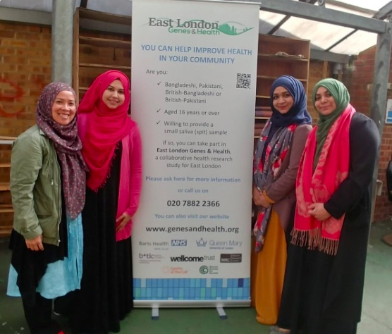

Slide 7
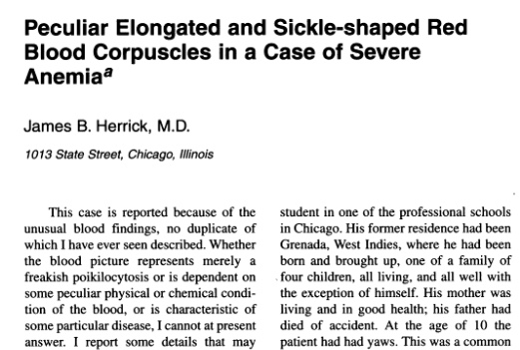

Slide 8
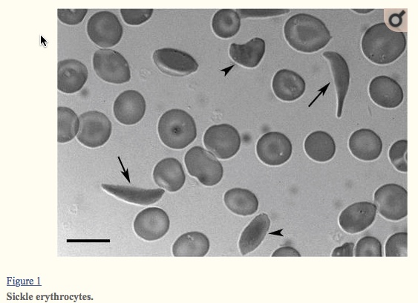

Slide 9
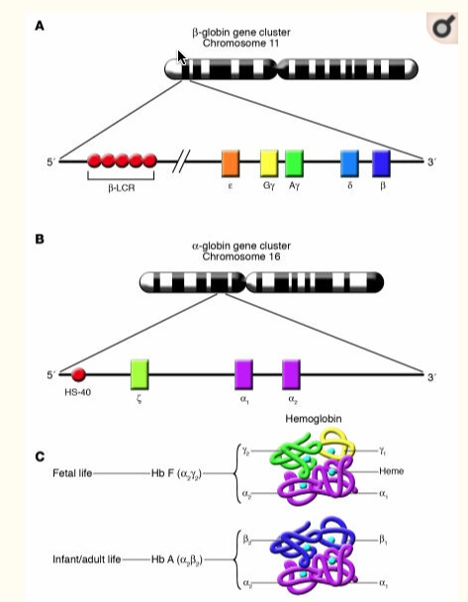

Slide 10
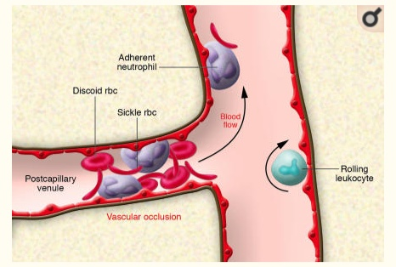
Biology of sickling

Slide 11
Understanding the multigenic phenotype
Why it matters:
  Stroke in 11% of 20 year olds
  Stroke in 24% of 45 year olds
Mutations targeting epistatic genes
  Adherence
  Thrombosis
  RBC dehydration
  Inflammation

Slide 12
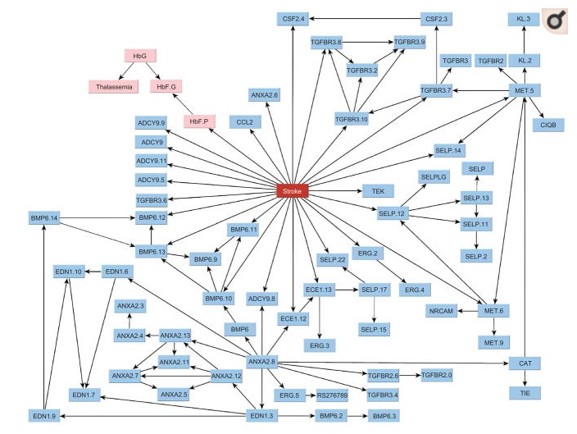

Slide 13
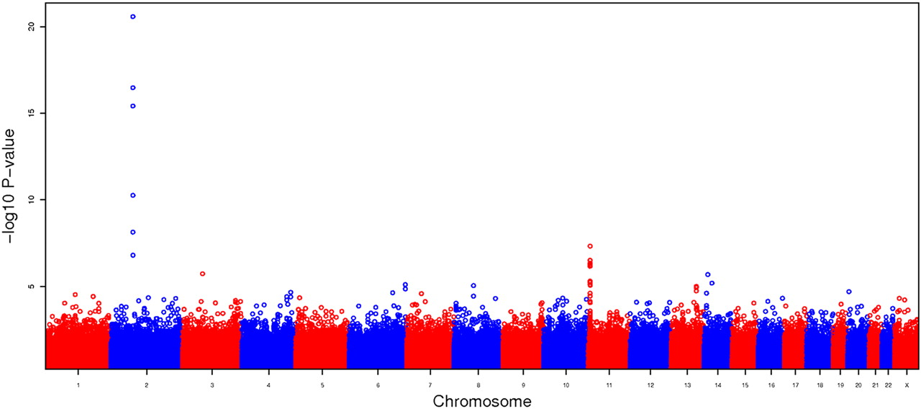

Manhattan plot summarizing the GWAS results for CSSCD using the additive model.
Nadia Solovieff et al. Blood 2010;115:1815-1822
©2010 by American Society of Hematology
Notes:
Manhattan plot summarizing the GWAS results for CSSCD using the additive model. The large spike on chromosome 2 corresponds to a region containing BCL11A, and the moderate spike on chromosome 11 corresponds to a region containing olfactory genes OR51B5 and OR51B6.

Slide 14
Genetic determinants of HbF levels and haemolysis
SNP 7203560 in NPRL3 (chr16p13.3)
Other variants in NPRL3 linked to familial focal epilepsy and focal cortical dysplasia
BCL11A gene
B cell tumours
Intellectual disorders with elevated HbF

Slide 15
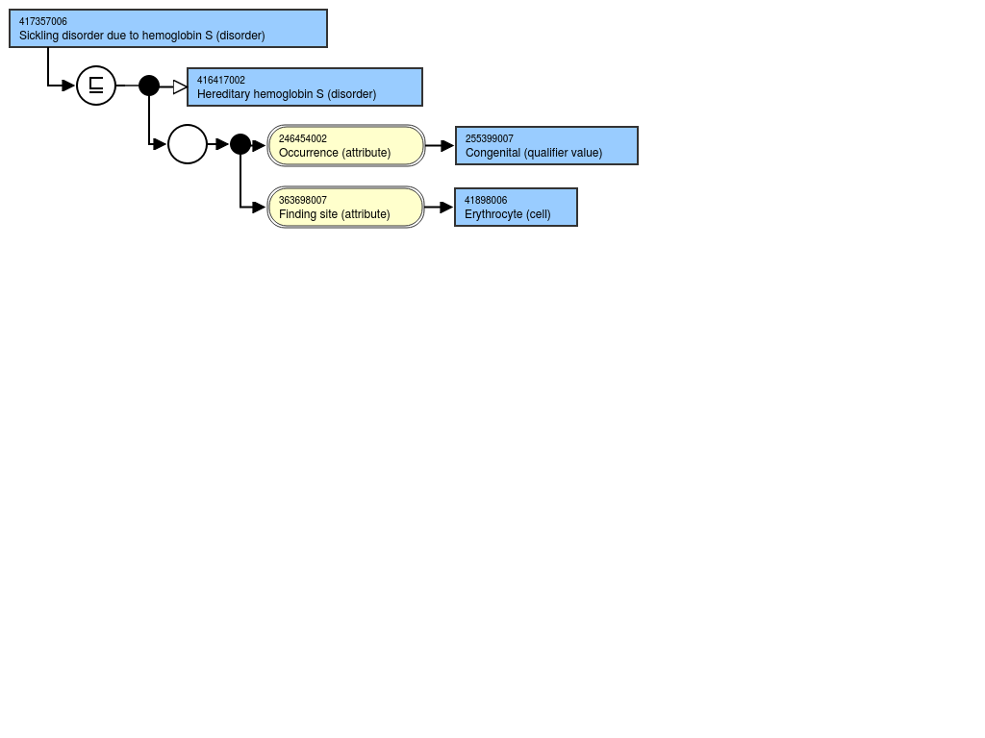
SNOMED CT representation

Slide 16

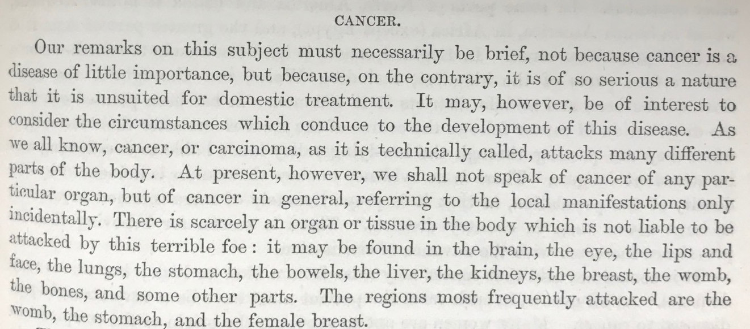

Slide 17
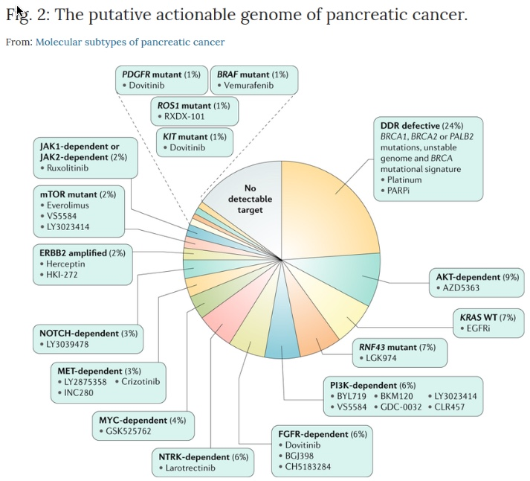

Slide 18
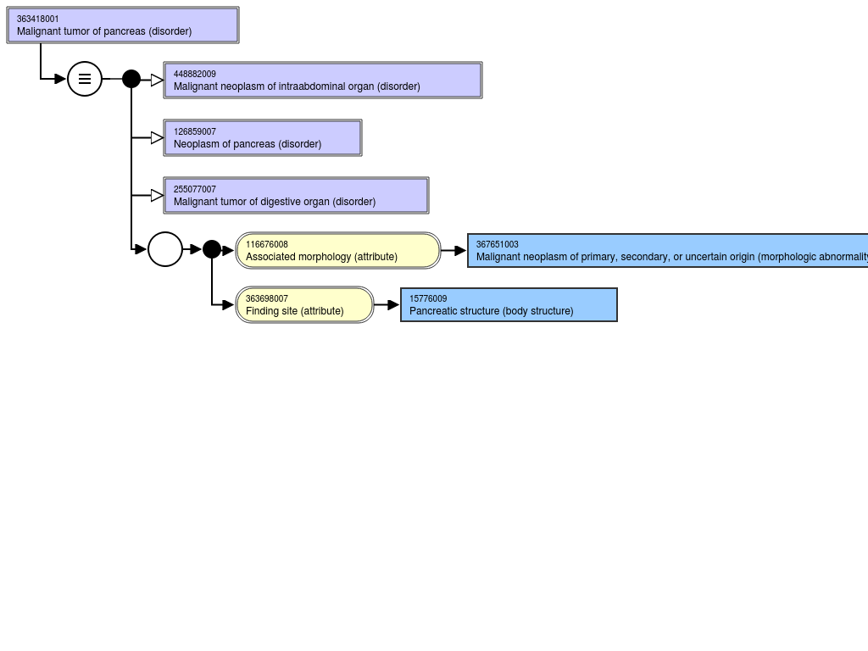
Cancer of pancreas

Slide 19
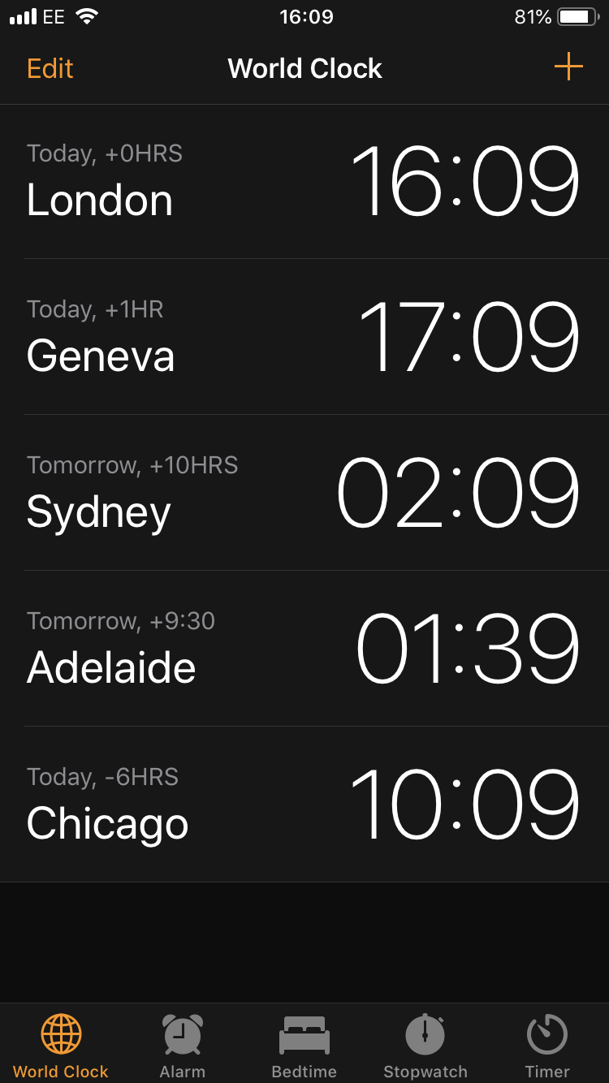

Slide 20
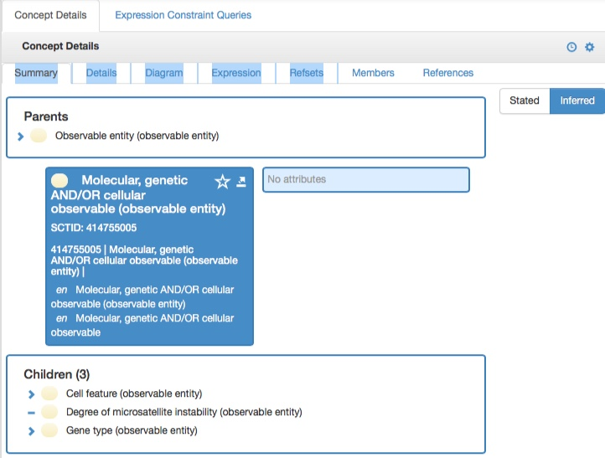

Slide 21
What is required?
Development of SNOMED Content Model
  Clinical finding, observable entity, body structure, substance
Improved information models for longitudinal data capture
Maps/links to other biological and medical ontologies
Implementation in laboratory systems
Implementation in EHR systems
Analytics using logical model in SNOMED using real world data
Global collaborations – genomics, data science and care delivery
Training and curriculum development of health care professionals

