Slide 1


SNOMED CT content coverage in support of genomic medicine
SNOMED CT
Genomics Session
London, UK
April 11, 2010
Olivier Bodenreider and David Herion
National Institutes of Health, Bethesda, Maryland, USA

Slide 2
Motivation
What concepts should be available on a problem list in the era of genomic medicine?
  Genetic variation
  Genetic diseases
  Specific phenotypes

Slide 3
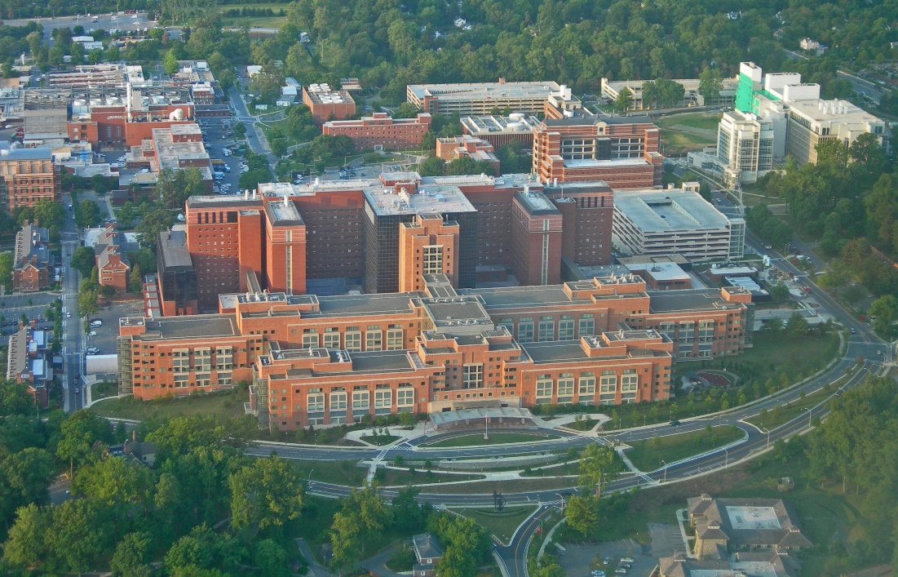
NIH Clinical Center
Research hospital
  4,500 inpatient admissions in 2018
  95,000 outpatient visits in 2018
  1300 physicians and 830 nurses
Patients from all 50 states in the US and from around the world
1,600 clinical research studies in progress
  Studies of the natural history of disease, especially rare diseases
  Clinical trials, predominantly Phase I and Phase II, often first-in-human to test safety and efficacy

Slide 4
Problem list in the era of genomic medicine – a few examples for illustration purposes
BCR-ABL1 translocation
  Causal relationship to AML
Vitamin D receptor polymorphisms
  E.g., BsmI [allele B/b, single-nucleotide polymorphism (SNP) G>A, rs1544410]
  Risk for osteoporosis, particularly with glucocorticoid administration
Apo Ɛ4
  Risk-modifying genes for Alzheimer Disease
  250695009 | Apolipoprotein E phenotype E4:4 (finding) |
CFTR mutations
  Associated not only with cystic fibrosis, but also clinically isolated pancreatic insufficiency, and non-tuberculous mycobacterial infection

Slide 5
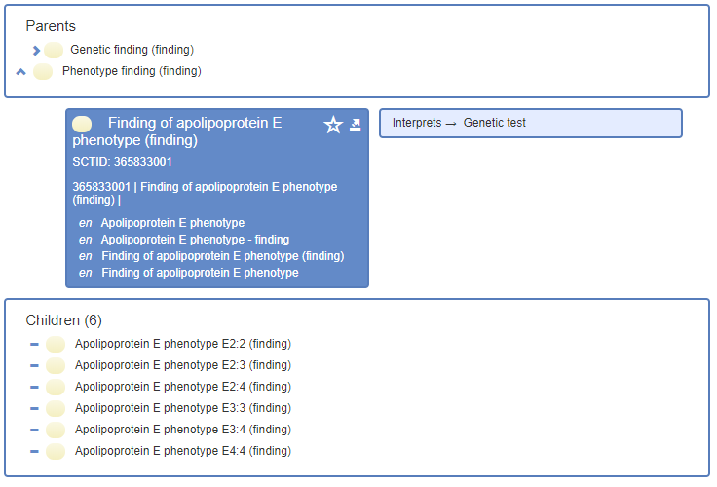
Risk-modifying genes for Alzheimer Disease

Slide 6
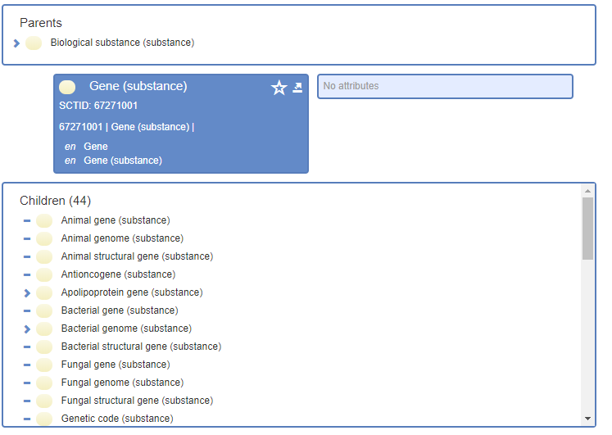
Genetic variation in SNOMED CT – genes

Slide 7
Genetic variation in SNOMED CT – genes
SNOMED CT only has a handful of specific genes
  441471003 | Proprotein convertase subtilisin/kexin type 9 gene (substance) |
  442411007 | Apolipoprotein B (including Ag(x) antigen) gene (substance) |
  412642004 | Apolipoprotein E gene (substance) |
  707675004 | Neutrophil gelatinase associated lipocalin (substance) |

Slide 8
Genetic variation in SNOMED CT – genetic variants
SNOMED CT has types of genetic variants as findings
  471282000 | Chromosome microdeletion (finding) |
  50334000 | Genetic polymorphism (finding) |
Genetic translocation is not listed, but specific translocations are referred to
  444157002 | Detection of BCR-ABL t(9;22) translocation (procedure) |

Slide 9
Genetic variation in SNOMED CT – mutations
SNOMED CT has a handful of specific mutations as findings
  719007008 | Positive for tumor protein p53 (finding) |
  412738007 | BRCA2 gene mutation positive (finding) |
SNOMED CT has 22 of the CYP450 variants as findings (pharmacogenomics)
  738545001 | Cytochrome P450 family 2 subfamily C member 9 poor metabolizer (finding) |
Not all mutations are under 55446002 | Genetic mutation (finding) |

Slide 10
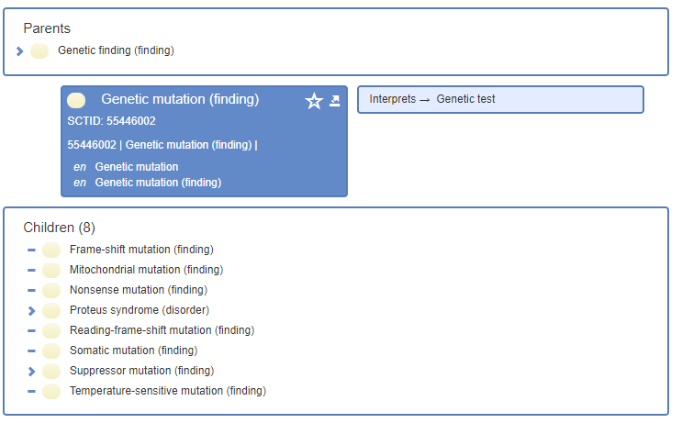
Genetic variation in SNOMED CT – mutations

Slide 11
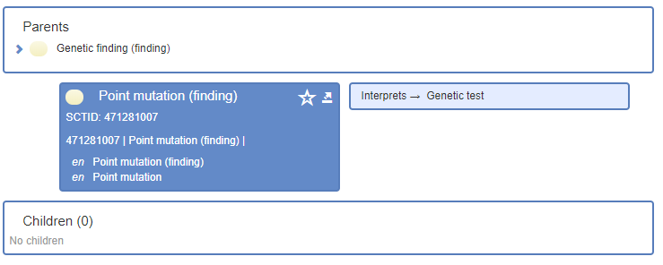
Genetic variation in SNOMED CT – mutations
SNOMED CT has most types of mutations, although not necessarily under 55446002 | Genetic mutation (finding) |

Slide 12
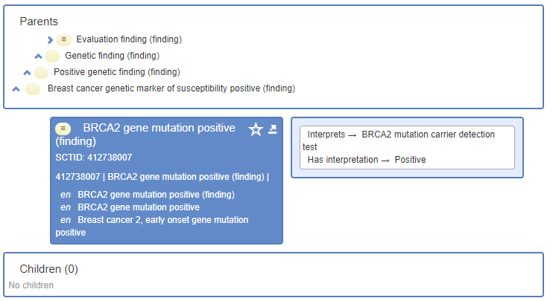
Genetic variation in SNOMED CT – mutations

Slide 13
Genetic variation in SNOMED CT – genetic diseases
Better represented in SNOMED CT since Orphanet content has been included
Coverage still incomplete
  E.g., Hyper IgE Syndrome (HIES)
    autosomal dominant (AD, or type 1) form
    autosomal recessive (AR, or type 2) form

Slide 14
Discussion
Genes
  Should they be included in SNOMED CT?
    Only the genes of clinical significance?
  Recommendations for an alternative?
    Interoperability with SNOMED CT?
Genetic variation
  Should genetic variants (including SNPs) be included in SNOMED CT?
    Yes when actionable
    Would support annotation directly by sequencing companies
    Pre-/post-coordinated?
  Recommendations for an alternative?
    Interoperability with SNOMED CT?
Genetic diseases and phenotypes
  How much granularity should be in SNOMED CT?
  Recommendations for a finer grained reference?
    Interoperability with SNOMED CT?

Slide 15

olivier.bodenreider@nih.gov

