Slide 1


E-Learning Advisory Group
Wednesday 10th April 2019
Waldorf Hilton Hotel, London, UK
Linda Bird
Head of Education and Product Support

Slide 2

Mackenzie Room
1:30pm – 3:00pm
3:30pm – 4:30pm
WELCOME !!

Slide 3

Agenda
Introductions
ELAG administration
ELAG Member reports
SNOMED International update
  EPS work plan
  Foundation courses
  Implementation course
  Authoring levels 1 and 2
  SNOMED for developers
  SNOMED for data analysts
  SNOMED for clinicians
  Other education activities
Feedback and discussion

Slide 4
INTRODUCTIONS

Slide 5

ELAG
Administration

Slide 6

Declaration of Interests
Could all members of ELAG please
  Go to http://snomed.org/elag
  Click on Group Members → Declaration of Interests
  Add any potential conflicts of interest
  Update the ‘Last updated’ date
  (even if no changes)
  Note: If you don’t have access
  please email lbi@snomed.org

Slide 7
ELAG Terms of Reference
Purpose
  To facilitate delivery of E-Learning products and services for development of knowledge and skills related to SNOMED CT
Scope
  Informing, contributing to, supporting and reviewing
    SNOMED International’s E-Learning products and services
  Advising on, supporting and encouraging use of
    SNOMED International’s E-Learning resources
  Sharing information between
    SNOMED International, its Members and
    other stakeholders
  Advising on Member education priorities

Slide 8
ELAG Membership
Kirstine Gøeg Expert Advisor
Penny Livesay Expert Advisor
Marcelo Carrascal Argentina
Aileen dela Pena Australia
Katrien Scheerlinck Belgium
Linda Parisien Canada
Camilla Wiberg Denmark
Danielsen
Krista Kärt Estonia
Mikko Hårkønon Finland
Vicky Fung Hong Kong
Manisha Mantri India
  Theresa Barry Ireland
Kristina Dienine Lithuania
Syazrin bin Malaysia
Mohd Sakri
Pim Volkert Netherlands
Aleksandar New Zealand
Zivaljevic
Marianne Norway
Bartvedt van Os
Agnieszka Poland
Suchodolska
Leandro Luis Portugal
Gonzalo Marco Spain
Cuenca
Daniel Karlson Sweden
Pero Grgic Switzerland
Fernando Portilla Uruguay
Katharine Priest UK
Suzy Roy USA

Slide 9
ELAG Workplan 2019
Meetings
  April 2018 – London, UK
  October 2018 – Kuala Lumpur, Malaysia
Objectives
  To review and provide advice on authoring course and certification
  To review and provide advice on developers course and certification
  To provide advice on education collaborations and partnerships
  To advise on national and international education priorities
  To participate in sharing for translation and national use

Slide 10

ELAG
Member Reports

Slide 11

ELAG Member Reports
SNOMED CT education activities in your region
  New or planned SNOMED CT education activities
  Feedback on existing SNOMED CT E-Learning experiences
  National or regional SNOMED CT priorities
  Education collaboration or partnership opportunities
  CME/CPD course accreditation recommendations for regions

Slide 12
ELAG Member Reports
Australia – Aileen dela Pap (by email)
Belgium – Ingrid Mertens
Canada – Linda Perisien
Denmark – Camilla Wiberg Danielsen
Estonia – Krista Kart (by email)
Finland – Mikko Hårkønen
India – Manisha Mantri (by email and phone)
Ireland – Theresa Barry
Malaysia – Syazrin bin Mohd Sakri
Sweden – Daniel Karlson
Switzerland – Pero Grgic
U.K. – Katharine Priest

Slide 13

SNOMED International Update

Slide 14
Education and Product Support Team
Mission
  To increase awareness, knowledge and understanding of SNOMED CT and to improve the ease and effectiveness of SNOMED CT implementations
Scope
  Development, maintenance and delivery of:
    E-Learning materials
    Guides
    Technical specifications
    Reference documents
    Product support responses
    Presentations at specific events

Slide 15
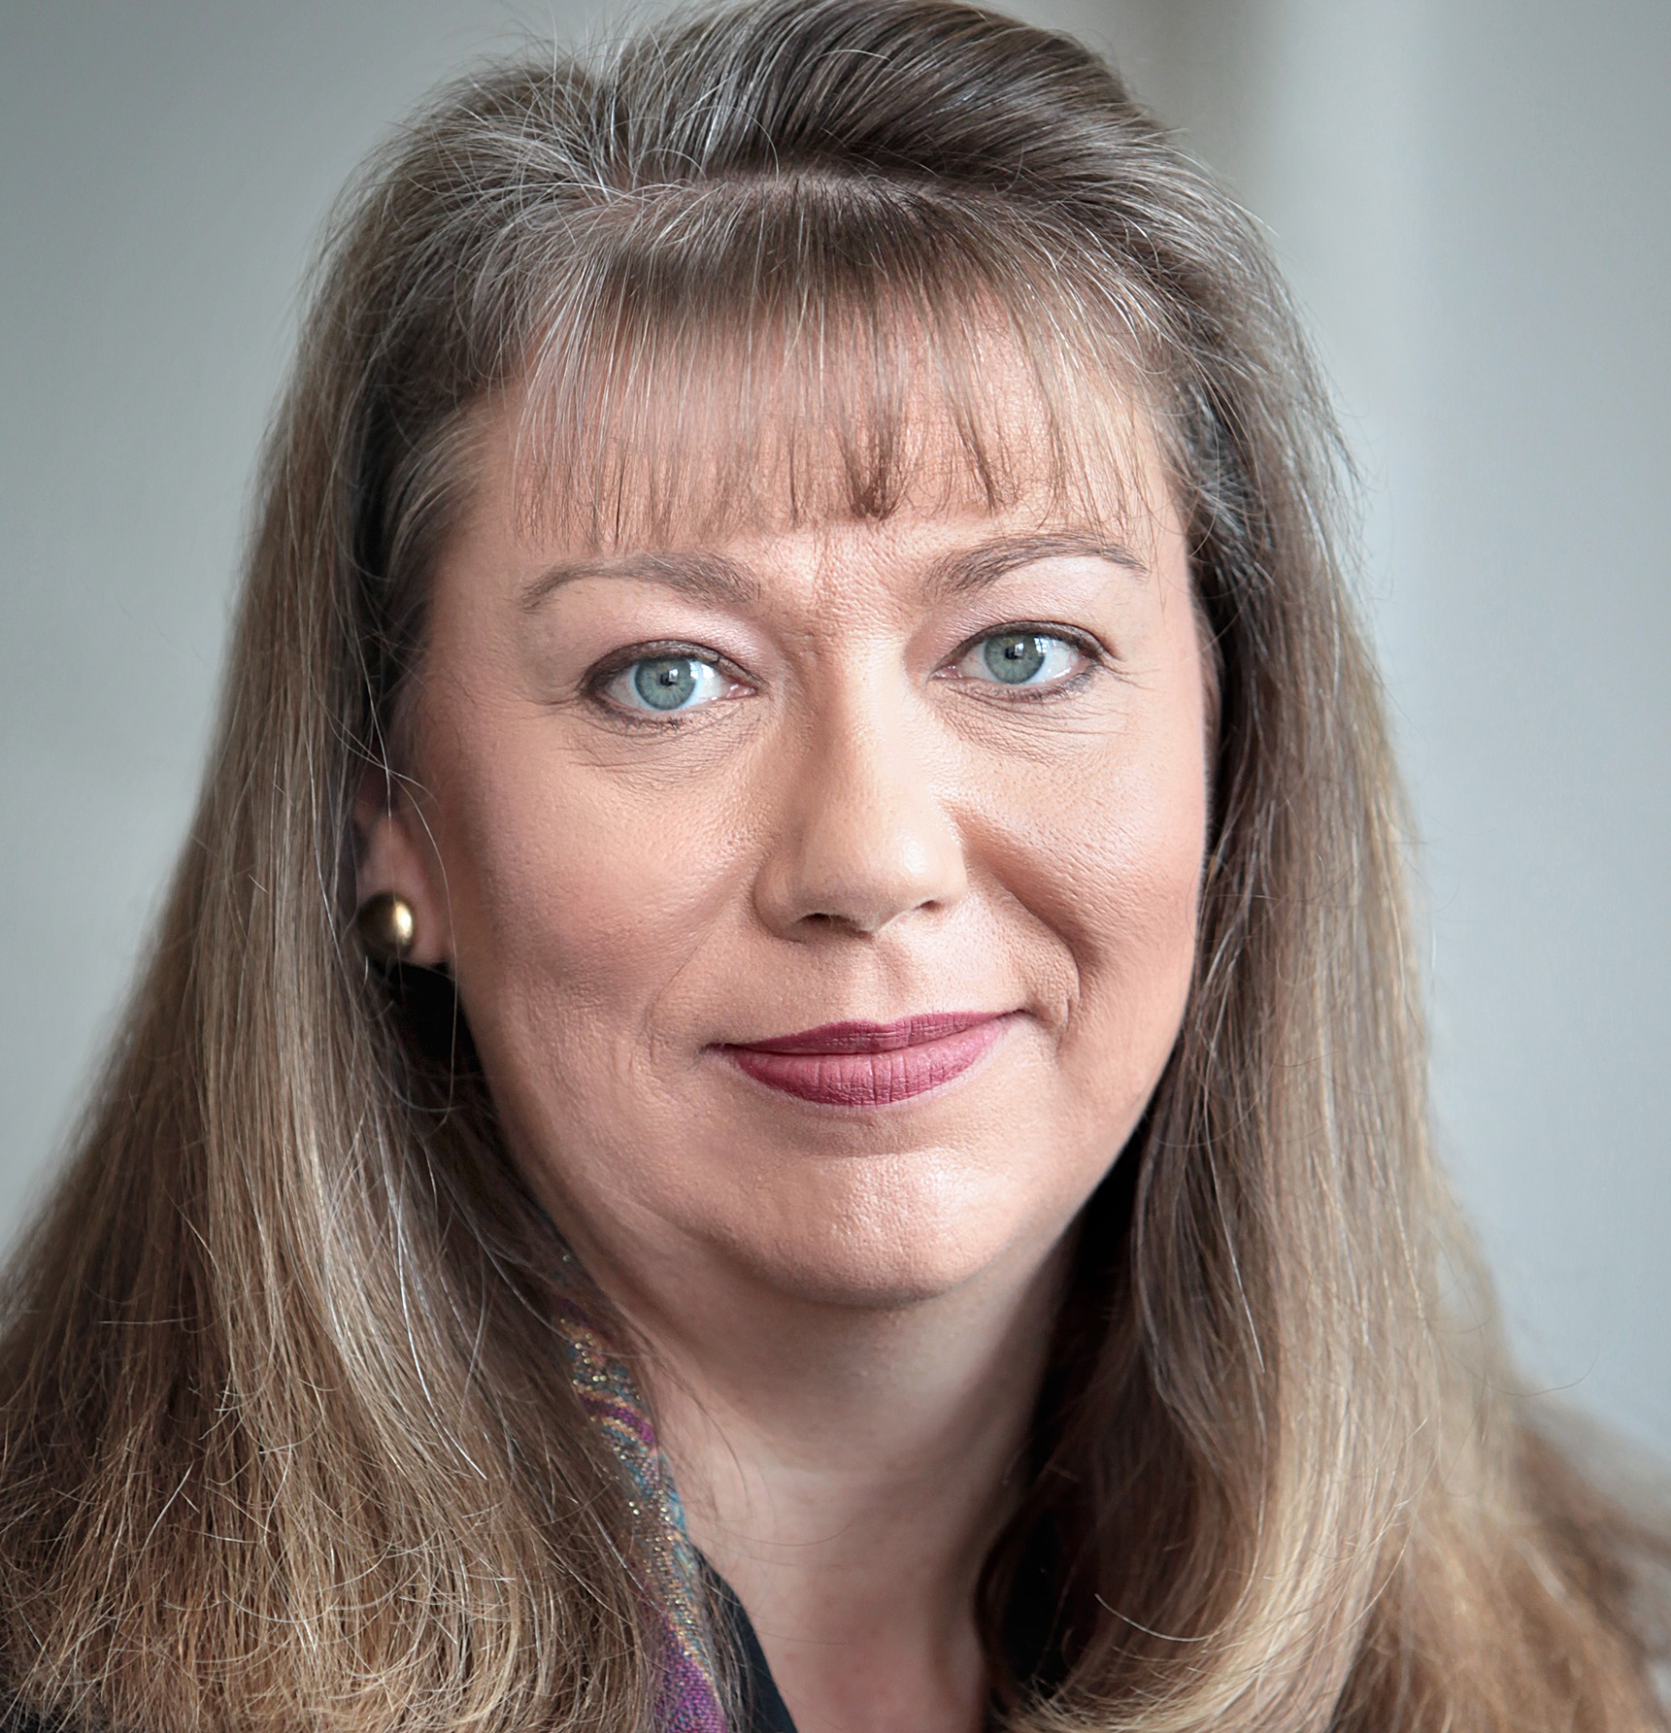

Education and Product Support Team
Linda Bird
Head of Education & Product Support
David Markwell
Senior Product Support Specialist
Anne Højen
Education & Product Support Specialist
Jon Zammit
Education & Product Support Specialist
Ian Spiers
Terminology Education Specialist
Cathy Richardson
Senior Terminologist
Louise Jones
E-Learning Administrator
Penny Livesay
E-Learning
Authoring Specialist

Slide 16
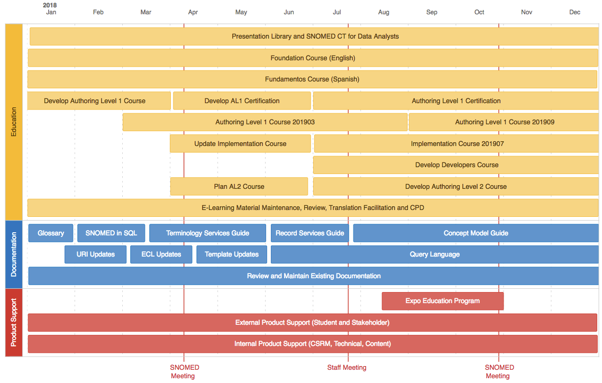

EPS Work Plan 2019
Education
Documentation
Product Support

Slide 17

EPS Work Plan 2019
Documentation
  SNOMED Glossary - http://snomed.org/gl
  Accessing SNOMED CT using SQL
  SNOMED language specifications
  Concept model practical guide
  Significant updates to
    Terminology Services Guide - http://snomed.org/tsg
    Record Services Guide - http://snomed.org/rsg
Product support
  Expo tutorials
  Support for external stakeholders
    User support reference group (USRG)
  Support for internal stakeholders
    MRCM and HRCM updates

Slide 18
EPS Work Plan 2019
Education
  Foundation courses
    Continue delivery of English and Spanish courses
  Authoring courses
    Develop and deliver level 1 course and certification
    Plan and develop level 2 course
  Implementation course
    Revise, improve and deliver course (from July 2019)
  Developer course
    Plan and develop course (2019) and certification (2020)
  E-Learning platform and course catalogue
    Maintain and update
  CME/CPD credits
    Develop strategy and recommendations

Slide 19

SNOMED CT Course Catalogue

Slide 20
SNOMED CT Education
http://snomed.org

Slide 21
SNOMED CT Education
http://snomed.org/education
SNOMED CT Courses and Certification
SNOMED CT E-Learning Services
SNOMED CT Starter Tutorials
SNOMED CT Presentation Library
SNOMED CT Document Library

Slide 22
SNOMED CT Course Catalogue
The SNOMED CT Course Catalogue offers education courses and certification exams for beginners through to advanced users of SNOMED CT
https://courses.ihtsdotools.org or http://snomed.org/courses

Slide 23
SNOMED CT Courses
SNOMED CT Foundation Course
Curso de Fundamentos de SNOMED CT
SNOMED CT Implementation Course
SNOMED CT Authoring Level 1 Course / Certification
SNOMED CT
for Developers
SNOMED CT
for Data Analysts

Slide 24

Enhanced Member Benefits
Each Member is entitled to
  FREE SNOMED CT Foundation Course for all students
  Membership discount for all education courses
  NRC access to 1 FREE enrolment in each course per year
  NRC access to 1 FREE enrolment in each certification per year
Member discounts are offered automatically on login
To claim free NRC enrolment in education courses
  MF rep to email elearning@snomed.org
  Request ‘Member free’ voucher
  Include name and email of student
  Include planned course and intake
  Voucher will be provided for use
  in Course Catalogue

Slide 25

SNOMED CT Foundation Courses

Slide 26
SNOMED CT Foundation Course
Provides an introduction to a broad range of SNOMED CT related topics, including the why, what and how of SNOMED CT
What
  3 modules each containing 6 presentations and 1 assessment
  Final assessment at end of course
When
  Ongoing enrolment with immediate start
Fees
  FREE for students from SNOMED International Members
  Students from non-Member countries / territories
    400 USD - high income countries
    200 USD - middle income countries
    FREE - low income countries

Slide 27
Curso de Fundamentos de SNOMED CT
Este curso proporciona una introducción a un conjunto amplio de temas relacionados con SNOMED CT, incluyendo el por qué, el qué y el cómo de SNOMED CT
Qué
  3 módulos cada uno con 6 presentaciones y 1 evaluación
  Evaluación final
Cuando
  Inscripción continua con inicio inmediato.
Costo
  GRATIS para estudiantes de SNOMED International Members
  Estudiantes de países / territorios no miembros
    400 USD - paises de altos ingresos
    200 USD - países de ingresos medios
    GRATIS - países de bajos ingresos

Slide 28
SNOMED CT Foundation Courses
Student numbers
  English
    Completions – 1,976 (from 70 countries)
    Active – 210
  Spanish
    Completions – 68 (from 6 countries)
    Active – 138
Totals
  Completions – 2,044
  Active – 348

Slide 29
SNOMED CT Foundation Course (Spanish)
Enrolments

Slide 30
SNOMED CT Implementation
Course

Slide 31
SNOMED CT Implementation Course
Provides an in depth understanding of the stages in implementing a SNOMED CT enabled system – from
the decision to adopt SNOMED CT, through to design, procurement, development and use
What
  6 modules each with online presentations, tutor-led webinar, assignment and assessment, plus assessment at end of course
  Fixed schedule over 7 months (around 70 hours of study)
When
  Intakes start July and January
Fees
  Members - 500 / 250 / 50 USD (high/middle/low)
  Non-Members - 1000 / 500 / 100 USD (high/mid/low)

Slide 32
SNOMED CT Implementation Course
Student numbers
    Completions – 519
    Active – 0
Enrolments in July 2019 course
NOW OPEN!
(Relaunched with updated course materials)

Slide 33

SNOMED CT Authoring
Level 1 Course

Slide 34
SNOMED CT Authoring Level 1 Course
Teaches you the knowledge and skills needed to perform basic SNOMED CT authoring tasks, and prepares you for the SNOMED CT Authoring Level 1 certification exam
What
  5 modules each with online presentations, tutor-led webinar, assignment and assessment, plus additional exercises
  Students practice authoring on training authoring platform
  Fixed schedule over 5 months (around 70 hours of study)
When
  Intakes start March and September
Fees
  Members - 500 / 250 / 50 USD (high/middle/low income)
  Non-Members - 1000 / 500 / 100 USD (high/middle/low income)
  Additional discount for CDT course graduates (upon request)

Slide 35
SNOMED CT Authoring Level 1 Course
Student numbers
  Content Development Theory Course
    Completions – 296
  Authoring Level 1 Course
    Completions – 13 (Pilot)
    Active – 34 (March 2019)
Enrolments in September 2019 course NOW OPEN!

Slide 36
Authoring Level 1 Course – Modules
Introduction to authoring and requests
  Hierarchies, concept model, editorial guidance, logical design, versioning, extensions
Tooling, procedures and anatomy
  Authoring platform functionality, MRCM, attribute hierarchies, metadata
Content creation and clinical findings
  Context, qualifiers, record artifacts, events, naming, definings, DL
Content changes, products and substances
  Physical object, physical force, staging & scales, social context
Content authoring, inactivation & issues
  Observable entity, organism, specimen, environment & geographic location

Slide 37
Authoring Level 1 Course – Exercises
Request submission and management
Authoring platform functionality (and FSN quiz)
Concept authoring (and FSN quiz)
Concept review and correction
Concept inactivation and analysis

Slide 38
Authoring Level 1 Course – Pilot Feedback
Questions
Overall rating (4.25 out of 5)
Course met expectations, met professional
needs, timescale was suitable
How helpful was the following course materials?
Would you recommend course to others? (100%)
How could course be improved?
Strengths, weakness, single biggest
improvement, recommendations to
future students, other comments

Slide 39
Authoring Level 1 Course – Pilot Feedback
Comments
It was indeed a great learning experience
It was practical and I learnt a lot more about SNOMED
I really enjoyed the opportunity to practice
authoring on the authoring platform
My congratulations to you and your colleagues
in developing such a good course!

Slide 40
Authoring Level 1 Course – Pilot Feedback
Suggestions
More timely feedback on assignments
More reference to specific parts of Ed Guide
More help with FSN construction
Even more hands-on exercises
More practical exercises in module A
Make exercises available before webinars
so students can prepare and think about it
Demo

Slide 41

SNOMED CT Authoring Level 1 Certification

Slide 42
SNOMED CT Authoring Level 1 Certification
Recognizes your competence in performing basic SNOMED CT authoring tasks
What
  To achieve this certification you must pass the certification exam
  Exam includes a range of knowledge and skills based activities
  Exam will be proctored / invigilated
When
  Exam to be available from mid 2019
Fees
  Members - 200 USD
  Non-Members - 400 USD

Slide 43
Authoring Level 1 Certification
Recognizes your competence in performing basic SNOMED CT authoring tasks
Certification Plans
Currently being waitlisted (via course catalogue)
Exam available mid 2019
Proctoring solution currently being selected
Exam will include theory questions
plus hands on authoring exercises
on training authoring platform
Will publish curriculum and
supporting materials
http://snomed.org/certification

Slide 44
SNOMED CT Authoring Level 2 Course

Slide 45
Authoring Level 2 – Draft Topics
Authoring principles
    Advanced authoring principles, literature evaluation principles, mutability, historical associations, promotion, demotion
Authoring tooling techniques
    Expression constraints, queries, templates, reporting, batch authoring, MRCM, collaborative authoring
Authoring with description logic
    DL overview, SNOMED logic profile, definition status, minimum sufficient definitions, axioms, GCIs, existential restriction
Review and quality assurance
    Quality criteria, quality assurance and analysis, predicting and understanding classification results, content review and release processes, detecting and correcting errors, other considerations
Authoring specialties
    Clinical findings, procedures, pharmaceutical products

Slide 46

SNOMED CT for
Developers

Slide 47
SNOMED CT for Developers
A collection of E-Learning resources designed to teach software developers enough about SNOMED CT in as short as possible a time to develop software applications that leverage its capabilities
What
  5 topics with around 20 hours of presentations
    Introduction, Essentials, Specifications, Terminology services, Record services
  List of available resources for each topic
When
  Ongoing enrolment with immediate start
Fees
  Currently offered for FREE
  (fees to be introduced at a later date)

Slide 48
SNOMED CT for Developers
Student numbers
    Enrolments – 359 (180 since October 2018)
Plans
  Create a SNOMED Developers Course (late 2019)
    Possible modules
      SNOMED CT essentials
      SNOMED CT in SQL
      SNOMED CT terminology services
      SNOMED CT on FHIR
      SNOMED CT in the user interface
  Add a SNOMED Developers Certification (2020)

Slide 49

SNOMED CT for
Data Analysts

Slide 50
SNOMED CT for Data Analysts
A collection of E-Learning resources designed to give data analysts a solid understanding of how SNOMED CT can be used to support clinical data analytics requirements
What
  4 topics with around 15 hours of presentations
    Introduction, Features, Content, Analytics
  List of available resources for each topic
  Practical exercise to test understanding in an interactive way
When
  Ongoing enrolment with immediate start
Fees
  Currently offered for FREE
  (fees to be introduced at a later date)

Slide 51
SNOMED CT for Data Analysts
A collection of E-Learning resources designed to give data analysts a solid understanding of how SNOMED CT can be used to support clinical data analytics requirements
Student numbers
    Enrolments – 360 (181 since October 2018)

Slide 52
SNOMED CT for Data Analysts
A collection of E-Learning resources designed to give data analysts a solid understanding of how SNOMED CT can be used to support clinical data analytics requirements
What
  4 topics with around 15 hours of presentations
    Introduction, Features, Content, Analytics
  List of available resources for each topic
  Practical exercise to test understanding in an interactive way
When
  Ongoing enrolment with immediate start
Fees
  Currently offered for FREE
  (fees to be introduced at a later date)
New video available!
Powering clinical data analytics with SNOMED CT

Slide 53

Other
SNOMED
Education
Activities

Slide 54

CME / CPD Environment Scan
Goal
  To increase the uptake of SNOMED CT education by providing CME/CPD credits to students who participate in SNOMED CT courses
Approach
  Perform an environment scan of CME/CPD rules and processes
  Consider all 3 regions – Americas, EMEA and Asia Pacific
  Determine whether CME/CPD credits can be
  offered to SNOMED International students in
  a scalable and cost effective way
Discussion
  Which of the following organizations
  should we investigate? Any others?
  Any key contacts or advice?

Slide 55
CME / CPD Environment Scan - Americas
Medical
  Accreditation Council for Continuing Medical Education (ACCME)
  American Medical Association (AMA)
  American Academy of Family Physicians (AAFP)
  American Association of Nurse Practitioners (AANP)
  Committee on Accreditation of Continuing Medical Education (Canada)
  Royal College of Physicians and Surgeons of Canada
  Federation of Medical Regulatory Authorities of Canada
  College of Family Physicians in Canada
Health Informatics
  American Health Informatics Management Association (AHIMA)
  American Medical Informatics Association (AMIA)
  Canadian Health Information Management Association (CHIMA)
  Canadian College of Health Information Management (CCHIM)

Slide 56
CME / CPD Environment Scan - EMEA
Medical
  European Union of Medical Specialists (EUMS)’s European Accreditation Council for Continuing Medical Education (EACCME)
  European Board for Accreditation in Cardiology / Hematology etc
  Federation of Royal Colleges of Physicians of the UK
  Royal College of General Practitioners in the UK
  Nursing and Midwifery Council
  Royal College of Physicians of Ireland
  Health Professions Council of South Africa
Health Informatics
  European Federation for Medical Informatics

Slide 57
CME / CPD Environment Scan - Asia Pacific
Medical
  Australian Medical Association
  Royal Australian College of General Practitioners
  Royal Australasian College of Surgeons
  Royal Australasia College of Physicians
  Australian Association of Practice Management
  Royal New Zealand College of General Practitioners
  National University of Singapore – Centre for Medical Education
  Singapore Medical Council
  Hong Kong Academy of Medicine
  Hong Kong College of Family Physicians
Health Informatics
  Certified Health Information Australasia (CHIA)
  Australian Computer Society (ACS)

Slide 58
CME / CPD Environment Scan - International
Medical
  World Federation of Medical Education
Health informatics
  International Academy for CPD Accreditation

Slide 59
Potential Education Institution Partnerships
Translation, delivery and maintenance of
  Spanish Implementation Course
  Chinese Foundation Course
  Chinese Implementation Course
  Others?
Incorporate material into broader curriculum – e.g.
  NHS Digital’s Post Graduate Diploma in Digital Health Leadership
Other collaboration opportunities?

Slide 60

Next Steps
Advertise these education services in your country/territory
  Visit http://snomed.org/courses to enrol in a course
MF representatives please
  Nominate an ELAG representative
  Request your NRC free enrolment vouchers
Send questions, requests and feedback
to elearning@snomed.org

Slide 61

Feedback and Discussion

Slide 62

THANK YOU !!

