Slide 1












NRC-related questions about Snomed content
Elze de Groot
CMAG 12-2-2019

Slide 2
Translation Project
2019
  Translation of around 87,000 Snomed concepts to Dutch, mapping of around 9,000 procedures (70% new concepts)
2020-2021
  Translation of around 160,000 concepts to Dutch
The translation process highlights many issues in SNOMED CT
  Duplicates -> important, we can only translate one
  Modeling issues - > to be able to model the concepts correctly
  English spelling mistakes -> not our problem
  Irrelevant concepts -> UK/USA specific
  Ambigous concepts -> e.g. classification terms
  Questions about the meaning -> does not always result in a change
Problem: SLA allows us to request no more than 150 issues per release.

Slide 3
Questions about meaning
Terms from USA/UK
Terms from Read Codes
Terms from ICD-9-CM
Pose these questions directly to NRC responsible

Slide 4
Examples – Read Codes
229084007|Crozier conditional exercises (regime/therapy)|
  What kind of exercises are these?
229118001|Placing exercises (regime/therapy)|
  What kind of exercises are these?
311570008|Protected swallow technique (regime/therapy)
  Whats meant here?
262318008| Wrapping (procedure)|
  We have no idea what procedure this term refers to. The term 'wrapping' can be found in descriptions of very heterogenuous procedures, e.g. external wrapping to prevent aortic dilatation (https://www.ncbi.nlm.nih.gov/pmc/articles/PMC4522071/), cranial wrapping to treat hydrocephalus (https://www.ncbi.nlm.nih.gov/pmc/articles/PMC1545702/) and of course cabbage leaf wraps to treat osteoarthritis of the knee (https://www.ncbi.nlm.nih.gov/pubmed/26889617). Or even wrapping Christmas presents... It doesn't work as generic concept because it has no children. What procedure does this refer to?

Slide 5
Other examples
281051003 |Stillbirth [prevention record] (procedure)|
  Candidate for inactivation - Does it refer to preventive measures taken to prevent stillbirth
713061001 |Mellow Bumps Program (regime/therapy)|
  Candidate for move to extension - Program in UK
225299006 |Equipment-related procedure (procedure)| vs 223490009 |Appliance procedures (verrichting)|
  I think there is a difference, but what is the difference?
266685009 |Correction of misplacement (procedure)|
  The concept seems pretty vague: what kind of misplacement? Does it include ectopic tissue, dislocations, even wrongly placed appliances (as the only reference outside snomed suggests)? As a deliberately generic grouper it doesn't work, as it only has three descendants.
104576005 |Catecholamines, fractionated, challenge tests (procedure)|
  What is measured here? fractionated catecholamines following a challenge test?

Slide 6
Wrap up
We have a lot of requests that do not presume a change, but now do add to our 150 requests per release.
Investigate possibility to ask questions directly to the (mostly English speaking) NRCs that know the history of concepts from code systems like Read Codes and ICD-9-CM.

Slide 7
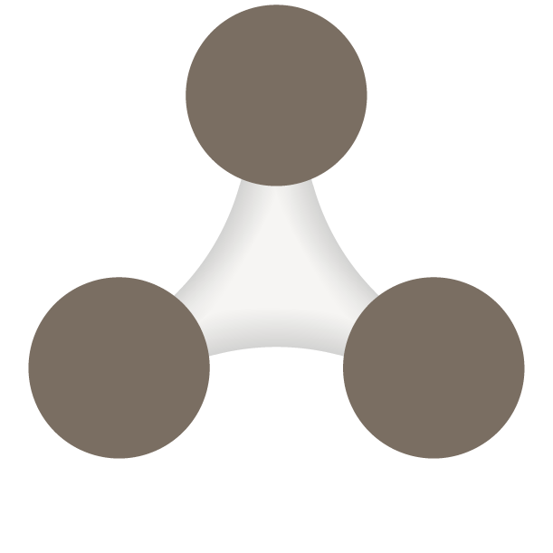
Centre of expertise for eHealth
Corporate presentatie dia
Wordt standaard niet getoond (is verborgen).
Neem dia op in presentatie door
‘Dia verbergen’ uit te zetten via rechter-muis-knop. Laatste optie in lijst
ADVISOR
PARTNER
SERVICE DESK
Better health through better information
Notes:
Slot
In de hedendaagse gezondheidszorg is informatie uitwisselen cruciaal voor samenwerking en kwaliteitsborging.
Wij maken deze verbindingen mogelijk.
Zo dragen wij bij aan een betere gezondheid door betere informatie.

