Slide 1
Disease association templates
Infectious disease

Slide 2
Attribute usage for infectious diseases:
ID | FSN | Number of findings/disorders modelled by the attribute
370135005 | Pathological process (attribute) | 6710
246075003 | Causative agent (attribute) | 5230
363698007 | Finding site (attribute) | 4634
116676008 | Associated morphology (attribute) | 3429
263502005 | Clinical course (attribute) | 690
246454002 | Occurrence (attribute) | 224
42752001 | Due to (attribute) | 195
255234002 | After (attribute) | 172
47429007 | Associated with (attribute) | 144
363714003 | Interprets (attribute) | 49
363713009 | Has interpretation (attribute) | 44
419066007 | Finding informer (attribute) | 6
418775008 | Finding method (attribute) | 6

Slide 3
Scope defined by the existing attributes used for concept modeling: 421 concepts
<< 40733004 |Infectious disease|:
[1..*] 47429007|Associated with (attribute)|=*
OR [1..*] 42752001|Due to (attribute)|=*
OR [1..*] 255234002|After (attribute)|=*
OR [1..*] 363713009|Has interpretation (attribute)|=*
OR [1..*] 363714003|Interprets (attribute)|=*
OR [1..*] 418775008|Finding method (attribute)|=*
OR [1..*] 419066007|Finding informer (attribute)|=*

Slide 4
Analysis and review for types of association patterns

Slide 5
|Associated with|
Infection associated with devices: 68 concepts (postoperative complication)
<< 40733004 |Infectious disease|:
[1..*] 47429007|Associated with (attribute)|=<<260787004|Physical object (physical object)|
Among these 68 concepts, 19 concepts have inferred|due to|(|procedure|) in their modeling. These need to be reviewed and changed according to the Editorial guide for disorder associated with devices.

Slide 6
Infection associated with event
: 1 concept (Needs to be changed to due to, temporal relationships)
<< 40733004 |Infectious disease|:
[1..*] <<47429007|Associated with (attribute)|=<<272379006|Event (event)|
801006 |Nonvenomous insect bite of foot with infection (disorder)| → Infection of foot due to and after nonvenomous insect bite (disorder) - it is a complication and sequela

Slide 7
Infection associated with another finding/disorder modelled by attribute |Associated with|: 68 concepts
This pattern does not follow the new modeling guidance. The concepts need to be reviewed and represented by one of three patterns: co-occurrent pattern, co-occurrent and due to pattern, or due to pattern.
<<40733004 |Infectious disease|:
[1..*] 47429007|Associated with (attribute)|=<<404684003|Clinical finding (finding)|

Slide 8
|Due to|
Infection due to procedure: 88 concepts
<< 40733004 |Infectious disease|:
[1..*] 42752001|Due to (attribute)|=<<71388002|Procedure (procedure)|
Due to procedure pattern should have parent concept Complication:
  All of them have been modelled as Complications

Slide 9
Infection due to another finding/disorder: 107 concepts
<< 40733004 |Infectious disease|:
[1..*] 42752001|Due to (attribute)|=<<404684003|Clinical finding (finding)|

Slide 10
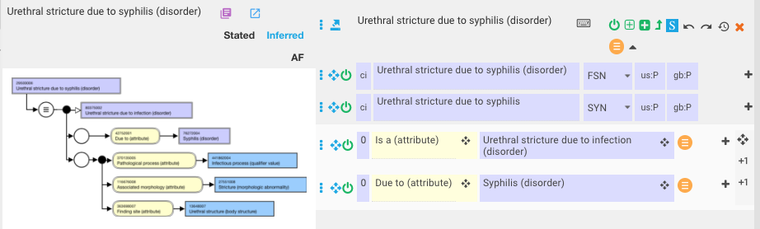
Infectious disease due to infectious disease 72 concepts
Only 20 concepts are modelled as Complications.

Slide 11
Due to pattern should have parent concept Complication
Exceptions:
  Infected varicose ulcer (disorder) is a infection of ulcer site rather than complication of varicose vein. Remove due to relationship and finding site.
  If a condition is the direct effect of causative agent, this concept should be modeled by causative agent rather than due to infection. For example,
  Meningitis due to infectious mononucleosis (disorder) - this concept is not suitable for modeling by causative agent because infectious mononucleosis cannot be sufficiently defined by causative agent.
  Uveitis due to leptospirosis (disorder) - this concept is modelled by causative agent. Therefore, due to infection is not needed.
  Uveitis due to secondary syphilis (disorder) - this concept can be modelled by both causative agent and due to. It is not possible to represent secondary syphilis without due to relationship.
  Arthritis co-occurrent and due to rubella (disorder) - it should be modelled as arthritis caused by rubella virus

Slide 12
|After|
Infection after procedure or other finding/disorder: 172
<< 40733004 |Infectious disease|:
[1..*] 255234002|After (attribute)|=*
Infection after procedure: 106
<< 40733004 |Infectious disease|:
[1..*] 255234002|After (attribute)|=<<71388002|Procedure (procedure)|
Infection after finding/disorder: 66
<< 40733004 |Infectious disease|:
[1..*] 255234002|After (attribute)|=(* MINUS <<71388002|Procedure (procedure)|)
Modelled as Sequela: 10
After pattern should have Sequela as parent concept
(385486001|Postoperative complication (disorder)| is complication with After modeling. It is not a sequela)

Slide 13
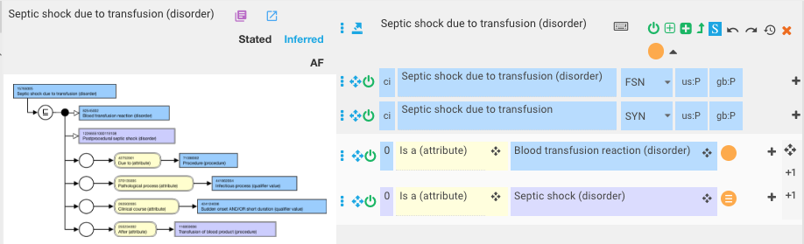
|Due to| and |After|
Infection due and after procedure or other finding/disorder: 69 (subconcept of both complication and sequela)
<< 40733004 |Infectious disease|:
[1..*] 42752001|Due to (attribute)|=*
AND [1..*] 255234002|After (attribute)|=*

Slide 14
Associated with findings 42 concepts (|Due to| OR |co-occurrent and due to|)
<< 40733004 |Infectious disease|:
[1..*] 363713009|Has interpretation (attribute)|=*
OR [1..*] 363714003|Interprets (attribute)|=*
OR [1..*] 418775008|Finding method (attribute)|=*
OR [1..*] 419066007|Finding informer (attribute)|=*

Slide 15
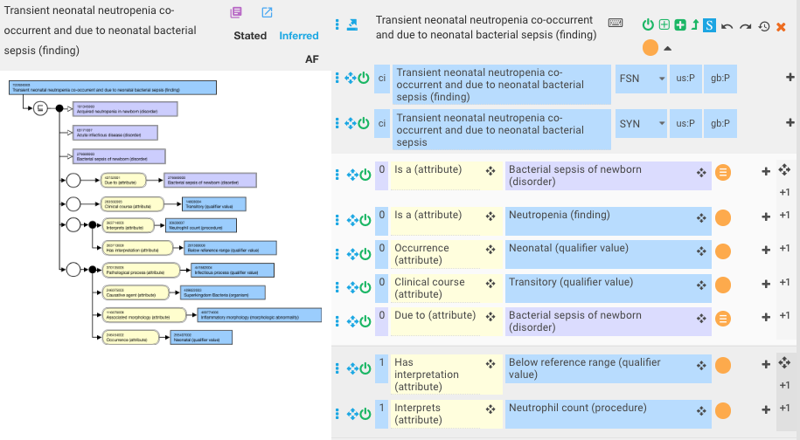
Associated with findings

Slide 16
|Pathological process|
Infectious disease modelled by pathological processes in more than one role group without |Due to|, |After|, |Associated with| : 776 concepts
<< 40733004 |Infectious disease|:[2..*]{
[1..1] 370135005 |Pathological process (attribute)|=*}
AND [0..0] 42752001|Due to (attribute)|=*
AND [0..0] 255234002|After (attribute)|=*
AND [0..0] 47429007|Associated with (attribute)|=*

Slide 17
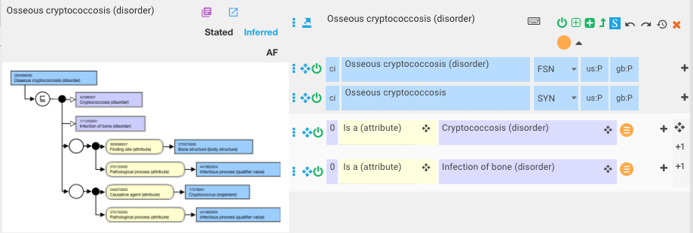
|Pathological process|

Slide 18
|Causative agent|
Infectious disease caused by substance: 56 concepts (might need a new model. but current existing content should be modelled consistently by two or more causative agent)
<< 40733004 |Infectious disease|:
[1..*] 246075003|Causative agent (attribute)|=(* MINUS <<410607006|Organism (organism)|)

Slide 19
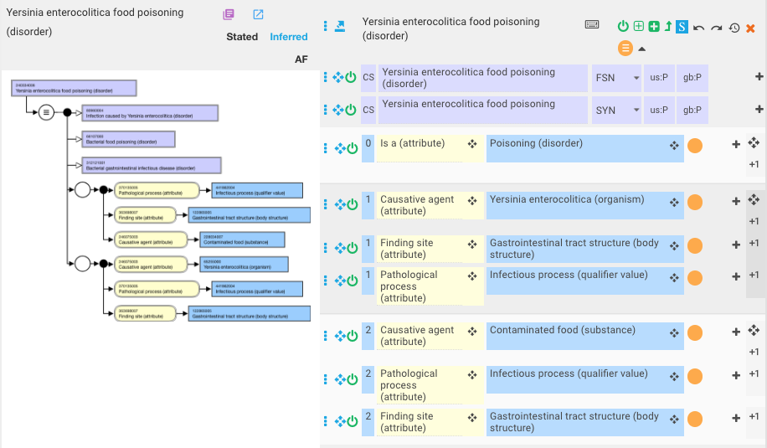
|Causative agent|

