Slide 2
Differences between 3 definitions of stroke
AHA/ASA consensus definition | AHA/ASA website | UptoDate® definition¹
Description: Acute neurological dysfunction | Description: N/A | Description: Acute neurologic injury
Sites: brain, spinal cord, retina | Sites: brain | Sites: brain
Types: Ischemic (due to infarction) Hemorrhagic (intracerebral, subarachnoid) Due to central venous thrombosis | Types: Ischemic (due to a clot obstructing the flow of blood to the brain Hemorrhagic TIA | Types: Ischemic (due to thrombosis, embolism, systemic hypoperfusion, central venous thrombosis) Hemorrhagic Due to occlusion of veins that drain the brain of blood
¹The definition of transient ischemic attack is changing with recognition that transient neurologic symptoms are frequently associated with permanent brain tissue injury.
²Author of this article is one of the authors of the consensus document

Slide 3
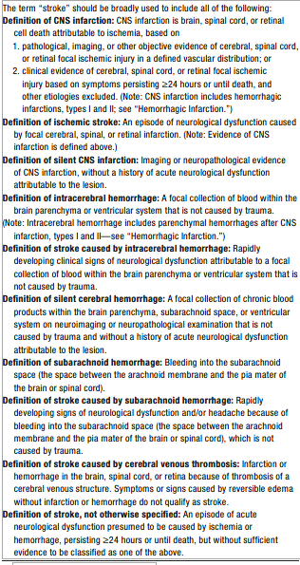
Stroke definitions AHA/ASA consensus document
Stroke. 2013 Jul;44(7):2064-89. doi: 10.1161/STR.0b013e318296aeca. Epub 2013 May 7.

Slide 4
Definition used for this model
Cerebrovascular accident (stroke) is a brain injury with neurological dysfunction due to
  Ischemia
  Hemorrhage
  Cerbral venous (sinus) thrombsois

Slide 5
Proposed Cerebrovascular accident upper level hierarchy
Cerebrovascular accident
  Ischemic stroke
    Occlusive
      Thrombotic stroke
      Embolic stroke
    Due to systemic hypoperfusion
  Hemorrhagic stroke
    Due to cerebral hemorrhage
    Due to subarachnoid hemorrhage
  Stroke due to cerebral venous thrombosis

Slide 6
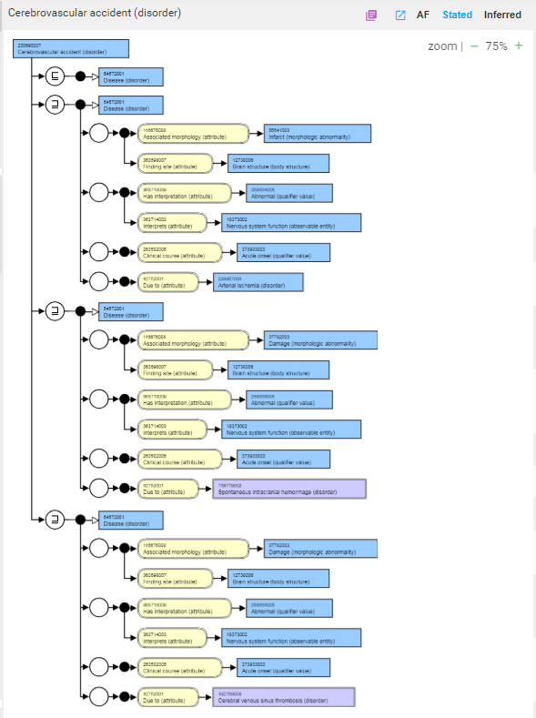
Cerebrovascular accident GCI model
Brain injury
Neurological dysfunction
Ischemic stroke
Acute course
Cause
Hemorrhagic stroke
Stroke due to cerebral venous (sinus) thrombosis

Slide 7
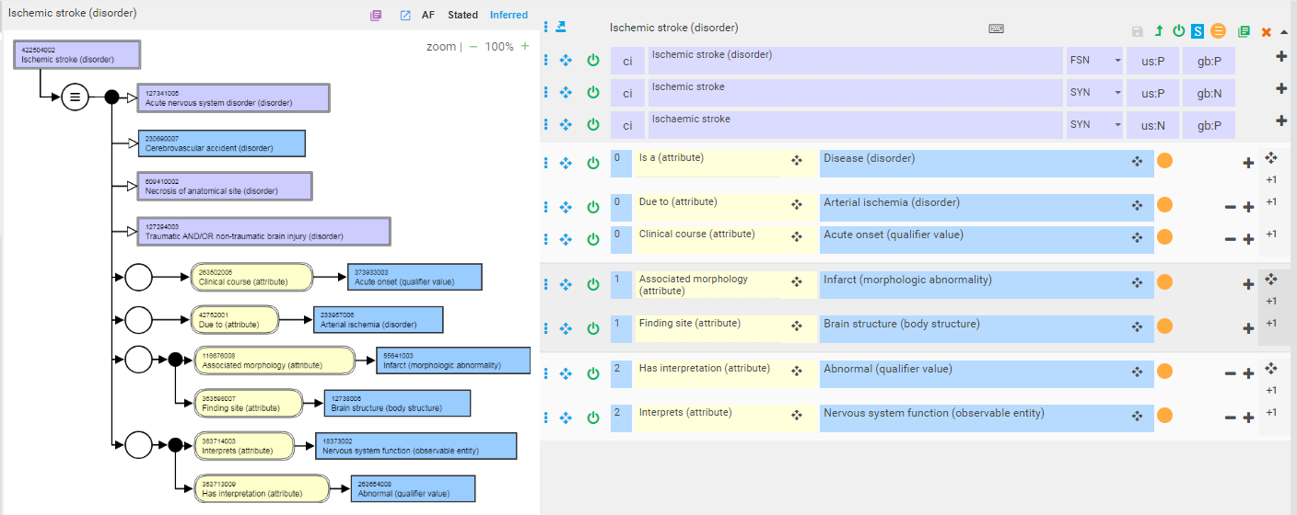
Model of ischemic stroke

Slide 8
Hemorrhagic stroke
“The term “hemorrhagic stroke” is confusing because it could mean hemorrhage after infarction or primary ICH or SAH. The use of this term should be discontinued. Hemorrhage may occur after infarction, either spontaneously or caused by antithrombotic or thrombolytic therapy”.
Stroke. 2013 Jul;44(7):2064-89. doi: 10.1161/STR.0b013e318296aeca. Epub 2013 May 7.
An updated definition of stroke for the 21st century: a statement for healthcare professionals from the American Heart Association/American Stroke Association.
Sacco RL, Kasner SE, Broderick JP, Caplan LR, Connors JJ, Culebras A, Elkind MS, George MG, Hamdan AD, Higashida RT, Hoh BL, Janis LS, Kase CS, Kleindorfer DO, Lee JM, Moseley ME, Peterson ED, Turan TN, Valderrama AL, Vinters HV; American Heart Association Stroke Council, Council on Cardiovascular Surgery and Anesthesia; Council on Cardiovascular Radiology and Intervention; Council on Cardiovascular and Stroke Nursing; Council on Epidemiology and Prevention; Council on Peripheral Vascular Disease; Council on Nutrition, Physical Activity and Metabolism.

Slide 9
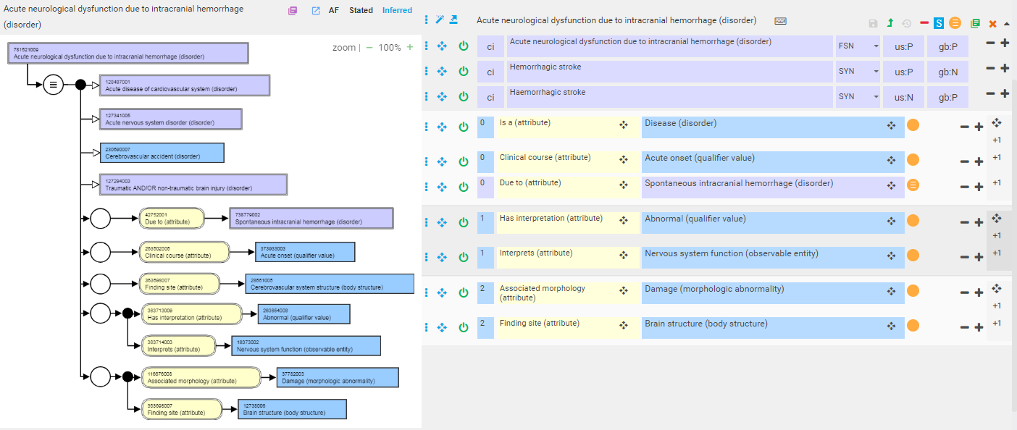
“Hemorrhagic stroke”
1
2
3
Because 28661005 |Cerebrovascular system structure (body structure)| is an indirect descendant of 113257007 |Structure of cardiovascular system (body structure)|
Because there is no non-traumatic brain injury
Required for modeling “injury”

Slide 10
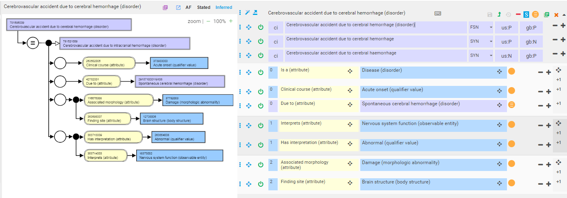
Model of Cerebrovascular accident due to cerebral hemorrhage

Slide 11
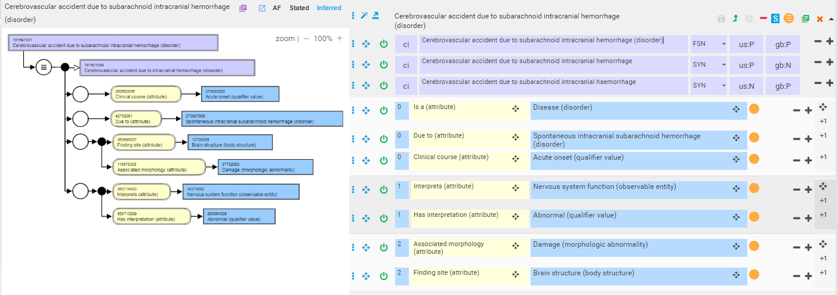
Model of Cerebrovascular accident due to subarachnoid hemorrhage

Slide 12
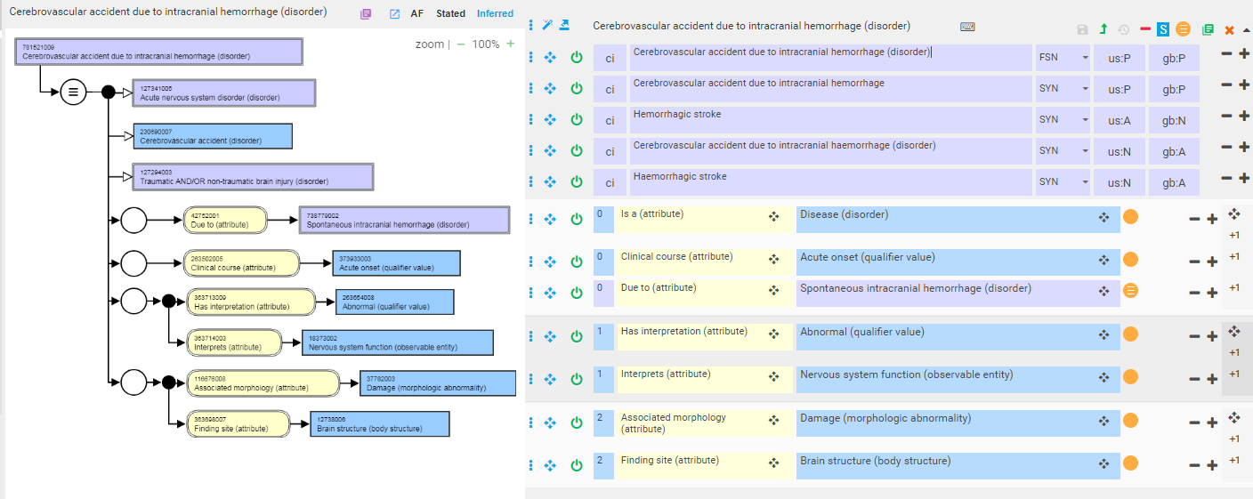
Model of Cerebrovascular accident due to intracranial hemorrhage (hemorrhagic stroke)

Slide 13
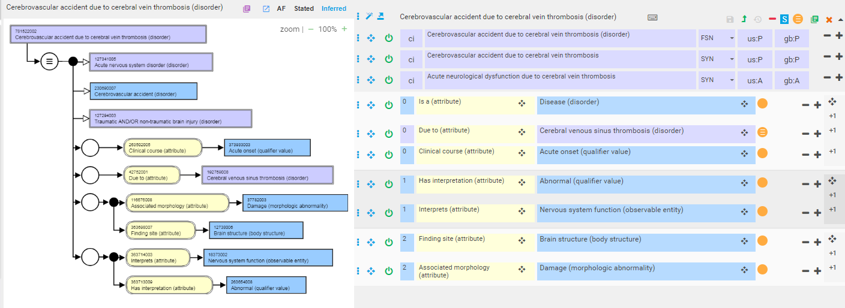
Model of Cerebrovascular accident due to cerebral vein thrombosis

Slide 14
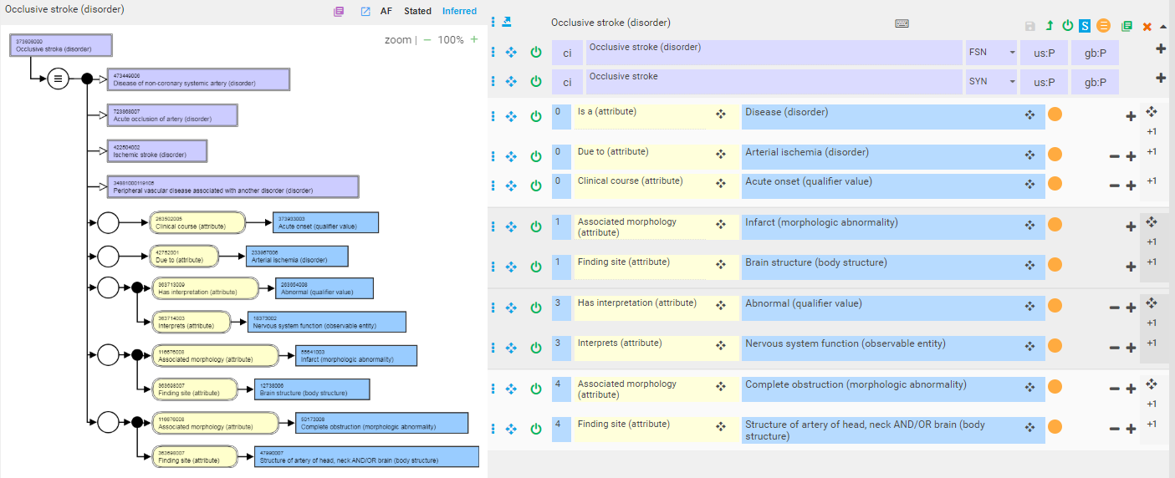
Model of occlusive stroke

Slide 15
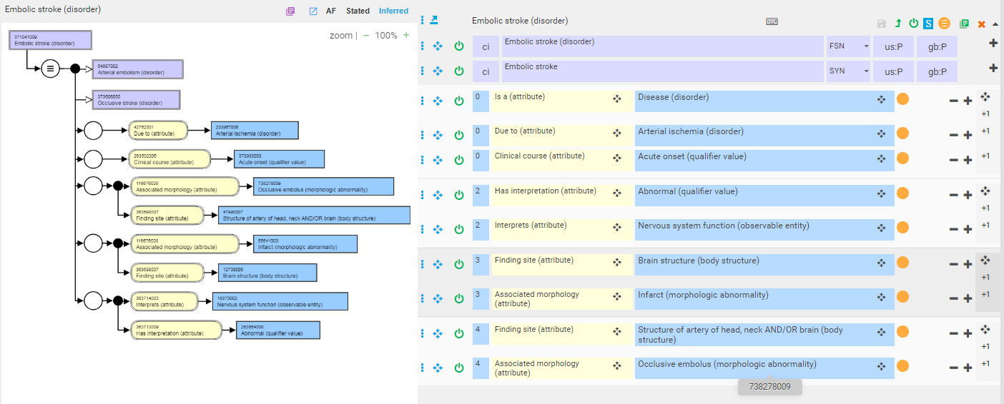
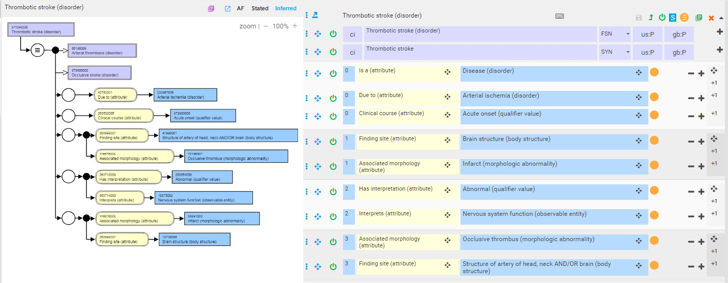
Model of thrombotic and embolic strokes

