Slide 1

New Zealand Activities
HL7 New Zealand
FHIR Validate-Code Operations
SNOMED on FHIR Meeting
Vancouver Oct 17, 2018
Peter Jordan, Chair HL7 New Zealand
Notes:
To change the image on this slide:
Right click on the slide and select ‘Format Background’
In the ‘Fill’ Section, select ‘Picture or Texture Fill’
Click on ‘Insert from File’, navigate to the appropriate picture (corporate imagery can be found in the ‘Stock Images’ folder on the OMC at http://omc) and choose an appropriate image
The background graphic will change
Do not click on ‘Apply to All’
Do not select ‘Tile picture as texture’
Please note: Product presentations must use medical images - landscapes can only be used in corporate presentations

Slide 2
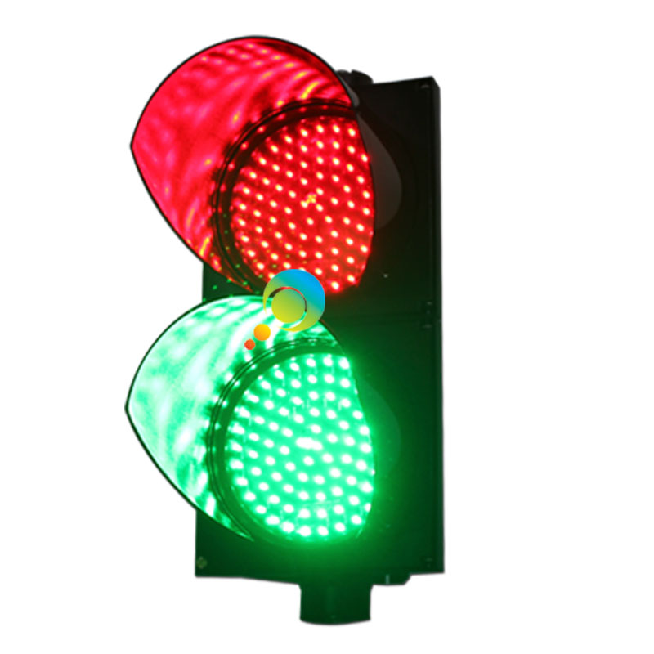

The Issue At Hand…
Code System based validation – “Validate that a coded value is in the code system”
Assume…
  SNOMED CT Versioned Edition Supplied in the version parameter (and available on Terminology Server)
  Language – assume matches Language RefSet on Server
Basic Use Cases – sufficient to highlight fundamental issues…
Boolean Result – is that sufficient?
n.b. Normative operation in R4
Constrain Result to code value only?
Add a (coded) Display Result Parameter?
(valid, absent, unknown, unmatched, invalid…)

Slide 3
CODE / DISPLAY | RESULT | MESSAGE | DISPLAY
Invalid SCTID No Term | False | The code value passed is invalid
Unrecognised SCTID No Term | False | The code value passed is unknown
Valid SCTID No Term | True |  | Preferred Term
Invalid SCT Code Valid SCT Term | False | The code value passed is invalid | ???
Valid SCTID Valid SCT Term (synonym) | True |  | Preferred Term
Valid SCTID Invalid SCT Term (case) | False | The display value passed violates case significance rule | Preferred Term
Valid SCTID Unrecognised SCT Term | False | The display value passed is unknown | Preferred Term
Valid SCTID Term for a different SCTID | False | The code and display values passed do not match | ???
Valid SCTID Valid SCT Term (preferred) | True |  | Preferred Term
Unrecognised SCTID Unrecognised SCT Term | False | The code and display values passed are unknown
Notes:
Questions…
Should we always return the Preferred Term if the Code is syntactically valid and recognised?
Should there be separate results for the Code and Display – or is it always a combination if a display term is provided?
How does the behaviour differ for Value Sets that contain terms (i.e. should terms outside of an extensional Value Set be considered)?

