Slide 1


E-Learning Advisory Group
Monday 15th October 2018
Vancouver, Canada
Linda Bird
Head of Education and Product Support

Slide 2

Agenda
Welcome and introductions
ELAG administration
ELAG Member reports
SNOMED International update
Course catalogue
Authoring courses and certification
Other education activities
Feedback and discussion

Slide 3

ELAG
Administration

Slide 4

Declaration of Interests
Could all members of ELAG please
  Go to http://snomed.org/elag
  Click on Group Members → Declaration of Interests
  Add any potential conflicts of interest
  Update the ‘Last updated’ date (even if no changes)

Slide 5
ELAG Terms of Reference
Purpose
  To facilitate delivery of E-Learning products and services that address requirements of Members and other stakeholders for development of knowledge and skills related to SNOMED CT
Scope
  Informing, contributing to, supporting and reviewing
    SNOMED International’s E-Learning products and services
  Advising on, supporting and encouraging use of
    SNOMED International’s E-Learning resources
  Sharing information between
    SNOMED International, its Members and other stakeholders
  Advising on Member education priorities
Recent updates to ToR
  Meetings may be recorded
  Skills matrix - CDT course example removed

Slide 6
ELAG Membership
Kirstine Gøeg Expert Advisor
Penny Livesay Expert Advisor
Marcelo Carrascal Argentina
Aileen dela Pena Australia
Katrien Scheerlinck Belgium
Linda Parisien Canada
Camilla Wiberg Denmark
Danielsen
Krista Kärt Estonia
Vicky Fung Hong Kong
Manisha Mantri India
  Theresa Barry Ireland
Kristina Dienine Lithuania
Pim Volkert Netherlands
Aleksandar New Zealand
Zivaljevic
Marianne Norway
Bartvedt van Os
Agnieszka Poland
Suchodolska
Leandro Luis Portugal
Gonzalo Marco Spain
Cuenca
Lotti Barlow Sweden
New member Switzerland
Ian Spiers UK
Fernando Portilla Uruguay
Suzy Roy USA

Slide 7

ELAG Workplan 2018
Meetings
  April 2018 – London, UK
  October 2018 – Vancouver, Canada
  December 2018 – Teleconference
Objectives
  To review and provide advice on the pilot learning pathways
  for software developers and data analysts
  To review and provide advice on future E-Learning courses
  including updated education for terminology authors
  Advise on national and international priorities and
  activities to increase understanding of SNOMED CT
  Sharing of E-Learning materials for translation and
  national use

Slide 8

ELAG
Member Reports

Slide 9

ELAG Member Reports
SNOMED CT education activities in your region
  New or planned SNOMED CT education activities
  Plans or progress in localising SNOMED CT education material
  Feedback on existing SNOMED CT E-Learning experiences
  Country or regional SNOMED CT priorities and requirements
Please refer to meeting agenda for summary of reports

Slide 10
ELAG Member Reports
Marcelo Carrascal Argentina
Aileen dela Pena Australia
Katrien Scheerlinck Belgium
Linda Parisien Canada
Camilla Wiberg Denmark
Danielsen
Krista Kärt Estonia
Vicky Fung Hong Kong
Manisha Mantri India
  Theresa Barry Ireland
Kristina Dienine Lithuania
Pim Volkert Netherlands
Aleksandar New Zealand
Zivaljevic
Marianne Norway
Bartvedt van Os
Agnieszka Poland
Suchodolska
Leandro Luis Portugal
Gonzalo Marco Spain
Cuenca
Lotti Barlow Sweden
New member Switzerland
Ian Spiers UK
Fernando Portilla Uruguay
Suzy Roy USA

Slide 11

SNOMED International Update

Slide 12
Education and Product Support Team
Mission
  To increase awareness, knowledge and understanding of SNOMED CT and to improve the ease and effectiveness of SNOMED CT implementations
Scope
  Development, maintenance and delivery of:
    E-Learning materials
    Guides
    Technical specifications
    Reference documents
    Product support responses
    Presentations at specific events

Slide 13
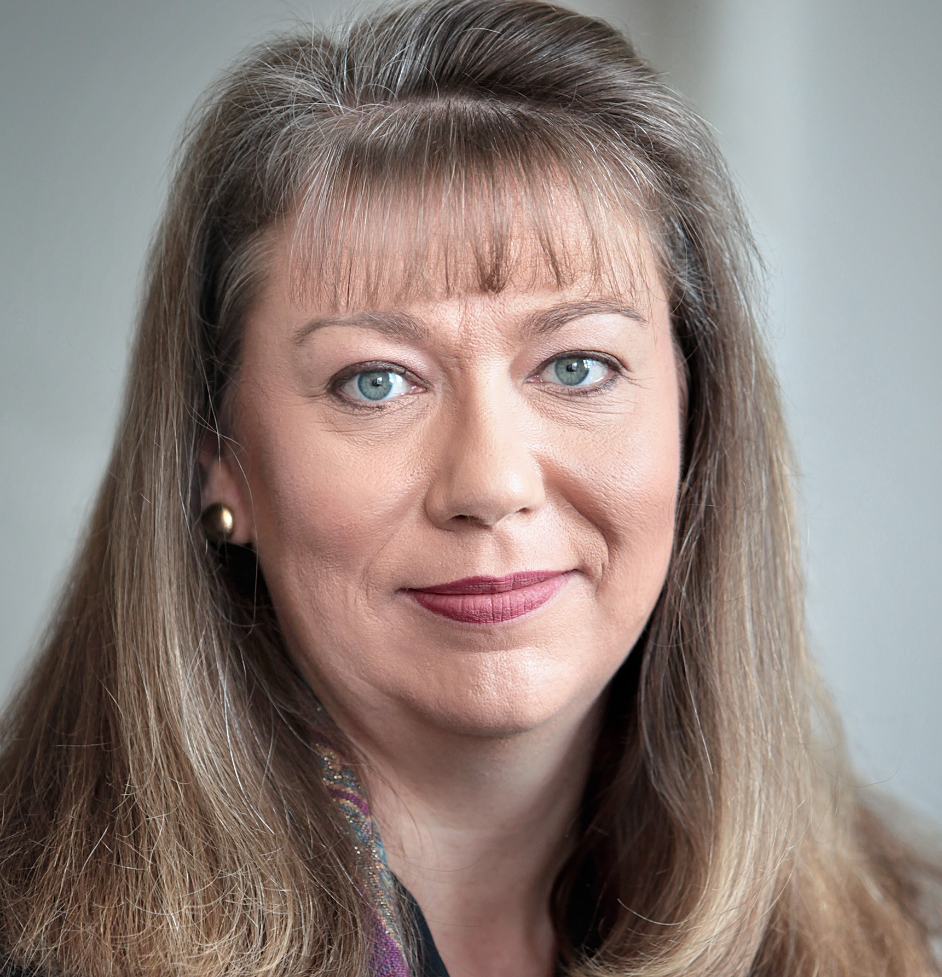
Education and Product Support Team
Linda Bird
Head of Product Support
David Markwell
Senior Product Support Specialist
Anne Højen
Implementation Specialist
Jon Zammit
Implementation Specialist
Cathy Richardson
Senior Terminologist
Louise Jones
E-Learning Administrator
Penny Livesay
E-Learning
Authoring Specialist

Slide 14

E&PS Work Plan - 2018
Education
  Delivery
  Development
  Maintenance
Documentation
  New guides and specifications
  Maintenance and updates
Product Support
  Internal and external PS activities

Slide 15

Documentation - 2018
Published
  Practical guide to extensions – http://snomed.org/extpg
  HRCM tables for editorial guide – http://snomed.org/eg
  SNOMED CT OWL guide – http://snomed.org/owl
Work in progress
  SNOMED in SQL – http://snomed.org/sqlpg
  Major updates to SNOMED Glossary – http://snomed.org/gl
  Updates to SNOMED CT URI Specification – http://snomed.org/uri
To do
  Commence updates to Terminology Services Guide – http://snomed.org/tsg

Slide 16

Product Support - 2018
MRCM reference sets
  Prepare for publication - 20180731 and 20190131
SNOMED CT HL7 FHIR group
  Provide support and advice to this group
SNOMED CT expo
  Education tutorials and workshops
Other product support activities
  Provide SNOMED CT support to other internal teams
  Freshdesk responses and other enquiries

Slide 17
Education - 2018
Courses
  Foundation course
  Implementation course
Learning pathways
  SNOMED CT for developers
  SNOMED CT for data analysts
Pilot courses
  SNOMED CT authoring level 1 course
  Curso de Fundamentos
Other activities
  New course catalogue with shopping cart facilities
  Migration of moodle platform to external hosting
  Updates to existing courses
    Description logic, reference sets, SQL guidance

Slide 18
E-Learning Courses
https://elearning.ihtsdotools.org/
Foundation Course
  Total completions - 1865 (from 67 countries)
  Active - 54
Implementation Course
  Total completions - 468 (from 50 countries)
January 2018 course
Enrolled - 72
Completed - 37
May 2018 course
Enrolled - 84
Active - 67
Due for completion in November
  Next intake is July 2019
    Time required for updates and maintenance
    Then 2 intakes per year (Jan and July)

Slide 19
E-Learning Pathways
https://elearning.ihtsdotools.org/
SNOMED CT for Developers
  Enrolments - 243
SNOMED CT for Data Analysts
  Enrolments - 197
Presentation Library (formerly named ‘Open Access Area’)
  Search via the Presentation Index
Individual presentations views (all courses and pathways)
  Total - 78,024
  Last 12 months - 19,923

Slide 20
E-Learning Pilots - Fundamentos
Curso de Fundamentos (Spanish)
  Student numbers
  Enrolled – 97 (from Spain, Chile, Argentina, Uruguay)
  Completed – 15
Translations performed by Chile
Student support by Spain, Chile, Argentina, Uruguay
  Delivered via Freshdesk
Plans to launch the course discussed on Sunday

Slide 21
E-Learning Pilots - Authoring Level 1 Course
Authoring level 1 course
  Student numbers
  Enrolled – 24
  Active – 17 (in Module B)
Authoring level 1 certification
  Waitlisted for April 2019
More details later in the meeting . . .

Slide 22

SNOMED CT Course Catalogue

Slide 23
Background
April 2018
  Management Board and General Assembly requested that SNOMED International introduces fees for its education services
  To supplement revenue from Member and license fees and to avoid the need to increase Member fees
October 2018
  SNOMED International launched the SNOMED CT Course Catalogue at https://courses.ihtsdotools.org
  Fees will now be charged for SNOMED CT courses and exams
  SNOMED International Members will be given
    Free enrolment in Foundation Course
    Discounts for other courses and exams

Slide 24
SNOMED CT Course Catalogue
The SNOMED CT Course Catalogue offers education courses and certification exams for beginners through to advanced users of SNOMED CT.

Slide 25

SNOMED CT Foundation Course
Provides an introduction to a broad range of SNOMED CT related topics, including the why, what and how of SNOMED CT
What
  3 modules each containing 6 presentations and 1 assessment
  Final assessment at end of course
When
  Ongoing enrolment with immediate start
Fees
  FREE for students from SNOMED International Members
  Students from non-Member countries / territories
    400 USD - high income countries
    200 USD - middle income countries
    FREE - low income countries

Slide 26
SNOMED CT Implementation Course
Provides an in depth understanding of the stages in implementing a SNOMED CT enabled system – from
the decision to adopt SNOMED CT, through to design, procurement, development and use
What
  6 modules each with online presentations, tutor-led webinar, assignment and assessment, plus assessment at end of course
  Fixed schedule over 7 months (around 70 hours of study)
When
  Next intake starts July 2019 (and every 6 months)
Fees
  Members - 500 / 250 / 50 USD (high/middle/low)
  Non-Members - 1000 / 500 / 100 USD (high/mid/low)

Slide 27

SNOMED CT Authoring Level 1 Course
Teaches you the knowledge and skills needed to perform basic SNOMED CT authoring tasks, and prepares you for the SNOMED CT Authoring Level 1 certification exam
What
  5 modules each with online presentations, tutor-led webinar, assignment and assessment, plus additional exercises
  Students practice authoring on training authoring platform
  Fixed schedule over 5 months (around 70 hours of study)
When
  Intakes start March 2019 and September 2019
Fees
  Members - 500 / 250 / 50 USD (high/middle/low income)
  Non-Members - 1000 / 500 / 100 USD (high/middle/low income)
  Additional discount for CDT course graduates (upon request)

Slide 28

SNOMED CT Authoring Level 1 Certification
Recognizes your competence in performing basic SNOMED CT authoring tasks
What
  To achieve this certification you must pass the certification exam
  Exam includes a range of knowledge and skills based activities
  Exam will be proctored / invigilated
When
  Currently being waitlisted
  Enrolment will commence early 2019
  Exam to be available from April 2019
Fees
  Members - 200 USD
  Non-Members - 400 USD

Slide 29

SNOMED CT for Developers
A collection of E-Learning resources designed to teach software developers enough about SNOMED CT in as short as possible a time to develop software applications that leverage its capabilities
What
  5 topics with around 20 hours of presentations
    Introduction, Essentials, Specifications, Terminology services, Record services
  List of available resources for each topic
When
  Ongoing enrolment with immediate start
Fees
  Currently offered for FREE
  (fees to be introduced at a later date)

Slide 30

SNOMED CT for Data Analysts
A collection of E-Learning resources designed to give data analysts a solid understanding of how SNOMED CT can be used to support clinical data analytics requirements
What
  4 topics with around 15 hours of presentations
    Introduction, Features, Content, Analytics
  List of available resources for each topic
  Practical exercise to test understanding in an interactive way
When
  Ongoing enrolment with immediate start
Fees
  Currently offered for FREE
  (fees to be introduced at a later date)

Slide 31
E-Learning Platform – New Menus
ABOUT
  Public information and guides for each course
ENROL
  Links to relevant pages in course catalogue
LEARN
  Direct links to each course (for those enrolled)
VIEW
  Links to various additional resources
    Document and presentation libraries
    Starter presentations
    Member education resources
    Chinese foundation course PDFs
CONTACT
  English and Spanish helpdesk contacts

Slide 32

Next Steps
Members are requested to advertise these education services within their country/territory
Please send all questions or feedback to elearning@snomed.org

Slide 33
Authoring Courses and Certification

Slide 34

Goals of Authoring Education
For SNOMED International
  To increase quality of CRS submissions and promotion requests
  To provide basic training to accompany Managed Service rollout
  To increase the quantity and quality of authors globally
    Authors who we can outsource work to
    Authors who could participate in distributed authoring
  To make it easier to find new terminology authors for the team
For Member NRCs
  To make the onboarding of new authors easier and more consistent with international practices
  To potentially speed up the processing
  of content requests
For all
  To support the continued improvement
  and enhancement of SNOMED CT
Notes:
Use the ‘Standard Slide’ layout for most purposes.
Other Layouts that can be applied are shown in the Layout options. All these are permitted in our E-Learning presentation where appropriate.
If possible avoid customizing layouts for individual slides as these will cause problems if we need to update to a new corporate style. It may occasionally be necessary to slightly alter the size of a frame to avoid an ugly display but these cases should be the exception rather than the rule.
If you find there is an additional Layout that would be helpful discuss with the team so we can decide to add this to the standard template.

Slide 35


SNOMED CT Authoring Levels
Author in specific hierarchies
Experience
LEVEL 2
Basic authoring tasks
LEVEL 1
Broad coverage of a range of SNOMED topics
FOUNDATION
FOUNDATION
Notes:
The main prerequisite for starting the Authoring Level 1 Course is that you have successfully completed the SNOMED CT Foundation Course.
[click]
The Foundation Course provides a broad coverage of a range of SNOMED CT topics, which gives you a good foundation.
[click]
This level 1 course then builds upon the foundation, and gives you a more detailed understanding of SNOMED CT from an authoring perspective.
[click]
As we’ve said, in this level, we focus on teaching you how to perform the basic authoring tasks to start on your authoring journey.
[click]
Once you have successfully completed level 1 certification, you may choose to progress to the next level – level 2.
[click]
Level 2 builds upon level 1 with additional knowledge and skills that are needed to be a competent SNOMED CT author. It will explain a range of methods and techniques for authoring, updating and reviewing the quality of terminology content, and help you understand a variety of additional considerations in the authoring process. It also provides the opportunity to specialize your authoring skills in specific clinical hierarchies, such as clinical findings and procedures.
[click]
It is important to understand that progressing from level to level isn’t just about the theory and skills you learn by doing the formal courses. To truly progress as an author, you also need the opportunity to put this knowledge and these skills into practice, and gain experience through the regular authoring of SNOMED CT content.

Slide 36
Authoring Level 1 - Course Modules
Each module has
  E-Learning presentations
  Assignment
  Interactive webinar with tutor
  Assessment
Module | Knowledge | Capability
A | Content overview | Content requests
B | Procedures & anatomy | Using authoring tooling
C | Clinical findings | Content creation
D | Products & substances | Content updates
E | Observables & organisms | Authoring
Notes:
The SNOMED CT Authoring Level 1 Course is delivered through 5 learning modules. In each of these modules, we have a knowledge focus and a capability focus. In module A, the knowledge focus is on providing a general introduction to SNOMED CT’s content hierarchies and concept model. And the capability focus is on teaching you how to make and manage good quality content requests. In Module B, we will primarily teach you about the procedure and body structure hierarchies, and introduce you to the tooling you’ll need as a terminology author. Module C has a focus on clinical findings and content creation, although we also look at a range of other smaller hierarchies. Module D focuses on products and substances, and how to edit existing content. Finally, module E introduces the Observable Entity and Organism hierarchies, as well as a number of other related hierarchies, such as specimen. The capability focus for module E is on practicing the authoring skills you have learnt throughout the course.
[click]
For each of these modules, you will need to watch a series of online E-Learning presentations, complete an assignment, attend an interactive webinar with a tutor, and pass an online assessment. To successfully complete the course, you must complete all the mandatory components for each module within the required timeframes, as defined in your course schedule.

Slide 37
Level 1 Authoring – Curriculum
Module A: Introduction to authoring and requests
Module B: Introduction to tooling, procedures & anatomy
Module C: Content creation and clinical findings
Module D: Content updates, products and substances
Module E: Content review, maintenance & observables
    SNOMED CT: A Purpose Built Terminology
    Content Hierarchy Introduction
    Concept Model Overview
    Content Development Introduction
    Introduction to Editorial Guidance
    Making a Request Submission
    Managing a Request Submission
    SNOMED CT Logical Design & Versioning
    Extensions – Content & Creation

Slide 38
Level 1 Authoring – Curriculum
Module A: Introduction to authoring and requests
Module B: Introduction to tooling, procedures & anatomy
Module C: Content creation and clinical findings
Module D: Content updates, products and substances
Module E: Content review, maintenance & observables
    Introduction to Content Development Tools
    Introduction to Authoring Platform
    MRCM
    Attribute Hierarchies
    Procedures
    Evaluation Procedures
    Body Structure
    Model Component Hierarchy

Slide 39
Level 1 Authoring – Curriculum
Module A: Introduction to authoring and requests
Module B: Introduction to tooling, procedures & anatomy
Module C: Content creation and clinical findings
Module D: Content updates, products and substances
Module E: Content review, maintenance & observables
    Clinical Findings
    Situations with Explicit Context
    Qualifier Values
    Record Artifacts
    Events
    Introduction to Content Creation
    Defining Concepts
    Authoring with Description Logic
    Creating Content in the Authoring Platform

Slide 40
Level 1 Authoring – Curriculum
Module A: Introduction to authoring and requests
Module B: Introduction to tooling, procedures & anatomy
Module C: Content creation and clinical findings
Module D: Content updates, products and substances
Module E: Content review, maintenance & observables
    Products
    Substances
    Physical Objects
    Physical Forces
    Staging and Scales
    Social Contexts
    Editing Existing Concepts

Slide 41
Level 1 Authoring – Curriculum
Module A: Introduction to authoring and requests
Module B: Introduction to tooling, procedures & anatomy
Module C: Content creation and clinical findings
Module D: Content updates, products and substances
Module E: Authoring, observables and organisms
    Observable Entity
    Organism
    Specimen
    Environment and Geographic Location
    Content Development Considerations/Issues

Slide 42

Authoring Training Platform
Enables the authoring of SNOMED CT extensions
  Your extension is called the Snomed Land extension
Hands on exercises to practice basic authoring tasks
  Creating new concepts
  Editing existing concepts
Notes:
As I’ve mentioned, this course has some practical hands on components, which will require you to perform some authoring activities in the online training environment. The Authoring Training Platform is an instance of the SNOMED International Managed Service, which enables you to author in a SNOMED CT extension. For the purposes of this course, your extension will be known as the ‘Snomed Land extension’.
[click]
You will have the opportunity to learn and practice some basic authoring tasks, such as creating new concepts and editing existing concepts. While you are only required to complete the mandatory activities, you’re strongly encouraged to allow some additional time to practice these skills.
[click]
Please note, that before you are granted access to the authoring platform, we will ask you to accept the terms of usage for the tool, to ensure that these rules are respected and we can protect the integrity of the exercises for all our students. Thank you in advance for you cooperation with this.

Slide 43

Level 1 Authoring – Assignments
Assignment A: Content requests and management
Assignment B: Accessing the authoring platform
Assignment C: Creating concepts
Assignment D: Updating content
Assignment E: Authoring content considerations

Slide 44
Authoring Level 1 Certification
Competent to perform basic SNOMED CT authoring tasks
To register for exam
  You must successfully complete the authoring level 1 course
  Visit SNOMED CT course catalogue – http://snomed.org/courses
To achieve certification
  Achieve pass mark in the certification exam
  Proctored exam including
  knowledge and skills based activities
Authoring level 1 certification
  Digital certificate
  Name published on SNOMED
  Certification Register
  Unlocks level 2 authoring training
  Recertification is required every 3 years
Notes:
As I said earlier, one of the objectives of the course is to prepare you for the Authoring Level 1 certification exam. Authoring level 1 certification recognizes your competence in performing basic SNOMED CT authoring tasks.
[click]
Once you have successfully completed the course, you can register for the certification exam by visiting the SNOMED CT course catalogue using the link shown on the slide. Please note that this link will not be available until late 2018.
[click]
To achieve certification you must pass the exam, which includes a range of knowledge and skills based activities. Please note that the exam will be electronically proctored (or invigilated) to ensure that all students comply with the examination rules and policies.
[click]
If you are successful in achieving certification you will receive a digital certificate verifying your certification status and (if you agree) your name will be published on the SNOMED Certification Register. You will also have the option then of progressing on to the Authoring Level 2 course and certification. To retain your certification and demonstrate that your knowledge and skills are uptodate, you must recertify every 3 years.

Slide 45

Level 1 Authoring – Timeline
September 2018 to January 2019
  Level 1 pilot course delivered to 24 students (now 17 students)
April 2019
  Launch of level 1 certification exam (fees apply)
    Online with proctoring
March 2019 to July 2019
  First full intake (fees apply)
September 2019 to January 2020
  Second full intake (fees apply)

Slide 46
Level 2 Authoring – Draft Proposal
Module A – Authoring principles
  Modelling principles and approaches
  Literature evaluation principles
Module B – Authoring with description logic
  DL in SNOMED CT
  Authoring with advanced DL features
Module C – Authoring tooling techniques
  Expression constraints, batch authoring, template authoring
Module D – Review and quality assurance
  Detection and correction of errors
  Impact of content decisions
  Quality criteria, review, quality assurance and analysis
Module E – Authoring specialties
  Clinical findings and finding with explicit context
  Procedures and procedure with explicit context

Slide 47
Level 2 Authoring – Draft Proposal
Prerequisites
  Authoring Level 1 Certification AND
  1 year FTE of authoring experience
Certification
  1 x 2 hr knowledge exam
  1 x 2 hr authoring exercises
Recertification
  Every 3 years sit a challenge exam (1 x 2 hours)
Timeline
  Course development in 2019
  Course launched in 2020
  Level 2 certification to follow course

Slide 48
Other Education Activities

Slide 49
Other Education Activities
Migration of Moodle platform to external hosting
Updates to Implementation Course
  New description logic enhancements to SNOMED CT
  Updated reference set presentations
  Additional SQL guidance
Updates to Developers Pathway
  MB have requested that this is developed into a course
  Additional E-Learning material and assessment
Translations
  Chile is interested in translating other courses to Spanish
  Stakeholders in China are planning to translate and deliver the Foundation course in Chinese

Slide 50
SNOMED CT Expo
Tutorials
  SNOMED CT Quick Start
  Introduction to SNOMED CT
  SNOMED CT Implementation Pathways
  SNOMED CT Translation Experiences
  Introduction to Reference Sets
  Analytics and Clinical Decision Support
Workshops
  SNOMED CT Managed Service for Beginners (x2)
  SNOMED CT Authoring Demonstration
  SNOMED CT Authoring for NRCs
  Creating a SNOMED CT Extension
  From scratch to publication

Slide 51

Any Other Business?

Slide 52
E-Learning Advisory Group

