Slide 1
Intolerance to substance

Slide 2
Intolerance to substance
Intolerances can represent a variety of pathological processes and due to the difficulty in precisely defining an intolerance pathological process, it becomes problematic to apply the model for hypersensitivity dispositions to defining intolerance to a substance. For this reason, as well as the difficulty in associating a material agent with a disposition, it is proposed that substances are related to the intolerance disposition by use of the associated with attribute. The parent concept, Intolerance to substance (finding) is primitive but can be used as a parent to fully define Intolerance to specific substances.

Slide 3
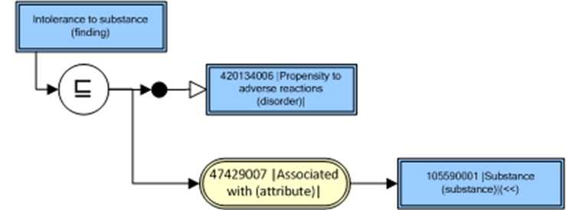
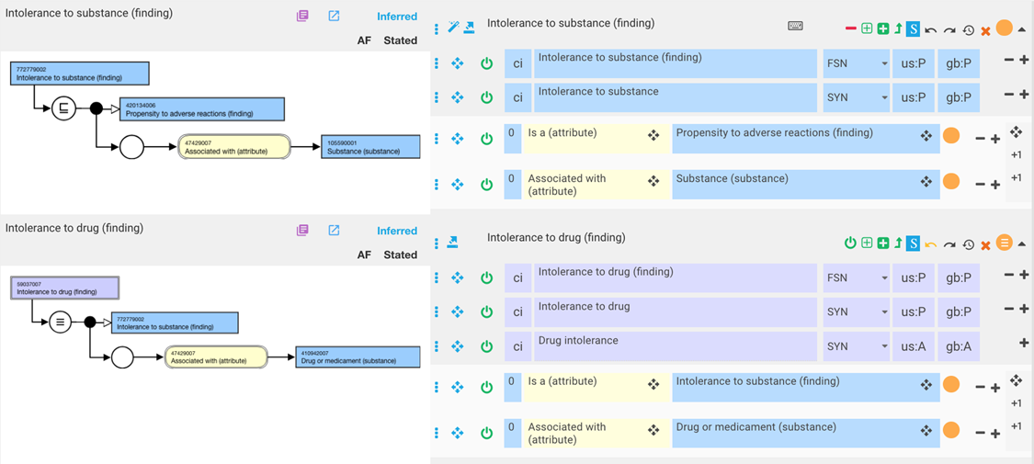
Intolerance to substance 2
FSN: Intolerance to X (finding)
Preferred Term: Intolerance to X
Synonym: X intolerance
Model
Example

Slide 4
Allergy vs. Intolerance (FHIR)*
Adverse reactions may be:
  An allergy (typically type I hypersensitivity, plus other "allergy-like" reactions, including pseudoallergy)
  An intolerance (typically non-immune adverse reactions that are not determined or perceived to be allergic or "allergy-like", and are to some degree idiosyncratic and/or individually specific [i.e. are not a reaction that is expected to occur with most or all patients given similar circumstances])
In clinical practice distinguishing between allergy and intolerance is difficult and may not be practical. Often the term "allergy" is used rather generically and may overlap with "intolerance", and the boundaries between these concepts may not be well-defined or understood. As noted above, the term "intolerance" should generally be applied to a propensity for adverse reactions which is either determined (to the extent that is possible) or perceived to not be allergic or "allergy-like". If it is not possible to determine whether a particular propensity condition is an allergy or an intolerance, then the type element should be omitted from the resource
*FHIR Release 3 (STU

Slide 5
Allergy WAO/EAAACI
Allergy: Allergy is a hypersensitivity reaction initiated by immunological mechanisms.
Allergy can be antibody-or cell-mediated. In the majority of cases the antibody typically responsible for an allergic reaction belongs to the IgE isotype and these individuals may be referred to as suffering from an IgE-mediated allergy.
Not all IgE associated ’allergic’ reactions occur in ’atopic’ subjects. In non-IgE-mediated allergy the antibody can belong to the IgG isotype, eg, anaphylaxis due to immune complexes containing dextran, and the classical, nowadays rare, serum sickness previously referred to as a Type III reaction.
Both IgE and IgG antibodies are found in allergic bronchial pulmonary aspergillosis (ABPA). Allergic contact dermatitis is representative of allergic diseases mediated by lymphocytes.

Slide 6
Hypersensitivity WAO/EAAACI
Hypersensitivity: Hypersensitivity causes objectively reproducible symptoms or signs, initiated by exposure to a defined stimulus that is tolerated by normal subjects.
Non-allergic hypersensitivity: Non-allergic hypersensitivity is the preferred term to describe hypersensitivity in which immunological mechanisms cannot be proven

Slide 7
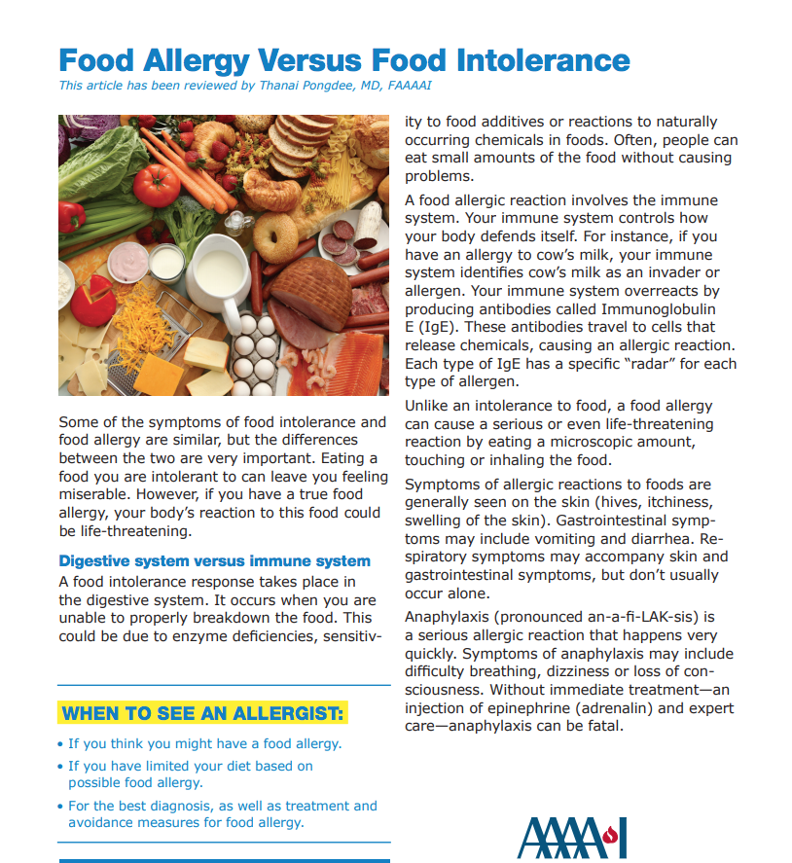
Joint AAAAI/ACAAI practice parameters - Food intolerance*
Food intolerance: Nonimmunologic reactions to food (food intolerances) can include metabolic, pharmacologic, toxic, and/or undefined mechanisms. Because food intolerances can sometimes mimic reactions typical of an immunologic response, it is important to keep these mechanisms in mind when evaluating patients reporting adverse food reactions
An adverse reaction to milk, for example, might be due to an immunologic response to milk protein or an intolerance caused by an inability to digest lactose.
Most adverse reactions to food additives, such as artificial colors and various preservatives, have no defined immunologic mechanisms and are most appropriately categorized as food intolerances if reproducible reactions do occur.
Other common food intolerances include those related to pharmacologic (eg, caffeine) or toxic (eg, scromboid) effects of food, whereas for others, no clear mechanism or mechanisms have been defined
*Food allergy: A practice parameter update—2014

Slide 8
Joint AAAAI/ACAAI practice parameters - Drug intolerance
Drug intolerance is an undesirable pharmacologic effect that may occur at low or usual doses of the drug without underlying abnormalities of metabolism, excretion, or bioavailability of the drug. Humoral or cellular immune mechanisms are not thought to be involved, and a scientific explanation for such exaggerated responses has not been established (eg, aspirin-induced tinnitus at low doses).
Drug allergy is an immunologically mediated response to a pharmaceutical and/or formulation (excipient) agent in a sensitized person
Pseudoallergic (anaphylactoid) reactions are immediate systemic reactions that mimic anaphylaxis but are caused by non–IgE-mediated release of mediators from mast cells and basophils.
Drug Allergy: An Updated Practice Parameter 201

Slide 9
Inconsistencies within and between standards
FHIR makes a distinction between intolerance and allergy but groups non-allergic hypersensitivity (pseudoallergy)with allergy
WAO/EAAACI definition of hypersensitivity sounds like intolerance but includes allergy and non-allergic hypersensitivity as distinct entities. There is no mention of “intolerance” and the meaning of non-allergic hypersensitivity is not clear as to whether it specifically refers to allergy-like symptoms without an immunologic cause
Joint AAAAI/ACAAI practice parameters exclude abnormalities of metabolism, excretion, or bioavailability in the definition of drug intolerance but include metabolic, pharmacologic, toxic, and/or undefined mechanisms in the definition of food intolerance

Slide 10
Proposed organization of Hypersensitivity and Intolerance in SNOMED CT
420134006 |Propensity to adverse reactions (finding)|
  609433001 |Hypersensitivity disposition (finding)|
    609328004 |Allergic disposition (finding)|
    773319003 |Non-allergic hypersensitivity disposition (finding)|*
  772779002 |Intolerance to substance (finding)|
*The propensity to adverse reactions resembling allergy mostly due to non-immunologic activation of mast cells and basophils

Slide 11
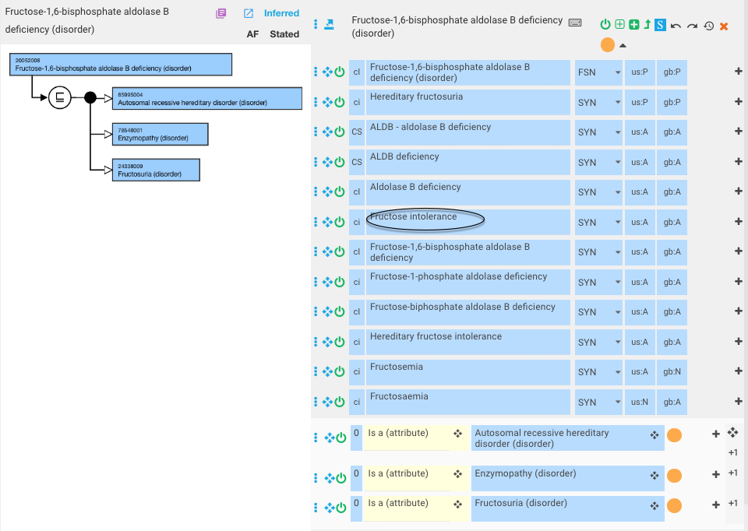
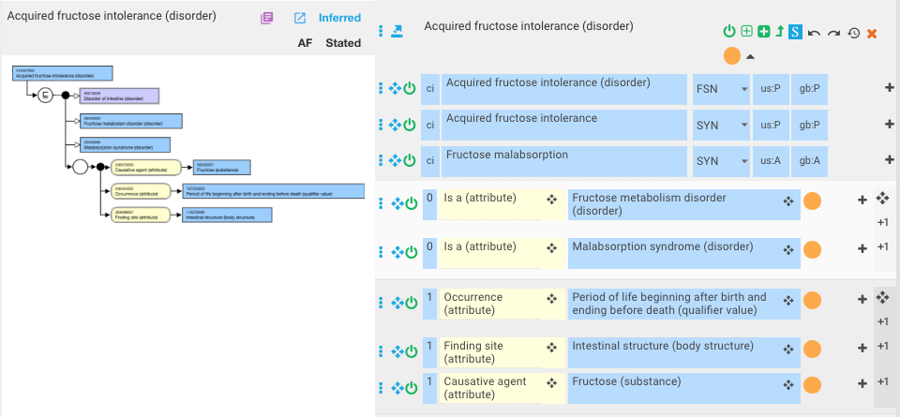
Modeling of food intolerance due to metabolic defects

Slide 12
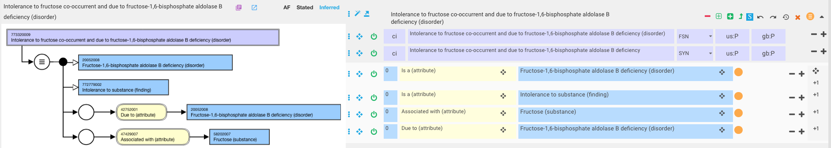
Intolerance to fructose co-occurrent and due to fructose-1,6-bisphosphate aldolase B deficiency

Slide 13
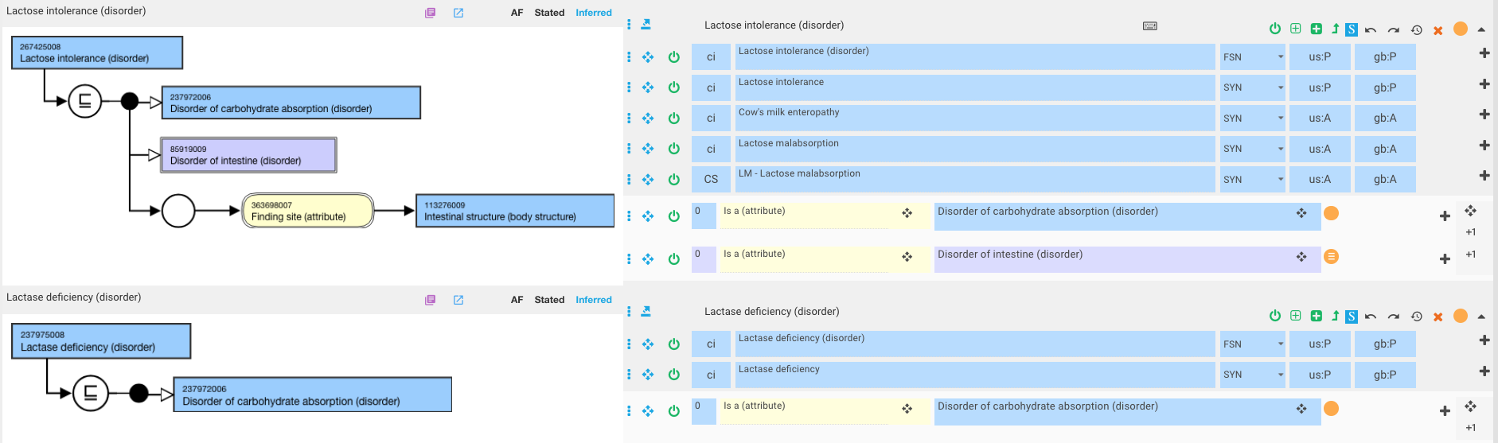
Lactose intolerance/Lactase deficiency

Slide 14
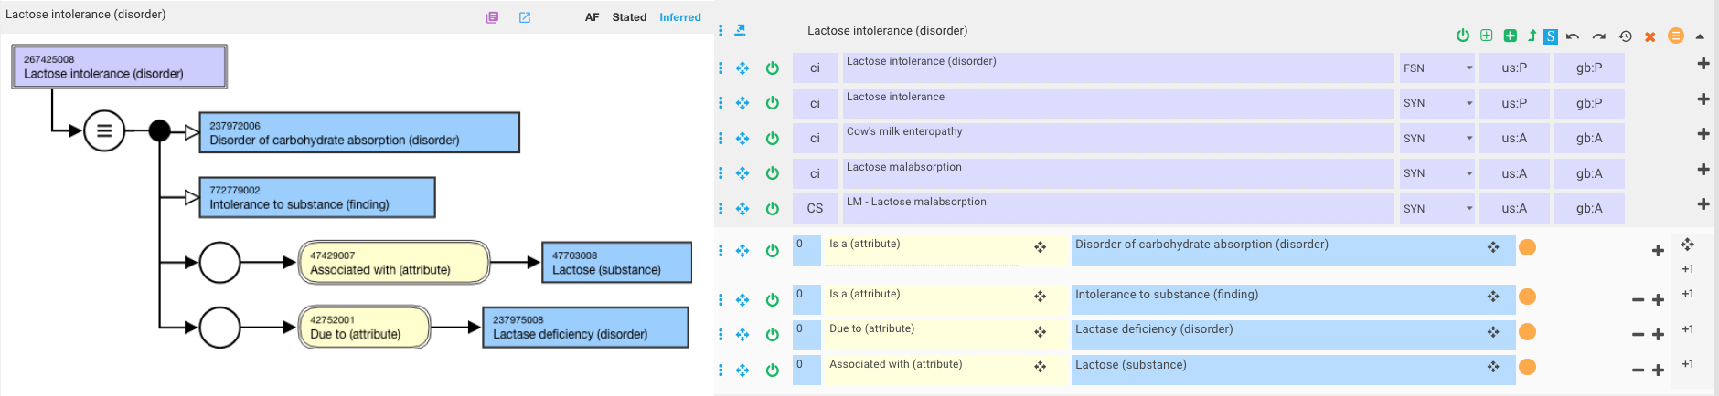
Proposed model for Lactose intolerance
Note that this would require this intolerance to substance to be a disorder in order to retain Disorder of carbohydrate absorption (disorder) as a parent

