Slide 1
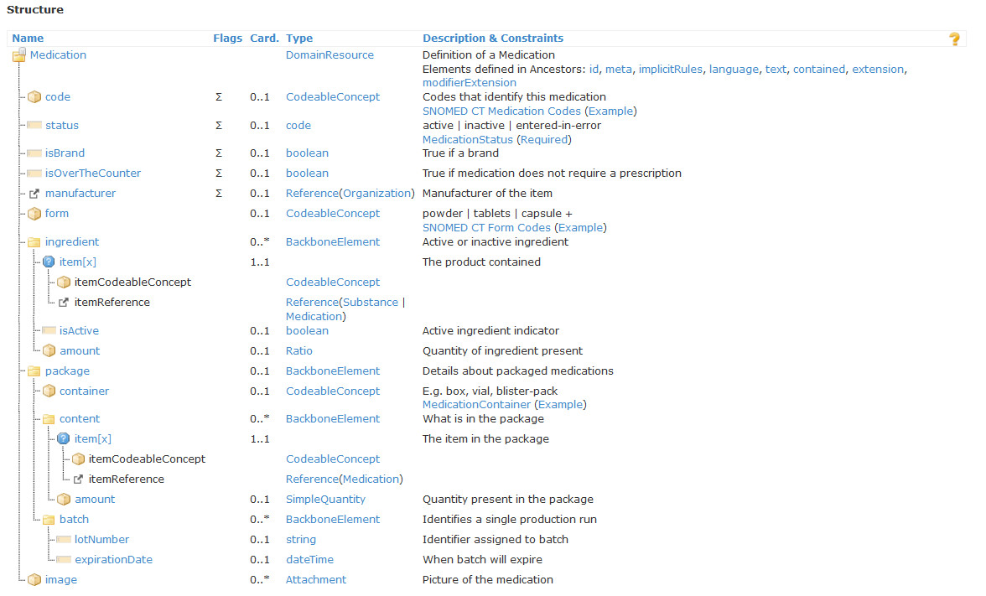
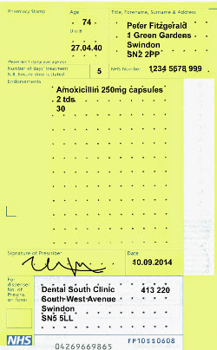
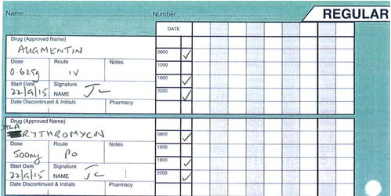
Medication
VMP = [VTM
+ unit strength
+ formulation]
+ units per dose
+ doses per day
+ course duration
Primary Care
Amoxycillin 250mg capsules
2 tds
supply 30
?
AMP OR AMPP
OR VMP OR VMPP
OR VTM
VTM
+ total dose
+ route
+ dosing schedule
Until stopped
Hospital
Amoxycillin 500mg
Oral route
9am, 6pm, 10pm

Slide 2
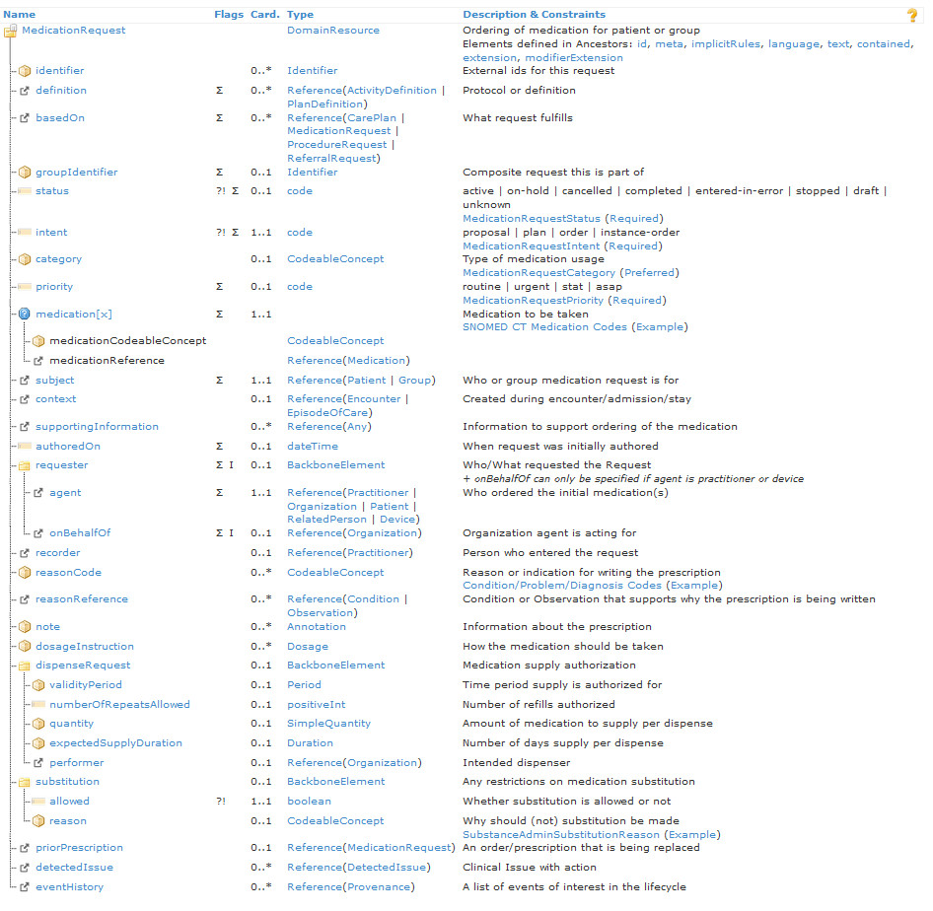
Medication Request
US clinicians issue single prescription that includes authority to repeat dispense
UK clinicians record an authority to repeat prescribe, but there is (almost) no notion of an authority to repeat dispense

