Slide 1

Discovery
Actionable information from data
Towards a computable language of health
The structure/ semantic conundrum
Data Storage Model vs Information Model

Slide 2
Simple Working example
We have two events from two different sources
E1 – Haemoglobin 14 g/dl
E2 – Haemoglobin 140 g/l

Slide 3
Standard Data Model
FHIR or EMIS or Cerner etc
Class Observation {
Concept code e.g. Haemoglobin estimation
float value e.g. 4 or 140
Concept Units e.g. g/dl or g/l
}

Slide 4
It follows that
Ob 1 {
Concept=Haemoglobin estimation
Value = 140
Units= g/dl }
And
Ob 2 {
Concept=Weight
Value = 150000
Units= g/dl }
Are both legitimate. A search for g/dl or a value of >10000 are all legitimate
Or
“I hired a bouncer which resulted in a 6”

Slide 5
An information model?
What do you want to know about Discovery data?
Type anything Hemag
Haemoglobin
Haemoglobin …. Haemoglobin estimation…
Haemoglobin… units
Haemoglobin… units… grams/ litre

Slide 6
Semantic modelling

Slide 7
It follows that
Grammar
Rule 44a Concepts must be related by direction
Query for “haemoglobin ….. Has value -> 14 g/dl” is legitimate
Querying for “haematology test ..is a… Binding substance” is not
Query for “14 g/dl” … is not
Rule 2a Concepts must have properties when the variables are co-dependent
Query Either “{14 g/dl}” or “{140 g/l}” is legitimate
Query for “14….has units -> units g/l” is not legitimate as 14+ g/l are part of the measure

Slide 8
It follows that
Syntax
Haemoglobin…… Has value-> between >=0 and <=10 g/dl → with UCUM conversion
Or
Haemoglobin estimation -> Has Value -> between >0 and < 10 g/dl-> With UCUM conversion
Both approaches find both E1 and E2

Slide 9
Or….
The real model | Structural representation ()
I am allergic to Penicillin | Event type= Allergy/ Adverse reaction === 294461000 |Antibacterial drug allergy (disorder)| : 246075003 |Causative agent (attribute)| = 373270004 |Penicillin -class of antibiotic- (substance)| }
I react badly to Amoxicillin | Event type = Allergy Adverse reaction 281647001 |Adverse reaction (disorder)|: 246075003 |Causative agent (attribute)| = 72687004 |Amoxicillin (substance)
I vomited with Amoxicillin 250 mg capsules | Event type = Allergy Adverse reaction 422400008 |Vomiting (disorder)| 417318003 |Is manifestation of (link assertion) 281647001 |Adverse reaction (disorder)|: 246075003 |Causative agent (attribute)| = 27658006 |Amoxicillin (product)

Slide 10
Discovery Data Service
GP practice
Hospital
An Event
Proprietary format
An Event
Proprietary format
Data Service
Normalise to common model
Inbound
Outbound
An Event
Standards format
Data subset
Common model
GP practice
New Service
Patient
Warehouse

Slide 11
One Information model
Many representations
The real model | Possible representation (Event attributes and concepts)
I am allergic to Penicillin | Event type = Allergy Allergy to = Penicillin drug group (allergy)
I react badly to Amoxicillin | Event type = Adverse reaction Substance = Amoxicillin (substance)
I vomited with Amoxicillin 250 mg capsules | Event type = Adverse reaction Product = Amoxicillin 250 mg capsules Reaction = Vomiting

Slide 12
Bypass pre-coordination stage –it’s a blind alley
Free Text
Simple hierarchy
Snomed Expressions
Precoordinated
“is a”

Slide 13
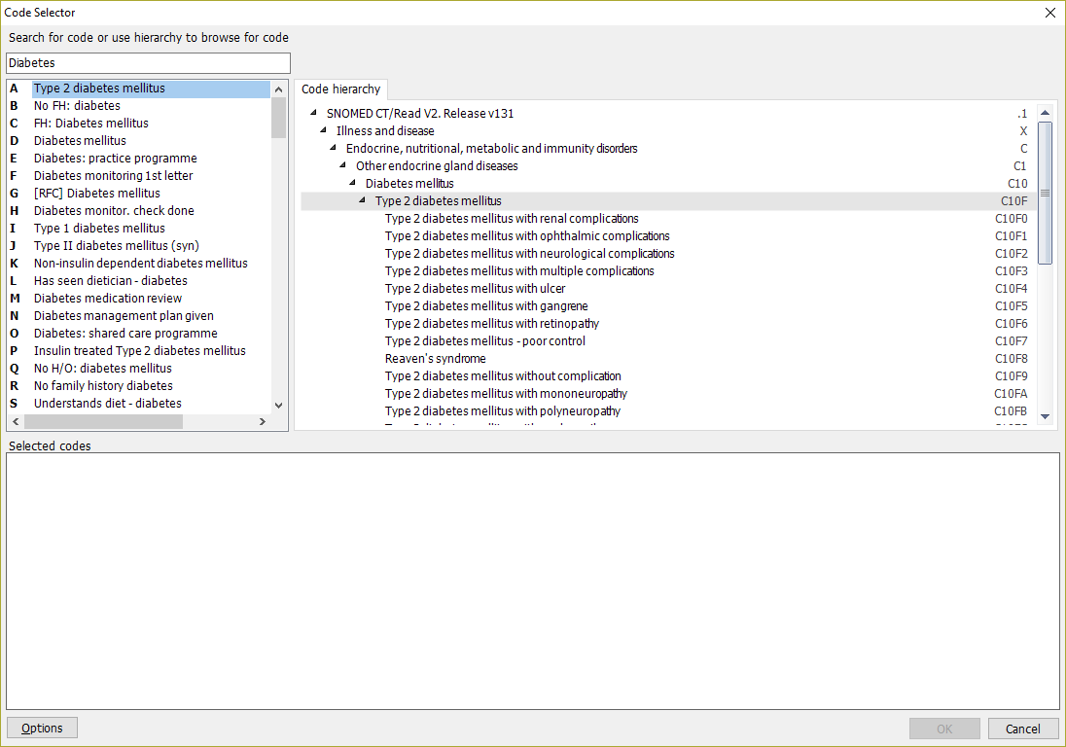
Simple hierarchy (Read 2/Snomed)
IIlustrates the dead end

Slide 14
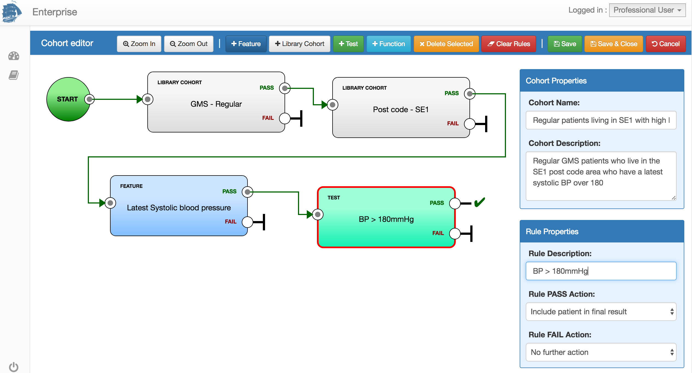
Cohorts and query

Slide 15
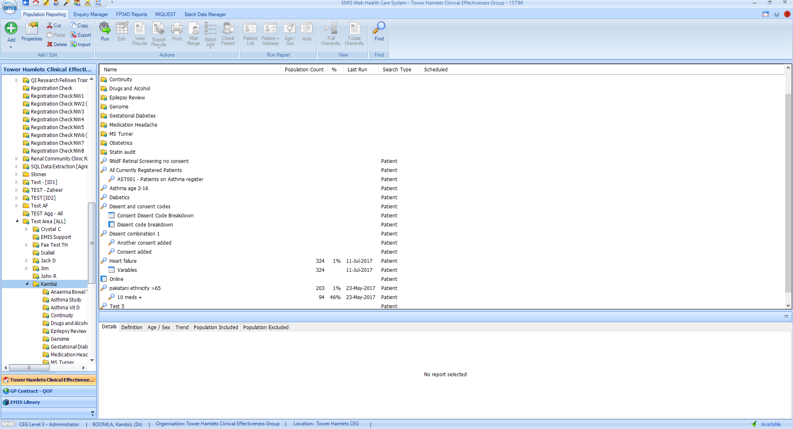
Find Any cohort

