Slide 1
Ontologies in Pathology data – an untapped minefield?
Syed M Hasan Rizvi, MB BS, MBA (Cantab) FRCPath
Barts Health NHS Trust

Slide 2


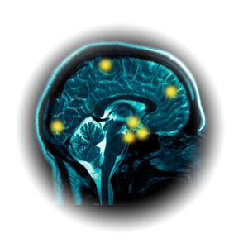
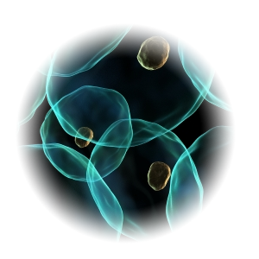
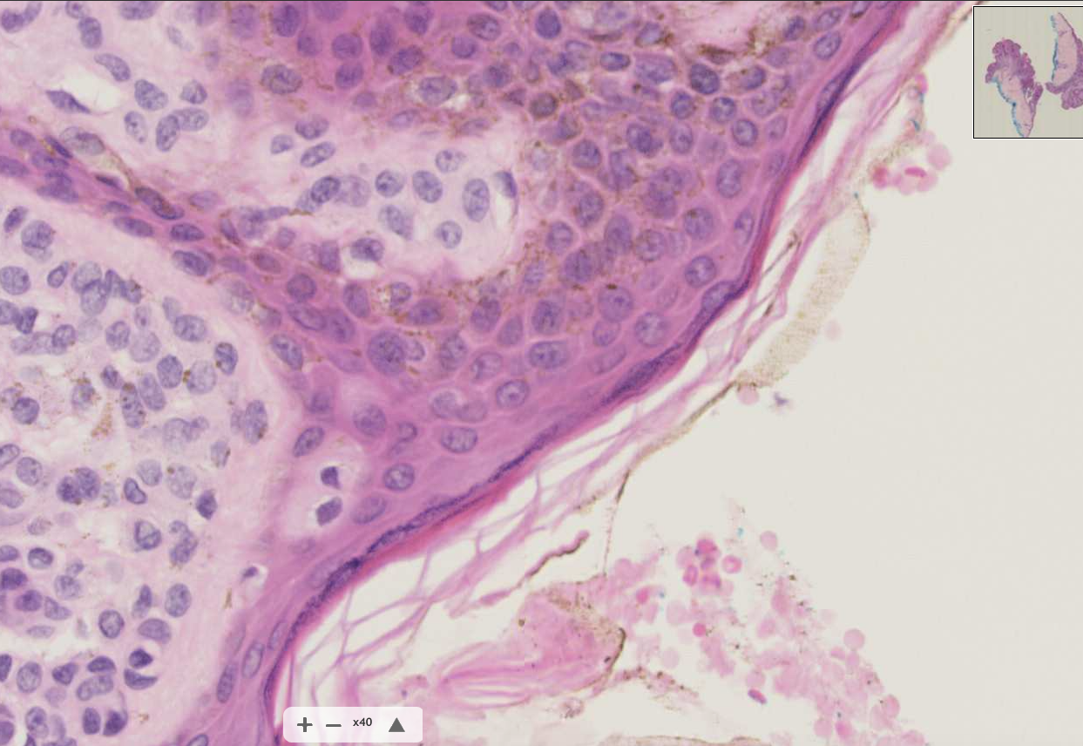
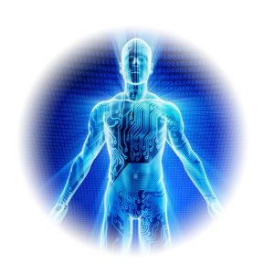
Brief background and direction of travel: (R)Evolution
Informatics
Singularity - integration
?
Digital Imaging
Molecular analysis
Personalised
Medicine/
Data dependency
Monoclonal antibody based detection
Genome Mapping
Genomics, Automation
Electron Microscope
Flourescence
Molecular biology structure/function
Biomarkers
“Theranostics”
Special stains, Immunostains, Electron microscopy
Refining Classification
Microscope
Microscopic description
R virchow – names & classification
Observation
Macroscopic description
Thomas Hodgkin

Slide 3
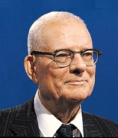
“In God We Trust …
- all others must bring data”
W Edwards Deming

Slide 4
Harnessing data: Where is the data and what does it look like?
Who knows about it and who can get it and how? How do we use it?
?

Slide 5
Harnessing data: Where is the data and what does it look like?
Cloud/Servers – Data
HIS (Cerner)
IT as an enabler?
EPR
External interfacing (Education
Research
Registries
Hospitals)
Network level
Service Level
Clinical /Pathology coding
QMS
LIMS
PACS
Somerset/MDT data
Middlewares
(the patches)
Molecular
Pharmacy

Slide 6
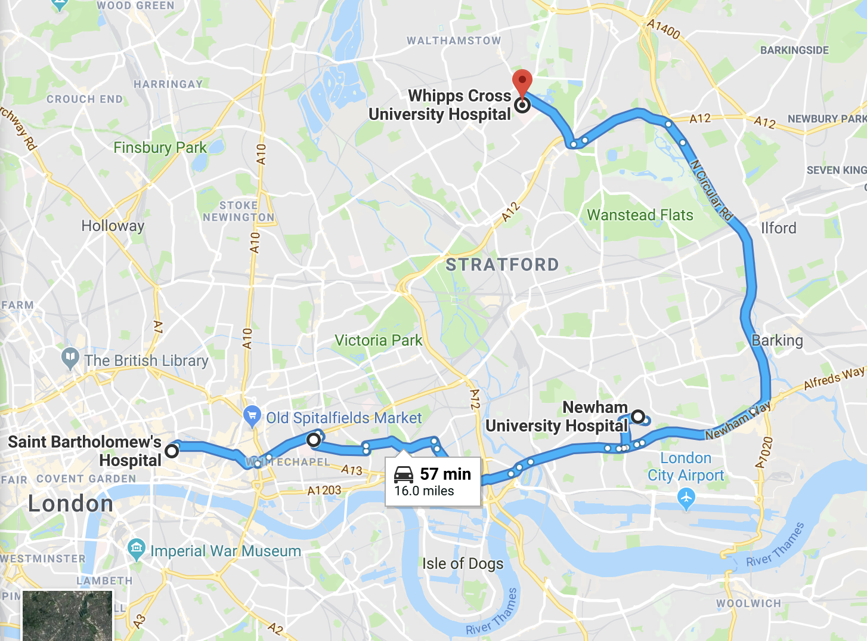
Harnessing data: Where is the data and what does it look like?
Homerton
Royal London

Slide 7
Harnessing Data - What does it look like
Numerical values (Origin of test, e.g. Blood Glucose)
Histopathology: Natural language
Synoptic reporting (uptake)
Genomics: ?
Digital pathology?
Coding (for billing, for classification/public health)

Slide 8
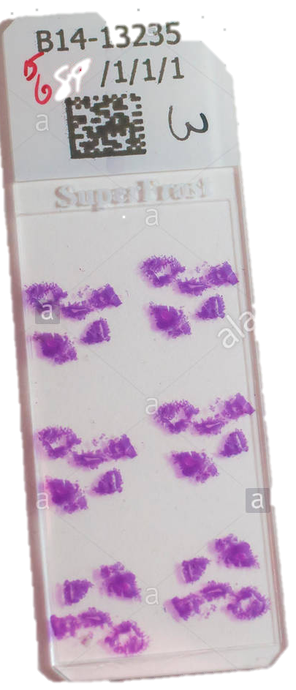
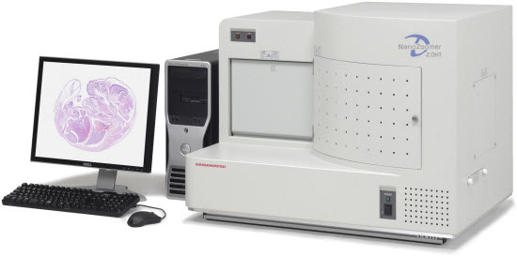
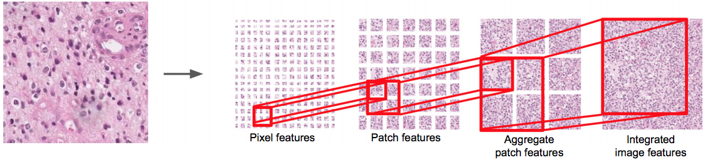
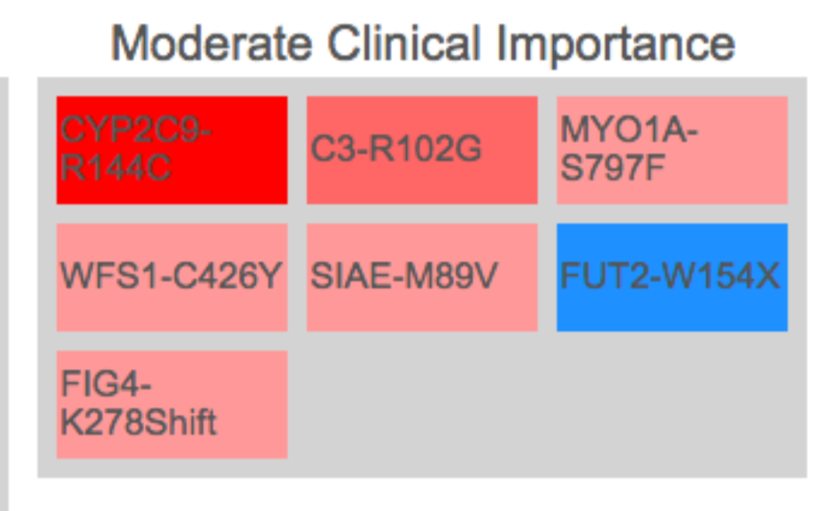
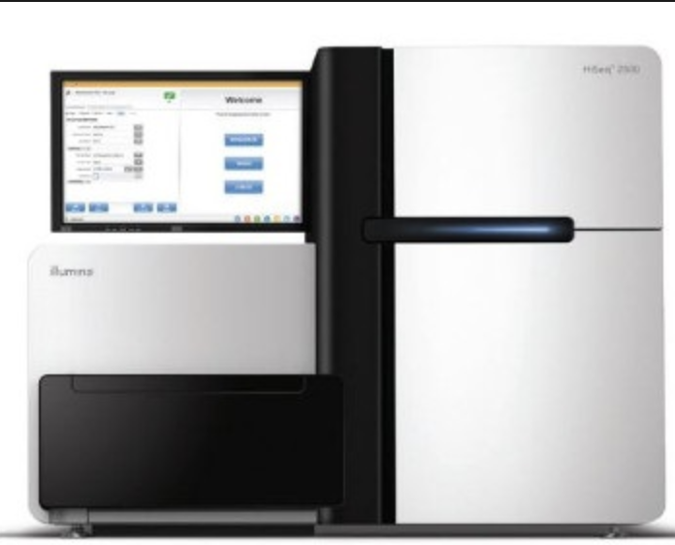
Harnessing data: Where is the data and what does it look like?
Digital Pathology Scanner
Whole Slide Image: Digital image = Data
1001101010010101010110101001
Human Tissue
(Microscope based interpretation)
Data
(Available for Analytics)
Next Gen Sequencer
ATGCATGCATGCATGCATGCATGCAT
1001101010010101010110101001

Slide 9
Where do we want to be? Ontologies: Establish and explore inter-relationships
Path data
Patient data
BIG DATA
EVENTS (CLASSIFICATION)
VS
EPISODES and relationships
- ONTOLOGY(ies)
Standardised/structured data
Standards of communication
Interoperability
Scalable

Slide 10
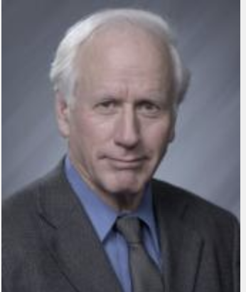
Brief historical background:
18th Century - La Croix/Sauvages, Cullen, Farr
19th Century - Bertillon - classification of causes of death (1893)
CPT - current procedural terminology (US – billing)
LOINC (logical observation identifier names and codes)
CAP - SNOP and then SNOMED CT
UMLS – unified medical language system
Notes:
Clem Mc Donald

Slide 11
Desired (data) end state: “I have dream”
National Lab Medicine Catalogue (NLMC)
Dare I say NPfIT
Standardization
Synoptic report data – Searchable
Structured information, Public Health, Research, Trials

Slide 12
The East London Story:

Slide 13
The East London Story
Homerton
Royal London

Slide 14
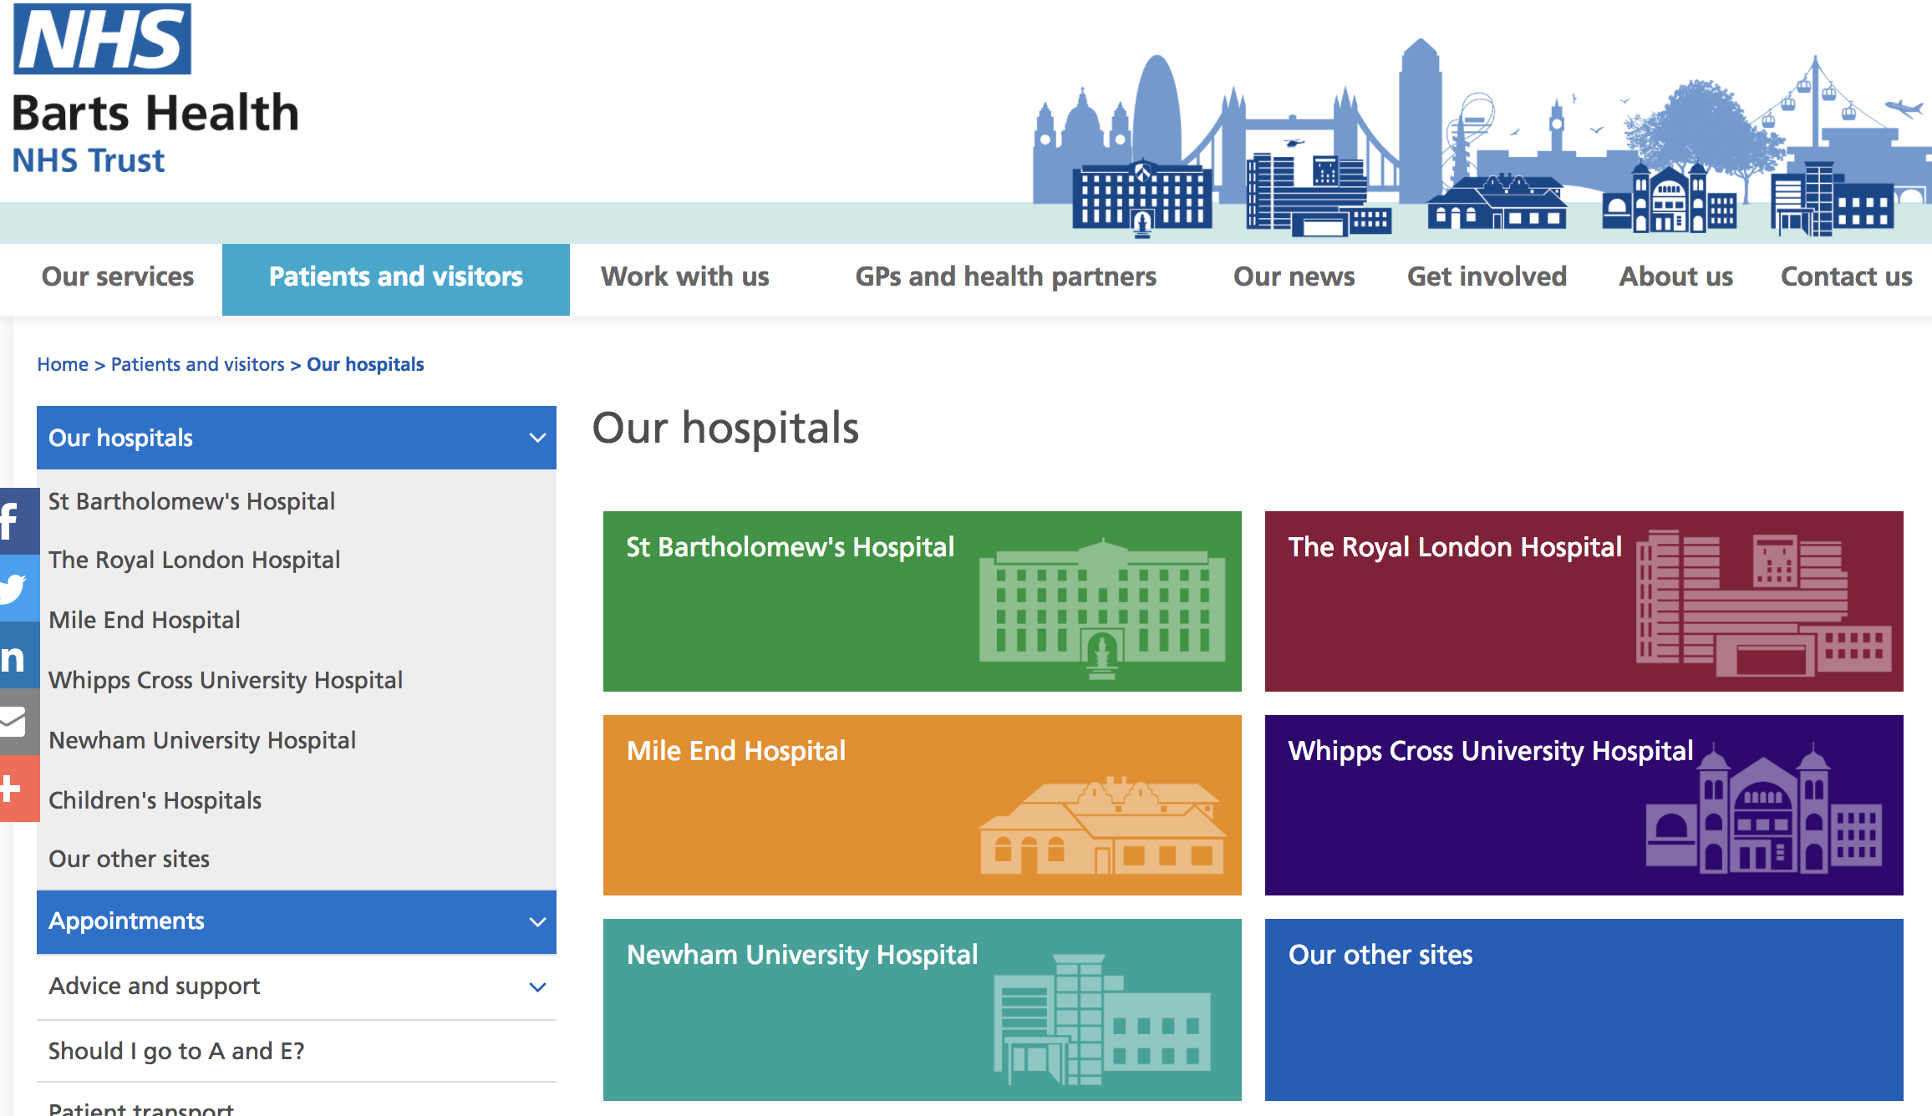
The East London Story

Slide 15
The East London Story
Start with the people – CCIO, CIO
Build a system (capability)
Implementation hurdles…working with partners
Complying with standards

Slide 16
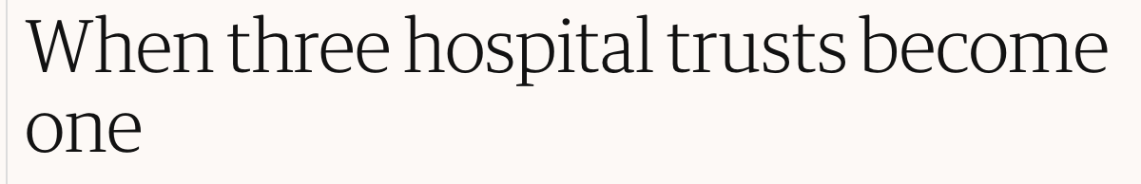



The East London Story

Slide 17
The East London Story
Homerton
HIS
Royal London

Slide 18
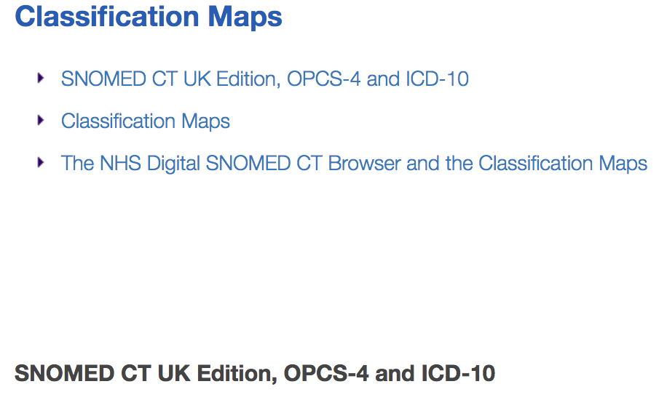
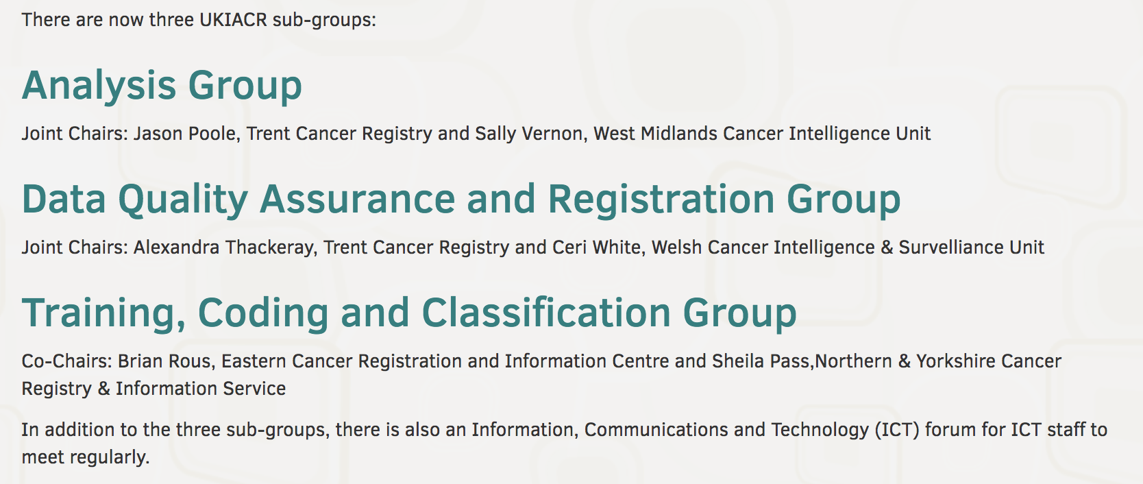
National
Founding member SNOMED International
NHS Digital
UK & I Association of Cancer registries

Slide 19
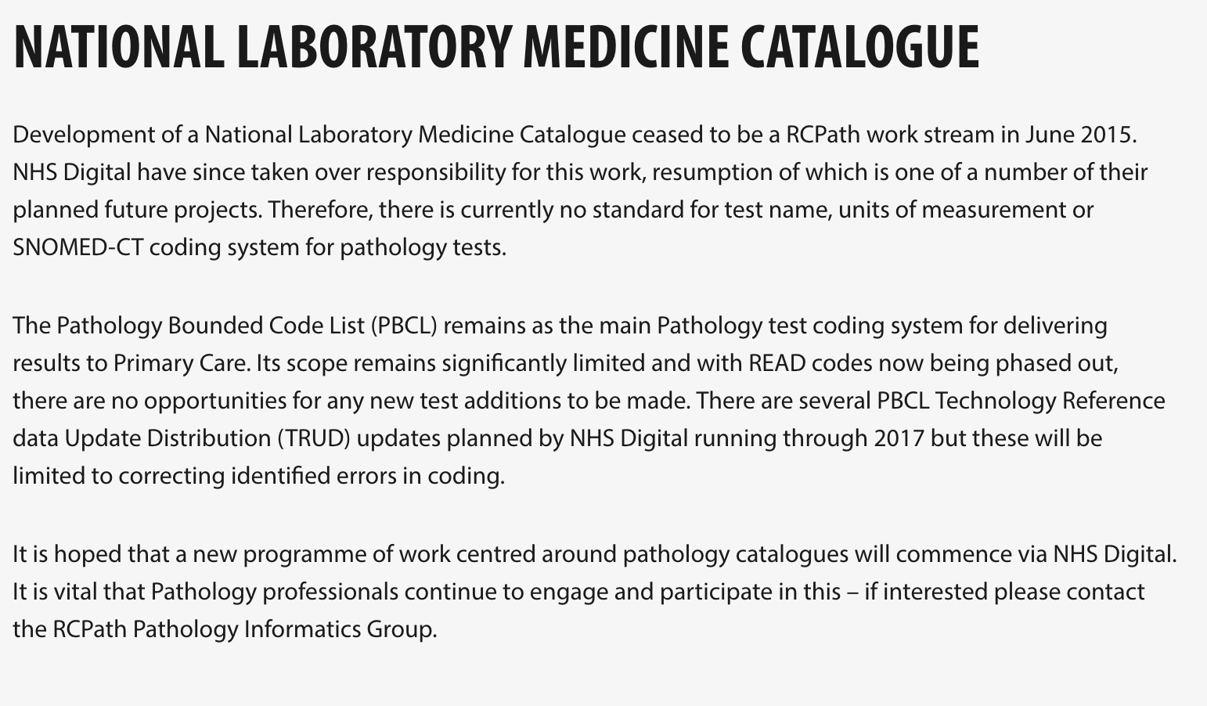
RCPATH https://www.rcpath.org/profession/digital-pathology/pathology-informatics/national-laboratory-medicine-catalogue.html

Slide 20
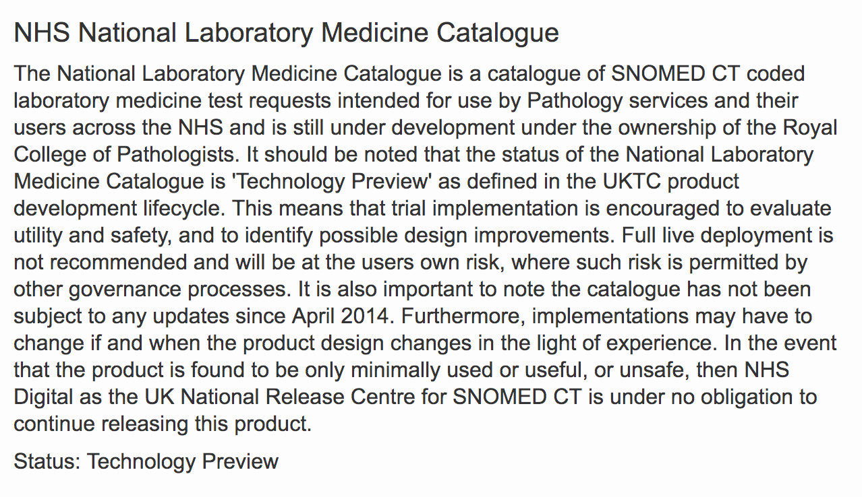
NHS DIGITAL https://isd.digital.nhs.uk/trud3/user/guest/group/0/pack/38

Slide 21
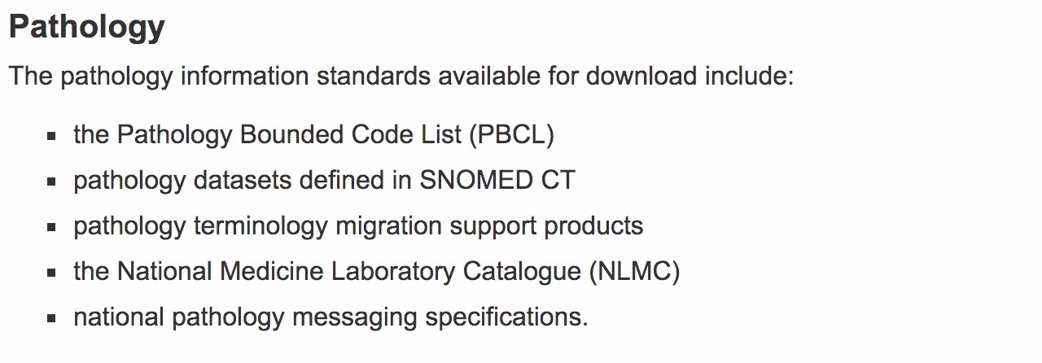

Slide 22
Summary:
Building IT infrastructure
Staff (Leaders, champions…and followers)
Standardised nomenclature
Interoperability
Optimism!

Slide 23
We shall overcome….
Thank you!

