Slide 1
Discovery – data services in east London
Charles Gutteridge
12th April 2018

Slide 2
Everyone makes a lifelong data trail
Birth
Death
Fitness
Illness
Feeling
The web
Hospital care
Symptoms
Community care
Your EHR

Slide 3
Data assets
How long?
What for?
Sharing?

Slide 4
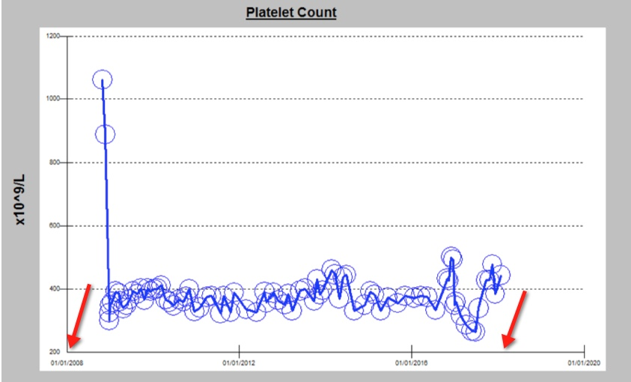

Slide 5
HIE Patient 2 Case Study
Patient admitted through A&E to ITU 4th October 2013
Patient having tonic clonic seizures;
Serotoninergic syndrome, GCS (Glasgow coma score) 12;
Initial diagnosis was possible paracetamol overdose;
Drug history obtained from HIE GP summary view by pharmacist
GP history showed patient had been on citalopram;
Determined patient had overdosed on citalopram and not paracetamol;
Treatment and medication regime change accordingly.

Slide 6
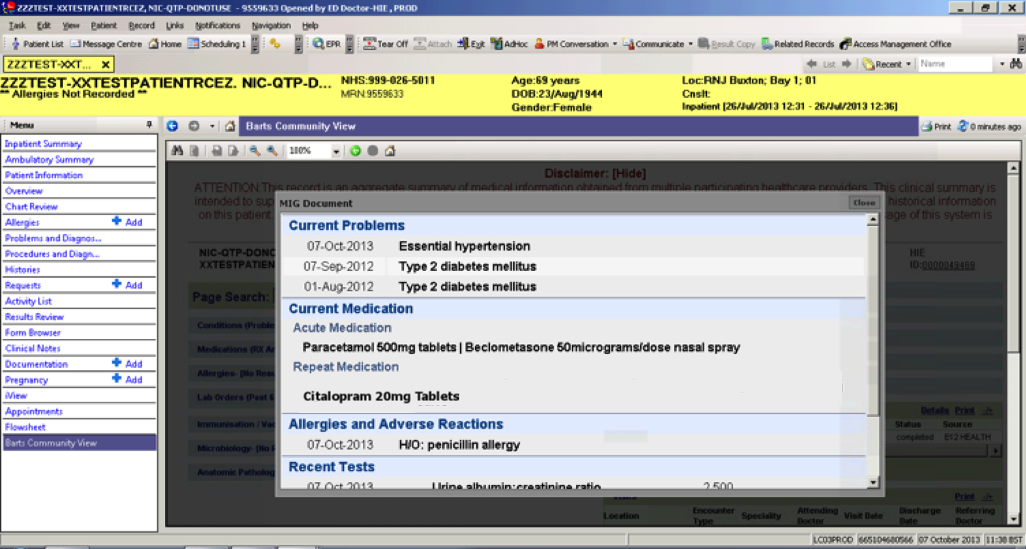
Patient GP summary view accessed in HIE. Doctor can see patient has been prescribed Citalopram. Diagnosis of paracetamol overdose reviewed and revised, treatment regime changed accordingly.

Slide 7
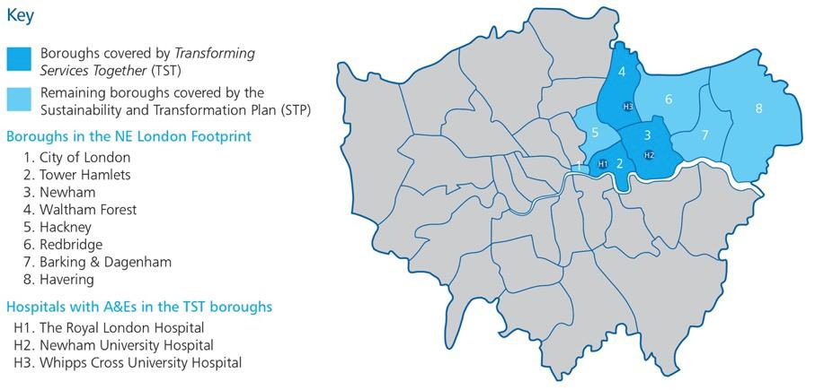
Local Geography for Discovery East London – Phases I / II
Phase II

Slide 8
eLPR – Live Links
St Josephs Hospice
East London Foundation Trust
North East London Foundation Trust
Rio and Orion
Homerton
University Hospital and
Community
Barts Health
WEL GPs
Newham
Social Care
C&H GPs
Newham & Tower Hamlets CHS
Emis Web Community
West Essex GPs
SystemOne

Slide 9
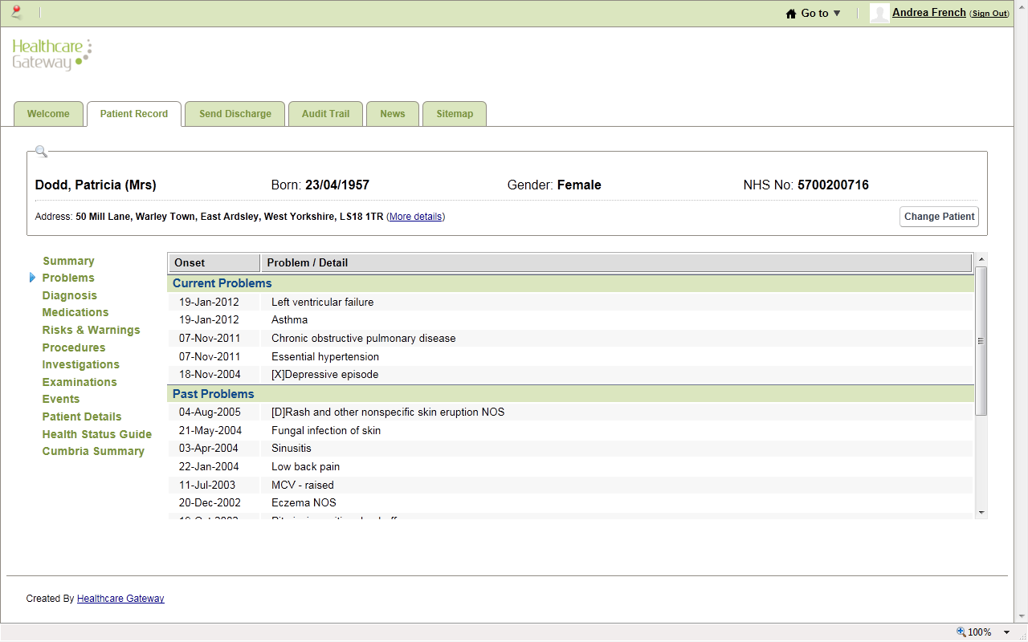
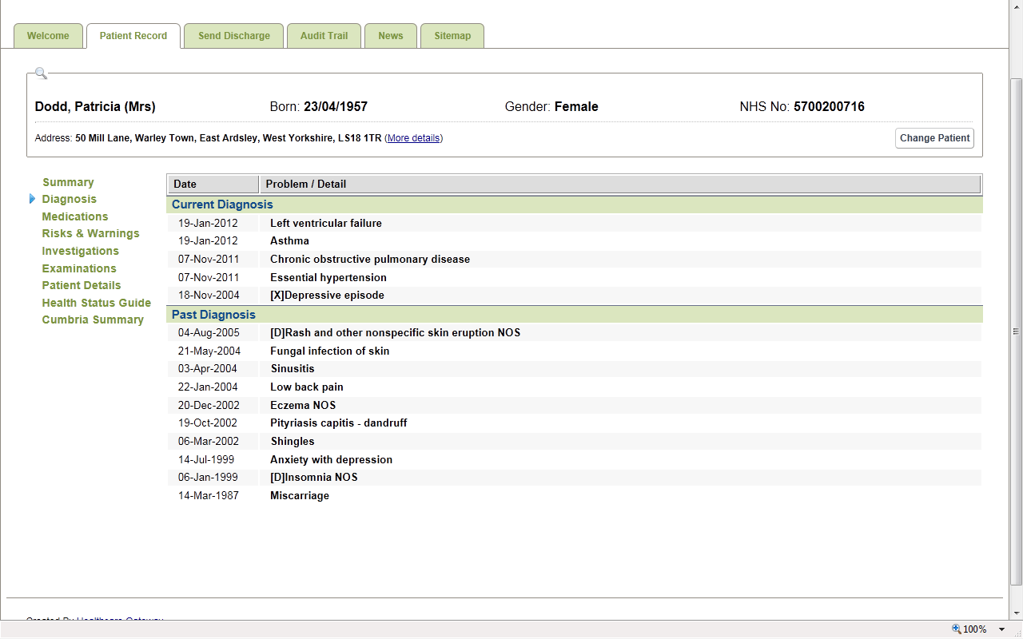
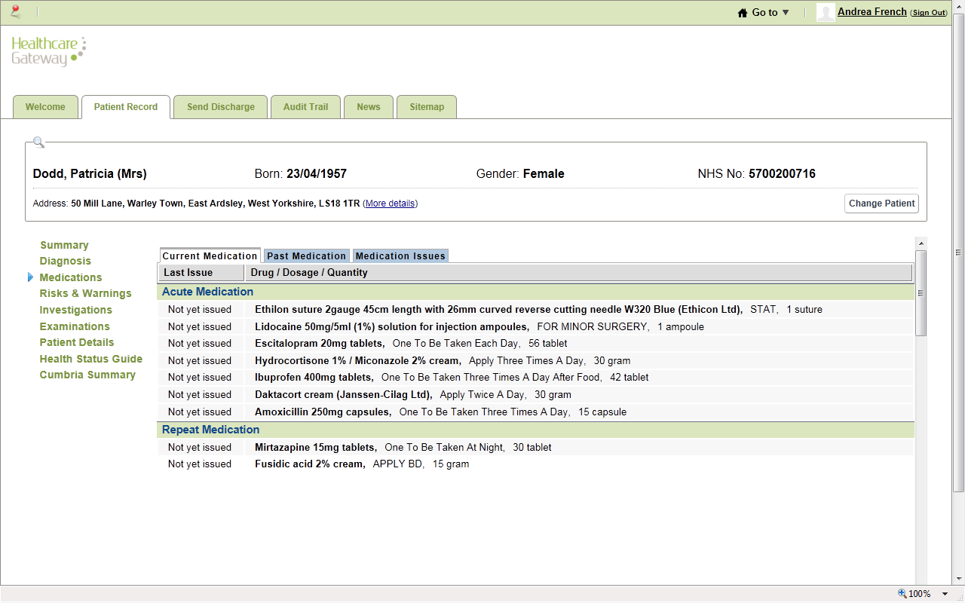
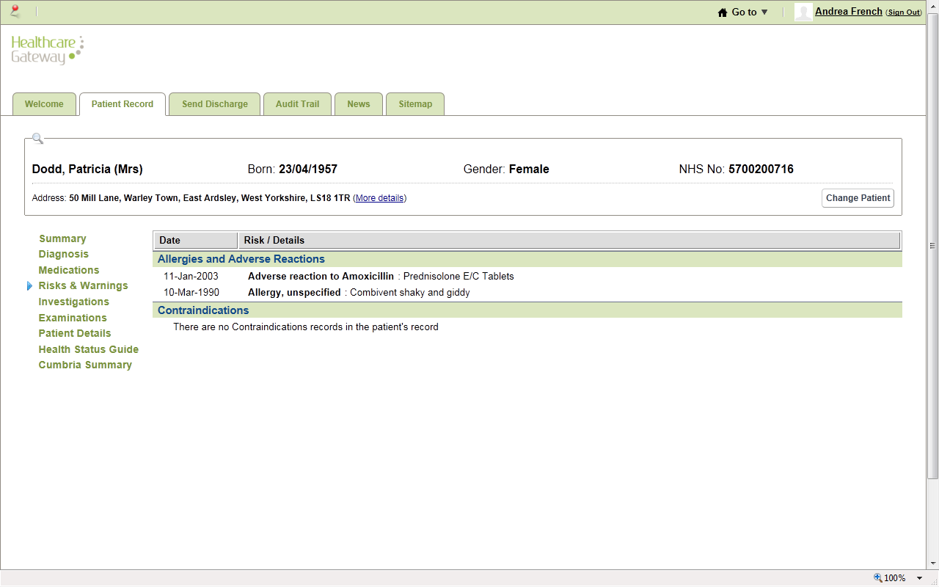
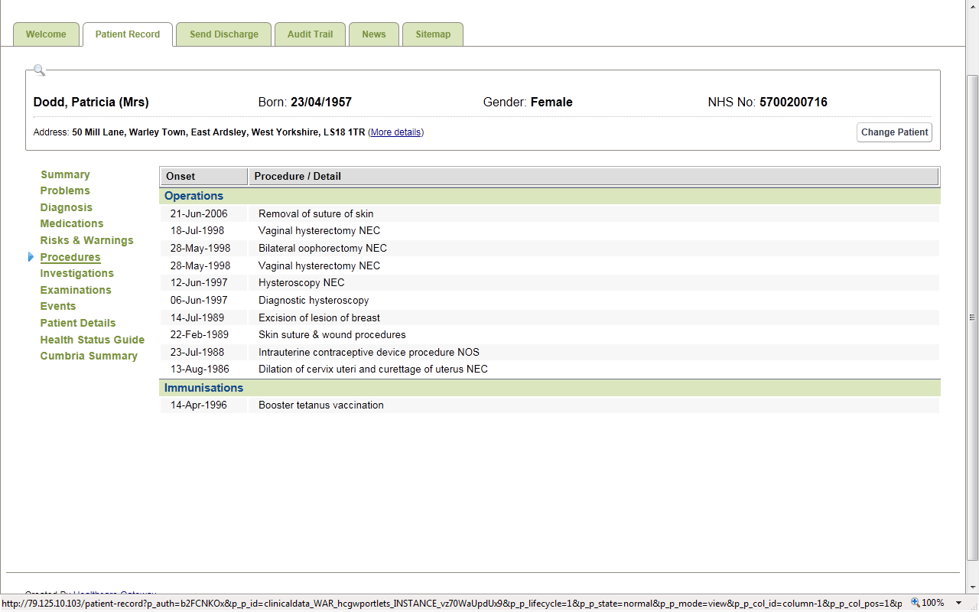
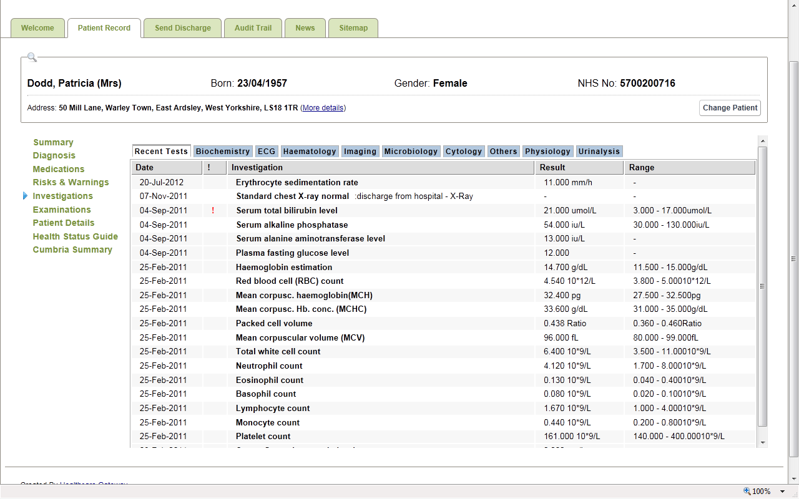
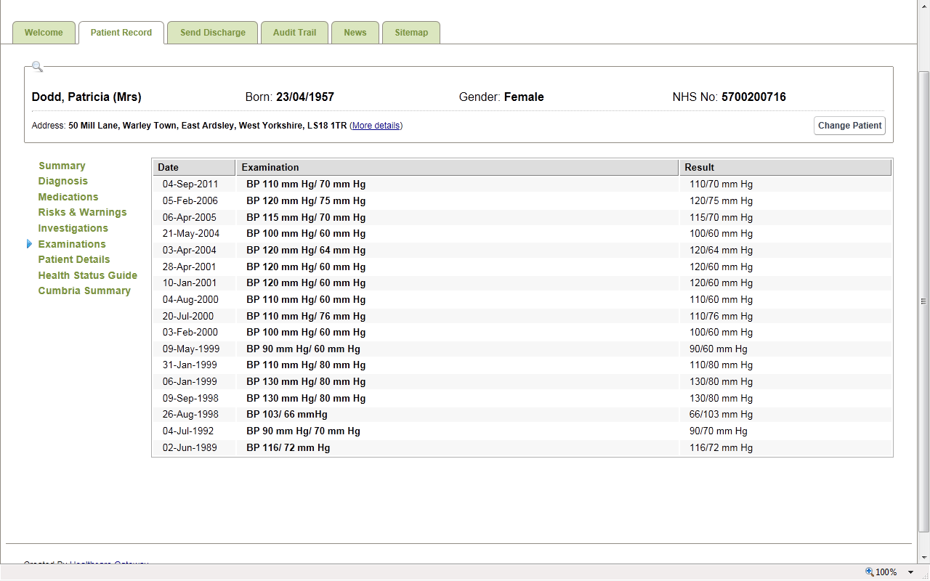
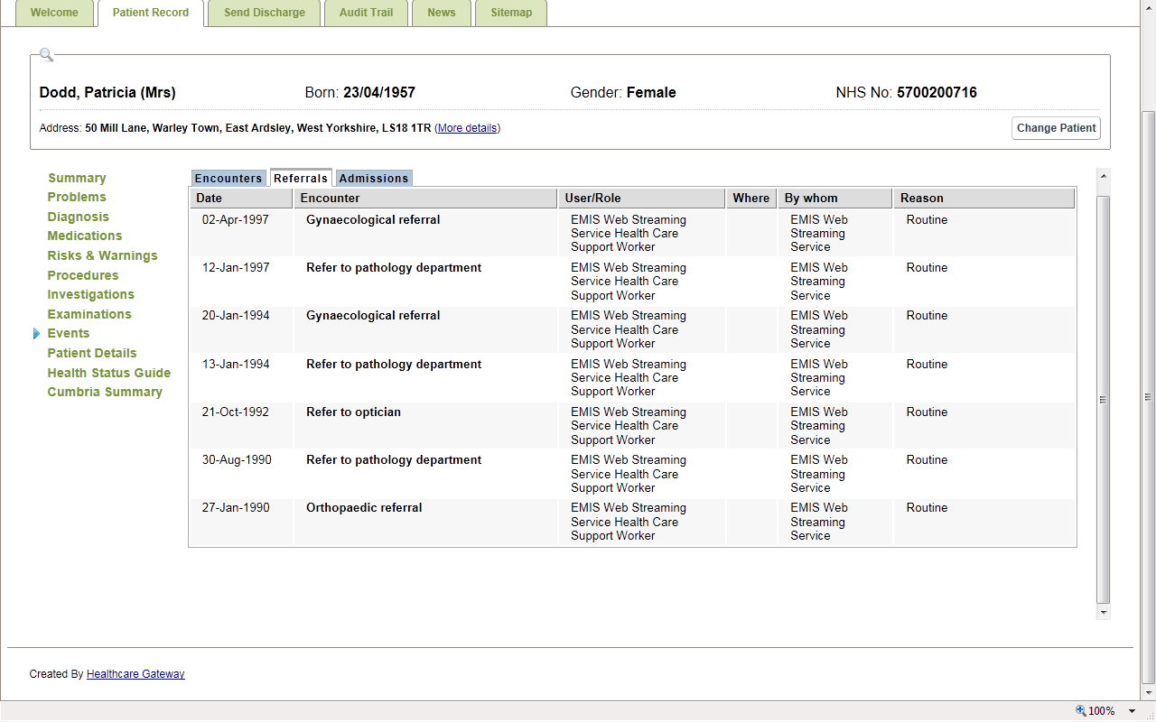
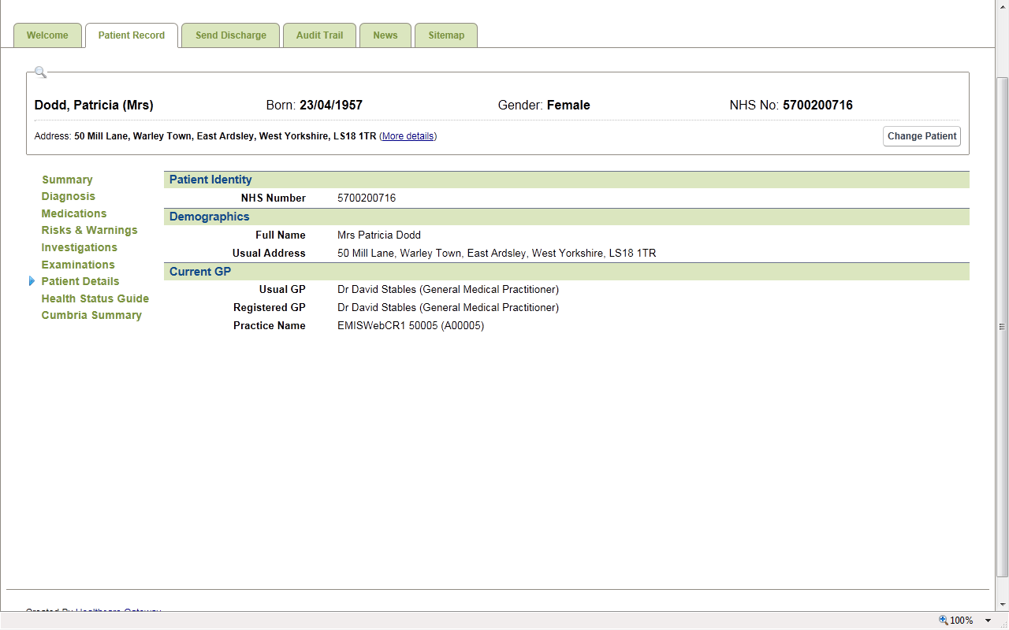
9 other summary pages from EMIS available
Problems
Diagnosis
Medications
Risks & Warnings
Procedures
Investigations
Examinations
Events
Patient Details

Slide 10
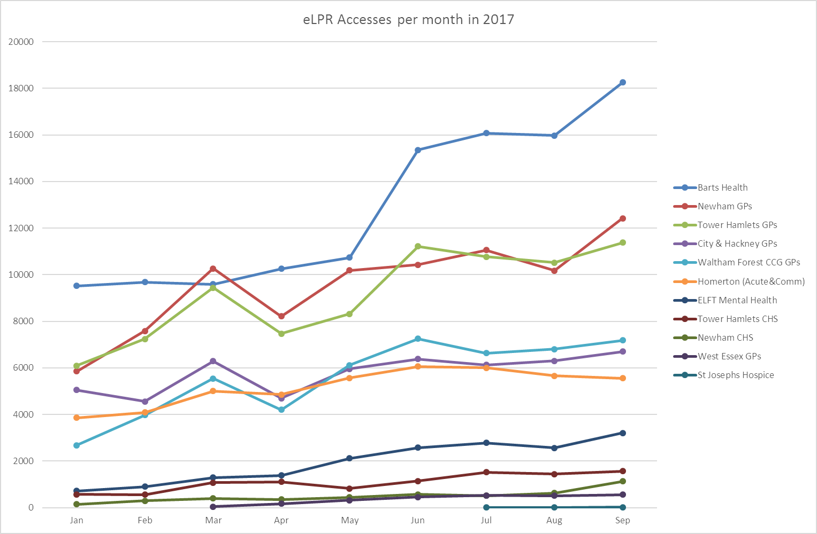
eLPR – Access per Month

Slide 11
Developing actionable insights
Clinical characteristics
Counting
Patient level
Prediction
What will happen to me?
Population health estimation
Can we find a cause?

Slide 12
Developing a data architecture
Business
intelligence
Queries
Clinical
Data
EHR
Content
Population
Health Data
NLP
Research archive
ID Management
Decision support

Slide 13
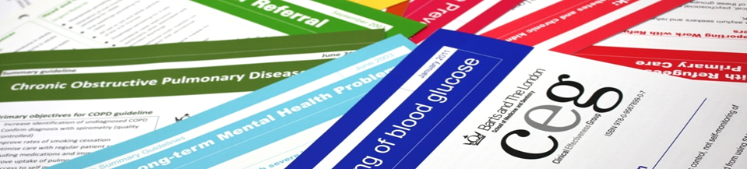

Discovery – a Learning Health System for East London
A collaboration between four boroughs: Newham, Tower Hamlets, City and Hackney, Waltham Forest
and two hospitals, Homerton and Barts Health
Pop. approx. 1.5 million: 183 general practices and 700 GPs, four hospital trusts and 1400 consultants.
….strive to become learning health systems by making clinical data research grade and lowering the cost of data acquisition and knowledge generation
Victor Dzau. Transforming Academic Health System for an uncertain future (2013)
Every consenting patient’s characteristics and experience is available to learn from
Best practice immediately available
Improvement is continuous
This happens routinely and efficiently
This is part of a culture
Charles Friedman. Toward Complete & Sustainable Learning Systems (2014)

Slide 14
National Context – Target Architecture
Towards a Learning Health and Care System
The Discovery East London programmes are aligned with national principles:
Establish local learning health and care systems with a focus on local priorities and direct or individual care innovation in the context of population health.
Create a ‘diameter of trust’ for citizens to share information for direct care, service redesign and research
Leverage scale to track and manage patients across complex pathways to enable organisational service redesign across the STP footprint.
With Academic Health Science Networks and ‘testbed’ sites, take collective responsibility for driving national adoption of proven innovations.
Link and share data across boundaries for service redesign and promote data and life sciences research strategies

Slide 15
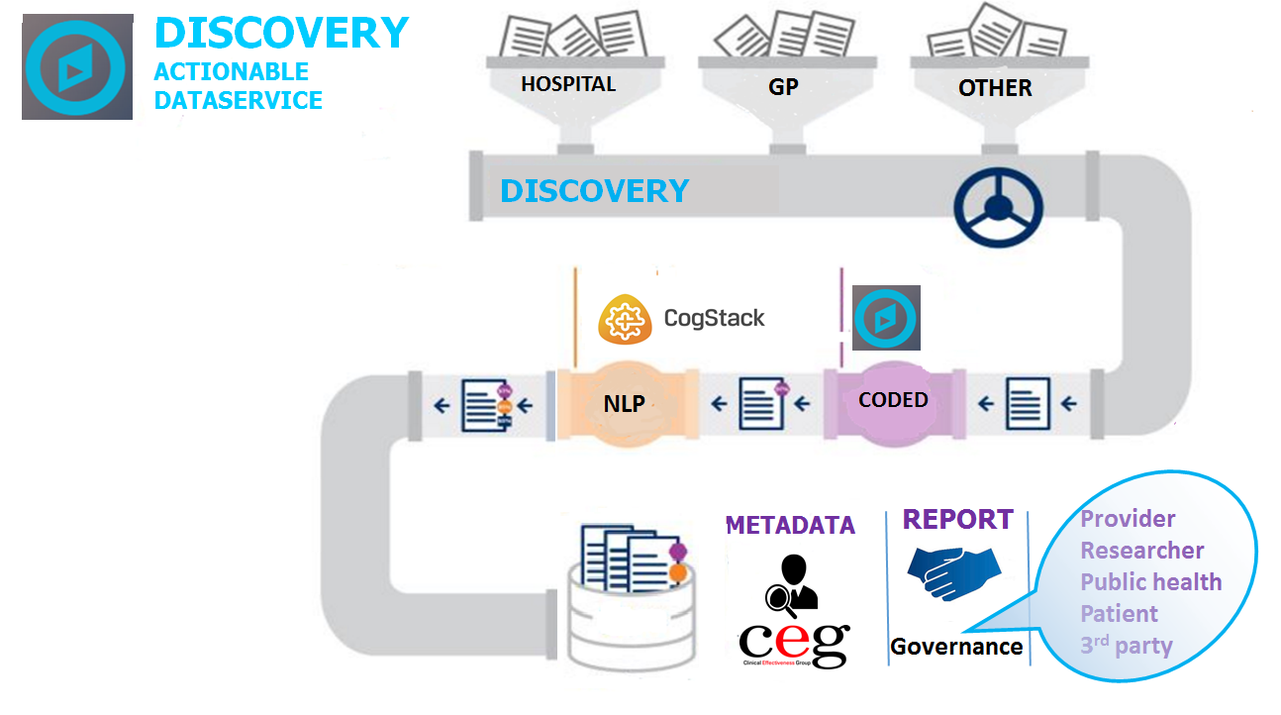

Linked research cohorts

Slide 16
Current Data Status
Barts Health & Homerton FT
  ADT
  Clinical Data
GP data
  All Structured data
  Text (Q4 17/18)
  Deceased & Moved (Q4 17/18)
Next
  ELFT (Q4 17/18)
  Adastra(Urgent Care) Q4 17/18
Local Authority-School Data (Weight Measurement)
  City & Hackney(c15,000)
  Newham (c18,000)
  Tower Hamlets (c6,000)
Current Practice Sign Up & Activation
As at 12th March 2018
 | Total Practices | Not Activated
City & Hackney | 43 | 4
Newham | 52 | 2
Tower Hamlets | 35 | 0
Waltham Forest | 37 | 14
Hurley Group | 9 | 0
#CollectShareUse

Slide 17
Discovery East London – Current Projects
Governance and approval by Discovery programme board
Atrial Fibrillation
Clinical Effectiveness Group Analytics
Child Health
East London Genes & Health
Natural Language Processing
Where is my patient and who is providing care?

