Slide 1
Clinical Engagement & Reference Groups– moving forward
Jane Millar
Ian Green

Slide 2
Purpose of the session
Provide updates
Promote discussion
Gain feedback and ideas
In other words “INTERACTIVE”

Slide 3
Topics for discussion
Clinical portal
Introducing the clinical engagement team
Overview of clinical engagement strategy
Overview of clinical groups
Progress with Clinical Reference Groups (CRG’s)
Managing clinical requirements

Slide 4
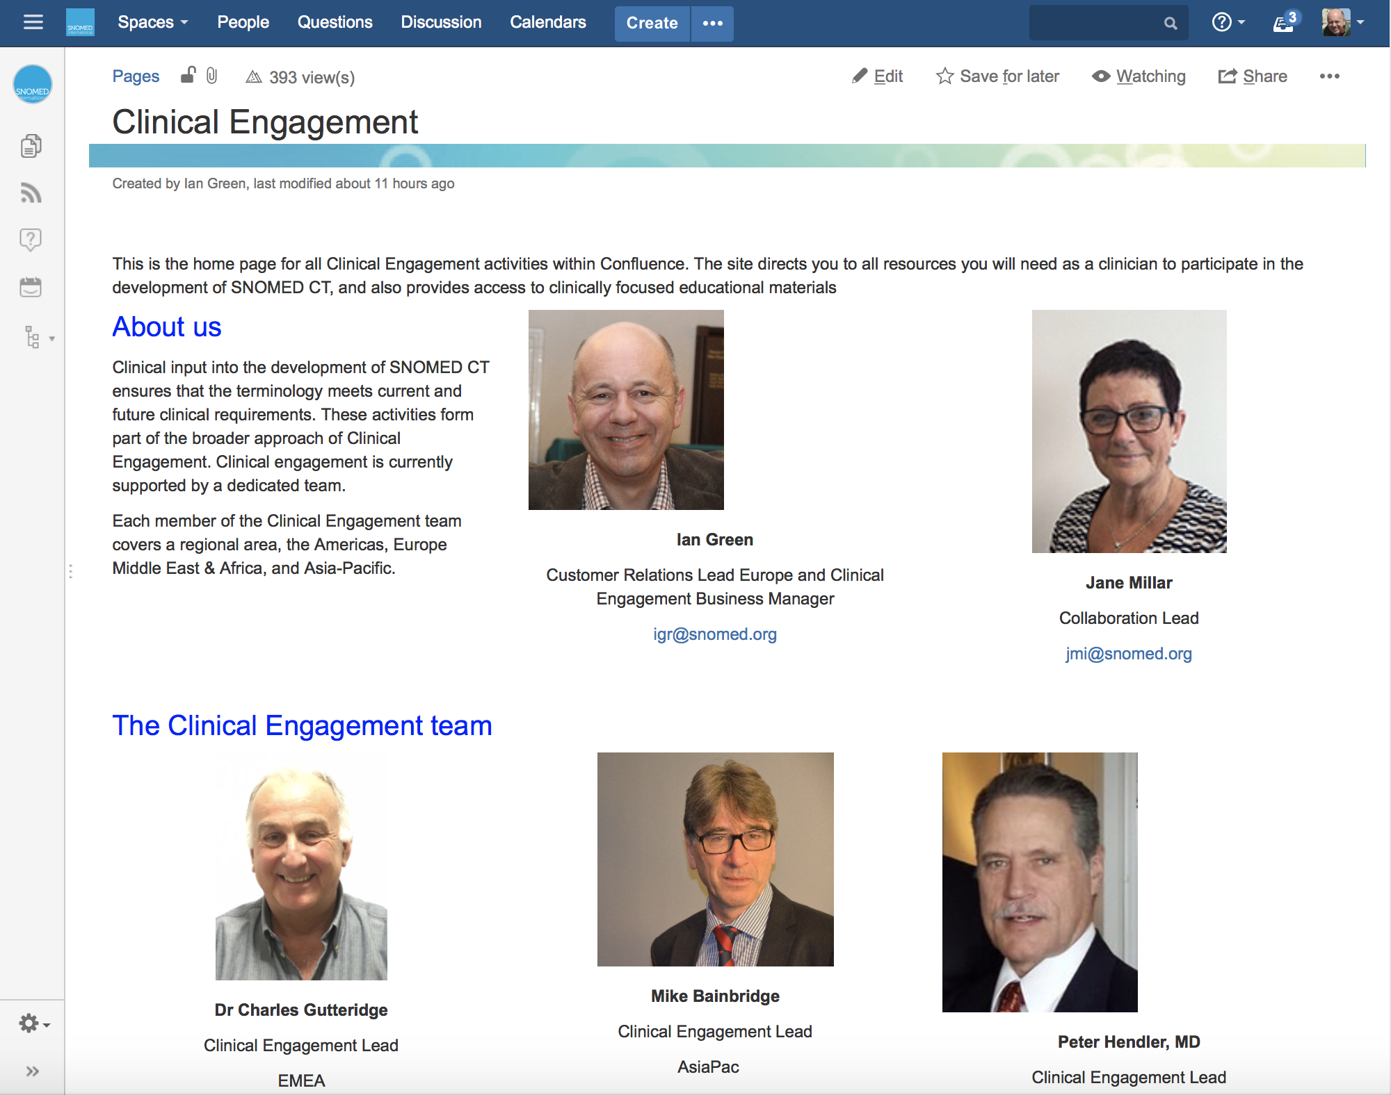
Clinical Portal
https://confluence.ihtsdotools.org/display/CP/Clinical+Engagement
Notes:
Front page
Clinical reference groups
Ways of working

Slide 5

Overview of CE strategy

Slide 6
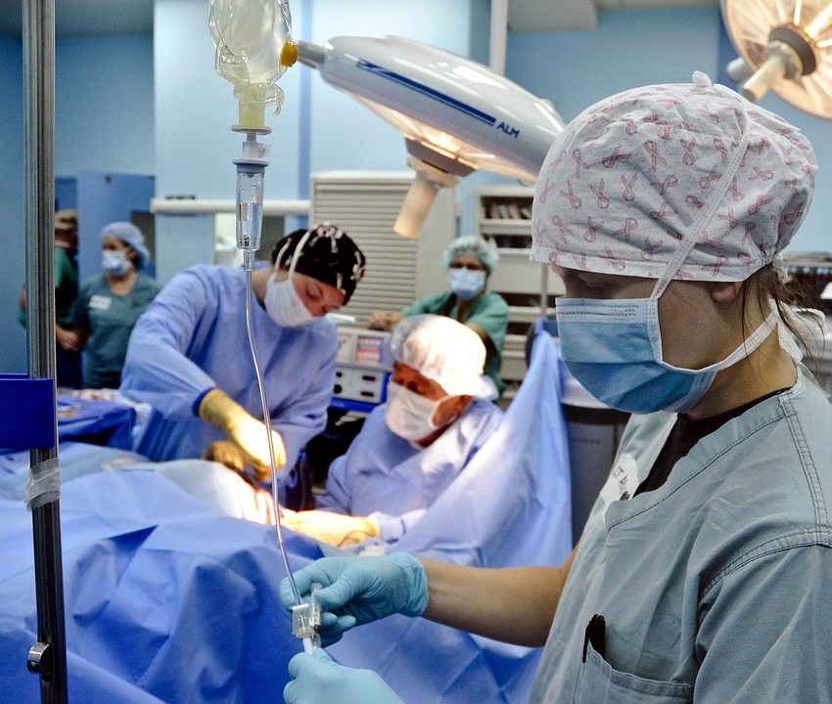

Vision of Clinical Engagement
To ensure that all activities of the SNOMED International are influenced by global clinical communities
SNOMED International’s culture has a progressive and sustainable approach to engaging clinicians

Slide 7
Principles
Raising the profile of clinical engagement within the organization
Consistency of approach across the regions of the world in terms of clinical engagement
Clinical engagement encompasses all healthcare professional groups globally
Consistent and timely communication with National Release Centers and all relevant stakeholders
Foster and encourage a culture of open engagement and discussion between clinicians
Continuous leverage of experience and shared learning across the regions
Assuring the quality and clinical relevance of SNOMED International products and services

Slide 8
Clinical engagement goals/objectives to support SNOMED International strategic direction
  Raise the profile of SNOMED CT for clinicians locally/nationally/globally
Identify and support local/regional/national/global health care professional ambassadors/SMEs for SNOMED CT
Identify and gather use case examples from clinical and research perspectives to demonstrate benefits of using SNOMED CT
Increase the access to relevant SNOMED CT educational materials for healthcare professionals
Identify key clinical requirements/priorities/trends to inform SNOMED International products and services
  Demonstrate high value clinical decision support capabilities of SNOMED CT
  Identify clinically focused interoperability opportunities to enhance SNOMED CT

Slide 9
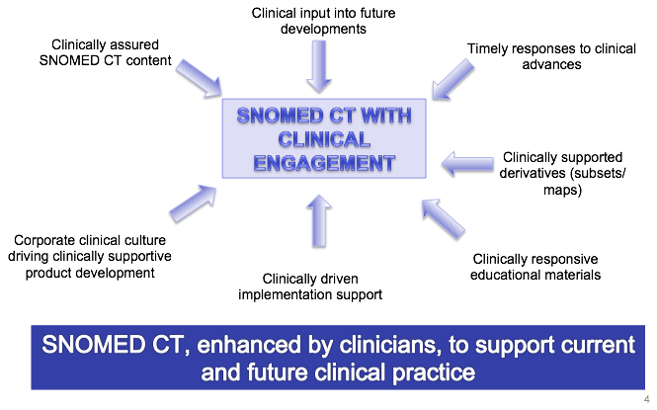
Clinical Engagement

Slide 10
Summary of Key Activities for 2018
Embed the approach to clinical engagement through Clinical Reference Groups (CRG’s)
Refine and increase the use of SNOMED In Action to showcase clinical use cases
Develop a robust mechanism to ensure clinical input into SNOMED CT developments
Identify clinical champions (ambassadors) through CRG and clinical engagement activities
Develop educational materials targeted at clinicians, in cooperation with the EP&S team
Develop robust relationships with global clinical groups and initiatives, to ensure SNOMED CT inclusion in global clinical developments
Clinical leads to support the delivery of SNOMED CT presentations to high profile global/regional clinical meetings

Slide 11
Clinical Engagement and clinical groups
Clinical group model agreed – development and implementation

Slide 12
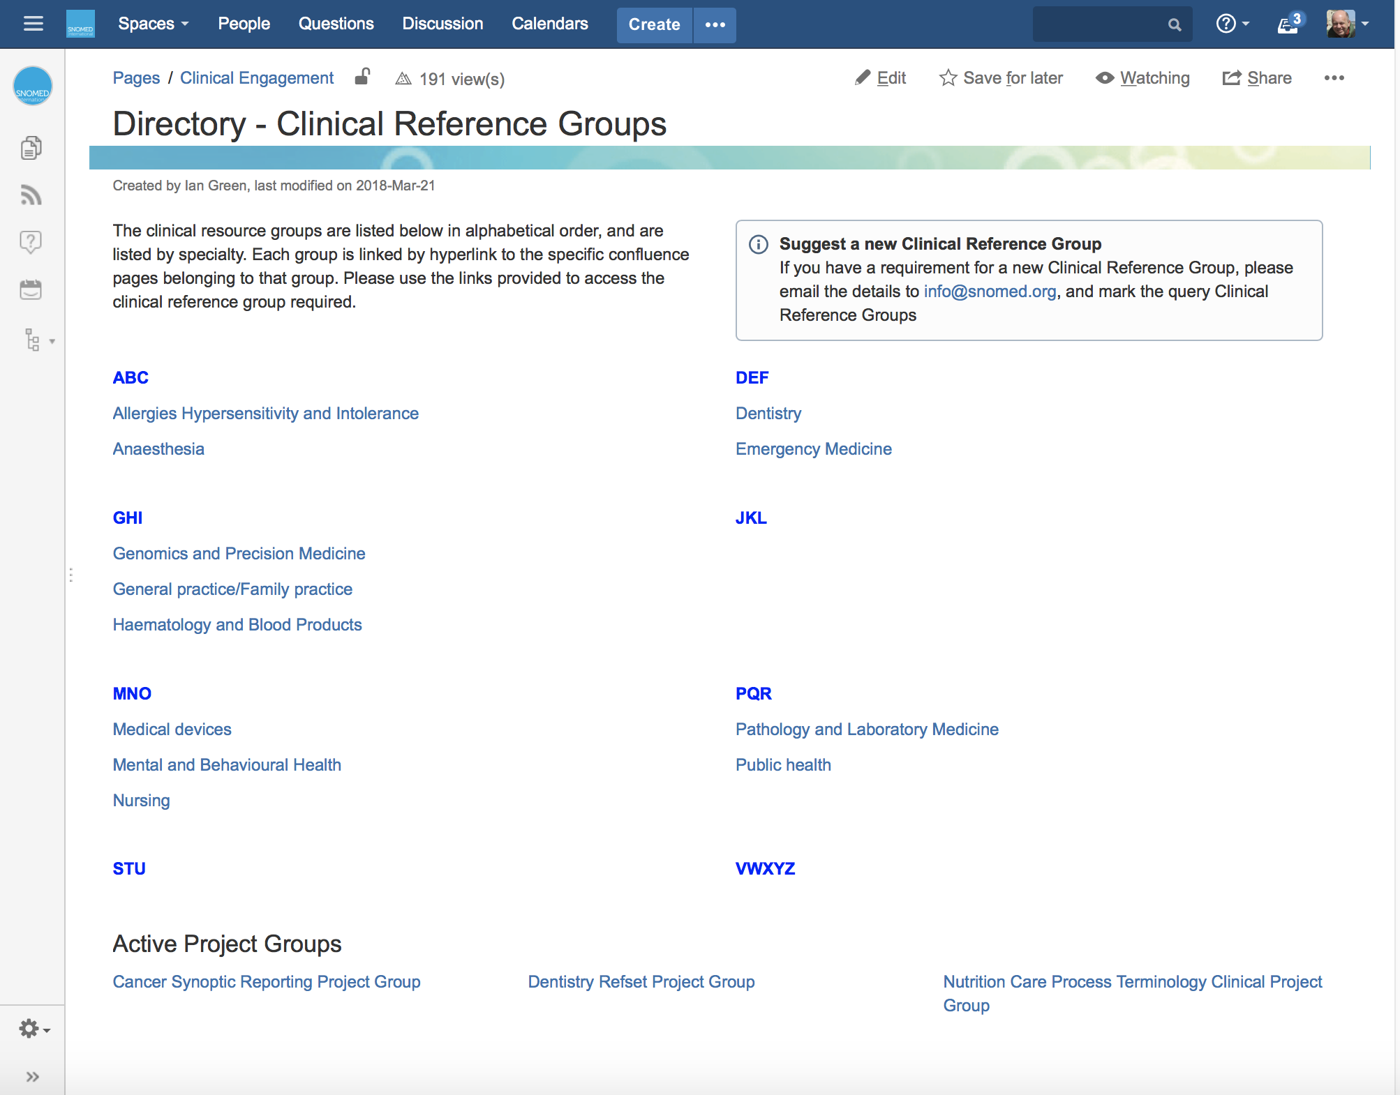
Clinical directory link
https://confluence.ihtsdotools.org/display/CP/Directory+-+Clinical+Reference+Groups
Notes:
Directory front page
Existing groups
Planned groups
Confluence site structure

Slide 13
Drivers for change
Clinical engagement strategy
  Increase profile of SNOMED CT globally across all clinical groups
  Requirement to collaborate inter and multi professionally on content development and implementation
  Requirement for effective sharing and distribution of good practice
  Improved communication to a global network of clinicians
  Specification of clinical requirements for SNOMED International prioritization
Increasing demand from clinical bodies to have a “relationship” with SNOMED International
Local and national strategies specify more clinical validation
Putting in place 100+ clinical SIG’s to cover all specialties is not sustainable for SNOMED International

Slide 14
Clinical Reference Groups (CRG) - principles
Virtual
  Face to face - for specific agreed deliverables
  Face to face - if there is a clinical engagement event
Specialty based
Advisory
Open membership, including Vendors, multi-professional etc . . .
Route for identifying work items that have clinical global relevance
Topics raised by clinicians and SNOMED International

Slide 15
Clinical Reference Groups (in practice)
Confluence based site
Discussion forum
  Virtual meetings when required
Identify a domain lead(s)
Discussion items raised by group members and/or SNOMED International – uni and multi-professional
Open membership, but need to be group registered to take an active part in discussions
Membership available to clinicians and non-clinicians
Setting up a clinical reference group
  Confirm criteria/requirements for CRG
  Publish clear statement of ways of working via Confluence site to manage clinician expectations
  Set up Confluence site
  Notification of CRG to clinicians, clinical groups and other potential stakeholders
  Identify domain lead
Notes:
----- Meeting Notes (30/11/16 09:46) -----
task allocation internal or external, need a reason to put one in place

Slide 16
Clinical groups model
Clinical Reference Groups (e.g. PaLM, Nutrition)
  Open
  Topic focus
  Forum for sharing and to support discussion
  Identification of rising global clinical themes
Project groups (e.g. Cancer Synoptic Reporting)
  Task and finish
  Delivering agreed work plan item(s)
  Specific membership based on skills/knowledge
  SNOMED International supported
  Funding based on project plan agreed by SNOMED International
  Project plan with deliverables and timescales based on SNOMED International work plan
Clinical Editorial groups (e.g. GP/FP subset group)
  Ongoing
  Focused on specific BAU SNOMED International derivative product(s)(e.g. GP/FP subset)
  Clinical validation
  Specific membership based on skills/knowledge
  SNOMED International supported
    Allocated SNOMED International author
    Additional SNOMED International staff, as products move into wider usage
    Collaboration lead where linked to a formal agreement

Slide 17
Clinical groups – progress update
Currently established groups
  CRG’s – 6
  Project groups – 2
  Editorial groups – 3
Being established
  CRG’s – 6
Early discussions to establish requirements
  CRG’s - 2
Directory of clinical groups can be found here:
    https://confluence.ihtsdotools.org/display/CP/Directory+-+Clinical+Reference+Groups

Slide 18
Engagement
Through:
  Regional clinical engagement leads
  Jane and Ian
  Helpdesk
Clinicians who:
  Are implementing SNOMED CT
  Have specialty knowledge
  Want to influence SNOMED CT development
  Prepared to work collaboratively in an international group
  Prepared to work on a voluntary basis
Members perspective
  Members to leverage international discussions to assist in national developments
  Promote CRG’s at national level for international requirements
  Identify individuals who will bring an international perspective

Slide 19
Clinical question
Review by clinical engagement (CE) team
What specialty (ies) ?
Decision to proceed?
NO
STOP
DRAFT
YES
INTERNATIONAL REQUIREMENTS
Existing
CRG ?
NO
Create CRG
YES
CRG analysis and recommendations
Review by clinical engagement (CE) team
Internal impact analysis and recommendations coordinated by CE team
Decision to escalate?
NO
STOP
YES
DECISION
Decision to proceed CSRM lead
SMT for work plan support
New content area and modeling
Existing content (some gaps) and reorganization
ACTION
Add item to work plan
Clinical quality assurance and CRS request(s)
Clinical project next release cycle
“Customer guidance
for requesting changes
to SNOMED CT “
Work continues in CRG
Create clinical project group

