Slide 1
Sepsis – test modeling with pathological process

Slide 2
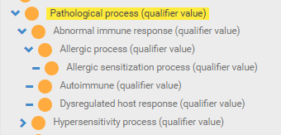
Pathological process (qualifier value) hierarchy

Slide 3
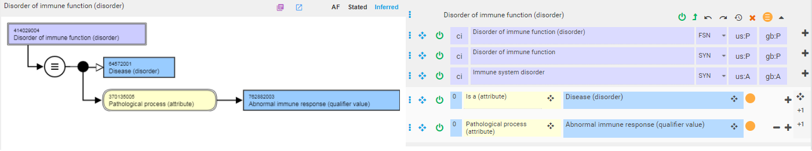
Disorder of immune function

Slide 4
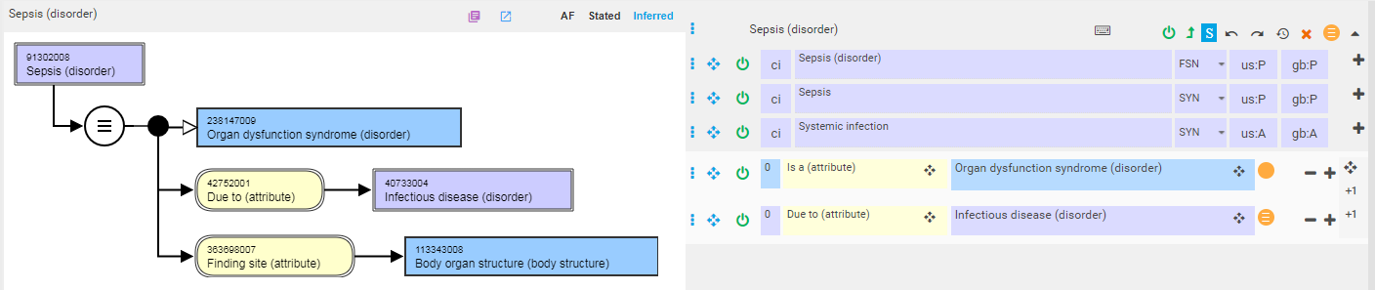
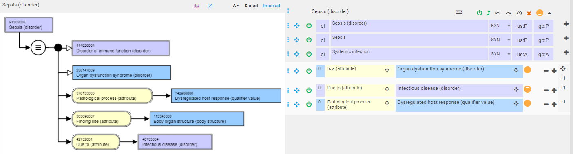
Sepsis
Without pathological process
With pathological process

Slide 5
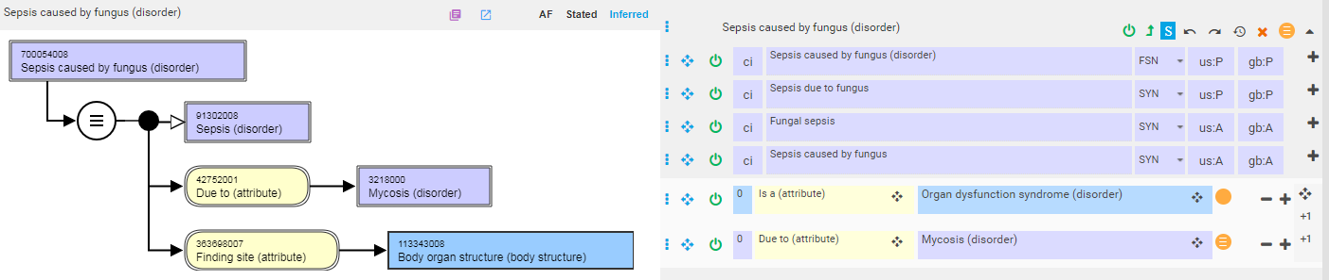
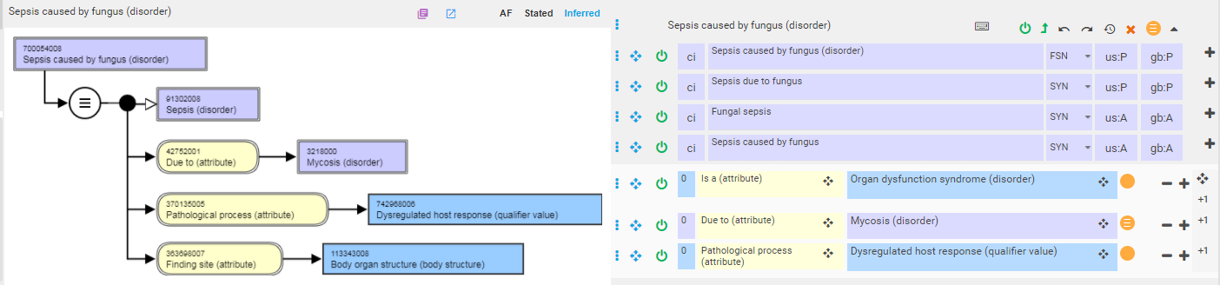
Sepsis due to a infection caused by a specific organism
Without pathological process
With pathological process

Slide 6
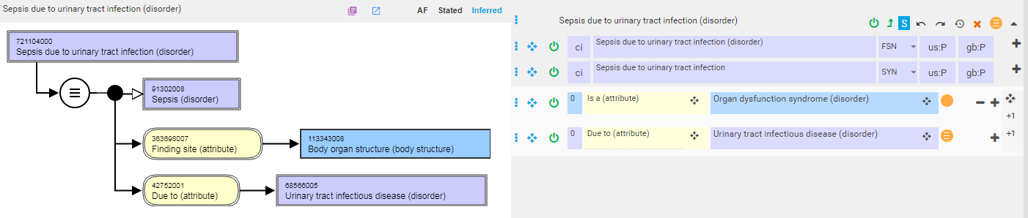

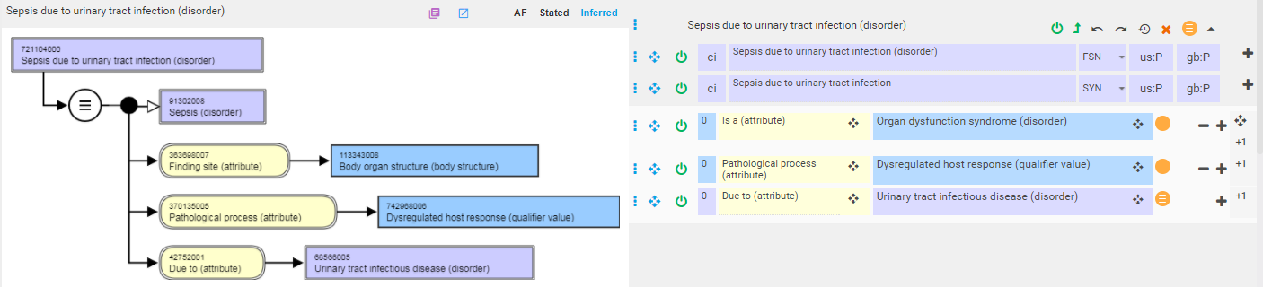
Sepsis due to infection of specific body site
With pathological process

Slide 7
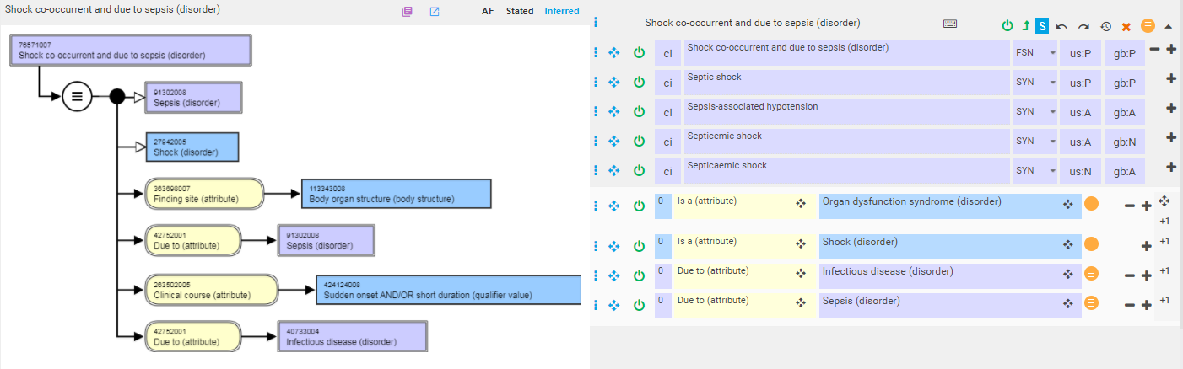
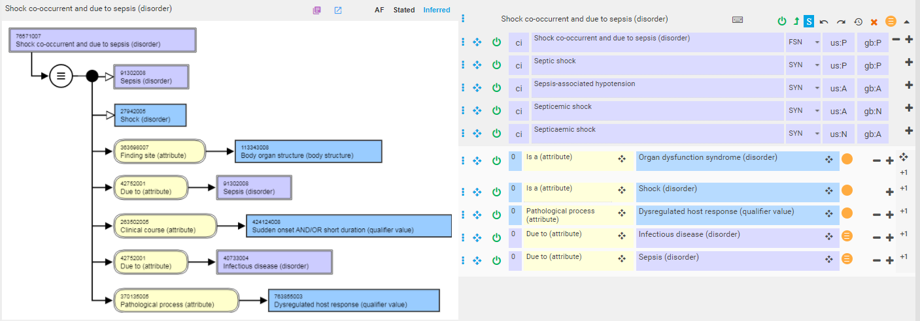
Septic shock
With pathological process

Slide 8
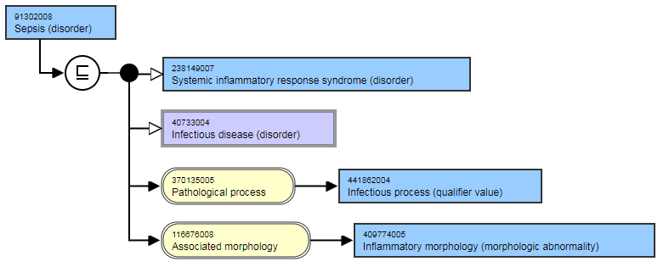
Summary
Adding pathological process dysregulated host response to the definition of sepsis results in an inferred parent of 414029004 |Disorder of immune function (disorder)| rather than 40733004 |Infectious disease (disorder)| as in the original model above
The descendants of Sepsis are not impacted by including pathological process dysregulated host response in the new model

