Slide 1
Modeling allergic disorders

Slide 2
Allergic disorders
Interpreted as abnormal structures (SDP) modeled with a role group consisting of a body site +morphology.
  Examples
    32295003 |Allergic ileitis (disorder)|
    10629471000119106 |Allergic rhinitis caused by mold (disorder)|

Slide 3
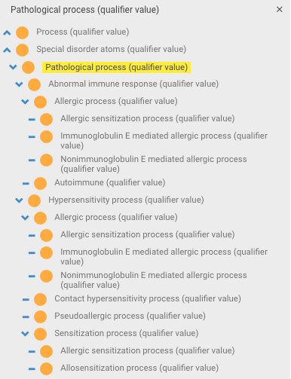
Revised pathological process hierarchy

Slide 4
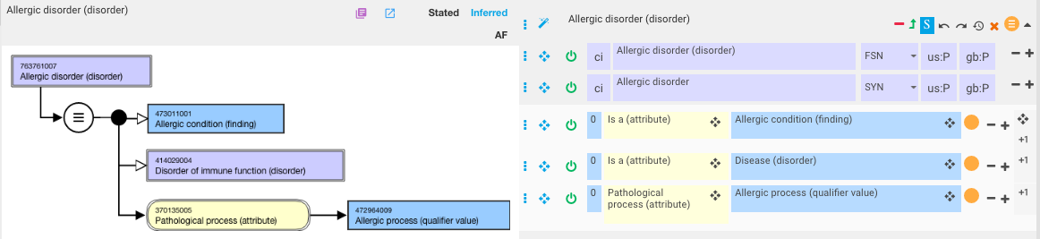
Proposed model for Allergic disorder

Slide 5
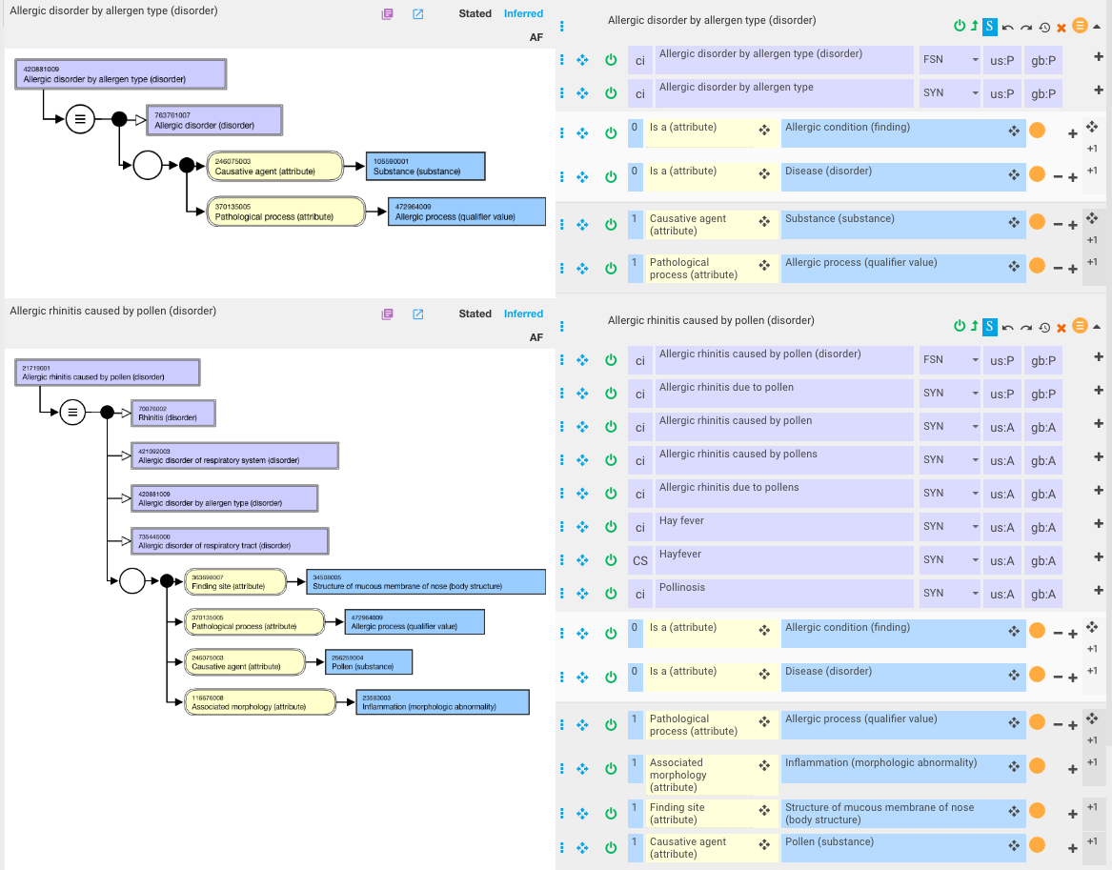
Allergic disorder by allergen type

Slide 6
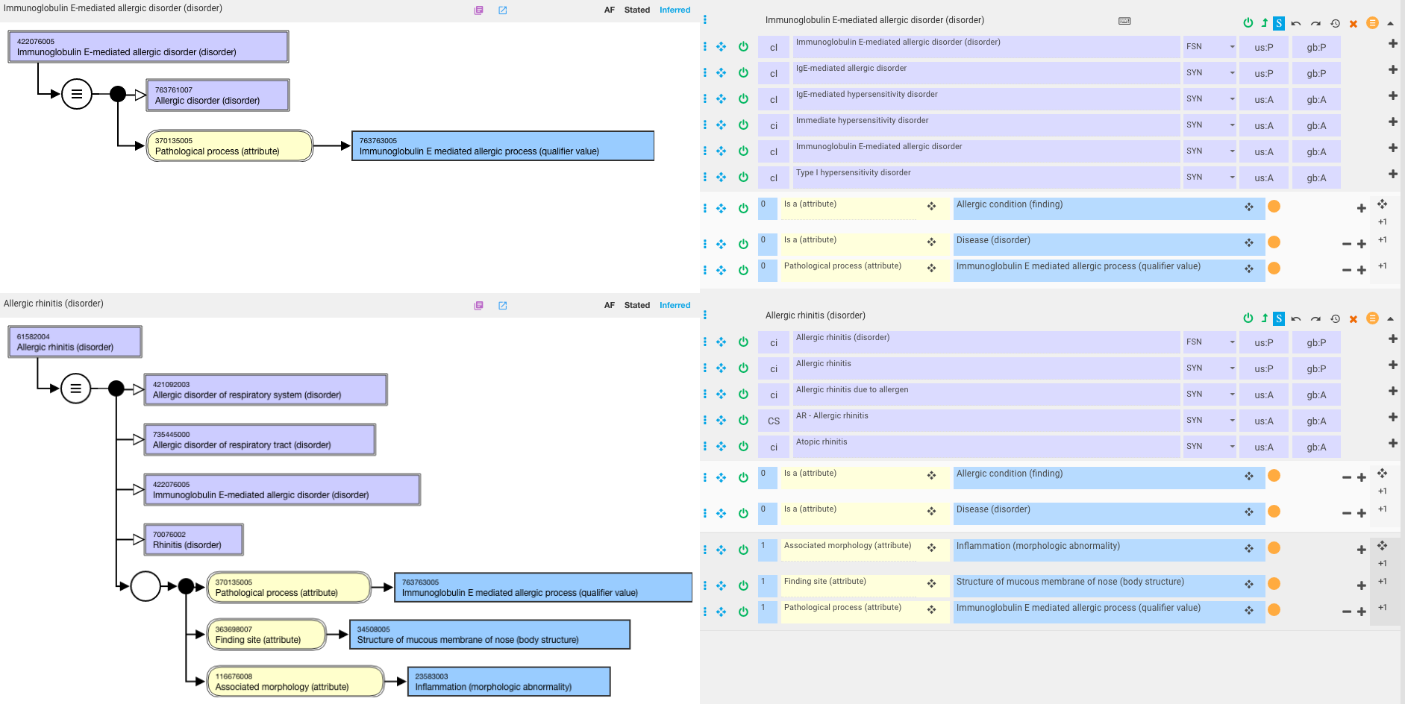
Immunoglobulin E-mediated immune disorder

Slide 7
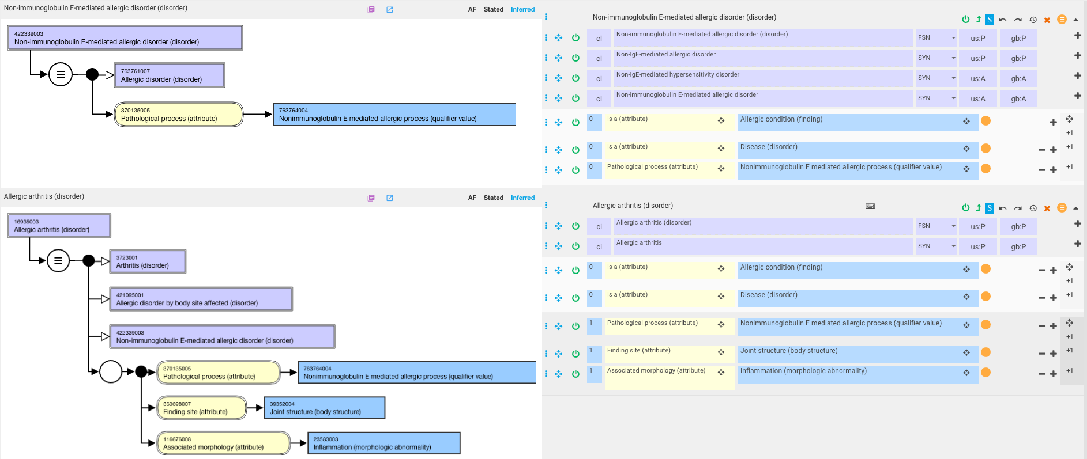
Non-immunoglobulin E-mediated immune disorder

Slide 8
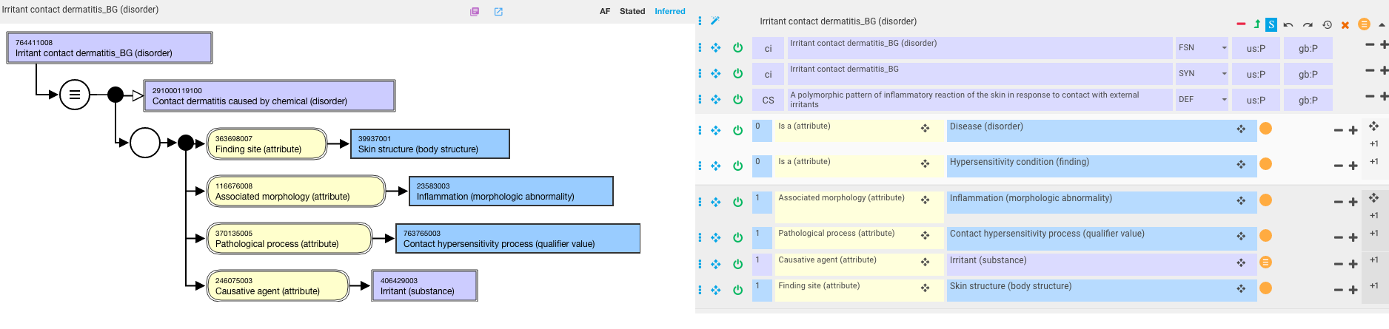
Irritant contact dermatitis – fully defined

