Slide 1
Reactive arthritis, postinfectious arthritis, Reiter disease
Reference: article from UpToDate titled Reactive arthritis
  Literature review current through: Nov 2017. | This topic last updated: Jul 21, 2016”.

Slide 2
Reactive vs. postinfectious arthritis - 1
Reactive arthritis is conventionally defined as an arthritis that arises following an infection, although the pathogens cannot be cultured from the affected joints. It is generally regarded as a form of spondyloarthritis.
Reactive arthritis has been defined by consensus as a form of arthritis that is associated with a coexisting or recent antecedent extraarticular infection.
Only certain enteric and genitourinary pathogens are conventionally accepted as capable of causing reactive arthritis. These include Chlamydiatrachomatis, Yersinia, Salmonella, Shigella, Campylobacter, Clostridium difficile, and Chlamydia pneumoniae.
Various other bacterial and viral infections have been suggested as triggers for postinfectious arthritis but they are by convention not considered as “reactive arthritis.”

Slide 3
Reactive vs. postinfectious arthritis -2
Antecedent or concomitant infection — Laboratory tests, such as stool cultures to test for Salmonella, Shigella, Campylobacter, and Yersinia, can sometimes confirm a preceding or concomitant infection with one of the pathogens that classically induce reactive arthritis.

Slide 4
Reactive vs. postinfectious arthritis -3
An arthritis is conventionally considered to be a reactive arthritis only if it includes a combination of oligoarthritis of peripheral joints, most often with asymmetric involvement of the lower extremity, enthesitis, dactylitis, or inflammatory back pain.

Slide 5
Reactive vs. postinfectious arthritis -4
Arthritis is a common manifestation in patients with acute rheumatic fever (ARF) following streptococcal pharyngitis. These patients typically lack features common to the spondyloarthritides (eg, enthesitis), and this condition is generally not considered to be a form of reactive arthritis.

Slide 6
Summary/conclusions - Reactive vs. postinfectious arthritis
Reactive arthritis and postinfectious arthritis are not the same and not related by a parent-child relationship because:
  Reactive arthritis can start during or after an infection
  Reactive arthritis may be associated with dactylitis, enthesitis and inflammatory back pain but not all features may be present at (e.g. only 20-90% of patients with reave arthritis present with enthesitis).
  Reactive arthritis is considered a kind of spondyloarthrits
  Reactive arthritis is usually associated with the following organisms: Chlamydiatrachomatis, Yersinia, Salmonella, Shigella, Campylobacter, Clostridium difficile, and Chlamydia pneumoniae.

Slide 7
Reactive arthritis vs. Reiter syndrome
The term “reactive arthritis” has sometimes been used historically to refer to the clinical triad of postinfectious arthritis, urethritis, and conjunctivitis, which was formerly called Reiter syndrome. However, these patients represent only a subset of patients with reactive arthritis.
Reasons that the classical triad was formerly called Reiter syndrome.
  The presence of the extraarticular manifestations present in the syndrome described by Reiter is inconstant.
  The classic symptoms attributed to Reiter were actually reported before Reiter’s description.
  A proposal to remove Reiter’s name from the syndrome and which was widely supported by professional medical societies and patient advocacy groups related to the discovery that Hans Reiter was a war criminal.
Reiter syndrome be retained as a synonym both for reactive arthritis and for the classic triad for retrieval purposes.

Slide 8
Proposed models

Slide 9
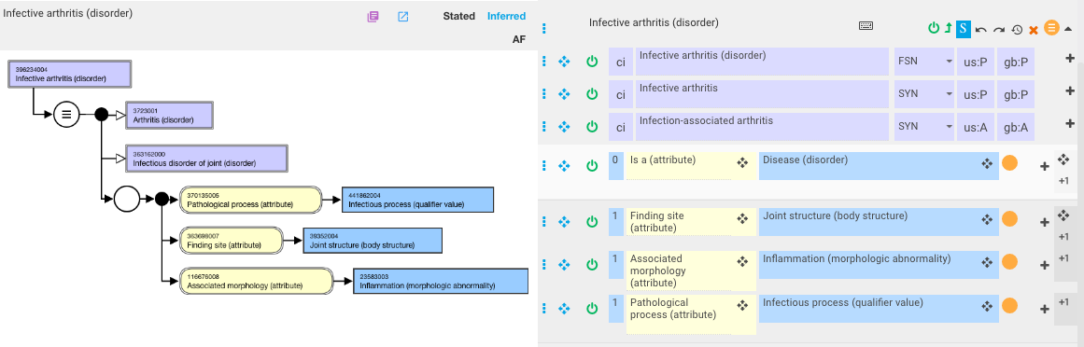
Infective arthritis

Slide 10
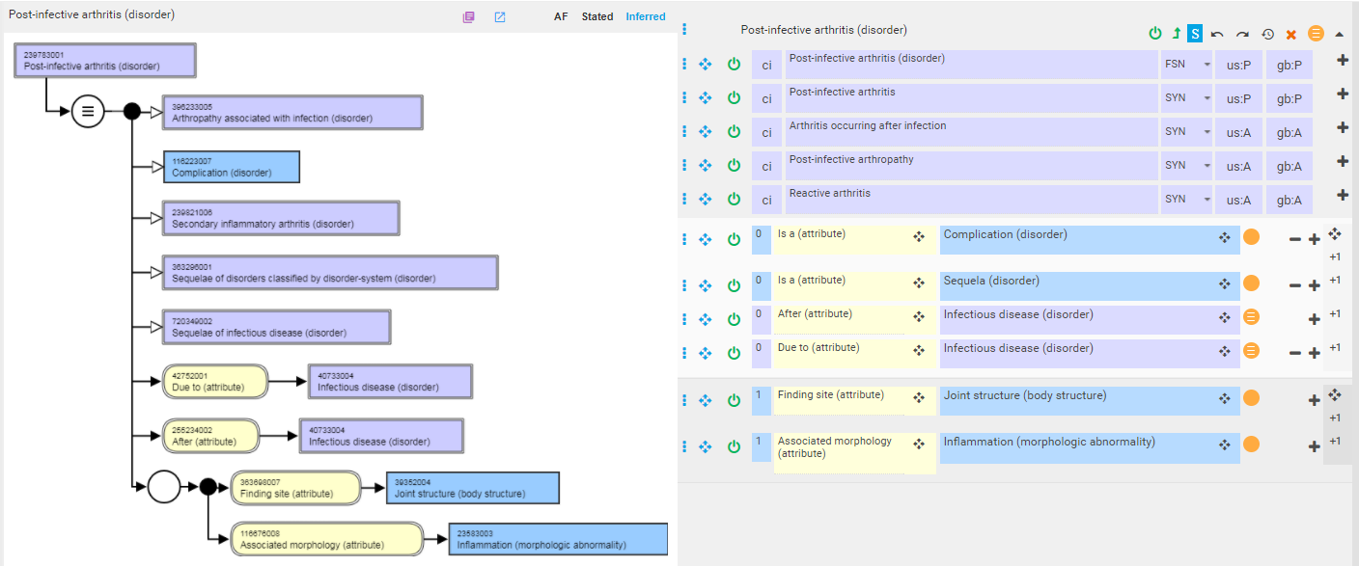
Post-infective arthritis

Slide 11
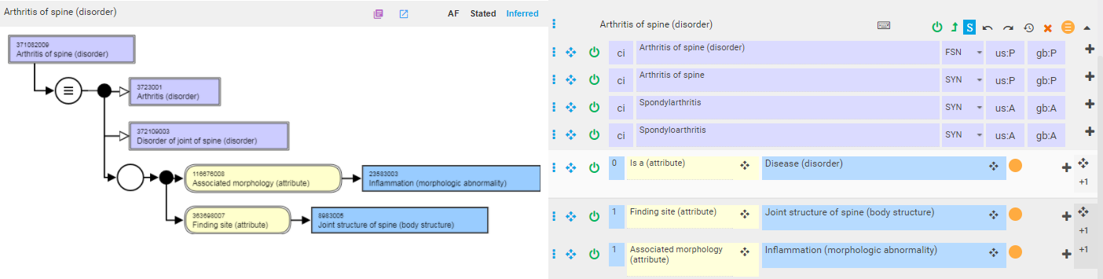

Spondyloarthritis
Spondyloarthritis is an umbrella term for inflammatory diseases that involve both the joints and the entheses (the sites where the ligaments and tendons attach to the bones). The most common of these diseases is ankylosing spondylitis. Others include reactive arthritis, psoriatic arthritis and enteropathic arthritis, which is associated with the inflammatory bowel disease.

Slide 12
Classification of Spondyloarthits
Spondyloarthritis
  Axial Spondyloarthritis (predominate involvement of the spine)
    Ankylosing spondylitis
    Non-radiographic axial spondyloarthritis
  Peripheral spondyloarthritis (predominate involvement of the peripheral joints)
    Reactive arthritis
    Psoriatic arthritis
    Peripheral spondyloarthritis related to inflammatory bowel disease

Slide 13
Reactive arthritis
Reactive arthritis is therefore considered to be a peripheral spondyloarthritis due to an antecedent or co-occurrent infection

Slide 14
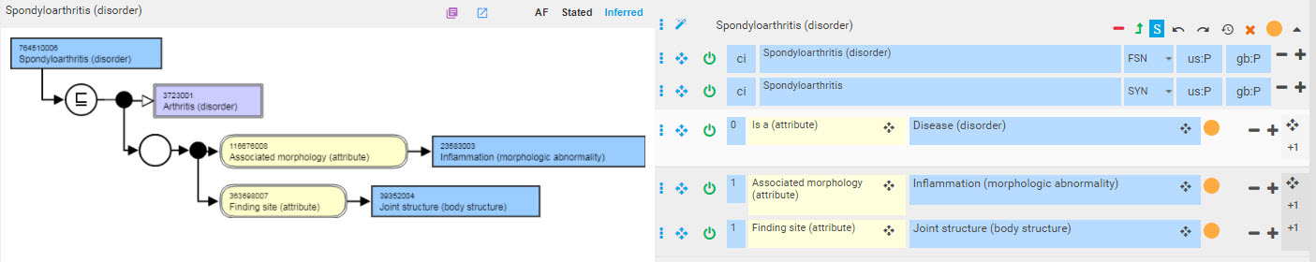
Spondyloarthritis

Slide 15
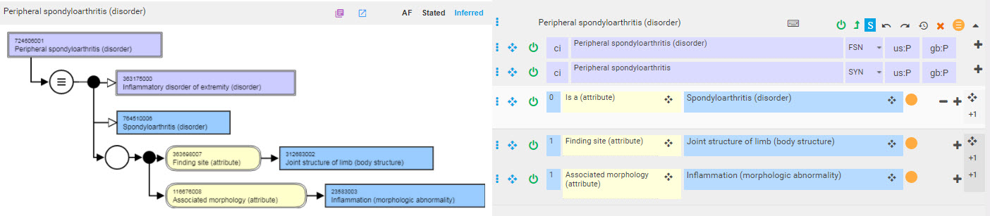
Peripheral spondyloarthritis

Slide 16
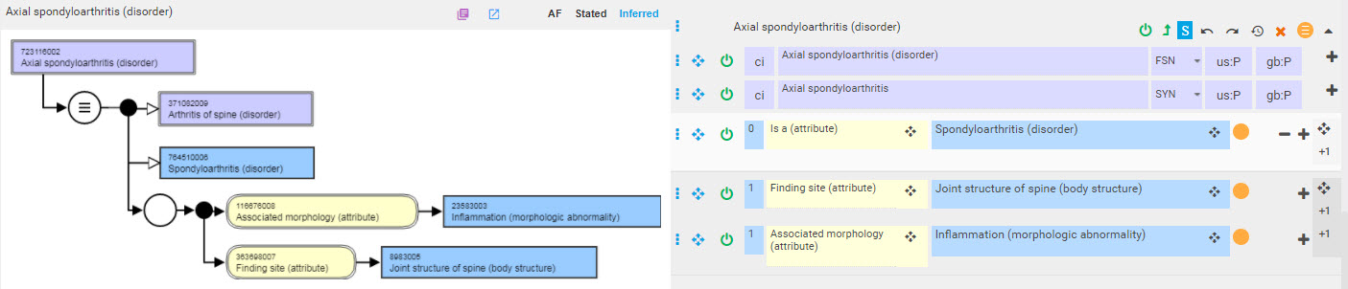
Axial spondyloarthritis

Slide 17
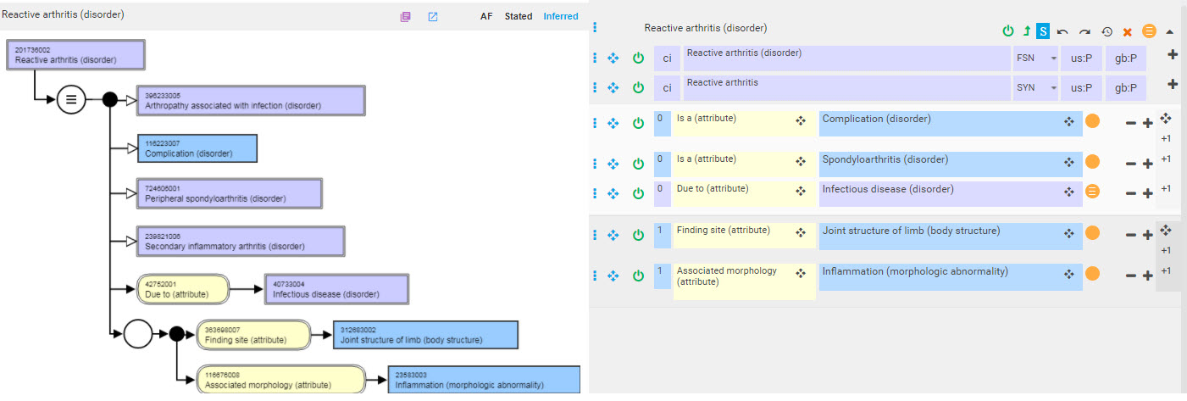
Reactive arthritis

Slide 18
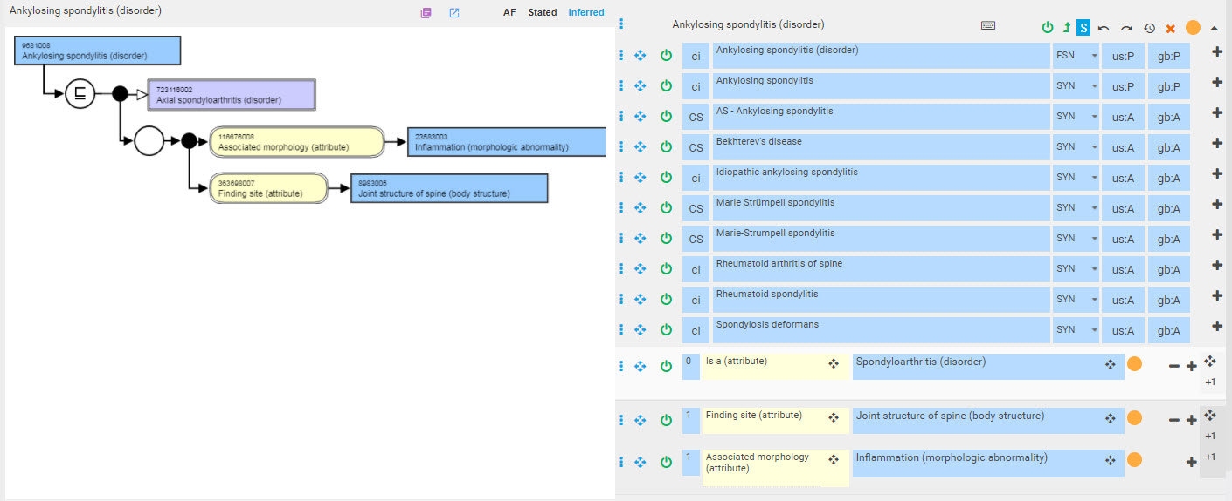
Ankylosing spondylitis

Slide 19
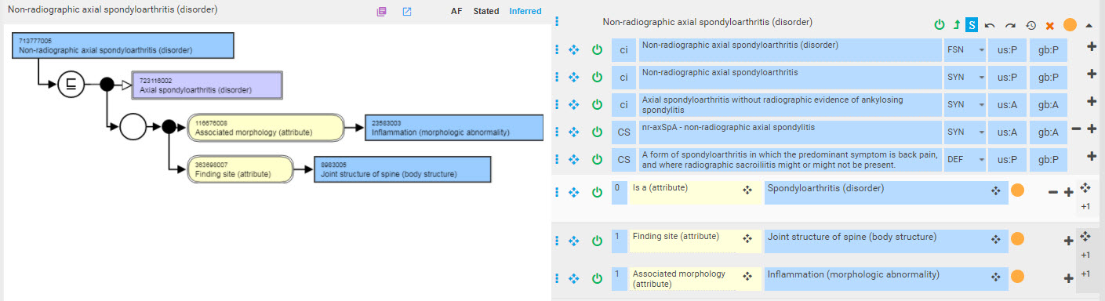
Non-radiographic axial spondylitis

Slide 20
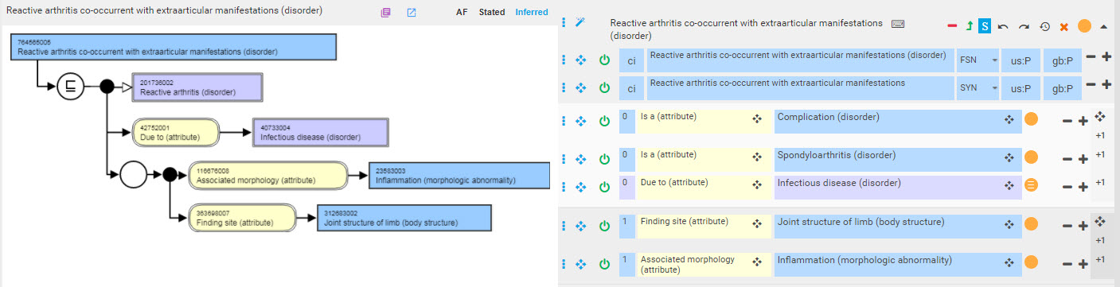
Reactive arthritis co-occurrent with extrarticular manifestations

Slide 21
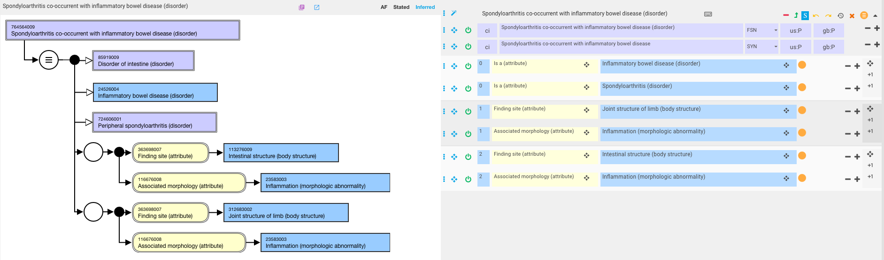
Spondyloarthritis co-occurrent with inflammatory bowel disease

Slide 22
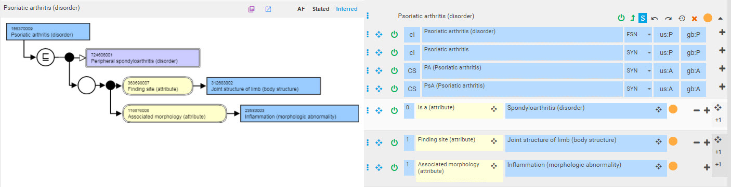
Psoriatic arthritis

Slide 23
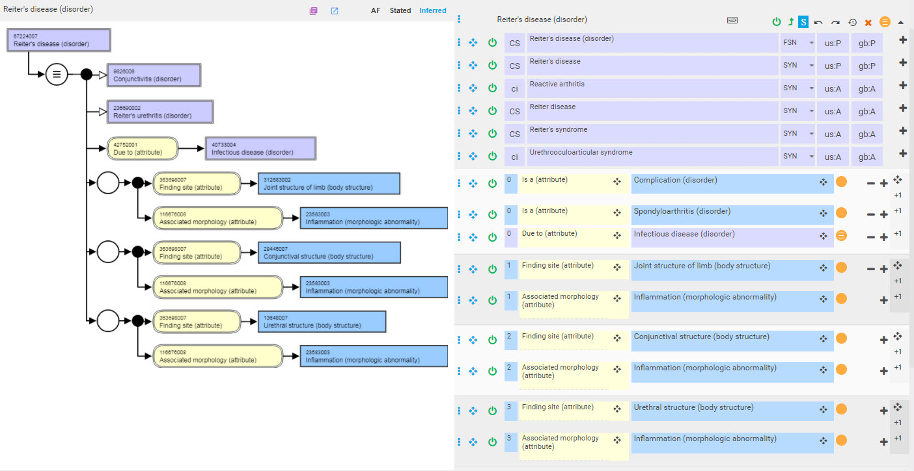
Reiter disease

Slide 24
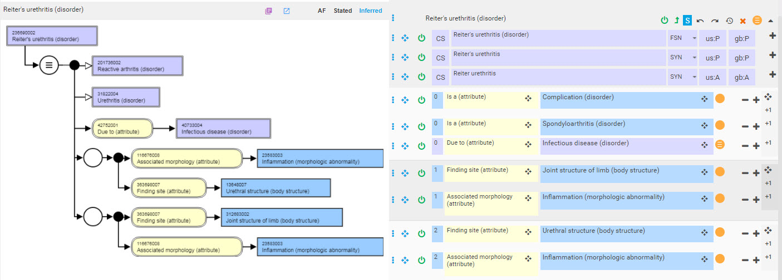
Reiter’s urethritis

Slide 25
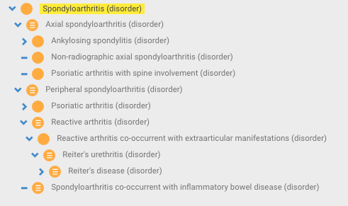
Spondyloarthritis hierarchy

Slide 26
Final analysis
Proposal addresses difference between Reactive arthritis, Reiter disease and Postinfectious arthritis
Model reorganizes hierarchy based on current view of spondyloarthritides
Model enables specifying extraarticular manifestations as part of a syndrome of which reactive arthritis is a part by using simple co-occurrence pattern

