Slide 1
Hypersensitivity dispositions as clinical findings

Slide 2
Hypersensitivity/allergic/pseudoallergic dispositions
May be considered as findings about potential adverse conditions such as diseases, structures, processes

Slide 3
Summary of proposed changes
Move hypersensitivity/allergy/pseudoallergy condition under clinical finding.
Make all of the above conditions primitive
Move 420134006 |Propensity to adverse reactions (disorder)|under clinical finding
The condition classes would have only 3 asserted subhierarchies:
  Hypersensitivity/allergic/pseduoallergic disease
  Hypersensitivity/allergic/pseudoallergic disposition
  Hypersensitivity/allergic/pseudoallergic reaction

Slide 4
Hypersensitivity/allergic/pseudoallergic diseases
Model:
  Due to pathological process (i.e. due to allergic reaction)
Example:
  Allergic rhinitis (disorder)
    isA disease (disorder)
    isA Allergic condition (finding)
      due to type 1 hypersensitivity response (disorder)
      RG {finding site structure of mucous membrane of nose (body structure)+ associated morphology inflammation}
Fully define these as a disease due to allergic reaction or a specific subtype of allergic reaction {caused by substance x}
  The above is how allergic diseases were defined at the onset and several existing examples currently in SNOMED still use this model
This removes the uncertainty around these being either dispositions or reactions but as a specific temporal relationship is not mentioned, it leaves open the possibility that the causative allergic reaction is either still present at the time of the manifestation or that it has resolved.

Slide 5
Hypersensitivity/allergic/pseudoallergic dispositions
Model:
  Has realization pathological process i.e. allergic process (or allergic reaction process?)
Model these as propensity to adverse reactions has realization allergic process
  The current range for has realization is 719982003 |Process (qualifier value)|
  Move 308489006 |Pathological process (qualifier value)|under 719982003 |Process (qualifier value)|
  Add causative agent substance and its appropriate descendants to a role group with has realization allergic process to indicate that the allergen causes the realization of the disposition and not the disposition itself.
  Example Allergy to penicillin
    isA propensity to adverse reactions (finding)
    isA allergic condition (finding)
      RG {has realization allergic process (or allergic reaction process ?) + causative agent penicillin}

Slide 6
Hypersensitivity/allergic/pseudoallergic reactions
Model:
  Pathological process allergic (or allergic reaction?) process
Model as adverse reaction pathological process allergic process {caused by substance x}
  Example
    Allergic reaction to penicillin
      isA adverse reaction (disorder)
      isA allergic condition (finding)
        Pathological process allergic process (or allergic reaction process ?)

Slide 7
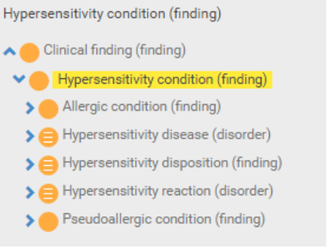
Summary of hypersensitivity/allergy hierarchies
Should all be findings

Slide 8
Pseudoallergy

Slide 9
Hypersensitivity/allergy/pseudoallergy models - summary
Hypersensitivity/allergy/pseudoallergy condition (finding)
  Primitive groupers for hypersensitivity/allergy/pseudoallergy diseases, dispositions and reactions (processes)
Hypersensitivity/allergy/pseudoallergy disease (disorder)
  Disorder due to allergic reaction
Hypersensitivity/allergy/pseudoallergy disposition (finding)
  Propensity to adverse reactions has realization hypersensitivity/allergy/pseudoallergy process
Hypersensitivity/allergy/pseudoallergy reaction (disorder)
  Adverse reaction pathological process hypersensitivity/allergy/pseudoallergy process

