Slide 1
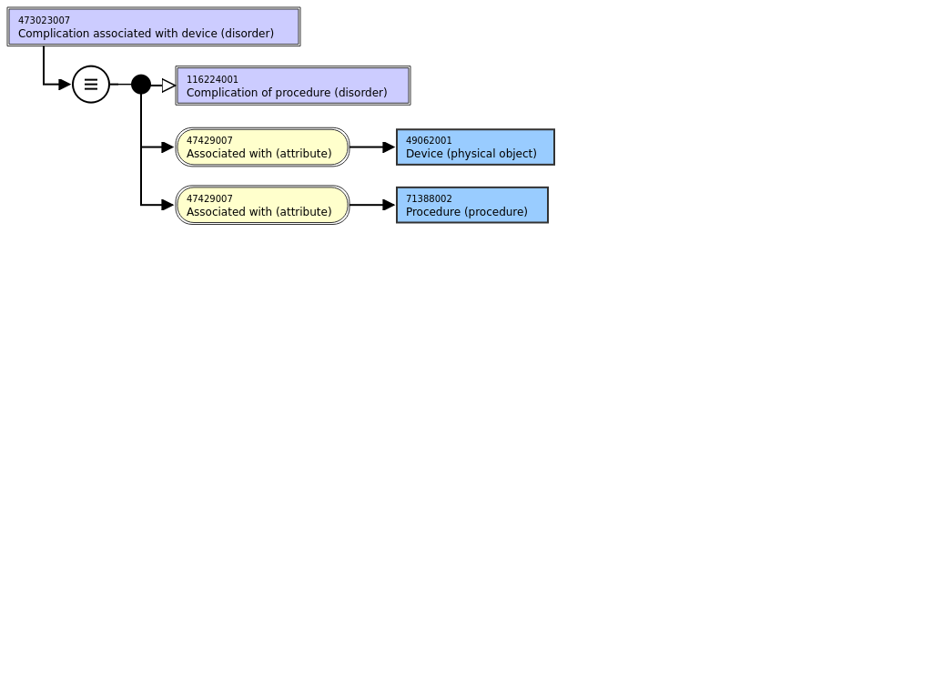
Device complications

Slide 2
Major types of concepts represented under 473023007 |Complication associated with device (disorder)|
Problem with device itself
  461431000 |Failure of cardiac valve prosthesis (disorder)|
Disorder due to presence of device
  Example: 213134006 |Internal prosthetic device causing pain (disorder)|
Disorder related to procedure to implant/insert/apply device
  723154002 |Post cerebral ventricular shunt leak (disorder)|

Slide 3
Suggested modeling of device complications
Problem with device itself
  These are really findings about the device such as malfunction, failure, displacement, etc.
  The following sibling concepts exist in SNOMED CT and could potentially serve as parents for various device problems
    405651005 |Equipment problem (finding)
    397839006 |Equipment malfunction (finding)|
    397933008 |Equipment error/failure (finding)|

Slide 4

Equipment vs device
Medical device (brief):
An article, instrument, apparatus or machine that is used in the prevention, diagnosis or treatment of illness or disease, or for detecting, measuring, restoring, correcting or modifying the structure or function of the body for some health purpose. Typically, the purpose of a medical device is not achieved by pharmacological, immunological or metabolic means.
Medical equipment:
Medical devices requiring calibration, maintenance, repair, user training and decommissioning – activities usually managed by clinical engineers. Medical equipment is used for the specific purposes of diagnosis and treatment of disease or rehabilitation following disease or injury; it can be used either alone or in combination with any accessory, consumable or other piece of medical equipment. Medical equipment excludes implantable, disposable or single-use medical devices.

Slide 5
405651005 |Equipment problem (finding)
Add 397839006 |Equipment malfunction (finding)|under 405651005 |Equipment problem (finding)
Retire 397933008 |Equipment error/failure (finding)|and replace with Equipment error (finding) and Equipment failure (finding) and add as siblings of 397839006 |Equipment malfunction (finding)|
Create an analogous hierarchy of Device problem (finding)/Device malfunction (finding), Device error (finding) and Device failure (finding) under 405651005 |Equipment problem (finding).

Slide 6
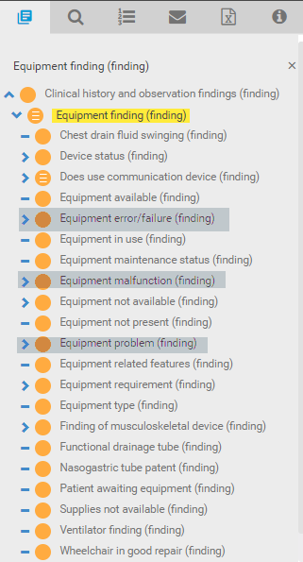
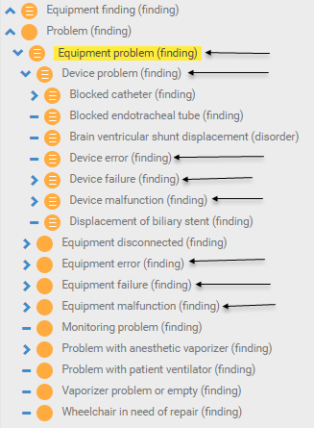
Equipment problem (finding)
Current Equipment finding subhierarchy
Proposed changes to Equipment problem subhierarchy

Slide 7
Modeling equipment/device problems
Use has interpretation with range of 364697006 |Equipment observable (observable entity), 408699006 |Device observable (observable entity)|
Use interprets with range of 260245000 |Findings values (qualifier value)|
  May require moving some additional hierarchies such as 718498007 |Appearance (property) (qualifier value)| under 260245000

Slide 8
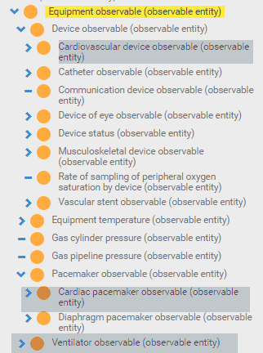
Equipment vs device
Inconsistent assignment of equipment and device observables

Slide 9
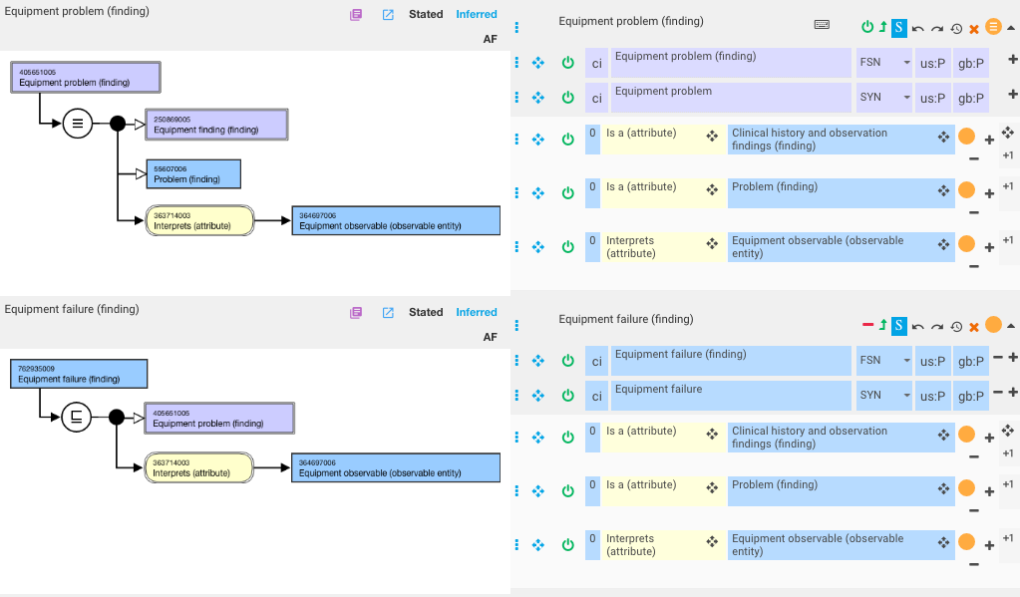
Equipment problem

Slide 10
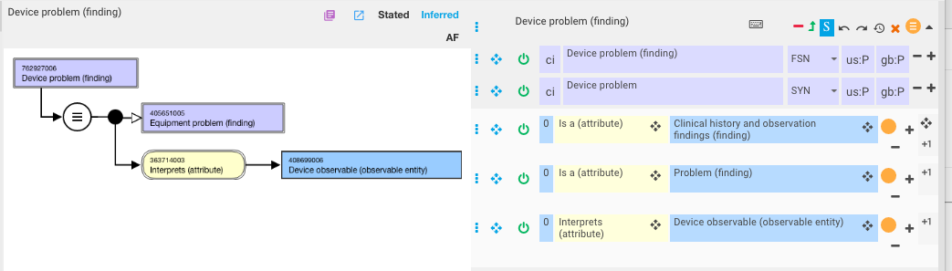
Device problem

Slide 11
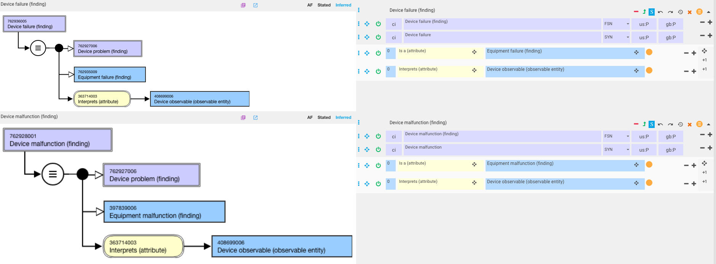
Device failure and malfunction

Slide 12
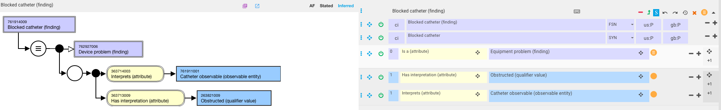
Example of a specific device problem 1

Slide 13
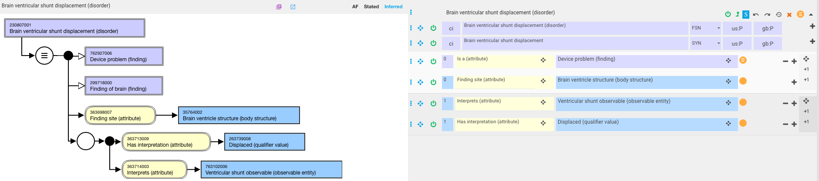
Example of a specific device problem 2

Slide 14
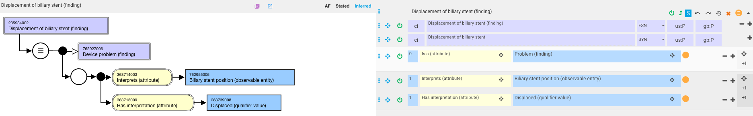
Example of a specific device problem 3

Slide 15
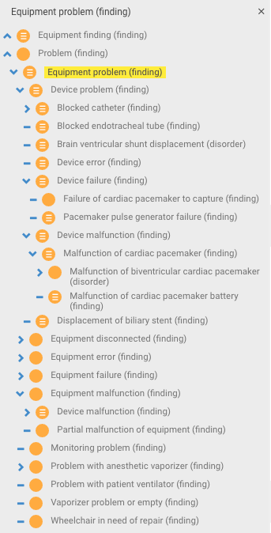
Revised equipment problem hierarchy

Slide 16
Next steps
Will necessitate creation of new device/equipment observables and findings values qualifier values as needed.
Requires the ability to distinguish medical devices from medical equipment and cleanup of equipment observable hierarchy

