Slide 1
Arthritides represented both as joint inflammation and multisystem disorders

Slide 2
Issue
Certain arthritides that are part of multisystem disorders that include arthritis as the predominate feature may refer to the entire multisystem disorder or specifically to the arthritis
  Examples
    Rheumatoid arthritis
    Reactive arthritis (previously called Reiter disease)
Rheumatoid arthritis is a systemic inflammatory disease that can involve other tissues and organs as well as synovial joints. Rheumatoid arthritis is an inflammation of synovial tissue with symmetric involvement of peripheral joints, hand, feet, and wrists being most commonly affected. Rheumatoid arthritis can also affect non-articular muscular structures such as tendons, ligaments, and fascia.
Cojocaru M, Cojocaru IM, Silosi I, Vrabie CD, Tanasescu R. Extra-articular Manifestations in Rheumatoid Arthritis. Mædica. 2010;5(4):286-291.

Slide 3
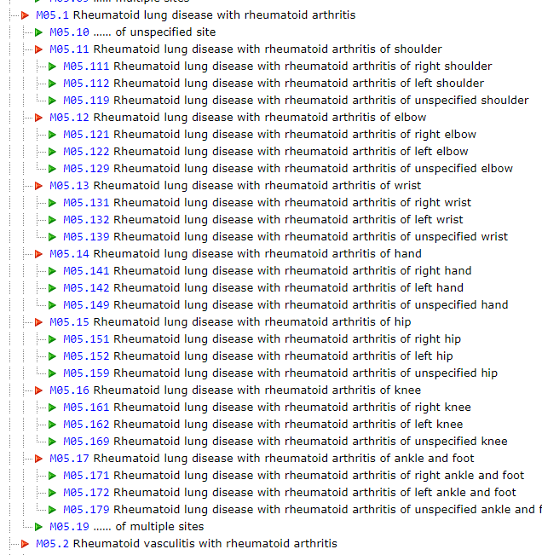
Use cases
There is a requirement to describe extraarticular manifestations of multisystem disorders that include arthritis but which are currently represented only as the arthritis
  Example
    193250002 |Myopathy due to rheumatoid arthritis (disorder)|
Many examples from ICD-10

Slide 4
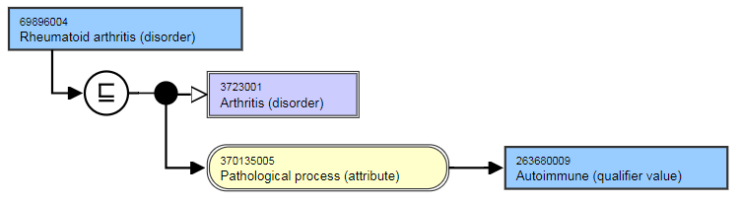
193250002 |Myopathy due to rheumatoid arthritis (disorder)|
If 193250002 |Myopathy due to rheumatoid arthritis (disorder)|were to be defined using |due to|=|69896004 Rheumatoid arthritis (disorder)it would mean the muscle inflammation is due to joint inflammation.
Currently 193250002 |Myopathy due to rheumatoid arthritis (disorder)|is primitive with no defining attributes except finding site

Slide 5
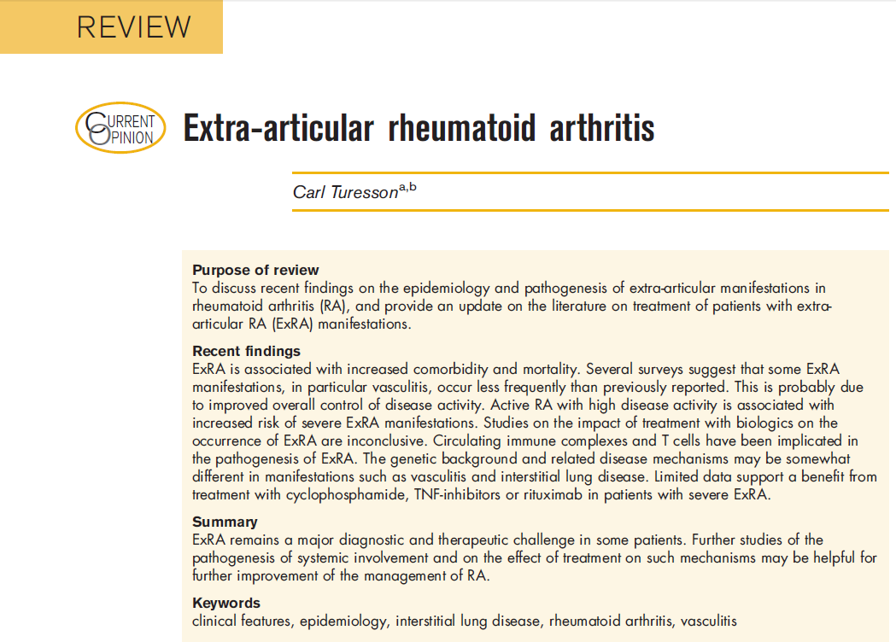
Proposal
Multisystem arthritic disorders are composed of the arthritis and extraarticular manifestations
Create a top level primitive (under disease) called Extraarticular rheumatoid arthritis (disorder)
Define Extraarticular manifestations of rheumatoid arthritis as subtypes of Extraarticular rheumatoid arthritis (disorder)

Slide 6
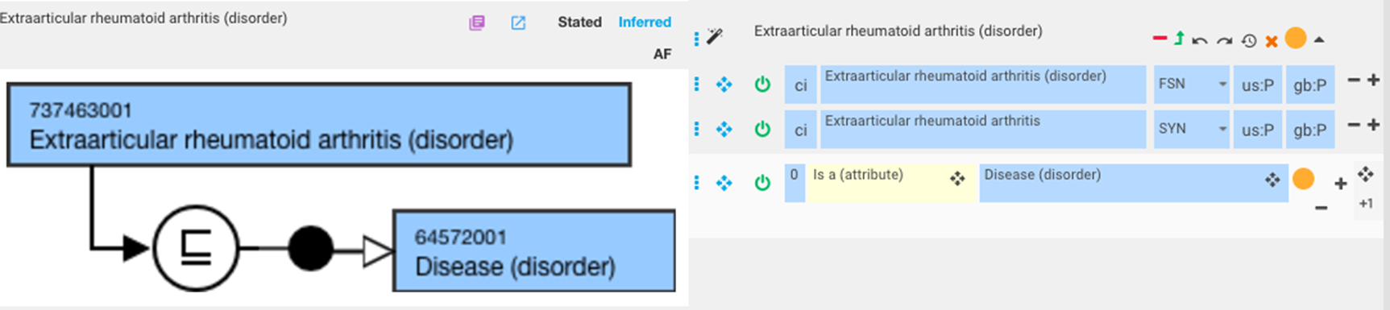
Extraarticular rheumatoid arthritis

Slide 7
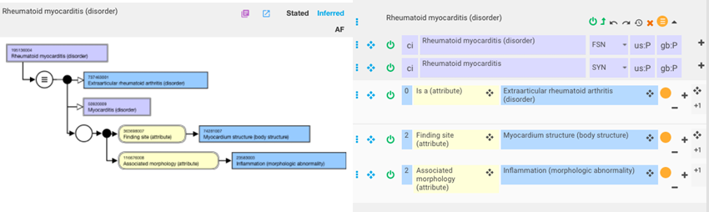
Rheumatoid myocarditis

Slide 8
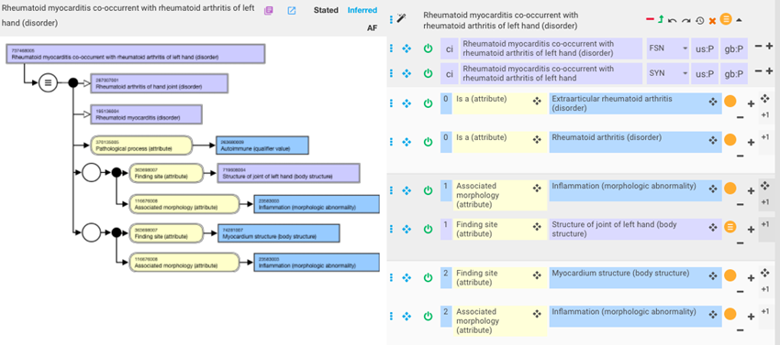
Rheumatoid myocarditis with rheumatoid arthritis of left hand

