Slide 1
Allergy Topics

Slide 2
Briefing paper
Remodel of 414029004 |Disorder of immune function (disorder)|
Replacing “Psedudoallergy” with “Nonallergic hypersensitivity”
Revised allergy project deliverables
Modeling contact dermatitis

Slide 3
Briefing paper
Summary of proposed changes
  Make condition classes (hypersensitivity/allergy/pseudoallergy condition) primitive and assign the appropriate disease, disposition and reaction (process) classes underneath.
  Redefine allergic diseases as diseases due to allergic reaction. This represents a reversion to a previous model.
  Redefine hypersensitivity dispositions with a has realization relationship to allergic/pseudoallergic process
  Move condition and disposition classes (including Propensity to adverse reactions under clinical findings
  Rename (or retire and replace) Pseudoallergy concepts with Nonallergic hypersensitivity
  Add new pathological process of abnormal immune response as a parent of allergic process and autoimmune and use this to redefine Disorder of immune function (disorder)

Slide 4
Why changes are critical
The current model has several shortcomings:
  Hypersensitivity condition and its immediate descendants represent a disjunction between dispositions, processes and diseases which themselves are disjunctions between dispositions and processes. As such, they should not be fully defined.
  Defining Hypersensitivity condition and its immediate descendants with a pathological process results in the pathological process being inherited by the disposition class. Pathological processes are not dispositions but rather the realization of dispositions.
  Defining allergy disposition using a role group containing after allergic sensitization + causative agent requires a different and imperfect model to be applied to defining nonallergic hypersensitivity (pseudoallergy)
  The WAO/EAAAI nomenclature as well as the allergy, hypersensitivity, intolerance CRG feels that “pseudoallergy” is an obsolete term.
  Redefining Disorder of immune function (disorder) as discussed above will enable allergic diseases and reactions as well as autoimmune diseases to correctly classify as disorders of immune function

Slide 5
Impact to terminology
Changes to the modeling of hypersensitivity conditions
  These are top level classes and will be restricted to only 3 subclasses: diseases, dispositions and reactions (processes).
  These changes should not appreciably affect the current terminology
Changes to modeling of hypersensitivity dispositions
  The changes provide a consistent model for both allergic and nonallergic hypersensitivity.
  These hierarchies will still be able to be queried by causative agent.
Change of Pseudoallergy to Nonallergic hypersensitivity
  TBD
Redefining Disorder of immune function will result in moving autoimmune and allergic disorders under a more appropriate grouper.
Moving condition and disposition classes under clinical finding
  TBD

Slide 6
Remodel of 414029004 |Disorder of immune function (disorder)|
IHTSDO-959 Update of the allergy-hypersensitivity model
  Plan to review and update the allergy- hypersensitivity model including the following:
    Expanding the pathological process qualifier hierarchy to include abnormal immune response (qualifier value) to subsume autoimmune (qualifier value) and allergic process (qualifier value).
    The above would then be used to retire has definitional manifestation immune system finding from Disorder of immune function and would result in allergic condition and autoimmune disease being correctly subsumed by Disorder of immune function.

Slide 7
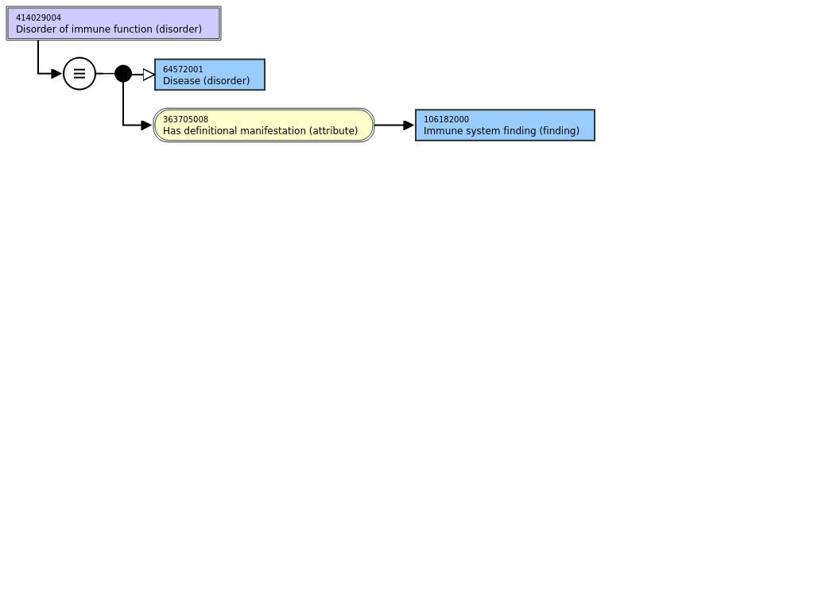
Current model of disorder of immune function

Slide 8
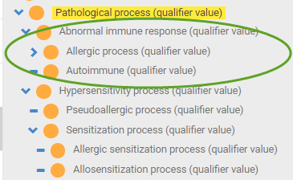
Proposed changes to model of disorder of immune function

Slide 9
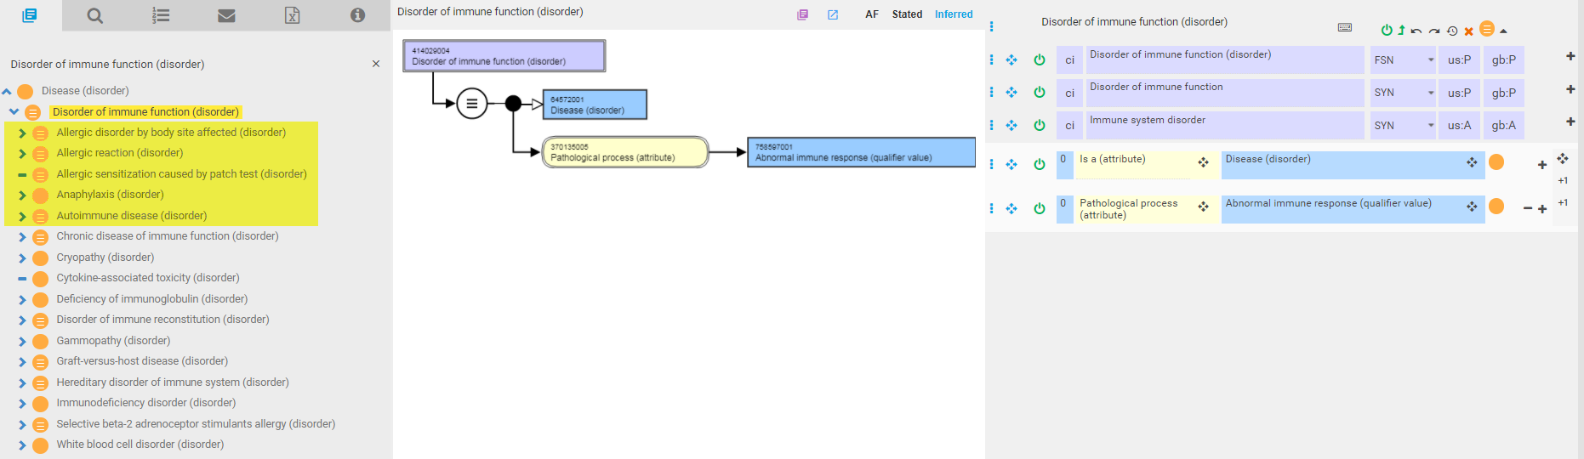
Revised disorder of immune function hierarchy

Slide 10
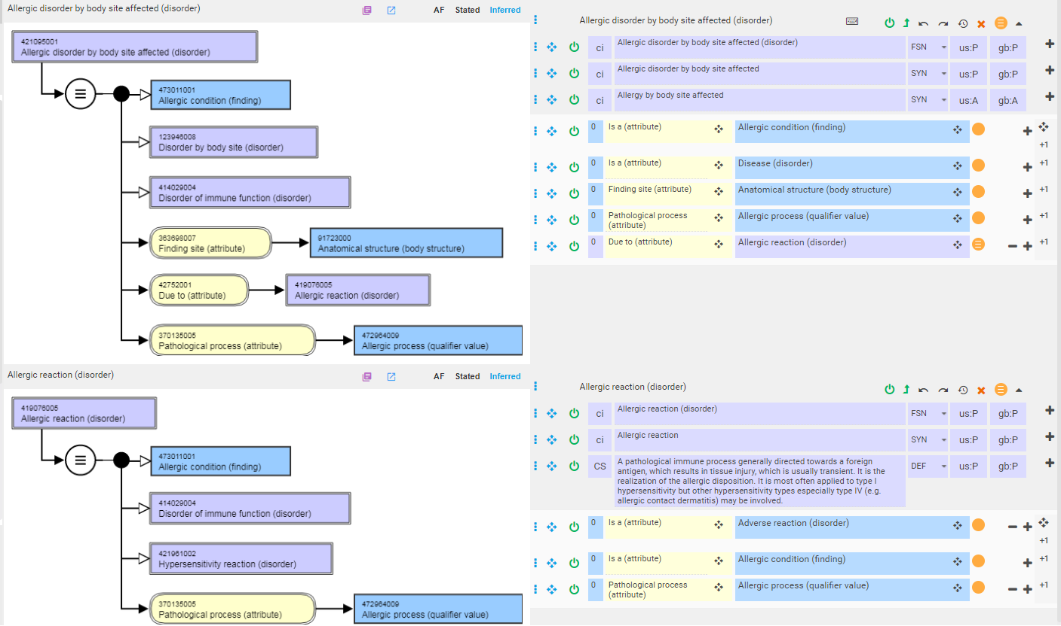
Modeling of allergic disorders 1
*Allergic dispositions and allergic condition (which is a supertype of allergic disposition) are not subtypes of Disorder of immune function because they are not defined by pathological processes and they are clinical findings rather than disorders

Slide 11
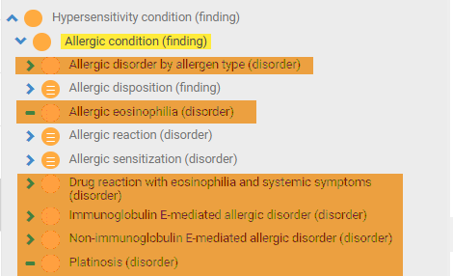
Modeling of allergic disorders 2
*Orange highlighted concepts will need to be remodeled to include pathological process = allergic process in order to classify under Disorder of immune function

Slide 12
Pseudoallergy

Slide 13


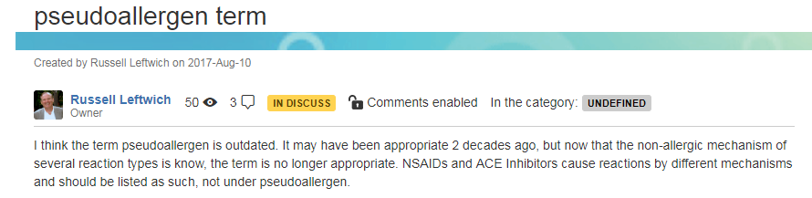
Pseudoallergy

Slide 14
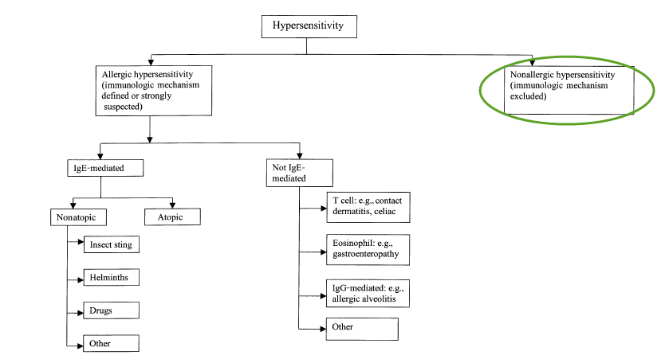
WAO view of hypersensitivity
X
We propose to use the term nonallergic hypersensitivity
when immunologic mechanisms cannot be proven, as
in hypersensitivity to aspirin (84). The term ‘‘pseudoallergy’’,
introduced many years ago (22) and still
occasionally used in some European countries, should
be abandoned.
*Hypersensitivity causes objectively reproducible symptoms or signs, initiated by exposure to a defined stimulus at a dose tolerated by normal subjects.

Slide 15
WAO definition of hypersensitivity
Hypersensitivity causes objectively reproducible symptoms or signs, initiated by exposure to a defined stimulus at a dose tolerated by normal subjects.

Slide 16

Proposed revision of hypersensitivity pathological process hierarchy

Slide 17
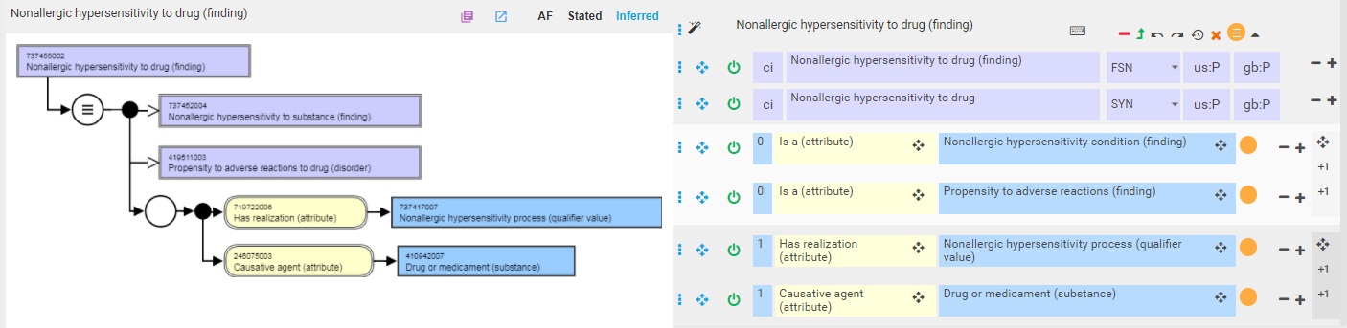
Revised model for nonallergic hypersensitivity

Slide 18
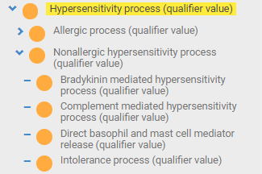
Possible revision of nonallergic hypersensitivity pathological processes to include specific subtypes

Slide 19
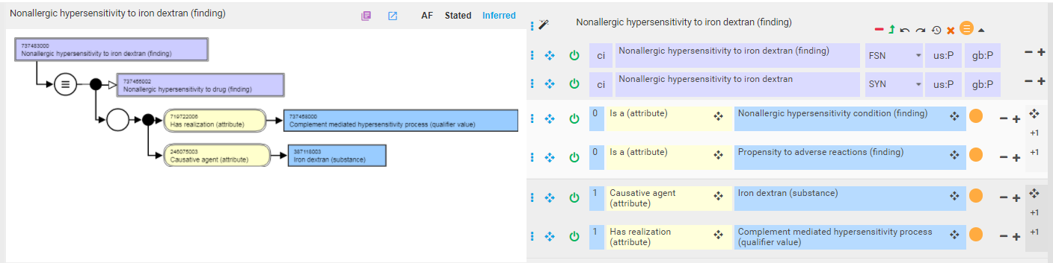
Example of nonallergic hypersensitivity with more specific nonallergic hypersensitivity pathological process 1

Slide 20
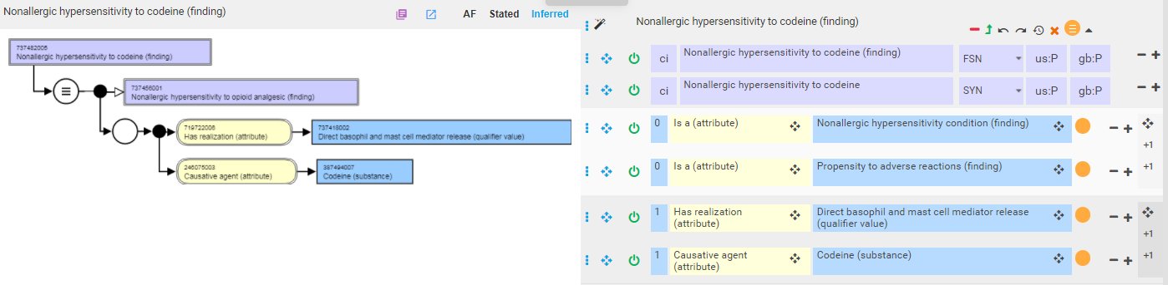
Example of nonallergic hypersensitivity with more specific nonallergic hypersensitivity pathological process 2

Slide 21
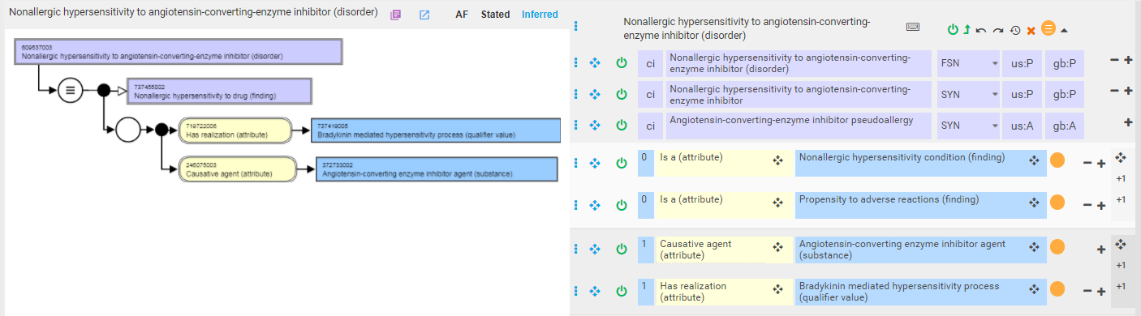
Example of nonallergic hypersensitivity with more specific nonallergic hypersensitivity pathological process 3

Slide 22
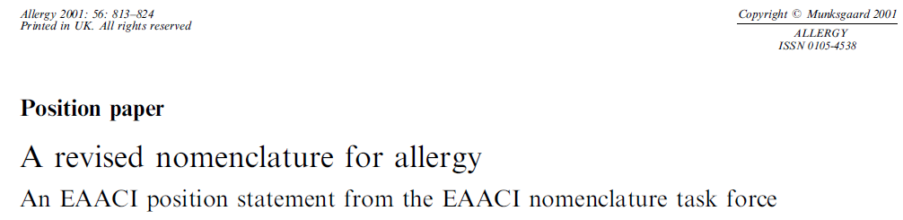
WAO position on nonallergic hypersensitivity
The term ‘‘nonallergic hypersensitivity’’ embraces many different disorders. However, it is not within the remit of this group to classify these entities.

Slide 23
Remaining questions
WAO definition of hypersensitivity would seem to include intolerance
Should “Pseudoallergy” just be replaced with “Nonallergic hypersensitivity” in the FSN or is there a subtle difference in what is implied by Pseudoallergy and Nonallergic hypersensitivity that would require retiring the former and replacing with the latter
  The allergy/hypersensitivity CRG felt that Pseudoallergy might imply signs and symptoms resembling allergy caused by non-immunologic release of vasoactive mediators form mast cells and basophils.

Slide 24
Allergy project - revised deliverables for January 2018
OVERVIEW
  The deliverable for allergy project in 2018 January release has to be revised because the tooling development for template based batch change has been rescheduled. There are some known issues in Allergy/Pseudoallergy/Reaction to substances. Addressing these issues will improve the quality and prepare for the batch change in future.
GOALS
  Address known issues to improve content quality
  Ensure consistent modeling to prepare for batch changes in future

Slide 25
SPECIFICATIONS

Slide 26
Review concepts that have more than one inferred causative agent (Scope: 218 concepts)
Task 1: Editorial decision on whether allergy to role of a product and whether allergy to a role combined with a structure (e.g. sulfite based food preservative) is valid.
Task 2: Editorial decision on whether allergy to a body system is valid.
Task 3: Identify substances, e.g. protein of x organism, to replace organisms in allergy model.
Task 4: Develop and approve concept model for allergy to products
Task 5: Changes in the drug and substance hierarchies (no resource for 2018 January release)

Slide 27
Allergy to compounds
Review concepts that they have been modeled by compound of substance. (Scope: 5 concepts) The concepts in disorder hierarchy are not specified as allergy to substance compounds except Iodine compounds allergy. However, there is an inactive concept Iodine allergy (disorder) which is replaced by Iodine compounds allergy.
Task: Develop editorial guide for concept modeling for these concepts.

Slide 28
Allergy to products
Review concepts with descriptions containing any word suggesting a dose form, such as “Topical”, “Rectal”, “Inhaled”, “Inhalation”, “Solution” (Scope of review: 9 concepts)
  The modeling of these concepts depend on substance of product, e.g. dialysis fluid.
  These disorders should be modeled by products instead of substances.
  The concept model for hypersensitivity to products needs to be developed and approved and then changes applied to content.
  Development of the concept model for allergy to product is dependent upon revision of the product hierarchy based on the new concept model for products
Task: Develop and approve concept model for allergy to products.
id | fsn
294162002 | Allergy to inhaled corticosteroids (disorder)
294300002 | Peritoneal dialysis solution allergy (disorder)
294302005 | Hemofiltration solution allergy (disorder)
294304006 | Cardioplegia solution allergy (disorder)
294852006 | Plasma protein solution allergy (disorder)
294854007 | Albumin solution allergy (disorder)
402386006 | Allergic urticaria due to inhaled allergen (disorder)
419081001 | Pharmaceutical fluid or solution allergy (disorder)
294409000 | Chlorinated solutions allergy (disorder)

Slide 29
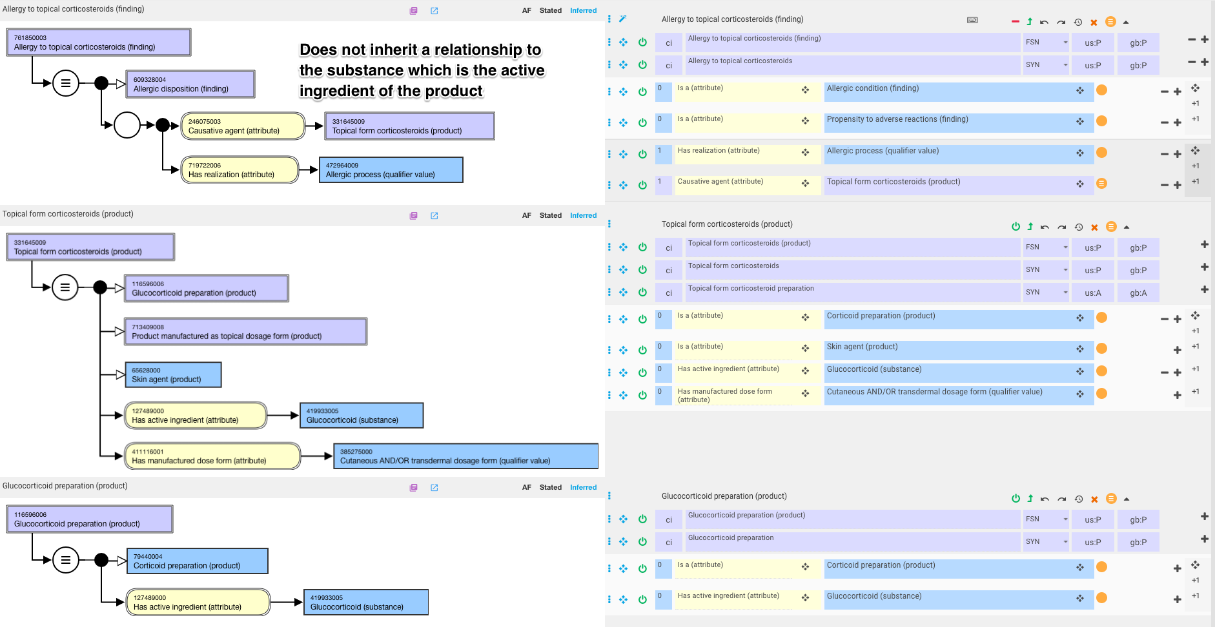
Allergy to products 2

Slide 30
Review primitive concepts which have causative agent
If possible, they should be fully defined (Scope: ?116 concepts)
  Task 1: Review and identify modeling patterns
  Task 2: Develop editorial guide according to patterns
  Task 3: Changes in the drug and substance hierarchies (no resource for 2018 January release)
14589007 | Phacoanaphylaxis (disorder)
14654002 | Localized anaphylaxis (disorder)
15470004 | Toxic diffuse goiter with acropachy (disorder)
16623004 | Coffee-workers' lung (disorder)
18690003 | Farmers' lung (disorder)
19514005 | Arthritis mutilans (disorder)
23315001 | Sequoiosis (disorder)
25847004 | Seborrheic psoriasis (disorder)
26151008 | Graves' disease with acropachy AND with thyrotoxic crisis (disorder)
27040004 | Experimental allergic encephalomyelitis (disorder)
27520001 | Pustular psoriasis of the palms AND/OR soles (disorder)
28031001 | Cell-mediated immune reaction (disorder)
28505005 | Acute idiopathic thrombocytopenic purpura (disorder)
28840001 | Generalized pustular psoriasis, exanthematous type (disorder)
29268000 | Contact hypersensitivity (disorder)
30352005 | Allergic-infective asthma (disorder)
Sample of affected content reveals several concepts which are not allergies and need to be moved to other hierarchies and several concepts which cannot be fully defined

Slide 31
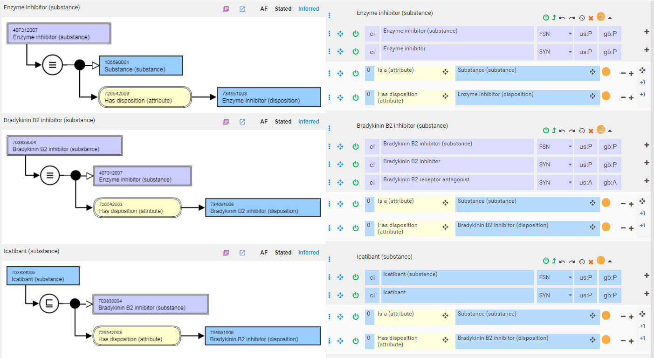
Modeling of substance groupers by disposition

Slide 32
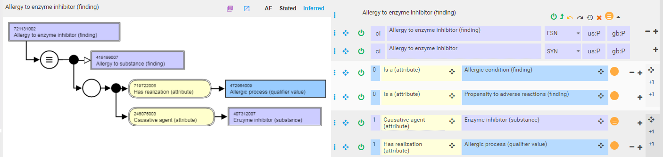
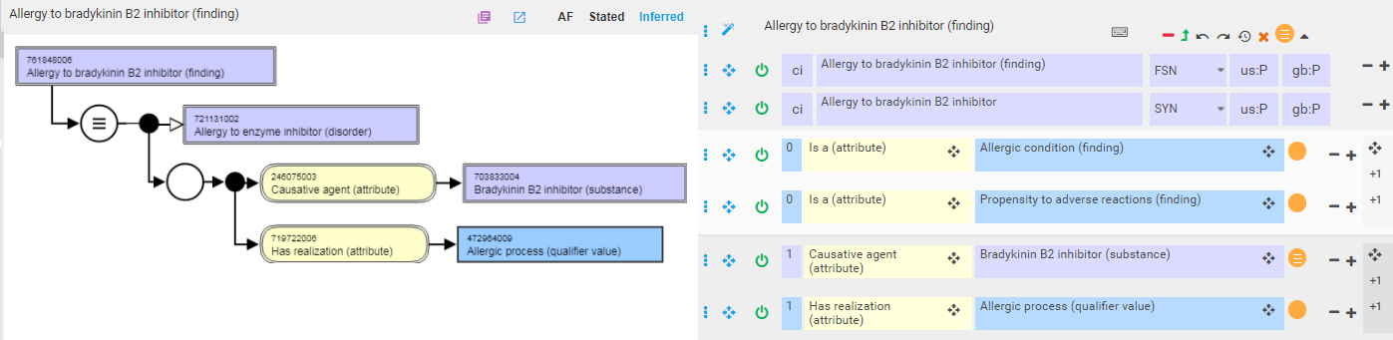
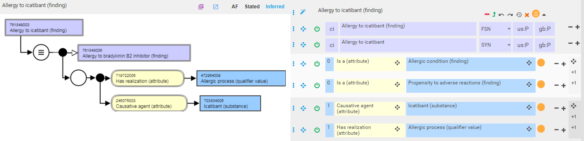
Modeling allergy to substances

Slide 33
Potential impact to allergy content by the new models for substance and product hierarchies
Allergy to substance dispositions
  Should have minimum impact to allergy content.
  The disposition groupers are fully defined and they will generate hierarchical relationships to individual substances similar to current content.
  The potential impact could be that some grouper concepts that are not dispositions will not have hierarchical relationships in future.
Allergy to substance modifications - The hierarchical relationships will become a flat list as siblings. Property chain would potentially be needed for modelling allergy to substance modifications, e.g. |Causative agent| o |Is modification of| SubObjectPropertyOf |Causative agent|.
Editorial guide on choice of Allergy to product containing X vs. Allergy to product containing Only X at MP and MPF levels
Requirement and solutions for subsumptions between Allergy to substance and Allergy to product

Slide 34
Should Allergen class hierarchy be retired?
The subhierarchy for allergen class has not been fully maintained for some years and means that it is inconsistently populated.
  Some substances are included in this hierarchy while substances that have similar allergenic characteristics are not.
  It is also the case that if the hierarchy was consistently populated it would include most of the substance concepts and so makes it value in being able to differentiate allergens and nonallergens limited.
One further issue is that some of the allergen concepts that are included have no association with the substance from which they originate.
  For example all of the flower and weed pollen allergen concepts exist with no association to the plant pollen substances from which originate.
It is proposed that the concept of Allergen class (substance) and its subhierarchy is retired.
  Concepts of "allergen" and "pseudo allergen" would be represented as Qualifier values in the new dispositions subhierarchy?

Slide 35
Should Allergen class hierarchy be retired? 2
One could conceivably address the issue of what substances to assign under an allergen class hierarchy by restricting the content to substances that are currently the causative agents of allergy concepts.

Slide 36
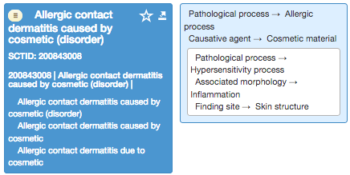
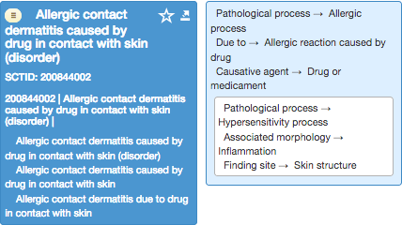
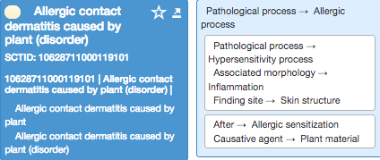
Modeling contact dermatitis
There is variability of how contact dermatitis caused by specific substances is managed in SNOMED CT as demonstrated below:

Slide 37
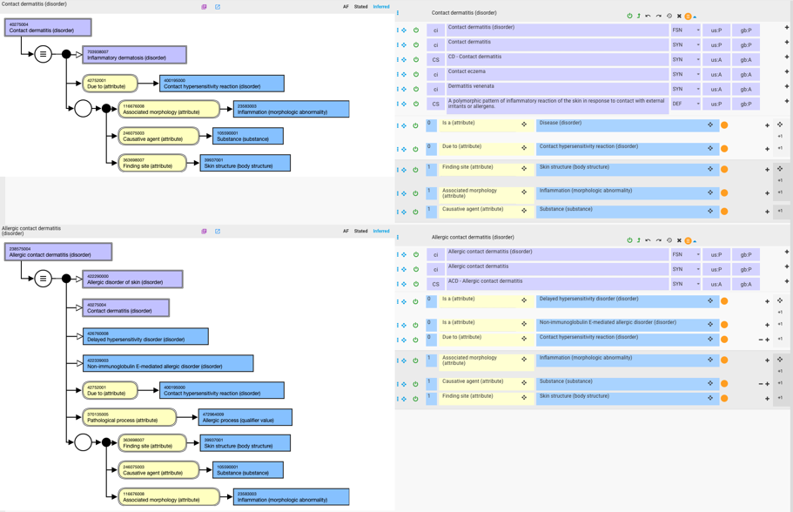
Proposed model for contact dermatitis
Add pathological process to role group with causative agent. Retest model

