Slide 1
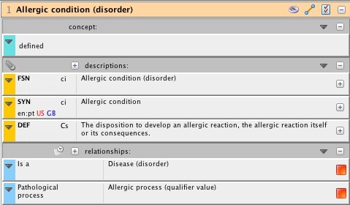
Allergic condition

Slide 2
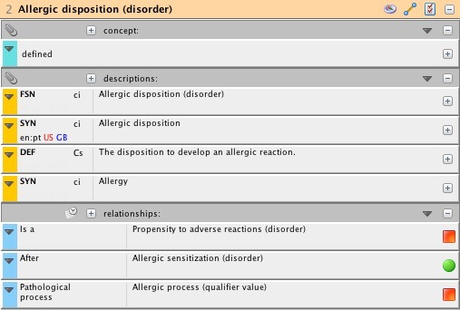
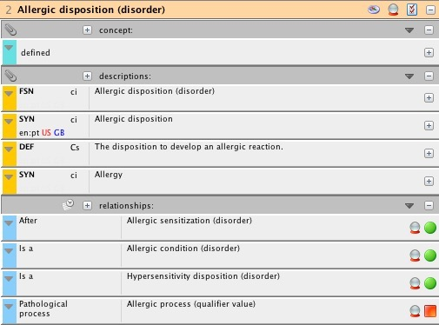
Allergic disposition
Stated view
Inferred view

Slide 3
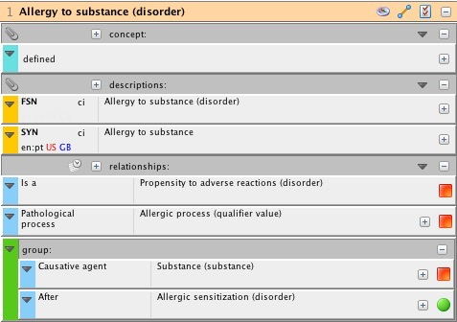
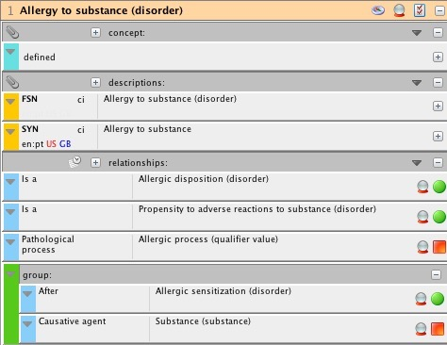
Allergy to substance (original model)
Stated view
Inferred view

Slide 4
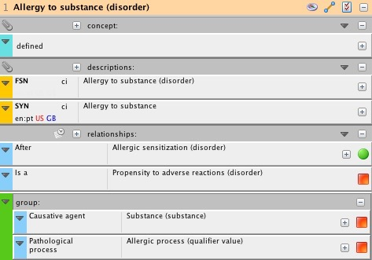
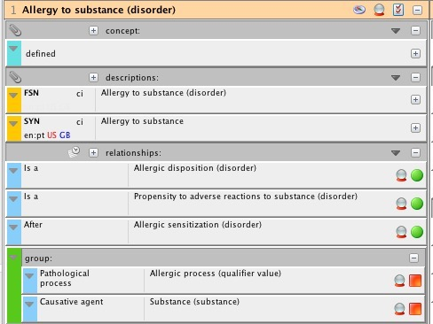
Allergy to substance (alternate model)
Stated view
Inferred view

Slide 5
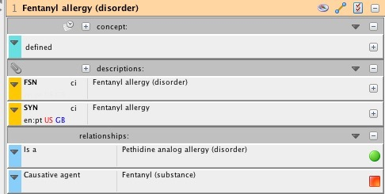
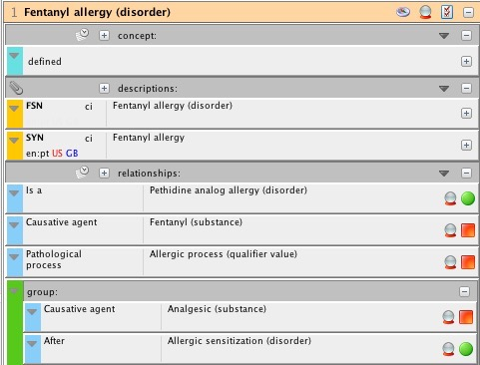
Fentanyl Allergy
Stated view
Inferred view

Slide 6
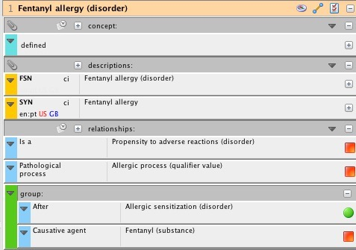
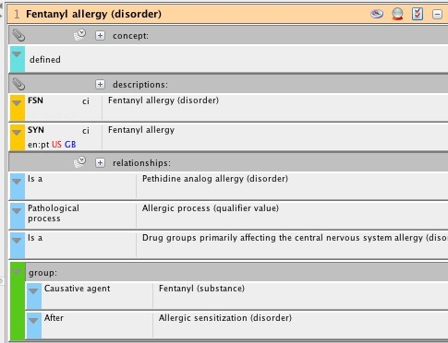
Fentanyl allergy remodeled 1
Stated view
Inferred view

Slide 7
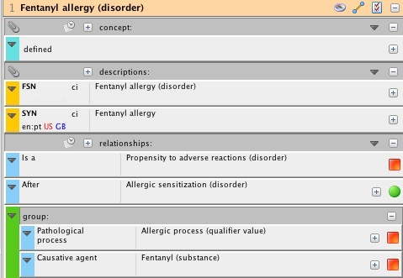
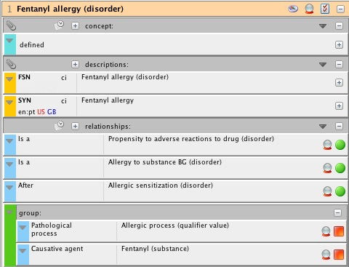
Fentanyl allergy remodeled 2
Stated view
Inferred view

Slide 8
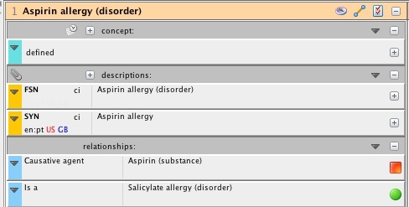
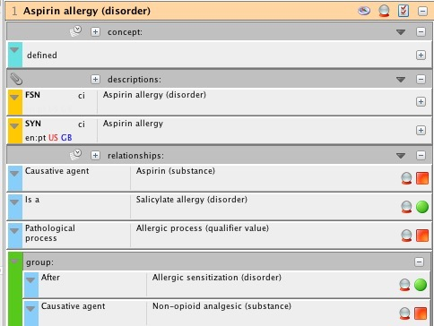
Aspirin Allergy
Stated view
Inferred view

Slide 9
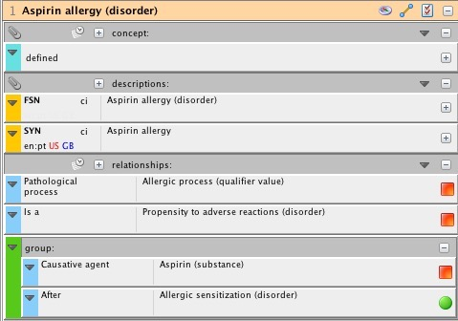
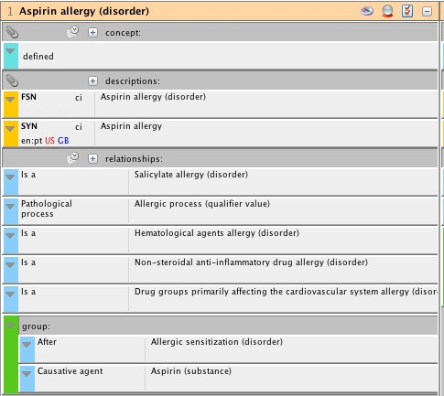
Aspirin allergy remodeled 1
Stated view
Inferred view

Slide 10
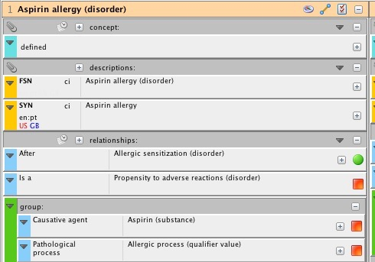
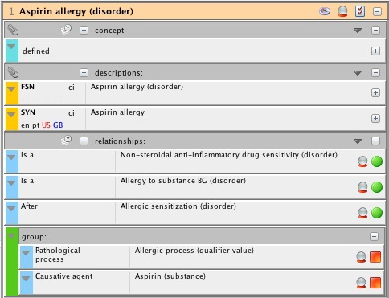
Aspirin allergy remodeled 2
Stated view
Inferred view

Slide 11
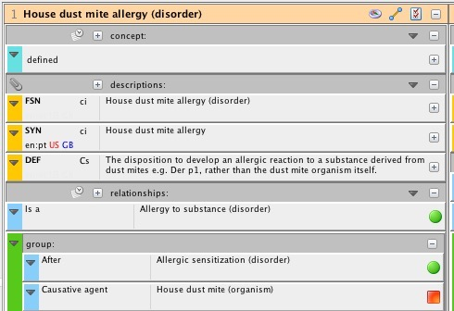
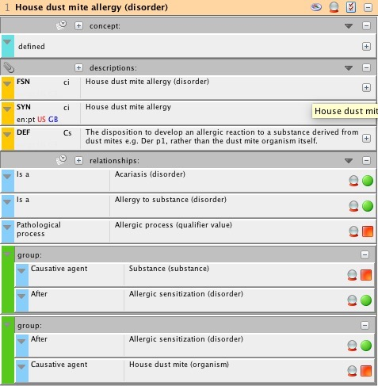
House dust mite allergy
Stated view
Inferred view

Slide 12
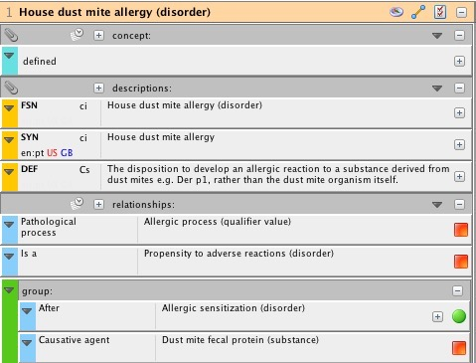
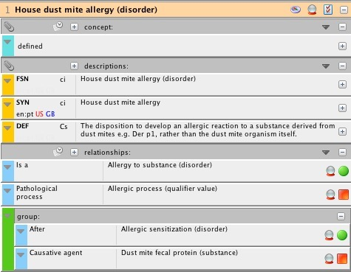
House dust mite allergy remodeled 1
Stated view
Inferred view
New causative agent

Slide 13
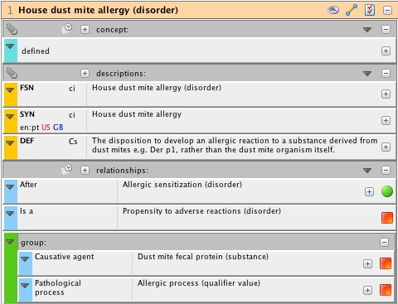
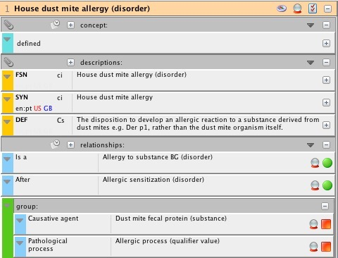
House dust mite allergy remodeled 2
Stated view
Inferred view

