Slide 1
Drug Concept Model and Substance Redesign Update for EAG
30 March 2017

Slide 2
Drug Concept Model Update

Slide 3
Current status
Review of second iteration of Editorial Guidelines completed by PG
Third iteration of Editorial Guidelines expected to be distributed to PG for review by mid April
  Notifications to EAG, MAG, CMAG
Continuing to prototype and test proposed changes and confirm which changes will be part of 2017-July and 2018-January Releases

Slide 4
Concept Model
Concept classes include
  Grouper
    Based on structure or disposition
  Virtual Medicinal Product
    Active ingredient
  Virtual Medicinal Product Form
    Active ingredient, manufactured dose form
  Virtual Clinical Drug
    Active ingredient, manufactured dose form, basis of strength substance, product strength

Slide 5
Concept Model, cont.
New attributes:
  Has basis of strength substance
  Has presentation strength numerator value
  Has presentation strength numerator unit
  Has presentation strength denominator value
  Has presentation strength denominator unit
New semantic tags:
  virtual medicinal product
  virtual medicinal product form
  virtual clinical drug
  unit of presentation
New hierarchies:
  Number (qualifier value)
  Unit of presentation (unit of presentation)

Slide 6
2017-July Release
Expected to include changes for a subset of concepts in the Product hierarchy:
  Descriptions updated in accordance with new terming guidelines for selected concepts
  Existing stated parents and definition status will be retained in most cases
  Missing attributes will be added
  Errors in existing content will be corrected as they are identified
  New |Has basis of strength substance|, |Has presentation strength numerator value|, |Has presentation strength numerator unit|, |Has presentation strength denominator value|, and |Has presentation strength denominator unit| attributes will be added for subset of concepts (tablets, capsules)

Slide 7
Other related work
Roles solution
Model for national extension
  Planning for development of model and editorial guidelines that could be used by a national extension
Use of product concept as attribute value in other hierarchies
  Requires existing content to be cleaned up

Slide 8
Substance Hierarchy Redesign

Slide 9
Current status
Documentation/proposal completed and approved for:
  Use cases
  Review of work prior to 2016
  Salts, bases, and derivatives
  Groupers (structural, disposition, and role)
Breaking down into more detailed plan and testing to identify deliverables for 2017-July and 2018-January
Reviewing and categorizing grouper concepts (e.g. structural, disposition, role)

Slide 10
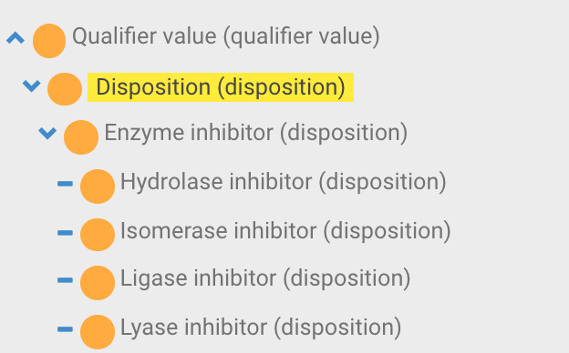
Dispositions
Testing proposed plan for dispositions
New hierarchy, semantic tag, and attribute type
  |Disposition (disposition)| hierarchy created in |Qualifier value| hierarchy
  |Has disposition| attribute

Slide 11
Dispositions
Groupers representing disposition in Substance hierarchy to be sufficiently defined; new terming patterns to be applied
When a solution has been agreed, the deployment plan will be determined and Editorial Guidelines will be documented and made available for review

Slide 12
Other
Other tasks being initiated as they arise and resources become available
  Example: correcting misalignment between INN, US, and GB preferred terms

