Slide 1
Comparison of allergy content between SNOMED CT and ICD-11

Slide 2
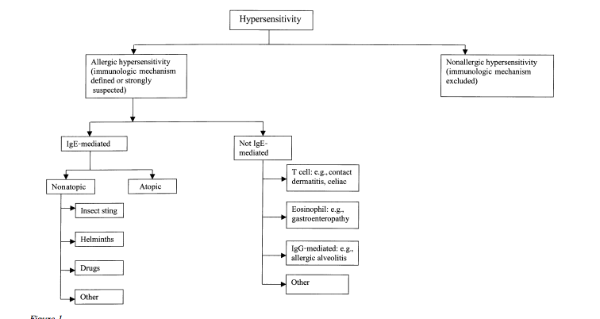
WAO/EAAACI view of hypersensitivity¹
¹Johansson SG, Hourihane JO, Bousquet J, Bruijnzeel-Koomen C, Dreborg S, Haahtela T, Kowalski ML, Mygind N, Ring J, van Cauwenberge P, van Hage-Hamsten M, Wüthrich B; EAACI (the European Academy of Allergology and Cinical Immunology) nomenclature task force. A revised nomenclature for allergy. An EAACI position statement from the EAACI nomenclature task force. Allergy. 2001 Sep;56(9):813-24.

Slide 3
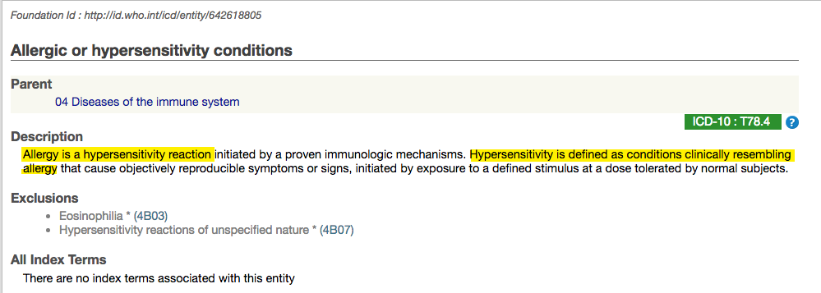
ICD-11 view of allergy

Slide 4
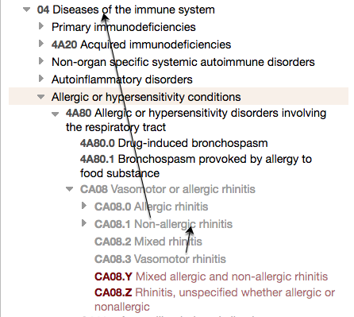
Issues with ICD-11 organization of hypersensitivity diseases
Vasomotor rhinitis is a kind of non-allergic rhinitis
Non-allergic rhinitis is not a disease of the immune system

Slide 5
Feedback from Jane Millar on IHTSDO interaction with WHO on ICD-11
The fact is that WHO to date has not responded to any of our queries that relate to content – Phil and Dave have provided me with sets of feedback 3 times over the last 2 years and each time WHO have done nothing with it. Shelley and I visited them end of 2017 and again they said they would give us feedback and nothing has been forthcoming.
There is meant to be a frozen version in April which I have been promised we will have access to – this is effectively the version for final QA ahead of release in June this year which is definitely going ahead. But the release of ICD-11 MMS is for update in 5 years, they will be collecting feedback during this period based on implementation.
With regard to definitions, it is not clear which of the definitions will be released because they are not happy with their quality – originally we were going to have common definitions but because of the quality of them, WHO advised against us adopting them.
I know this is not the answer you wanted, but it is the current situation. Shelley and I will be arranging another visit mid-year but meanwhile I would make sure we have a record of the points you are raising so that if we manage to open channels in a productive way, we can go forward.
In defense of WHO, they have had enormous amount of work to do to deliver even ICD-11 MMS given the state the work was in even as recent as 2 years ago, but if we are going to be serious about a linkage between SNOMED CT and ICD-11, these are part of many issues which will need addressing.

Slide 6
Allergy SNOMED CT-ICD-11 mapping performed by Phil Brown and David Robinson
Gap analysis between SNOMED CT and ICD-11 allergy content based on above mapping

