Slide 1
Allergy to substance modeling issues

Slide 2
Allergy to substance combinations

Slide 3

Current model

Slide 4

Proposed model (using GCIs)

Slide 5

Proposed model as a product (using GCIs)

Slide 6


Comparison of existing and proposed models
Current model
Proposed model
An allergy to a combination of oxytocin and ergometrine is necessarily an allergy to both oxytocin and ergometrine such that someone allergic to the combination would be expected to react if either component is administered
An allergy to amoxicillin or to clavulanic acid is necessarily an allergy to the combination of amoxicillin and clavulanic acid such that someone allergic to either amoxicillin or to clavulanic acid would be expected to react if they were administered a combination of amoxicillin and clavulanic acid
Should FSNs reflect the disjunctive nature of the allergy i.e. Allergy to X or Y (finding) ?

Slide 7
Allergy to physical objects

Slide 8
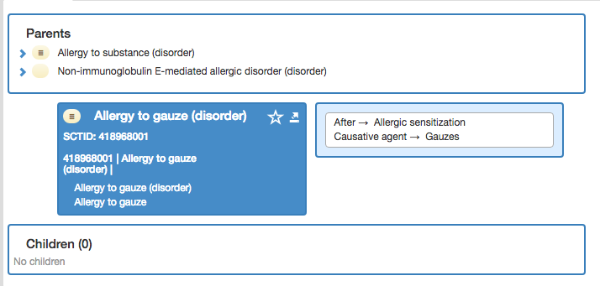

Allergy to physical objects - 1

Slide 9
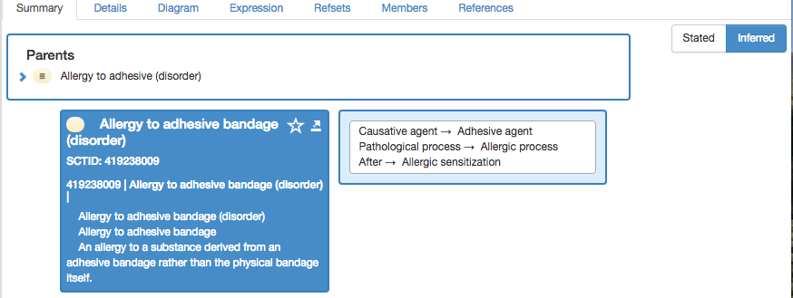
Allergy to physical objects - 2

Slide 10
Issues
An allergy to a physical object is not directed to the object itself but rather to a substance derived from the object
The substance responsible for an allergy to an adhesive bandage may not be the adhesive.
Allergic Contact Dermatitis from Medical Adhesive Bandages in Patients Who Report Having a Reaction to Medical Bandages.
Widman, Travis J.; Oostman, Holly; Storrs, Frances J. Dermatitis. 19(1):32-37, January/February 2008.
“We were able to identify an allergen in four out of twenty-six patients that was related to their presumed adhesive allergy (Mastisol, neomycin/bacitracin [two different patients], and cortisone-10 cream, respectively). However, there were no positive allergic reactions to the tapes or bandages or any relevant allergic reactions to our customized adhesive tray. Eight (73%) of the 11 patients who had the bandage or tape left on for 7 days had an irritant reaction”.

Slide 11
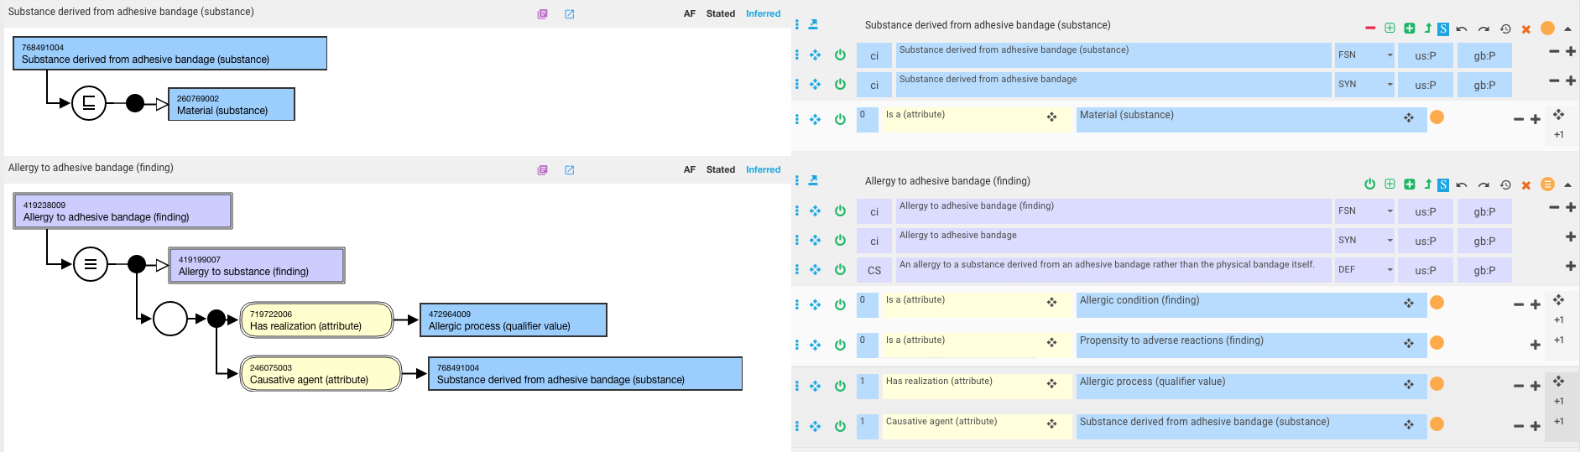
Proposed solution - 1

Slide 12

Proposed solution - 2

