Slide 1
Review of proposed hypersensitivity/allergy model

Slide 2
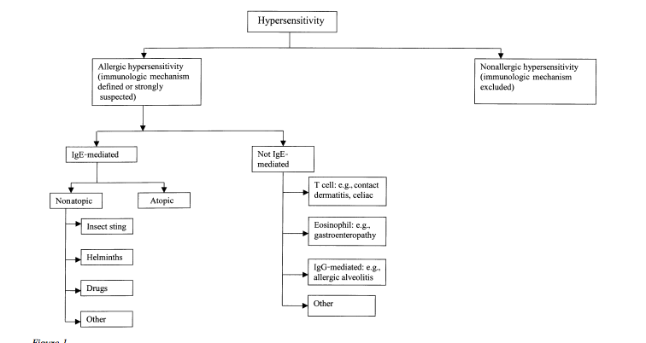
WAO/EAAACI view of hypersensitivity¹
¹Johansson SG, Hourihane JO, Bousquet J, Bruijnzeel-Koomen C, Dreborg S, Haahtela T, Kowalski ML, Mygind N, Ring J, van Cauwenberge P, van Hage-Hamsten M, Wüthrich B; EAACI (the European Academy of Allergology and Cinical Immunology) nomenclature task force. A revised nomenclature for allergy. An EAACI position statement from the EAACI nomenclature task force. Allergy. 2001 Sep;56(9):813-24.

Slide 3
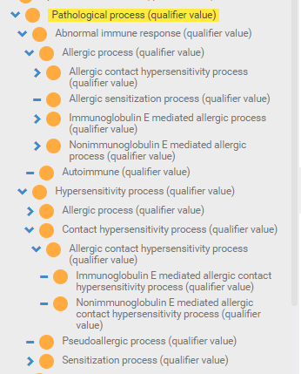
New pathological process (qualifier value) hierarchy
Hypersensitivity disorders and reactions are defined by underlying pathological processes while hypersensitivity dispositions are defined by their realization as pathological processes.
In order to fully describe the full range of hypersensitivity responses additional qualifier values have been added under the Pathological process (qualifier value) subhierarchy as shown below:

Slide 4
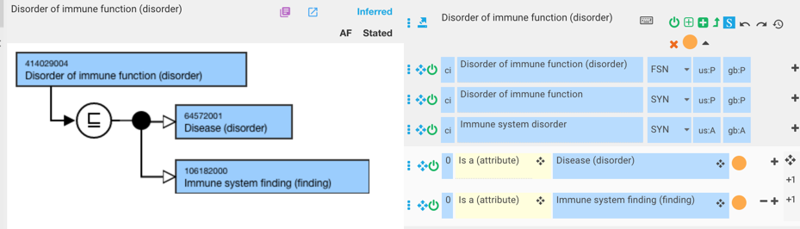
Disorder of immune function – current model

Slide 5
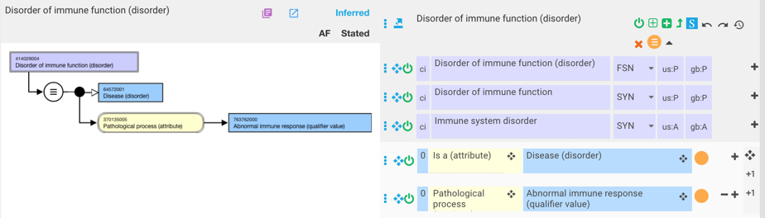
Disorder of immune function (disorder) – new model

Slide 6
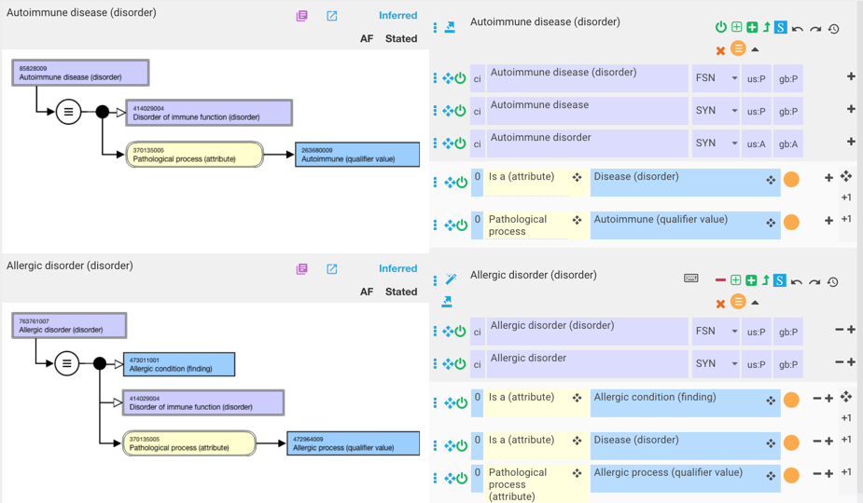
Allergic and autoimmune disorder

Slide 7
Top level hierarchies
The top level organizing hierarchy is Hypersensitivity condition (finding) which is a primitive class and subsumes Allergic condition (finding) and non-allergic hypersensitivity (pseudoallergic) condition (finding) as per the WAO/EAAACI nomenclature^{1,2}. Hypersensitivity condition is a direct descendant of clinical finding.
Allergic and non-allergic hypersensitivity condition both of which are primitive each have three allowable descendants representing diseases (mostly abnormal structures), processes (allergic and non-allergic hypersensitivity reactions) and propensities to developing allergic and non-allergic hypersensitivity reactions (dispositions).
¹Johansson SGO, O’B Hourihane J, Bousquet J, Bruijnzeel-Koomen C, Dreborg S, Haahtela T, Kowalski ML, Mygind N, Ring J, van Cauwenberge P, van Hage-Hamsten M, Wüthrich B. A revised nomenclature for allergy. An EAACI position statement from the EAACI nomenclature task force. Allergy 2001; 56:813-824.
²Johansson SGO, Bieber T, Dahl R, Friedmann PS, Lanier BQ, Lockey RF, Motala C, Ortega Martell JA, Platts-Mills TAE, Ring J, Thien F, Van Cauwenberge P, Williams HC. Revised nomenclature for allergy for global use: Report of the Nomenclature Review Committee of the World Allergy Organization, October 2003. J Allergy Clin Immunol 2004; 113: 832-836.

Slide 8
Allergic and non-allergic hypersensitivity(pseudoallergic) diseases
These classes represent manifestations of pathologic processes that may result in abnormal structures (e.g. allergic rhinitis). They are defined as diseases and allergic conditions containing a role group consisting of an associated morphology and a finding site that represents the abnormal structure, a pathological process of allergic/non-allergic hypersensitivity process or one its descendants and if specified, a causative agent relationship to a substance)

Slide 9
Terming
FSN: Allergic disease X (caused by Y) (disorder)
  Example:
    61582004 |Allergic rhinitis (disorder)|
    473460002 |Allergic conjunctivitis (disorder)|
    91926002 |Allergic rhinitis caused by grass pollen (disorder)|
    449729000 |Allergic rhinitis caused by house dust mite (disorder)|
Preferred Term:
  Allergic disease X (caused by Y)
  Example:
    Allergic rhinitis
    Allergic conjunctivitis
    Allergic rhinitis caused by grass pollen
    Allergic rhinitis caused by house dust mite
For naming conventions for causative drug allergens see section on Allergic and non-allergic hypersensitivity (pseudoallergic) dispositions

Slide 10
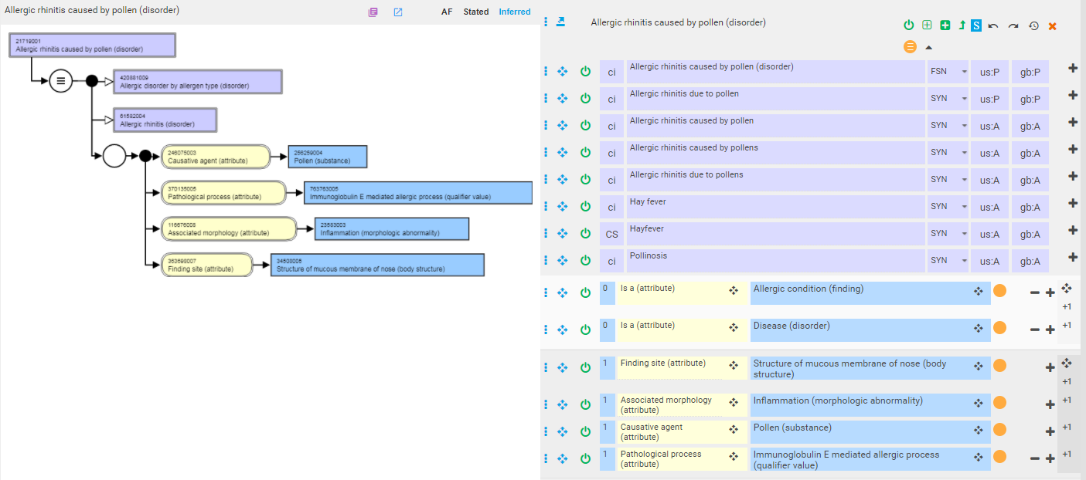
Model

Slide 11
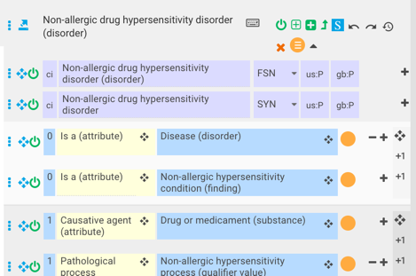
Non-allergic hypersensitivity (pseudoallergic) diseases
Consists of 427640001 |Non-allergic drug hypersensitivity disorder (disorder)|and 5 descendants
Descendants consist of terms like X agent induced asthma/urticarial/angioedema
As X agents are known “pseudoallergens” the FSNs should be renamed simply to asthma/urticarial/angioedema caused by X (disorder) and the concepts remodeled according to the model below:

Slide 12
Allergic and non-allergic hypersensitivity (pseudoallergic) dispositions
These classes represent propensities to develop allergic or non-allergic hypersensitivity (pseudoallergic) reactions under appropriate conditions (i.e. allergen or pseudoallergen exposure).
As propensities, do not have a pathophysiologic manifestation prior to being realized as processes, allergic and non-allergic hypersensitivity (pseudoallergic) dispositions are considered to be clinical findings rather than disorders to further distinguish them from their realizations as allergic and non-allergic hypersensitivity (pseudoallergic) reactions.
Allergic and non-allergic hypersensitivity (pseudoallergic) dispositions are defined thus as propensities to adverse reactions and allergic conditions realized as allergic or non-allergic hypersensitivity (pseudoallergic) processes.

Slide 13
Terming
FSN
  Allergy to X [and Y] (finding)¹
  Non-allergic hypersensitivity to X [and Y] (finding)¹
  Examples
    Allergy to Artemisia vulgaris pollen (finding)
    Allergy to sulfamethoxazole and trimethoprim (finding)
    Non-allergic hypersensitivity to imidapril (disorder)
PT
  Same as above without sematic tag for allergic dispositions
  Pseudoallergy to X for non-allergic hypersensitivity dispositions
  Examples
    Allergy to Artemisia vulgaris pollen
    Pseudoallergy to imidapril
Synonyms
  When the BAN (British Approved Name) and/or USAN (United States Adopted Name) differs from the INN, then synonyms should be added using the following pattern, with Z = BAN or USAN. A synonym containing the scientific name of the organism should also be added.
  Example
    Allergy to acetaminophen
    Allergy to acetaminophen and ibuprofen
  ¹X and Y = INN or the scientific name of the organism and with X and Y in alphabetical order for concepts representing multiple substances:

Slide 14
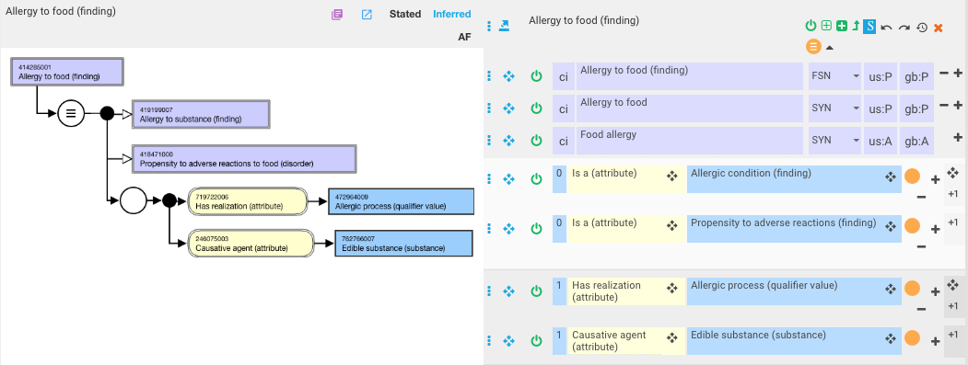
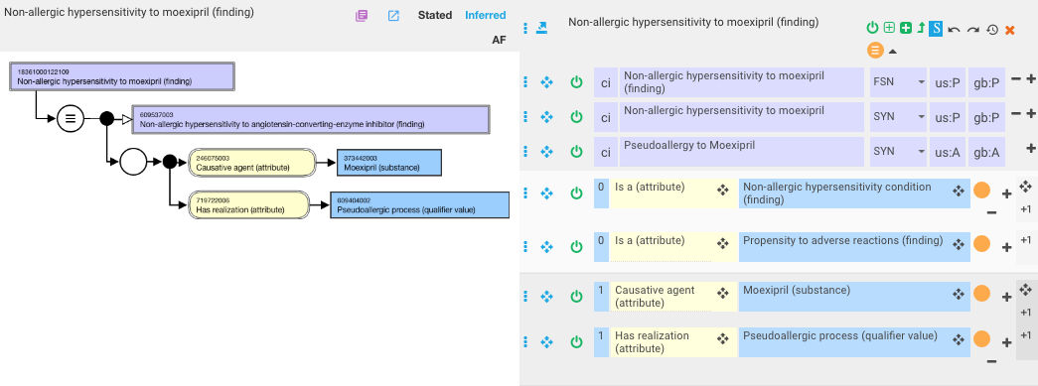
Model

Slide 15
Allergic and non-allergic hypersensitivity (pseudoallergic) reactions
These classes represent pathological processes and are defined as adverse reactions and allergic conditions with a pathological process of allergic or non-allergic hypersensitivity (pseudoallergic) process.

Slide 16
Terming
FSN: Allergic reaction (caused by X) (disorder), Non-allergic reaction (caused by X) (disorder), Anaphylactoid reaction (caused by X)
  Example:
    418809008 |Allergic reaction caused by dye (disorder)|
    609409007 |Non-allergic hypersensitivity reaction caused by sulfite (disorder)|
    698300001 |Anaphylactoid reaction caused by food additive (disorder)|
Preferred Term:
  Allergic reaction (caused by X)
  Anaphylactoid reaction (caused by X)
  Pseudoallergic reaction (caused by X)
    Example:
      Allergic reaction caused by pollen
      Anaphylactoid reaction caused by food additive
      Pseudoallergic reaction caused by sulfite

Slide 17
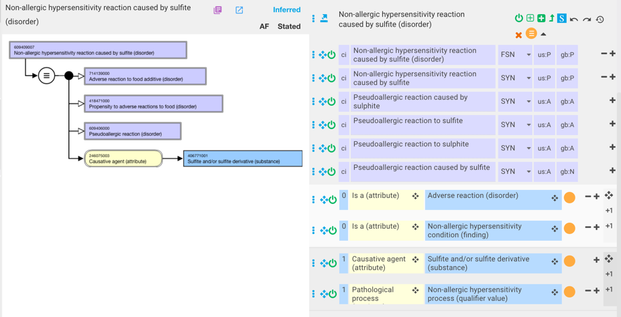
Model - 1

Slide 18
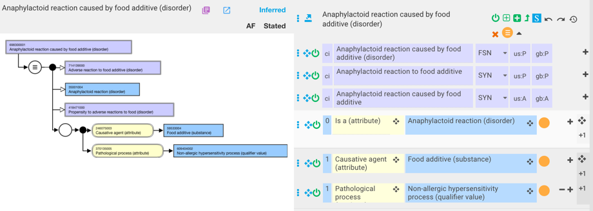
Model - 2

Slide 19
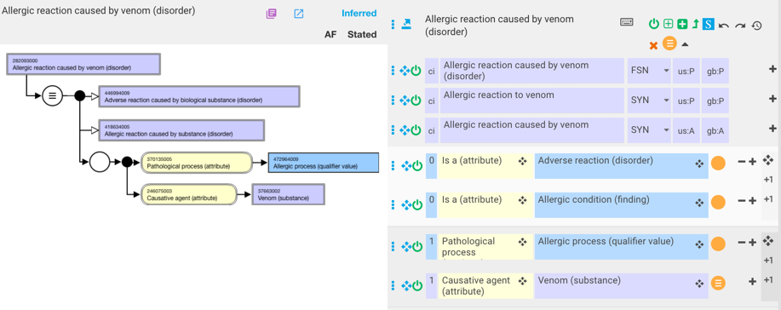
Model - 3

Slide 20
Modeling contact hypersensitivity

Slide 21
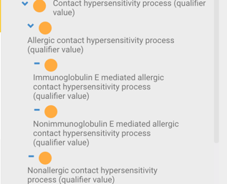
New pathological processes to support modeling of contact hypersensitivity

Slide 22
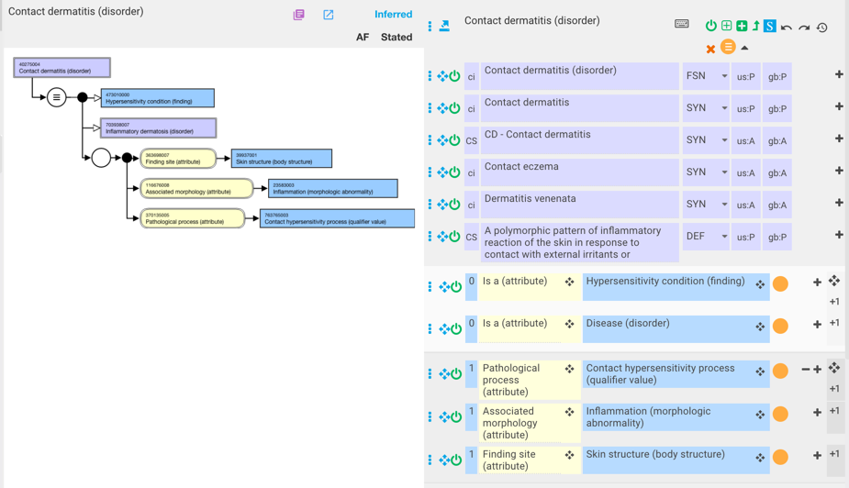
Contact dermatitis

Slide 23
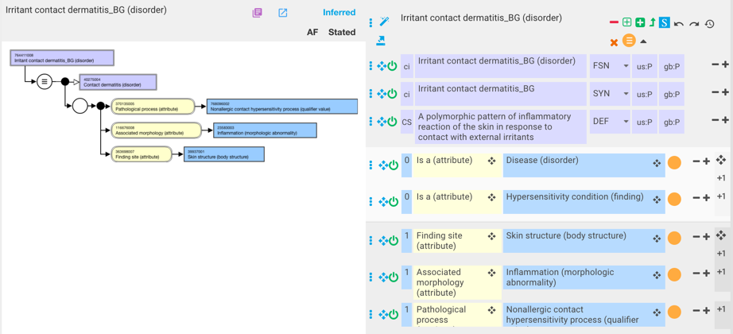
Irritant contact dermatitis

Slide 24
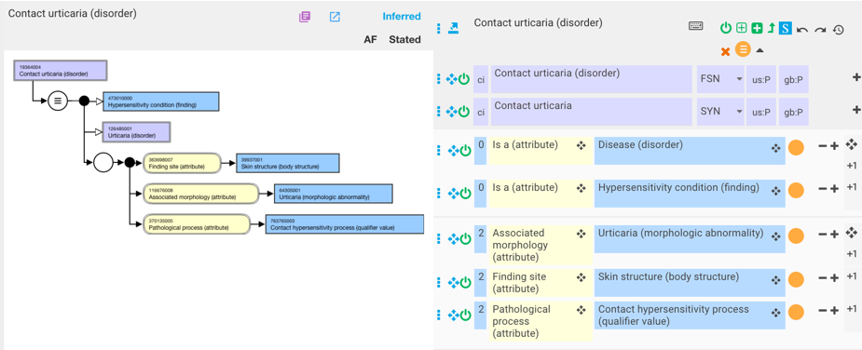
Contact urticaria

Slide 25
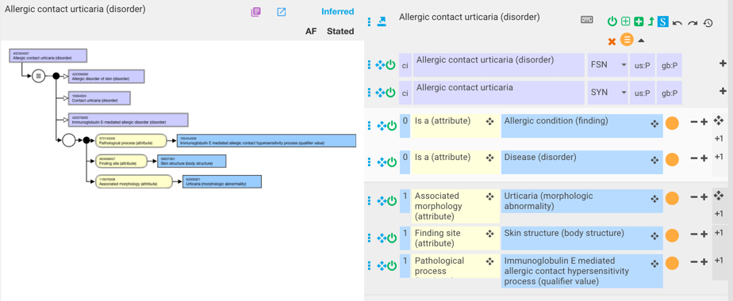
Allergic contact urticaria

