Slide 1
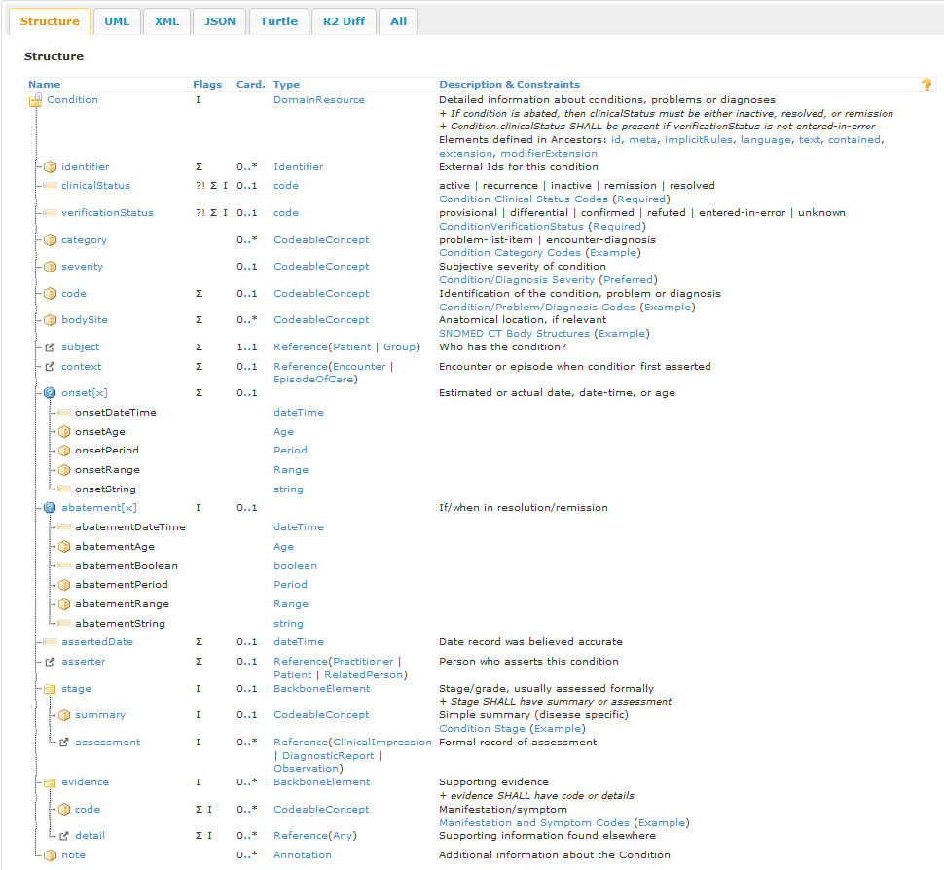
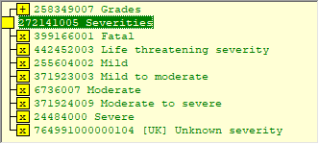
91011001 Active Ménière's disease
<<58184002 Recurrent disease
194351009 Inactive Ménière's disease
426071002 Hodgkin's disease in remission
<<370996005 Patient condition resolved
Including AADR and FH?
Risks?
<<442083009 Anatomical or acquired body structure
OR <<123037004 Body structure ??
Pacemaker vegetation?
“May include laterality”
Finding context Known present
Subject relationship context ??
Temporal context Current or past
<<80631005 Clinical stage finding
<<261612004 Stages
<<258349007 Grades
46909005 Cardiac murmur, intensity grade I/VI
13131000 Spondylolisthesis, grade 3
312092000 Tooth mobility - grade 2
391120009 MRC Breathlessness Scale: grade 1
Signs, symptoms, observables?

