Slide 1




Clinical Engagement Strategy
2016 - 2020
Shelley Lipon,
Customer Relations Executive Americas

Slide 2
Why clinical engagement ?
INTRODUCTION
“Clinicians are frequently the first to hear, see and identify patient conditions and findings that need documentation. Further, clinicians are in a unique position to see correlations between the items that need documentation. Being able to contribute to terms, definitions, and the valuable relationships available within SNOMED CT improves usability. Working with the entire design team for an EHR allows for better presentation, and proper representation that may significantly contribute to timeliness, efficiency, and, most important, improved care outcomes”.
Mark Jurkovitch, Chair, SNOMED International Dentistry Special Interest Group

Slide 3
Benefits of clinical engagement
INTRODUCTION
Informing direction of SNOMED International products and services
Improving quality, and thus clinical usability and acceptability, of SNOMED International products and services, based on clinical knowledge and expertise
Identification of clinical champions who support and endorse the implementation of SNOMED CT and related products and services
Promote collaboration between international healthcare professional groups that improve SNOMED International products and services

Slide 4
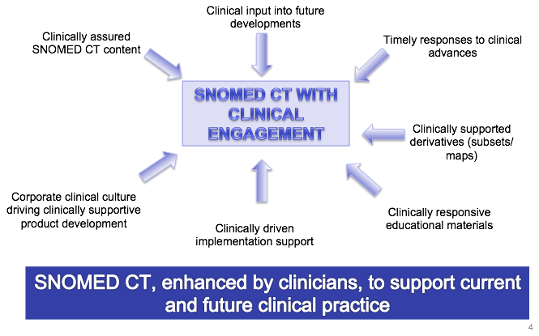
Clinical Engagement
INTRODUCTION

Slide 5
Format of the strategy
INTRODUCTION
Background
Vision for Clinical Engagement
Principles
Clinical engagement objectives
Implementation plans
  International
  Regional
    AsiaPAC
    EMEA
    Americas
Appendix
  Background information

Slide 6
SNOMED International strategic directions
INTRODUCTION
Demonstrate successful large scale implementations of SNOMED CT
Remove barriers to adoption for our customers and stakeholders
Enable continuous development of our product to meet customer requirements
Provide scalable products and services that drive SNOMED CT adoption
Set new trends and shape new technologies that increase the overall use of SNOMED CT

Slide 7
Who are our clinical stakeholders?
INTRODUCTION
Doctors
Allied Health Professionals
Clinical
Educators
Clinical Care Providers
Nurses
Clinical Colleges

Slide 8
Clinical Engagement – current state
INTRODUCTION
Healthcare Professions Coordination Group (HPCG)
Professional Special Interest Groups (SIG’s)
SNOMED International SNOMED CT Authoring team - experienced clinicians
Clinical collaborations e.g. ICN, WONCA, WASPaLM
Content development projects – clinicians as Subject Matter Experts
Clinical quality assurance of specific areas of SNOMED CT under review

Slide 9


Vision of Clinical Engagement
VISION
To ensure that all activities of the SNOMED International are influenced by global clinical communities
SNOMED International’s culture has a progressive and sustainable approach to engaging clinicians

Slide 10
Principles
PRINCIPLES
Raising the profile of clinical engagement within the organization
Consistency of approach across the regions of the world in terms of clinical engagement
Clinical engagement encompasses all healthcare professional groups globally
Consistent and timely communication with National Release Centers and all relevant stakeholders
Foster and encourage a culture of open engagement and discussion between clinicians
Continuous leverage of experience and shared learning across the regions
Assuring the quality and clinical relevance of SNOMED International products and services

Slide 11
Clinical engagement goals/objectives to support SNOMED International strategic direction
OBJECTIVES
  Raise the profile of SNOMED CT for clinicians locally/nationally/globally
Identify and support local/regional/national/global health care professional ambassadors/SMEs for SNOMED CT
Identify and gather use case examples from clinical and research perspectives to demonstrate benefits of using SNOMED CT
Increase the access to relevant SNOMED CT educational materials for healthcare professionals
Identify key clinical requirements/priorities/trends to inform SNOMED International products and services
  Demonstrate high value clinical decision support capabilities of SNOMED CT
  Identify clinically focused interoperability opportunities to enhance SNOMED CT

Slide 12
Work plan approach
IMPLEMENTATION PLANS
There will be an annual international work plan which will include global clinical engagement activities
Each region will develop and agree on an annual work plan based on a common framework and the agreed goals/objectives
All clinical engagement plans will deliver on the strategic direction for the SNOMED International and will be a collaborative effort with the CSRM team functions.
All clinical engagement activities within Member countries will be undertaken only following consultation with the relevant national authority
All clinical engagement activities will need to coordinate with relevant SNOMED International Lines of Business in order to ensure appropriate and timely delivery
Each clinical engagement lead will report on activities to ensure linkages and shared learning's are optimized

Slide 13
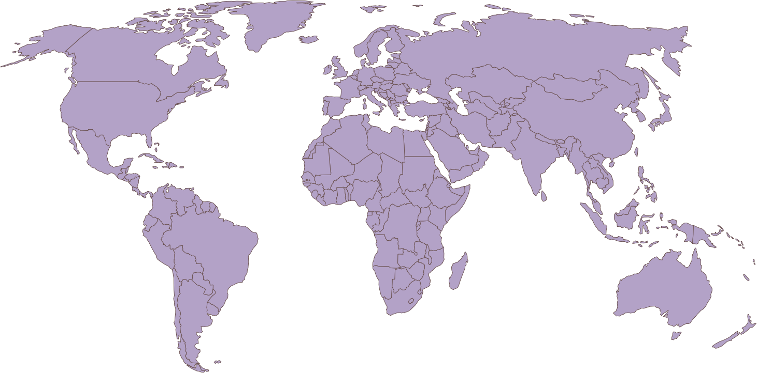
International work plan
IMPLEMENTATION PLANS

Slide 14
Work plan 2016-17(International)
IMPLEMENTATION PLANS
Strategic Objective | Deliverable | Mechanisms/Action Plans | Measures of Success
Raise the profile of SNOMED CT for clinicians locally/nationally/ globally | Clinical engagement web interface and forum, to provide information, documentation and educational materials Annual calendar identifying key opportunities for clinical engagement leads to promote SNOMED CT globally Provide documentation on subset development and maintenance Create and publish a document on “SNOMED CT and Precision Medicine” | Member countries will be consulted to agree engagement activities within their borders Gather requirements from clinicians/clinical groups globally on what information, documentation and educational materials are required to increase the implementation of SNOMED CT (Design, develop and implement a web interface based on requirements). Identify key areas of focus for the coming year and resulting opportunities for clinical engagement e.g. Genomics and “Big data” Publish subset development and maintenance guidance documentation Create initial list of available subsets by specialty Develop a document to support the genomics strategy, that targets clinicians and clinical groups on how SNOMED CT can support the developments in precision medicine | Number of clinicians accessing portal “SNOMED CT and Precision Medicine” published

Slide 15
Work plan 2016-17(International)
IMPLEMENTATION PLANS
Strategic Objective | Deliverable | Mechanisms/Action Plans | Measures of Success
Identify and support local/regional/national/ global health care professional ambassadors/subject matter experts for SNOMED CT | To develop an identified group of global clinician ambassadors/SMEs Develop a sustainable clinically focused community within SNOMED International Provide access to clinical validation resources for SNOMED CT content | Identification of global ambassadors /SMEs - through the delivery of clinical sessions by the clinical leads, and by supporting clinician interest in advanced functionality within SNOMED CT Develop a description of the role of professional ambassadors/SMEs Analyze and provide recommendations on future role and management of SIGs Develop a quality assurance process for clinicians/clinical groups, including standardization of feedback methodology, and leveraging of existing SNOMED International tooling (or identification of new requirements) Identify International clinical Groups e.g. CMSS (Council of Medical Specialty Societies) | List of clinician ambassadors/SMEs providing global coverage Number of clinicians involved with SNOMED International (baseline) Agreed documented approach for the future of SIG’s in the context of clinical engagement, following consultation with existing clinical groups and organization leads

Slide 16
Work plan 2016-17(International)
IMPLEMENTATION PLANS
Strategic Objective | Deliverable | Mechanisms/Action Plans | Measures of Success
Identify and gather use case examples from clinical and research perspectives to demonstrate benefits of using SNOMED CT | Standard template for clinical use cases Central list of documented use cases | Develop and agree standard template for recording clinical use cases Add requirement to web interface design to enable publication of use cases | Number of use cases documented and published
Increase the access to relevant SNOMED CT educational materials for healthcare professionals | Provision of a central source of educational materials Development and documentation of clinician focused education requirements | Education baseline assessment for clinicians – what we have in place, and what we are missing Delivery of documented clinical education requirements Develop new/revised clinically focused education materials/module based on stated requirements | Inventory of clinical educational materials available, and under development Publication of clinical educational materials available through a central point
Identify key clinical requirements/priorities/trends to inform SNOMED International products and services | Structured methodology for identifying clinical requirements/priorities/trends to inform SNOMED International products and services Roadmap for Genomics | Develop and agree methodology/template for gathering requirements/ priorities/ trends and developing subsets Develop strategy and roadmap for supporting genomics | Methodology developed and implemented Genomics strategy published Genomics roadmap developed

Slide 17
Work plan 2016-17(International)
IMPLEMENTATION PLANS
Strategic Objective | Deliverable | Mechanisms/Action Plans | Measures of Success
Demonstrate high value clinical decision support capabilities of SNOMED CT | Provision of a tool that demonstrates high value decision support and analytic capability for clinicians Plan for ongoing engagement with key high value users | Build/enhance tooling to demonstrate decision support and analytic capability Identify users of SNOMED CT that are interested, and capable of moving to a high value implementation Develop plan for long term engagement with high value users | Tool that is operational and accessible to demonstrate advanced decision support and analytic capabilities
Identify clinically focused interoperability opportunities to enhance SNOMED CT | Provide recommendations to Collaboration Lead on global collaboration opportunities Recommend potential future derivatives based on clinical feedback, in conjunction with discussion with vendors | Identification of interoperability/collaboration requirements through clinical contacts Document future potential derivatives for discussion with Collaboration lead, and Release team | Number of additional collaboration activities List of future potential derivatives, with justifications

Slide 18
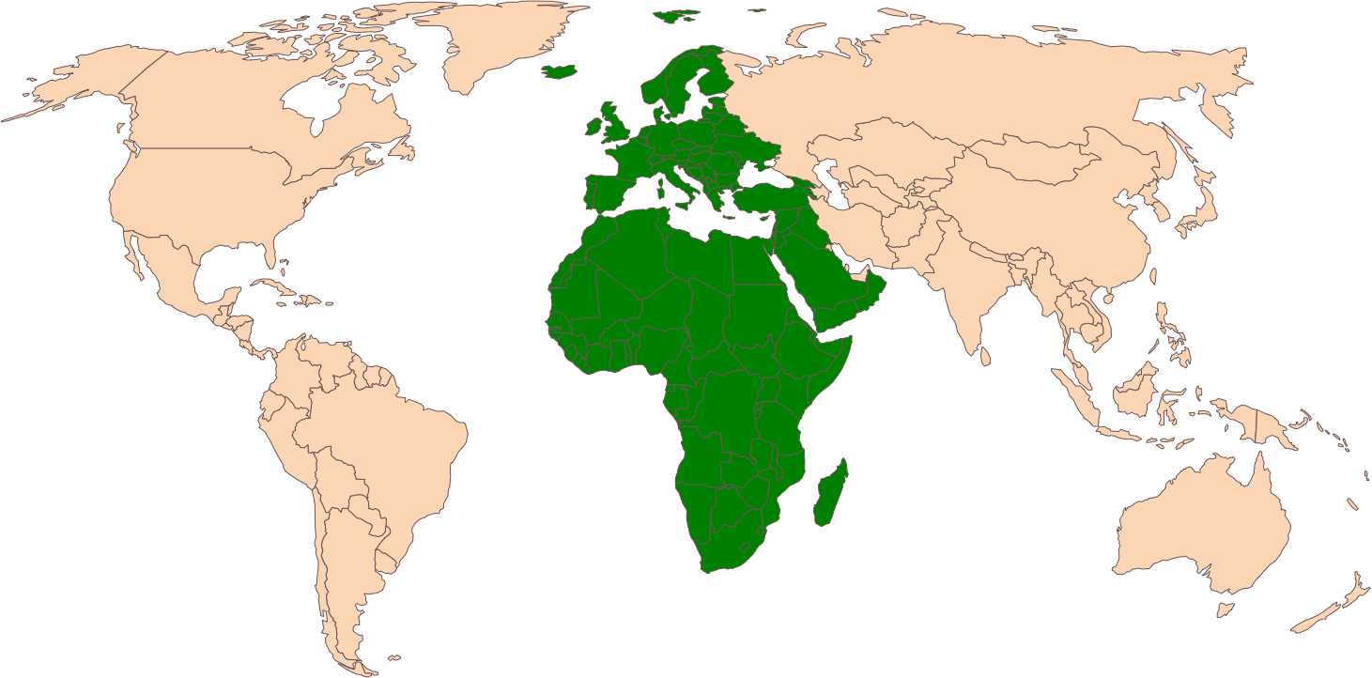
EMEA
IMPLEMENTATION PLANS

Slide 19
Work plan 2016-17(EMEA)
IMPLEMENTATION PLANS
Strategic Objective | Deliverable | Mechanisms/Action Plans | Measures of Success
Raise the profile of SNOMED CT for clinicians locally/nationally/ globally | Identified clinical areas for the region Engagement/work plan for each clinical area within EMEA | Member consultation Target primary care, pathology and physiotherapy to develop a solid base of SNOMED CT knowledge and commitment Within first six months, build connections with Royal College of GPs, Royal College of Pathology and Chartered Society of Physiotherapy Develop work plan with specific deliverables for each clinical area for 1, 2, 5 years | Assess delivery of work items against the stated deliverables in the work plan
Identify and support local/regional/national/ global health care professional ambassadors/SMEs for SNOMED CT | Identified group of local/national/regional healthcare professionals as ambassadors/SMEs for SNOMED CT | Document areas of clinical interest based on discussions with NRC’s within EMEA Identify ambassadors/SMEs by targeting specific areas of clinical interest, that are driving enquiry (e.g. dataset creation) | List of ambassadors/SMEs at local/national/regional levels

Slide 20
Work plan 2016-17(EMEA)
IMPLEMENTATION PLANS
Strategic Objective | Deliverable | Mechanisms/Action Plans | Measures of Success
Identify and gather use case examples/requirements from a clinical and research perspective to demonstrate benefits | Central list of documented use cases | Leverage links with General Practice, Pathology and Physiotherapy to support subset development Identify and document use case examples/ requirements Identify ways to to support the clinical and vendor uptake of subsets through the development of implementation guidance Gather vendor feedback on clinical issues (single or areas), based on use case requirements Use CE leads to target area through the identification of ambassadors to review use case/content, and develop solutions to the issues | Numbers of documented use cases Numbers of subsets taken by vendors for incorporation into live systems Numbers of subsets produced
Increase the access to relevant SNOMED CT educational materials for healthcare professionals | Central source of educational materials through clinician portal Develop clinician focused education material | Gather requirements at a regional level to feed into baseline assessment – what we have, and what we are missing | Inventory of educational materials available, and under development Agreed educational materials available via clinician portal

Slide 21
Work plan 2016-17(EMEA)
IMPLEMENTATION PLANS
Strategic Objective | Deliverable | Mechanisms/Action Plans | Measures of Success
Identify key clinical requirements/priorities/ trends to inform SNOMED International products and services | Identification of regional requirements/priorities/trends to inform SNOMED International product and service development | Documentation of regional requirements based on specified drivers Documentation and communication of identified content issues/errors | Incorporation of clinical requirements into SNOMED International Work Plan
Demonstrate high value clinical decision support capabilities of SNOMED CT | List of users interested in High Value implementation identified | Identify users of SNOMED CT that are interested and capable of moving to a High Value implementation | Number of potential High Value users identified
Identify clinically focused interoperability opportunities to enhance SNOMED CT | Recommendations to Collaboration Lead on global interoperability opportunities | Identification of interoperability requirements through clinical contacts | Number of additional collaboration activities

Slide 22
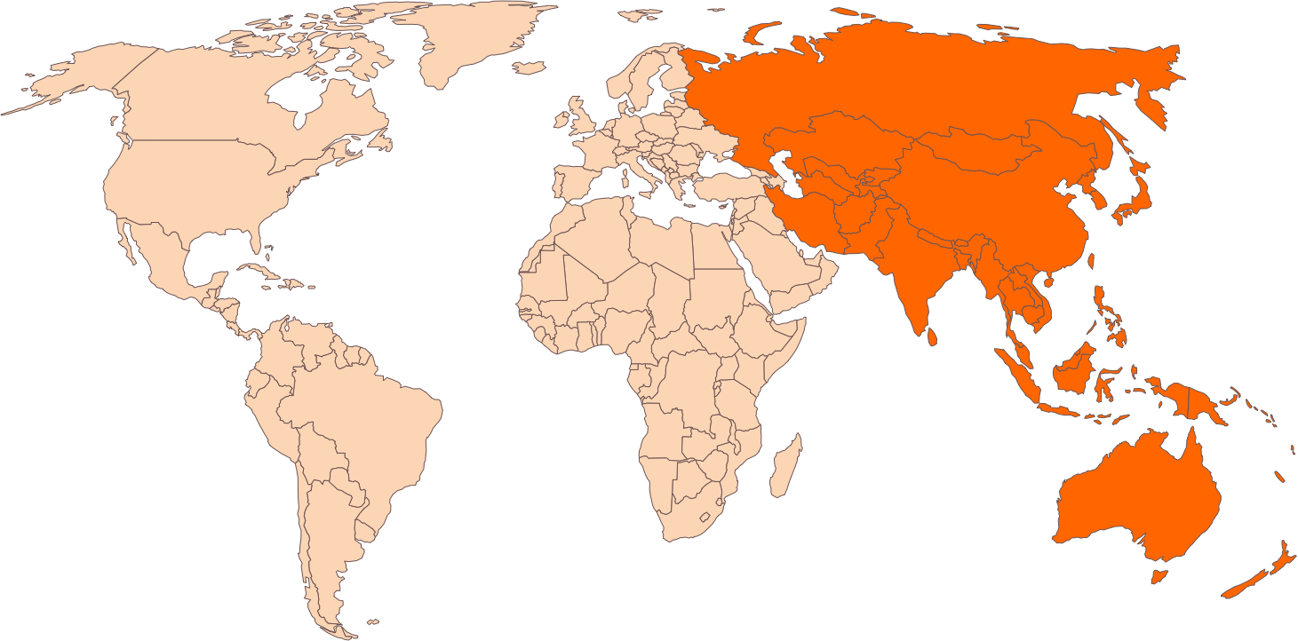
ASIA PAC
IMPLEMENTATION PLANS

Slide 23
Work plan 2016-17(ASIA PAC)
IMPLEMENTATION PLANS
Strategic Objective | Deliverable | Mechanisms/Action Plans | Measures of Success
Raise the profile of SNOMED CT for clinicians locally/nationally/ globally | Identified clinical areas for the region Engagement/work plan for each clinical area | Member consultation The 2-3 clinical areas to be target for ASIA PAC, will be General Practice, Surgical Logbook and Procedure recording and the requirements of Precision medicine Within first six months we will build connections with the colleges of General Practice, Medicine, Surgery and Interested parties for Precision Medicine Develop work plan with specific deliverable(s) for each clinical area for 1, 2, 5 years | Assess delivery of work items against the stated deliverables in the work plan
Identify and support local/regional/national/ global health care professional ambassadors/SMEs for SNOMED CT | Identified group of local/national/regional healthcare professionals as ambassadors/SMEs for SNOMED CT | Identify ambassadors/SMEs by targeting specific areas of clinical interest, that are driving enquiry (e.g. dataset creation), specifically targeting the development of cancer specialty subset development Use HIMSS level implementations to identify areas which may provide ambassadors | List of ambassadors/SMEs at local/national/regional levels

Slide 24
Work plan 2016-17(ASIA PAC)
IMPLEMENTATION PLANS
Strategic Objective | Deliverable | Mechanisms/Action Plans | Measures of Success
Identify and gather use case examples/requirements from a clinical and research perspective to demonstrate benefits | Central list of documented use cases | Identify a clinical group(s) associated with subset development – general practice, cancer subspecialties Identifying use case examples/ requirements Identify ways to roll out – subsets/implementation guidance Gather vendor feedback on clinical issues (single or areas), based on use case requirements Use CE leads to target area through the identification of ambassadors to review use case/content, and develop solutions to the issues | Numbers of documented use cases Numbers of subsets taken by vendors for incorporation into live systems Numbers of subsets produced
Increase the access to relevant SNOMED CT educational materials for healthcare professionals | Central source of educational materials through clinician portal Clinician focused education material/module | Gather requirements at a regional level to feed in to baseline assessment – what we have, and what we are missing | Inventory of educational materials available, and under development Agreed educational materials available via clinician portal

Slide 25
Work plan 2016-17(ASIA PAC)
IMPLEMENTATION PLANS
Strategic Objective | Deliverable | Mechanisms/Action Plans | Measures of Success
Identify key clinical requirements/priorities/ trends to inform SNOMED International products and services | Identification of regional requirements/priorities/trends to inform SNOMED International product and service development | Documentation of regional requirements based on specified drivers General practice Cancer subspecialties Documentation and communication of identified content issues/errors | Incorporation of clinical requirements into SNOMED International Work Plan
Demonstrate high value clinical decision support capabilities of SNOMED CT | List of users interested in High Value implementation identified | Identify users of SNOMED CT that are interested and capable of moving to a High Value implementation | Number of potential High Value users identified
Identify clinically focused interoperability opportunities to enhance SNOMED CT | Recommendations to Collaboration Lead on regional interoperability opportunities | Identification of interoperability requirements through clinical contacts | Number of additional collaboration activities

Slide 26
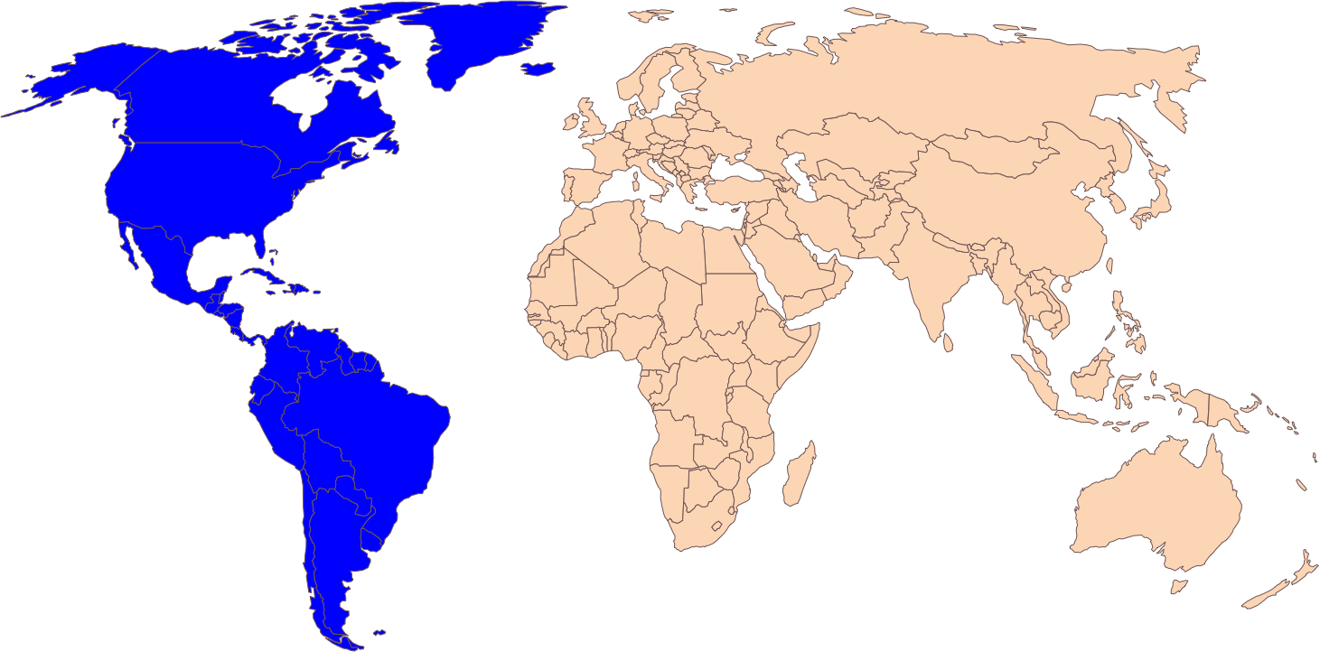
Americas
IMPLEMENTATION PLANS

Slide 27
Work plan 2016-17(Americas)
IMPLEMENTATION PLANS
Strategic Objective | Deliverable | Mechanisms/Action Plans | Measures of Success
Raise the profile of SNOMED CT for clinicians locally/nationally/ globally | Identified clinical areas for the region Engagement/work plan for each clinical area | Member consultation For each region identify,2-3 clinical areas that we would wish to target <specify clinical areas> Within first six months leverage experience within the US to refine the CE approach and develop documentation and presentations Define work plan – which will include a focus on other countries within the Americas in the 2nd half of the year Within work plan specify deliverable(s) for each clinical area for 1, 2, 5 years | Assess delivery of work items against the stated deliverables in the work plan
Identify and support local/regional/national/ global health care professional ambassadors/SMEs for SNOMED CT | Identified group of local/national/regional healthcare professionals as ambassadors/SMEs for SNOMED CT | Setting up calls and visits, to present subsumption approach and demonstrate (to locate cohorts) Identify committed individual clinicians to be ambassadors/SMEs | List of potential ambassadors/SMEs

Slide 28
Work plan 2016-17(Americas)
IMPLEMENTATION PLANS
Strategic Objective | Deliverable | Mechanisms/Action Plans | Measures of Success
Identify and gather use case examples from a clinical and research perspective to demonstrate benefits | Central list of documented Use Cases | Identify a clinical group(s) or large healthcare organizations, associated with subset development Gather description of use cases/frameworks Target national committees who have informatics/information groups in place Develop mechanism for vendor input into clinical subset development Identify groups with potential future interest/work in reimbursement space Identify groups with potential future interest/work in outcomes and quality measurement | Numbers of documented use cases Numbers of subsets taken by vendors for incorporation into live systems Number of subsets produced
Increase the access to relevant SNOMED CT educational materials for healthcare professionals | Central source of educational materials through clinician portal Clinician focused education material/module | Gather requirements at a regional level to feed into baseline assessment – what we have, and what we are missing | Inventory of educational materials available, and under development Agreed educational materials available via clinician portal

Slide 29
Work plan 2016-17(Americas)
IMPLEMENTATION PLANS
Strategic Objective | Deliverable | Mechanisms/Action Plans | Measures of Success
Identify key clinical requirements/priorities/ trends to inform SNOMED International products and services | Identification of regional requirements/priorities/trends to inform SNOMED International product and service development | Documentation of regional requirements based on specified drivers Documentation and communication of identified content issues/errors | Incorporation of clinical requirements into SNOMED International Work Plan
Demonstrate high value clinical decision support capabilities of SNOMED CT | List of users interested in High Value implementation identified Tool to demonstrate High Value implementation | Identify users of SNOMED CT that are interested and capable of moving to a High Value implementation Working with technical to develop subsumption tooling for demonstration (to locate cohorts) | Number of potential High Value users identified Tool is operational
Identify clinically focused interoperability opportunities to enhance SNOMED CT | Recommendations to Collaboration Lead on regional interoperability opportunities | Identification of interoperability requirements through clinical contacts | Number of additional collaboration activities

Slide 30
2017 Key Deliverables
IMPLEMENTATION PLANS
Agreed process for the management and governance of clinical SIG’s
Agreed process for eliciting, documenting and publishing clinical use cases
Design of clinical portal to allow clinicians access to use case documentation and clinically focused educational materials
Identification of relevant clinical subsets in consultation with clinical groups and the vendor community
Delivery of a directory of national/regional SNOMED CT ambassadors
Development of a tool to demonstrate SNOMED CT value
Roadmap for Genomics data

Slide 31
Appendix
BACKGROUND
The following is background information covering SNOMED International approach to Clinical Engagement prior to this strategy

Slide 32
Healthcare Professionals Coordination Group
BACKGROUND
Coordinating representatives from all Healthcare Professional SIGs to work with relevant leads within the SNOMED International
Providing clinical consideration to SNOMED International products and services
Ensuring a focus on International requirements
Facilitate multidisciplinary input and agreement
Oversight of a framework for engagement with all relevant international Healthcare professional Groups
  Membership – chairs and vice chairs of professional SIGs
  Chair – Member of the SNOMED International Management Board

Slide 33
Professional Special Interest Groups
BACKGROUND
Management Board
Healthcare Professionals Coordination Group
Nursing
International Family Practice / General Practice
Dental
Anaesthesia
International Pathology and Laboratory Medicine (IpaLM)
Pharmacy
in liaison with the International Council of Nurses (ICN)
In liaison with the World Organization of Family Doctors (WONCA)
In liaison with the American Dental Association (ADA)
In liaison with the World Association of Societies of Pathology and Laboratory Medicine (WASPaLM)

Slide 34
Clinical Special Interest Groups (SIG’s)
BACKGROUND
The professional Special Interest Groups engage practicing professionals in a given clinical domain, discipline or specialty
  International professional organizations
  National professional organizations
  Academics
  Individual professionals with an interest in health informatics
Key stakeholders in the SNOMED International content development process.
Contribute to ensuring that SNOMED CT is clinically relevant and up to date with practice
Practical implementation advice and guidance
SIG’s are advisory and provide a mechanism for clinicians to get involved as and when they can or topic is appropriate.
No fixed membership

Slide 35

International clinical collaborations
BACKGROUND
International Council of Nurses (ICN)
  ICNP/SNOMED CT linkage tables (diagnoses and interventions)
  Future subset development
American Dental Association (ADA)
  Content development to support alignment between SNOMED CT and SNODENT
  Future subset development – general dentistry subset
World Organization of Family Doctors (WONCA)
  Subset definition and delivery
  SNOMED CT – ICPC2 linkage table
World Association of Societies of Pathology and Laboratory Medicine (WAsPaLM)

