Slide 1
Mapping of Rare Diseases and Syndromes and the use of Orphanet
Mapping SIG Quality Assurance Topic, May & June 2015

Slide 2
Background to topic
The goal of the SNOMED CT to ICD-10 mapping process is to identify the meaning of a SNOMED CT concept, determine the best location of that concept in the ICD-10 semantic space as identified by one or more ICD-10 classification codes and to create a link between the concept and the classification codes.
Briefly, the mapping methodology employed for construction of a map involves:
Evaluation of the SNOMED CT concept Fully Specified Name and its defining relationships in order to understand the clinical meaning of the concept
Location of the best place for the concept in ICD-10
Identification of target code(s) ensuring adherence to ICD-10 rules and conventions

Slide 3
Background to topic…
Where possible mapping output should be accurate, consistent and reproducible.
Both the IHTSDO Mapping Service Team and the UKTC Classifications Mapping team have been working to establish sensible principles when mapping problem areas.
Mapping (and coding) of Rare Diseases and Syndromes has historically been problematical, to say the least!
Today we will be looking at just 7 concepts. Let’s see if we can, as a group, agree the maps, taking account of the clinical meaning in SNOMED CT and using the advice from Orphanet and the definitions from ICD-11.

Slide 4
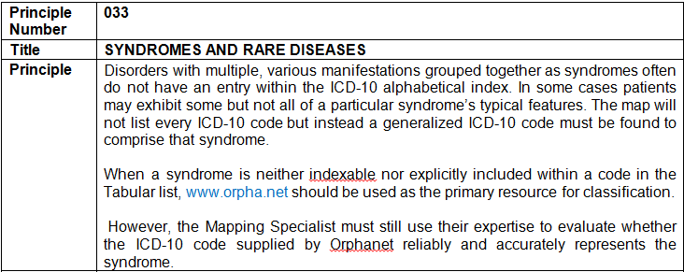
IHTSDO Mapping Principle

Slide 5
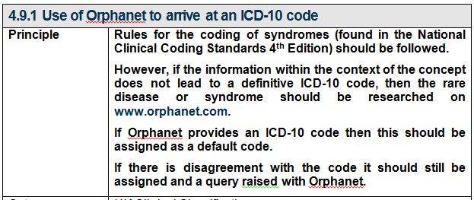
UK Mapping Principle for

Slide 6
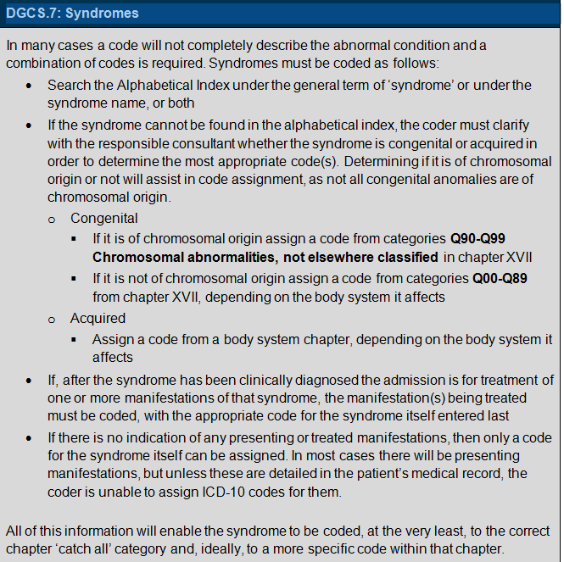
UK Standard for Coding Syndromes

Slide 7
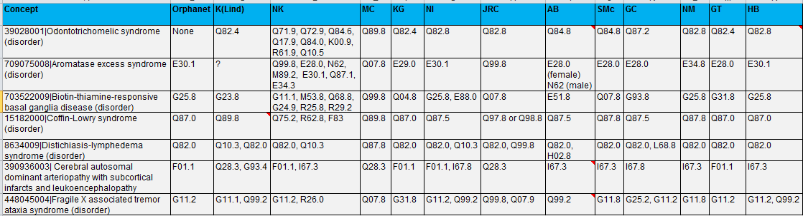
Collated Results of the mapping exercise

Slide 8
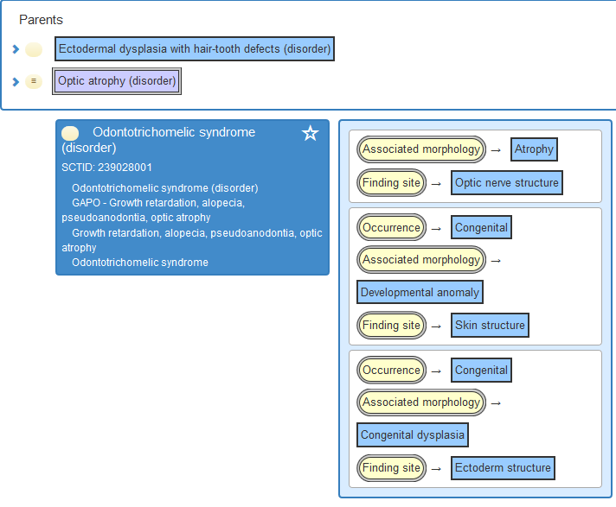
239028001|Odontotrichomelic syndrome

Slide 9
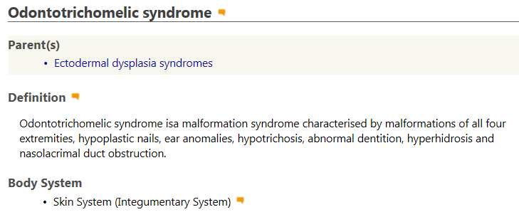
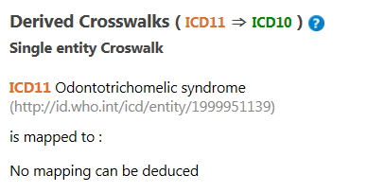
ICD-11

Slide 10

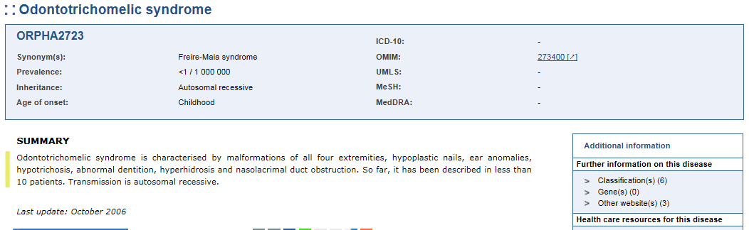
239028001|Odontotrichomelic syndrome
Groups suggested codes:

Slide 11
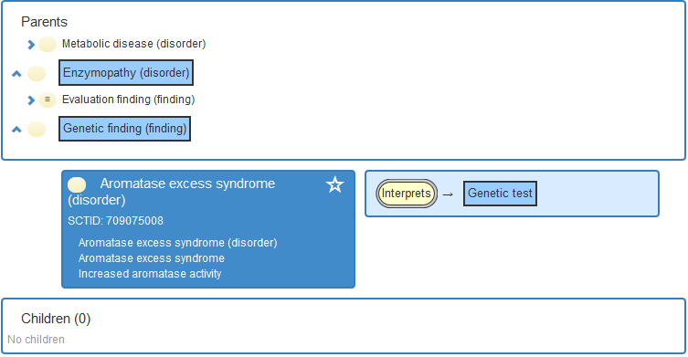
709075008|Aromatase excess syndrome

Slide 12
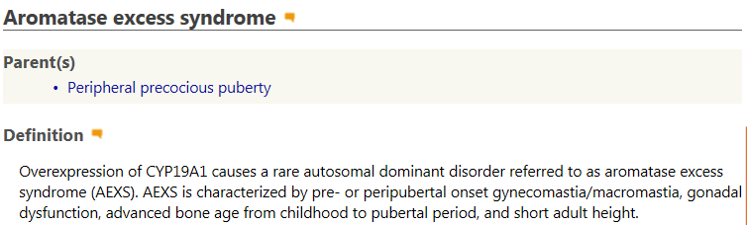
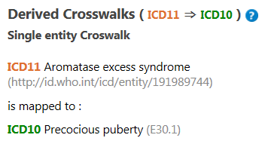
ICD-11

Slide 13
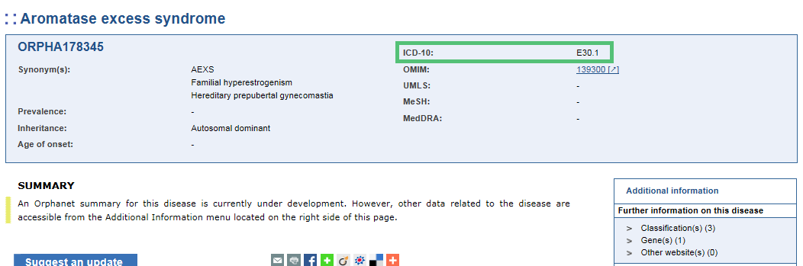
709075008|Aromatase excess syndrome
Groups suggested codes:

Slide 14
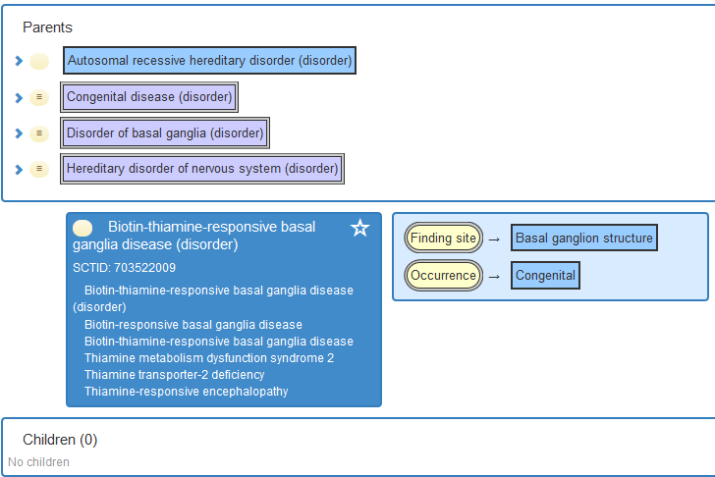
703522009|Biotin-thiamine-responsive basal ganglia disease

Slide 15
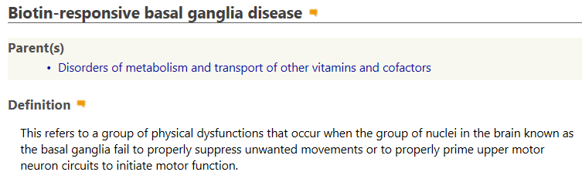
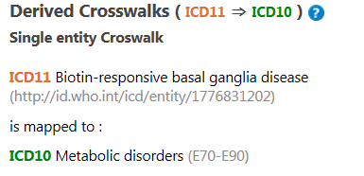
ICD-11

Slide 16
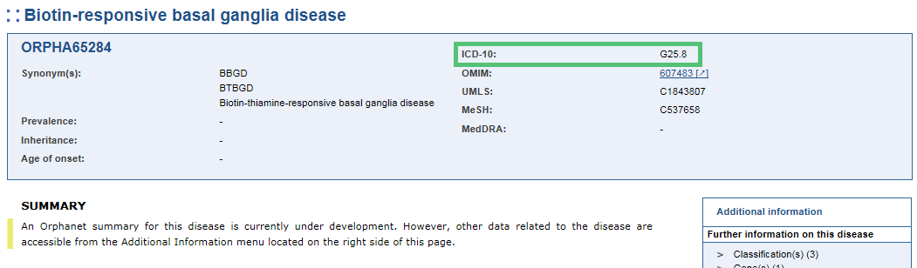
703522009|Biotin-thiamine-responsive basal ganglia disease
Groups suggested codes:

Slide 17
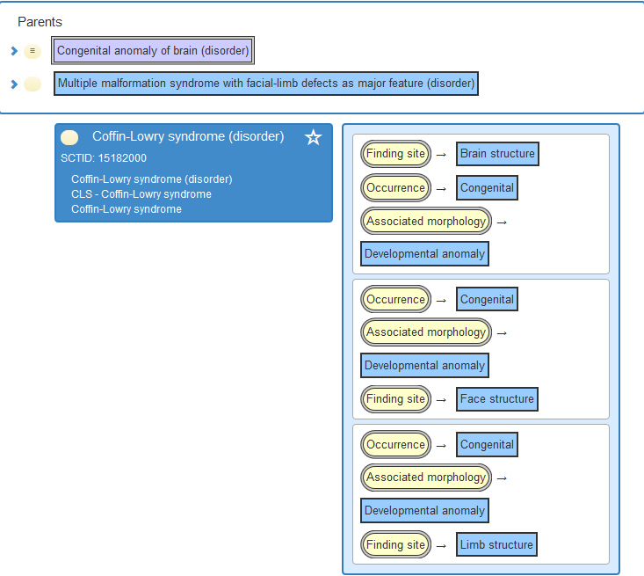
15182000|Coffin-Lowry syndrome

Slide 18
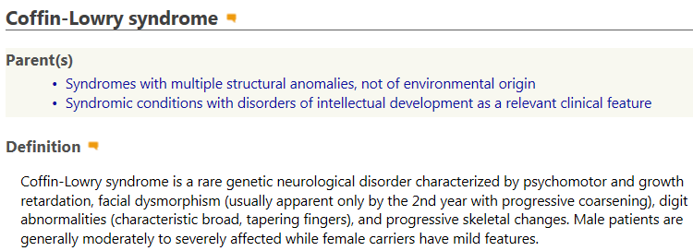
ICD-11

Slide 19
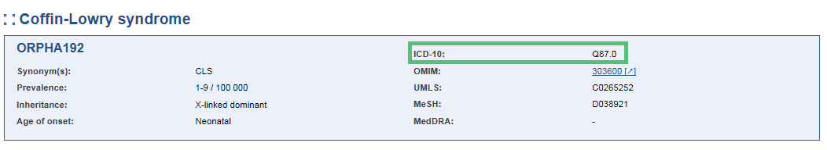
15182000|Coffin-Lowry syndrome
Groups suggested codes:

Slide 20
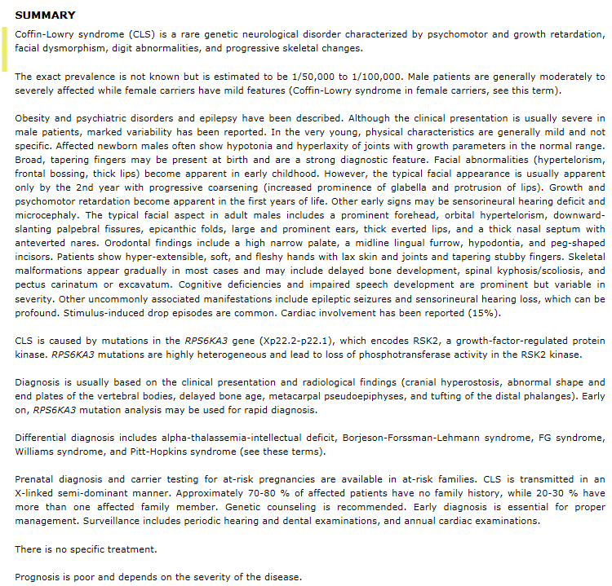
Orphanet summary:
15182000|Coffin-Lowry syndrome

Slide 21
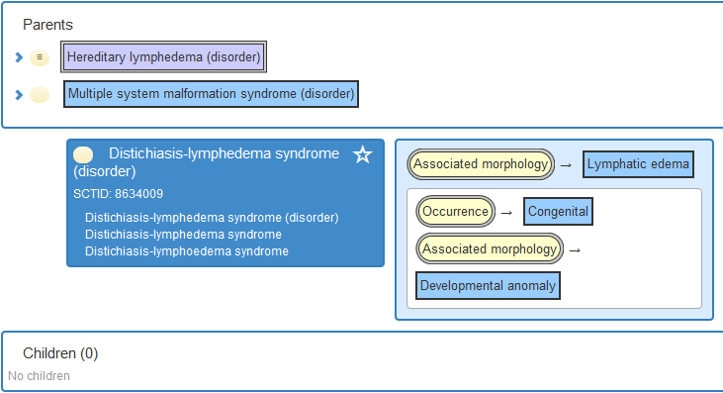
8634009|Distichiasis-lymphedema syndrome

Slide 22
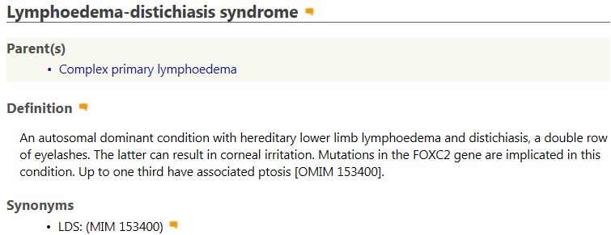
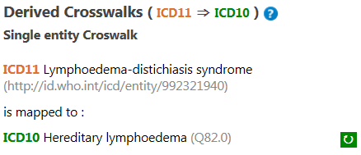
ICD-11

Slide 23
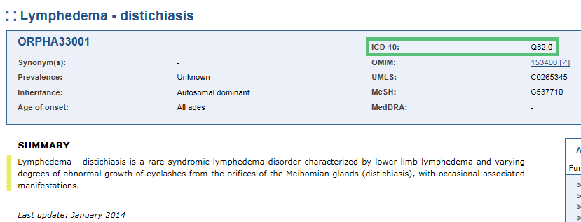
8634009|Distichiasis-lymphedema syndrome
Groups suggested codes are:

Slide 24
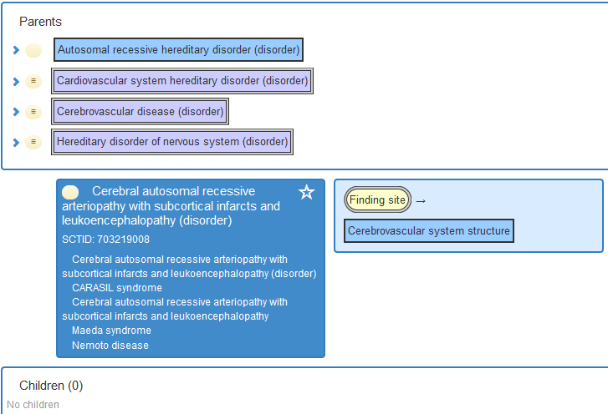
390936003|Cerebral autosomal dominant arteriopathy with subcortical infarcts and leukoencephalopathy

Slide 25
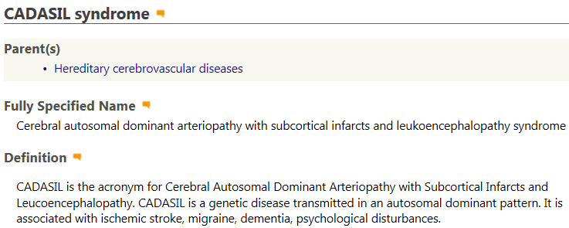
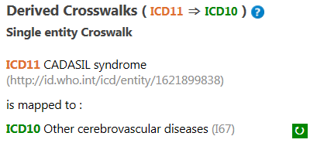
ICD-11

Slide 26
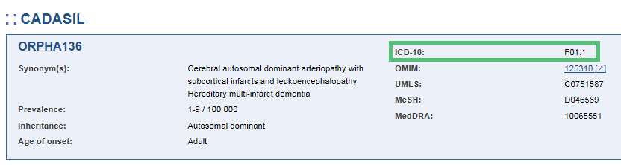
390936003|Cerebral autosomal dominant arteriopathy with subcortical infarcts and leukoencephalopathy
Groups suggested codes:

Slide 27
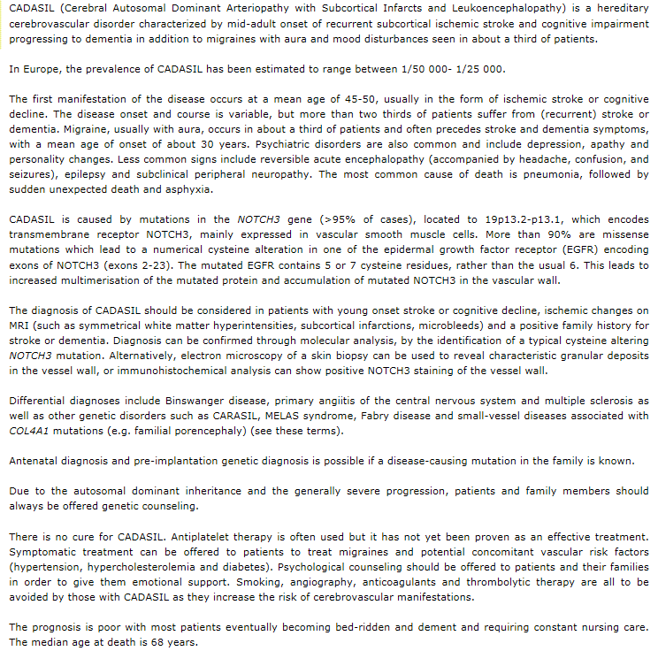
Orphanet summary:
Cerebral autosomal dominant arteriopathy with subcortical infarcts and leukoencephalopathy

Slide 28
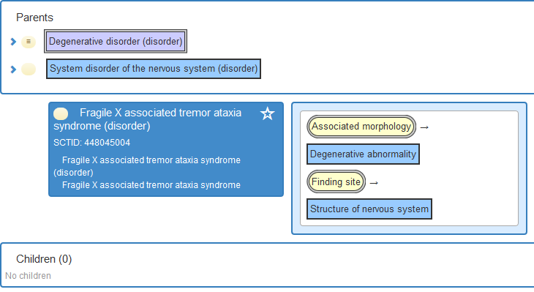
448045004|Fragile X associated tremor ataxia syndrome

Slide 29
ICD-10
Syndrome
- fragile X Q99.2

Slide 30
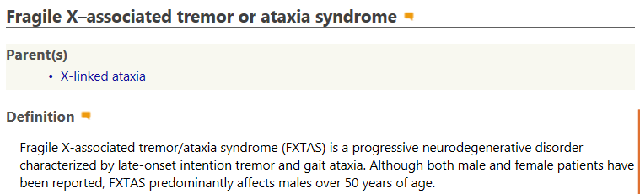
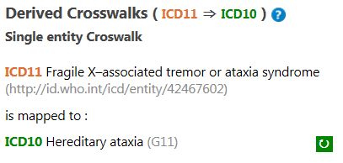
ICD-11

Slide 31
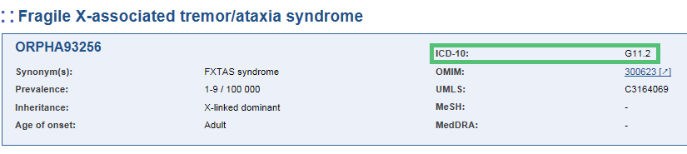
448045004|Fragile X associated tremor ataxia syndrome
Groups suggested codes:

Slide 32
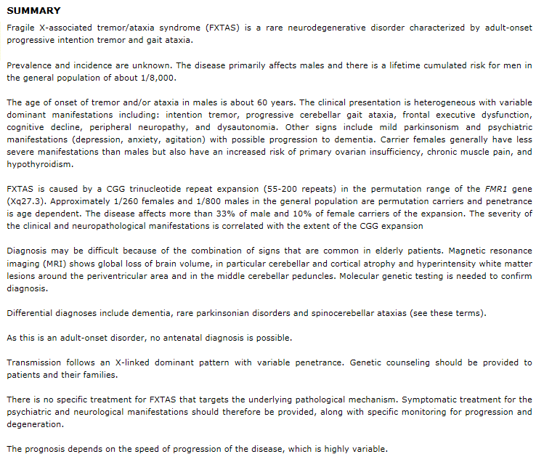
Orphanet summary:
448045004|Fragile X associated tremor ataxia syndrome

Slide 33
Conclusions

