Slide 1
Mapping SIG Conference Call
March 9, 2015
20:00 UTC
https://global.gotomeeting.com/join/137265341

Slide 2
Agenda
Welcome, apologies and conflicts of interest (HB)
Notes (Audio recording underway)
Review and agree agenda
  Meeting times from April (daylight saving)
Minutes and actions, Meeting time
Update on Allergy/ adverse sensitivity implementation guide (JRC/KWF)
Quality Assurance Topic (For April meeting)
  Mapping of Syndromes and Rare Disease – The Role of Orphanet
Mapping Service Team report (KL)
NRC Extension Maps report (NLM-KWF, CIHI-GT, UKTC-HB)

Slide 3
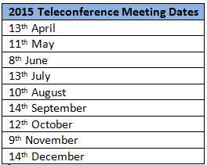
Upcoming Meetings
Next meeting:
11TH May 2015 19:00 UTC
IHTSDO Business Meeting April 26th-29th 2015 in Copenhagen – THERE WILL BE NO FACE-TO-FACE MEETING
IHTSDO Business Meeting & Showcase October 25th-30th 2015 in Uruguay

