Slide 1
Representation of Hypersensitivity and Allergy in SNOMED CT
Bruce J. Goldberg, MD, PhD

Slide 2
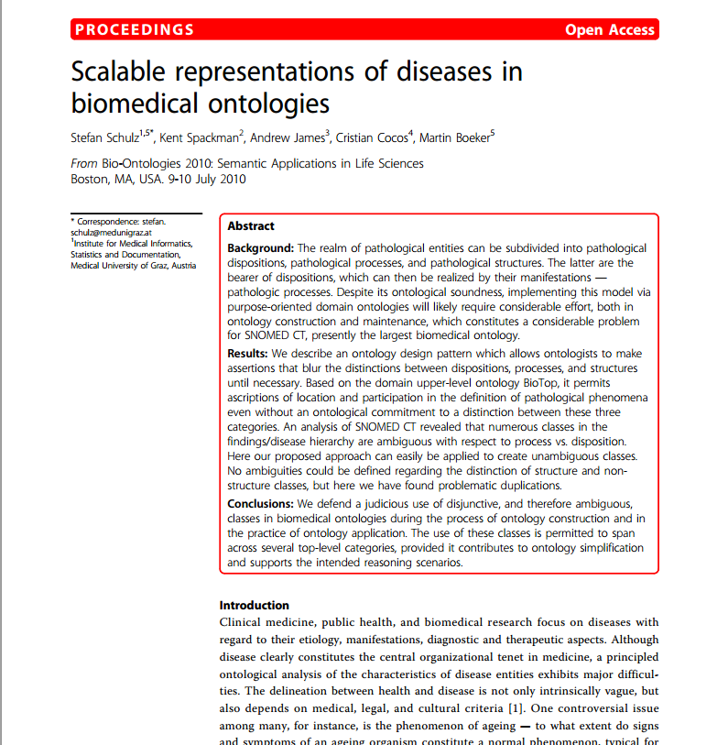
Hypersensitivity/allergy model
Hypersensitivity/allergy model is based on SDP (Structure, Disposition, Process) approach

Slide 3
Allergies represented by:
Dispositions (propensities):
  Allergy to x
Processes (reactions)
  Allergic reaction to x
Conditions (may be either propensities or reactions)
  Allergic rhinitis due to x

Slide 4
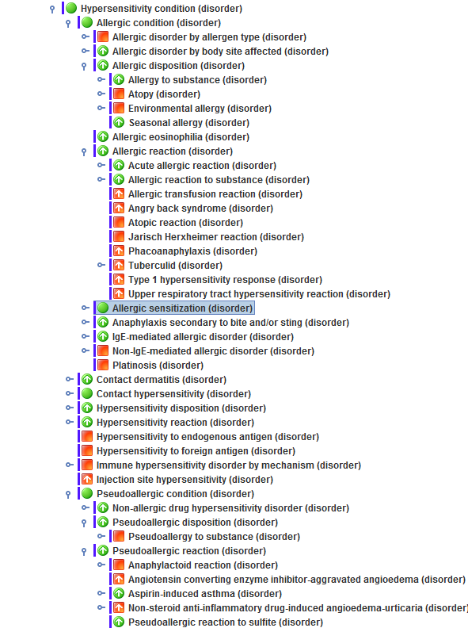
Overall organization of allergy content in SNOMED CT
Hypersensitivity condition
  Allergic condition
    Allergic disposition
    Allergic reaction
  Hypersensitivity disposition
  Hypersensitivity reaction
  Pseudoallergic condition
    Pseudoallergic disposition
    Pseudoallergic reaction

Slide 5
Hypersensitivity condition
Subsumes both allergic and pseudoallergic condition and thus can capture conditions that are either truly allergic, pseudoallergic or both¹
Important as cross reactivity related to structural classes for allergic conditions and to functional classes for pseudoallergic conditions
  Example Ibuprofen
¹As an additional measure, all pseudoallergy to x terms contain an additional description of allergy to x
Type of condition | Reacts to
Allergy | Only ibuprofen
Pseudoallergy | All NSAIDs

Slide 6
“Aspirational” model for representation of allergy in SNOMED CT

Slide 7
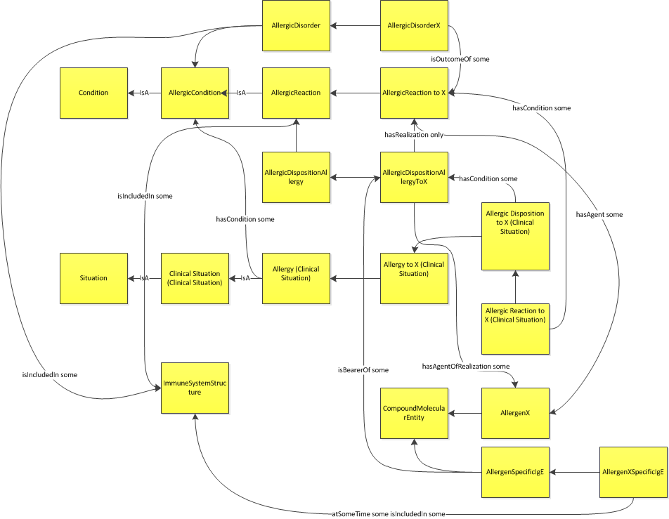
Revised “aspirational” model with clinical situation (patient life phase) interpretation

Slide 8
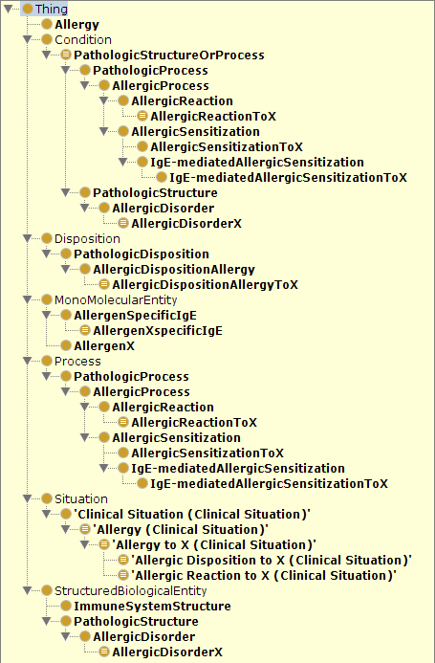
Aspirational (formal ontologic) model of Allergy

Slide 9
BioTop relations used in “aspirational” allergy model
BioTop Relation (object property) | Definition | Domains | Ranges
hasAgent | A participant of a process, with the additional condition that the component instance is causally active in the relevant process. | Processual entity
hasOutcome | participant which either - a) comes into being during the process or - b) undergoes some change during the process and constitutes (one of) the main result(s) of the process | Processual entity
outcomeOf | Inverse of hasOutcome |  | Processual entity
hasRealization | inverse of realizationOf | Disposition or Quality or Role | ProcessualEntity
realizationOf | Something that occurs can be the realization of a function, a disposition, or a role | Processual entity | Disposition or Quality or Role
hasLocus | relates a place with an entity which occurs, inheres, or is part of it | Disposition or ImmaterialNonphysicalEntity or ImmaterialPhysicalEntity or MaterialEntity or ProcessualEntity or Quality or Role or SpatialRegion | ImmaterialPhysicalEntity or MaterialEntity or SpatialRegion
bearerOf | Inverse relation of inheresIn. Relates an independent continuant to a dependent one (e.g. quality, state, function, or disposition) | ImmaterialPhysicalEntity or MaterialEntity or SpatialRegion | Disposition or Function or ImmaterialNonphysicalEntity or Quality or Role

Slide 10
Changes to original model - Stefan
  new btl2 (BioTopLite) namings of some relations
  for all classes distinguished between “general” and “related to Allergen X”
  added situation concepts

Slide 11
Changes to original model – details I
hasLocus: in btl2 „is included in“ (renamed for better understandability)
Allergen-specific IGE: is not always included in an immune system structure, because it can be isolated from it: therefore, btl2 compatible:
'at some time' some ('is included in' some ImmuneSystemStructure)
Allergen-specific IgE is related to “X”, therefore introduction of subclass
AllergenXspecific IGE
Allergic reaction and Allergic disorder:
If you mean that for every Allergic reaction there is some Allergic Disorder as an outcome and vice versa, then there should be used the quantifier “some”

Slide 12
Changes to original model – details II
Allergic reaction / allergic sensitization:
Subclasses introduced: Allergic reaction to X / allergic sensitization to X
(in order to distinguish the general classes from the specific ones)
Sensitization:
has outcome “some”
(not “only”) – because there is always some IgE as outcome (and I would not exclude that there is any other outcome)
Allergic dispositionAllergyToX:
I added the definitional condition “AllergicDispositionAllergy and 'has realization' only AllergicReactionToX”
This cannot be expressed by the current SNOMED CT syntax, which explains the additional relation with “hasAgentOfRealization”

Slide 13
Features of current implemented model for allergic conditions in SNOMED CT
Top level terms fully defined by means of pathological process role using the following role values
    Hypersensitivity process (qualifier value)
      Allergic process (qualifier value)
        Allergic sensitization process(qualifier value)
      Pseudoallergic process (qualifier value)

Slide 14
Features of currently implemented model for allergic conditions in SNOMED CT II
Novel approach taken to linking a causative agent to the allergy disposition for purposes of data retrieval
  Causative agents cause the realization of the disposition (the allergic reaction process) and not the disposition itself (the allergic disposition)
  Causative agent linked to the process of allergic sensitization which necessarily precedes an allergic disposition by use of the following role group:
    Group {|after|=|allergic sensitization|
    |causative agent|=|x substance|

Slide 15
Definitions-Hypersensitivity
Term | Current definition
Hypersensitivity condition | The disposition to develop an allergic or pseudoallergic reaction, the reaction itself or its consequences.
Hypersensitivity disposition | The disposition to develop an allergic or pseudoallergic reaction
Hypersensitivity reaction | A pathological process initiated by exposure to a defined stimulus at a dose tolerated by normal persons. It is the realization of the disposition to hypersensitivity.

Slide 16
Definitions-Allergy
Term | Current definition
Allergic condition | The disposition to develop an allergic reaction, the allergic reaction itself or its consequences
Allergic disposition | The disposition to develop an allergic reaction
 | A pathological immune process generally directed towards a foreign antigen, which results in tissue injury, which is usually transient. It is the realization of the allergic disposition. It is most often applied to type I hypersensitivity but other hypersensitivity types especially type IV (e.g. allergic contact dermatitis) may be involved

Slide 17
Definitions-Allergic sensitization
Term | Current definition
Allergic sensitization | A process characterized by a humoral or cell-mediated immune response to a foreign antigen resulting in the production of specific antibodies and/or immune cells which may then lead to an allergic disposition.

Slide 18
Definitions-Pseudoallergy
Term | Current definition
Pseudoallergic condition | The disposition to develop a pseudoallergic reaction, the pseudoallergic reaction itself or its consequences
Pseudoallergic disposition | The disposition to develop a pseudoallergic reaction
Pseudoallergic reaction | A pathological nonimmune process generally directed towards a foreign substance, which results in tissue injury, which is usually transient. It is the realization of the pseudoallergic disposition. A variety of mechanisms such as direct histamine release, complement activation, cyclooxygenase activation and bradykinin generation may be involved

Slide 19
Agents that can act as allergens or pseudoallergens
There are some substances that may be able to elicit allergic as well as pseudoallergic reactions
Examples Include NSAIDs, protamine and perhaps radiocontrast agents and opiates

Slide 20
NSAID hypersensitivity I
A classification scheme for NSAID hypersensitivity taking into account allergy and pseudoallergy has been developed
NSAID pseudo allergy
  Type 1: NSAID-induced asthma and rhinosinusitis
  Type 2: NSAID-induced urticaria/angioedema in patients with chronic urticaria
  Type 3: NSAID-induced urticaria/angioedema in otherwise asymptomatic individuals
  - Type 4: Blended reactions in otherwise asymptomatic individuals
NSAID allergy
  Type 5: Urticaria/angioedema to a single NSAID - urticaria and/or angioedema within minutes to one hour of taking a particular NSAID or ASA. These patients generally do not have underlying chronic urticaria.
  Type 6: Anaphylaxis to a single NSAID (not ASA) Type 6 reactions are distinguished from type 5 reactions based only upon severity. Typical symptoms of anaphylaxis include shortness of breath/wheezing due to bronchospasm or laryngeal edema and hypotension due to vascular collapse.

Slide 21
Review of allergy use cases I
    Use case 1
      Representation of Allergy to X i.e the disposition to developing an allergic reaction after exposure to allergen X
      Fit with IHTSDO strategy
        1B Problem list diagnosis
        1D Allergy list
        2A Medication / allergy management
    Use case 2
      Representation of specific allergic/immunologic disorders such as allergic rhinits
      Fit with IHTSDO strategy
        1B Problem list Diagnosis
          There are 29 diagnoses on the SNOMED CT core problem list that refer to allergy, anaphylaxis or hypersensitivity. Allergic rhinitis is the top 11th diagnosis.
        2A Medication / allergy management
        Relevant for decision support algorithms involving medication management in allergic individuals. An example would be an alert regarding use of radiocontrast agents in those with a history of an atopic disorder.

Slide 22
Review of allergy use cases II
    Use case 3
      Representation of specific allergic disorders caused by allergen X e.g. Allergic rhinitis due to pollen
      Fit with IHTSDO strategy
        1B Problem list diagnosis
        1D Allergy list
        2A Medication / allergy management
    Use Case 4
      Representation of Non-specified allergic reactions to allergen X such as allergic reaction to penicillin
      Fit with IHTSDO strategy
        1B Problem list diagnosis
        There is a need to distinguish an episode of an allergic reaction to a particular substance occurring at the time of an encounter from a disposition to an allergic reaction to a particular substance

Slide 23
Review of allergy use cases III
    Use Case 5
      Representation of specific types of allergic reactions to allergen x such as anaphylactic reaction to penicillin
      Fit with IHTSDO strategy
        1B Problem list diagnosis

Slide 24
Allergic disposition vs. History of allergy
History of x allergy may be interpreted as an allergy that has resolved or is in remission but more likely as allergy to x (the disposition) which is not currently manifest due to lack of exposure to the relevant allergen
For this reason all history of x allergy concepts in SNOMED CT have been retired for the Jan. 2015 release pointing to the corresponding allergy to x term
For those rare cases in which an allergy has resolved such as childhood egg, milk or peanut allergy, the documentation of allergy can just be removed from the record.
The clinical requirement for documenting an allergy that is no longer present is unclear as it may lead to unnecessary avoidance.
Patient reported histories of drug allergies are often innacurate¹
¹ Health care use and serious infection prevalence associated with penicillin “allergy” in hospitalized patients: A cohort study, Macy, Eric et al. Journal of Allergy and Clinical Immunology , Volume 133 , Issue 3 , 790 - 796

Slide 25

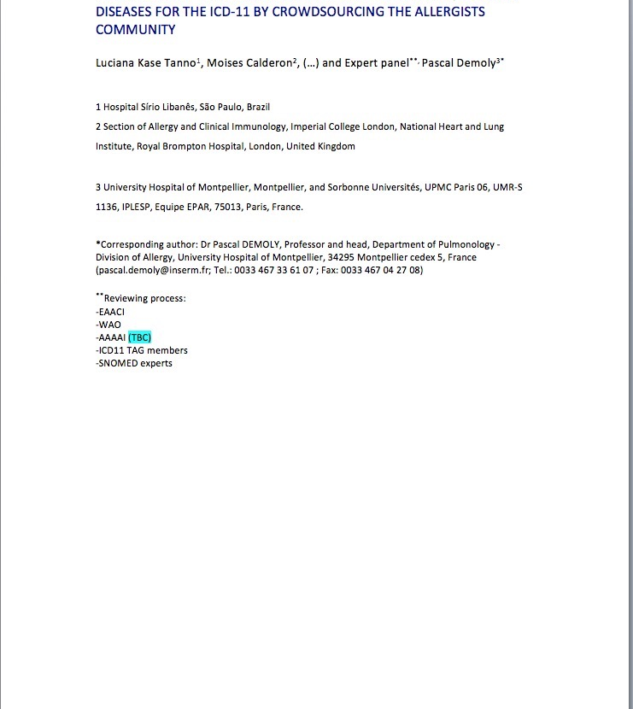
Allergy representation in ICD-11

