Slide 1
Draft Observables Ontology model for laboratory and related domains

Slide 2
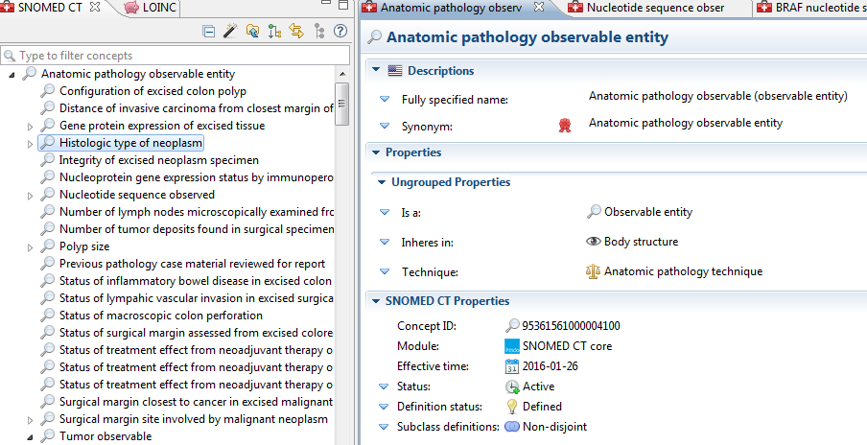
Observables ontology for anatomic pathology

Slide 3
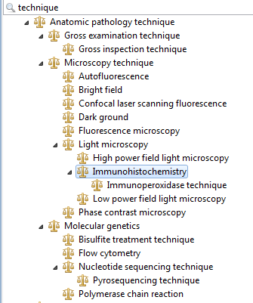
Technique build for Anatomic pathology ontology

Slide 4
Use cases for Laboratory Medicine
Observables Ontology
In the SAGE decision support development, after clinical findings and medications, the most frequent use case for aggregation queries was laboratory tests.
Use cases have come up repetitively in our configuration of data research networks for identifying test results across various lab methods:
Find all measurements of glycosylated hemoglobin
Has this patient had a low density lipoprotein measurement in the last six months?
Has the patient had a hemoglobin in the last 24 hours?
Since Method is an optional attribute in the LOINC model, it is frequently omitted from the technology preview

Slide 5
Agreed flattened quality observable model template for trial use
4548-4 Hemoglobin A1C/Hemoglobin:Mcnc:Pt:Bld:Qn
Observable entity
704318007|Property type|
118542001|Mass fraction|
<
704319004|Inheres in|
87612001|Blood(substance)|
704320005 |Towards|
259690008|glycosylated hemoglobin c-fraction|
704325000|Relative to|
38082009|Hemoglobin(substance)|
370134009 |Time aspect|
123029007|Single point in time|
370132008 |Scale type|
119297000|Quantitative|
704327008 |Direct site|
119297000|Blood specimen|
4548-4 | Hemoglobin A1c/Hemoglobin.total:MFr:Pt:Bld:Qn
17855-8 | Hemoglobin A1c/Hemoglobin.total:MFr:Pt:Bld:Qn:Calculated
4549-2 | Hemoglobin A1c/Hemoglobin.total:MFr:Pt:Bld:Qn:Electrophoresis
17856-6 | Hemoglobin A1c/Hemoglobin.total:MFr:Pt:Bld:Qn:HPLC
Notes:
Cream attributes are defining; brown are non-defining qualifiers

Slide 6
Agreed flattened quality observable model template for trial use
2089-1 | Cholesterol.in LDL:MCnc:Pt:Ser/Plas:Qn
Observable entity
704318007|Property type|
|Mass concentration|
<
704319004|Inheres in|
Plasma
704320005 |Towards|
Low density lipoprotein cholesterol
704325000|Relative to|
38082009|Hemoglobin(substance)|
370134009 |Time aspect|
123029007|Single point in time|
370132008 |Scale type|
119297000|Quantitative|
704327008 |Direct site|
Acellular blood specimen
2089-1 | Cholesterol.in LDL:MCnc:Pt:Ser/Plas:Qn
13457-7 | Cholesterol.in LDL:MCnc:Pt:Ser/Plas:Qn:Calculated
18262-6 | Cholesterol.in LDL:MCnc:Pt:Ser/Plas:Qn:Direct assay
49132-4 | Cholesterol.in LDL:MCnc:Pt:Ser/Plas:Qn:Electrophoresis
Notes:
Cream attributes are defining; brown are non-defining qualifiers

Slide 7
Proposed 272394005|Technique| hierarchy build
Technique
  Laboratory technique
    Chemistry technique
      Direct assay
      Electrophoretic technique
      Chromatography technique
        High performance liquid chromatography technique
  Hematology observable
  Microbiology observable
  Anatomic pathology observable
  Molecular pathology observable

Slide 8
Issues for discussion
Impact of assigning ‘default’ techniques for ‘methodless’ observables in order to define groupers of use in understanding the organization of observables and guiding aggregate queries for common clinical questions
Impact of deploying the observables as fully defined

Slide 9
Agreed flattened quality observable model template for trial use
49535-8 | Influenza virus B RNA:ACnc:Pt:Isolate:Ord:Probe.amp.tar
Observable entity
704318007|Property type|
Arbitrary concentration|
<
704319004|Inheres in|
Microbial isolate
704320005 |Towards|
RNA of Influenza virus B(substance)
Technique
Probe with target amplification
370134009 |Time aspect|
123029007|Single point in time|
370132008 |Scale type|
Ordinal value
704327008 |Direct site|
Microbial isolated specimen
Notes:
Cream attributes are defining; brown are non-defining qualifiers

Slide 10
Agreed flattened quality observable model template for trial use
54241-5 | Influenza virus B Ag:ACnc:Pt:Isolate:Ord
Observable entity
704318007|Property type|
Arbitrary concentration|
<
704319004|Inheres in|
Microbial isolate
704320005 |Towards|
Influenza virus B antigen(substance)
Technique
---
370134009 |Time aspect|
123029007|Single point in time|
370132008 |Scale type|
Ordinal value
704327008 |Direct site|
Microbial isolated specimen
Notes:
Cream attributes are defining; brown are non-defining qualifiers

