Slide 1
ICN-IHTSDO collaboration: building on success
Nick Hardiker, RN PhD FACMI
Director
ICN eHealth Programme

Slide 2
ICN and IHTSDO team up to ensure a common health terminology
    Geneva, Switzerland & Copenhagen, Denmark,
    March 17, 2010
  The International Council of Nurses (ICN) and the International Healthcare Terminology Standards Development Organisation (IHTSDO) today announced a collaborative agreement to advance terminology harmonization and foster interoperability in health information systems

Slide 3
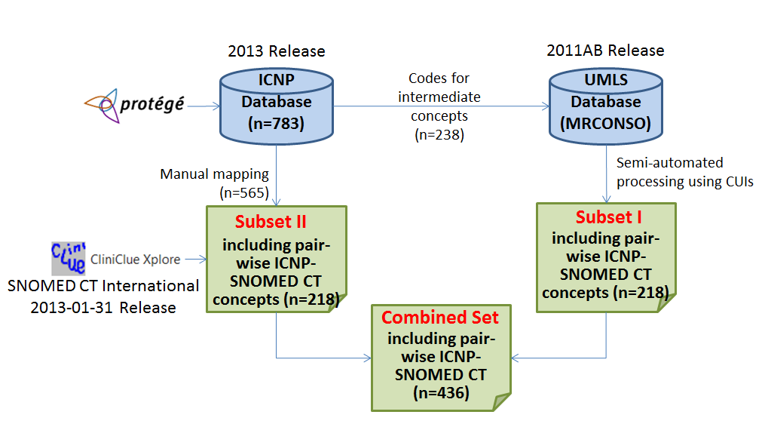

Slide 4
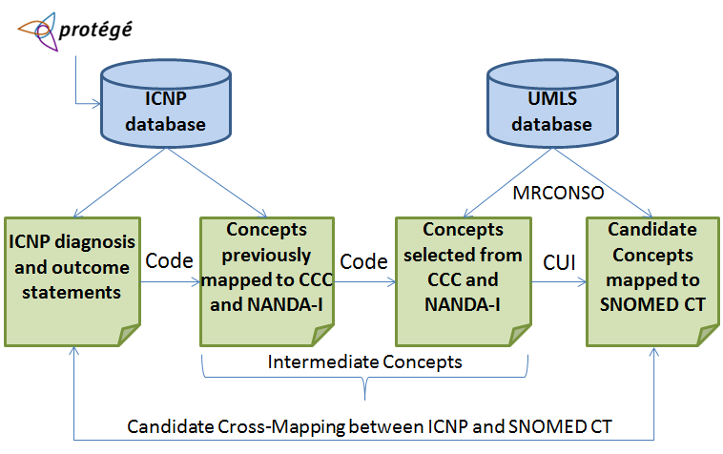

Slide 5
ICN and IHTSDO partner to provide a new Informatics Resource for nurses
    Geneva, Switzerland & Copenhagen, Denmark,
    20 January 2014
  The International Council of Nurses (ICN) and the International Health Terminology Standards Development Organisation (IHTSDO) are pleased to announce an equivalency table between the International Classification for Nursing Practice (ICNP) concepts and SNOMED CT concepts

Slide 6
ICN and IHTSDO extend collaboration to advance harmonisation of health terminology
    Geneva, Switzerland & Copenhagen, Denmark
    1 September 2014
  The International Council of Nurses (ICN) and the International Health Terminology Standards Development Organisation (IHTSDO) today announced an updated collaboration agreement to advance terminology harmonisation and foster interoperability in health information systems

Slide 7
Nursing diagnoses
Joint publication of a completed equivalence table between SNOMED CT and ICNP for Nursing Diagnoses (projected May 2015)
  Building on existing equivalence table
  Covering all in scope content in ICNP
  Including additions to SNOMED CT
  Full quality assurance – technically and content by both organizations
  In line with latest versions of SNOMED CT and ICNP
  Leading to a potential SNOMED CT Nursing subset

Slide 8
Nursing interventions
Joint publication of a completed equivalence table between SNOMED CT and ICNP for Nursing Interventions (projected February 2016)

Slide 9
ICN and IHTSDO deliver collaborative product
    Geneva, Switzerland & Copenhagen, Denmark
    4 September 2015
  The International Council of Nurses (ICN) and the International Health Terminology Standards Development Organisation (IHTSDO) are pleased to announce the delivery of an equivalency table between the Interantional Classification for Nursing Practice (ICNP) and SNOMED CT

Slide 10
Results to date
Joint release of an equivalency table for nursing problems
  Covers 526 ICNP diagnoses (65%)
  Resulted in 127 new clinical findings for SNOMED CT
  Agreed differences between the two terminologies
    32 ICNP nursing problems with no equivalent within SNOMED CT
196 ICNP positive diagnoses with no equivalent within SNOMED CT
A similar table for nursing interventions in development, for release in 2016
  Covers 740 ICNP interventions (73%)
  Resulted in 416 new procedures for SNOMED CT
  Agreed differences between the two terminologies
    20 ICNP interventions with no equivalent within SNOMED CT
Extension to incorporate additional content within the 2015 release of ICNP
  65 ICNP diagnoses (73%) and 257 interventions (98%)

Slide 11
New SNOMED CT content e.g.
Treating injury
Teaching about fall prevention
Supporting dignified dying
Screening child development
Reporting test result
Providing privacy
Promoting use of glasses
Nephrostomy care
Monitoring pain
Managing anxiety
Fluid therapy
Facilitating drug abuse recovery
Encouraging rest
Diabetic ulcer care
Assisting with mobility
Assessing skin integrity
Assessing attitude toward disease
Assessing ability to walk
Administering antipyretic

Slide 12
Missing content in SNOMED CT e.g.
Effective Cardiac Function
Able To Participate In Care Planning
Caregiver Able To Perform Caretaking
Effective Recovery from Abuse
Effective Continuity Of Care
Improved Nutritional Status
Improved Self Control
Reduced Distortion In Thinking
No Aggressive Behaviour
Family Able To Participate In Care Planning
Diet Tolerance
Effective Response To Therapy
No Fall-Related Injury
Knowledge Of Patient Controlled Analgesia
No Medication Side Effect

Slide 13
Anticipated coverage
98% coverage of ICNP nursing interventions
94% coverage of nursing problems
87% current overall coverage of ICNP by SNOMED CT
With the inclusion of positive nursing diagnoses, coverage of ICNP nursing diagnoses/outcomes could be as high as 96%
97% anticipated maximum overall coverage of ICNP by SNOMED CT

Slide 14
Maintaining momentum, building on success

Slide 15
Further analysis of differences and refinement of equivalencies and analyses of differences
  Seductive academic naval-gazing?

Slide 16
Publication of international nursing-relevant lists
  SNOMED CT nursing subsets for problems, outcomes and interventions
    Bounding the domain of nursing practice, or restricting it?

Slide 17
Subsets…
  Proof of concept by using existing ICNP catalogues?
    Community nursing
    Disaster nursing
    Nursing care of children with HIV and AIDS
    Nursing outcome indicators
    Paediatric pain management
    Palliative care
    Partnering with individuals and families to promote adherence to treatment
  Or by supporting the development of others?
    Hospitalized adult mental health client
    Hospitalised paediatric client
    Post-surgical total hip replacement
    Pressure ulcer prevention
    Special care nursery

Slide 18
Validation
  Coverage of other nursing terminological resources
    We have demonstrated a degree of theoretical coverage already – several times!
    Expanding the ‘universe’ of nursing within SNOMED CT and/or identifying outliers/anomalies
  Coverage of ‘real’ nursing data
    Validating existing practice, good and bad
  Outcome of practical application e.g. effect on decision-making
    Easier said than done!

Slide 19
Linkages
  Guiding clinical practice
    Things you should consider doing
    Plug-and-play decision support
    IHTSDO not IHCSDO
  Guiding recording practice
    Things you might like to record
    Plug-and-play care plan production
    Supporting implementation
    Benefits SNOMED CT and all terminologies that map to it
    A new collaboration pathway for ICN and IHTSDO and a proactive role for the IHTSDO Nursing SIG?

Slide 20
n.r.hardiker@salford.ac.uk

