Slide 1
X <care management> (procedure)
&
X <care> (regime)
Presented by ‘Ismat MS
Prepared for Nursing SIG
17 August 2015

Slide 2
The issues:
  X care (regime/therapy) from |Care regime|
  X care management (procedure) from |Care regime management|
What is |Care regime|?
  Is it just a grouper concept?
What is |Care regime management| procedures?
  Is it just care planning, or more?
How to differentiate the two concepts?

Slide 3
Current definition (1)
The Editorial Guideline define the concepts under (regime/therapy) as:
Aggregates of sub-procedures; AND repeated multiple times, over the space of an extended period of time; OR
Aggregates of sub-procedures; AND are focused on a single purpose but do not have any single sub-procedures as a necessary part.
There is no definition in the guidelines to define “Care regime” in |Care regime (regime/therapy)| and what should its subtypes be.
There is also no guideline to differentiate |Care regime (regime/therapy)| concepts with |Care regimes management (procedure)|.

Slide 4
Current definition (2)
The meaning was discussed during CTP cohort group discussion and meeting with Vice Chair of Nursing SIG:
|Care regime (regime/therapy)| or [X <care>] is a regime to manage patients’ health through direct patient contact;
|Care regime management (procedure)| or [X <care management>] is the act for managing care regimes, reserved mainly for administrative purposes and/or do not need direct patient contact.
However, this definition is still vague and cannot be applied to the current hierarchy. The application to actual setting is also questionable.

Slide 5
Unclear definition of Regime and therapy (1)
“Aggregates of sub-procedures” (a set of procedures) and “on a single purpose”:
  This means that an X care regime must be a group of procedures, and not a single procedure.
  This is difficult to determine since most procedures consists of multiple steps or sub-procedures leading to a single purpose – the second definition. Quantifying the procedure steps (or sub-procedure) are very subjective.
  For example, for |Appendectomy (procedure)|, one may say it is a single procedure because it is the removal of the appendix, but another may say that the whole procedure consists of incision, removal, and closure.
  For “eye care”, the Nursing Times outlines an elaborate step to conducting eye care from explaining the procedure to the patient, to hand washing by the care taker, to the actual swabbing of the eye, and ends with explaining warning signs to patient.
  It is suggested that the “set of procedures” must be for “a single purpose”. However, this definition is still insufficient.
http://www.nursingtimes.net/nursing-practice/specialisms/assessment-skills/eye-care/199389.article

Slide 6
Unclear definition of Regime and therapy (2)
|Regime and therapy (regime/therapy)| = a set of procedure for a single purpose AND is repeated in a single patient record:
The example given is |Antineoplastic chemotherapy regimen (regime/therapy)|. Here, the chemotherapy regimen is a group of sub-procedures for a single purpose, is given multiple times to the same patient, and spread across time (scheduled).
  Antineoplastic chemotherapy regimen may consist of administration of multiple drugs, multiple investigations, and multiple examinations, where each time the regime is repeated the combined sub-procedures differs as well. This is in line with the second definition as well.
Another example is |Cast care (regime/therapy)|, where the sub-procedures may differ for the next instance, but the purpose remains the same for the same patient.
  What if the cast care is only done once for the same patient and never repeated again? E.g. one episode of Epistaxis care – where the nose bleed has stopped after the first care. Can the end-user use this concept for this case?
When |Repair of Fallot’s tetralogy (procedure)| is captured in an EHR, this surgical procedure may consists of sub-procedures to repair the cardiac valve, cardiac ventricular wall, etc. This procedure may be done at different interval (scheduled) for the same purpose. Would this then be considered a “regime”?

Slide 7
Unclear definition of Regime and therapy (3)
|Regime and therapy (regime/therapy)| = a set of procedure for a single purpose AND is repeated for multiple patients or clinical setting:
In the same example for |Cast care (regime/therapy)|, the guideline explained that the sub-procedure may differ in different patients or different hospital/setting.
For example, Patient A and B with |Bladder care (regime/therapy)| will undergo the same/similar set of procedure for the same purpose.
We can also give another example, an antineoplastic chemotherapy regimen/ plan/ guideline that was developed to treat acute myeloid leukemia. Patient in Hospital A with acute myeloid leukemia and |Antineoplastic chemotherapy regimen (regime/therapy)| would have undergone the same/similar set of procedures. Hospital B may adopt the same regimen/ plan/ guideline, thus the set of procedure is again “repeated”.
For a set of procedures to be repeated either in the same clinical setting or institutions, the regime must have been a routine or well known, which can be referred to again and again. This may imply that the regime must have some kind of documentation, such as a care plan/ checklist/ clinical practice guideline, for it to be referred to for duplication.

Slide 8
Issue 1:
What is |Care regime (regime/therapy)|

Slide 9
If we use the same definition for current |Care regime (regime/therapy)| hierarchy and compare with other sibling concepts, we will find that this definition is insufficient to differentiate it from some of the other concepts.
Adjunctive care (regime/therapy) Advocacy (regime/therapy) Anesthesia management (regime/therapy) Biological treatment (regime/therapy) Care regime (regime/therapy) Child health procedures (regime/therapy) Clinical observation regime (regime/therapy) Deafness remedial therapy (regime/therapy) Desensitization therapy (regime/therapy) Dysphagia therapy regime (regime/therapy) Feeding and dietary regime (regime/therapy) Insulin regime (regime/therapy) Intervention regime (regime/therapy) Management of increased intracranial pressure (regime/therapy) Manual medicine (regime/therapy) Mental Health Care Programme Approach (regime/therapy) Mobilizing of body part (regime/therapy) Monitoring procedure (regime/therapy) | Personal and environmental management regime (regime/therapy) Physiatric mobilization of joint (regime/therapy) Physiatric stretching of fascia (regime/therapy) Physiatric stretching of muscle (regime/therapy) Physical and psychosocial approaches (regime/therapy) Preparation for procedure (regime/therapy) Prevention of deep vein thrombosis (regime/therapy) Primary prevention of cardiovascular disease (regime/therapy) Sleep restriction therapy (regime/therapy) Support (regime/therapy) Therapeutic regimen (regime/therapy) Therapy (regime/therapy) Toileting regime (regime/therapy) Treatments administered under the provisions of the law (regime/therapy)
Notes:
|Care regime (regime/therapy)| or [X <care>] is a regime to manage patients’ health through direct patient contact;
|Care regime management (procedure)| or [X <care management>] is the act for managing care regimes, reserved mainly for administrative purposes and/or do not need direct patient contact.

Slide 10
Even if we use the same definition for |Care regime (regime/therapy)| within its own child concepts, the current hierarchy does not reflect this definition. It does not refer to direct patient care only.
Activity care Aftercare Care of body sites Care of equipment and devices Care of patient states Care program approach level Care provision regime | Comfort measures Epistaxis care Health promotion Home care of patient Incision care Lymphedema care Mental health care Palliative care | Pediatric care Pressure ulcer care Psychosocial care Specimen care Spiritual care Terminal care Wound care

Slide 11
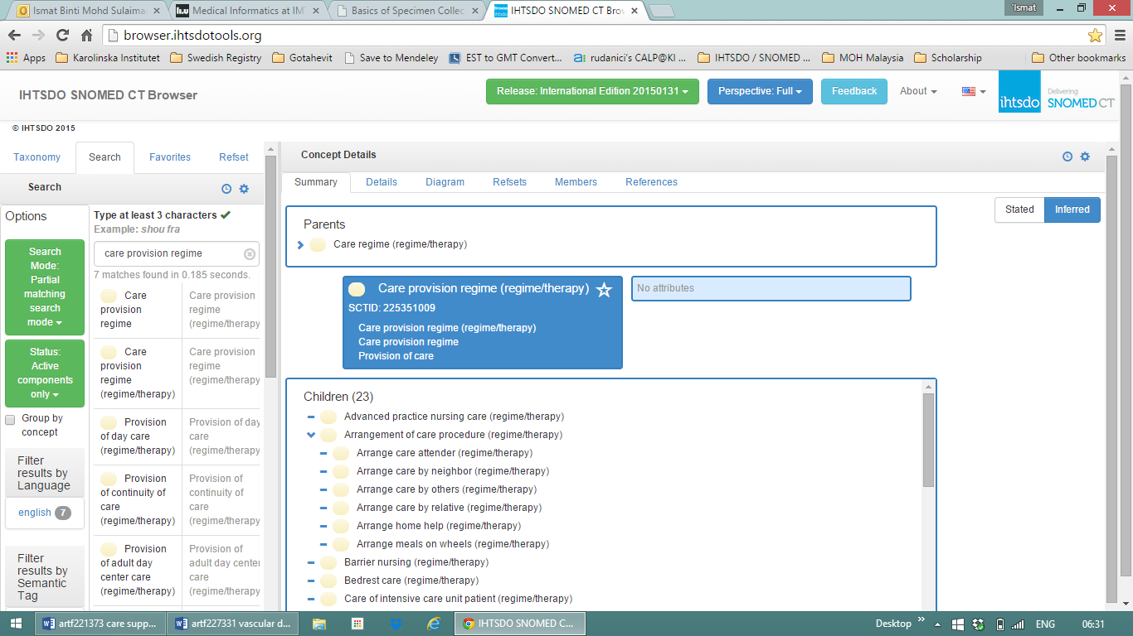
For example, |Care provision regime (regime/therapy)| and its subtypes relates to the administrative procedures for arranging the provision of the patient’s care to a caretaker.

Slide 12
Is |Care regime (regime/therapy)| merely a grouper concept?
If it is, how is this grouped together?
Nursing activity
It is noted that most subtypes are predominantly a “nursing” type of care. WHO and The International Council of Nursing define nursing as follows:
  Nursing encompasses autonomous and collaborative care of individuals of all ages, families, groups and communities, sick or well and in all settings. Nursing includes the promotion of health, prevention of illness, and the care of ill, disabled and dying people. Advocacy, promotion of a safe environment, research, participation in shaping health policy and in patient and health systems management, and education are also key nursing roles.
“Nursing” does not necessarily mean procedures done by nurses but also from other specialty such as allied health professionals.
If we were to record these concepts in a patient’s EHR, it rarely matters who carries out the “nursing” activity. In other words, a patient’s EHR with |Epistaxis care (regime/therapy)| or |Stoma care (regime/therapy)| or |Palliative care (regime/therapy)| would have meant that the procedure has been planned or done, regardless who has done it.
However, “nursing activity” cannot differentiate |Care regimes (regime/therapy)| with its other siblings.
The term “care” in FSN
It is also noted that most concepts under this hierarchy have the term “care” in the FSN.
Should all procedure concepts In line with regime/therapy definition with “care” be considered under this hierarchy? And
Should all concepts under this hierarchy have the term “care” to make it understood?
This is a similar case with <support> (regime/therapy), where almost all its subtypes has the term “support”.
Notes:
3 options was noted to define the scope for |Care regime (regime/therapy)|. Option 2 is currently recommended.
All regimes are nursing procedure;
For this option, it may be suggested that future terming structure would be X <nursing care> (regime/therapy). However, there is a high risk of using the term “nursing”. Although nursing care includes activities done by nursing and other healthcare professionals (e.g. allied healthcare), users may think that it is only for a nurses. It only raises confusion.
All regimes that have the term “care” are included in this hierarchy;
|Care regime (regime/therapy) acts as a grouper concept. In this case, |Care regime (regime/therapy)| compiles subtypes that has the term “care” in the description.

Slide 13
Issue 2:
What is |Care regime management (procedure)|

Slide 14
Confusing term
The distinction between “Care regime” and “Care regime management” is unclear because the terming structure of the FSN.
X <care management> concepts are children of |Care regimes management (procedure)|.
This means that “care management” is the management of care regimes.

Slide 15
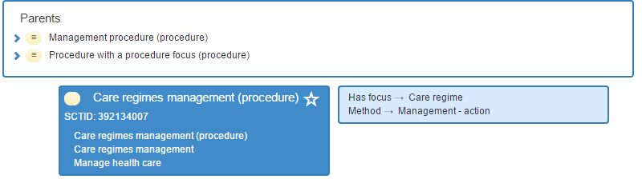
Examples:
  Epistaxis care (regime/therapy) vs Epistaxis care management (procedure).
  Bowel care (regime/therapy) vs Bowel care management (procedure).
  Eye care (regime/therapy) vs Eye care management (procedure).
  Stoma care (regime/therapy) vs Stoma care management (procedure).

Slide 16
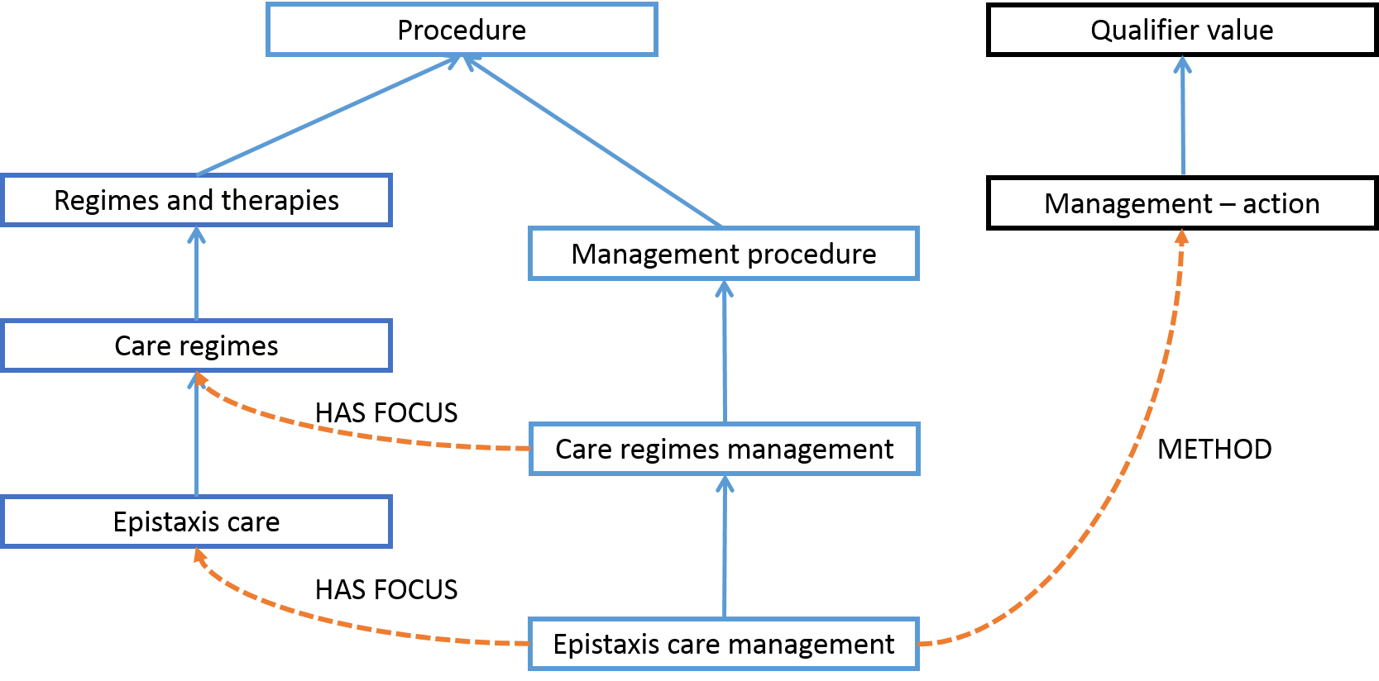
Example: Epistaxis care management

Slide 17
Unclear scope for |Care regime management| (1)
Problems seen:
  “Managerial” type of care mixed under |Care regime (regime/therapy)|:
  Overlapping concepts due to unclear boundary for “management”
    Enterostomy management and care (regime/therapy)
    Colostomy management and care (regime/therapy)
    Ileostomy management and care (regime/therapy)
    Urostomy management and care (regime/therapy)
Arrangement of care procedure (regime/therapy) Arrange care attender Arrange care by neighbor Arrange care by others Arrange care by relative Arrange home help Arrange meals on wheels | Specimen care (regime/therapy) Blood specimen care (regime/therapy) Sputum specimen care (regime/therapy) Stool specimen care (regime/therapy) Urine specimen care (regime/therapy) Making arrangements for care of dependents following death (regime/therapy) Making funeral arrangements (regime/therapy)

Slide 18
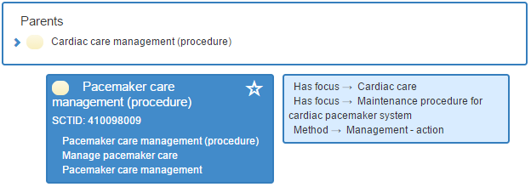
Unclear scope for |Care regime management| (2)
Sometimes it is difficult to draw the line, between managerial and direct patient care. For example, |Pacemaker care management (procedure)| may involve changing the pacemaker battery and ensuring the setting for pacemaker system is optimal.
If we were to provide guideline to separate it into two distinct concepts, there would be concepts that would not fit into either one. We need to see how this is applied or be used in a patients’ record, especially taking into account that there might be a continuous flow of action between care regime and care regime management.
Notes:
We may need to manage this: which concept is assigned, or if the user have to choose.

Slide 19
Relevance of |Care regime management|
Care Planning Guidance Nursing SIG PowerPoint slides:
The X <care> (regime/therapy) reflect the components of “Activity Bundle” – Need, goal, and activity.
Whereas X <care management> procedures is the action of creating the Activity bundle, which is a managerial/administrative tasks.
Core Care Plan
Activity Bundle
Need
Activity Bundle
Goal
Activity
Activity Bundle
Activity Bundle
Goal
Activity
Need
Need
Goal
Activity
Goal
Activity
Need
X <care management>
X <care management>
X <care> (regime/therapy)
X <care> (regime/therapy) or Single procedure

Slide 20
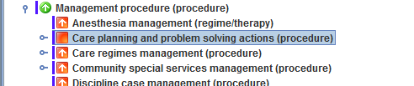
What other types of care management other than ‘care planning’?
However, SNOMED CT already has |Care planning and problem solving (procedure)|.
This concept only has attribute HAS FOCUS = Management-action, but there is no attribute relationship to |Care plan (qualifier value)|. An appropriate relationship to |Care plan (qualifier value)| and its meaning should be considered, as stated in section 3.5 Subsidiary and interrelated problems.

Slide 21
Issue 3:
Differentiating the two concepts

Slide 22
Agreement / Discussion:
Agree that the two concepts mean differently.
Needs to be discussed further: |Care regime management| is the ‘administrative/managerial’ part of |Care regime|.
  Determine the scope of “care management”
  Not only about care planning – multidisciplinary, more than creating the plan document (referral, scheduling, etc).
  If it is more than care planning – to be included in the guideline; may need to review FSN to reflect this
  Defining both |Care regime| and |Care regime management| to avoid redundancy. Reviewing the model: the redundancy may be due to the need to fit in the current model.
Agree that |Care regime| is a grouper concept
  Explore on the term “care” – groups regimes that has the term “care” in its FSN
How to deal with two concepts that overlaps or continuous? (Pacemaker example)

