Slide 1
Draft Observables Concept Model for Deployment of Anatomic/Molecular Pathology

Slide 2
Use cases for molecular pathology/genetics
Resected melanoma tests positive for BRAF V600E mutation
Patient is heterozygote for BRCA1 mutation
Resected colon cancer tests positive for MSH2 gene mutation
Finding of Human non-polyposis colon cancer type 1 genetic carrier
KRAS codon 12 sequence variant detected in excised malignant neoplasm
D2S123 mononucleotide microsatellite stability in excised malignant neoplasm

Slide 3
Query use cases for domain ontology in Molecular Pathology
Find all patient observations of a specific SNP for resected tumors regardless of lab technique employed (sequencing, IHC, PCR, probes)
Retrieve all patients with finding of specified oncogenetic risk factor
(Identify all findings for patients with sequence variants of a specific chromosome region)
(Identify all protein producing genes on the long arm of chromosome 3)

Slide 4
118598001 |Measurement property(qualifier)
Expanded SNOMED CT draft Lab/Pathology semantics
Measurement property
  (Entitic properties)
  Entitic integrity: degree of wholeness; absence of fragmentation or distortion
  Entitic number
  Anatomic Location: location of an entity within an organism
  Radial location: clockface direction within usually tubular or round structure
  Histologic feature : (phenotypic observations, gross or micro) clear demarcation, shape or configuration(propose value sets for exemplar specification)
  Histologic invasiveness: extension or infiltration of source into adjacent structures
  Nucleotide sequence property: disease specific assessment of aggressiveness as established by reference clinical classifications; value sets specified <<277457005|Histologic grading systems(staging scale)

Slide 5
Concept model extensions we are testing for Molecular Pathology
Agree upon HGNC, NCBI and UNIPROT as build reference resources which will support scalable modeling of SNOMED CT extensions and automated build of content
Expand concept model for Body structures to support fully defined concept of Gene (locus)
Define templates for observables for gene sequencing, DNA probes, immunohistochemistry…
  Expand Measurement property to include molecular features
  Expand Technique to include nucleotide sequencing, epigenetic and immunohistochemical procedures in clinical use
Agree upon proper application of concept model to definition of findings based upon genomic observables (nucleotide polymorphisms) some of which require molecular lab data

Slide 6
Agreed flattened quality observable model template for trial use
Fully specified name (observable entity)
Observable entity
704318007|Property type|
<<Measurement property *1
≡
704319004|Inheres in|
<<Body structure, <<Substance, <<Organism, <<Specimen *1
9216841000004100 |Inherent location |
<<Body structure, <<Substance, <<Organism, <<Specimen *0-1
704320005 |Towards|
<<Body structure, <<Substance, <<Clinical finding <<Organism *0-1
704326004 |Precondition|
<<Clinical findings, <<Procedures *0-many
370134009 |Time aspect|
<<Time patterns (qualifier) *1
370132008 |Scale type|
<<Scales types(qualifier) *0-1
246514001 |Units|
<<Units(qualifier) *0-1
246501002 |Technique|
<<Technique (technique) *0-many
Specimen preparation technique
<<Preparation Technique (technique) *0-many
704327008 |Direct site|
<<Body structure,<<Specimen *0-1
Notes:
Cream attributes are defining; brown are non-defining qualifiers

Slide 7
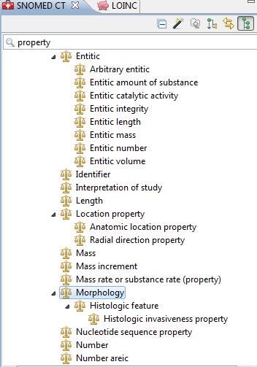
Include molecular

Slide 8

Template for gene or nucleotide sequence
|Nucleotide sequence/gene locus (cell structure)|
Nucleotide sequence(cell structure)
≡
Chromosome structure(cell structure)
Part of
Chromosome pair NN(cell structure)
GrCh38 Nucleotide Sequence start
Base pair NN
GrCh38 Nucleotide Sequence end
Base pair NN
Chromosomal region
Chromosome(p|q)region
We are further deploying
GrCh37 definitions and
expect there will
be more in the future
May be modeled entirely from HGNC reference data
Issues:
Addressing for microsatellites
Addressing for exon references; eg KRAS (exon 2) codon 12

Slide 9
100670521000004106 |BRAF gene locus (cell structure)|
B-RAF proto-oncogene serine threonine kinase
Nucleotide sequence(cell structure)
≡
Chromosome structure(cell structure)
Part of
Chromosome pair 7(cell structure)
GrCh38 Nucleotide Sequence start
140,719,327
GrCh38 Nucleotide Sequence end
140,924,764
Chromosome region
7q34

Slide 10
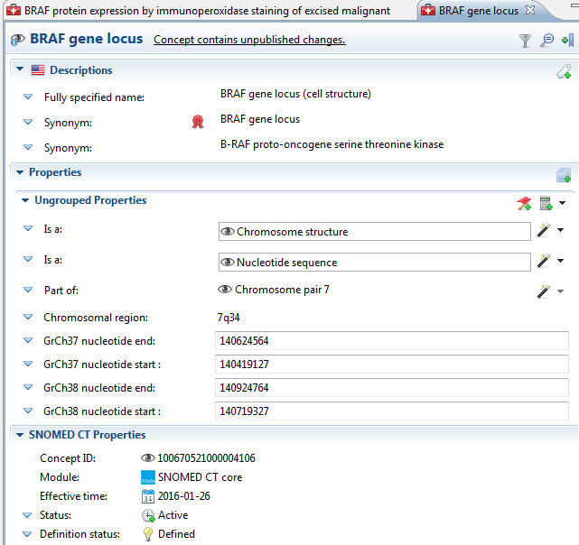
Concept model extension: Gene locus

Slide 11
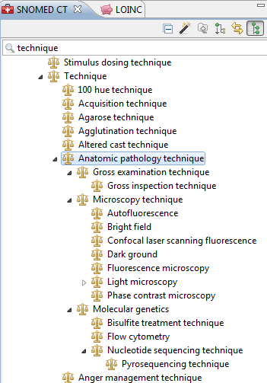
Techniques

Slide 12
Agreed flattened quality observable model template for trial use
| Gene nucleotide sequence detected (observable entity)|
Observable entity
704318007|Property type|
Nucleotide sequence property
≡
704319004|Inheres in|
<<Cell structure, <<Morphology
9216841000004100 |Inherent location |
<<Gene locus
370134009 |Time aspect|
Single point in time
246501002 |Technique
Nucleotide sequencing technique (technique)
704327008 |Direct site||
<<Specimen
370132008 |Scale type|
Variant call format
Most sequencing data today is reported in variant call
Format with file sizes for multi-sequence tests running
Several thousand bytes
Notes:
Cream attributes are defining; brown are non-defining qualifiers

Slide 13
Agreed flattened quality observable model template for trial use
455350031000004100 |BRAF nucleotide sequence detected in excised malignant neoplasm (observable entity)|
Observable entity
704318007|Property type|
Nucleotide sequence property
≡
704319004|Inheres in|
Malignant neoplasm
9216841000004100 |Inherent location |
BRAF gene locus
370134009 |Time aspect|
Single point in time
246501002 |Technique
Nucleotide sequencing technique (technique)
704327008 |Direct site||
Formalin-fixed paraffin embedded tissue sample
370132008 |Scale type|
Variant call format
Notes:
Cream attributes are defining; brown are non-defining qualifiers

Slide 14
Features of human nucleotide sequence by variant call format (Alexis)
Property | Example Value | Valuesets (not comprehensive, by far)
Human Genome Reference | GRCh37 | GRCh38
HUGO Gene Abbreviation | BRAF | STK11 TP53
Nucleic Acid Type Examined | DNA | RNA Mitochondrial DNA
Nucleic acid variant type | Single nucleotide variant | Insertion Deletion Translocation Copy number variant Methylation
Predicted protein variant type | Single amino acid substitution | Silent (no protein change) Insertion with frameshift and early truncation Insertion with frameshift and late truncation Deletion with frameshift and early truncation Deletion with frameshift and late truncation Fusion protein (translocation with another gene's protein) Complete non-expression of protein Splice region variant
Start coordinate | 140453135 | 140453155
Stop coordinate | 140453135 | 140453156
HGVS nucleic acid nomenclature | c.1799T>A | c.1779_1780delTGinsGA
HGVS protein nomenclature | p.Val600Glu | p.Asp594Asn
Human genetic variant from reference

Slide 15
Agreed flattened quality observable model template for trial use
BRAF V600E mutation identified in excised malignant neoplasm (finding)
Evaluation finding
Associated morphology
Nucleotide sequence variant
≡
Finding site
BRAF gene locus
Interprets
BRAF nucleotide sequence detected in malignancy
Has value
Chr7 140719927 BRAFV600E V G… |GRCh38;CM000669.2
Notes:
Cream attributes are defining; brown are non-defining qualifiers

Slide 16
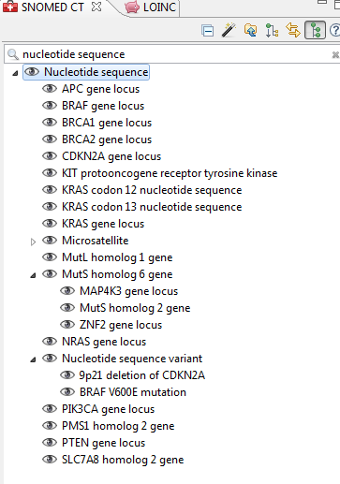
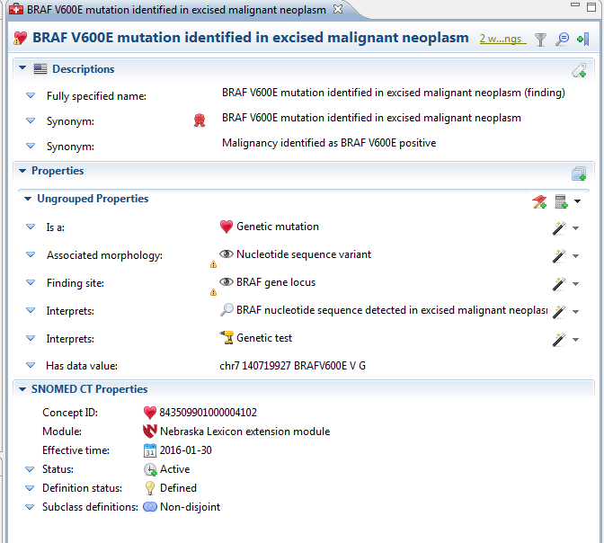
SNOW OWL exemplars

Slide 17
Agreed flattened quality observable model template for trial use
Immunohistochemical test for protein expression of gene or gene mutation (observable entity)
Tumor observable (observable entity)
704318007|Property type|
Entitic number (qualifier)
≡
704319004|Inheres in|
<<Cell structure, <<Morphology
9216841000004100 |Inherent location |
Gene locus or nucleotide seq (cell structure)
704320005 |Towards|
Protein (substance)
246501002 |Technique|
Immunohistochemical technique(technique)
370134009 |Time aspect|
Single point in time(qualifier)\
370132008 |Scale type|
Scales (qualifier)
704327008 |Direct site|
<<Specimen
Notes:
Cream attributes are defining; brown are non-defining qualifiers

Slide 18
Agreed flattened quality observable model template for trial use
BRAF protein expression by immunoperoxidase staining of excised malignant neoplasm (observable entity)
Tumor observable (observable entity)
704318007|Property type|
Entitic number (qualifier)
≡
704319004|Inheres in|
Malignant neoplasm (morphology)
9216841000004100 |Inherent location |
BRAF gene locus (cell structure)
704320005 |Towards|
BRAF human cellular protein (substance)
246501002 |Technique|
Immunoperoxidase technique(technique)
370134009 |Time aspect|
Single point in time(qualifier)\
370132008 |Scale type|
Nominal value (qualifier)
704327008 |Direct site|
Formalin fixed paraffin embedded tissue specimen
Notes:
Cream attributes are defining; brown are non-defining qualifiers

Slide 19
437494961000004105 |BRCA1 gene locus (cell structure)|
Breast cancer 1 BRCA1 gene locus
|Nucleotide sequence(cell structure)|
≡
|Chromosome structure(cell structure)|
Part of
|Chromosome pair 17(cell structure)|
GrCh38 Nucleotide start
43,044,295
GrCh38 Nucleotide end
43,170,295
Chromosome region
17q21.31

Slide 20
Agreed flattened quality observable model template for trial use
613814021000004100 |BRCA1 nucleotide sequence detected (observable entity)|
Observable entity
704318007|Property type|
Nucleotide sequence property
≡
704319004|Inheres in|
Body structure
9216841000004100 |Inherent location |
BRCA1 gene locus
370134009 |Time aspect|
Single point in time
246501002 |Technique
Nucleotide sequencing technique (technique)
370132008 |Scale type|
Variant call format
Notes:
Cream attributes are defining; brown are non-defining qualifiers

Slide 21
Agreed flattened quality observable model template for trial use
412734009 |BRCA1 gene mutation positive (finding)
Evaluation finding
Associated morphology
Nucleotide sequence variant
≡
Finding site
BRAF gene locus
Interprets
BRAF nucleotide sequence detected in malignancy
Has value
Chr7 140719927 BRAFV600E V G… |GRCh38;CM000669.2
Currently defined with
405823003|BRCA1 mutation carrier test (procedure)
Notes:
Cream attributes are defining; brown are non-defining qualifiers

Slide 22
Molecular pathology build
Literature review should easily identify the genes reported with clinically significant variants
Automated build of genetic structures is feasible using HGNC reference data sets
Observables build could be templated from those gene concepts and significant clinical findings could be fully modeled

