Slide 1
Care plan content
February 2015
presented by Zac Whitewood-Moores

Slide 2
What is a care plan? (ISO 13940)
dynamic, personalized plan including identified needed healthcare activities, health objectives and healthcare goals, relating to one or more specified health issues in a healthcare process
  A care plan may be recorded in one or more health records.
  A care plan could be subdivided from different perspectives by different constraints. One example is uniprofessional care plan, for example, a nursing care plan with the constraint of only one specific health professional involved. Other examples of specific constraints for a care plan are: care plan to address one health issue, one health condition, one contact, one clinical process, activities to be performed by one healthcare provider, etc.
  care plans are reviewed repeatedly during a healthcare process, each review based on a new healthcare needs assessment.
  The healthcare activities in a care plan follow a life cycle. Examples of statuses of such a life cycle are: 'planned', 'performed', 'cancelled', etc.; all of these statuses are included in the care plan
  In EN 13940-1:2007 programme of care was the preferred term for this concept.

Slide 3
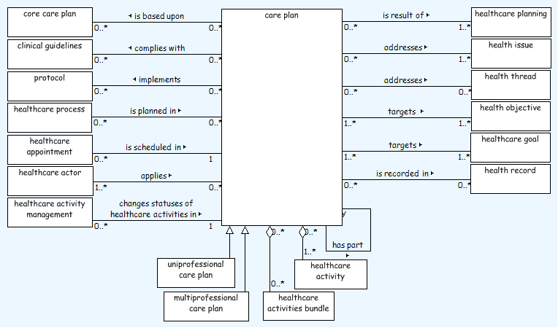
Care plan class diagram (ISO 13940)

Slide 4
Care plan representation in SNOMED CT

Slide 5
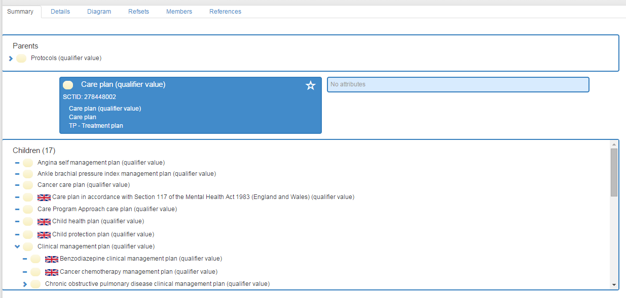
Qualifier value (n10 Int, n14 UK)

Slide 6
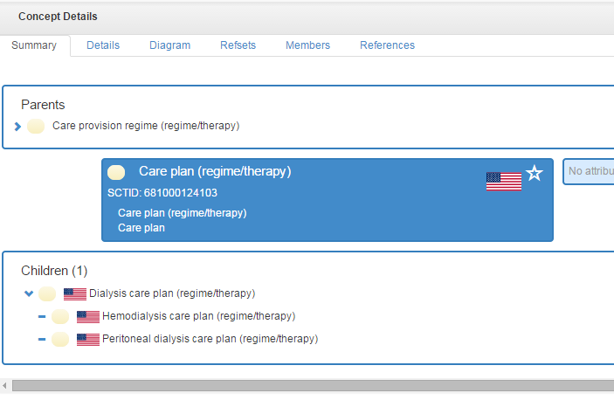
Regime/therapy (n3 US)

Slide 7
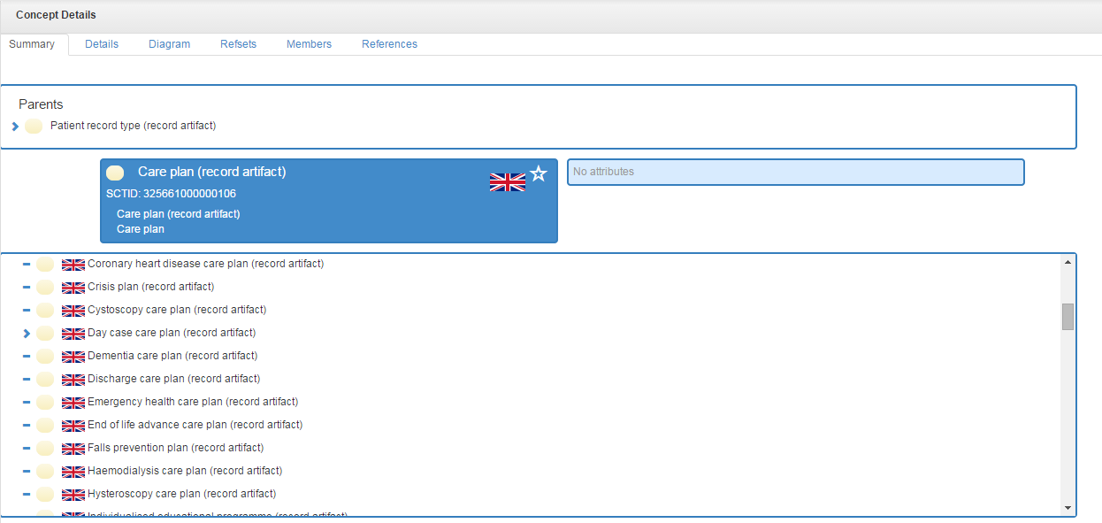
Record artifact (n112 UK)

Slide 8
Professional care planning
Evidence based plan for care
Outcome focussed
Activities needed
Structured care plans SHOULD be personalised, not fixed templates
A structured approach gives potential for interoperability and reporting

Slide 9
Outline of high level relationships
Core Care Plan
Activity Bundle
Need
Activity Bundle
Goal
Activity
Activity Bundle
Activity Bundle
Goal
Activity
Need
Need
Goal
Activity
Goal
Activity
Need

Slide 10
Outline of low level relationships
NEED
GOAL
ACTIVITY
At least one need, goal and activity is present in an activity bundle,
this may be in a referenced sub-bundle

Slide 11
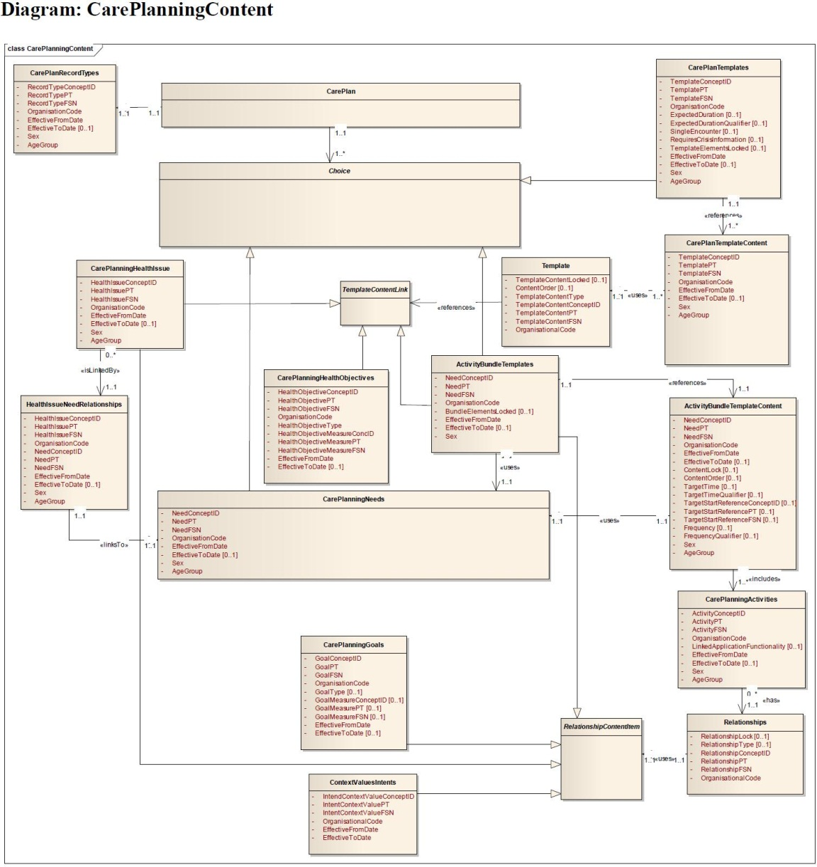
Outline technical model of content

Slide 12
Care planning content currently developed
A national electronic care plan library
Utilises approved language (SNOMED CT)
74 professionally assured and evidence-based core care plans
358 core activity bundles
allow the user to build personalised care plans.

Slide 13
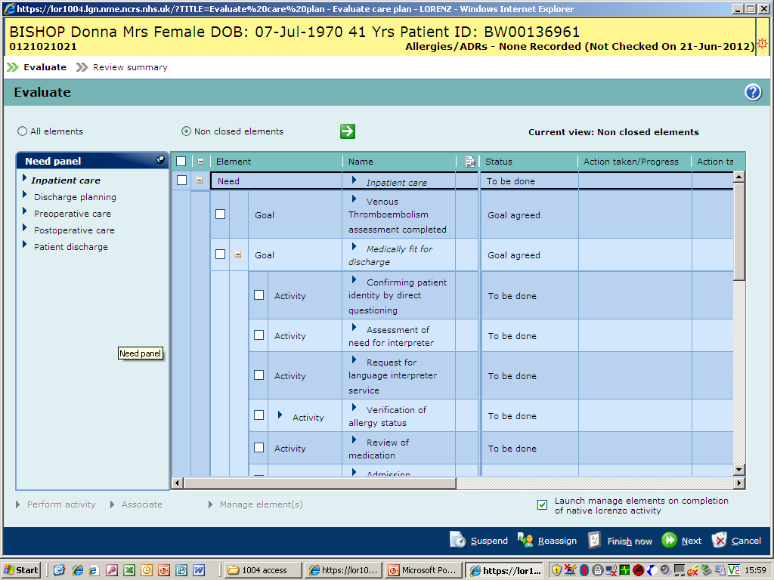

Slide 14
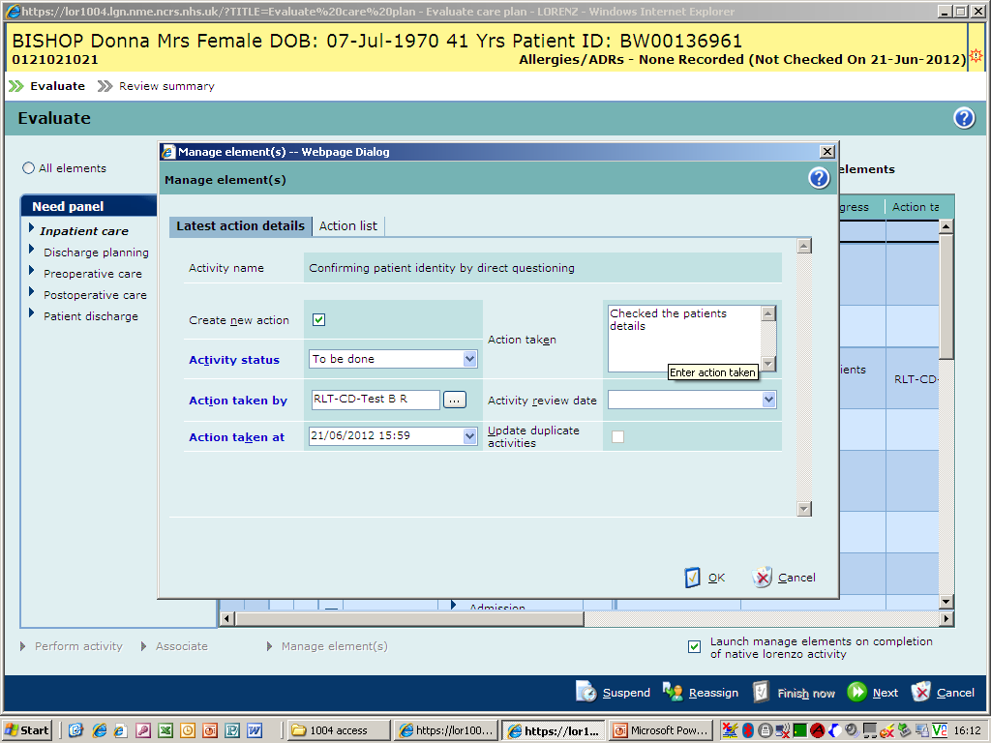

Slide 15
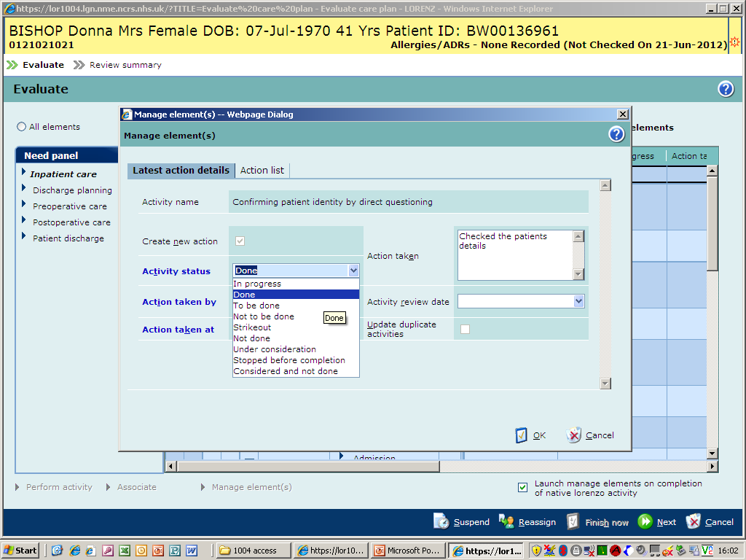

Slide 16
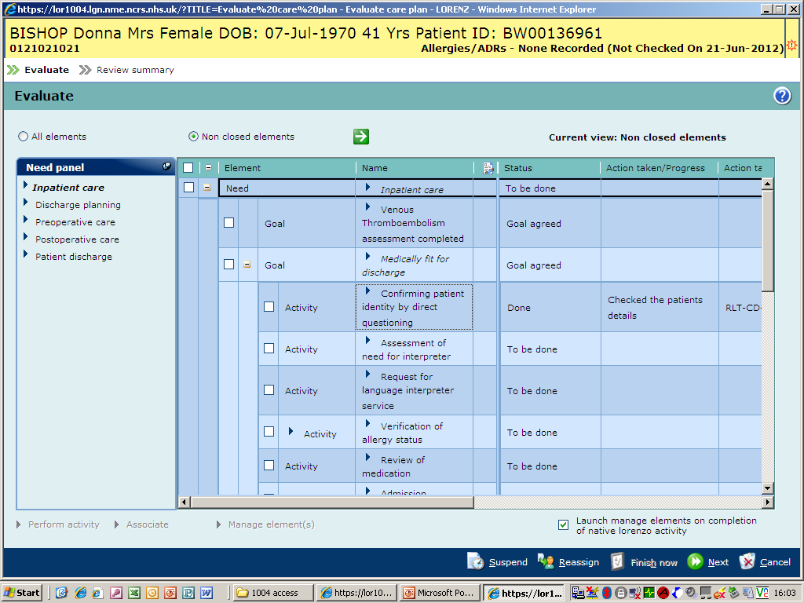

Slide 17
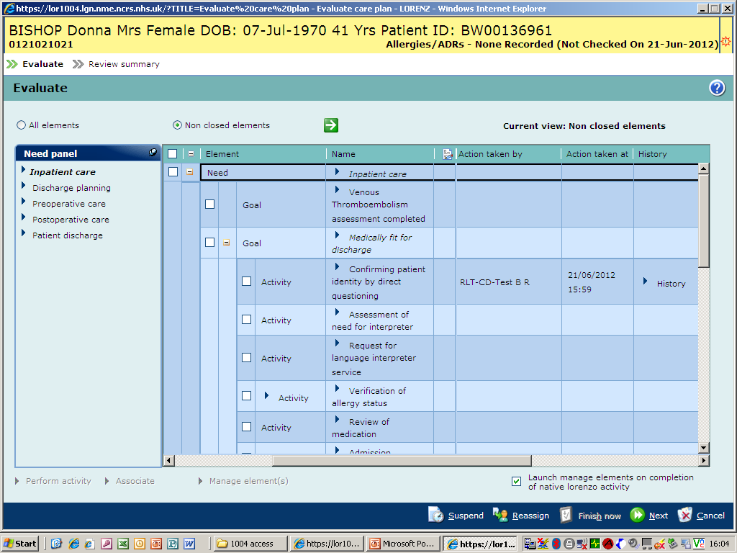

Slide 18
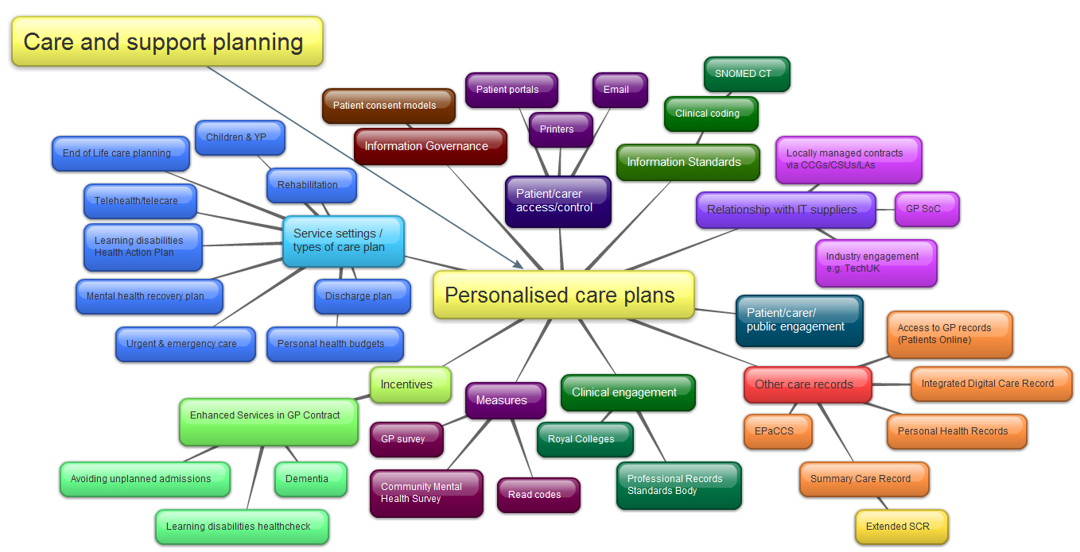
Care planning content and wider context
Read codes cannot be adequately context modified to support care planning
Mind map: Rachel Porter NHS England

Slide 19
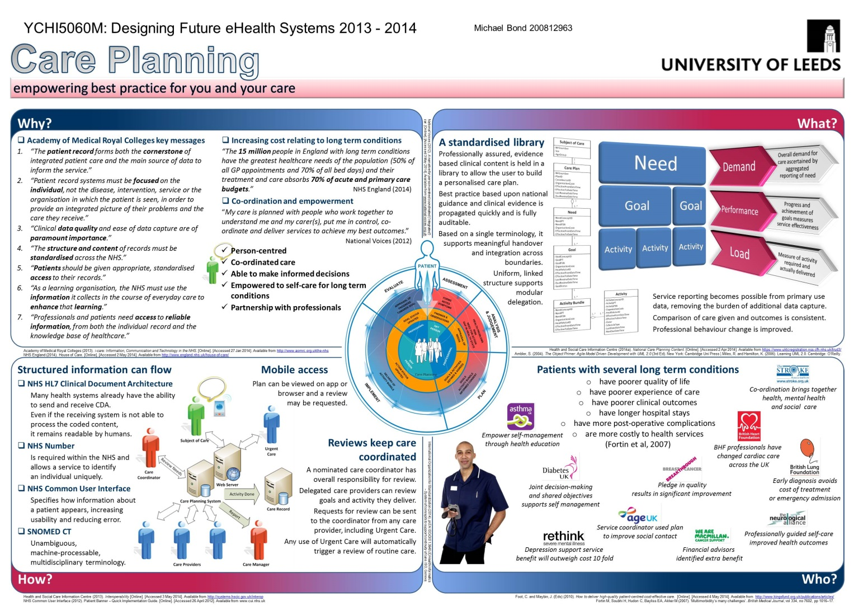

Slide 20
Qualifier value (n10 Int, n14 UK)
SUGGEST
DEPRECATE

Slide 21
Record Artifact vs Regime/therapy
US x3 currently
UK x112 currently
  Implemented in live records
Is a care plan a regime/therapy or a record artifact?
Is an international consensus desirable?
Should this be referred to the HCP coordination group for input from other professions?

