Slide 1
Observable Model
IHTSDO Observable and Investigation Model Project

Slide 2
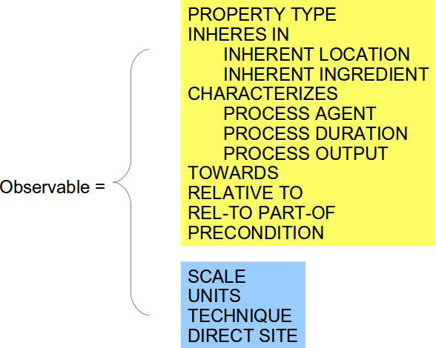
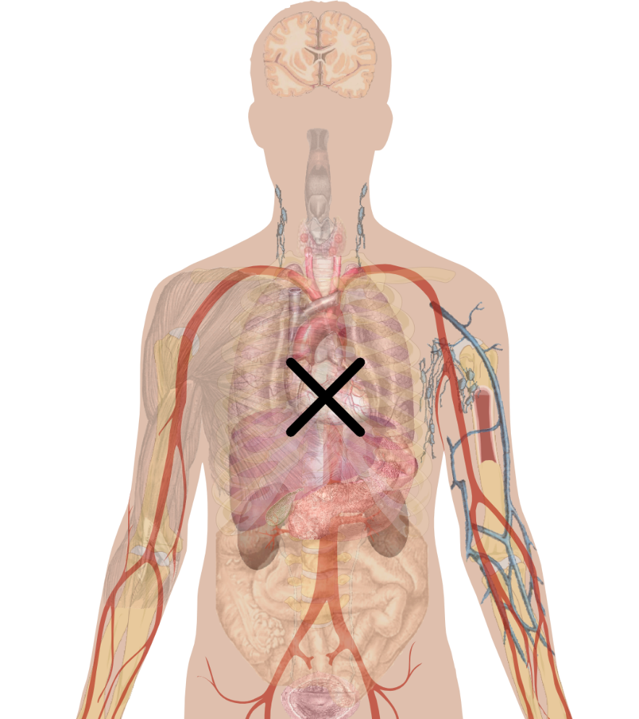
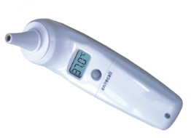
Observables model in 20 seconds
TECHNIQUE
WHAT
Observation device
SCALE
UNITS
DIRECT SITE
PROPERTY TYPE
INHERES IN
...
HOW
PRECONDITION

