Slide 1
Proposal for snomed ct subset for nursing units (location)
Judith J. Warren, PhD, RN, FAAN, FACMI

Slide 2
Background
National Database for Nursing Quality Indicators (NDNQI) developed by American Nurses Association
Reports quality indicators and benchmarks according to nursing unit
  Created a standardized nursing unit typology and value set
  Used by over 2000 hospitals
  In 11 countries
Need to share value set with other quality indicator developers and with HL7
  NLM’ Value Set Authority Center
  Requires using a standardized terminology
    Either SNOMED CT or LOINC

Slide 3
Content Committee Charge
By October 2014, submit a request for subsets that pertain to Nursing’s needs
Nursing Unit subset could be one of these
Steps needed
  Assess Nursing SIG support
  NDNQI is willing to collaborate in the name of standard harmonization
  Determine IP of NDNQI
  Identify team
  Create Inception document

Slide 4
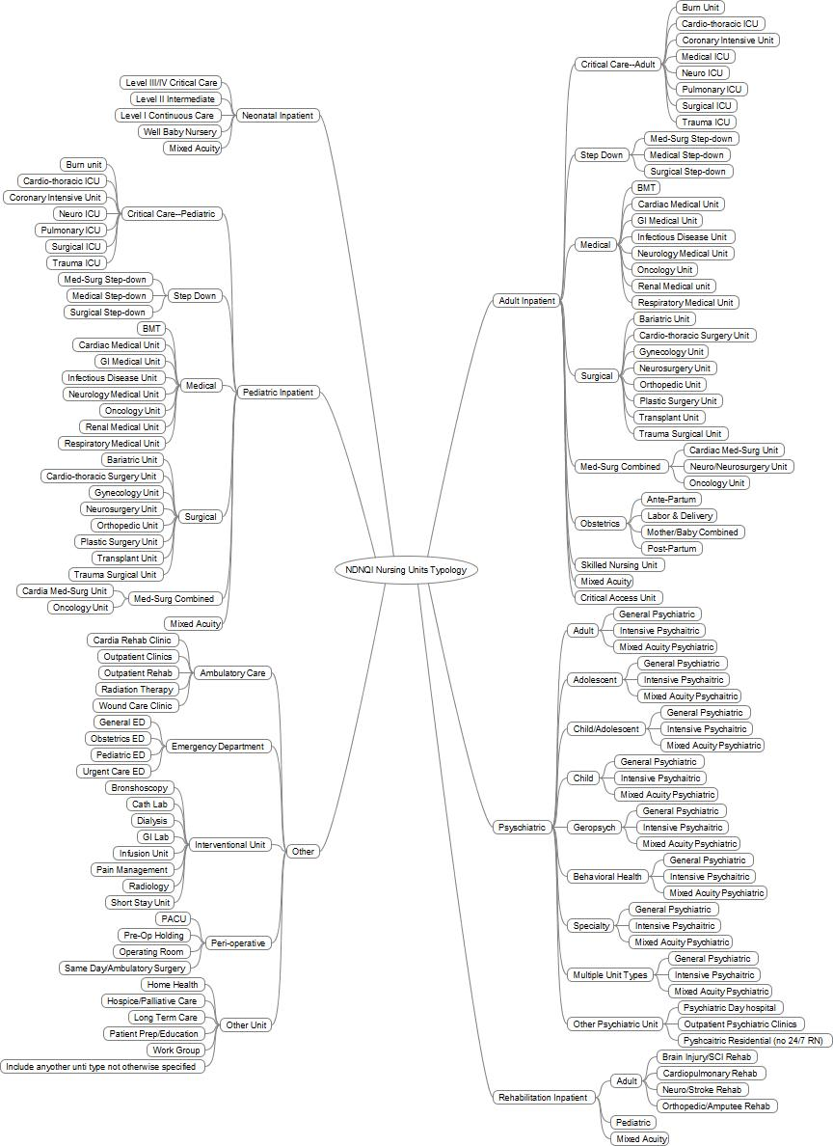
© NDNQI

Slide 5
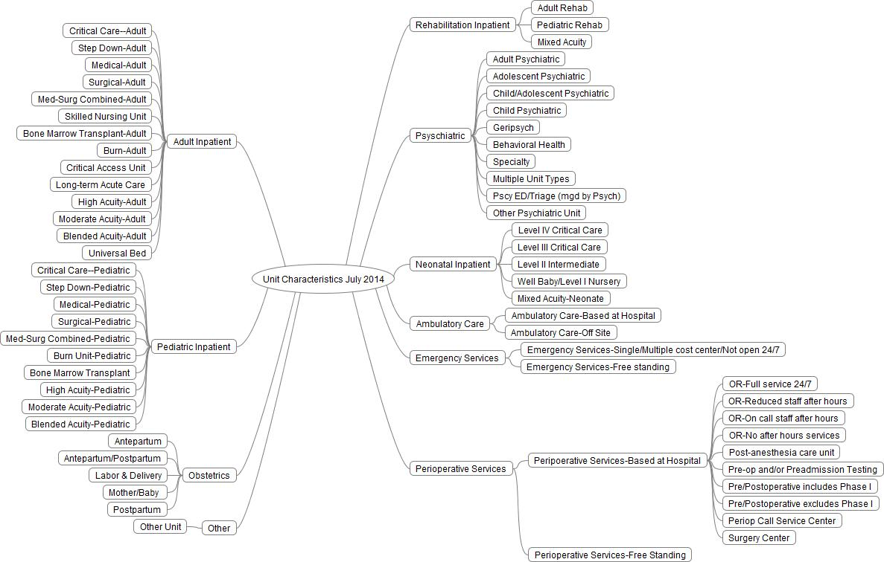
NDNQI 7/2014

Slide 6
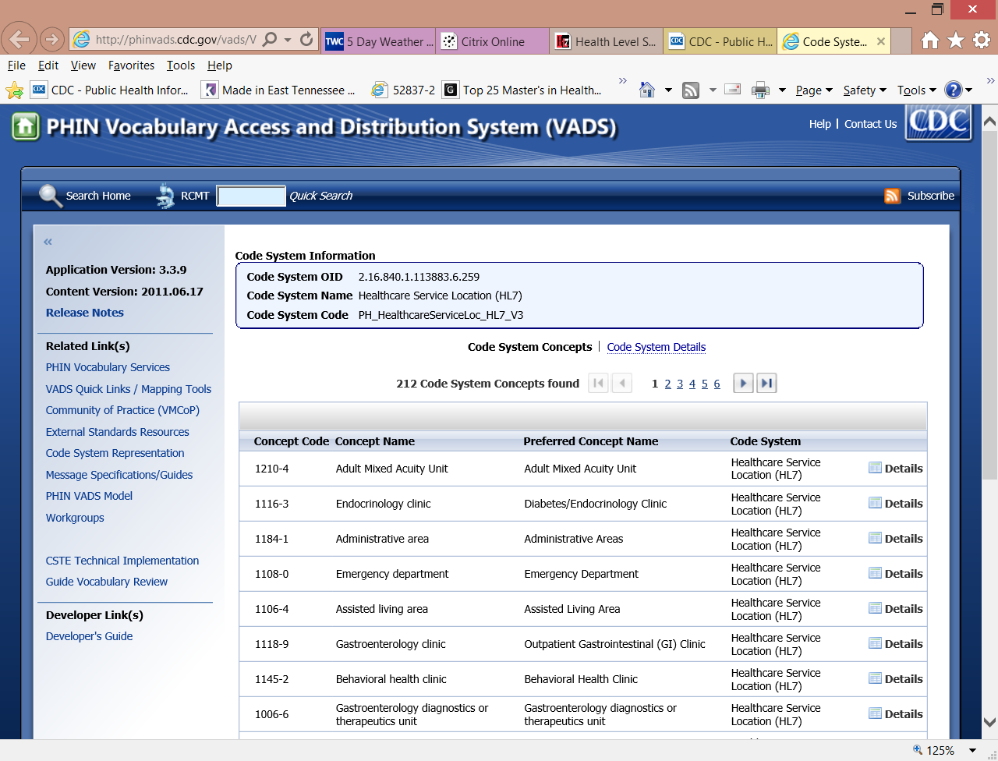

Slide 7
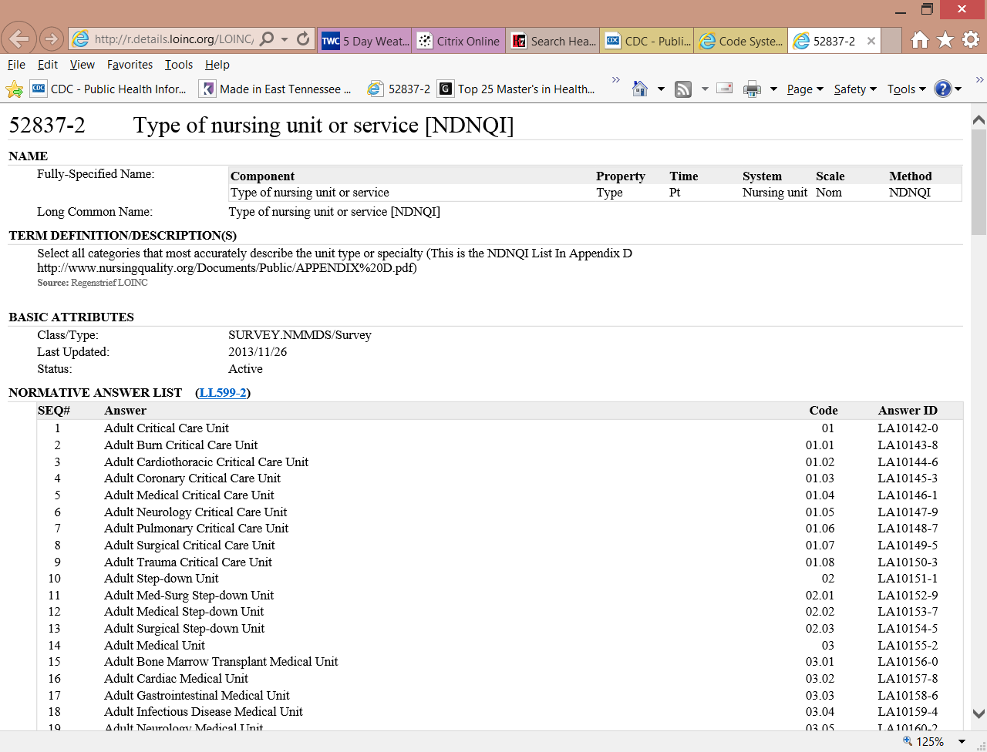

Slide 8
Questions
jjwarren@live.com

Slide 9
Reflections on the Nursing Units proposal
Similar subset in the UK to support clinical messages
Zac Whitewood-Moores

Slide 10
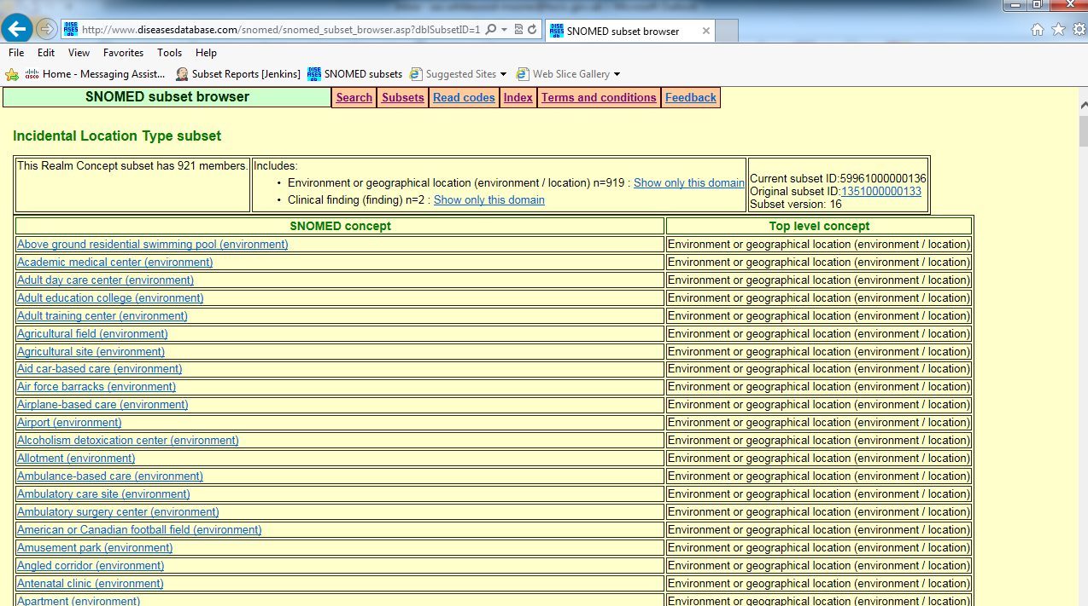
Incidental Location Type subset
http://www.diseasesdatabase.com/snomed/snomed_subset_browser.asp?dblSubsetID=1351000000133
Notes:
Don’t ask me about the name, before my time, and I hate it too!

Slide 11
Potential challenges
Is the externally curated list comprehensive?
Are there any unresolved IP issues?
Is there a formal collaboration agreement in place?
Nursing is a peripatetic profession, not all care takes place in Nursing Units
Increasingly healthcare activity is being shifted from hospitals to community settings
The Nursing profession are rarely independent actors, so is Nursing Units the right descriptor?

Slide 12
Suggested steps
Gap analysis to ensure all Nursing Units from the Classification are in SNOMED CT
  Most would apply internationally
  Any US only localities should go in US extension
Consider whether a refset would have international utility
Consider whether the Nursing emphasis in the classification should be in the refset too
Consider whether a wider, care setting refset would have greater utility

Slide 13
Questions?
Thoughts or comments …?
Email: zac.whitewood-moores@hscic.gov.uk

