Slide 1
ICN-IHTSDO collaboration
Nick Hardiker, RN PhD
Director
ICN eHealth Programme

Slide 2
Good artists borrow, great artists steal

Slide 3
The secret to creativity is knowing how to hide your sources

Slide 4
Harmonisation
ICN and IHTSDO Team-up to Ensure a Common Health Terminology
    Geneva, Switzerland & Copenhagen, Denmark,
    March 17, 2010
  The International Council of Nurses (ICN) and the International Healthcare Terminology Standards Development Organisation (IHTSDO) today announced a collaborative agreement to advance terminology harmonization and foster interoperability in health information systems.

Slide 5
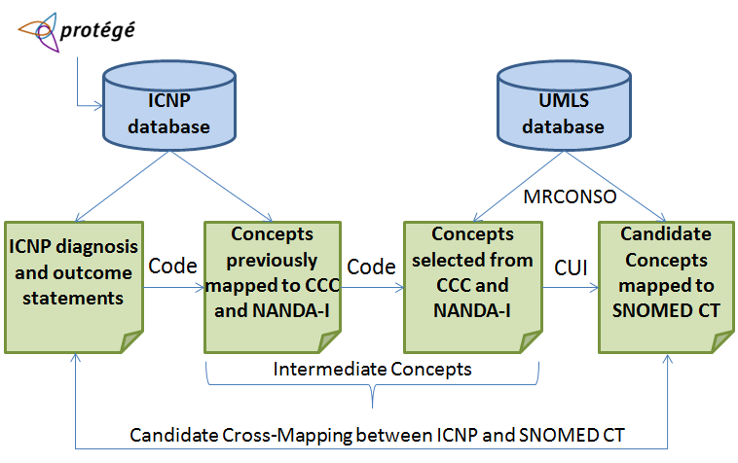

Slide 6
ICNP nursing diagnosis concepts | SNOMED–CT clinical findings | Mapping results
10000477 Anxiety | 48694002 Anxiety (finding) | Correct match
10000567 Constipation | 14760008 Constipation (disorder) | Correct match
10000567 Constipation | 35298007 Slow transit constipation (disorder) | Incorrect match
10000918 Impaired health maintenance | 24441001 Health maintenance alteration (finding) | Incorrect match
10000918 Impaired health maintenance | 414487007 Ineffective health maintenance (finding) | Correct match
10000960 Impaired dressing and grooming | 87788003 Self-dressing/grooming deficit (finding) | Correct match
10000956 Impaired ability to bath | 57982001 Self-bathing/hygiene deficit (finding) | Incorrect match
10021941 Lack of knowledge of medication regime | 129866007 Deficient knowledge of medication regimen (finding) | Correct match
10023202 Risk for complication with contraception use | 409044009 Contraception risk (finding) | Correct match
10015356 Risk for suicide | 225444004 At risk for suicide (finding) | Correct match

Slide 7
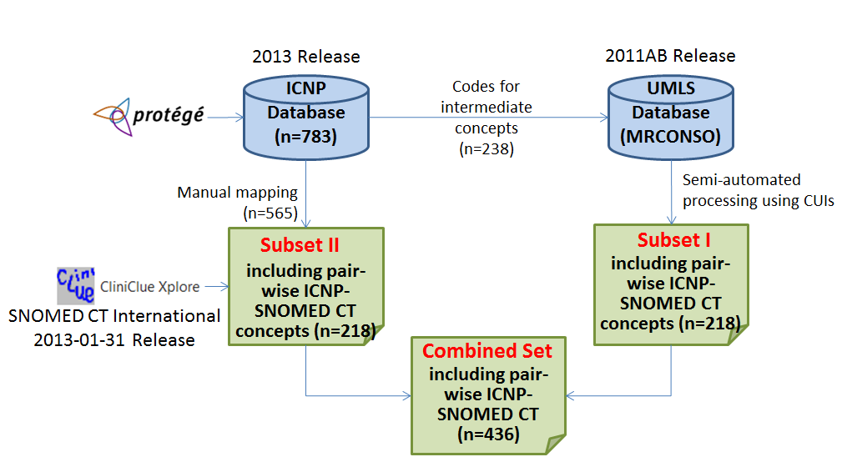

Slide 8
Seven concepts were mapped to either broader or narrower concepts in SNOMED CT
A single ICNP concept was mapped to two SNOMED CT concepts in three cases
Two ICNP concepts were mapped to the same SNOMED CT concept in 10 cases
A total of 436 ICNP concepts were mapped to 424 SNOMED CT concepts

Slide 9
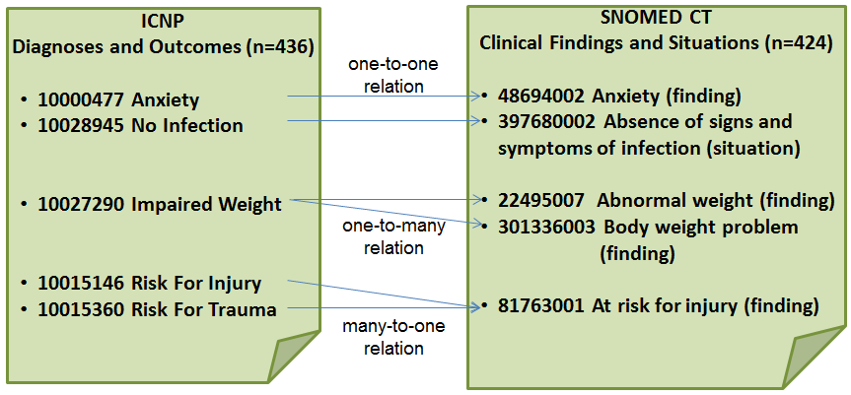

Slide 10
International Council of Nurses (ICN) and International Health Terminology Standards Development Organisation (IHTSDO) partner to provide a new Informatics Resource for nurses
    Geneva, Switzerland, Copenhagen, Denmark,
    20 January 2014
  The International Council of Nurses (ICN) and the International Health Terminology Standards Development Organisation (IHTSDO) are pleased to announce an equivalency table between the International Classification for Nursing Practice (ICNP) concepts and SNOMED CT concepts. The table contains ICNP Diagnosis and Outcomes Statements that have semantic equivalencies with SNOMED CT concepts.

Slide 11
“This equivalency table between ICNP and SNOMED CT is a tangible demonstration of how collaboration among standards development organisations can contribute to improved and standardized documentation of healthcare delivery,”noted ICN CEO David Benton. “Greater standardization supports the larger goal of interoperability of systems as well as better understanding of the contributions that each discipline makes to health outcomes and the effective and efficient use of health resources. “
“The IHTSDO is pleased to see this work being made available to users internationally and hopes that there will be feedback on its usage over time in supporting the care of individuals on a multidisciplinary basis. Continued collaboration with ICN is important to the IHTSDO going forward, providing a key link to the nursing profession internationally” said Jane Millar, Head of Collaboration at IHTSDO.

Slide 12
Collaboration
ICN and IHTSDO extend collaboration to advance harmonisation of health terminology
    Geneva, Switzerland & Copenhagen, Denmark
    1 September 2014
  The International Council of Nurses (ICN) and the International Health Terminology Standards Development Organisation (IHTSDO) today announced an updated collaboration agreement to advance terminology harmonisation and foster interoperability in health information systems. The new collaboration agreement signed today will be reviewed on completion of the work or in April 2016, whichever is earliest

Slide 13
As part of their collaboration agreement, ICN and the IHTSDO has agreed to undertake further work that defines the relation of SNOMED CT and the International Classification of Nursing Practice (ICNP) to enable their interoperability in health information systems globally
It builds on work already undertake to produce an equivalence table for Nursing Diagnoses

Slide 14
Nursing diagnoses
Joint publication of a completed equivalence table between SNOMED CT and ICNP for Nursing Diagnoses – May 2015 (Q2)
  Building on existing equivalence table
  Covering all in scope content in ICNP
  Including additions to SNOMED CT
  Full quality assurance – technically and content by both organizations
  In line with latest versions of SNOMED CT and ICNP
  Leading to a potential SNOMED CT Nursing subset

Slide 15
Nursing interventions
Joint publication of a completed equivalence table between SNOMED CT and ICNP for Nursing Interventions – February 2016 (Q1)
  Building a new equivalence table
  Covering all in scope content in ICNP
  Including additions to SNOMED CT
  Full quality assurance – technically and content by both organizations
  In line with latest versions of SNOMED CT and ICNP
  Leading to a potential SNOMED CT Nursing subset

Slide 16
Methodology Nursing Diagnoses/Problems
2011-2012
2013-2014
ICN: eHealth research team prepared equivalence table of 783 ICNP nursing diagnoses/outcomes to SNOMED CT
  IHTSDO: Review and validation of ICN equivalence table for 540 ICNP nursing diagnoses/problems
    407 (75%) equivalencies identified

Slide 17
Method: Harmonizing Nursing Diagnoses/Problems
2014
2014-2015
2015
ICN: Submitted 133 requests into SIRS
IHTSDO & ICN: Anticipate approximately 128 new concepts in SNOMED CT Clinical Finding hierarchy, Jan 2015 release
ICN: Equivalency table of ICN nursing diagnoses/problems and SNOMED CT to be released in June 2015 (with new release of ICNP) along with SNOMED CT subset

Slide 18
n.r.hardiker@salford.ac.uk

